Slide 1
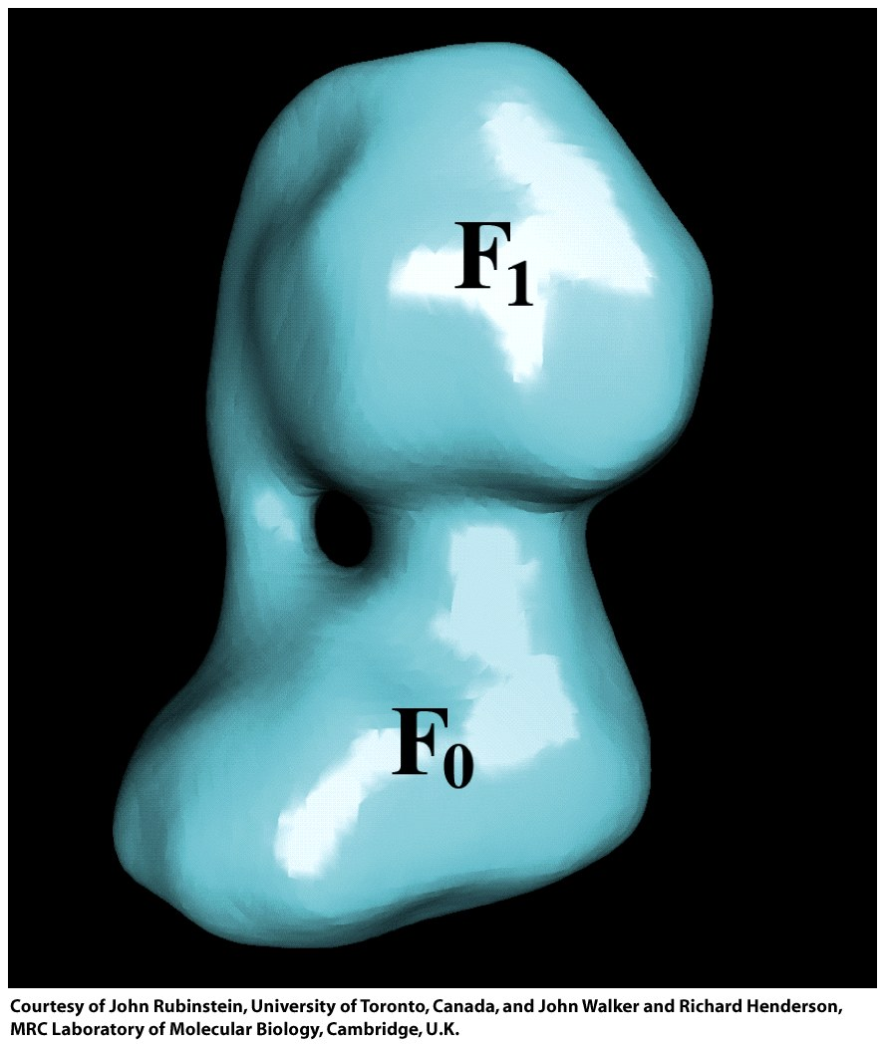
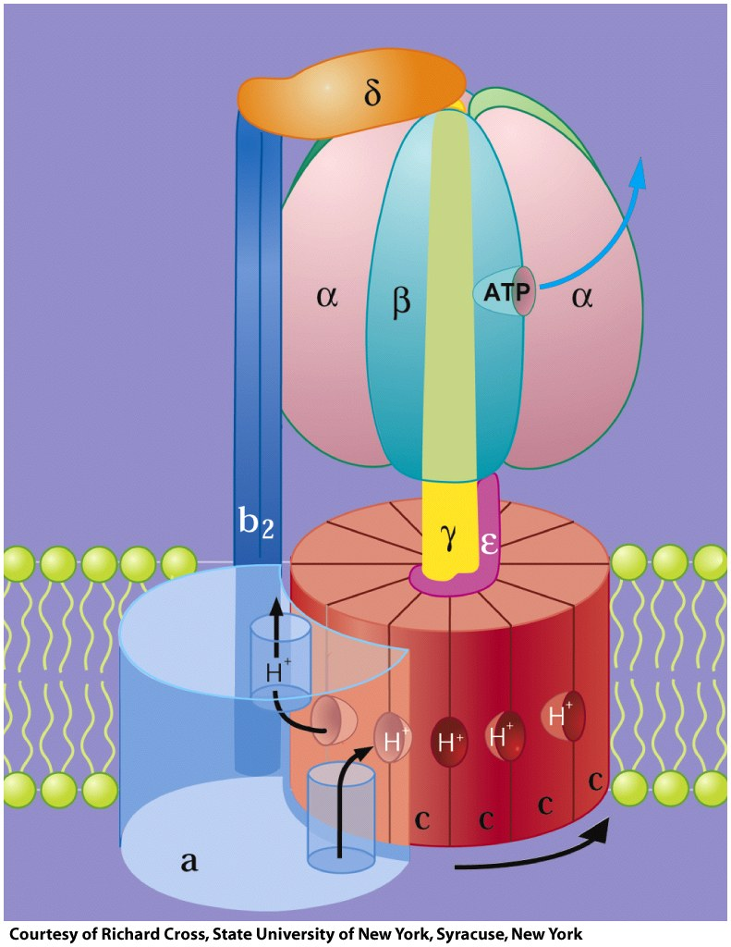
ATP synthase is a multi-subunit complex with membrane and matrix components
from bovine heart
from E. coli
matrix
cytosol
ATPase
inner
mb
inner
mb
Proton translocator
Cryo EM
reconstruction
IM space
periplasm

Slide 2
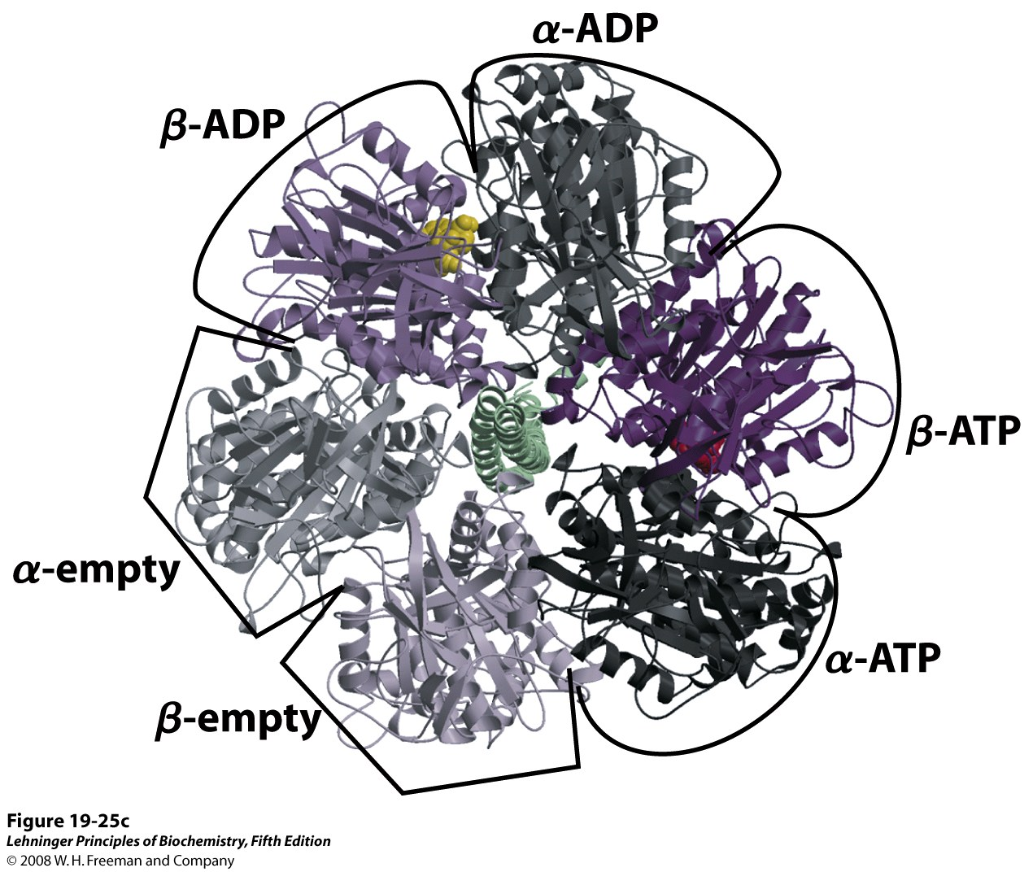
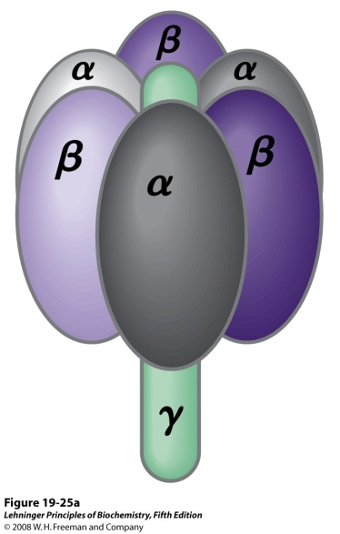
ATP synthesis happens in the F1 complex
Notes:
FIGURE 19-25c Mitochondrial ATP synthase complex. (c) F₁ viewed from above (that is, from the N side of the membrane), showing the three β and three α subunits and the central shaft (γ subunit, green). Each β subunit, near its interface with the neighboring α subunit, has a nucleotide-binding site critical to the catalytic activity. The single γ subunit associates primarily with one of the three αβ pairs, forcing each of the three β subunits into slightly different conformations, with different nucleotide-binding sites. In the crystalline enzyme, one subunit (β-ADP) has ADP (yellow) in its binding site, the next (β-ATP) has ATP (red), and the third (β-empty) has no bound nucleotide.

Slide 3
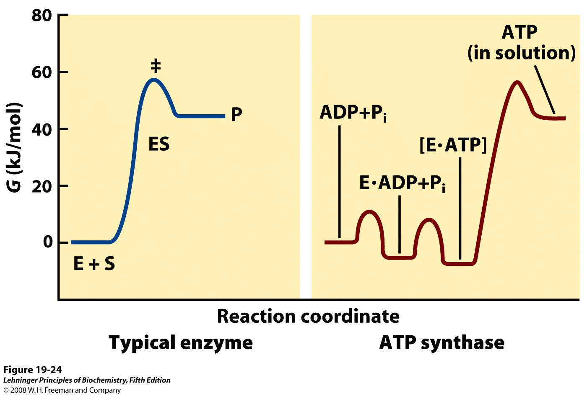
Unlike most enzymes, product release is the rate-determining step for ATP synthase
Notes:
FIGURE 19-24 Reaction coordinate diagrams for ATP synthase and for a more typical enzyme. In a typical enzyme-catalyzed reaction (left), reaching the transition state (‡) between substrate and product is the major energy barrier to overcome. In the reaction catalyzed by ATP synthase (right), release of ATP from the enzyme, not formation of ATP, is the major energy barrier. The free-energy change for the formation of ATP from ADP and P_{i} in aqueous solution is large and positive, but on the enzyme surface, the very tight binding of ATP provides sufficient binding energy to bring the free energy of the enzyme-bound ATP close to that of ADP + P_{i}, so the reaction is readily reversible. The equilibrium constant is near 1. The free energy required for the release of ATP is provided by the proton-motive force.

Slide 4
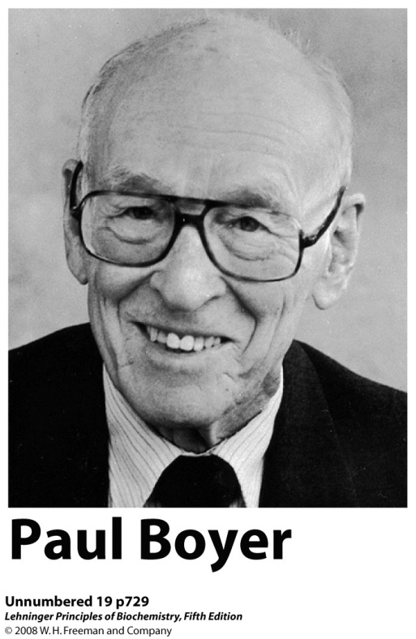
The “binding change” mechanism explains how rotational motion drives ATP synthesis
Rotation of the γ subunit induces sequential conformational changes in the α and β subunits. The conformations promote:
1. ADP and P_{i} binding
(Loose or ADP conformation)
2. ATP formation
(Tight or ATP conformation)
3. ATP release
(Open or empty conformation)
Figure 18-24

Slide 5
Proton movement across the membrane spins the rotor and drives ATP synthesis
Binding and release of 3 protons turns the rotor 120°, resulting in the synthesis of one ATP
Rotor: Ring of c subunits plus γ and ε
(The rotor rotates.)
Stator: α/β ring plus a, b₂ and δ
(The stator is stationary.)

Slide 6
Transporters allow substrates and products of ATP synthesis to cross the inner mitochondrial membrane
+
+
+
+ + + +
+
+ +
+ +
-
-
-
-
-
-
-
-
-
-
-
The electrochemical gradient provides the driving force for this transmembrane movement
P_{i} + H⁺
Cytoplasm
Matrix

