Slide 1
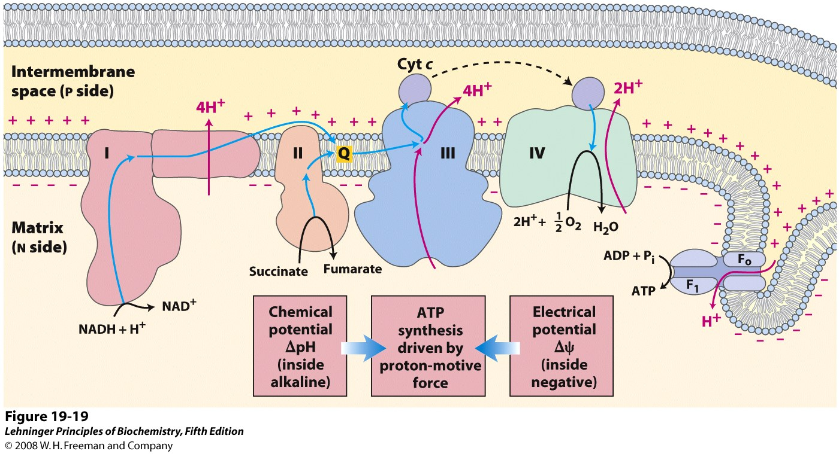
In the ETC, electrons pass through a series of protein complexes and e⁻ carriers to O₂
Intermediate steps (instead of direct transfer to O₂) allow multiple opportunities for coupling e⁻ transfers with H⁺ translocations
Notes:
FIGURE 19-19 Chemiosmotic model. In this simple representation of the chemiosmotic theory applied to mitochondria, electrons from NADH and other oxidizable substrates pass through a chain of carriers arranged asymmetrically in the inner membrane. Electron flow is accompanied by proton transfer across the membrane, producing both a chemical gradient (ΔpH) and an electrical gradient (Δψ). The inner mitochondrial membrane is impermeable to protons; protons can reenter the matrix only through proton-specific channels (F_{o}). The proton-motive force that drives protons back into the matrix provides the energy for ATP synthesis, catalyzed by the F₁ complex associated with F_{o}.

Slide 2
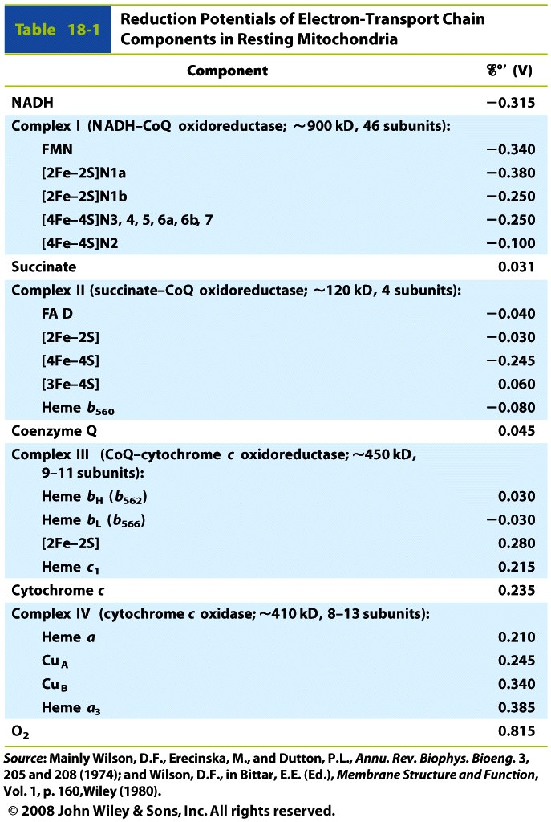
Each protein complex contains multiple redox cofactors used to transfer electrons
Electrons move from cofactors of lower to higher reduction potential
within each complex and from one complex or carrier to the next

Slide 3
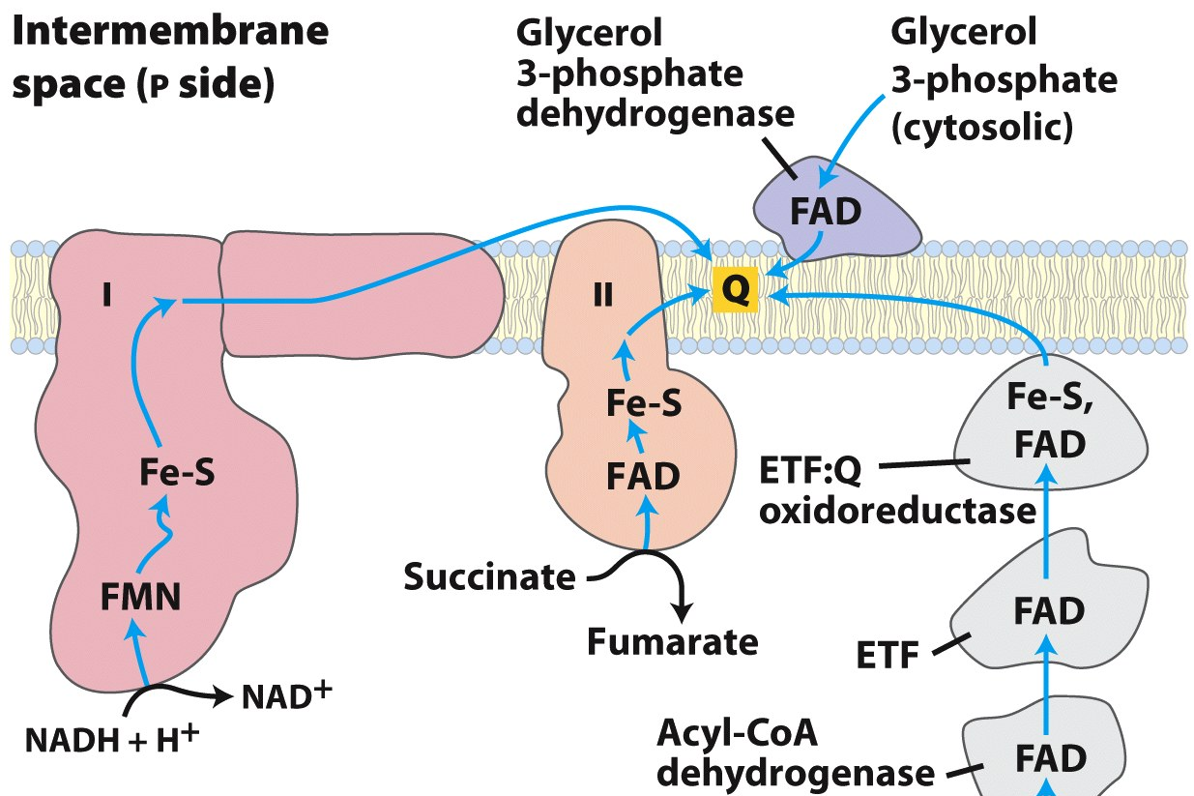
Electrons enter the ETC (and are transferred to CoQ) through different enzymes
NADH
via Malate
From:
glycolysis
Intermembrane space
4H⁺
Glycerol-3-P DH
Complex I
Matrix
ETF:CoQ
oxidoreductase
reduced ETF
From:
fatty acid oxidation
Complex II
(Succinate DH)
NADH
From:
PDH complex
TCA cycle
Notes:
FIGURE 19-8 Path of electrons from NADH, succinate, fatty acyl–CoA, and glycerol 3-phosphate to ubiquinone. Electrons from NADH pass through a flavoprotein to a series of iron-sulfur proteins (in Complex I) and then to Q. Electrons from succinate pass through a flavoprotein and several Fe-S centers (in Complex II) on the way to Q. Glycerol 3-phosphate donates electrons to a flavoprotein (glycerol 3-phosphate dehydrogenase) on the outer face of the inner mitochondrial membrane, from which they pass to Q. Acyl-CoA dehydrogenase (the first enzyme of β oxidation) transfers electrons to electron-transferring flavoprotein (ETF), from which they pass to Q via ETF:ubiquinone oxidoreductase.

Slide 4
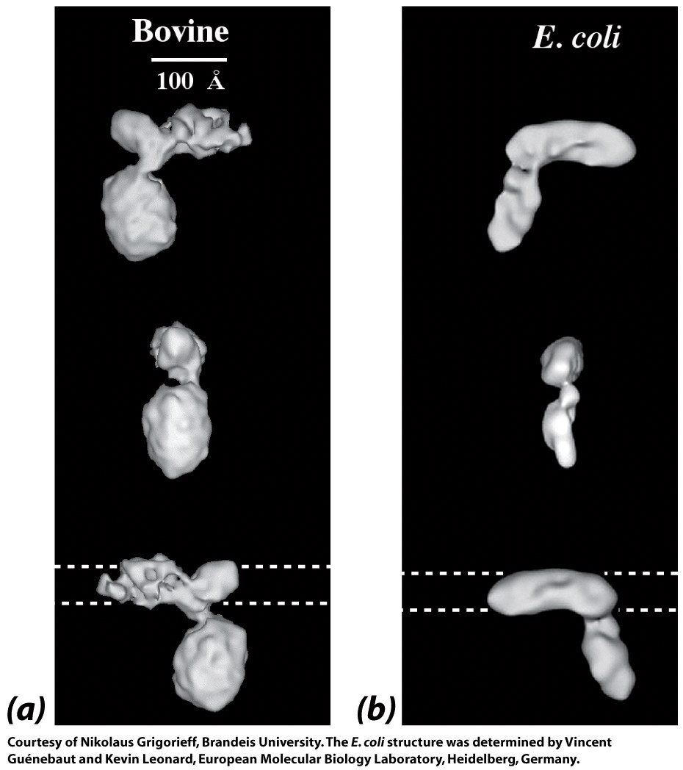
Complex I (NADH-CoQ oxidoreductase) is a large, L-shaped protein complex

Slide 5
Complex I uses three kinds of redox centers
FMN
2Fe-2S center
4Fe-4S center
Flavin nucleotides transfer one or two e⁻ (and H⁺) at a time
Iron-sulfur clusters transfer only one e⁻ at a time
Notes:
FIGURE 19-5a–c Iron-sulfur centers. The Fe-S centers of iron-sulfur proteins may be as simple as (a), with a single Fe ion surrounded by the S atoms of four Cys residues. Other centers include both inorganic and Cys S atoms, as in (b) 2Fe-2S or (c) 4Fe-4S centers. (d) The ferredoxin of the cyanobacterium Anabaena 7120 has one 2Fe-2S center (PDB ID 1FRD); Fe is red, inorganic S is yellow, and the S of Cys is orange. (Note that in these designations only the inorganic S atoms are counted. For example, in the 2Fe-2S center (b), each Fe ion is actually surrounded by four S atoms.) The exact standard reduction potential of the iron in these centers depends on the type of center and its interaction with the associated protein.

Slide 6
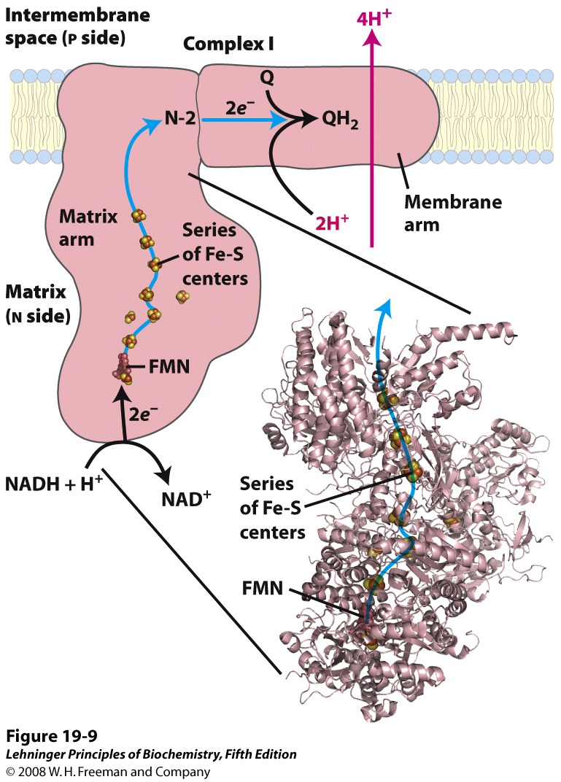
NADH transfers a hydride to FMN, then e⁻ move one-by-one (via Fe-S centers) to CoQ
Notes:
FIGURE 19-9 NADH:ubiquinone oxidoreductase (Complex I). Complex I catalyzes the transfer of a hydride ion from NADH to FMN, from which two electrons pass through a series of Fe-S centers to the ironsulfur protein N-2 in the matrix arm of the complex. The domain that extends into the matrix has been crystallized and its structure solved (PDB ID 2FUG); the structure of the membrane domain of Complex I is not yet known. Electron transfer from N-2 to ubiquinone on the membrane arm forms QH₂, which diffuses into the lipid bilayer. This electron transfer also drives the expulsion from the matrix of four protons per pair of electrons. The detailed mechanism that couples electron and proton transfer in Complex I is not yet known, but probably involves a Q cycle similar to that in Complex III in which QH₂ participates twice per electron pair (see Figure 19-12). Proton flux produces an electrochemical potential across the inner mitochondrial membrane (N side negative, P side positive), which conserves some of the energy released by the electron-transfer reactions. This electrochemical potential drives ATP synthesis.

Slide 7
Coenzyme Q is a membrane-soluble, diffusible electron (and proton) carrier

Slide 8
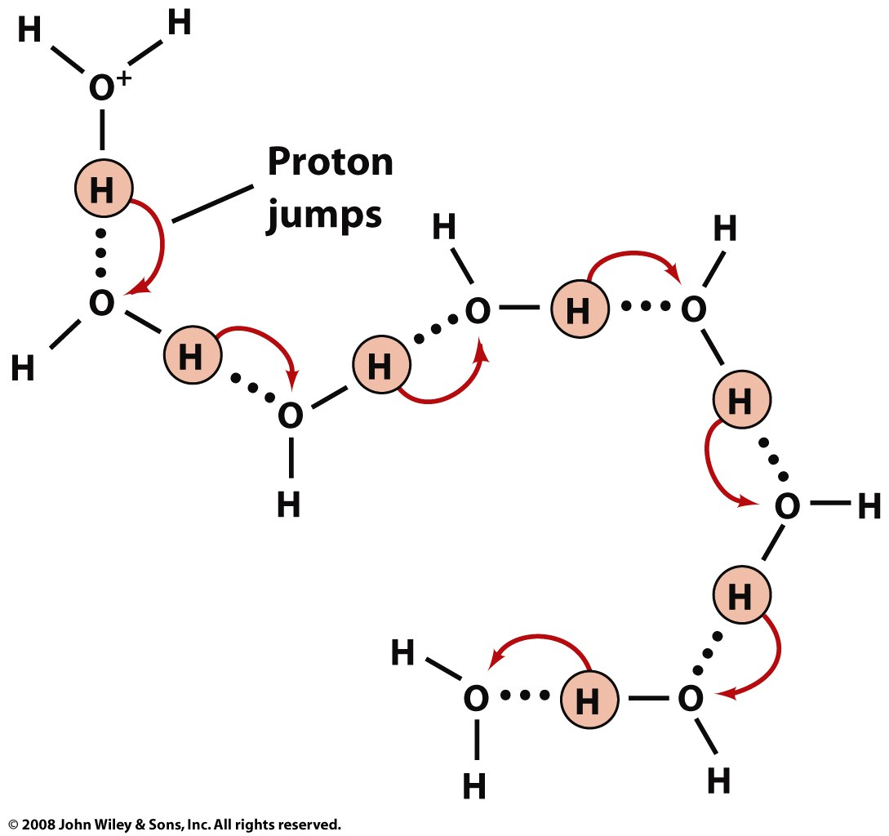
Complex I may translocate protons via proton jumping (involving aa sidechains)
Proton
jumps
4 protons are translocated for every two electrons transferred
Notes:
FIGURE 19-9 NADH:ubiquinone oxidoreductase (Complex I). Complex I catalyzes the transfer of a hydride ion from NADH to FMN, from which two electrons pass through a series of Fe-S centers to the ironsulfur protein N-2 in the matrix arm of the complex. The domain that extends into the matrix has been crystallized and its structure solved (PDB ID 2FUG); the structure of the membrane domain of Complex I is not yet known. Electron transfer from N-2 to ubiquinone on the membrane arm forms QH₂, which diffuses into the lipid bilayer. This electron transfer also drives the expulsion from the matrix of four protons per pair of electrons. The detailed mechanism that couples electron and proton transfer in Complex I is not yet known, but probably involves a Q cycle similar to that in Complex III in which QH₂ participates twice per electron pair (see Figure 19-12). Proton flux produces an electrochemical potential across the inner mitochondrial membrane (N side negative, P side positive), which conserves some of the energy released by the electron-transfer reactions. This electrochemical potential drives ATP synthesis.

Slide 9
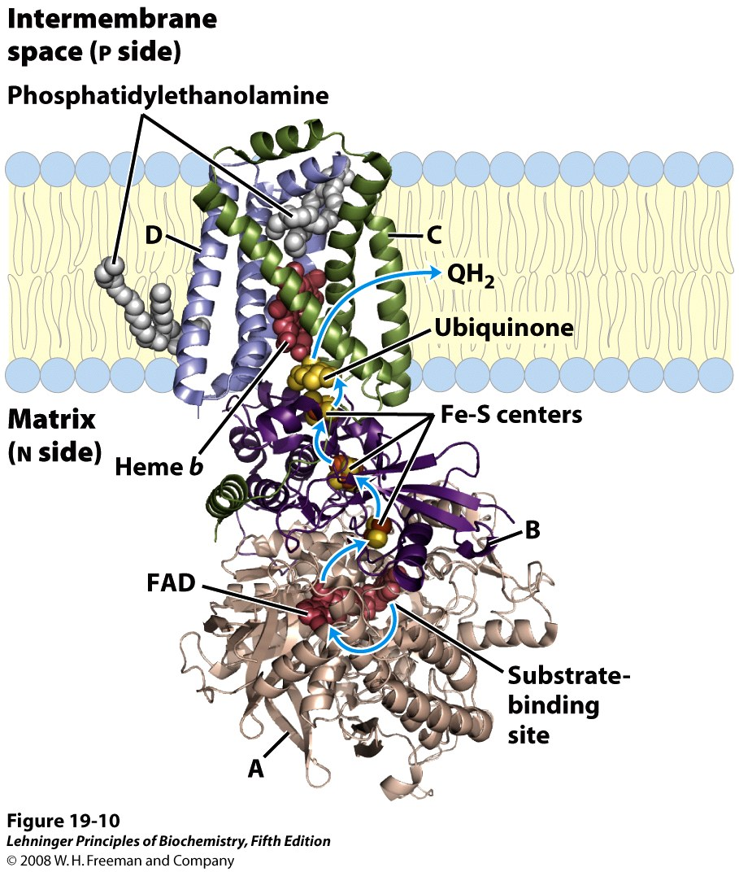
Complex II (succinate-CoQ oxidoreductase) is succinate dehydrogenase from TCA cycle
Electrons move
one-at-a-time
from FAD to CoQ
(No protons are pumped)
Notes:
FIGURE 19-10 Structure of Complex II (succinate dehydrogenase). (PDB ID 1ZOY) This complex (shown here is the porcine heart enzyme) has two transmembrane subunits, C and D; the cytoplasmic extensions contain subunits A and B. Just behind the FAD in subunit A is the binding site for succinate. Subunit B has three sets of Fe-S centers; ubiquinone is bound to subunit B; and heme b is sandwiched between subunits C and D. Two phosphatidylethanolamine molecules are so tightly bound to subunit D that they show up in the crystal structure. Electrons move (blue arrows) from succinate to FAD, then through the three Fe-S centers to ubiquinone. The heme b is not on the main path of electron transfer but protects against the formation of reactive oxygen species (ROS) by electrons that go astray.

Slide 10
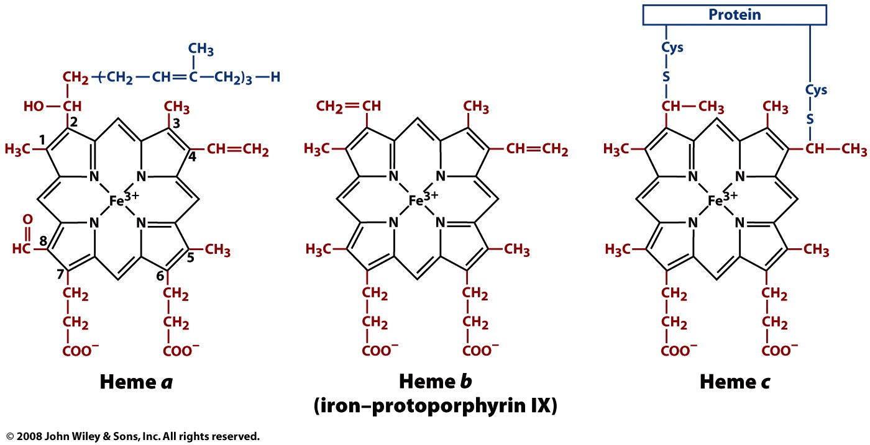
Electron transport involves different kinds of hemes
Hemes transfer one electron at a time
Complex IV
Complexes II and III
(and hemoglobin & myoglobin)
Complex III and
Cytochrome C

Slide 11
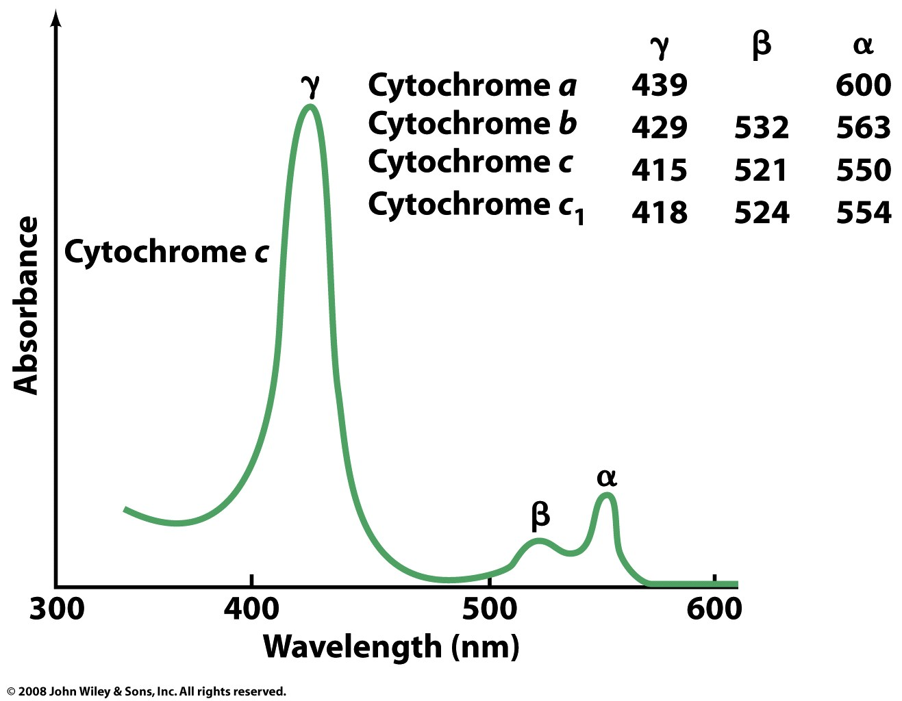
Cytochromes (heme-containing redox proteins) are named by heme type
Wavelength of α-peak is used to distinguish different cytochromes

Slide 12
Q is reduced to QH₂ near the membrane-matrix interface of Complex I or II
Complex I
Complex II
IM space
Matrix
Fumarate
The protons of QH₂ come from the matrix

Slide 13
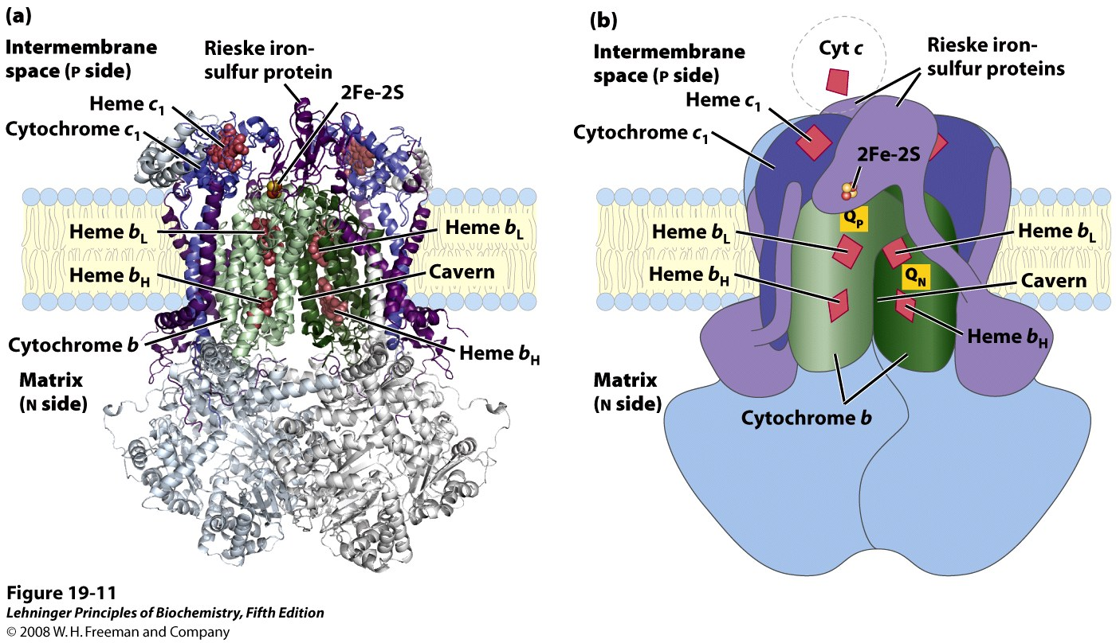
Complex III (CoQ-cytochrome c oxidoreduct-ase) pumps protons with the help of CoQ
4H⁺
“Q-cycling” allows for the release of 4 protons to the IM space
(from QH₂) for every 2e⁻ transferred to Cytochrome c
Notes:
FIGURE 19-11 Cytochrome bc₁ complex (Complex III). The complex is a dimer of identical monomers, each with 11 different subunits. (a) The functional core of each monomer is three subunits: cytochrome b (green) with its two hemes (b_{H} and b_{L}); the Rieske iron-sulfur protein (purple) with its 2Fe-2S centers; and cytochrome c₁ (blue) with its heme (PDB ID 1BGY). (b) This cartoon view of the complex shows how cytochrome c₁ and the Rieske iron-sulfur protein project from the P surface and can interact with cytochrome c (not part of the functional complex) in the intermembrane space. The complex has two distinct binding sites for ubiquinone, Q_{N} and Q_{P}, which correspond to the sites of inhibition by two drugs that block oxidative phosphorylation. Antimycin A, which blocks electron flow from heme b_{H} to Q, binds at Q_{N}, close to heme b_{H} on the N (matrix) side of the membrane. Myxothiazol, which prevents electron flow from QH₂ to the Rieske iron-sulfur protein, binds at Q_{P}, near the 2Fe-2S center and heme b_{L} on the P side. The dimeric structure is essential to the function of Complex III. The interface between monomers forms two caverns, each containing a Q_{P} site from one monomer and a Q_{N} site from the other. The ubiquinone intermediates move within these sheltered caverns. Complex III crystallizes in two distinct conformations (not shown). In one, the Rieske Fe-S center is close to its electron acceptor, the heme of cytochrome c₁, but relatively distant from cytochrome b and the QH₂-binding site at which the Rieske Fe-S center receives electrons. In the other, the Fe-S center has moved away from cytochrome c₁ and toward cytochrome b. The Rieske protein is thought to oscillate between these two conformations as it is first reduced, then oxidized.

Slide 14
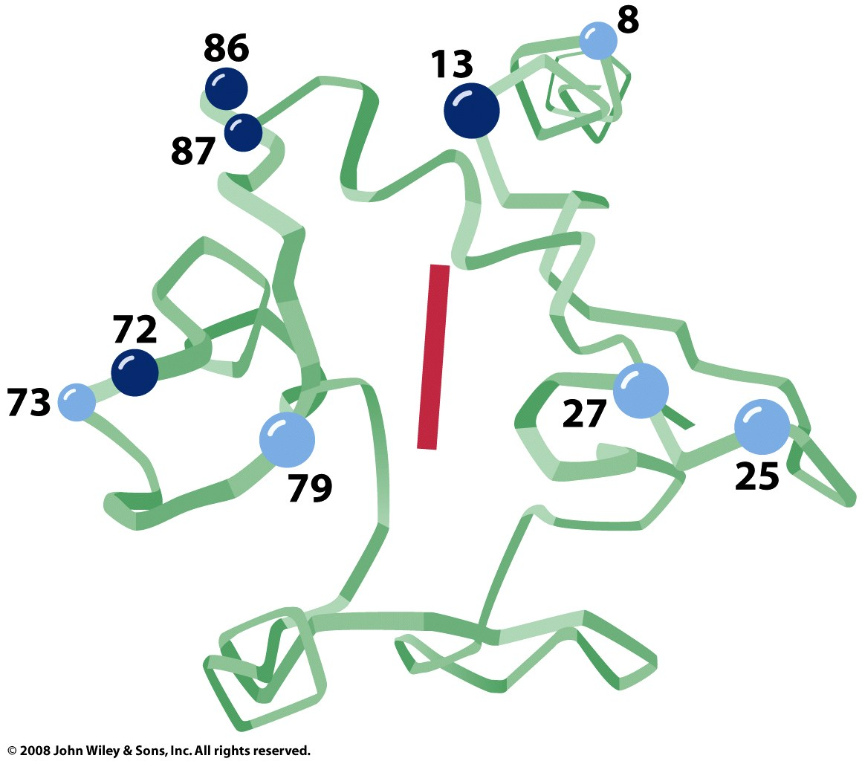
Cytochrome c is a small peripheral mb protein that diffuses in the IM space
Since it has just one heme, cytochrome c is a 1e⁻ carrier
Lysine sidechains
are involved in binding
to Complex IV

Slide 15
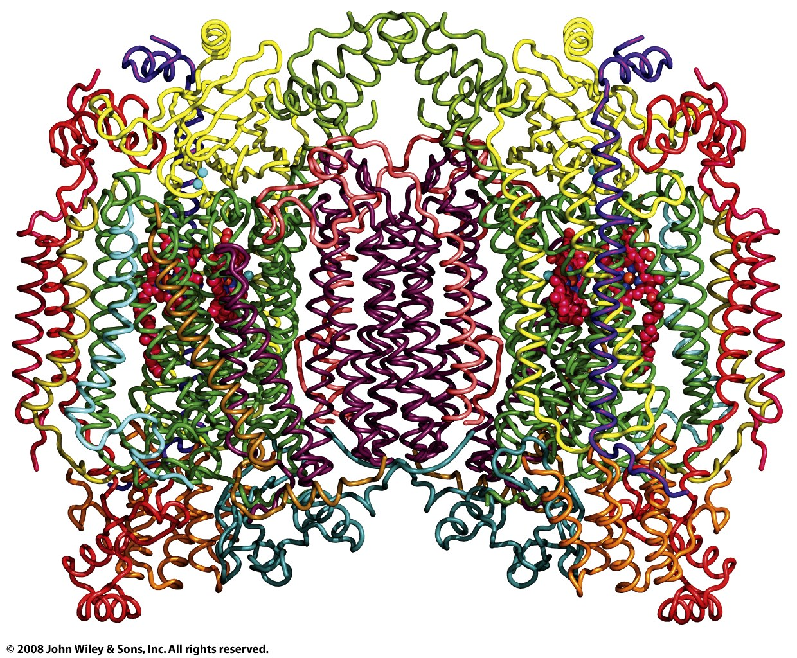
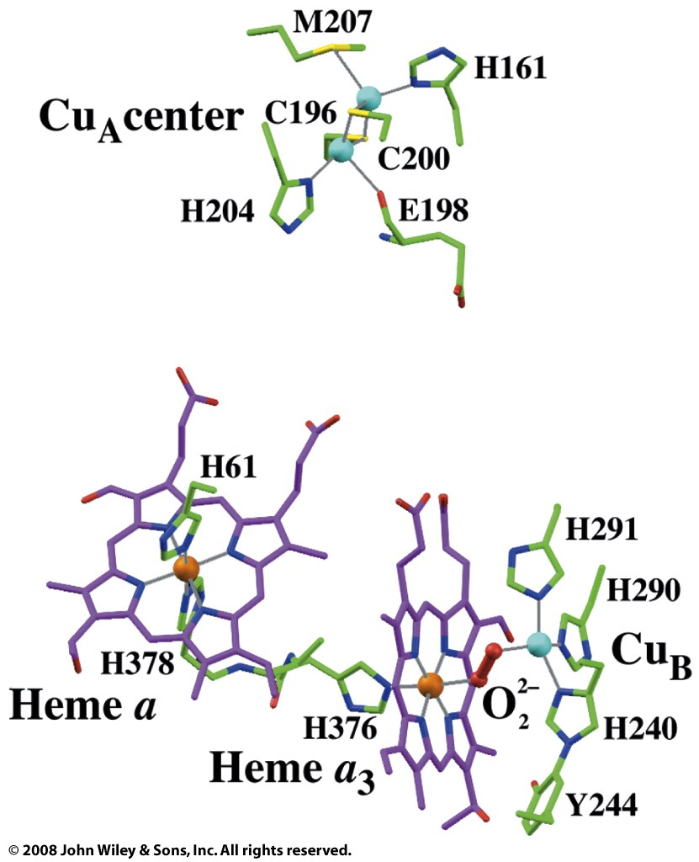
Complex IV (Cytochrome c oxidase) transfers electrons to O₂ (reducing it to H₂O)

Slide 16
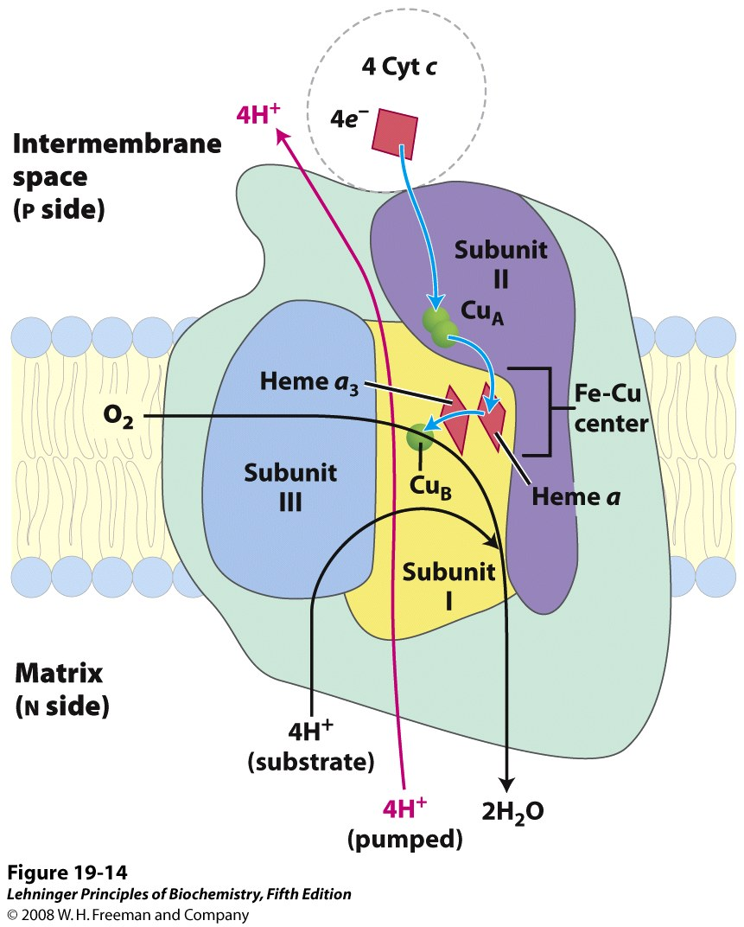
4 electrons (and 4 matrix protons) are used to reduce one molecule of O₂ to 2 H₂O
2 protons are translocated for every
two electrons transferred
Notes:
FIGURE 19-14 Path of electrons through Complex IV. The three proteins critical to electron flow are subunits I, II, and III. The larger green structure includes the other 10 proteins in the complex. Electron transfer through Complex IV begins with cytochrome c (top). Two molecules of reduced cytochrome c each donate an electron to the binuclear center Cu_{A}. From here electrons pass through heme a to the Fe-Cu center (cytochrome a₃ and Cu_{B}). Oxygen now binds to heme a₃ and is reduced to its peroxy derivative (O₂^{2–}; not shown here) by two electrons from the Fe-Cu center. Delivery of two more electrons from cytochrome c (top, making four electrons in all) converts the O₂^{2–} to two molecules of water, with consumption of four "substrate" protons from the matrix. At the same time, four protons are pumped from the matrix by an as yet unknown mechanism.

Slide 17
2-electron transfers from NADH→O₂ result in 10H⁺ translocated; from FADH₂→O₂, 6H⁺
Notes:
FIGURE 19-16 Summary of the flow of electrons and protons through the four complexes of the respiratory chain. Electrons reach Q through Complexes I and II. The reduced Q (QH₂) serves as a mobile carrier of electrons and protons. It passes electrons to Complex III, which passes them to another mobile connecting link, cytochrome c. Complex IV then transfers electrons from reduced cytochrome c to O2. Electron flow through Complexes I, III, and IV is accompanied by proton flow from the matrix to the intermembrane space. Recall that electrons from β oxidation of fatty acids can also enter the respiratory chain through Q (see Figure 19-8). The structures shown here are from several sources: Complex I, Thermus thermophilus (PDB ID 2FUG); Complex II, porcine heart (PDB ID 1ZOY); Complex III, bovine heart (PDB ID 1BGY); cytochrome c, equine heart (PDB ID 1HRC); Complex IV, bovine heart (PDB ID 1OCC).

Slide 18
The electrochemical potential of the proton gradient is used to drive ATP synthesis
To make ATP, 4H⁺ move back into the matrix;
10/4 = 2.5 ATP per 2e⁻ from NADH;
6/4 = 1.5 ATP per 2e⁻ from FADH₂
Notes:
FIGURE 19-19 Chemiosmotic model. In this simple representation of the chemiosmotic theory applied to mitochondria, electrons from NADH and other oxidizable substrates pass through a chain of carriers arranged asymmetrically in the inner membrane. Electron flow is accompanied by proton transfer across the membrane, producing both a chemical gradient (ΔpH) and an electrical gradient (Δψ). The inner mitochondrial membrane is impermeable to protons; protons can reenter the matrix only through proton-specific channels (F_{o}). The proton-motive force that drives protons back into the matrix provides the energy for ATP synthesis, catalyzed by the F₁ complex associated with F_{o}.

