Slide 1
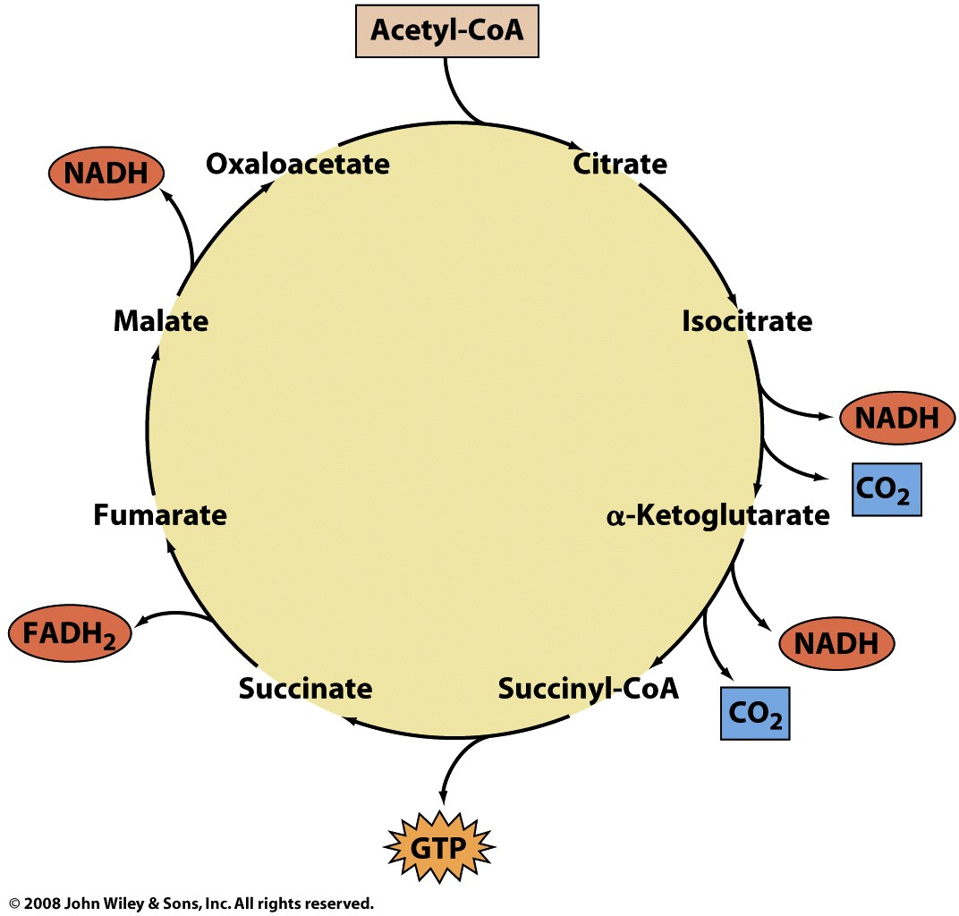
The oxidation of acetyl-CoA to CO₂ in the TCA cycle generates reduced cofactors

Slide 2
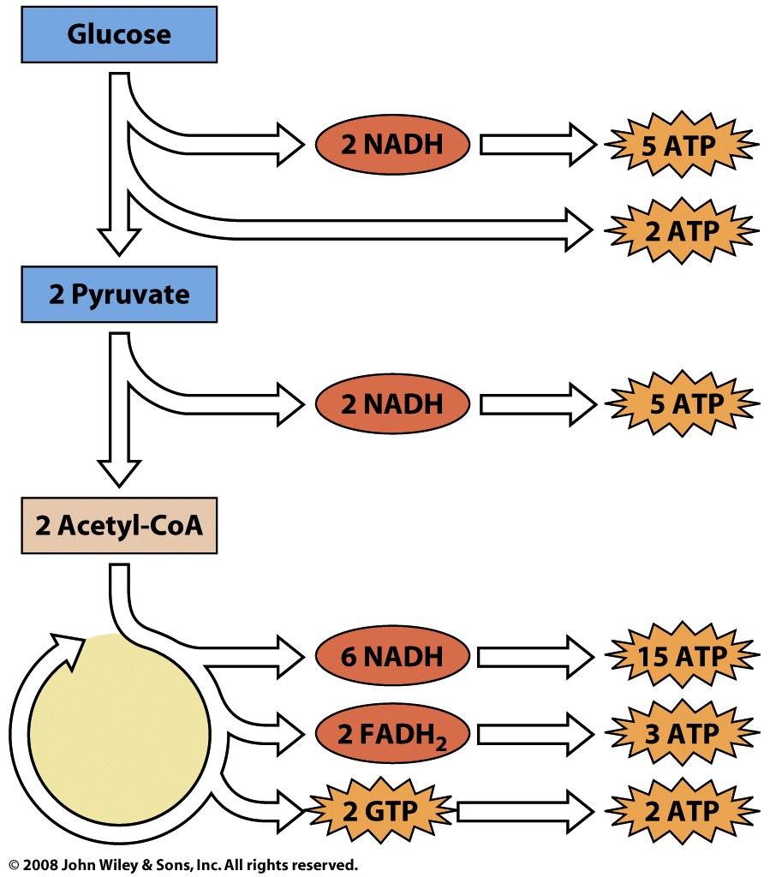
Reduced redox cofactors produced in glucose oxidation are used to make ATP
32 ATP

Slide 3
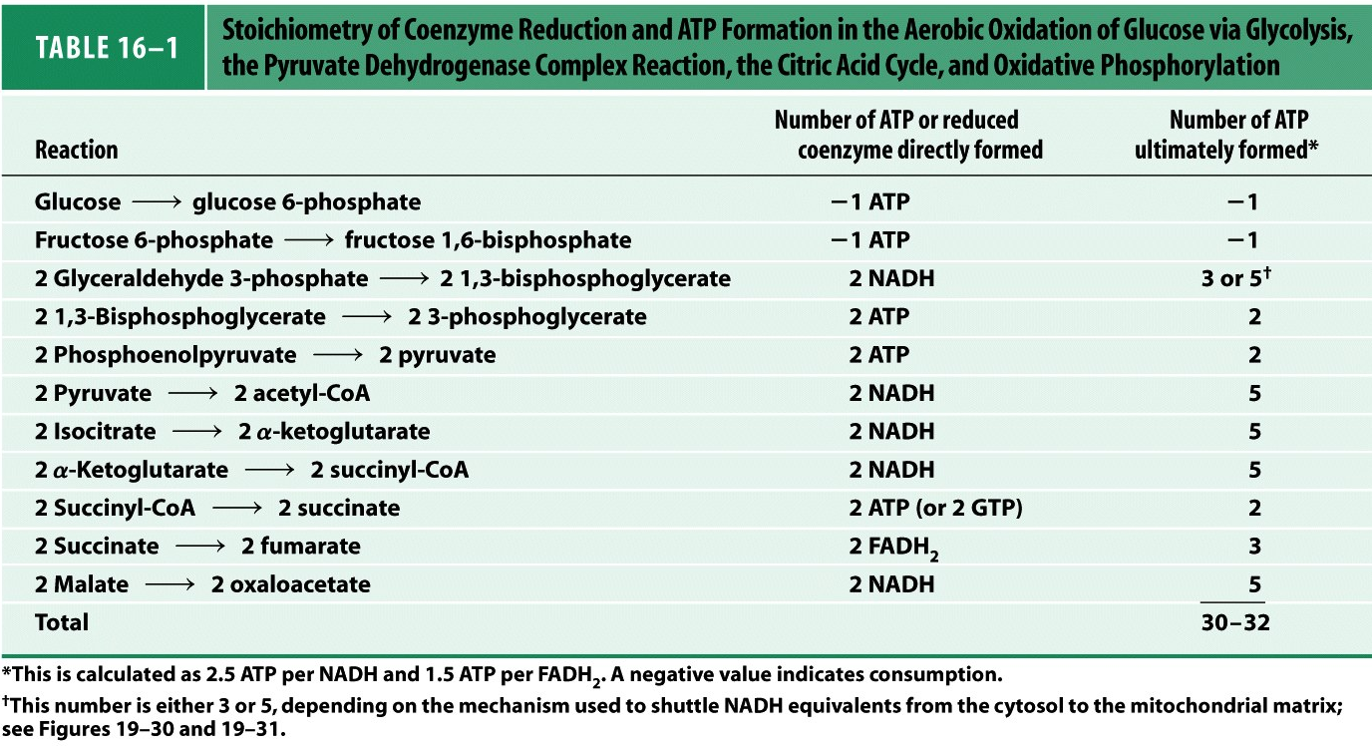
Notes:
TABLE 16-1 Stoichiometry of Coenzyme Reduction and ATP Formation in the Aerobic Oxidation of Glucose via Glycolysis, the Pyruvate Dehydrogenase Complex Reaction, the Citric Acid Cycle, and Oxidative Phosphorylation

Slide 4
How are reduced redox currencies (NADH, FADH₂) used to make ATP?
Electrons spontaneously move from compounds of lower reduction potential to higher reduction potential
Reduction potential is a measure of electron affinity
Electron transfers are exergonic, releasing free energy
The exergonic transfer of electrons can be coupled to endergonic processes to make them favorable
The transfer of electrons from NADH (or FADH₂) to O₂ is highly exergonic
ATP synthesis from ADP and P_{i} is endergonic
Electron transfers are coupled to ATP synthesis through the creation of an electrochemical proton gradient

Slide 5
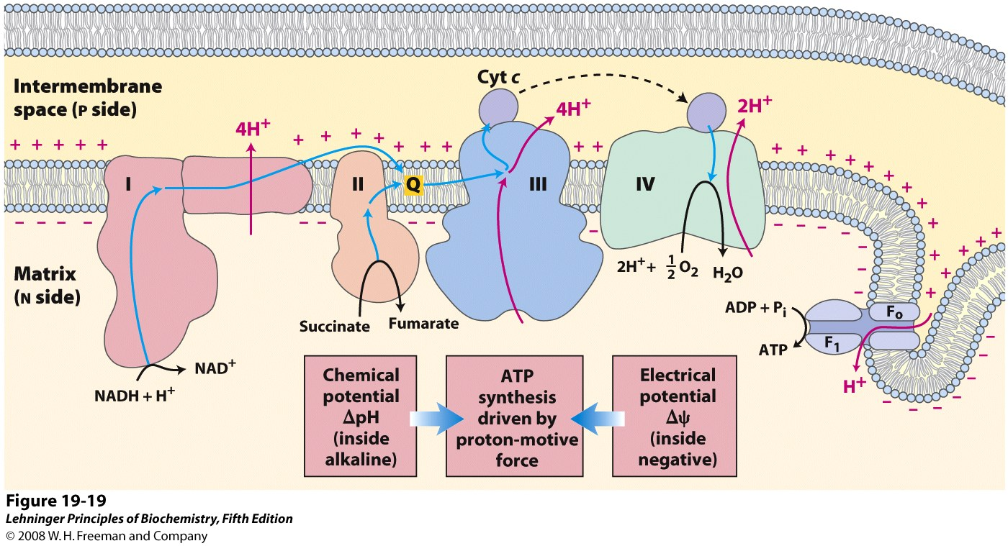
Electron transfers drive H⁺ gradient formation; gradient potential drives ATP synthesis
Notes:
FIGURE 19-19 Chemiosmotic model. In this simple representation of the chemiosmotic theory applied to mitochondria, electrons from NADH and other oxidizable substrates pass through a chain of carriers arranged asymmetrically in the inner membrane. Electron flow is accompanied by proton transfer across the membrane, producing both a chemical gradient (ΔpH) and an electrical gradient (Δψ). The inner mitochondrial membrane is impermeable to protons; protons can reenter the matrix only through proton-specific channels (F_{o}). The proton-motive force that drives protons back into the matrix provides the energy for ATP synthesis, catalyzed by the F₁ complex associated with F_{o}.

Slide 6
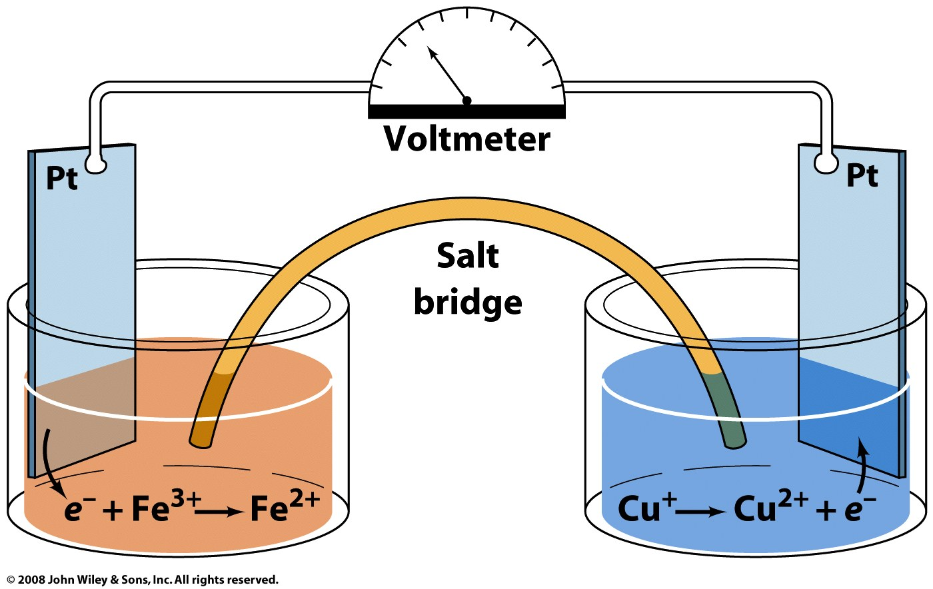
Reduction potentials are measured using an electrochemical cell
Measured voltage = ΔE
ΔE = E _{acceptor} – E _{donor}
Under standard conditions, measurement against the standard hydrogen half cell (1M H⁺, 1ATM H₂) gives standardE (E ° ≡ 0 for H⁺ + e⁻ → ½ H₂)

Slide 7
