Slide 1
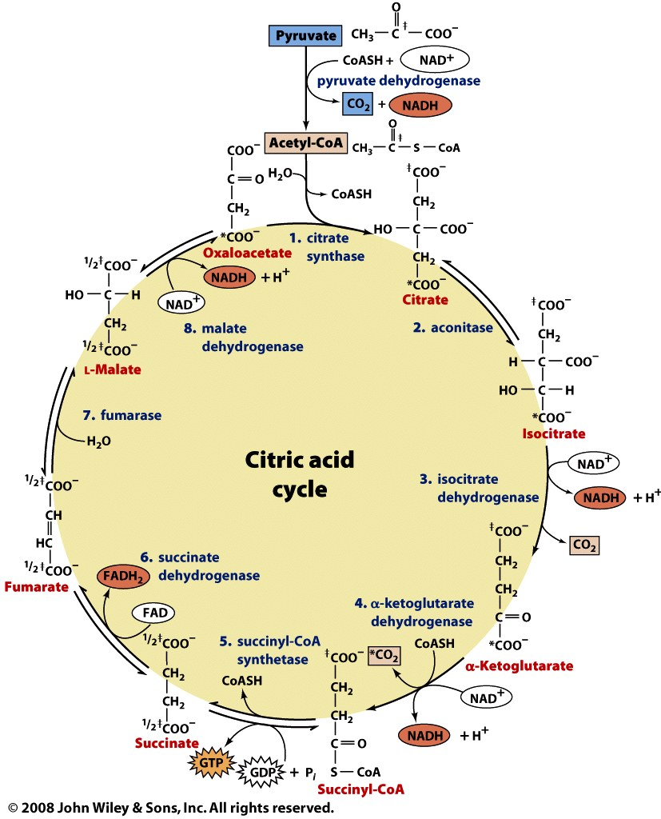

Slide 2
How is the oxidation of pyruvate regulated?

Slide 3
PDH complex is regulated by product inhibition and covalent modification
Product inhibition:
Acetyl-CoA binds and inhibits E₂
NADH binds and inhibits E₃
Covalent modification (eukaryotes only): reversible phosphorylation of E₁ Ser
Phosphatase activated by insulin (high [glc]) and Ca²⁺
Kinase activated by NADH and acetyl-CoA

Slide 4
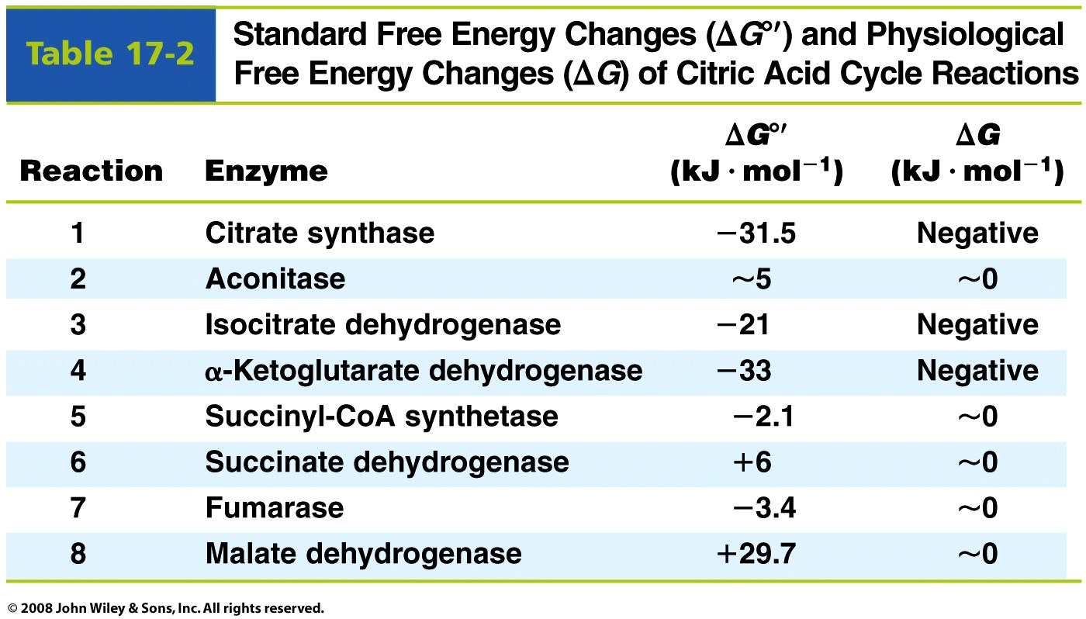
The slowest steps of the citric acid cycle have negative ΔG’s, and are regulated

Slide 5
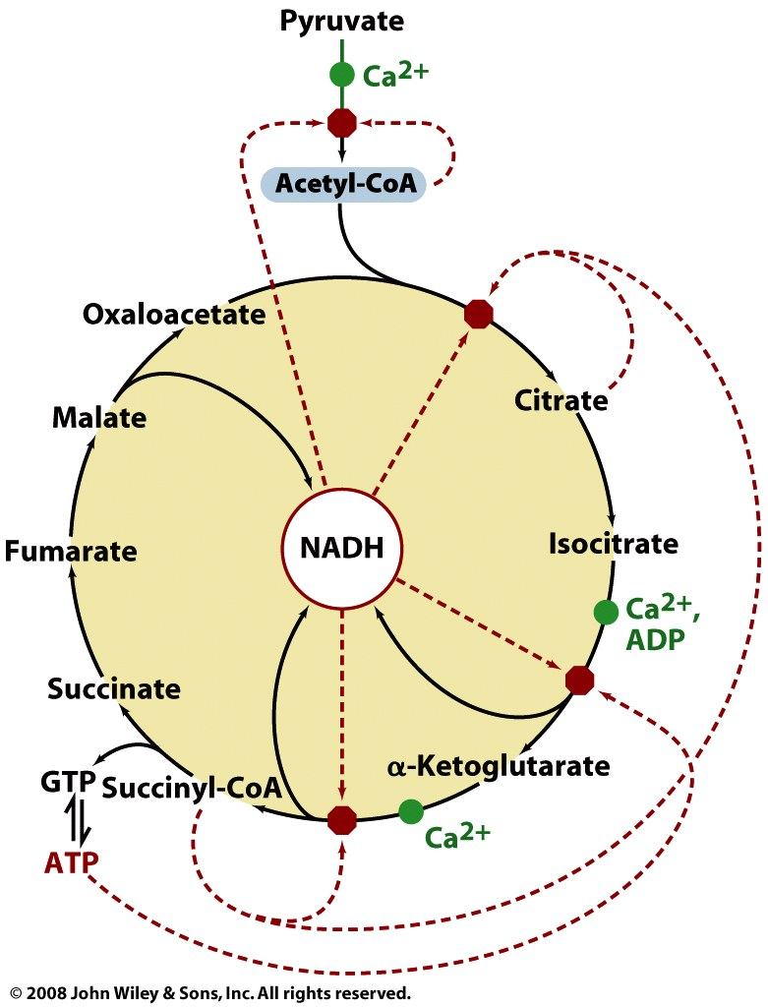
Compounds reflecting energy status and energy use are regulators of the TCA cycle
NADH
Product inhibitor of NAD⁺-using dehydrogenases
Inhibitor of citrate synthase
Pathway intermediates
Citrate and succinyl-CoA act via product inhibition or competitive feedback inhibition
Levels of substrates OAA and acetyl-CoA determine activity of citrate synthase
Adenylates
Allosteric inhibitors (ATP) or activators (ADP) of isocitrate DH
Ca²⁺ (muscle contraction)
Allosteric activator of the dehydrogenases

Slide 6
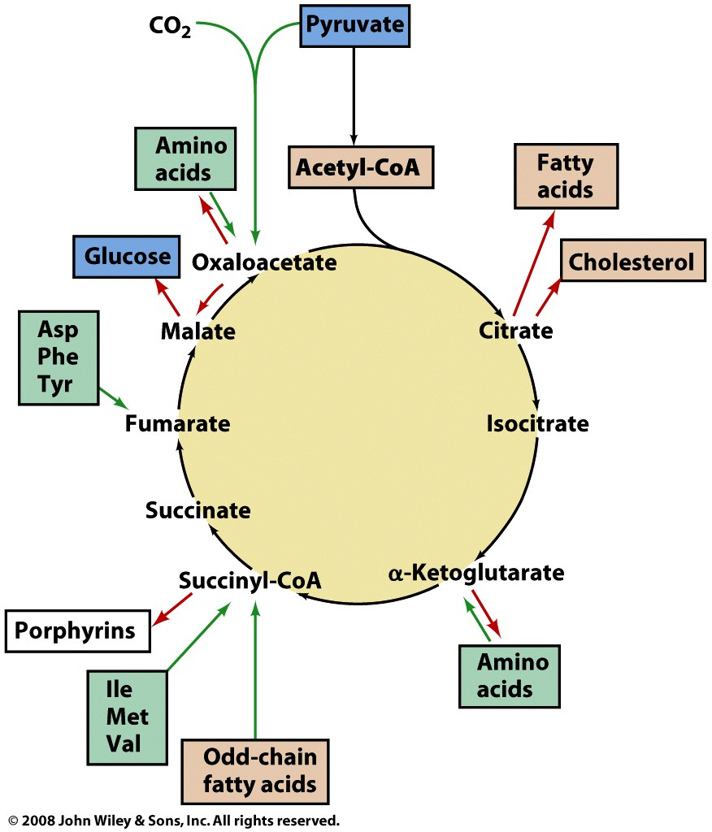
TCA cycle intermediates are made and used in additional metabolic pathways
Cataplerotic reactions use cycle intermediates to make:
Glucose
Amino acids
Lipids
Cofactors
Anaplerotic reactions generate cycle intermediates from:
Pyruvate
Amino acids
Odd-chain fatty acids

Slide 7
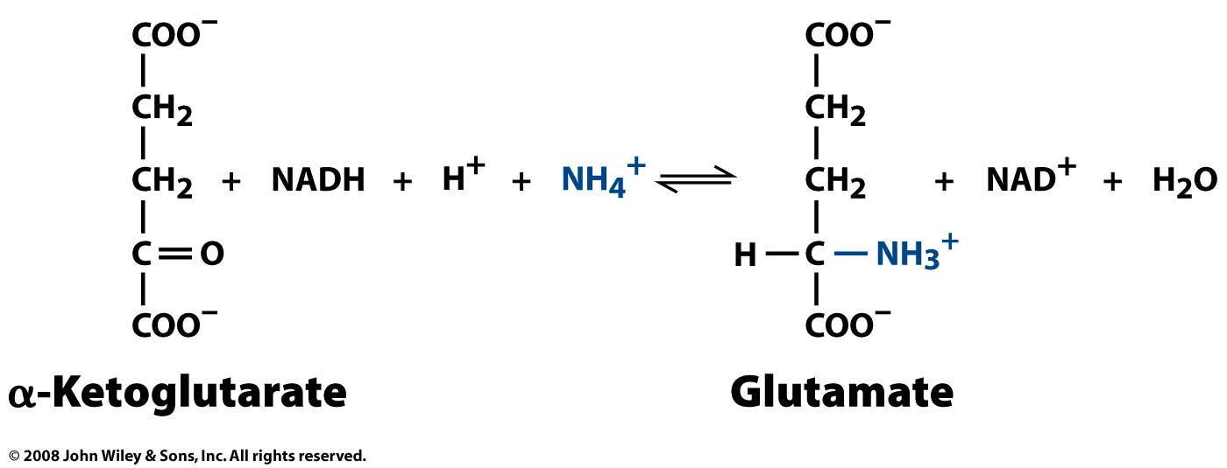
Amino acids and TCA cycle intermediates are readily inter-converted
Reductive amination:
Transamination:

Slide 8
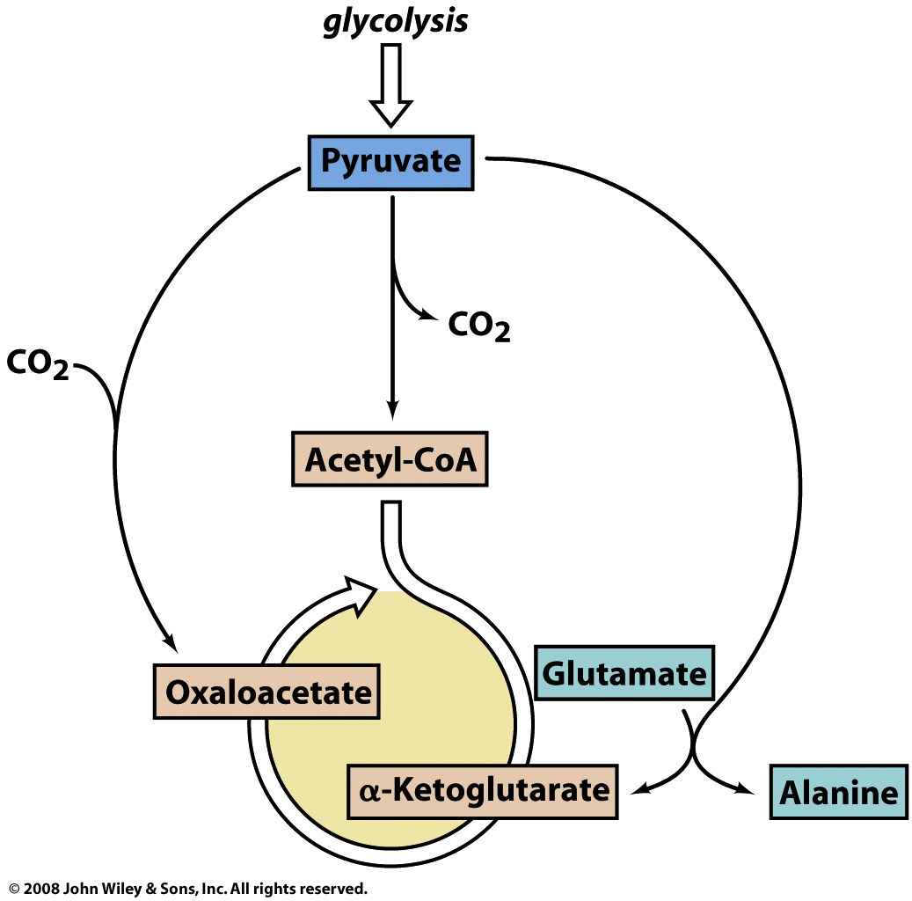
Production of pyruvate increases flux through TCA cycle by increasing [substrate]
Action of PDH complex increases [acetyl-CoA] (as does FA oxidation), but [OAA] can limit flux
Pyruvate carboxylase is activated by acetyl-CoA, and can generate more OAA to enhance flux
Pyruvate can also act in transamination rxns, yielding α-KG (from Glu)
or OAA (from Asp)
fatty acid oxidation
pyruvate carboxylase
(with biotin)
PDHC
amino-
transferase

Slide 9
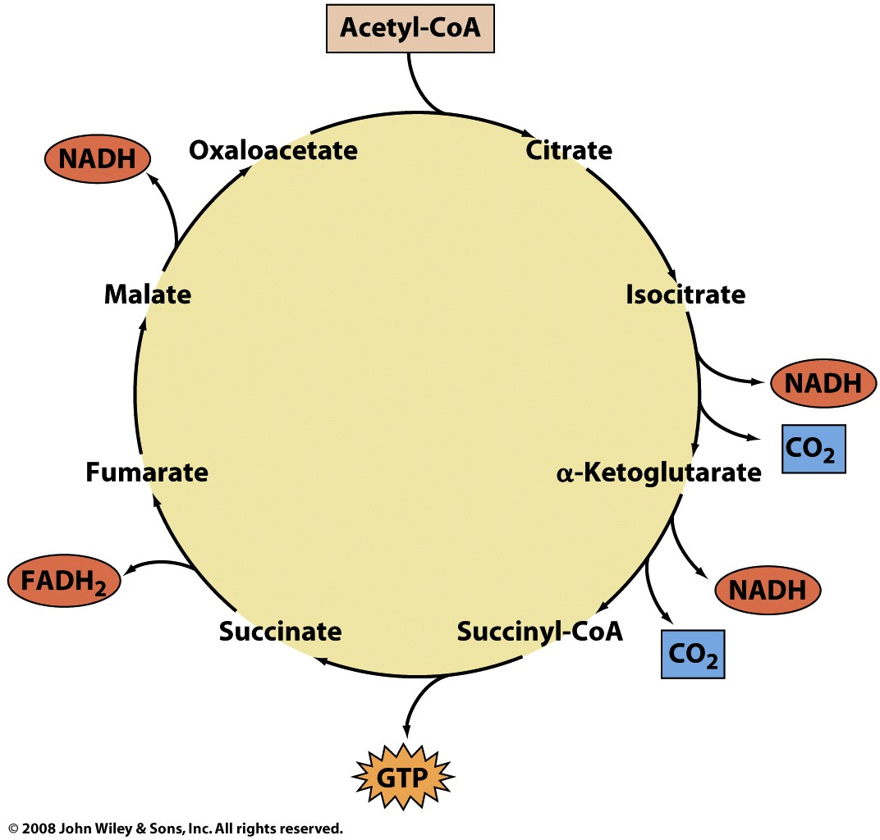
The oxidation of acetyl-CoA to CO₂ in the TCA cycle generates energy currencies

