Slide 1
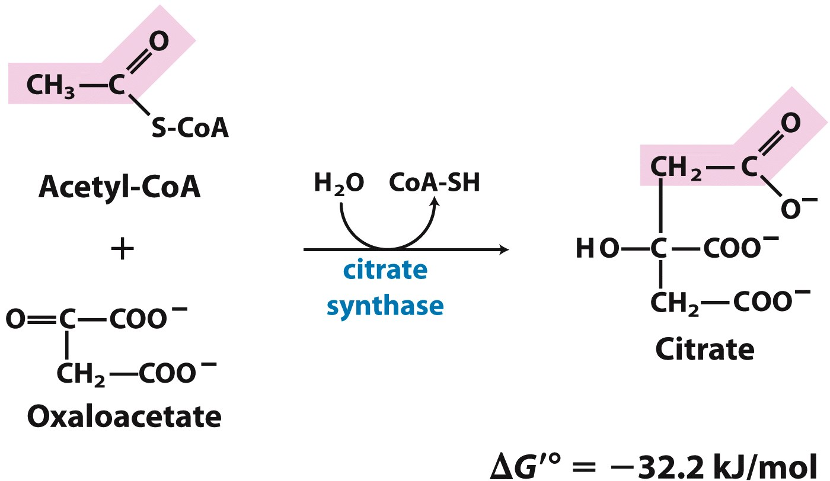
(1) Citrate synthase catalyzes C-C bond formation between acetate and oxaloacetate
Driven mainly by thioester hydrolysis

Slide 2
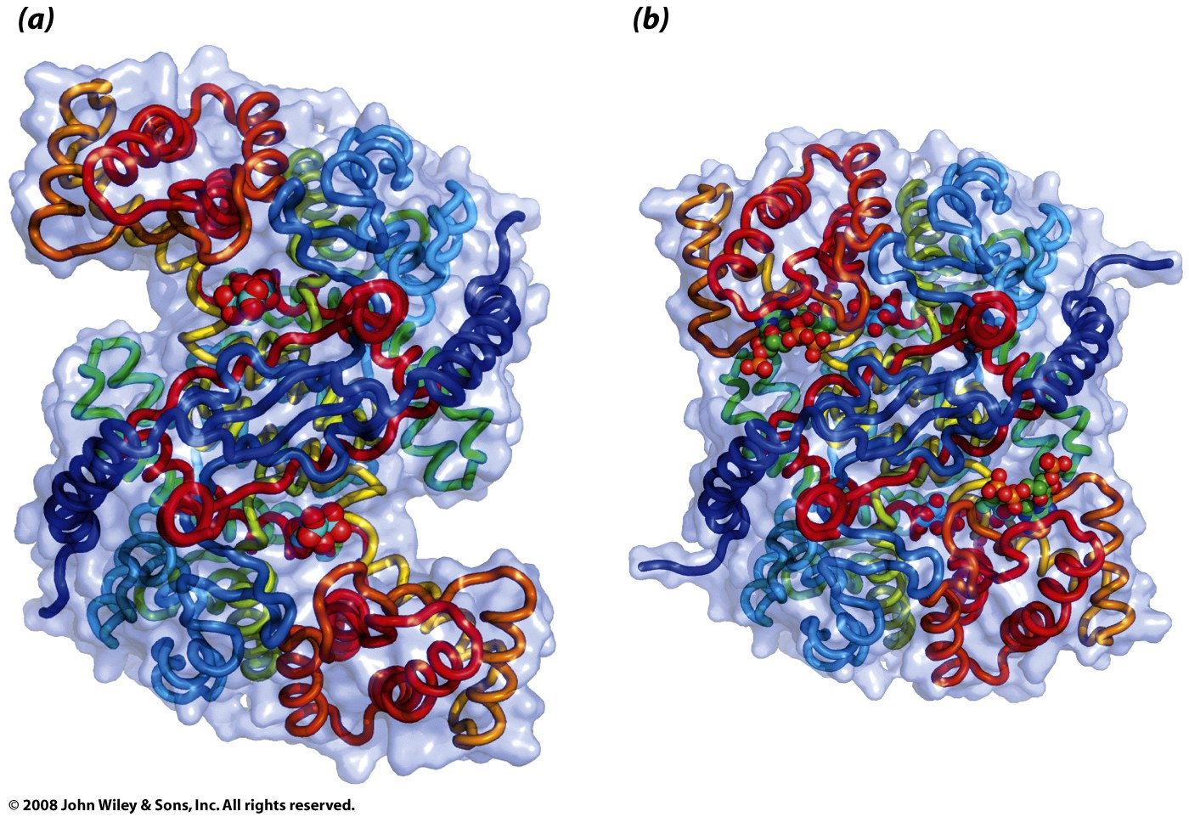
(1) Citrate synthase changes conformation in response to substrate binding (induced fit)
Substrates bind sequentially: oxaloacetate, then acetyl-CoA

Slide 3
(1) Citrate synthase changes conformation in response to substrate binding (induced fit)
chomp!
chomp!
Substrates bind sequentially: oxaloacetate, then acetyl-CoA

Slide 4
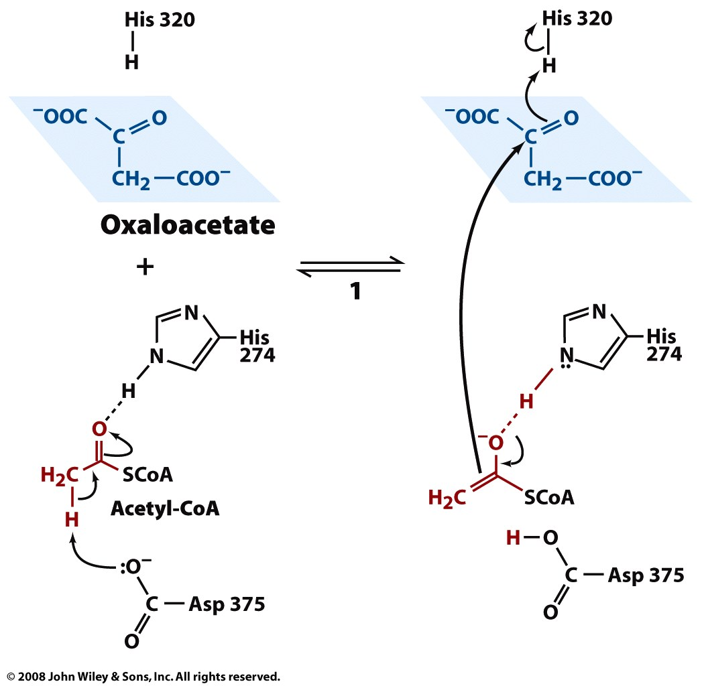
(1) In the rate-limiting step, acetyl-CoA is deprotonated to form an enolate

Slide 5
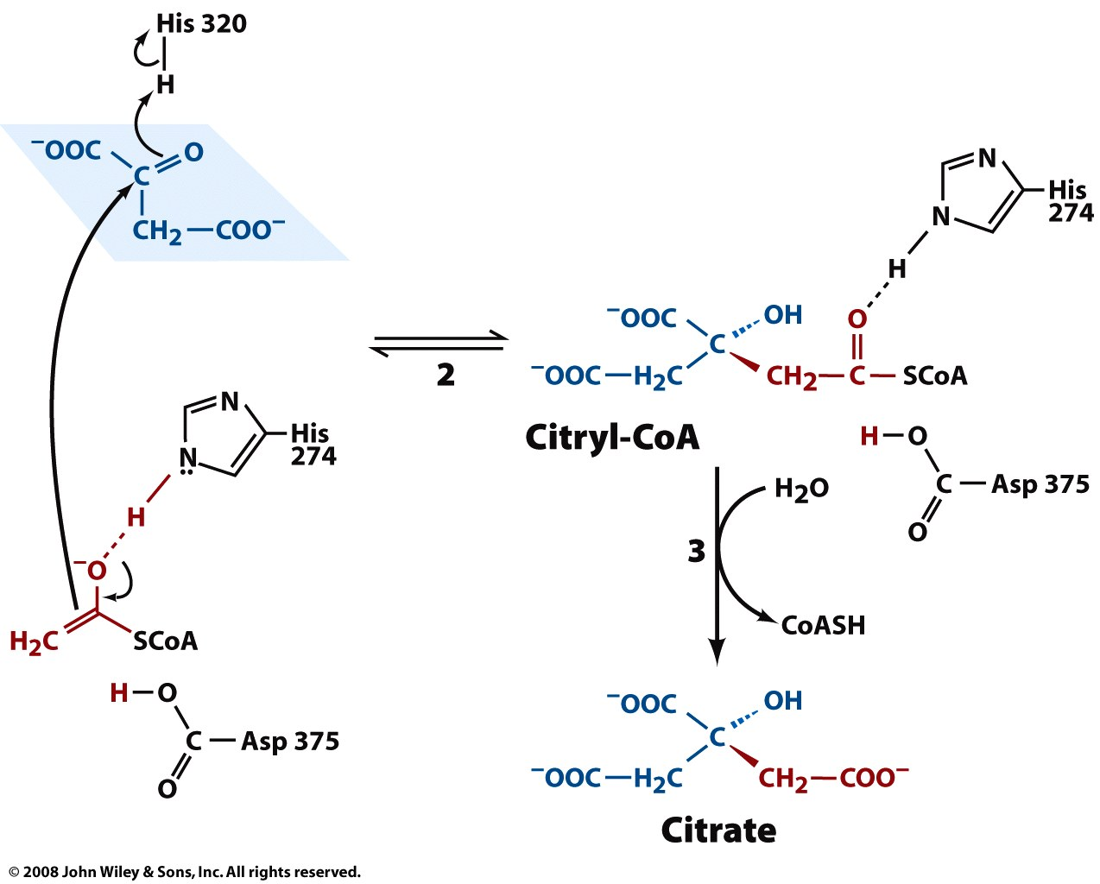
(1) The nucleophilic enolate attacks the carbonyl of oxaloacetate to yield citryl-CoA

Slide 6
(1) Hydrolysis of the “high-energy” thioester citryl-CoA makes the reaction irreversible
A second conformational change allows hydrolysis at this step

Slide 7
(2) Aconitase catalyzes the stereospecific conversion of citrate to isocitrate

Slide 8
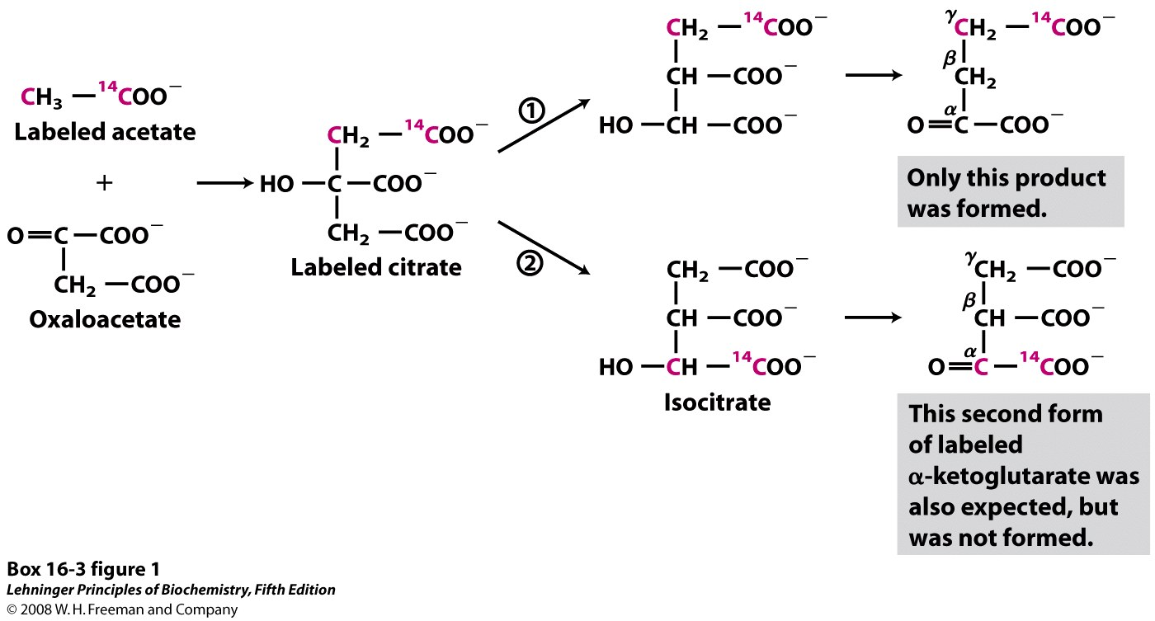
(2) Starting with a radio-labeled acetyl group yields label in only one position
Notes:
BOX 16-3 FIGURE 1 Incorporation of the isotopic carbon (¹⁴C) of the labeled acetyl group into α-ketoglutarate by the citric acid cycle. The carbon atoms of the entering acetyl group are shown in red.

Slide 9
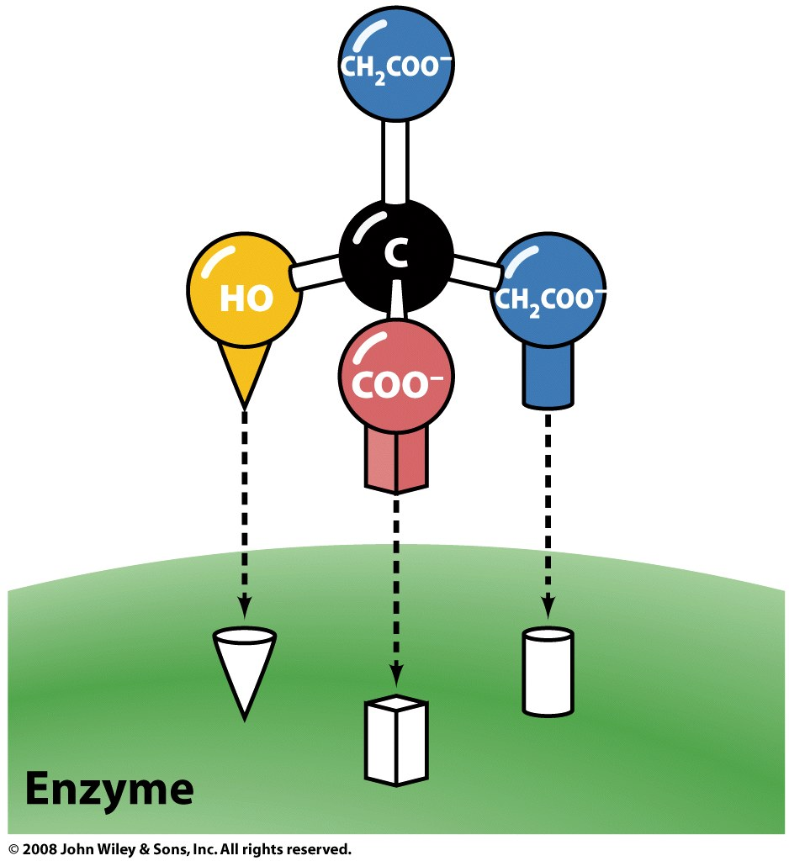
(2) Aconitase can distinguish between the pro-R and pro-S substituents of citrate
pro-S
pro-R
OH is always added here

Slide 10
(3) Isocitrate dehydrogenase catalyzes the oxidative decarboxylation of isocitrate
ΔG'°= -21 kJ/mol

Slide 11
(3) In the first step, isocitrate is oxidized to oxalosuccinate, an unstable intermediate
Notes:
MECHANISM FIGURE 16-11 (part 1) Isocitrate dehydrogenase. In this reaction, the substrate, isocitrate, loses one carbon by oxidative decarboxylation. See Figure 14-13 for more information on hydride transfer reactions involving NAD⁺ and NADP⁺.

Slide 12
(3) In the second step, oxalosuccinate is decarboxylated
Notes:
MECHANISM FIGURE 16-11 (part 2) Isocitrate dehydrogenase. In this reaction, the substrate, isocitrate, loses one carbon by oxidative decarboxylation. See Figure 14-13 for more information on hydride transfer reactions involving NAD⁺ and NADP⁺.

Slide 13
(3) In the final step, the enolate rearranges and is protonated to form the keto product
H⁺
Notes:
MECHANISM FIGURE 16-11 (part 3) Isocitrate dehydrogenase. In this reaction, the substrate, isocitrate, loses one carbon by oxidative decarboxylation. See Figure 14-13 for more information on hydride transfer reactions involving NAD⁺ and NADP⁺.

Slide 14
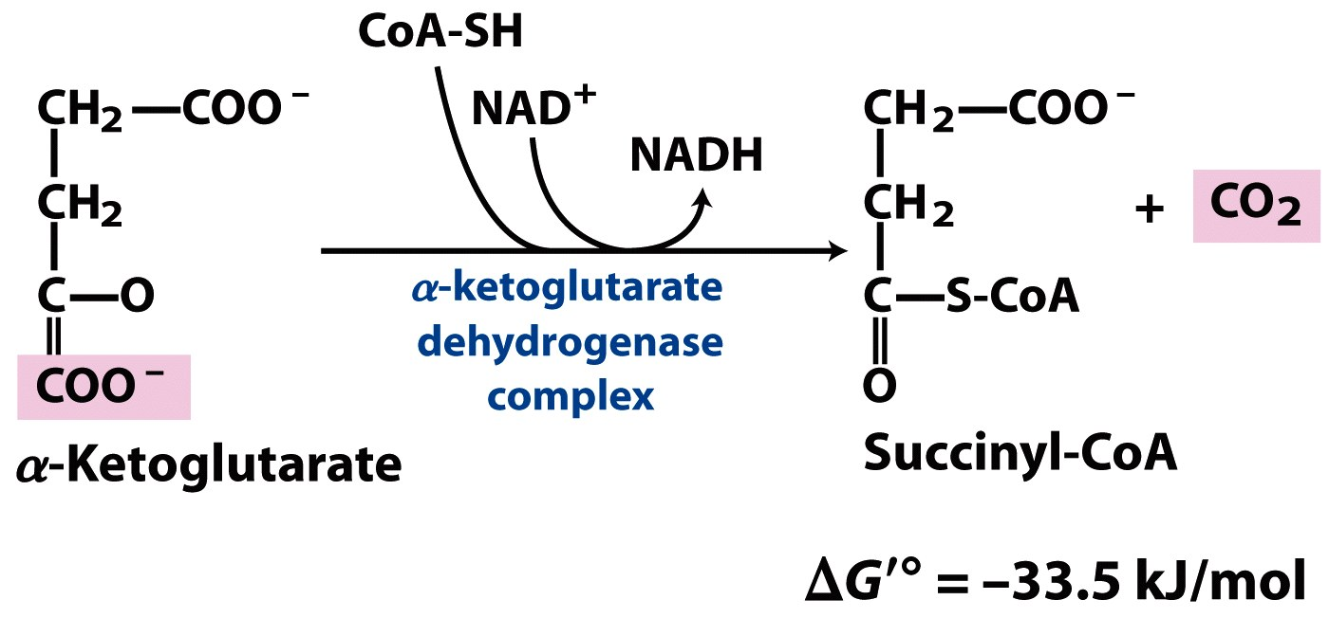
(4) α-KG DH complex couples an oxidative decarboxylation with thioester formation
‘high-energy’
intermediate

Slide 15
(4) α-Ketoglutarate DH complex is similar to pyruvate DH complex
Enzyme | PDH complex | α-KGDH complex | Cofactors
E1 | Pyruvate DH | α-Ketoglutarate DH | TPP
E2 | Dihydrolipoyl transacetylase | Dihydrolipoyl transsuccinylase | Lipoic acid, Coenzyme A
E3 | Dihydrolipoyl DH | Dihydrolipoyl DH | FAD, NAD
How do E1, E2, and E3 differ between PDH complex and a-KG complex?

Slide 16
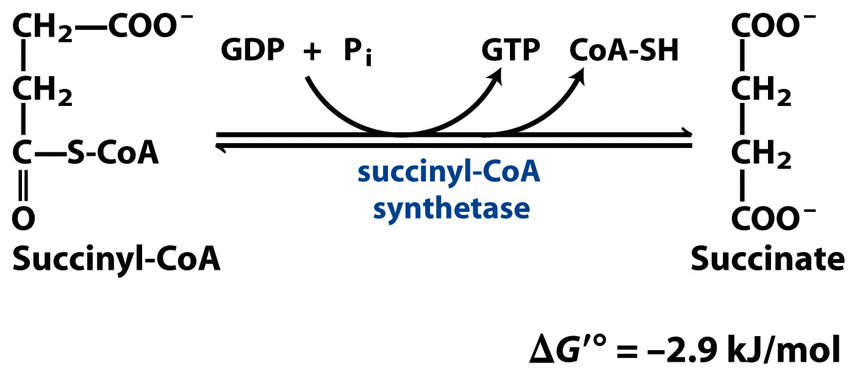
(5) Succinyl-CoA synthetase couples thioester hydrolysis with NTP synthesis
ATP
equivalent

Slide 17
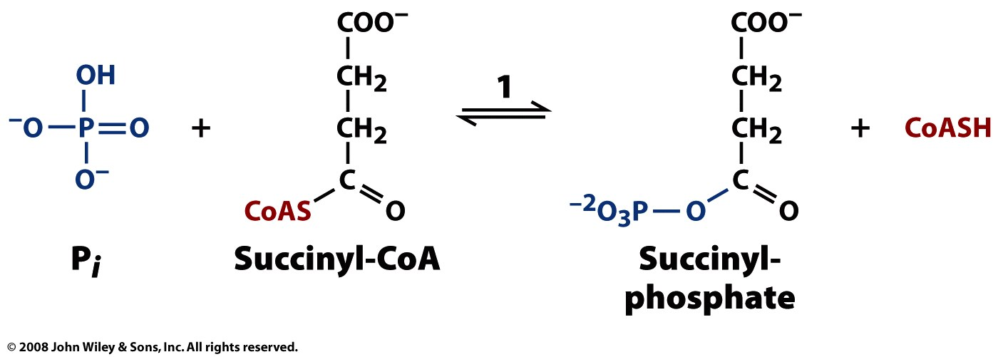
(5) In the first step, the “high-energy” thio-ester becomes a “high-energy” anhydride
‘high-energy’
intermediate

Slide 18
(5) In the second step, the enzyme becomes the “high-energy” compound
‘high-energy’
intermediate

Slide 19
(5) In the third step, the phosphoryl group is transferred to form the “high-energy” NTP
ATP
equivalent

Slide 20
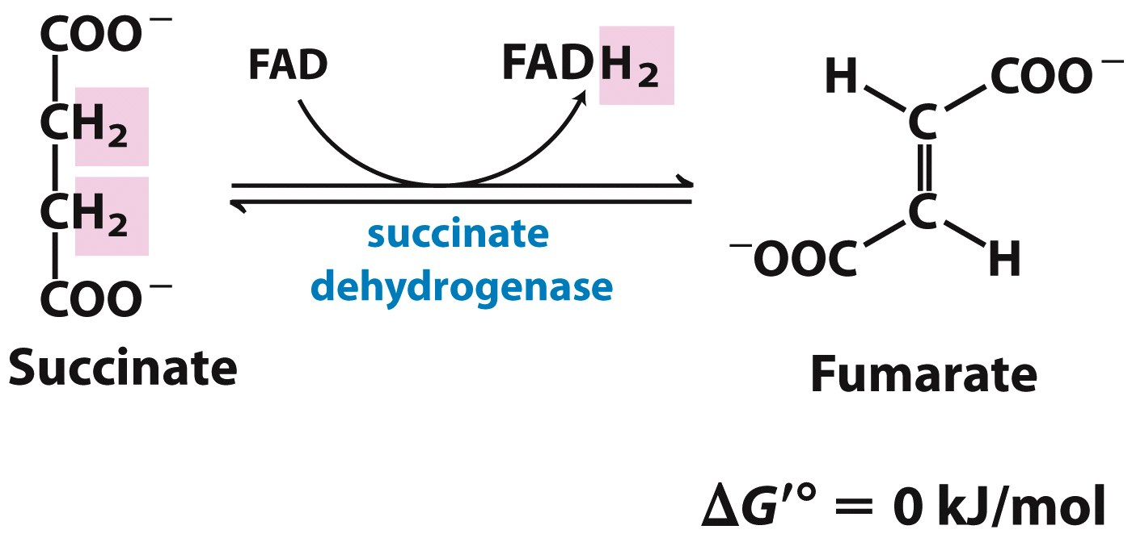
(6) The integral membrane protein succinate DH catalyzes succinate oxidation
(tightly bound in enzyme)

Slide 21
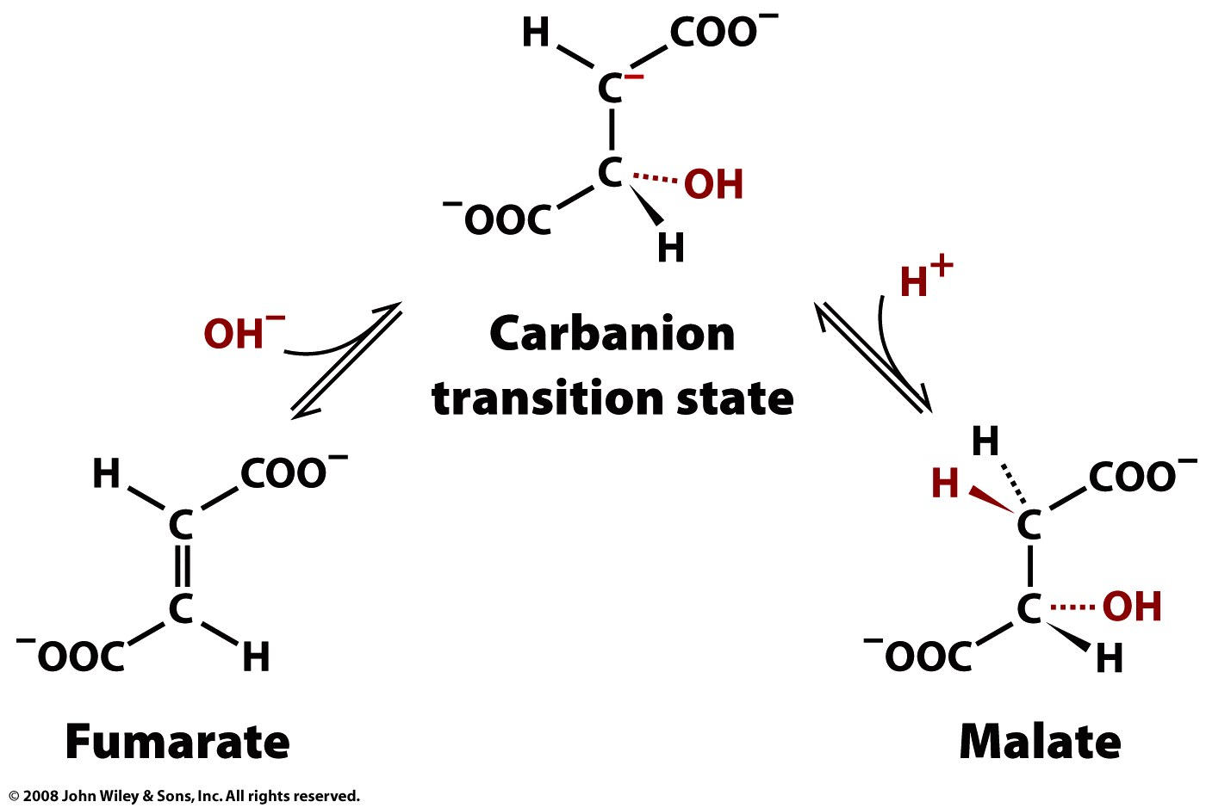
(7) Fumarase catalyses the stereospecific conversion of fumarate to L-malate
fumarase
fumarase

Slide 22
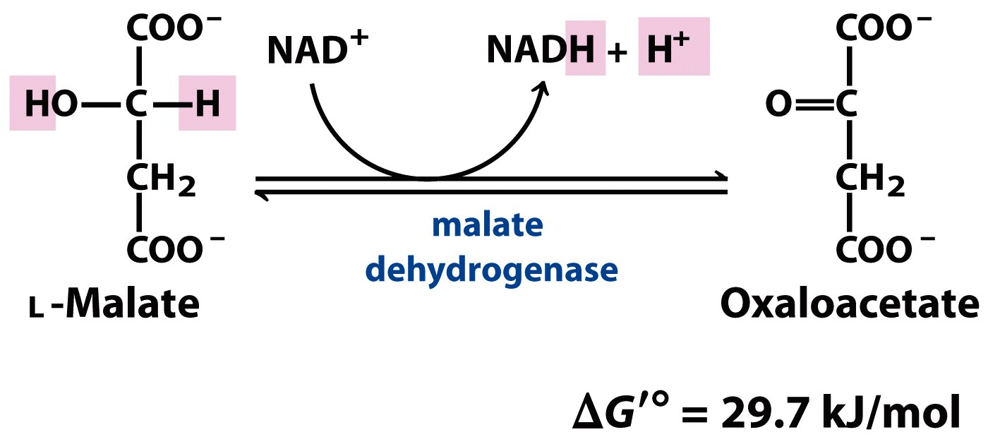
(8) Malate dehydrogenase catalyzes the final step in regenerating oxaloacetate

Slide 23
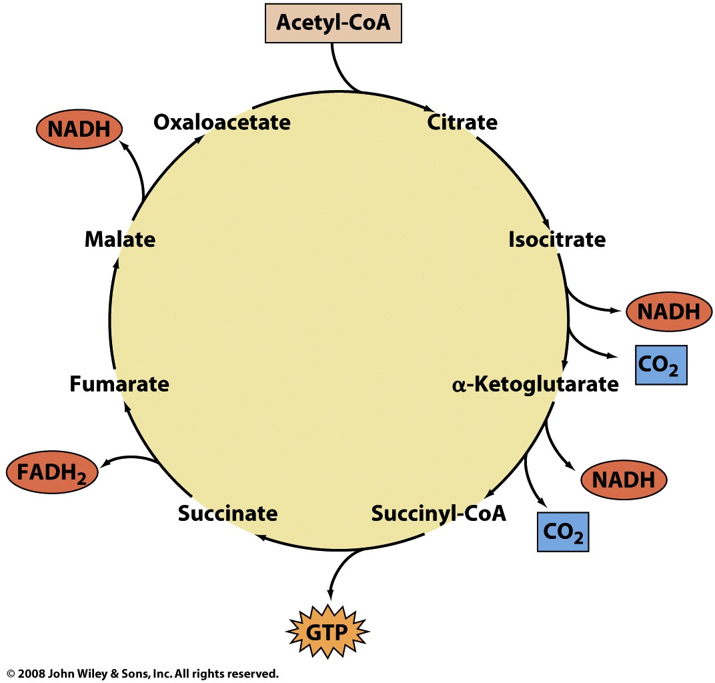
The oxidation of acetyl-CoA to CO₂ in the TCA cycle generates energy currencies

