Slide 1
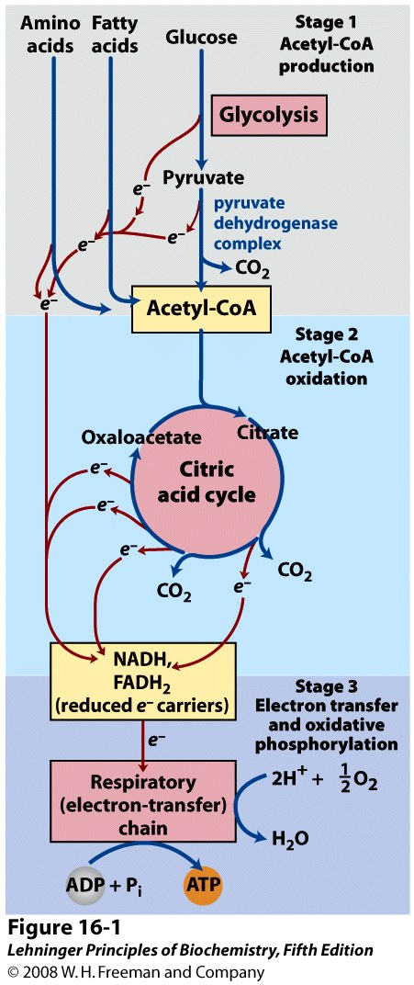
The breakdown of sugars, proteins, and fats converges on a common oxidative pathway
Notes:
FIGURE 16-1 Catabolism of proteins, fats, and carbohydrates in the three stages of cellular respiration. Stage 1: oxidation of fatty acids, glucose, and some amino acids yields acetyl-CoA. Stage 2: oxidation of acetyl groups in the citric acid cycle includes four steps in which electrons are abstracted. Stage 3: electrons carried by NADH and FADH₂ are funneled into a chain of mitochondrial (or, in bacteria, plasma membrane-bound) electron carriers—the respiratory chain—ultimately reducing O₂ to H₂O.This electron flow drives the production of ATP.

Slide 2
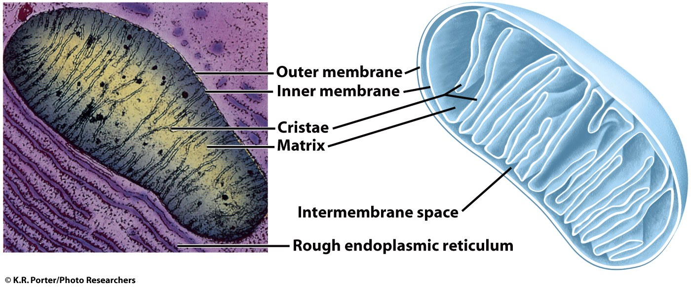
Aerobic metabolism occurs in mitochondria
glycolysis
(cytosol)
Intermembrane
space
pyruvate
PDH complex,
Citric acid cycle
(pyruvate → 3 CO₂)
Oxidation of electron carriers
ATP synthesis
(by protein complexes in the inner mb)

Slide 3
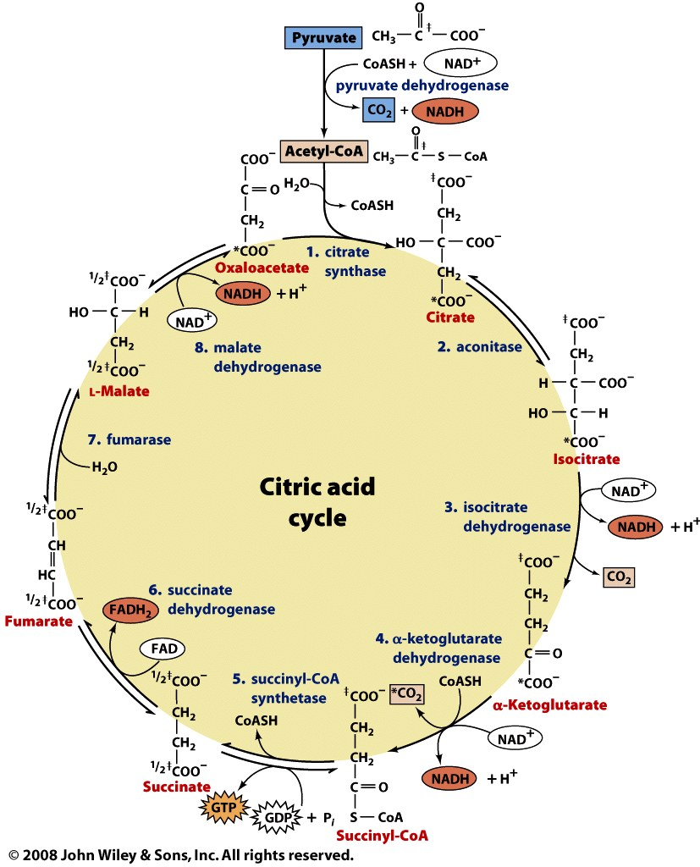

Slide 4
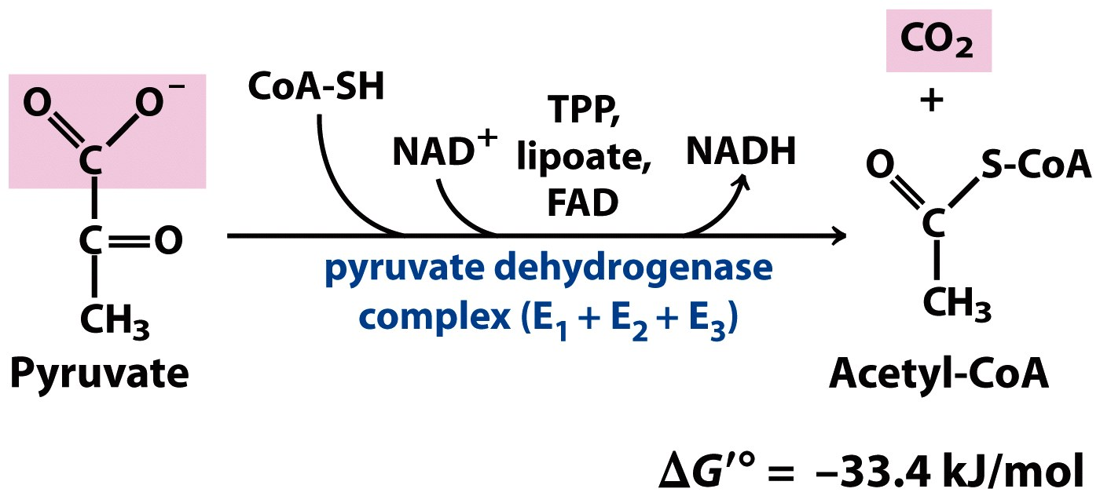
Pyruvate is oxidatively decarboxylated to acetyl-CoA in an irreversible reaction
Oxidation: exergonic
Decarboxylation: exergonic
Thioester formation: endergonic
Net reaction: exergonic
+
Notes:
FIGURE 16-2 Overall reaction catalyzed by the pyruvate dehydrogenase complex. The five coenzymes participating in this reaction, and the three enzymes that make up the enzyme complex, are discussed in the text.

Slide 5
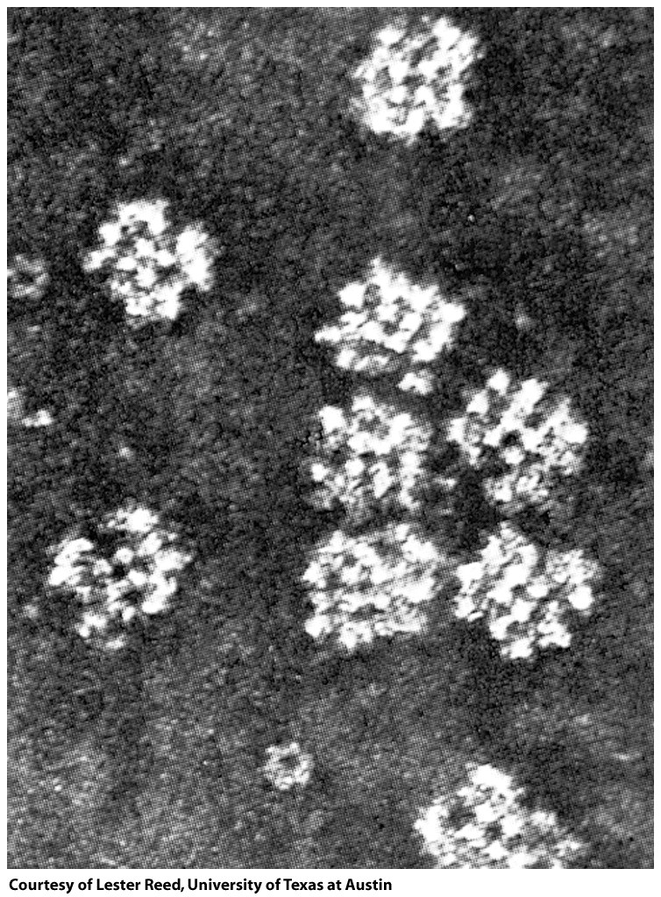
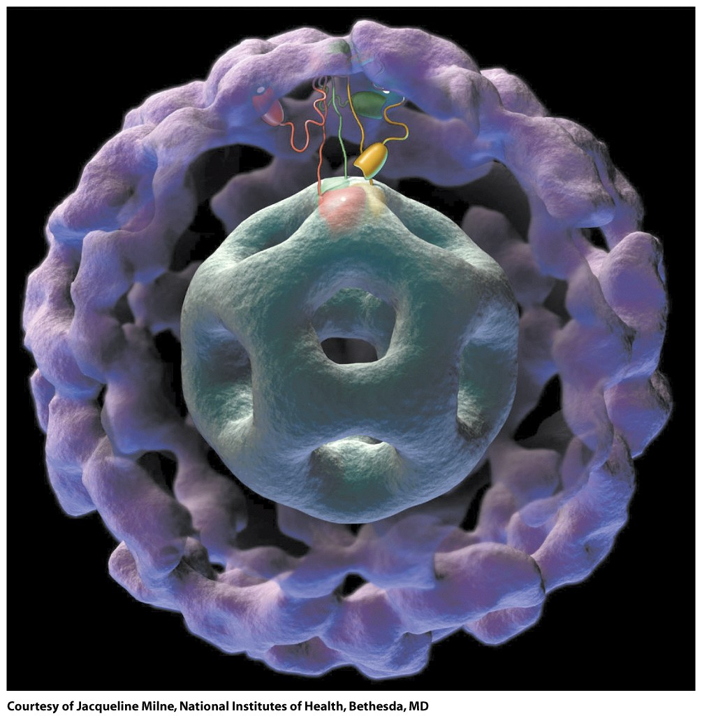
Pyruvate DH complex is a huge multi-enzyme structure, with dozens of subunits

Slide 6
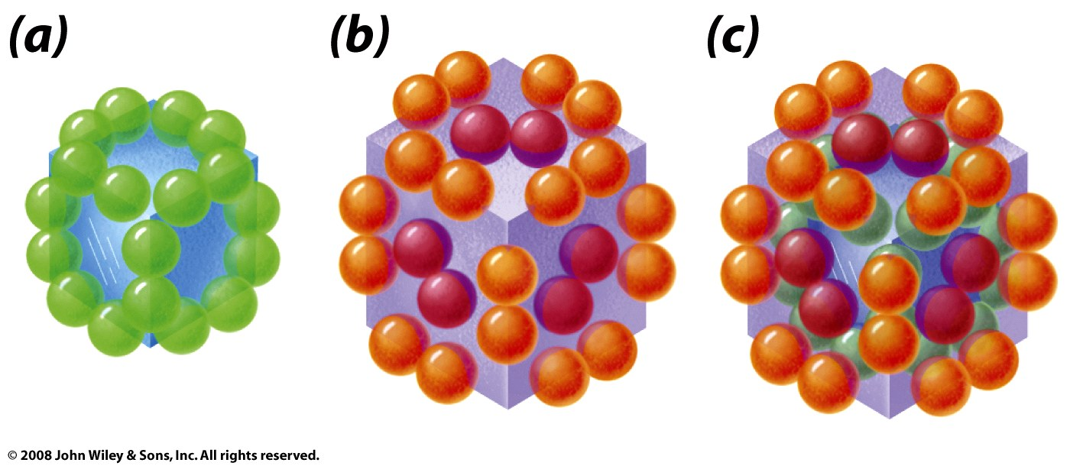
PDH complex is composed of three major enzymes
Enzyme | Name | Cofactors | # in E. coli | # in mammals
E1 | Pyruvate DH | TPP | 24 | ~45 α₂β₂ tetramers
E2 | Dihydrolipoyl transacetylase | Lipoic acid, Coenzyme A | 24 | 60
E3 | Dihydrolipoyl DH | FAD, NAD | 12 | ~9 homodimers
Arrangement in E. coli:
E1
E2
E3

Slide 7
Lipoic acid is covalently bound to a lysine of E2 to form lipoamide

Slide 8
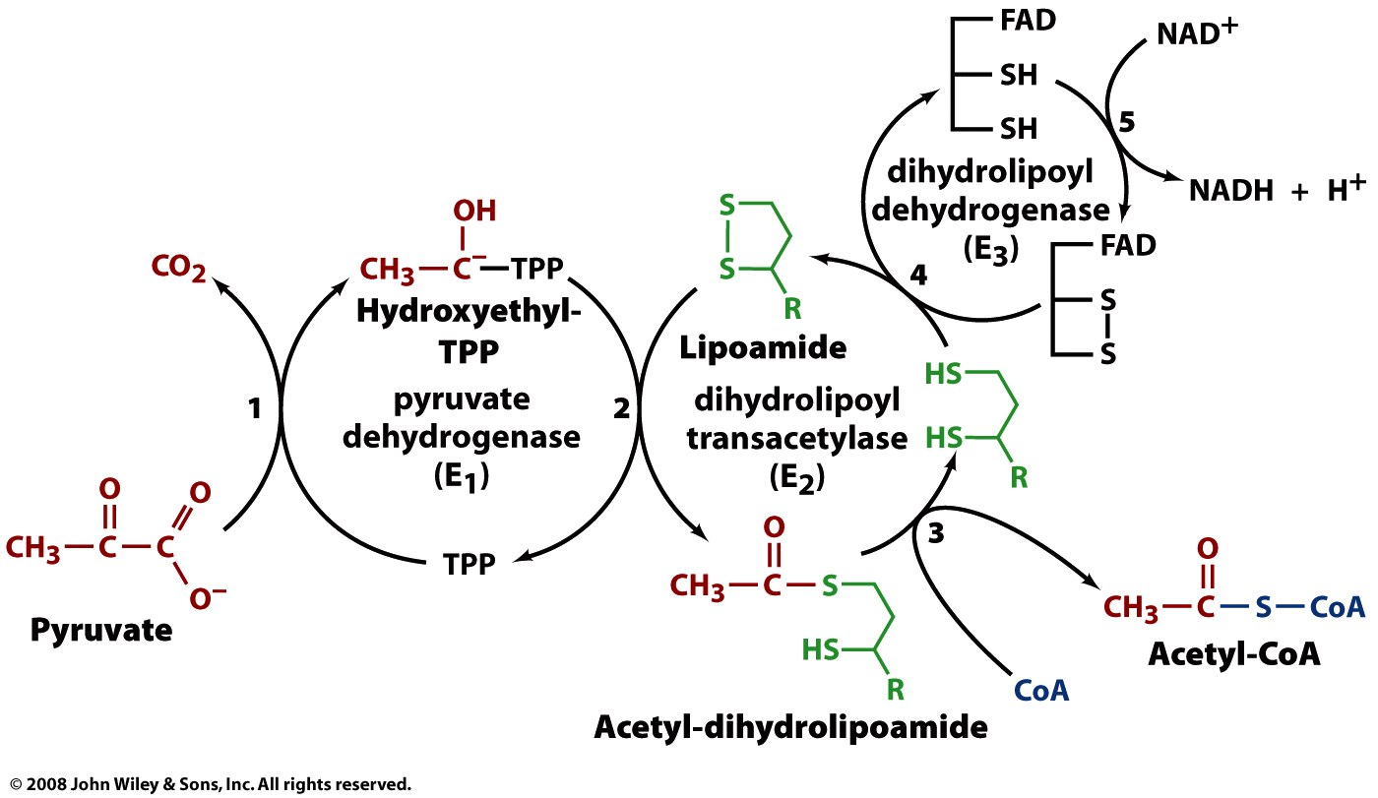
PDH complex carries out the oxidative decarboxylation of pyruvate in 5 steps

Slide 10
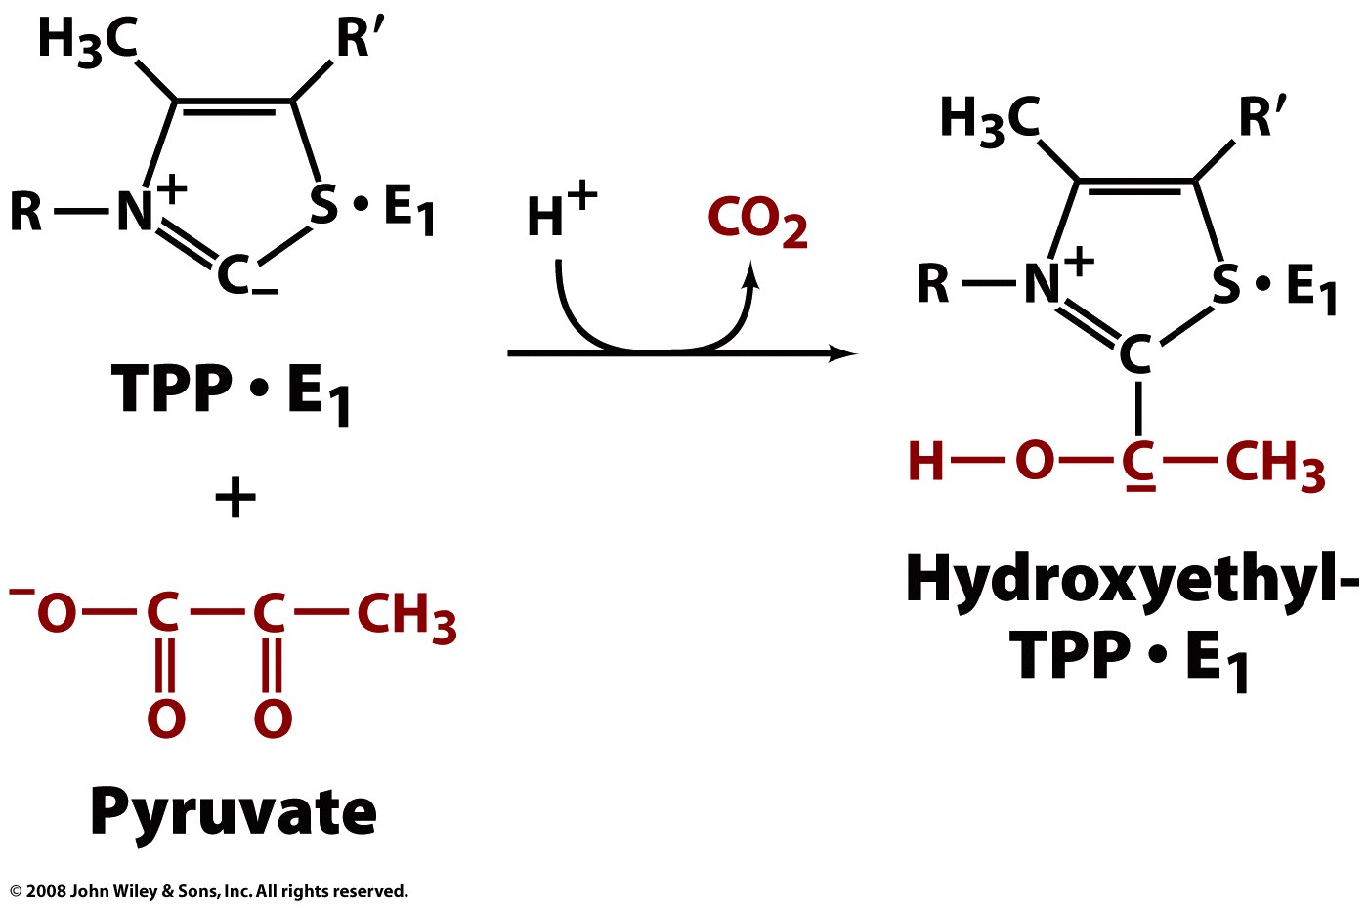
Reaction 1: pyurvate is decarboxylated with the help of TPP (in the E1 active site)

Slide 11
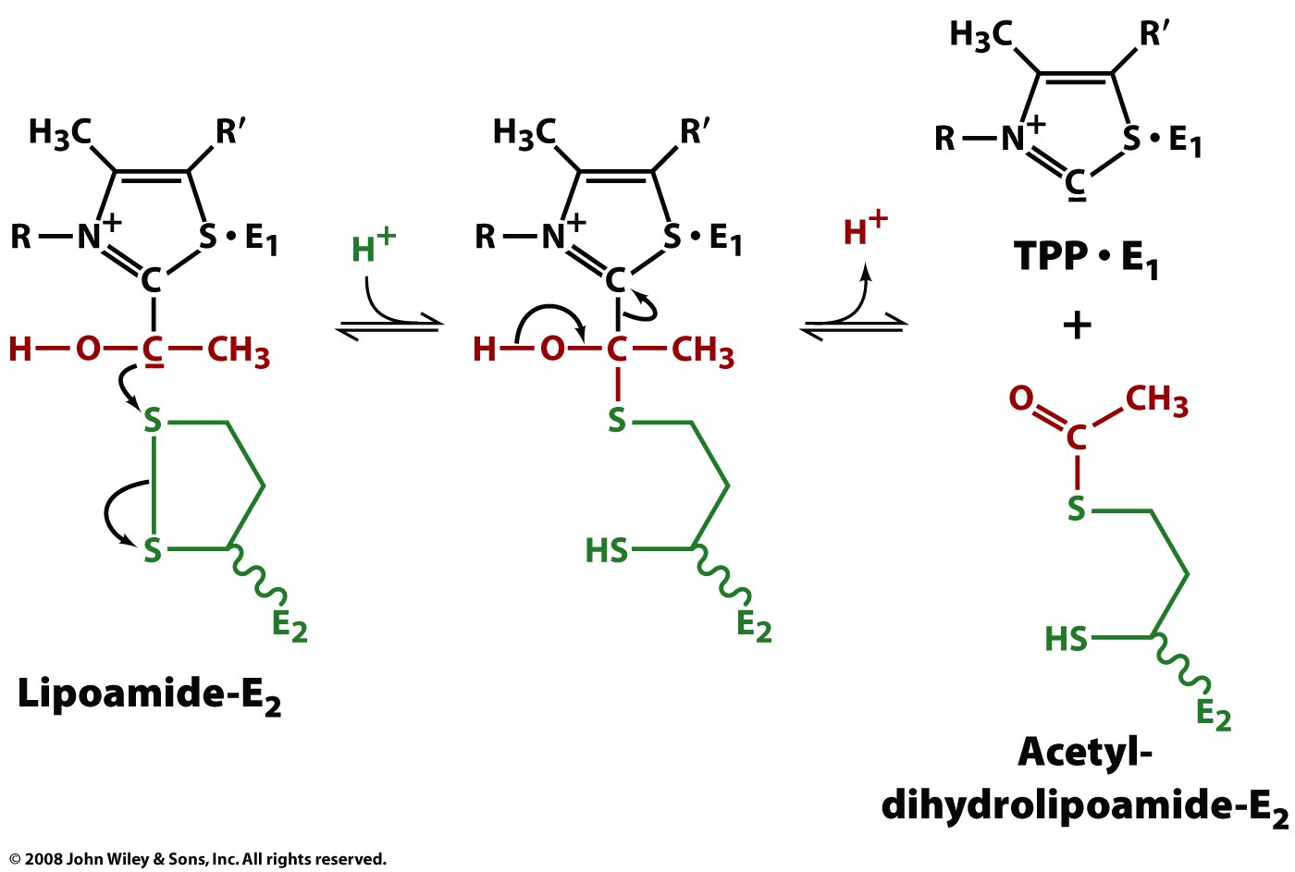
Reaction 2: The carbons are transferred to lipoamide in a redox rxn (in E1’s active site)
Hydroxyethyl-TPP·E₁
‘high-energy’
intermediate
The energy that would be released on oxidation is retained through the formation of the thioester

Slide 12
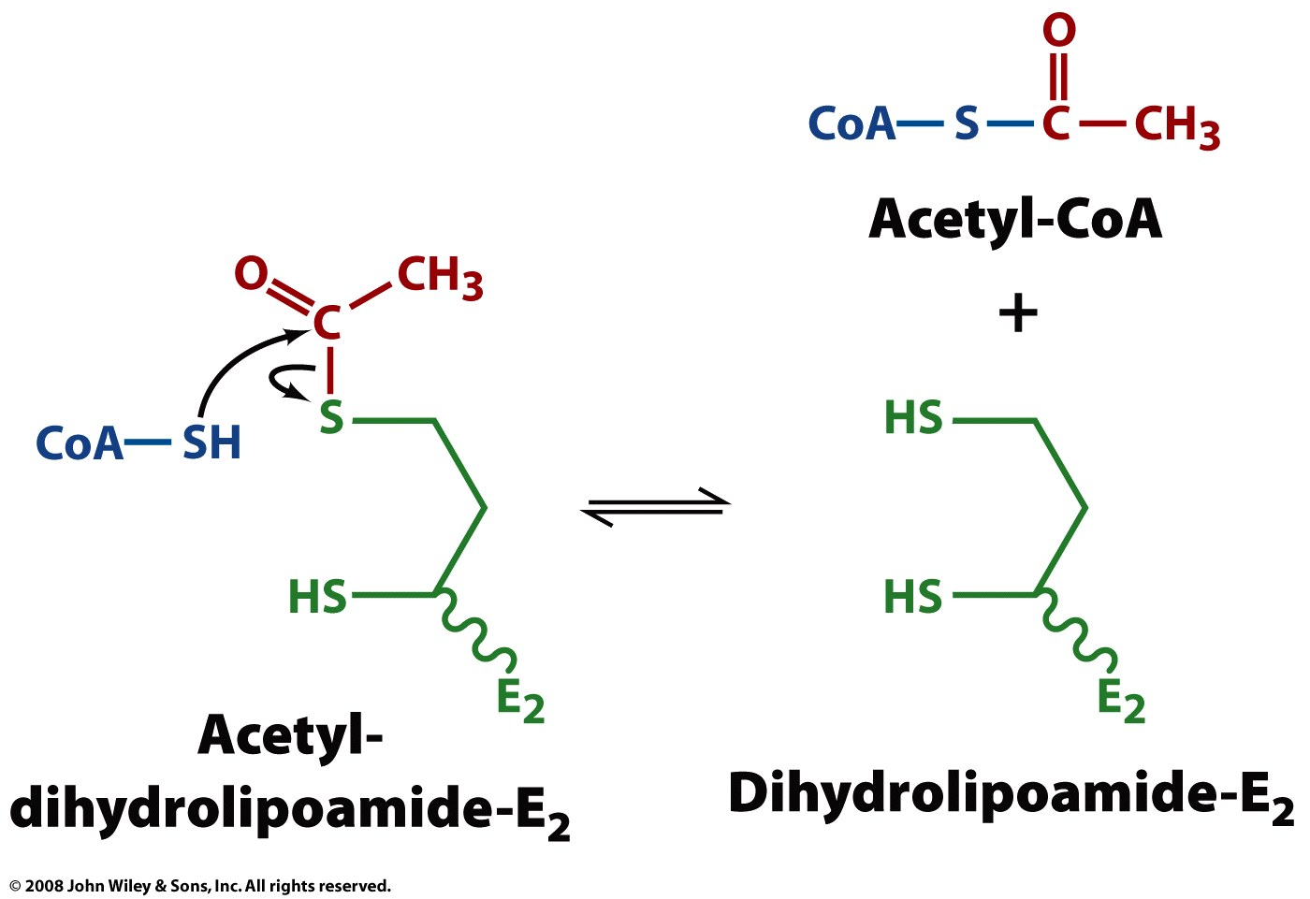
Reaction 3: The acetyl is transferred from dihydrolipoamide to CoA (in E2’s active site)
One thioester is exchanged for another
‘high-energy’
intermediate

Slide 13
Reaction 4: Dihydrolipoamide is oxidized to lipoamide (in the active site of E3)

Slide 14
Reaction 5: The thiols of E3 are oxidized and NAD is reduced (in E3’s active site)

Slide 15
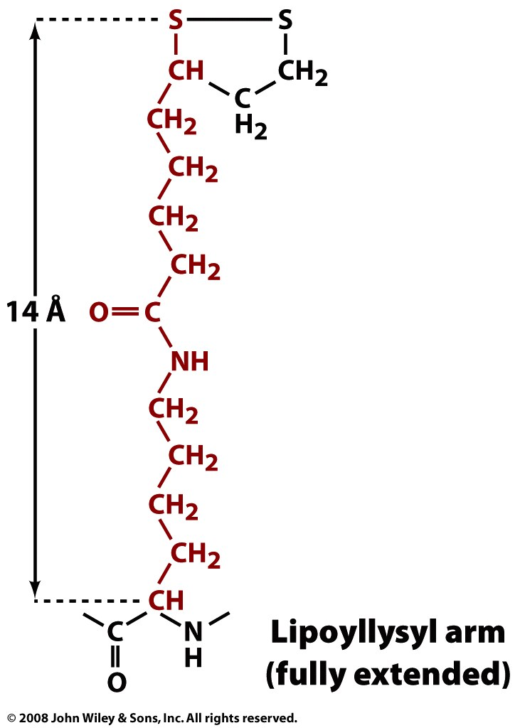
The length and flexibility of E2’s lipoyllysine allows linking of reactions of E1, E2, & E3
E3
E1
E2

