Slide 1
‘Metabolic flux’ describes the rate of flow of intermediates through a metabolic pathway

Slide 2
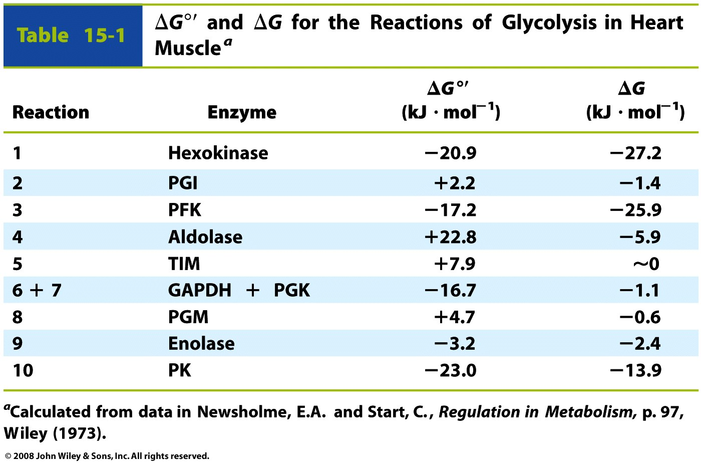
ΔG, determined by measuring [metabolites], reveals the rate-limiting steps of a pathway

Slide 3
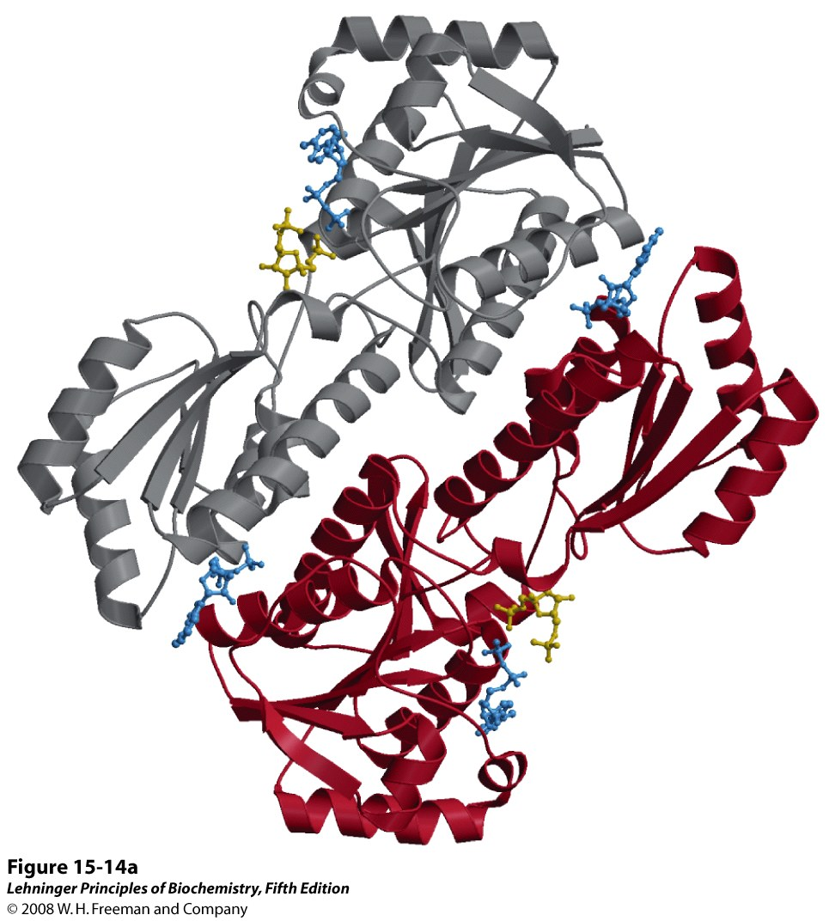
PFK is the major regulatory enzyme of glycolysis in muscle (F6P + ATP → F-1,6-BP + ADP)
Active site:
F-1,6-BP & ADP bound
Homotetramer (here, 2 subunits are shown)
Each subunit has catalytic and regulatory sites
Positive effectors:
F6P (substrate)
ADP, AMP
F-2,6-BP
Negative effectors:
ATP
citrate
Regulatory site: ADP bound
Notes:
FIGURE 15-14a Phosphofructokinase-1 (PFK-1) and its regulation. (a) Ribbon diagram of E. coli PFK-1, showing two of its four identical subunits (PDB ID 1PFK). Each subunit has its own catalytic site, where the products ADP and fructose 1,6-bisphosphate (blue and yellow ball-and-stick models, respectively) are almost in contact, and its own binding sites for the allosteric regulator ADP (blue), located at the interface between subunits.

Slide 4
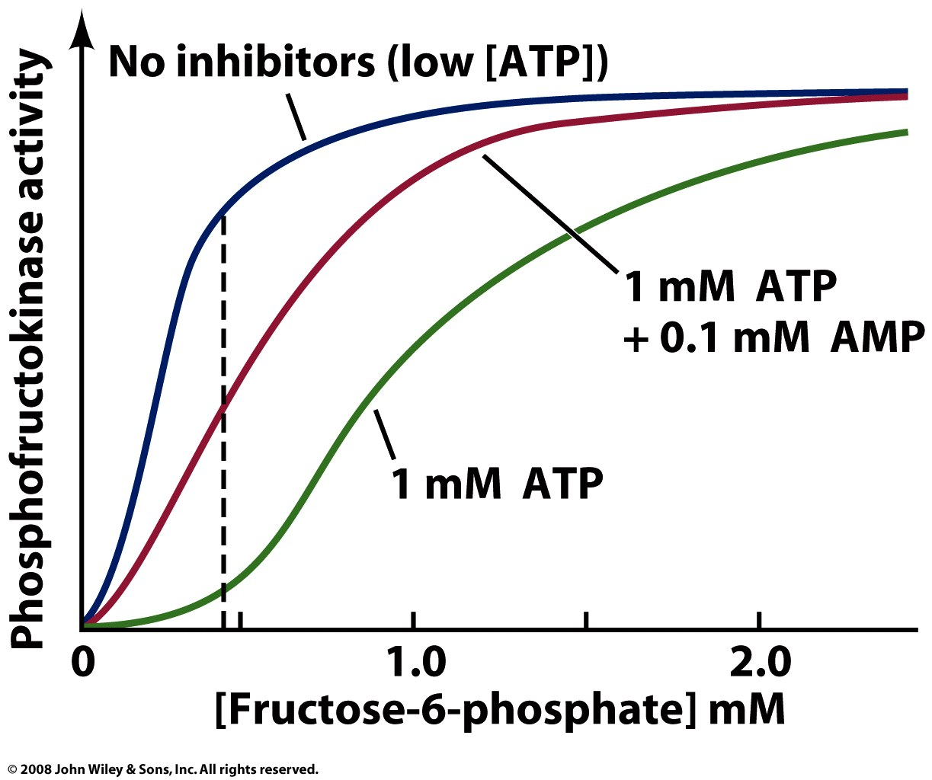
ATP, ADP, or AMP can bind at the same regulatory site and influence PFK activity

Slide 5
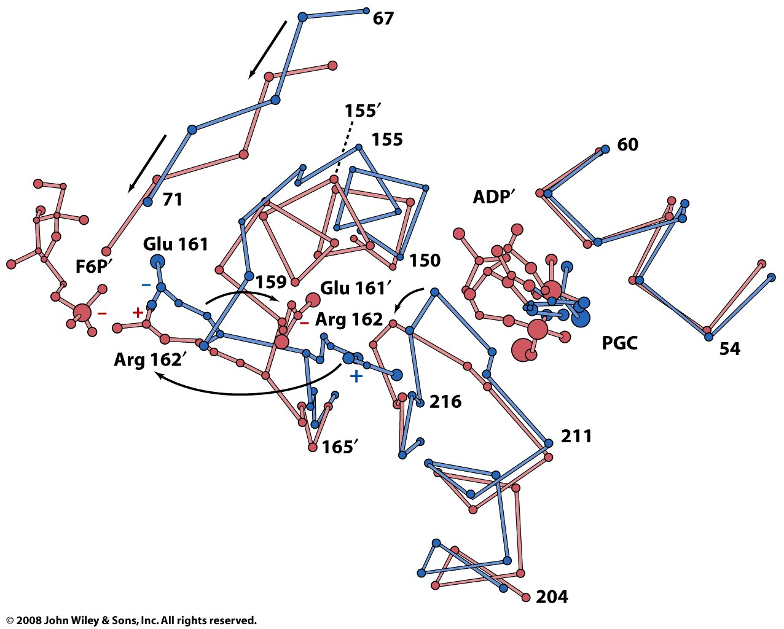
The R-state of PFK promotes binding of F6P; the T-state has low affinity for F6P
In T-state (blue), charge repulsion between Glu & F6P disfavors binding
Positive effector; stabilizes R-state
Shift to R-state (pink) creates salt bridge between Arg & F6P, promoting binding
Negative effector (non-biological); stabilizes T-state

Slide 6
Gluconeogenesis is a pathway in which glucose is synthesized from 2-4C precursors
Many organisms and many cell types require a constant supply of glucose (ex: neurons, red blood cells)
In humans, glucose can be synthesized from pyruvate (or lactate, or oxaloacetate, or certain amino acids) through this pathway (mainly occurring in the liver)
Uses many of the same enzymes as glycolysis – those that catalyze reversible reactions
For irreversible steps of glycolysis, uses other reactions (and other enzymes)
Opposite regulation vs. glycolysis

Slide 7
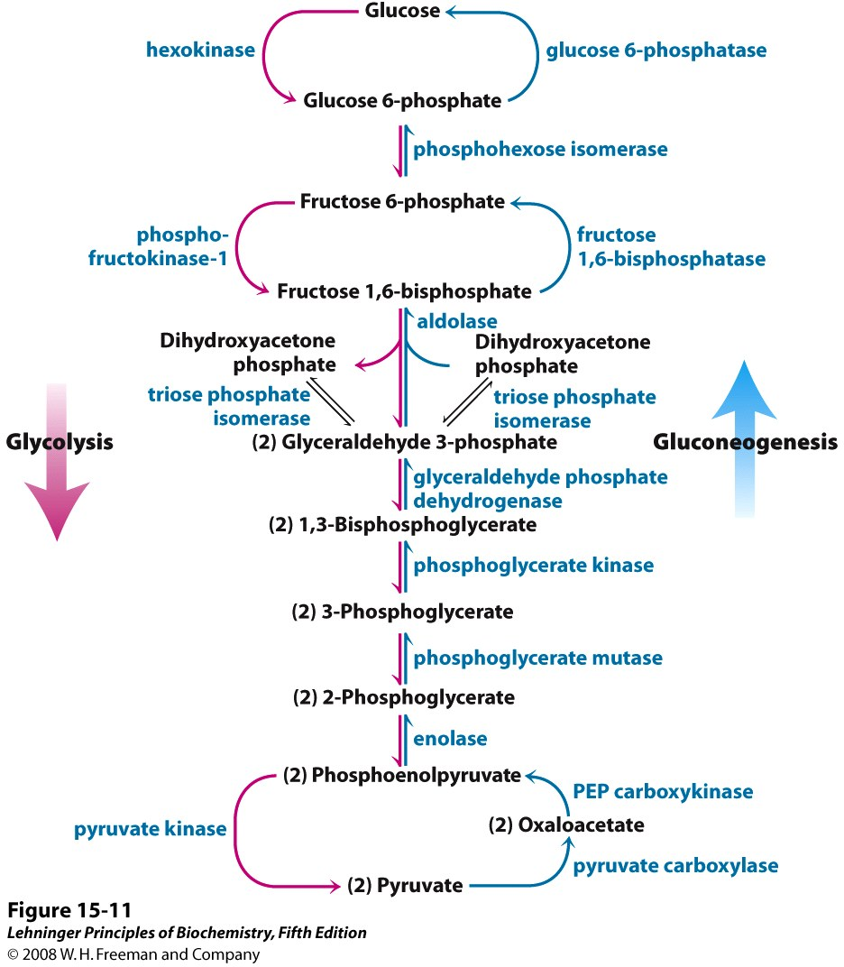
Notes:
FIGURE 15-11 Glycolysis and gluconeogenesis. Opposing pathways of glycolysis (pink) and gluconeogenesis (blue) in rat liver. Three steps are catalyzed by different enzymes in gluconeogenesis (the "bypass reactions") and glycolysis; seven steps are catalyzed by the same enzymes in the two pathways. Cofactors have been omitted for simplicity.

Slide 8
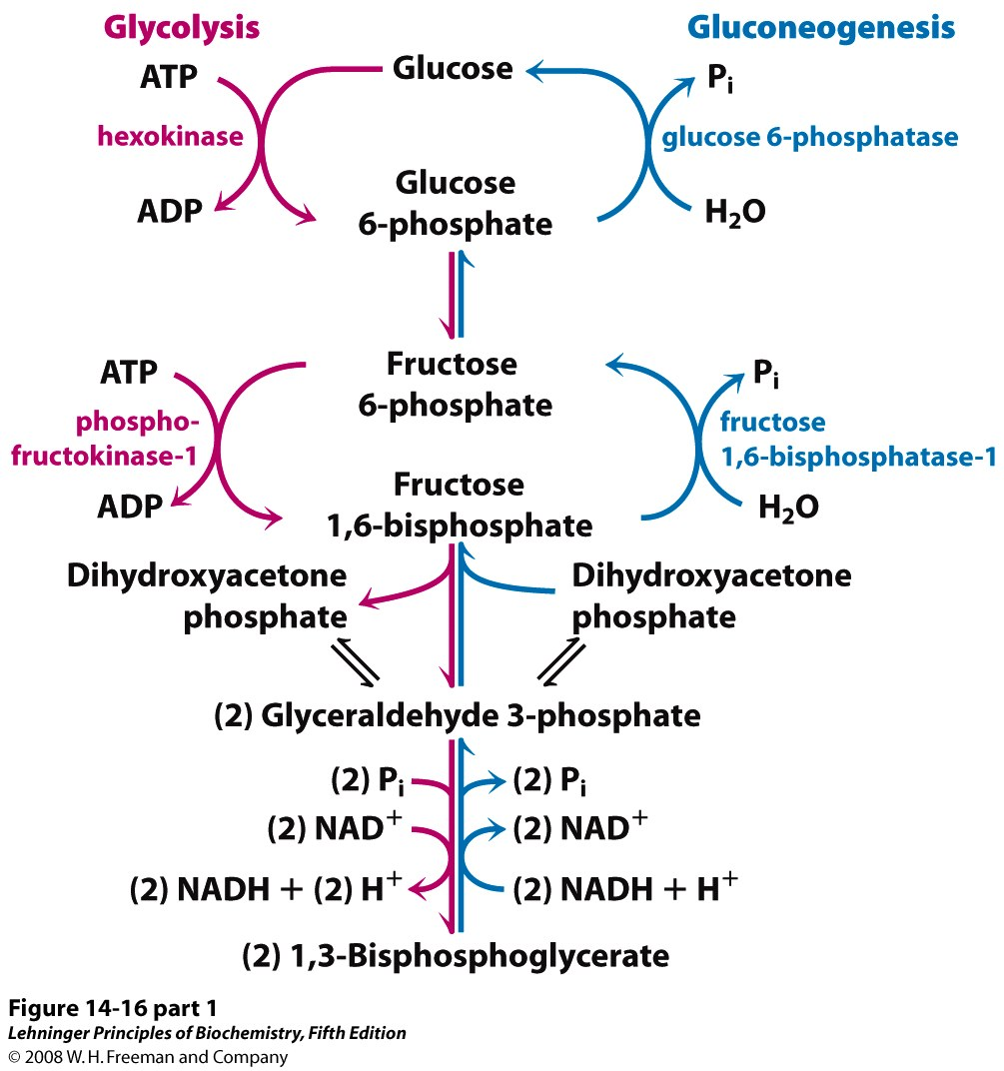
Phosphatases remove the phophoryl groups added by hexokinase and PFK
Notes:
FIGURE 14-16 (part 1) Opposing pathways of glycolysis and gluconeogenesis in rat liver. The reactions of glycolysis are on the left side, in red; the opposing pathway of gluconeogenesis is on the right, in blue. The major sites of regulation of gluconeogenesis shown here are discussed later in this chapter, and in detail in Chapter 15. Figure 14-19 illustrates an alternative route for oxaloacetate produced in mitochondria.

Slide 9
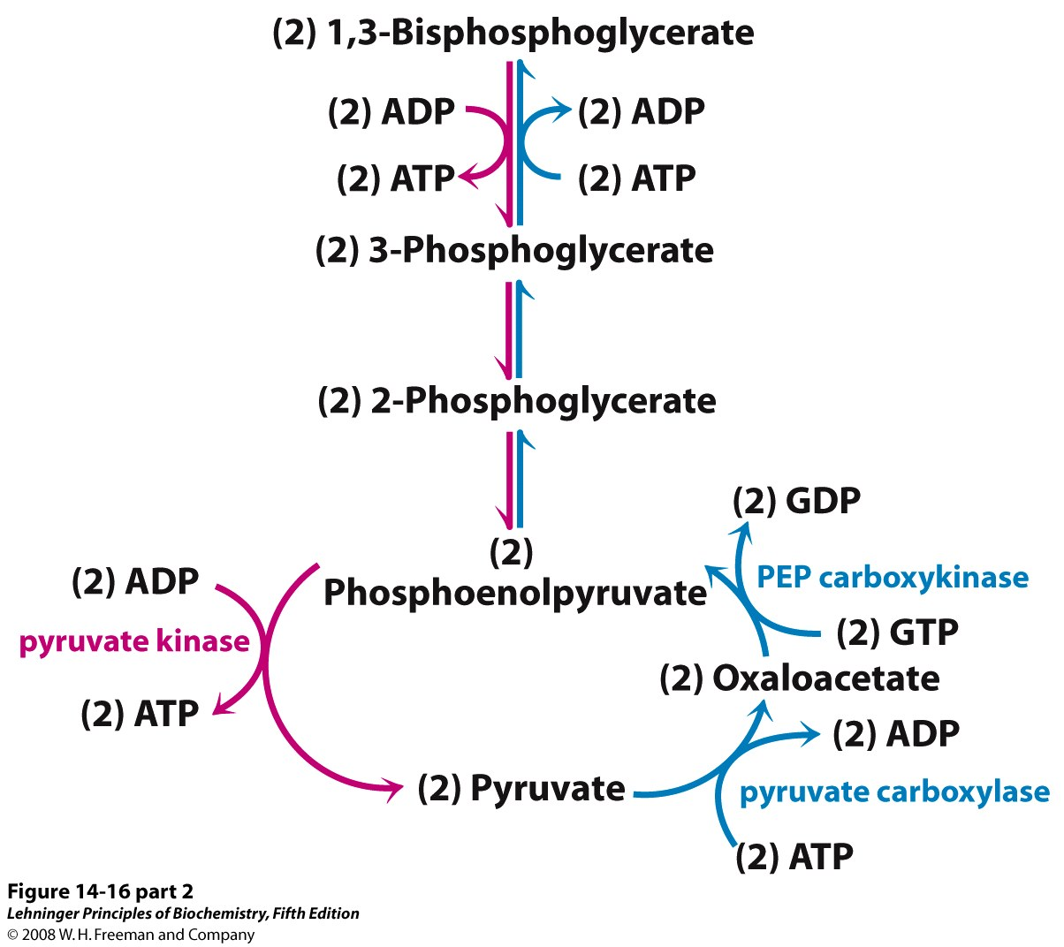
Two energy-requiring steps reverse the action of pyruvate kinase
Notes:
FIGURE 14-16 (part 2) Opposing pathways of glycolysis and gluconeogenesis in rat liver. The reactions of glycolysis are on the left side, in red; the opposing pathway of gluconeogenesis is on the right, in blue. The major sites of regulation of gluconeogenesis shown here are discussed later in this chapter, and in detail in Chapter 15. Figure 14-19 illustrates an alternative route for oxaloacetate produced in mitochondria.

Slide 10
Pyruvate carboxylase uses the energy of ATP hydrolysis to drive a carboxylation
Pyruvate
carboxylase

Slide 11
PEPCK couples decarboxylation and NTP hydrolysis to PEP formation
Phosphoenolpyruvate
carboxykinase
(PEPCK)

Slide 12
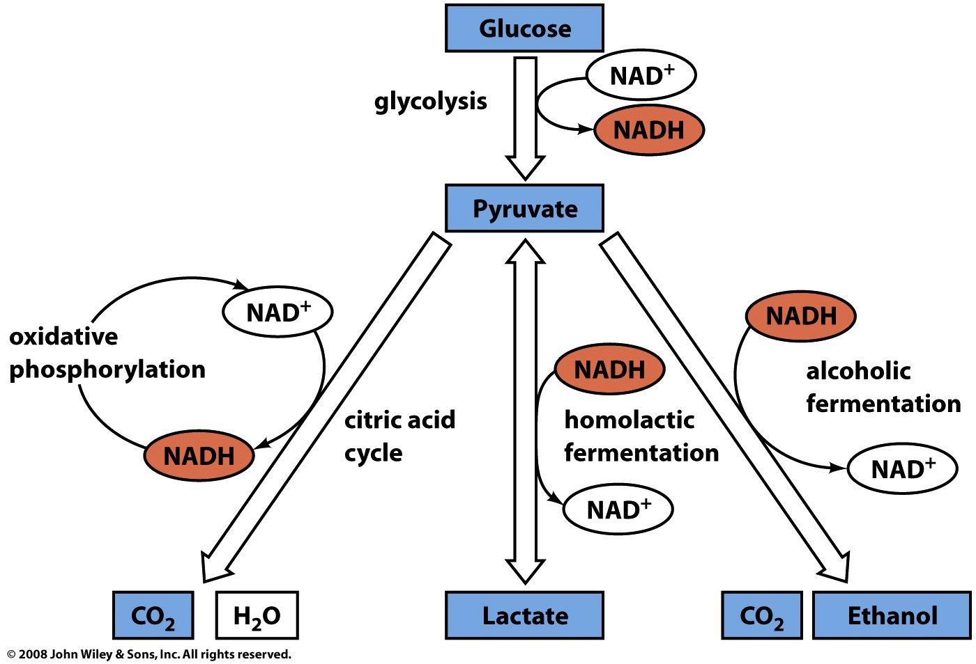
From glycolysis, pyruvate has multiple options for further metabolism
Anaerobic
(fast, low energy yield)
Aerobic
(slow, good energy yield)

Slide 13
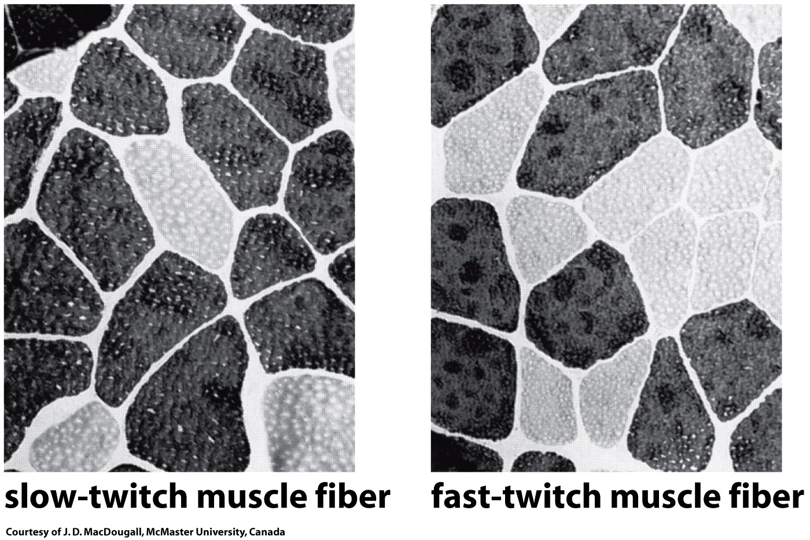
Different color in muscle can reflect different levels of aerobic vs. anaerobic metabolism
Lots of heme-containing mitochondria, used in aerobic metabolism
Fewer mitochondria; heavy reliance on anaerobic metabolism

Slide 14
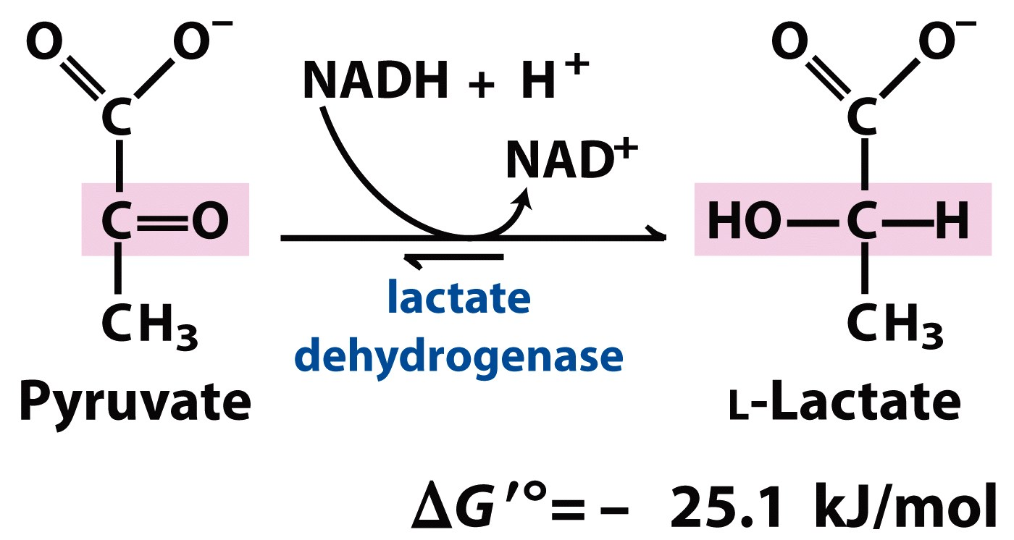
In homolactic fermentation, lactate DH reduces pyruvate to regenerate NAD⁺

Slide 15
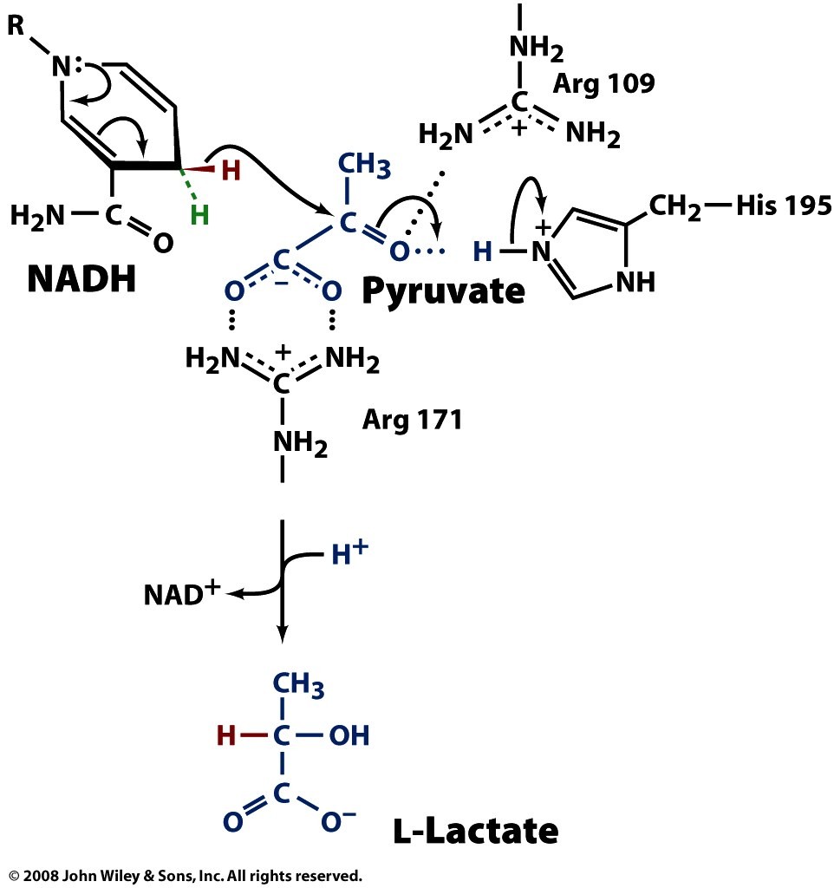
A hydride from NADH is transferred directly to pyruvate’s carbonyl carbon

Slide 16
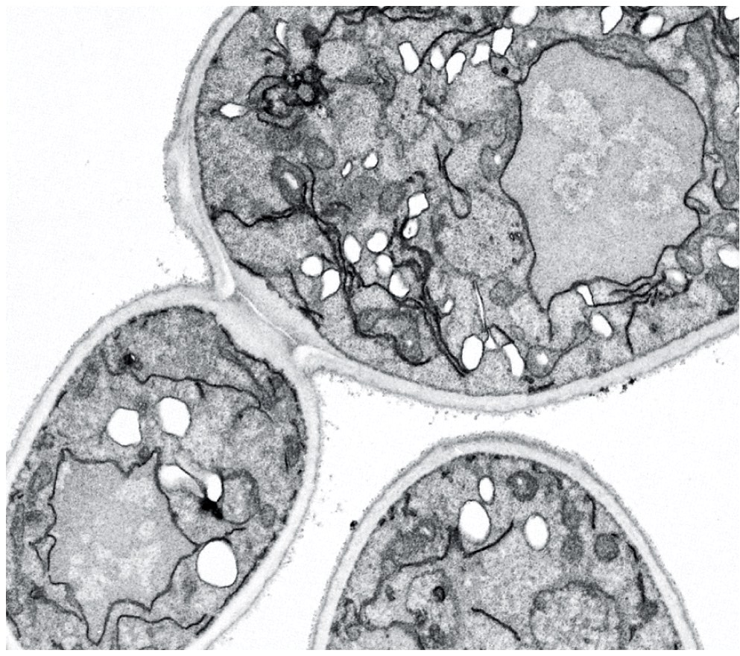
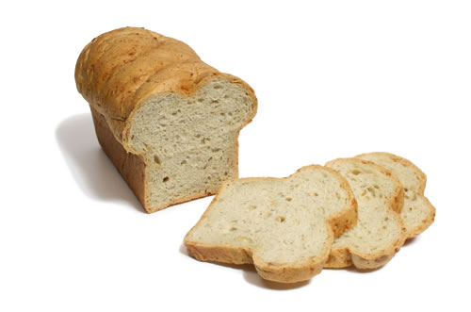
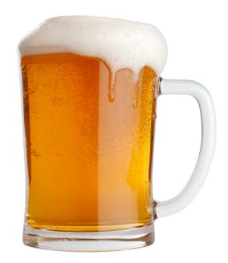
Yeast carry out alcoholic (ethanolic) fermentation, producing CO₂ and ethanol

Slide 17
Ethanolic fermentation converts pyruvate to ethanol in two steps

Slide 18
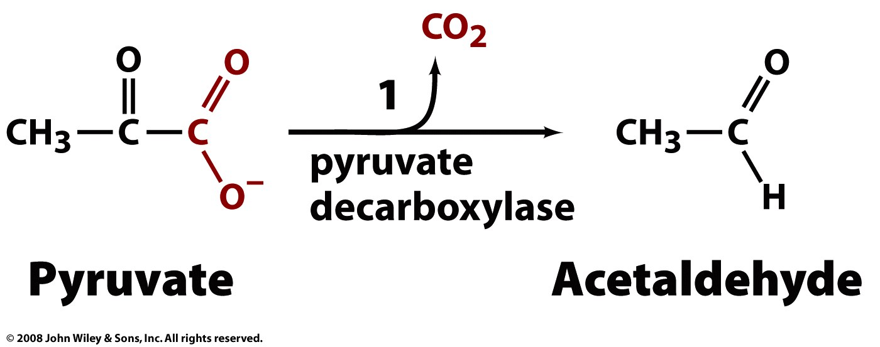
Pyruvate decarboxylase catalyzes the decarboxylation of pyruvate to acetaldehyde

Slide 19
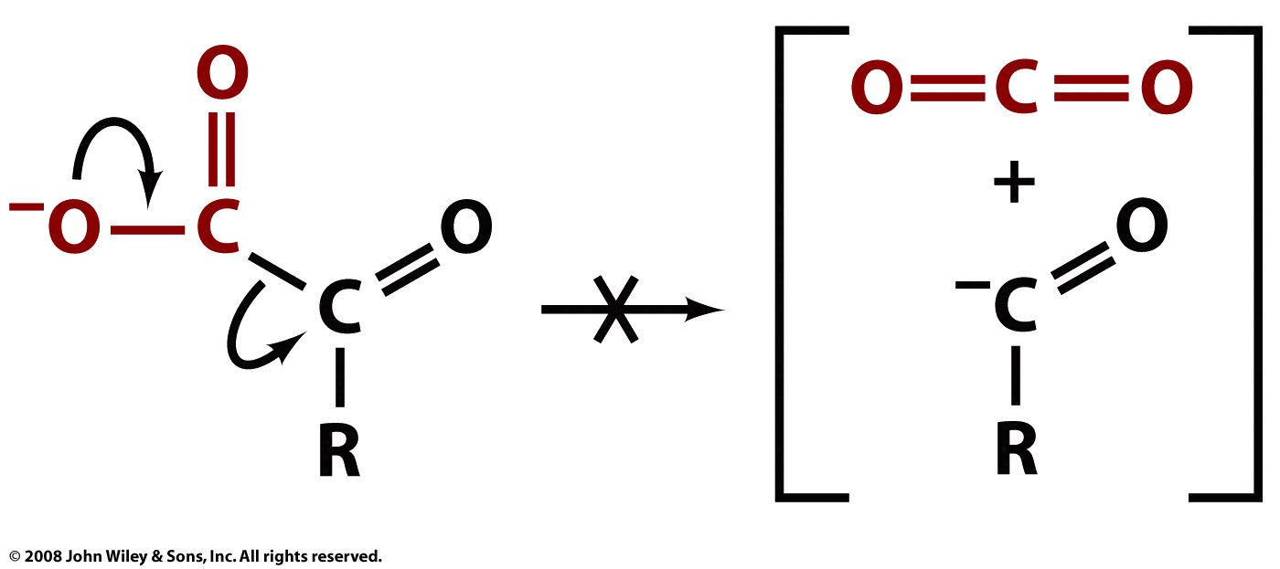
Decarboxylation does not happen without catalysis
unstable
carbanion intermediate

Slide 20
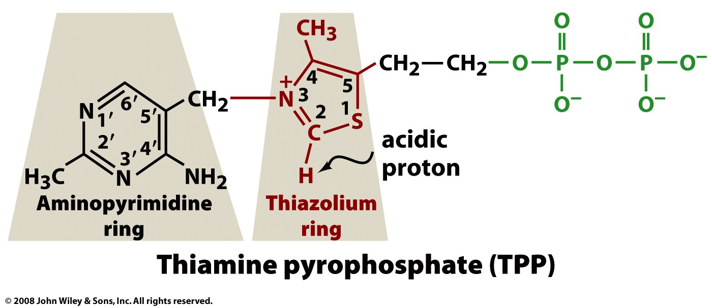
The cofactor TPP functions as an electron sink to stabilize carbanion intermediates

Slide 21
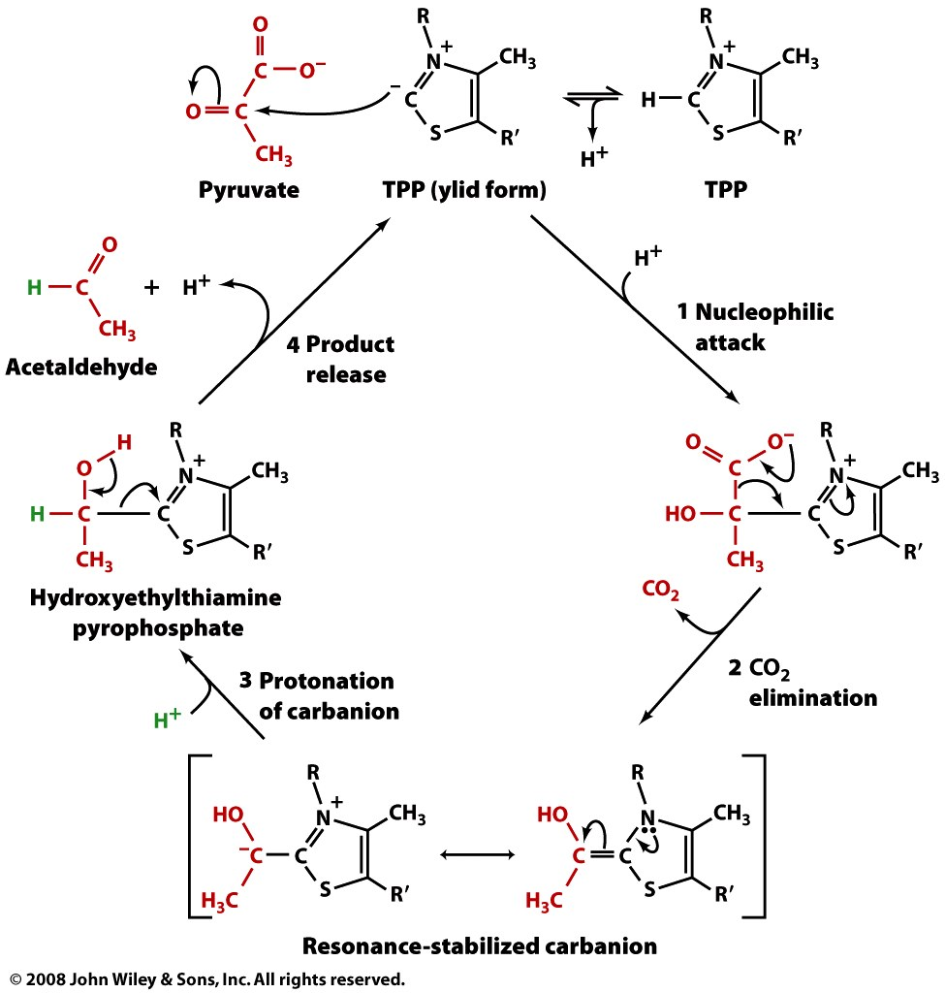
TPP catalyzes the decarboxylation of α-keto acids

Slide 22
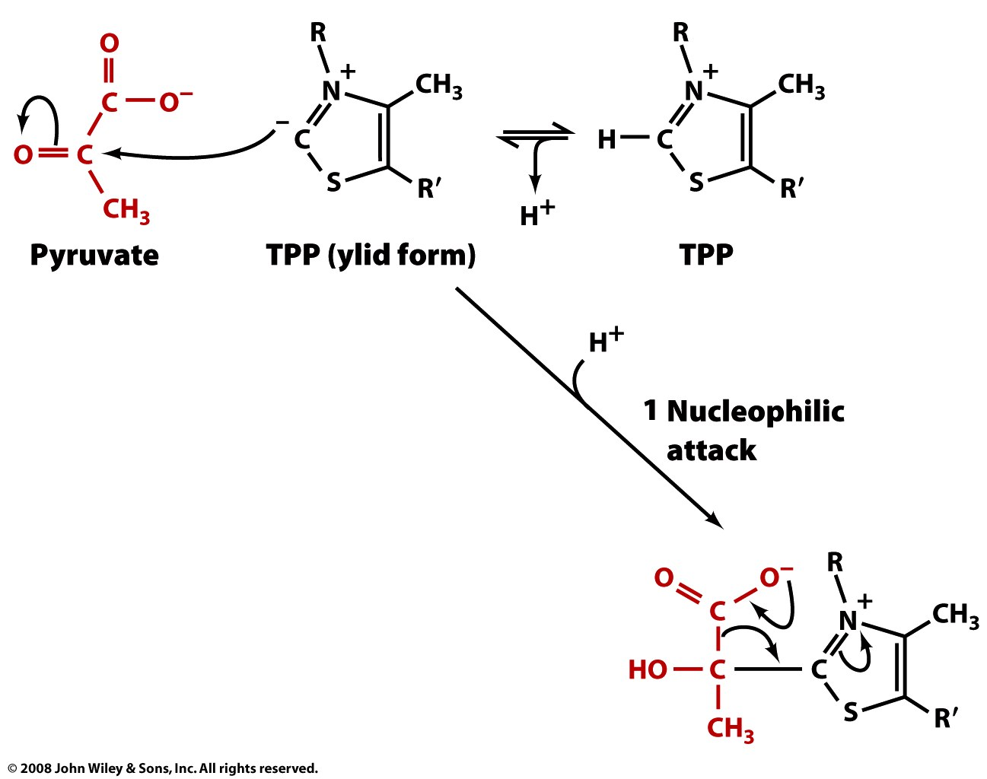

Slide 23
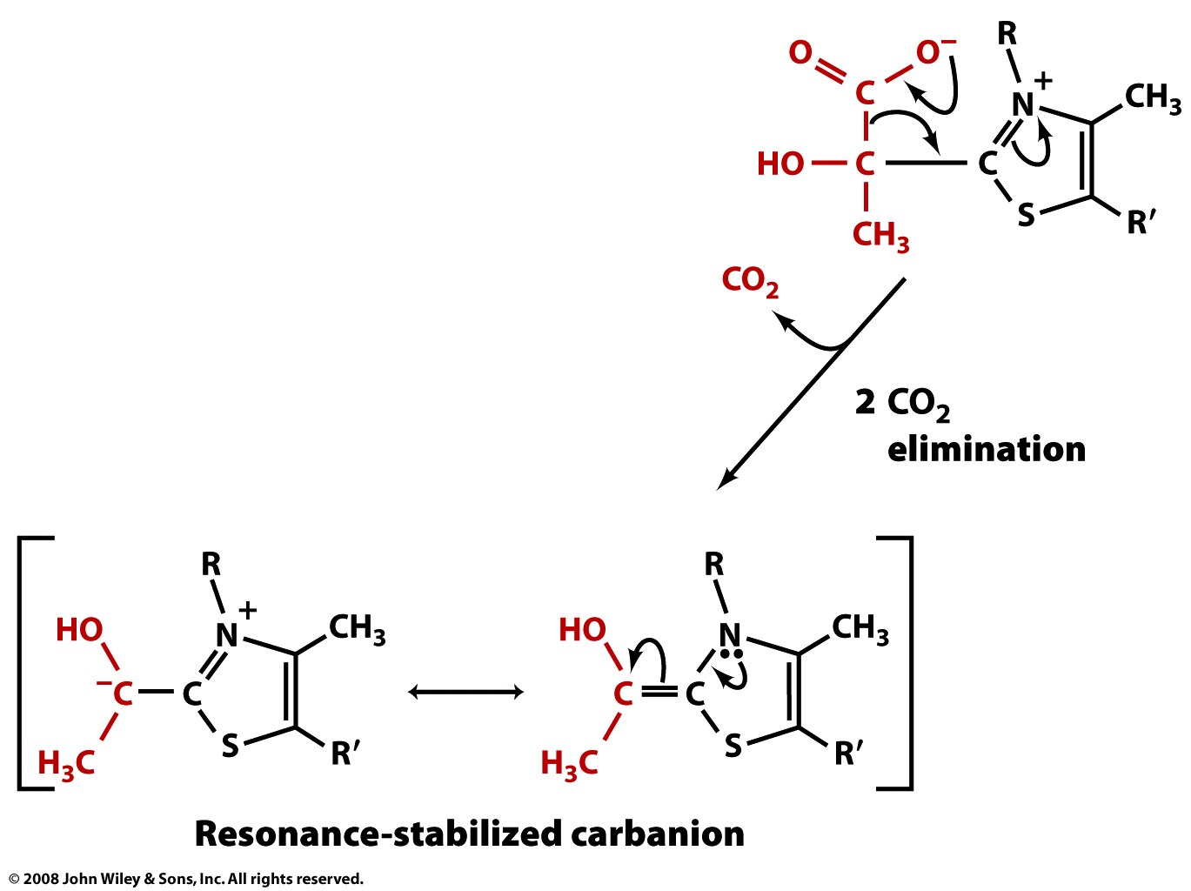

Slide 24
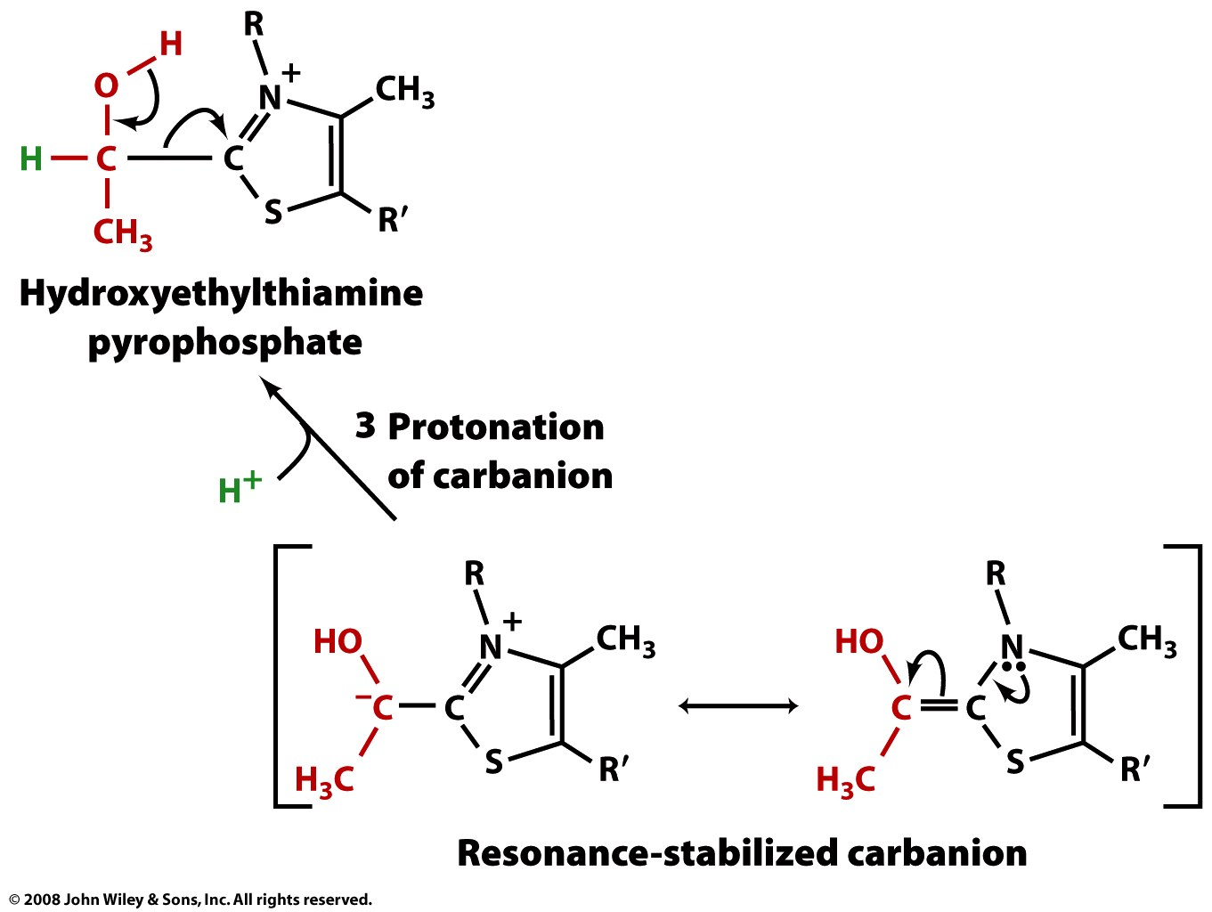

Slide 25
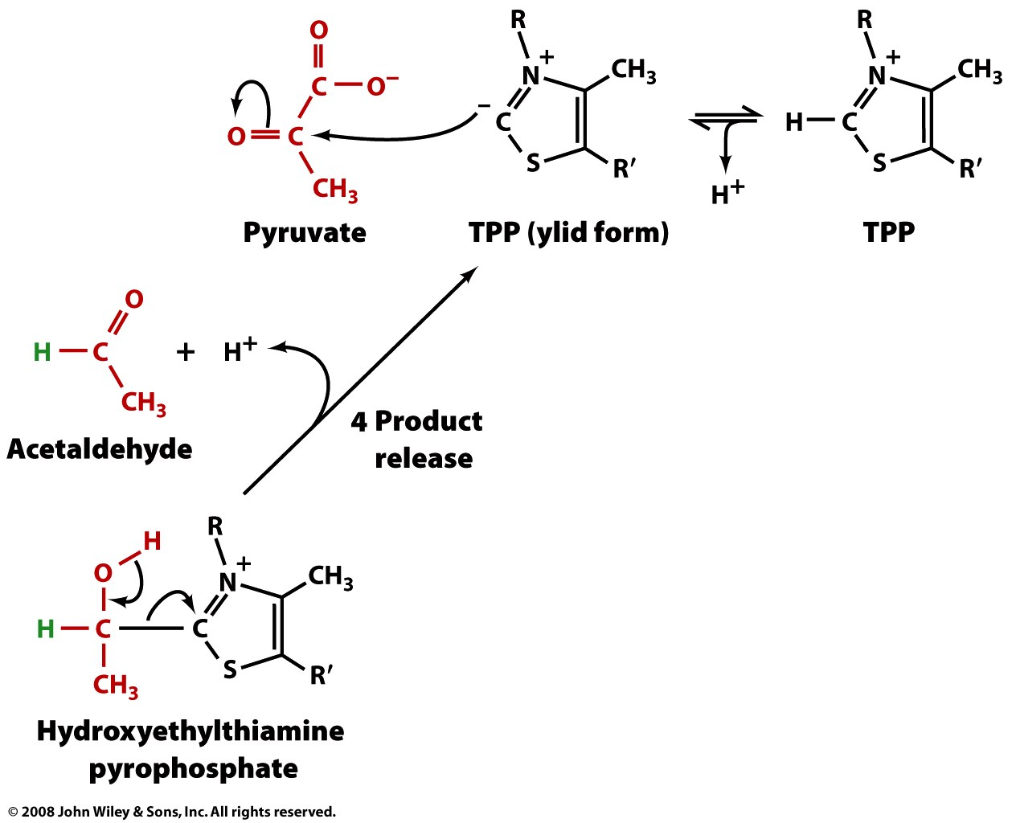

Slide 26
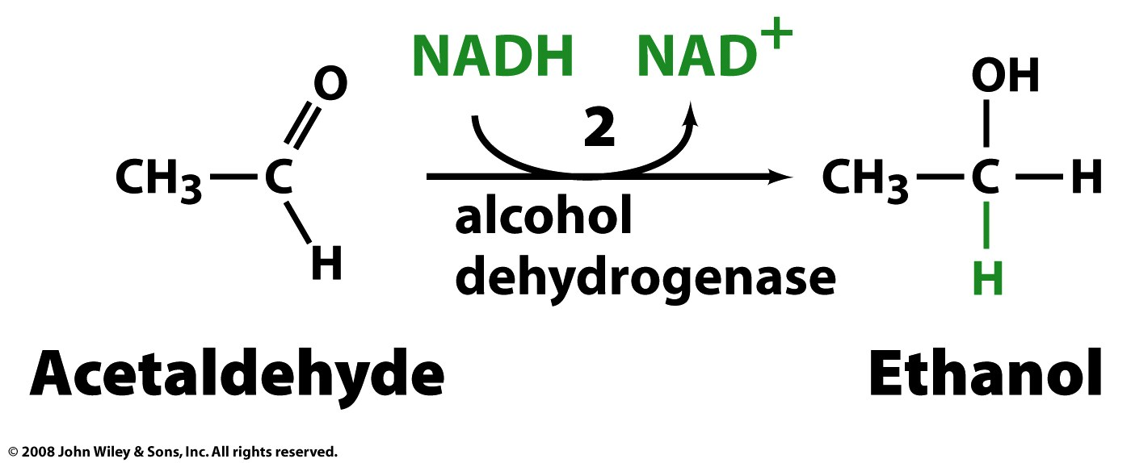
Alcohol DH regenerates NAD+ through the reduction of acetaldehyde to ethanol

Slide 27
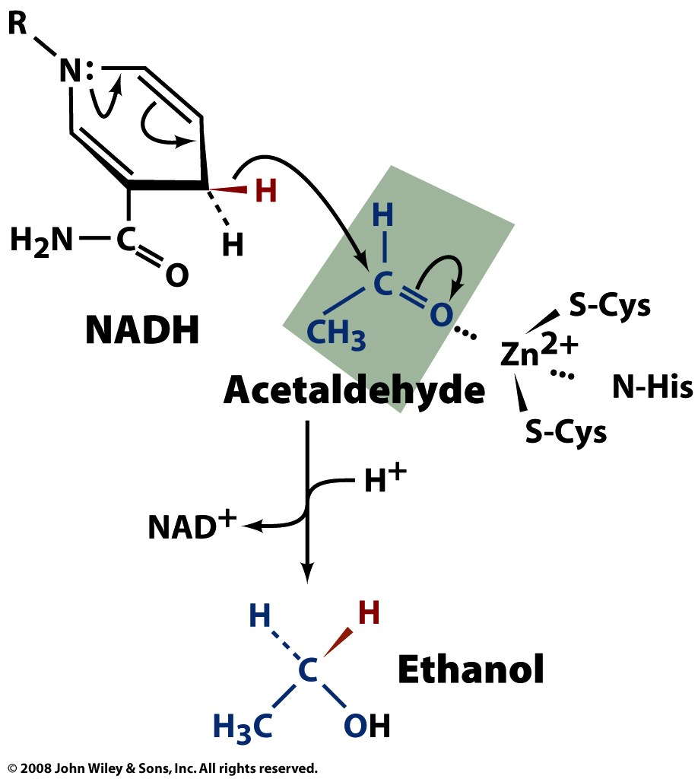
A hydride from NADH is transferred directly to acetaldehyde’s carbonyl carbon

Slide 28
From glycolysis, pyruvate has multiple options for further metabolism
Anaerobic
(fast, low energy yield)
Aerobic
(slow, good energy yield)

Slide 29
Oxidation of glucose releases more free energy & yields more ATP than fermentation
Fermentation: 2 ATP (per glucose)
glucose → 2 lactate + 2H⁺ ΔG'° = -196 kJ/mol
glucose → 2CO₂ + 2 ethanol ΔG'° = -235 kJ/mol
Oxidation: up to 32 ATP (per glucose)
glucose + 6O₂ → 6CO₂ + 6H₂O ΔG'° = -2850 kJ/mol

