Slide 1
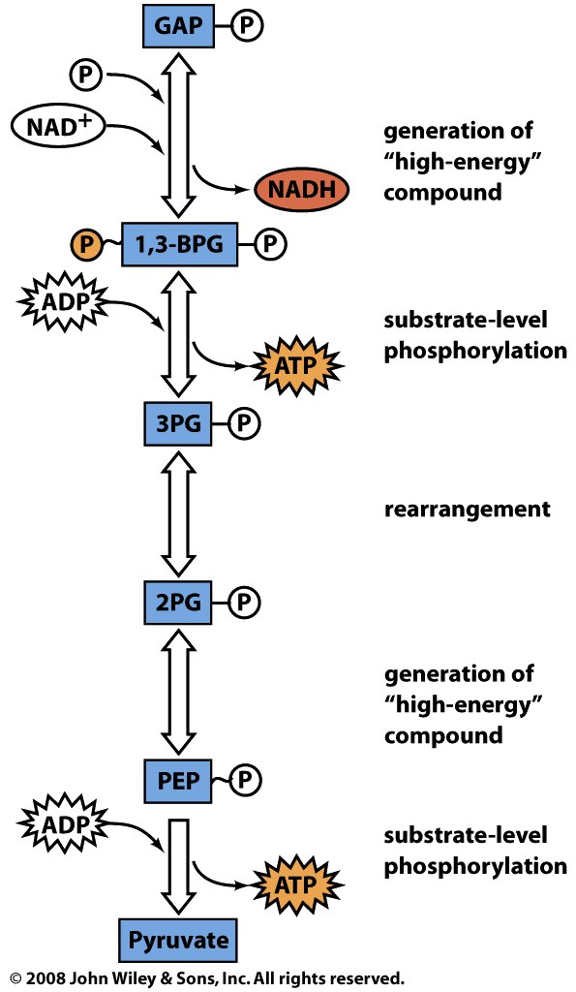
The payoff phase converts 2 GAP to 2 pyruvate, yielding 4 ATP and 2 NADH
2GAP + 4ADP + 2P_{i} + 2NAD⁺
2 pyruvate + 4ATP + 2H₂O + 2NADH

Slide 2
Step 6: GAPDH catalyzes the oxidation and phosphorylation of GAP to 1,3-BPG
NADH
made
NADH
made
This step provides for the net synthesis of ATP in glycolysis
The oxidation yields NADH, which can be used to make more ATP via aerobic metabolism
‘high-energy’
intermediate

Slide 3
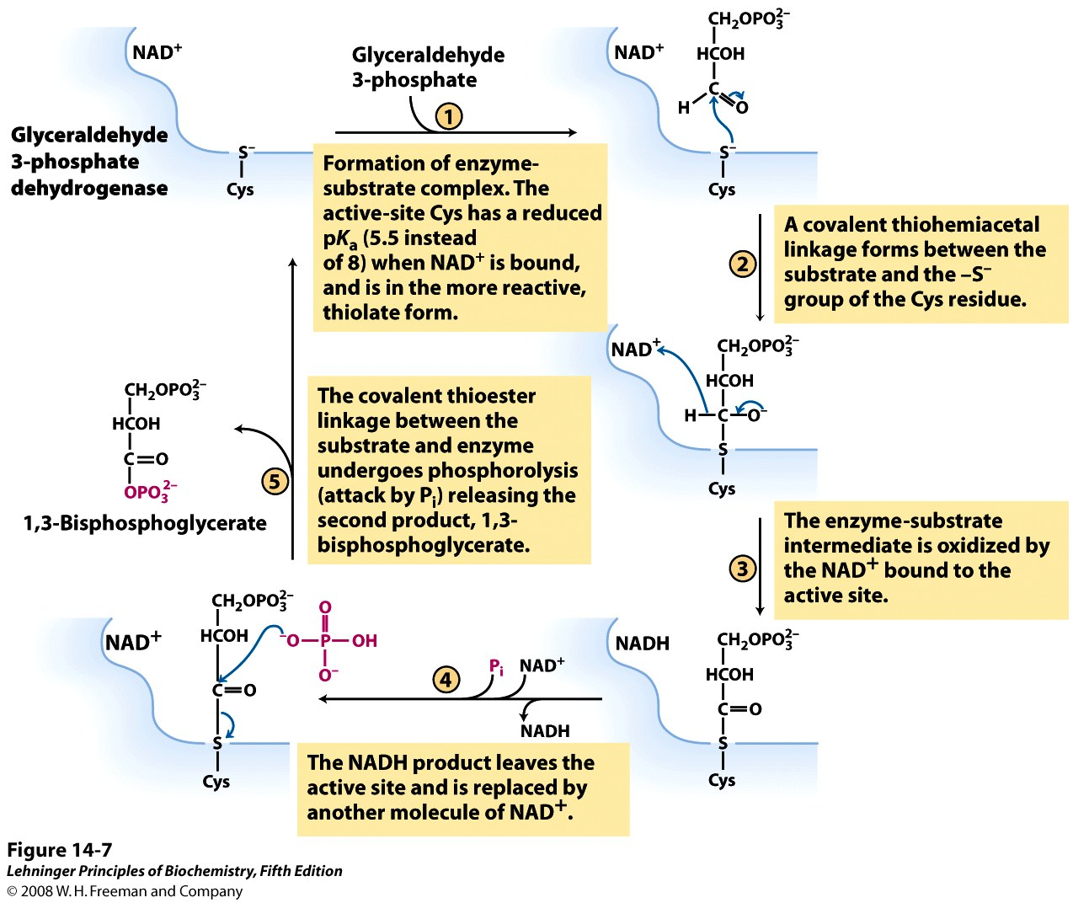
GAPDH links oxidation to phosphorylation through temporary formation of a thioester
Notes:
FIGURE 14-7 The glyceraldehyde 3-phosphate dehydrogenase reaction.

Slide 4
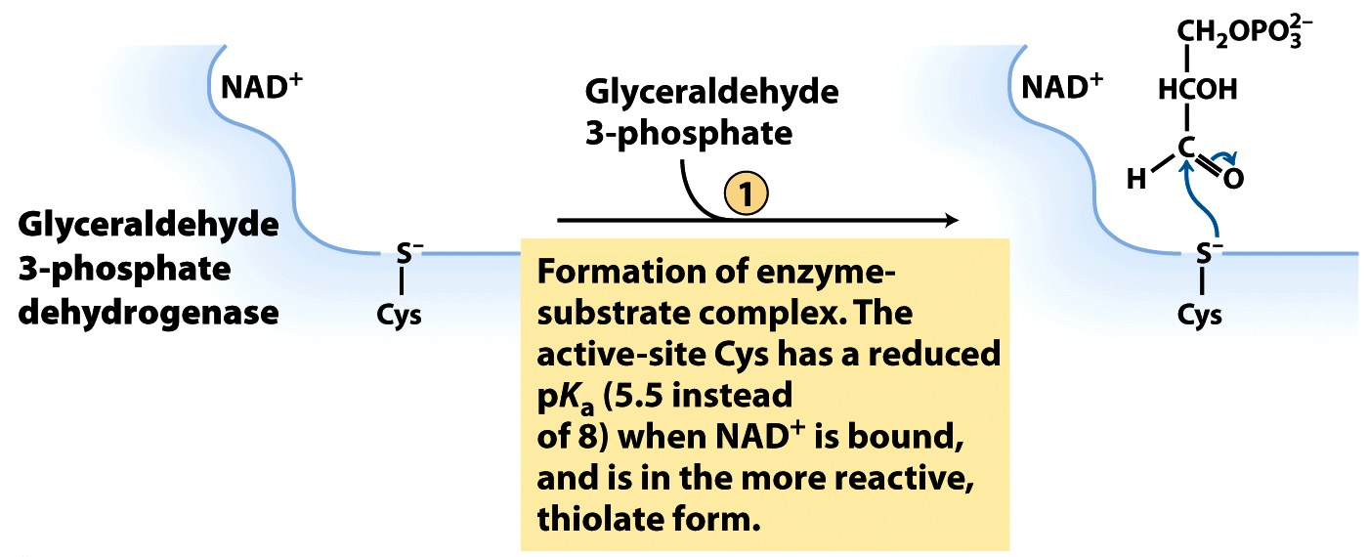
NAD+ binding to GAPDH promotes deprotonation of active-site Cys
Electrostatic catalysis
Notes:
FIGURE 14-7 (part 1) The glyceraldehyde 3-phosphate dehydrogenase reaction.

Slide 5
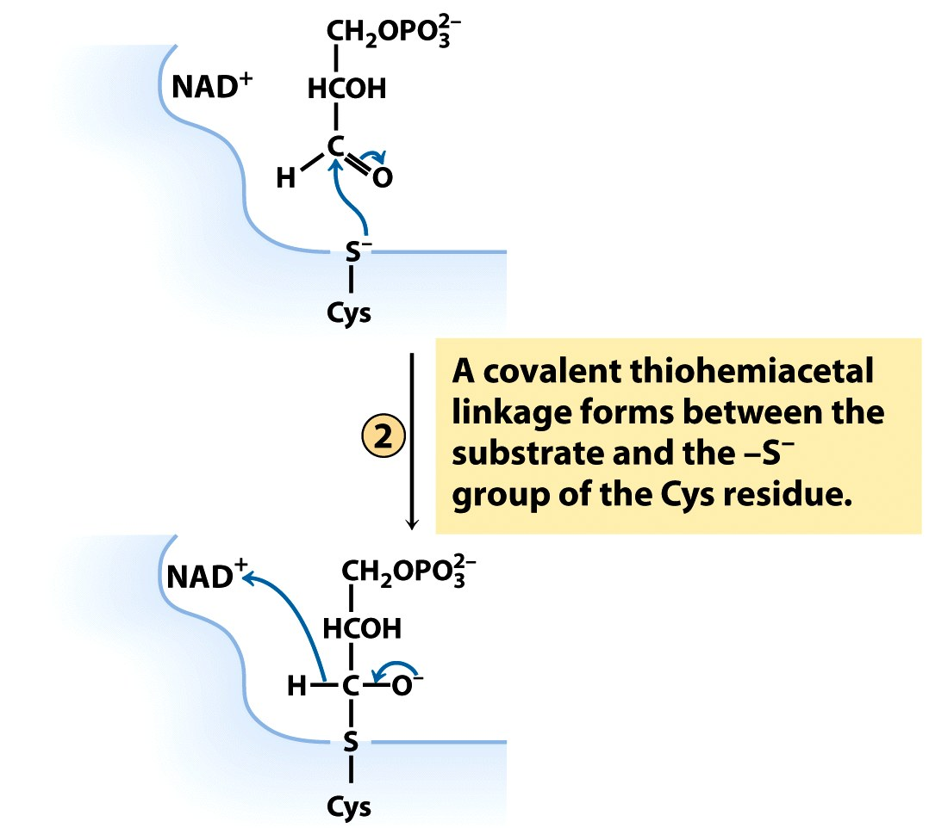
Deprotonated Cys is nucleophilic and attacks the electrophilic carbonyl carbon
Covalent catalysis
Notes:
FIGURE 14-7 (part 2) The glyceraldehyde 3-phosphate dehydrogenase reaction.

Slide 6
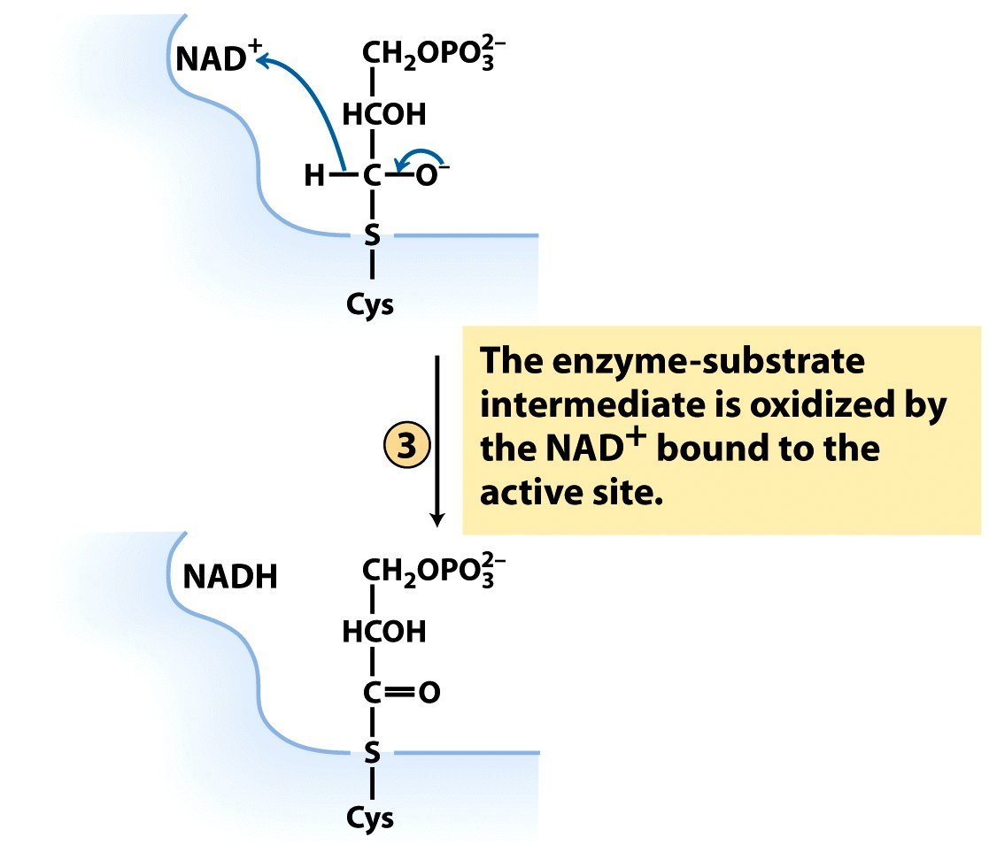
The tetrahedral intermediate kicks out a hydride ion, which is accepted by NAD⁺
Oxidation-reduction step
The energy that would be released on oxidation is retained through the formation of the thioester
Notes:
FIGURE 14-7 (part 3) The glyceraldehyde 3-phosphate dehydrogenase reaction.

Slide 7
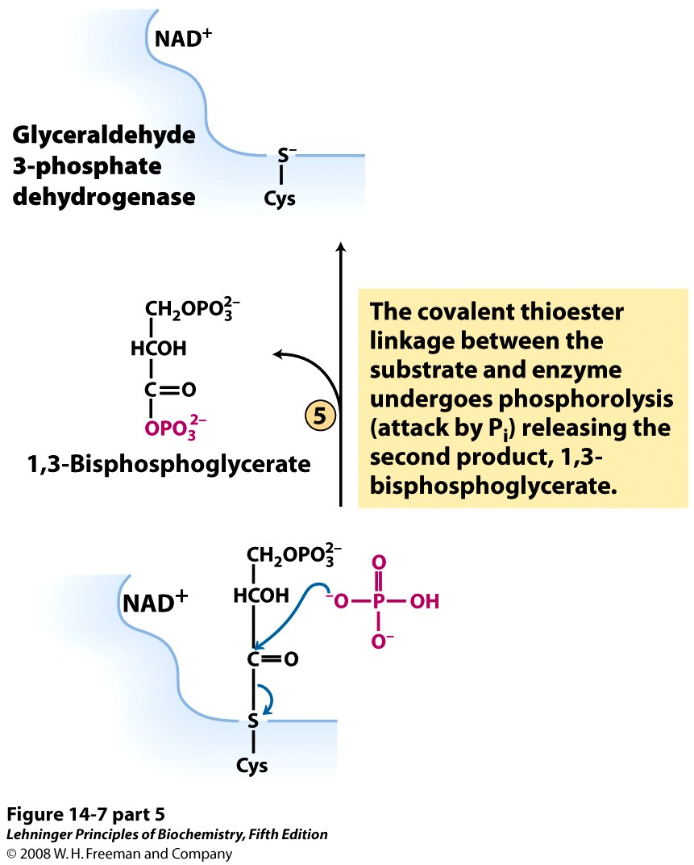
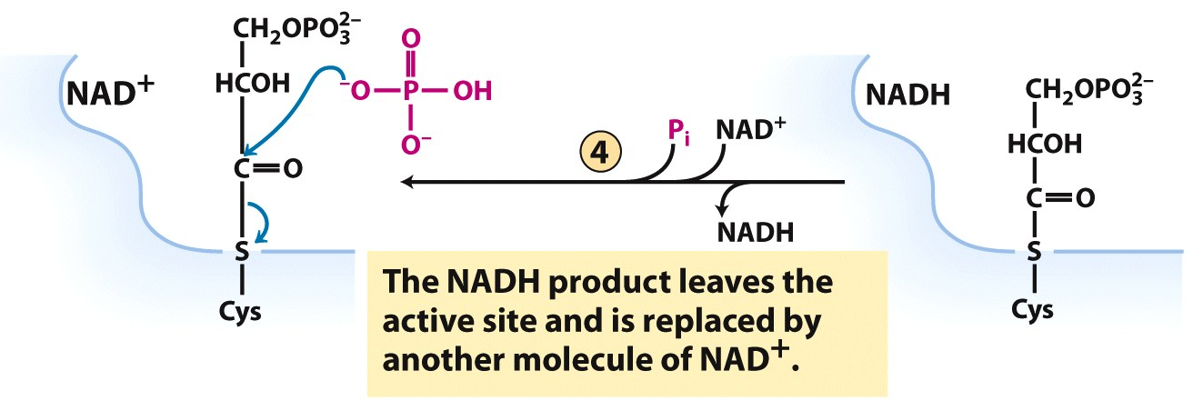
P_{i} acts as a nucleophile and releases the product
The energy of the broken thioester is retained in the mixed-anhydride product
Eeek! Tetrahedral intermediate not shown!
Notes:
FIGURE 14-7 (parts 4 & 5) The glyceraldehyde 3-phosphate dehydrogenase reaction.

Slide 8
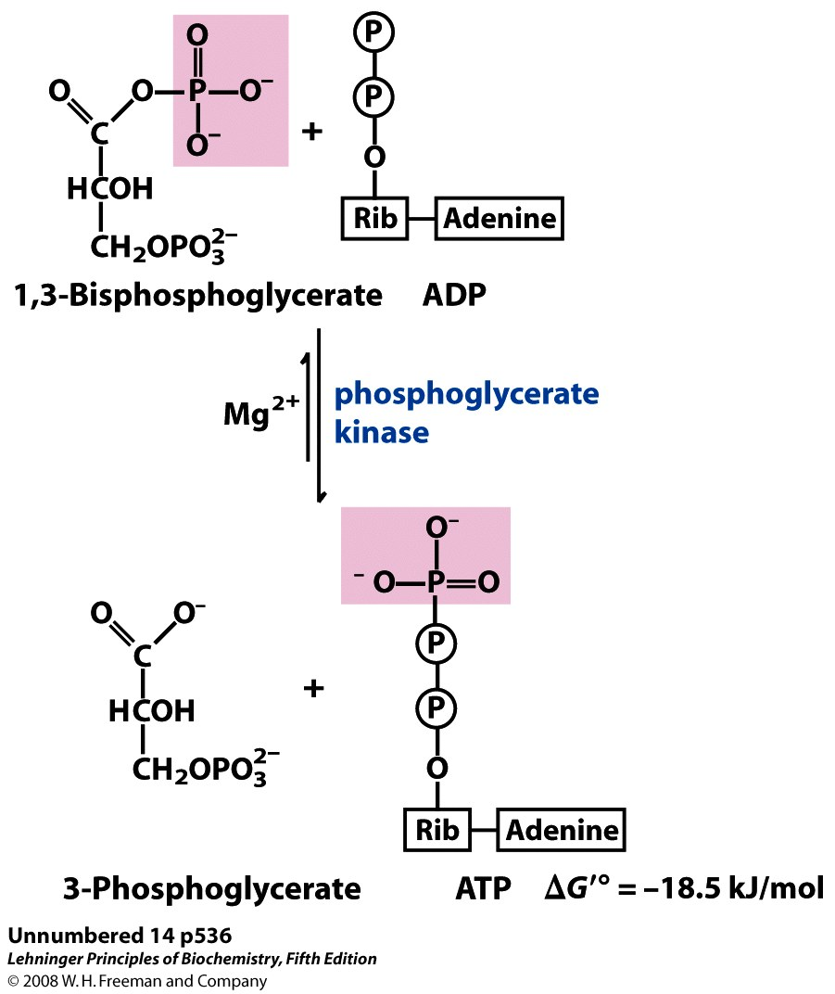
Step 7: Phosphoglycerate kinase (PGK) catalyzes the first synthesis of ATP
Substrate-level
phosphorylation
ATP made
This step replaces the two ATPs used in the preparatory phase
ATP made

Slide 9
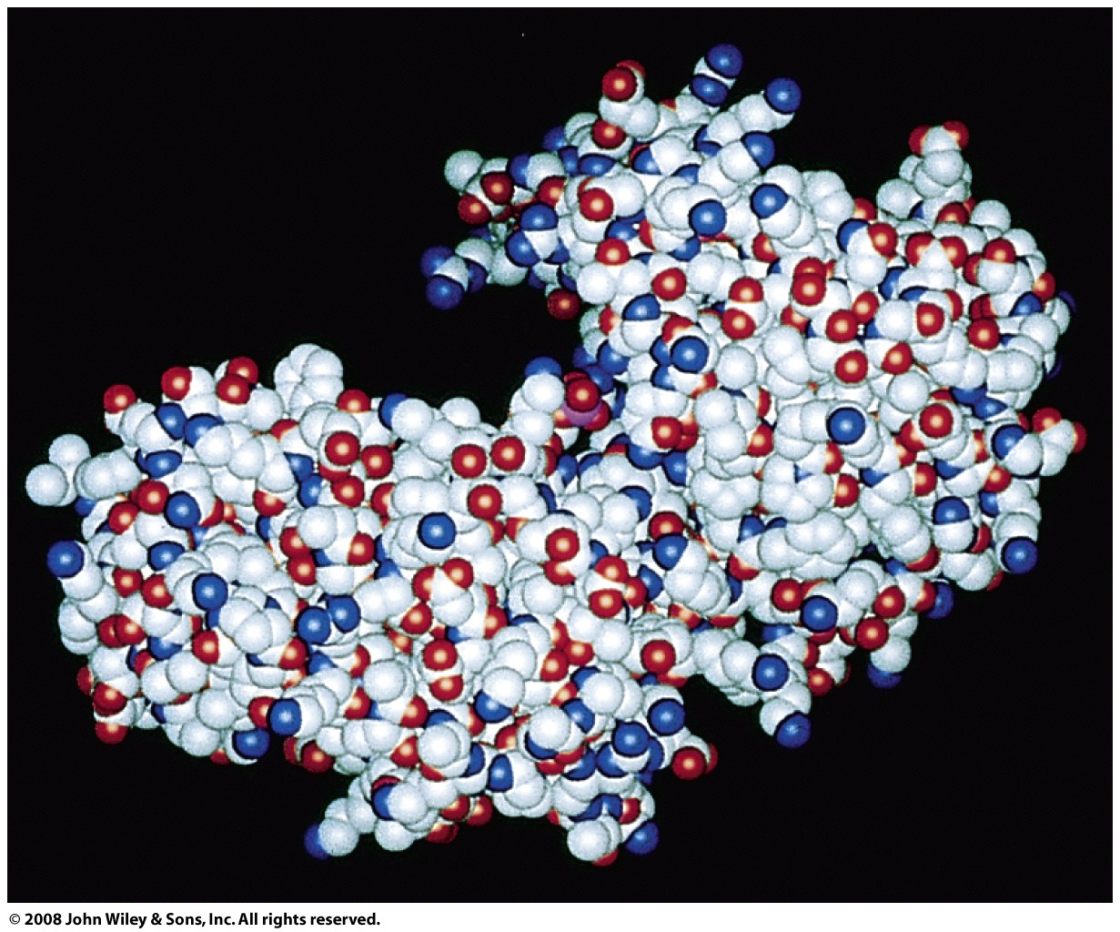
PGK undergoes a conformational change (induced fit) on binding its substrates
chomp!

Slide 10
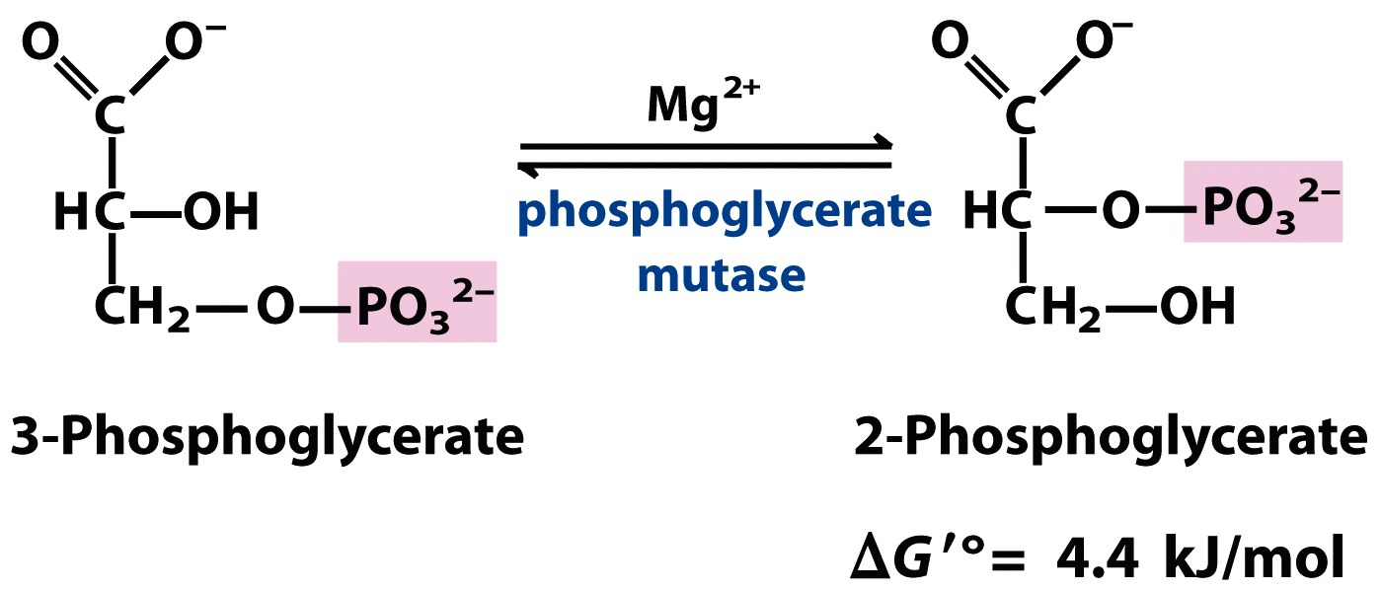
Step 8: PGM catalyzes the isomerization of 3PG to 2PG, in preparation for making PEP

Slide 11
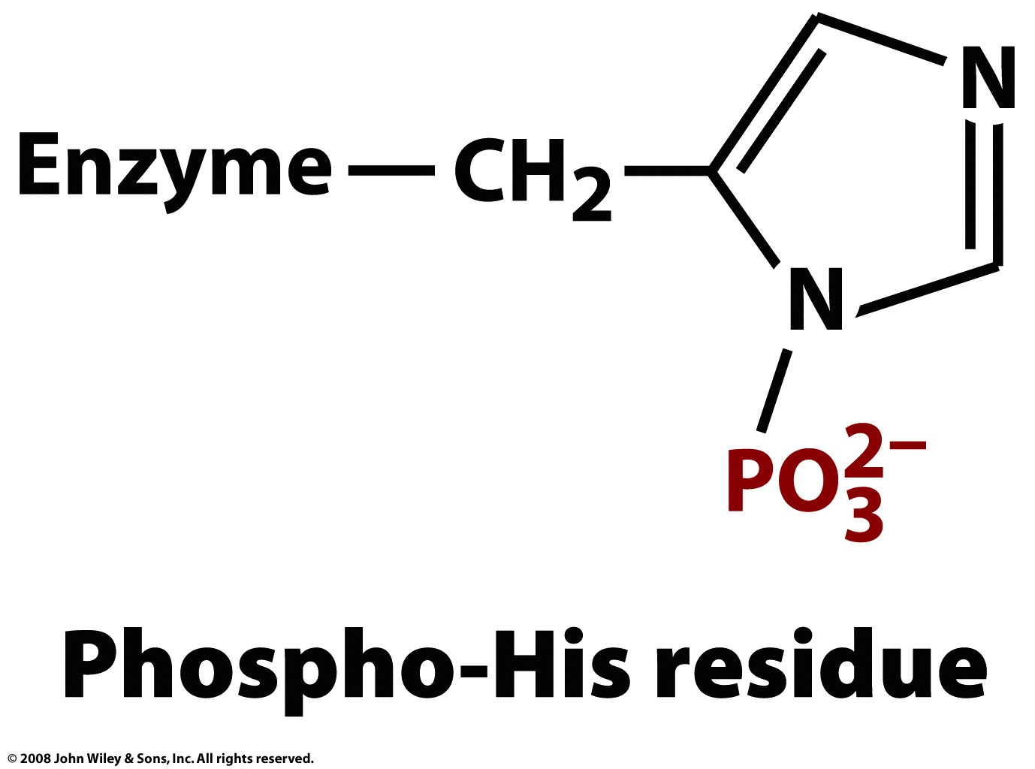
The active PGM enzyme contains a phospho-His in its active site

Slide 12
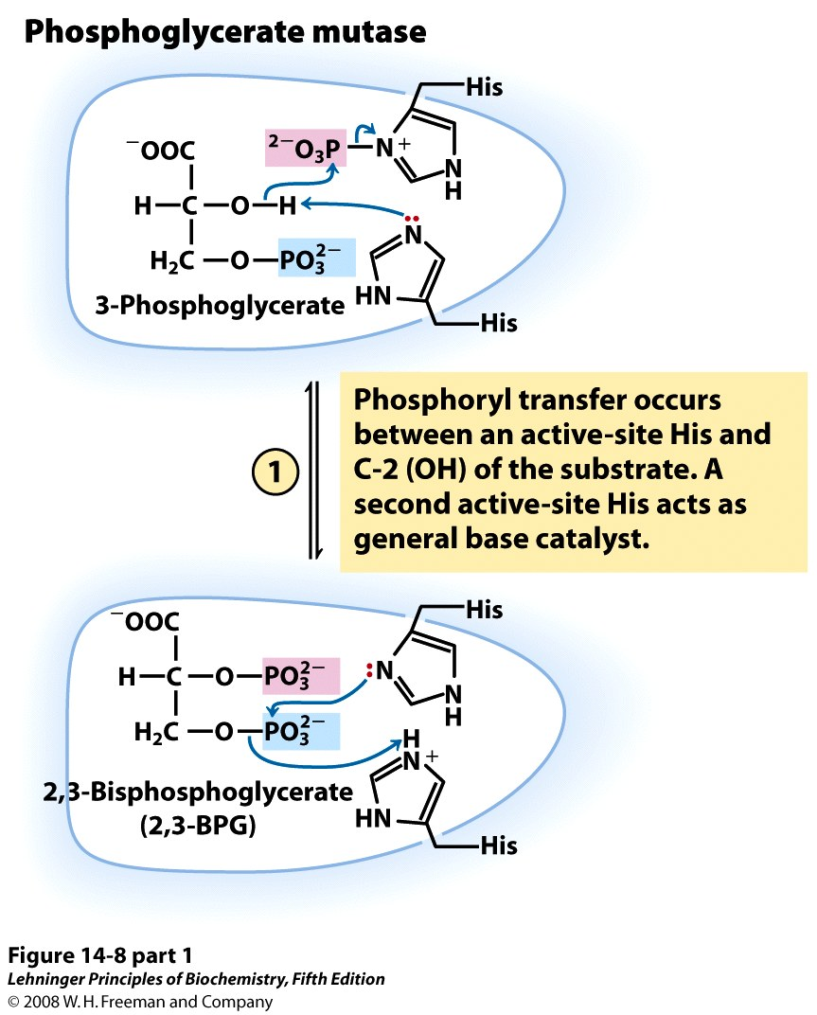
Notes:
FIGURE 14-8 (part 1) The phosphoglycerate mutase reaction.

Slide 13
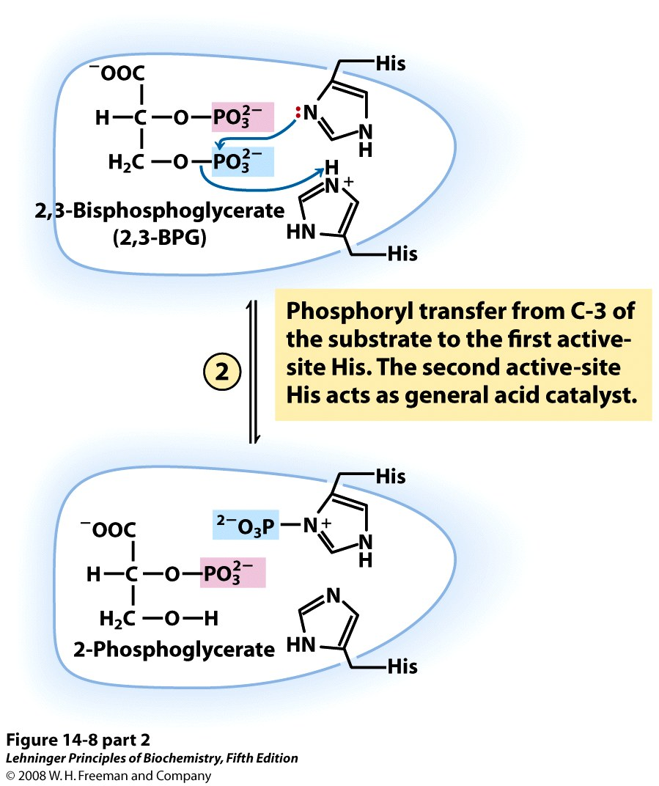
Notes:
FIGURE 14-8 (part 2) The phosphoglycerate mutase reaction.

Slide 14
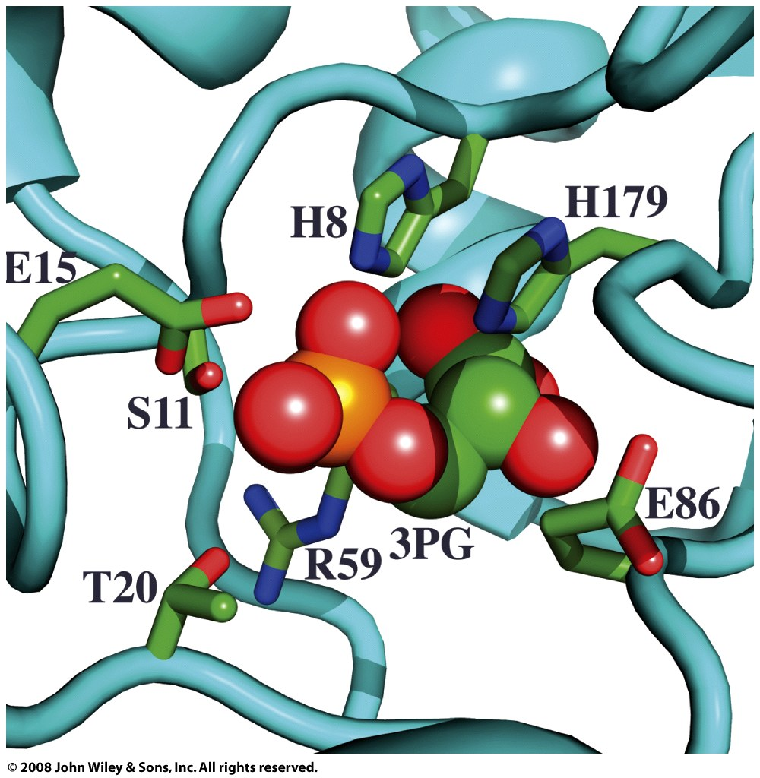

Slide 15
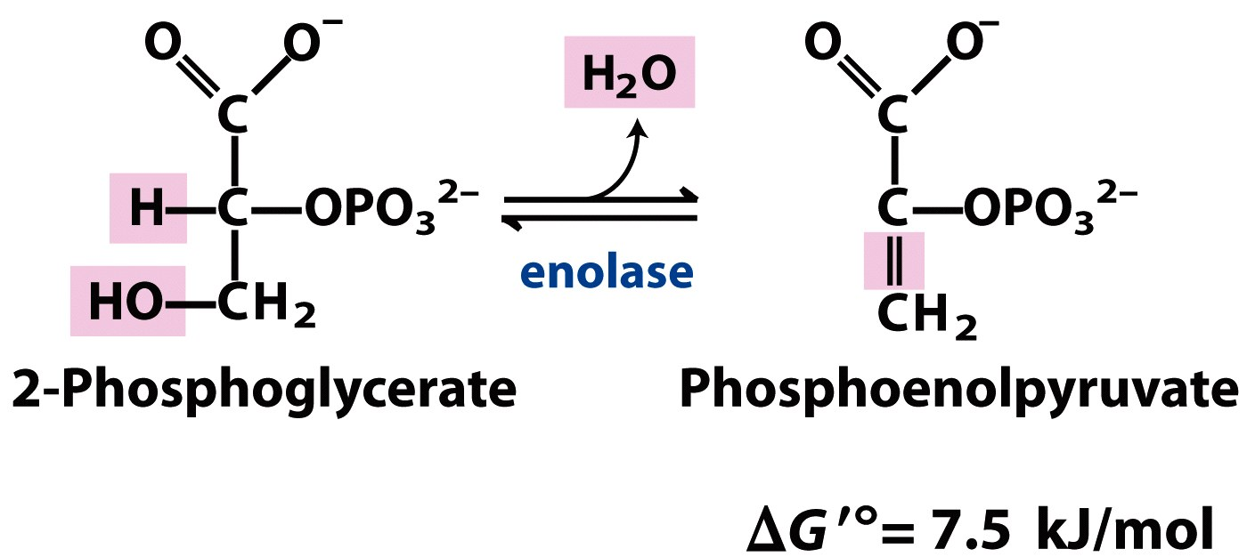
Step 9: Enolase catalyzes the dehydration of 2PG to PEP, a ‘high-energy’ intermediate
‘high-energy’
intermediate

Slide 16
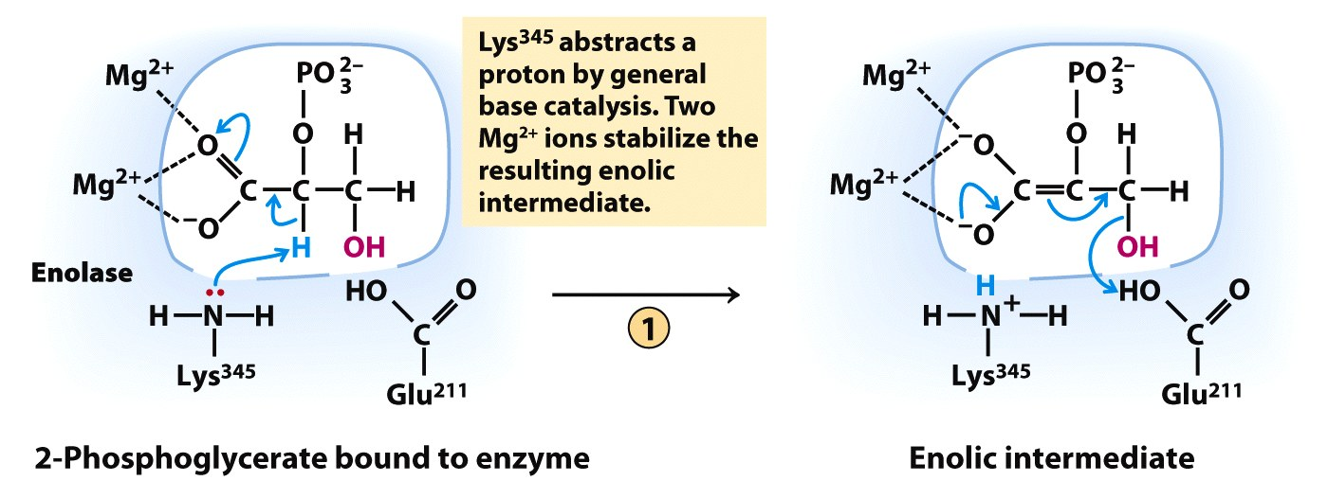
Mg²⁺ ions are essential in the enolate reaction
HOH
2
Phosphoenolpyruvate
Notes:
FIGURE 6-23a Two-step reaction catalyzed by enolase. (a) The mechanism by which enolase converts 2-phosphoglycerate (2-PGA) to phosphoenolpyruvate. The carboxyl group of 2-PGA is coordinated by two magnesium ions at the active site.

Slide 17
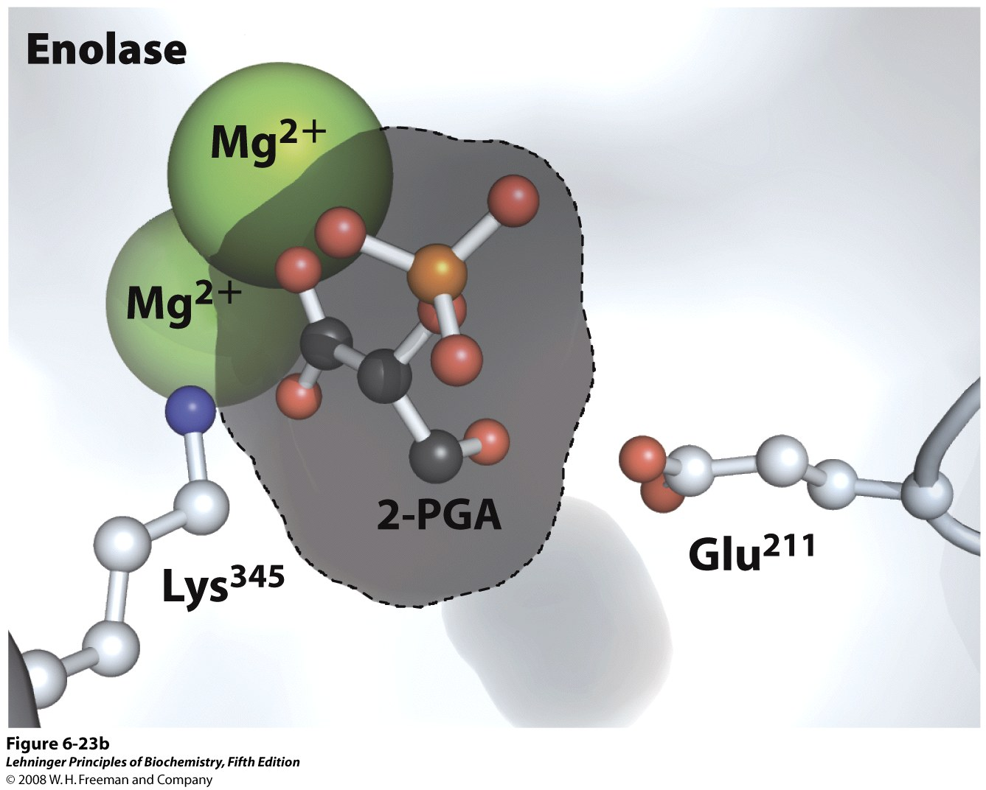
Notes:
FIGURE 6-23b Two-step reaction catalyzed by enolase. (b)The substrate, 2-PGA, in relation to the Mg²⁺ ions, Lys³⁴⁵, and Glu²¹¹ in the enolase active site. Nitrogen is shown in blue, phosphorus in orange; hydrogen atoms are not shown (PDB ID 1ONE).

Slide 18
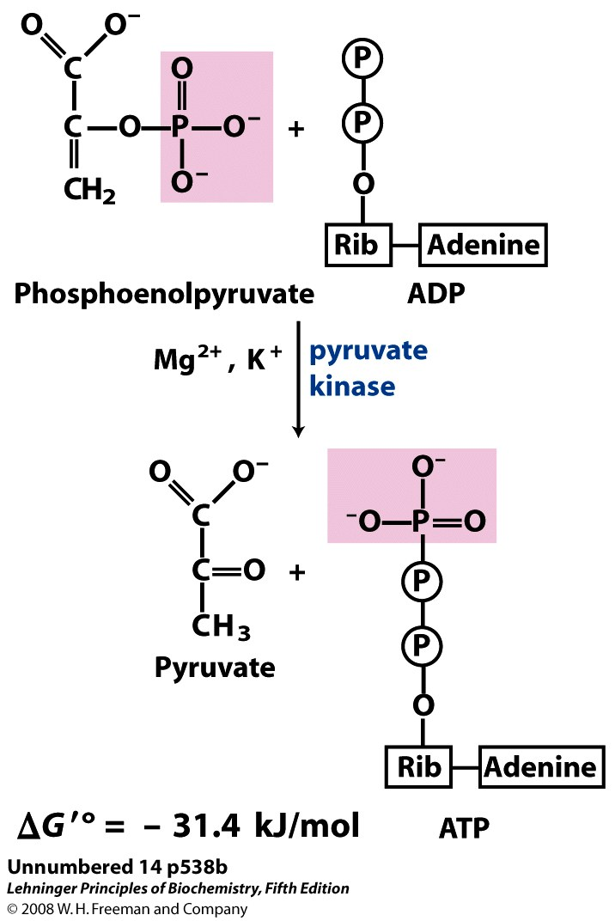
Step 10: Pyruvate kinase catalyzes a phosphoryl transfer from PEP to ADP
+ H⁺
Substrate-level
phosphorylation
ATP made
This step yields a net production of two ATPs per glucose
ATP made

Slide 19
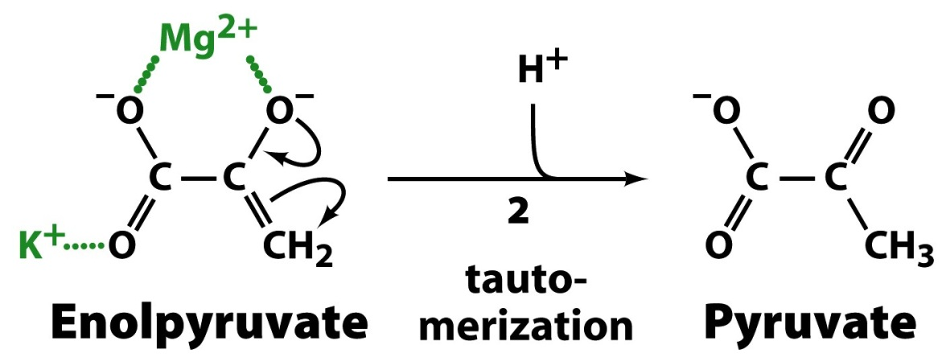
Catalysis by PK depends on Mg²⁺ and K⁺ ions

Slide 20
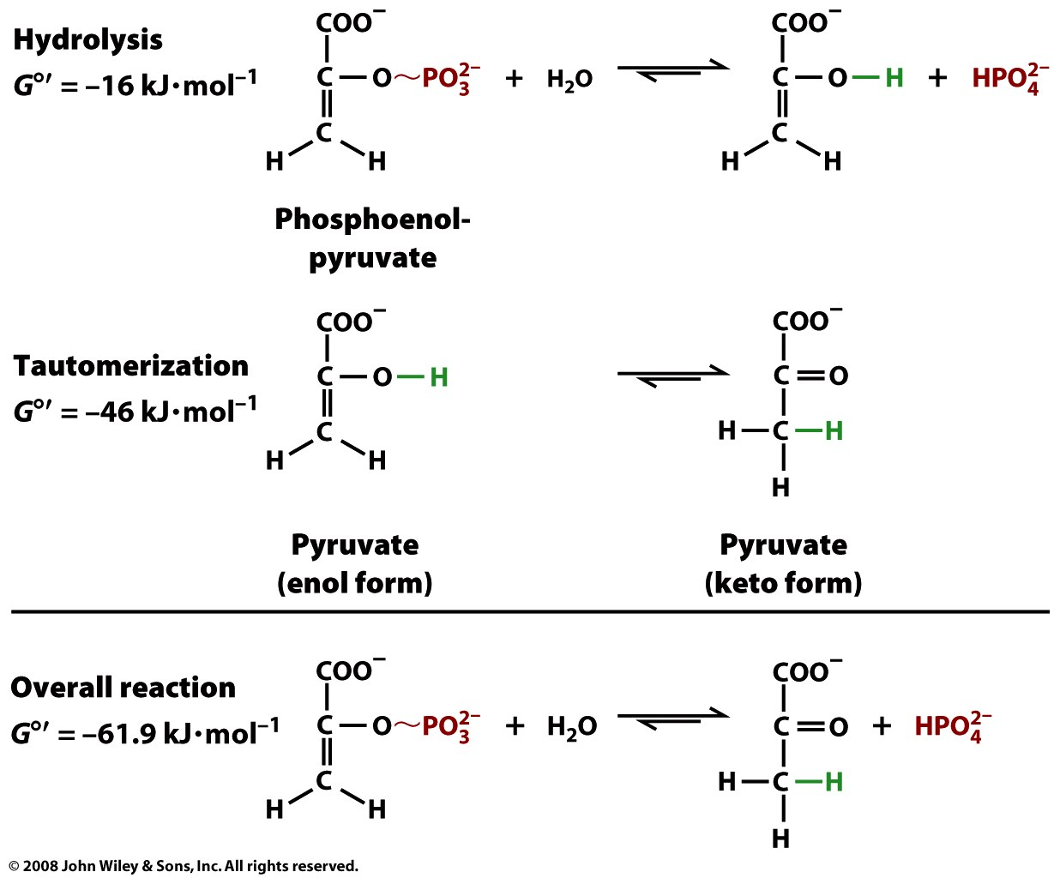
The enol-keto tautomerization of pyruvate is why PEP is a ‘high-energy phosphate’ cpd
Not sufficient for phosphoryl transfer to ADP

Slide 21
The payoff phase converts 2 GAP to 2 pyruvate, yielding 4 ATP and 2 NADH
2GAP + 4ADP + 2P_{i} + 2NAD⁺
2 pyruvate + 4ATP + 2H₂O + 2NADH

Slide 22
