Slide 1
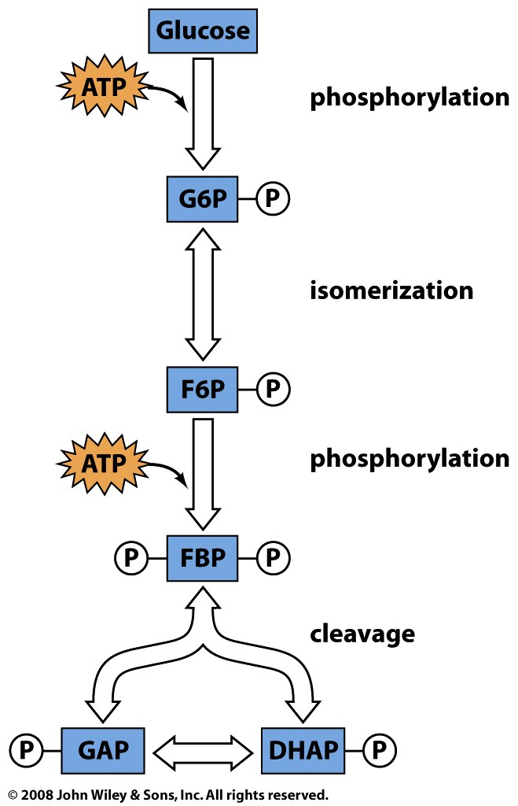
The preparatory phase uses 2 ATP and converts 1 glucose to 2 molecules of GAP
Glucose + 2ATP → 2GAP + 2ADP + 2H⁺
isomerization

Slide 2
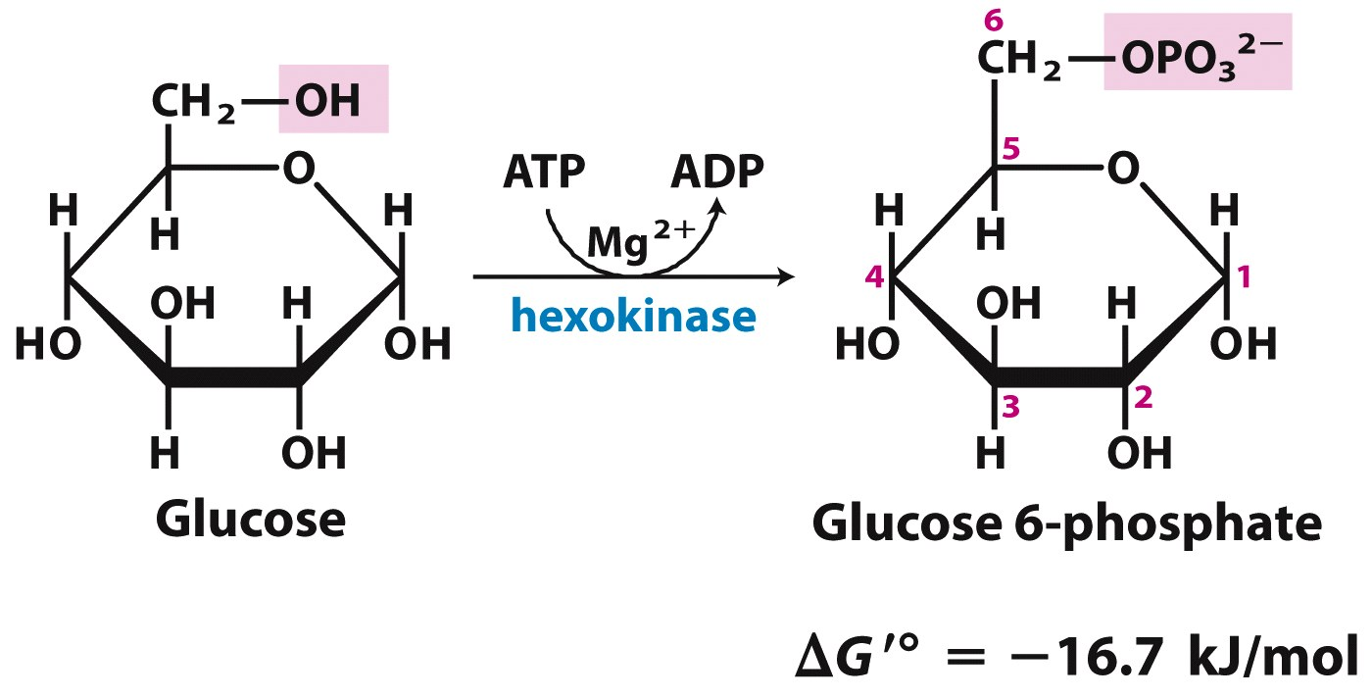
Step 1: Hexokinase catalyzes a phosphoryl transfer from ATP to glucose
‘Activates’ glucose
1 ATP used
+ H⁺
Keeps [glucose] low in the cell, so glucose can always move down its gradient into the cell

Slide 3
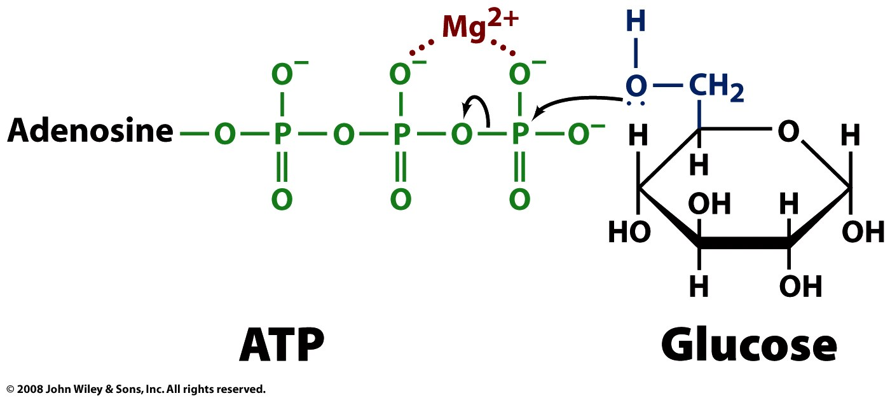
Mg²⁺ offsets negative charge on phosphates of ATP, allowing nucleophilic attack

Slide 4
Hexokinase undergoes a conformational change on binding glucose (induced fit)
chomp!
Notes:
FIGURE 6-22 Induced fit in hexokinase. (a) Hexokinase has a U-shaped structure (PDB ID 2YHX). (b)The ends pinch toward each other in a conformational change induced by binding of D-glucose (red) (derived from PDB ID 1HKG and PDB ID 1GLK)

Slide 5
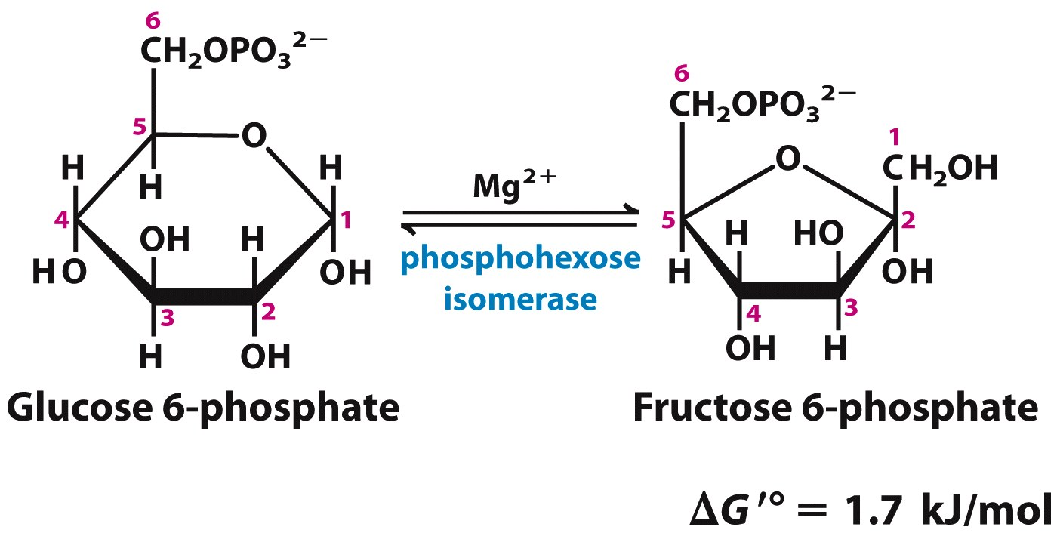
Step 2: PGI catalyzes the isomerization of the aldose G6P to the ketose F6P
phosphoglucose
isomerase
Moving the carbonyl to C2 prepares the molecule for cleavage in step 4

Slide 6
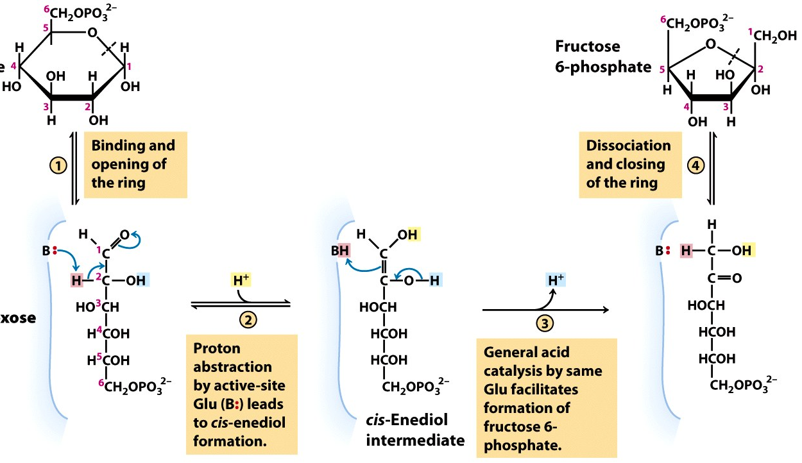
General acid-base catalysis promotes isomerization via an enediol intermediate
Glucose
6-phosphate
(general acid catalysis – protonation of ring O)
phosphoglucose
isomerase
Notes:
FIGURE 14-4 The phosphohexose isomerase reaction. The ring opening and closing reactions (steps 1 and 4) are catalyzed by an active-site His residue, by mechanisms omitted here for simplicity. The proton (pink) initially at C-2 is made more easily abstractable by electron withdrawal by the adjacent carbonyl and nearby hydroxyl group. After its transfer from C-2 to the active-site Glu residue (a weak acid), the proton is freely exchanged with the surrounding solution; that is, the proton abstracted from C-2 in step 2 is not necessarily the same one that is added to C-1 in step 3.

Slide 7
Step 3: PFK catalyzes the second phosphoryl transfer from ATP
Further ‘activates’ the sugar
1 ATP used
+ H⁺
This step ‘commits’ the hexose to being broken down
Phosphorylations become even: at both ends of the molecule

Slide 8
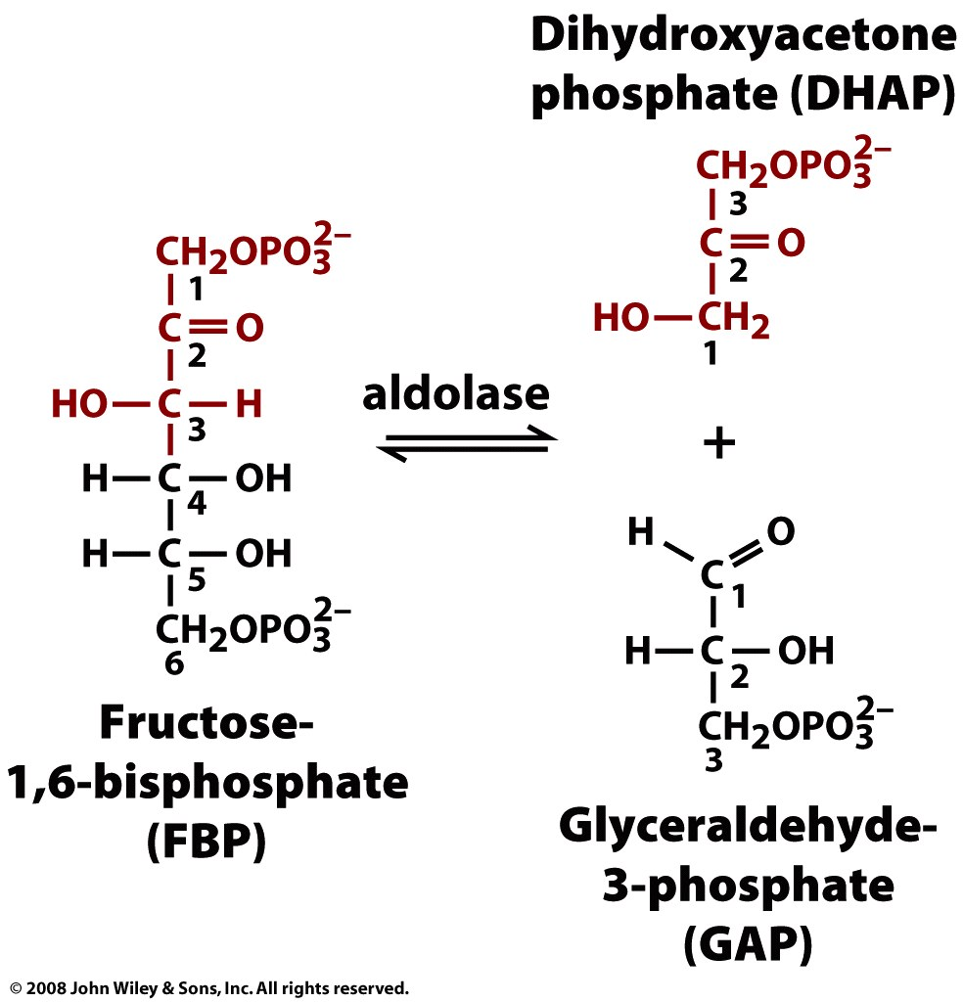
Step 4: Aldolase catalyzes the aldol cleavage of the hexose into 2 trioses
aldolase

Slide 9
(Non-enzymatic) base-catalyzed aldol cleavage forms an unstable enolate intermediate
Eeek! I have too much charge!
Aldolase promotes the reaction by forming a Schiff base instead:
+
+
(general acid catalysis)
+
NH-(Lys)
NH-(Lys)
∙∙
NH-(Lys)
NH-(Lys)
general base catalysis
Enamine
Schiff base (imine)
Aaahh… no charge

Slide 10
Schiff base formation on aldolase involves covalent and general acid-base catalysis
Notes:
FIGURE 14-5 The class I aldolase reaction. The reaction shown here is the reverse of an aldol condensation. Note that cleavage between C-3 and C-4 depends on the presence of the carbonyl group at C-2. A and B represent amino acid residues that serve as general acid (A) or base (B).

Slide 11
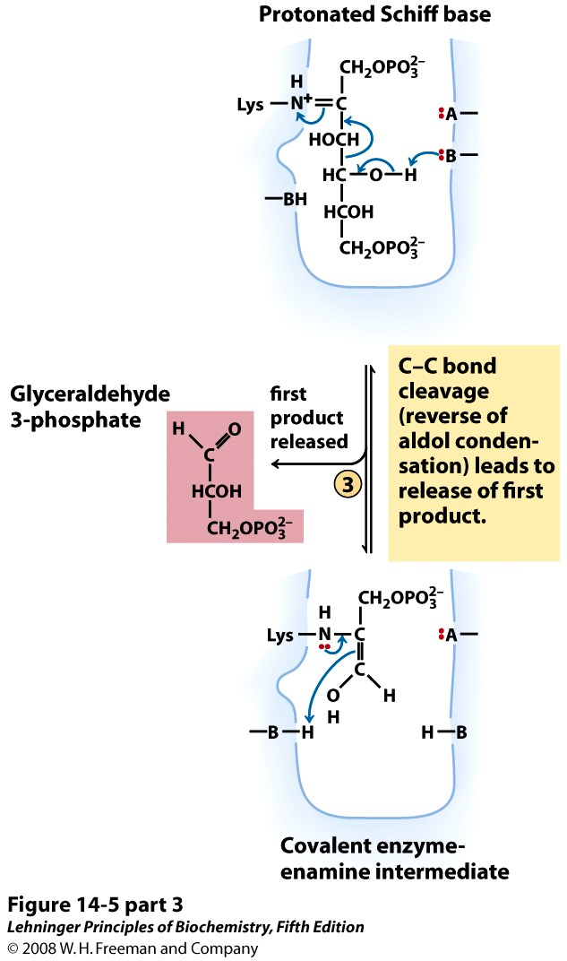
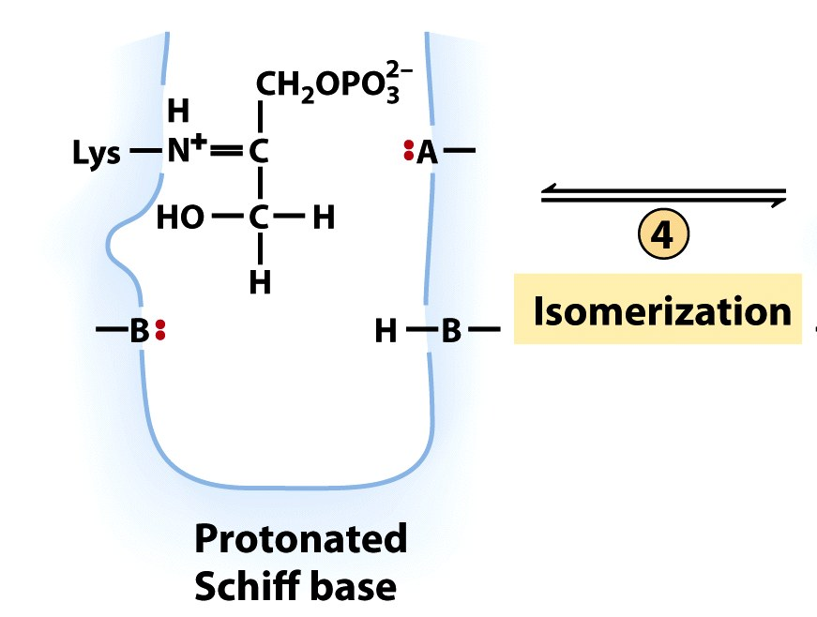
General acid-base catalysis and electron-poor Schiff base promote cleavage
Notes:
FIGURE 14-5 The class I aldolase reaction. The reaction shown here is the reverse of an aldol condensation. Note that cleavage between C-3 and C-4 depends on the presence of the carbonyl group at C-2. A and B represent amino acid residues that serve as general acid (A) or base (B).

Slide 12
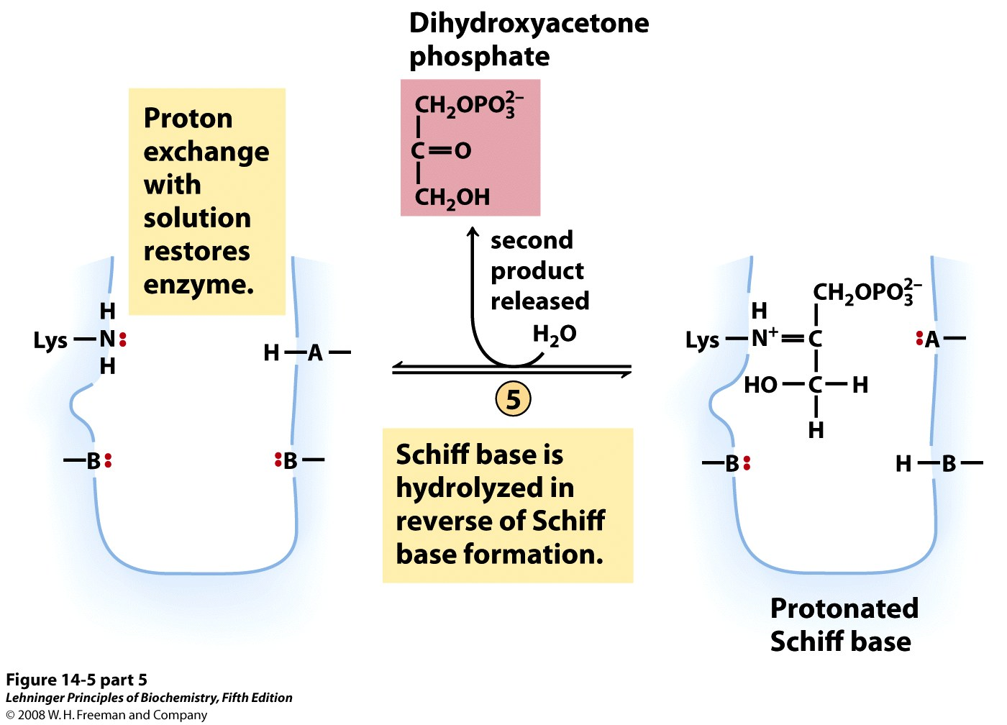
Aldolase releases 2nd product by reversing Schiff-base formation reactions
Notes:
FIGURE 14-5 (part 5) The class I aldolase reaction. The reaction shown here is the reverse of an aldol condensation. Note that cleavage between C-3 and C-4 depends on the presence of the carbonyl group at C-2. A and B represent amino acid residues that serve as general acid (A) or base (B).

Slide 13
2 trioses result from aldolase cleavage because hexose carbonyl is at C2
aldolase

Slide 14
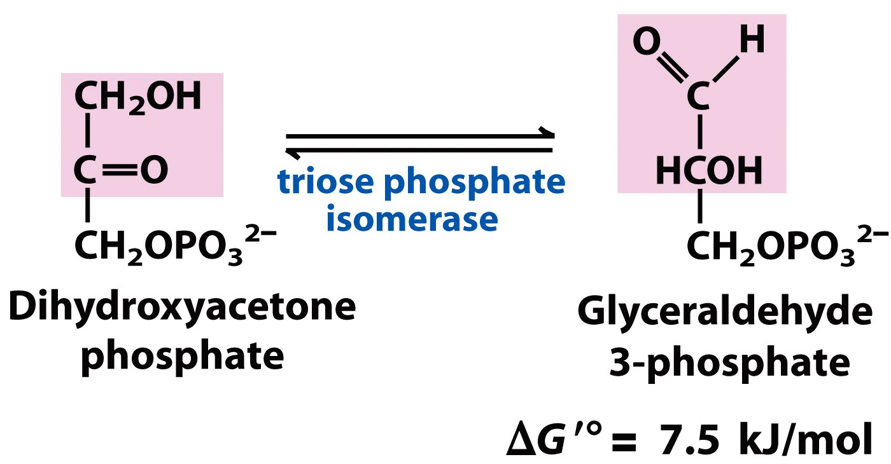
Triose phosphate isomerase interconverts the products of the aldolase reaction
Mechanism?
Two of the same molecule can continue through glycolysis: more efficient than two different

Slide 15
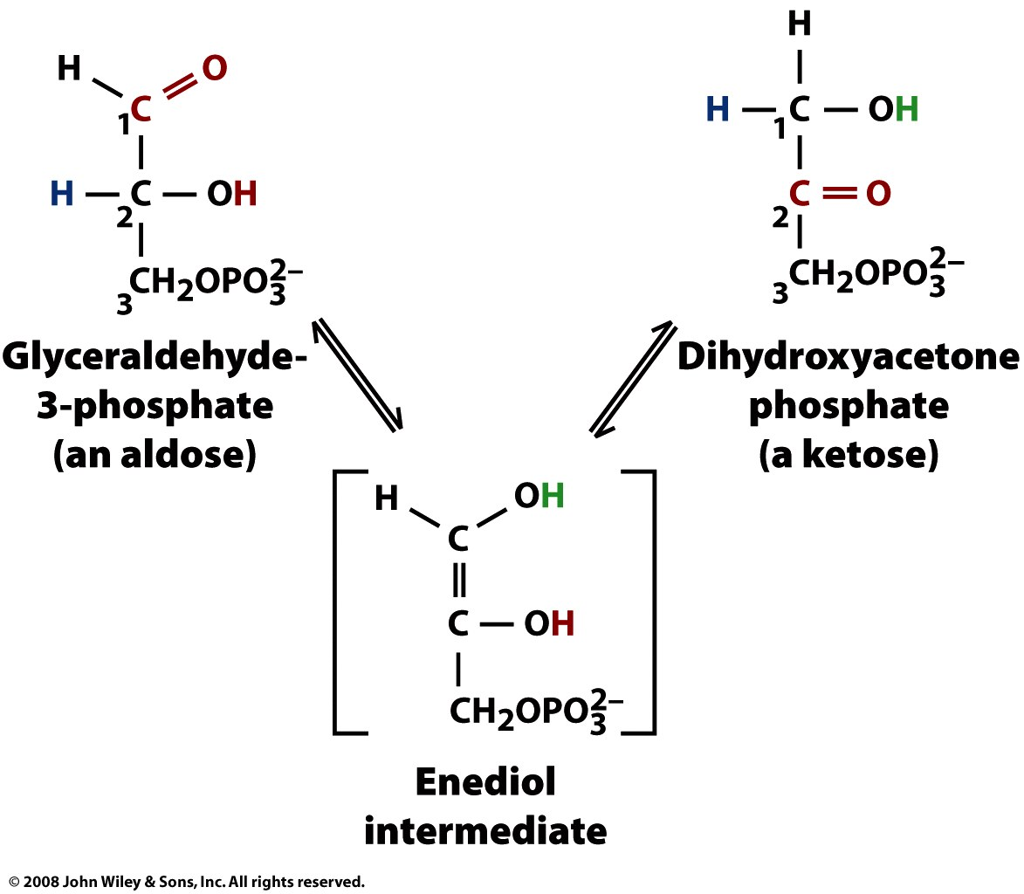
Aldose-ketose isomerization occurs through an enediol intermediate

Slide 16
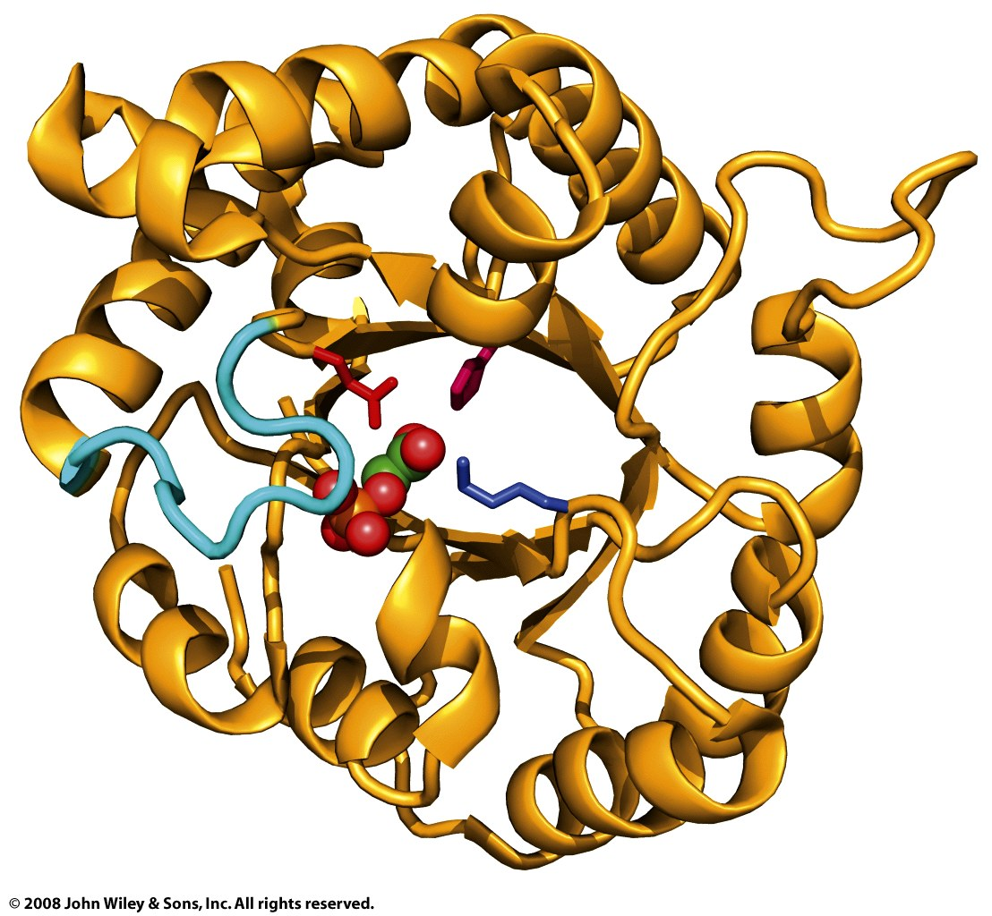
Triose phosphate isomerase (TIM) has a ‘TIM barrel’ fold, as do many other enzymes
Including aldolase, enolase, pyruvate kinase
Convergent or divergent evolution?

Slide 17
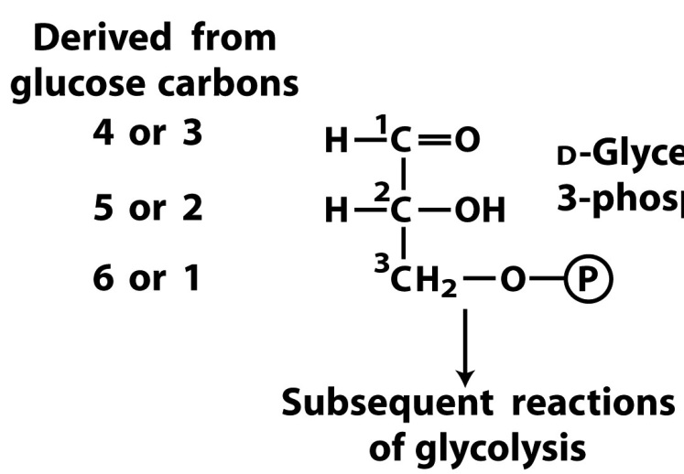
The preparatory phase uses 2 ATP and converts 1 glucose to 2 molecules of GAP
Glucose + 2ATP → 2GAP + 2ADP + 2H⁺
GAP
isomerization

