Slide 1
Metabolism encompasses degradative and biosynthetic pathways
Catabolism: reactions that break down nutrients and collect released energy and reducing power
Catabolic pathways are convergent
Anabolism: reactions that synthesize needed compounds, using stored energy and reducing power
Anabolic pathways are divergent

Slide 2
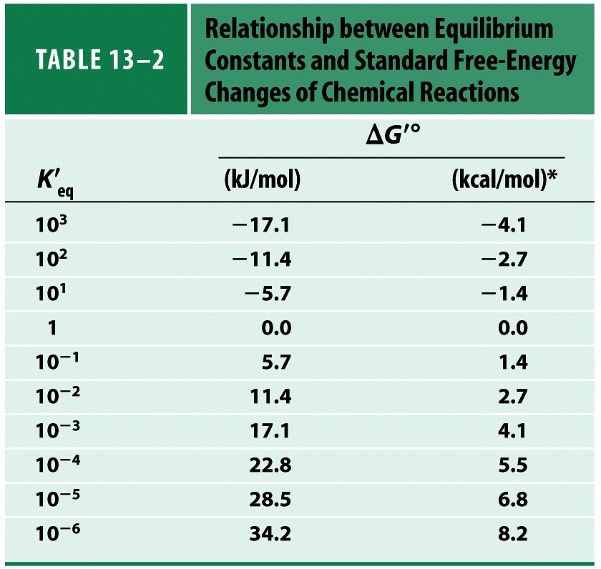

Slide 4
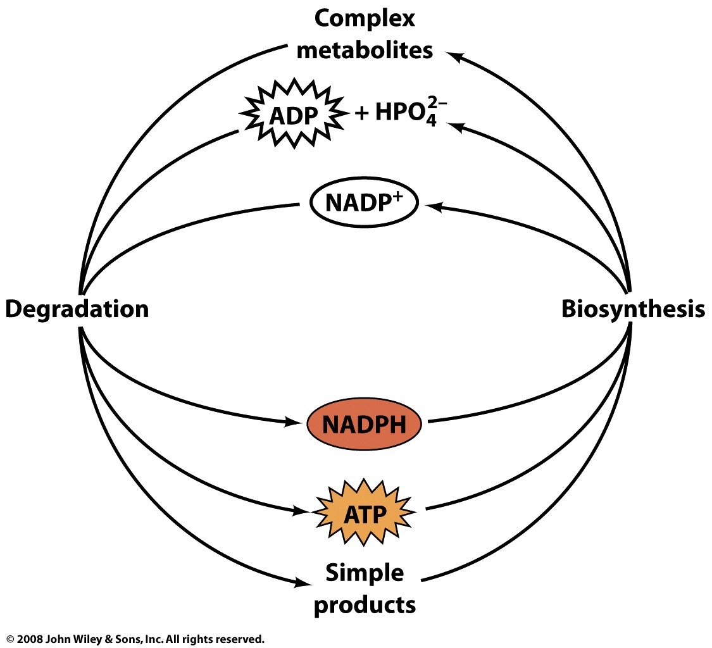
Energy currencies provide a common intermediate in energy transductions

Slide 5
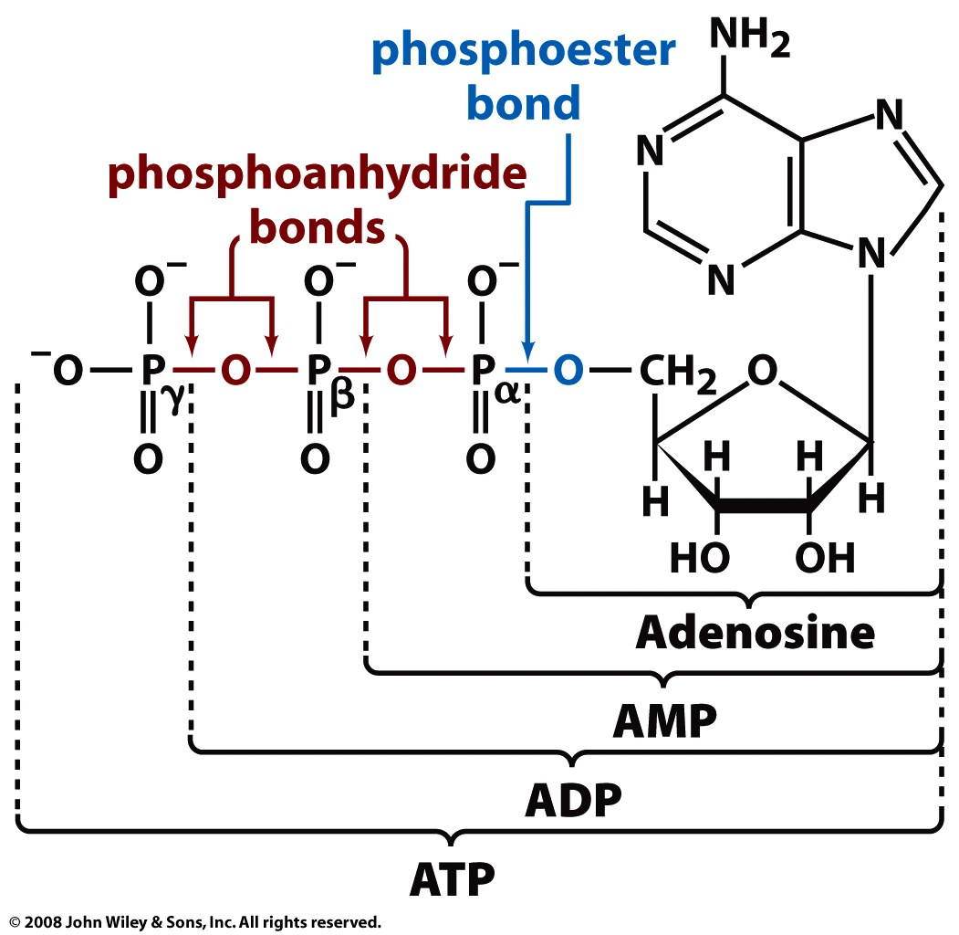
The adenylates (ATP, ADP, AMP) are the primary energy currency
Why?

Slide 6
The ΔG of ATP hydrolysis is large and negative
Reduced charge repulsion in products
Better resonance stabilization of products

Slide 7
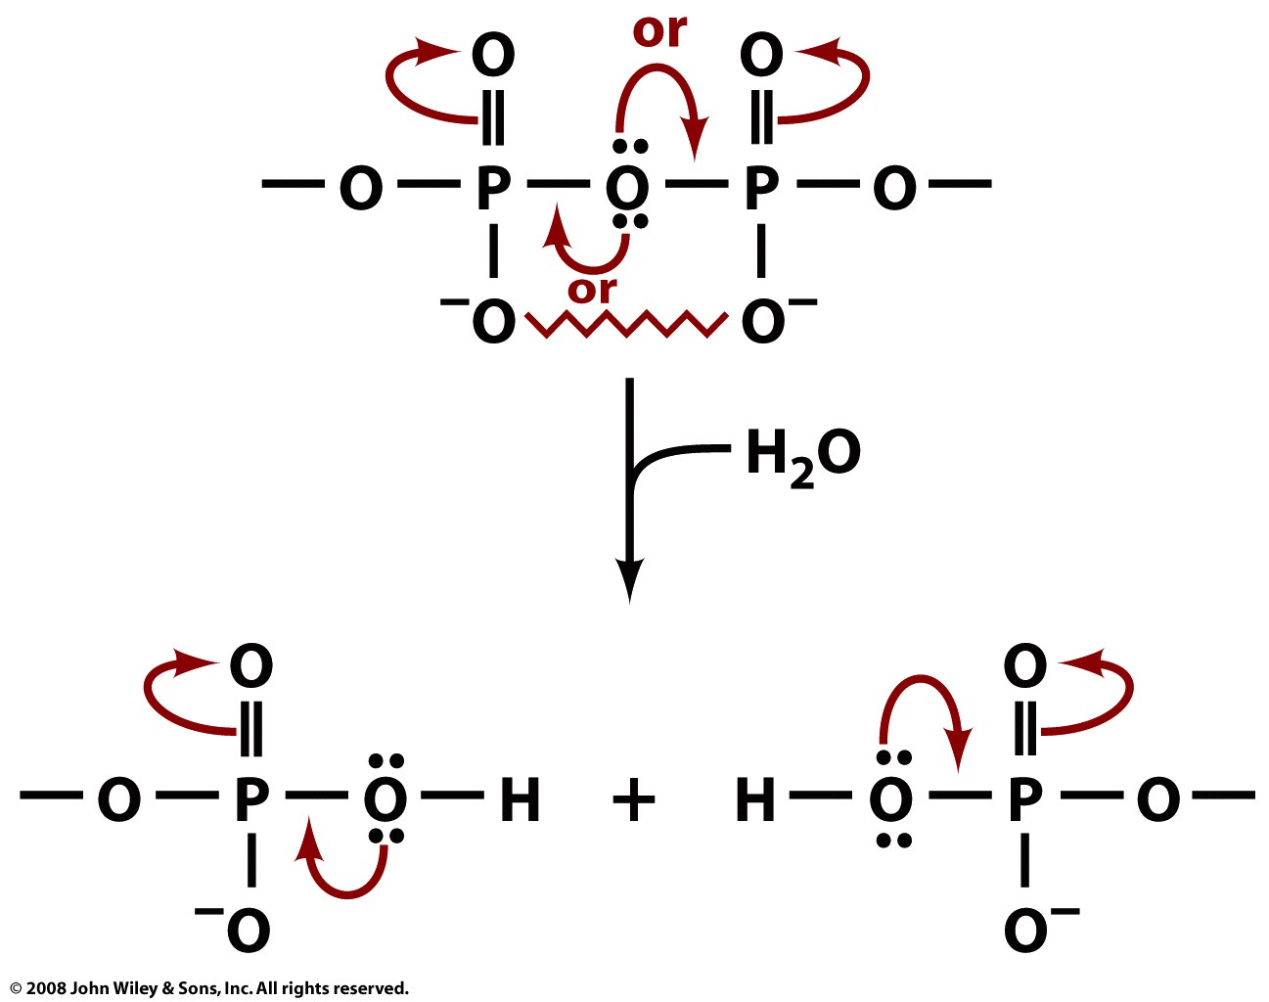
Products of phosphoanhydride hydrolysis have better resonance stabilization

Slide 8
The ΔG of ATP hydrolysis is large and negative
Reduced charge repulsion in products
Better resonance stabilization of products
More favored solvation of products
ΔG'° is -30.5 kJ/mol
Cells keep [ATP] relatively high
⇒ ΔG < -30.5 kJ/mol

Slide 9
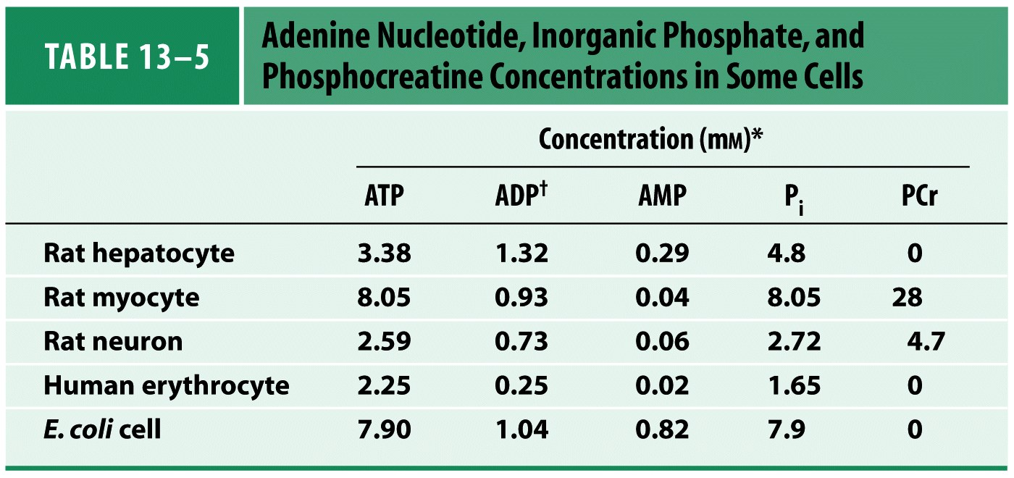
For practice: Calculate the ΔG of ATP hydrolysis in E. coli

Slide 10
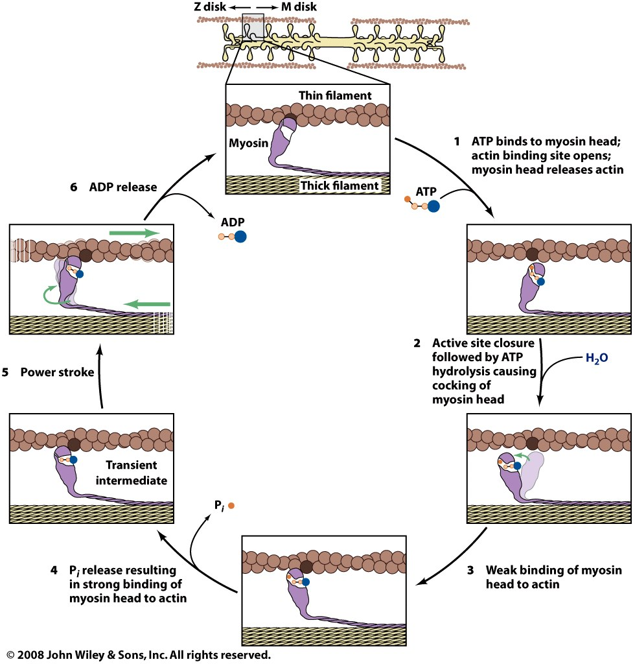
ATP binding and hydrolysis drives muscle contraction

Slide 11
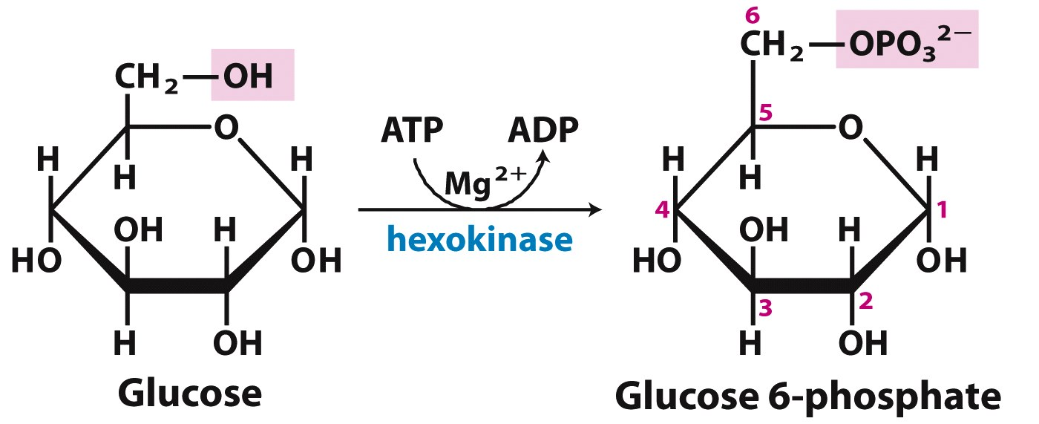
Phosphoryl transfer from ATP drives many reactions (via coupling)
ΔG’s are additive

Slide 12
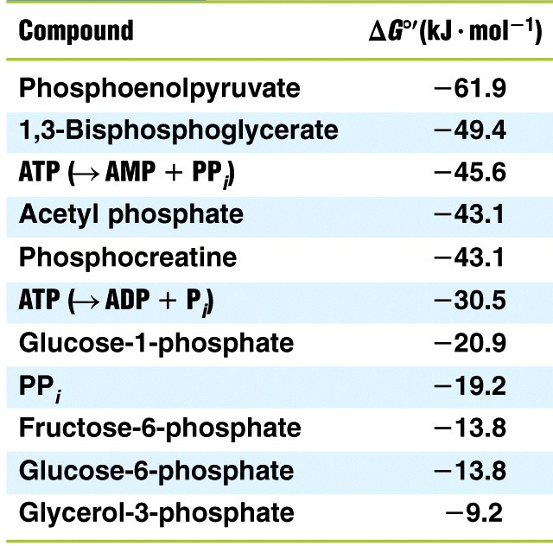
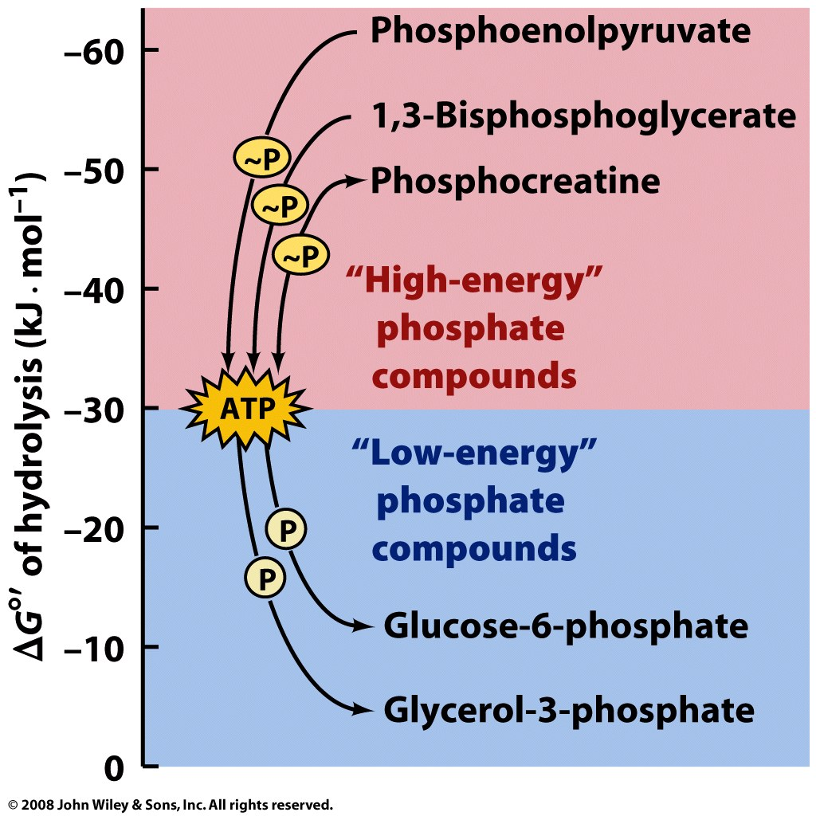
ΔG'° values of phosphate hydrolysis reflect ‘phosphoryl transfer potential’ (ptp)
High ptp
Low ptp

Slide 13
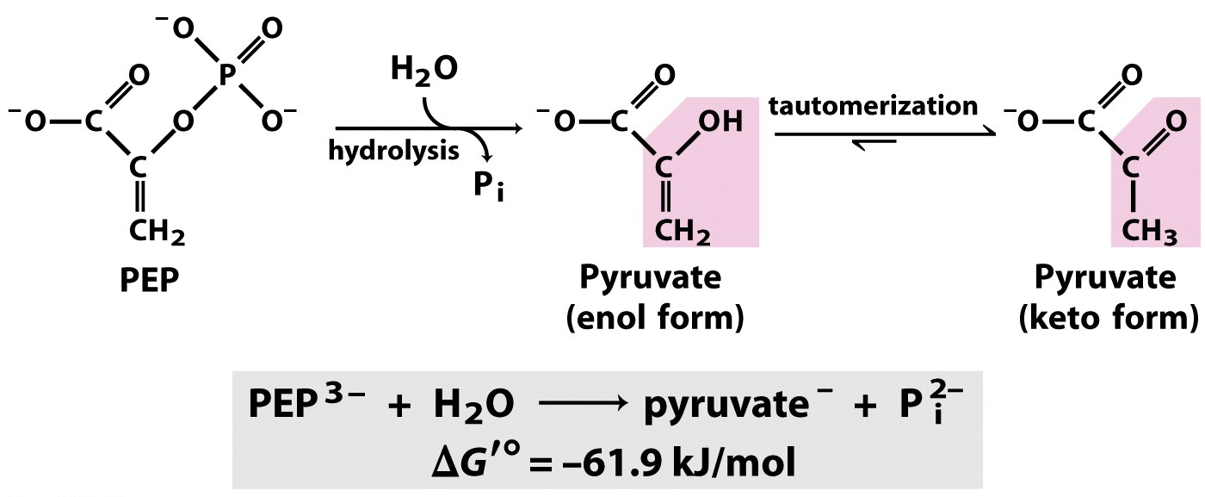
Other ‘high-energy phosphate’ compounds have great stabilization of hydrolysis products
Reduced charge repulsion and tautomerization:
Notes:
FIGURE 13-13 Hydrolysis of phosphoenolpyruvate (PEP). Catalyzed by pyruvate kinase, this reaction is followed by spontaneous tautomerization of the product, pyruvate. Tautomerization is not possible in PEP, and thus the products of hydrolysis are stabilized relative to the reactants. Resonance stabilization of P_{i} also occurs, as shown in Figure 13-11.

Slide 14
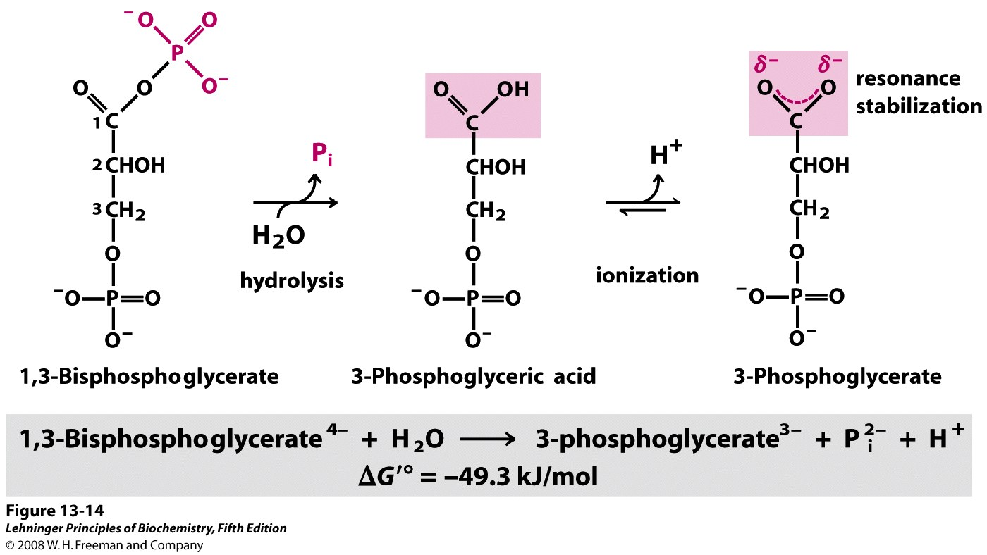
Other ‘high-energy phosphate’ compounds have great stabilization of hydrolysis products
Reduced charge repulsion and resonance stabilization:
Notes:
FIGURE 13-14 Hydrolysis of 1,3-bisphosphoglycerate. The direct product of hydrolysis is 3-phosphoglyceric acid, with an undissociated carboxylic acid group, but dissociation occurs immediately. This ionization and the resonance structures it makes possible stabilize the product relative to the reactants. Resonance stabilization of P_{i} further contributes to the negative free-energy change.

Slide 15
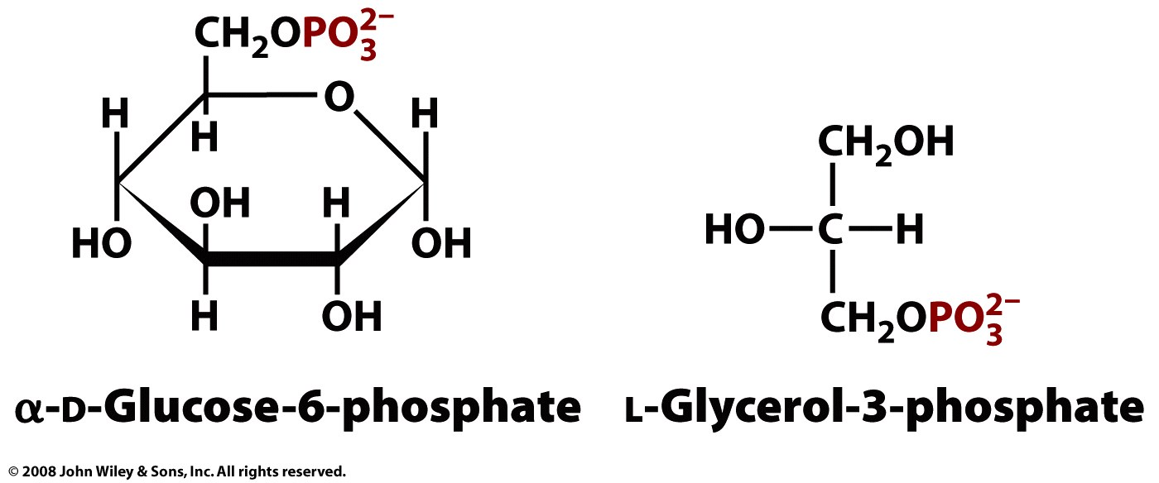
‘Low-energy phosphate’ compounds have less stabilization of hydrolysis products
ΔG'° of hydrolysis:
-13.8 kJ/mol
ΔG'° of hydrolysis:
-9.2 kJ/mol

Slide 16
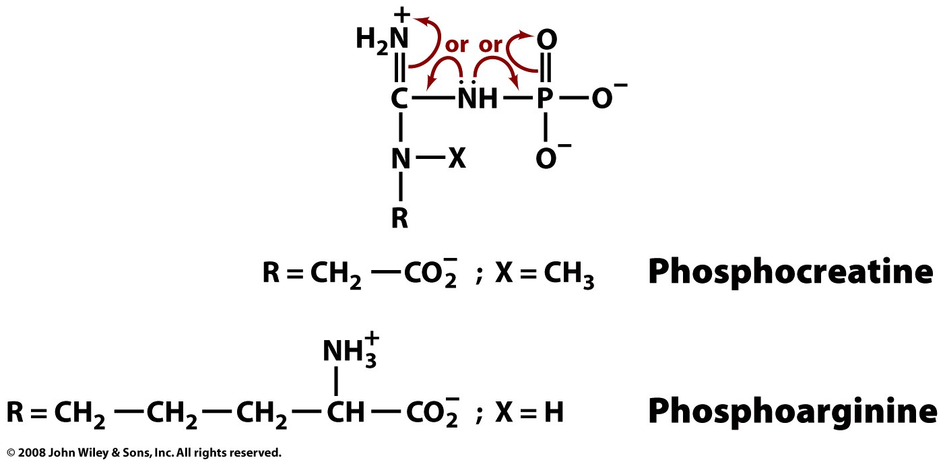
Phosphagens are ‘high-energy phosphate’ compounds used to quickly regenerate ATP
ex: ADP + phosphocreatine ↔ ATP + creatine
ΔG'° = -12.5 kJ/mol

Slide 17
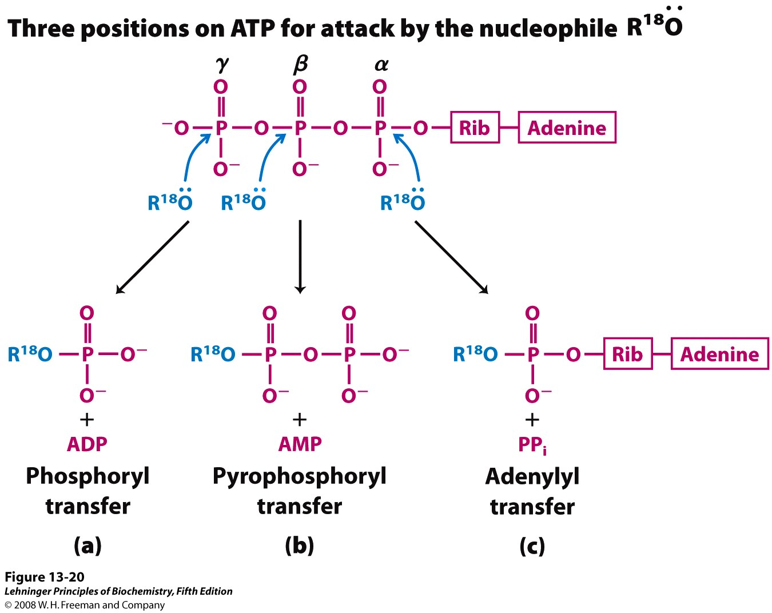
ATP may transfer additional functional groups (pyrophosphoryl or adenylyl)
Notes:
FIGURE 13-20 Nucleophilic displacement reactions of ATP. Any of the three P atoms (α, β, or γ) may serve as the electrophilic target for nucleophilic attack—in this case, by the labeled nucleophile R—¹⁸O:. The nucleophile may be an alcohol (ROH), a carboxyl group (RCOO–), or a phosphoanhydride (a nucleoside mono- or diphosphate, for example). (a) When the oxygen of the nucleophile attacks the γ position, the bridge oxygen of the product is labeled, indicating that the group transferred from ATP is a phosphoryl (—PO₃^{2–}), not a phosphate (—OPO₃^{2–}). (b) Attack on the β position displaces AMP and leads to the transfer of a pyrophosphoryl (not pyrophosphate) group to the nucleophile. (c) Attack on the α position displaces PP_{i} and transfers the adenylyl group to the nucleophile.

Slide 18
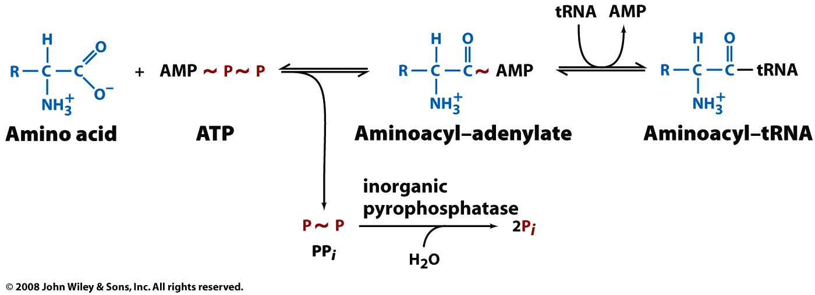
Adenylyl transfer is used to drive particularly disfavored reactions
Ex: activating amino acids for protein synthesis
ATP hydrolysis to AMP & PP_{i}: ΔG'° = -45.6 kJ/mol
PP_{i} hydrolysis to 2P_{i}: ΔG'° = -19.2 kJ/mol

Slide 19
Transphosphorylations between nucleotides control relative concentrations
Nucleoside diphosphate kinase:
ATP + NDP ↔ ADP + NTP ΔG'°≈ 0 kJ/mol
(dNDP) (dNTP)
Adenylate kinase:
2ADP ↔ ATP + AMP ΔG'°≈ 0 kJ/mol

Slide 20
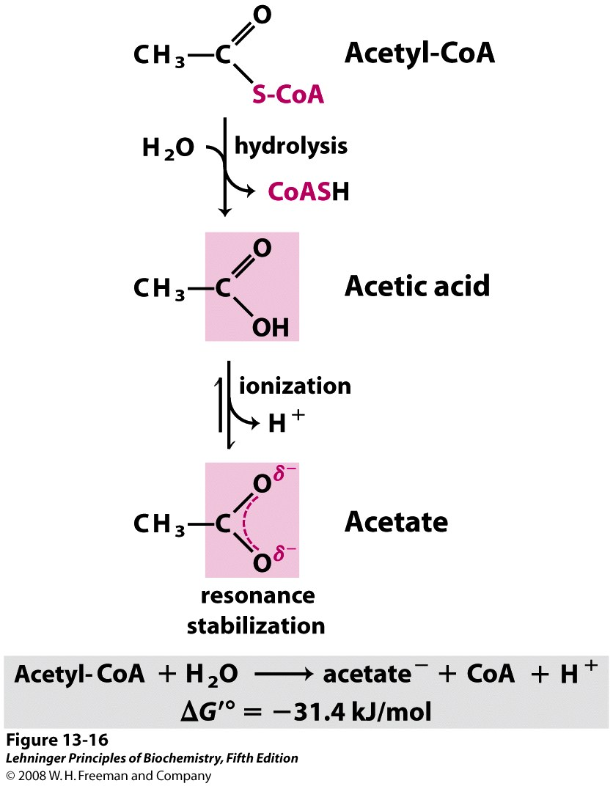
Thioesters also serve as energy currencies, due to large, negative ΔG'° of hydrolysis
Similar ΔG'° of hydrolysis as ATP
Notes:
FIGURE 13-16 Hydrolysis of acetyl-coenzyme A. Acetyl-CoA is a thioester with a large, negative, standard free energy of hydrolysis. Thioesters contain a sulfur atom in the position occupied by an oxygen atom in oxygen esters. The complete structure of coenzyme A (CoA, or CoASH) is shown in Figure 8-38.

Slide 21
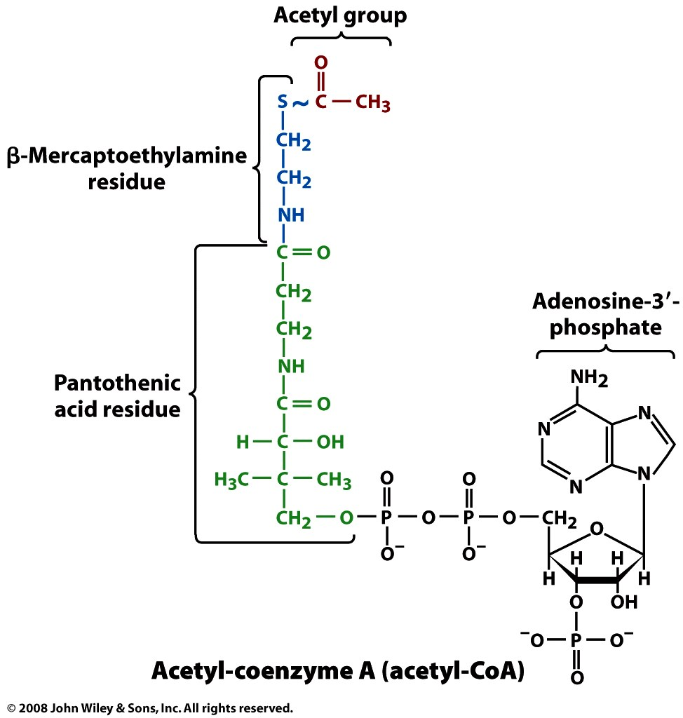
Coenzyme A functions as an acyl-carrier cofactor and thioester energy currency

Slide 22
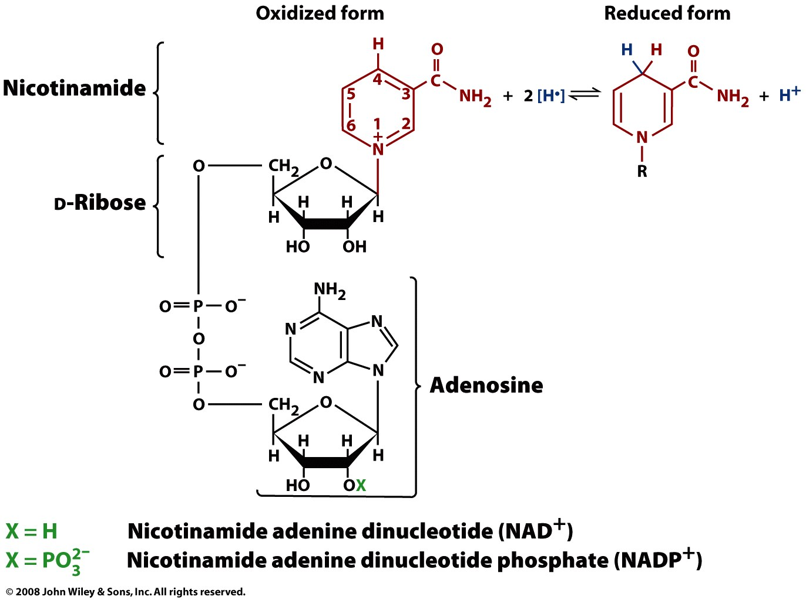
Redox energy currencies transfer reducing power (ex: NAD and NADP)
2 electron, 1 proton carriers
cosubstrates: diffuse between different enzymes
NAD: primarily used in catabolism
NADP: primarily used in anabolism

Slide 23
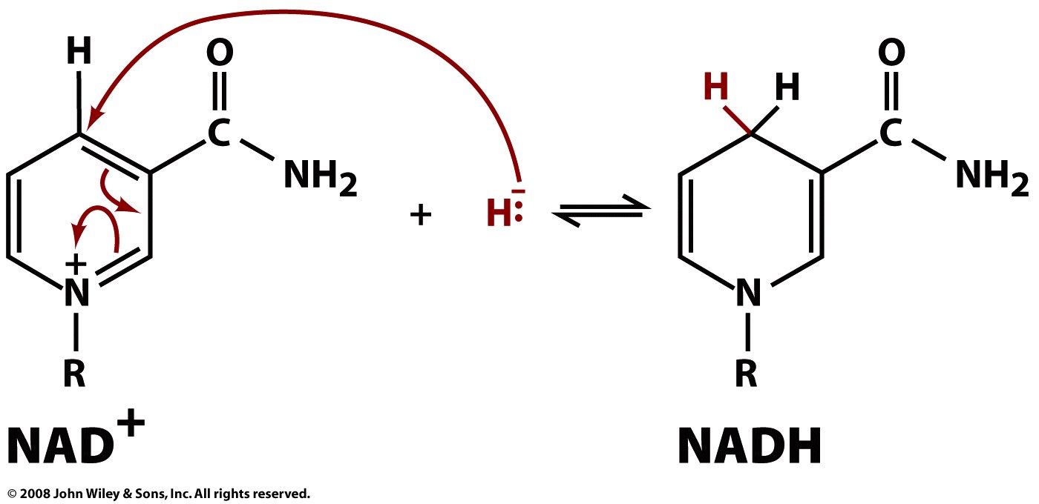
NAD+ accepts a hydride ion to become NADH

Slide 24
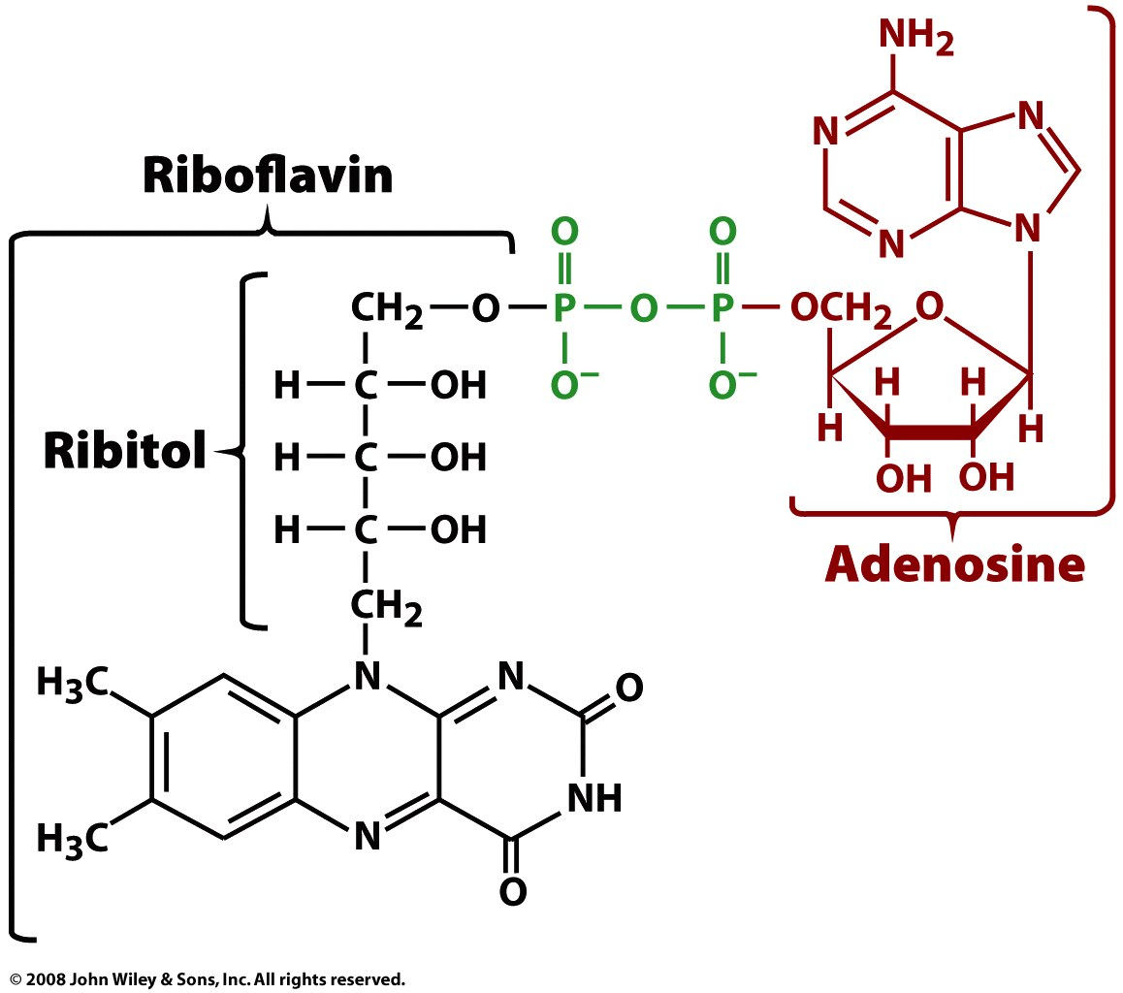
FAD and FMN are other redox currencies
Prosthetic groups: tightly bound to enzyme
Can transfer 1 or 2 electrons (plus 1 or 2 protons)

Slide 25
