Slide 1
How are enzymes regulated?
By controlling their concentration
Control of synthesis (activation or repression)
Degradation
By controlling the availability of substrate
Production, degradation, compartmentation of substrate
Reversible binding of competitive inhibitors
By controlling the activity of the enzyme
Reversible binding of modulators/effectors
Reversible or irreversible covalent modification

Slide 2
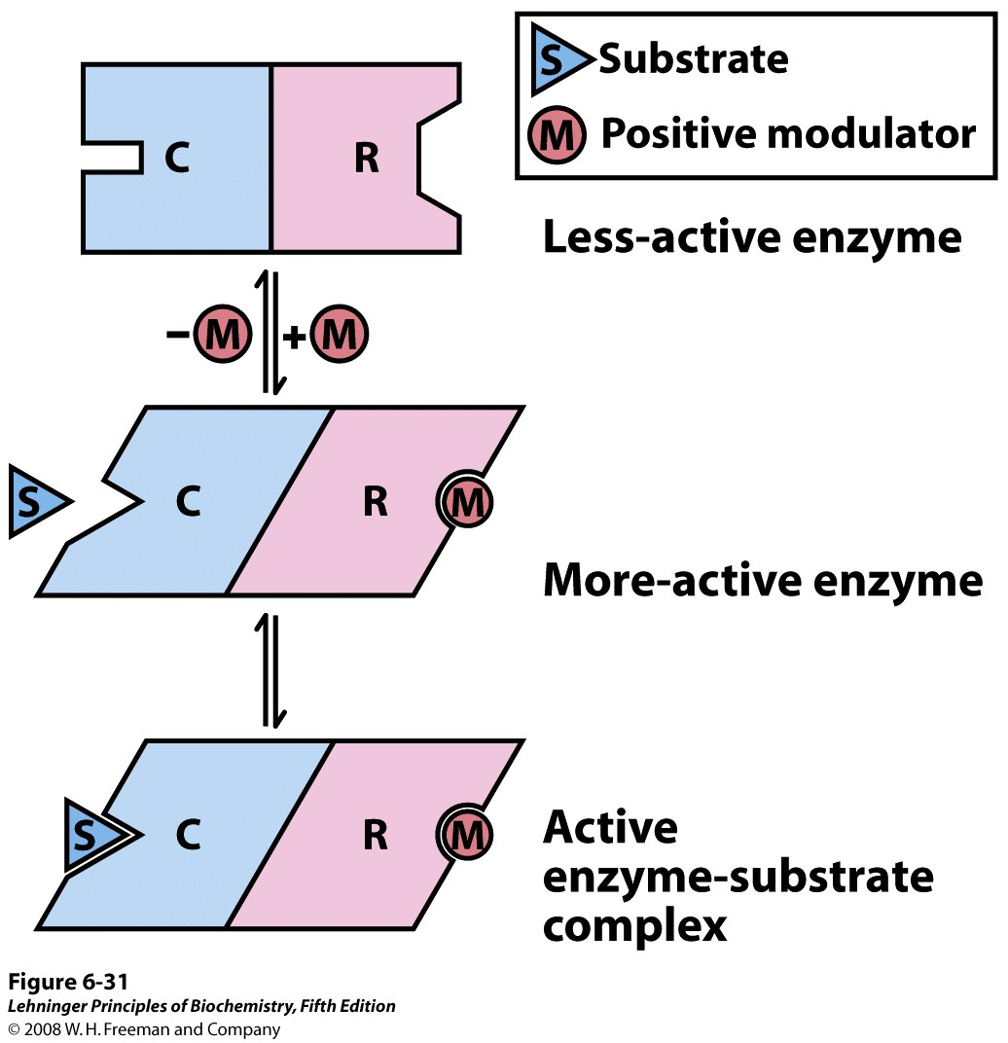
Modulator binding to an allosteric enzyme influences the shape of the active site
Many allosteric enzymes have separate subunits for binding a modulator (regulatory subunit, R) & for catalyzing the reaction (catalytic subunit, C)
Notes:
FIGURE 6-31 Subunit interactions in an allosteric enzyme, and interactions with inhibitors and activators. In many allosteric enzymes the substrate binding site and the modulator binding site(s) are on different subunits, the catalytic (C) and regulatory (R) subunits, respectively. Binding of the positive (stimulatory) modulator (M) to its specific site on the regulatory subunit is communicated to the catalytic subunit through a conformational change. This change renders the catalytic subunit active and capable of binding the substrate (S) with higher affinity. On dissociation of the modulator from the regulatory subunit, the enzyme reverts to its inactive or less active form.

Slide 3
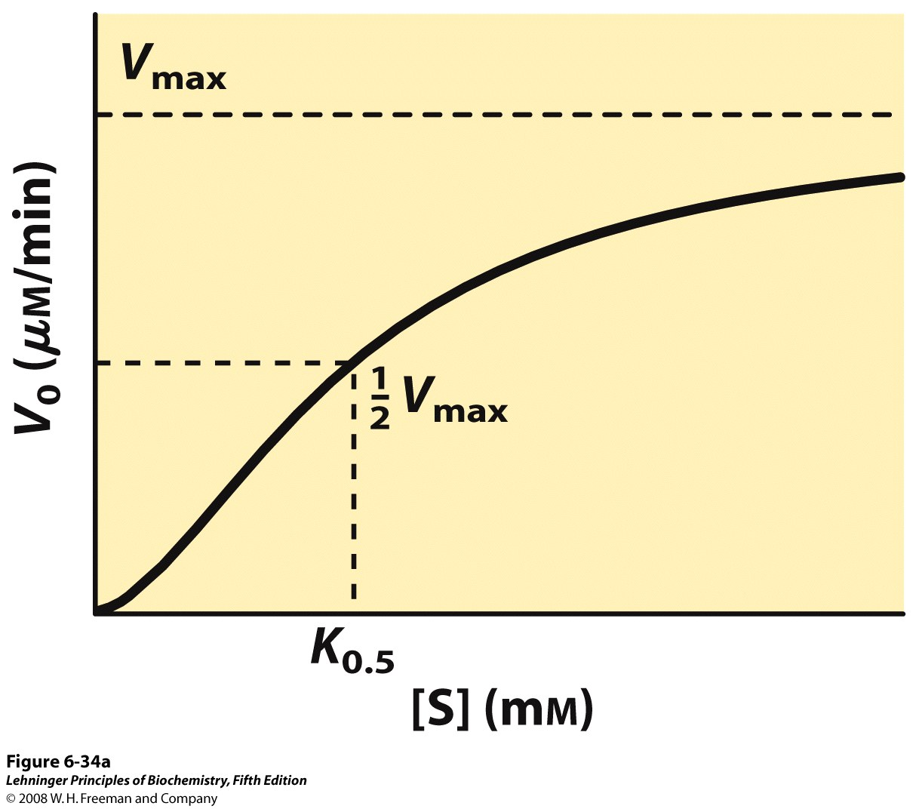
Allosteric enzymes may show sigmoidal kinetics (positive cooperativity)
Q: Why would sigmoidal kinetics be beneficial to an enzyme’s function?
Notes:
FIGURE 6-34a Substrate-activity curves for representative allosteric enzymes. Three examples of complex responses of allosteric enzymes to their modulators. (a) The sigmoid curve of a homotropic enzyme, in which the substrate also serves as a positive (stimulatory) modulator, or activator. Note the resemblance to the oxygen-saturation curve of hemoglobin (see Figure 5-12).

Slide 4
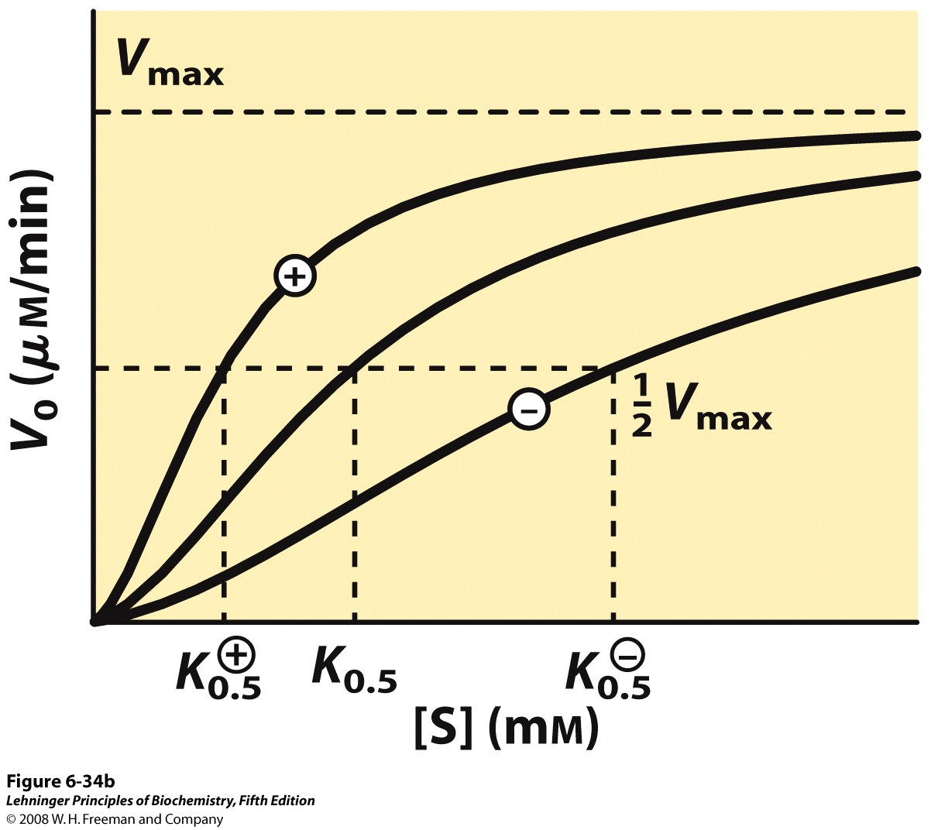
Modulators may affect the enzyme’s K_{0.5}
Notes:
FIGURE 6-34b Substrate-activity curves for representative allosteric enzymes. Three examples of complex responses of allosteric enzymes to their modulators. (b) The effects of a positive modulator (+) and a negative modulator (–) on an allosteric enzyme in which K_{0.5} is altered without a change in V_{max}. The central curve shows the substrateactivity relationship without a modulator.

Slide 5
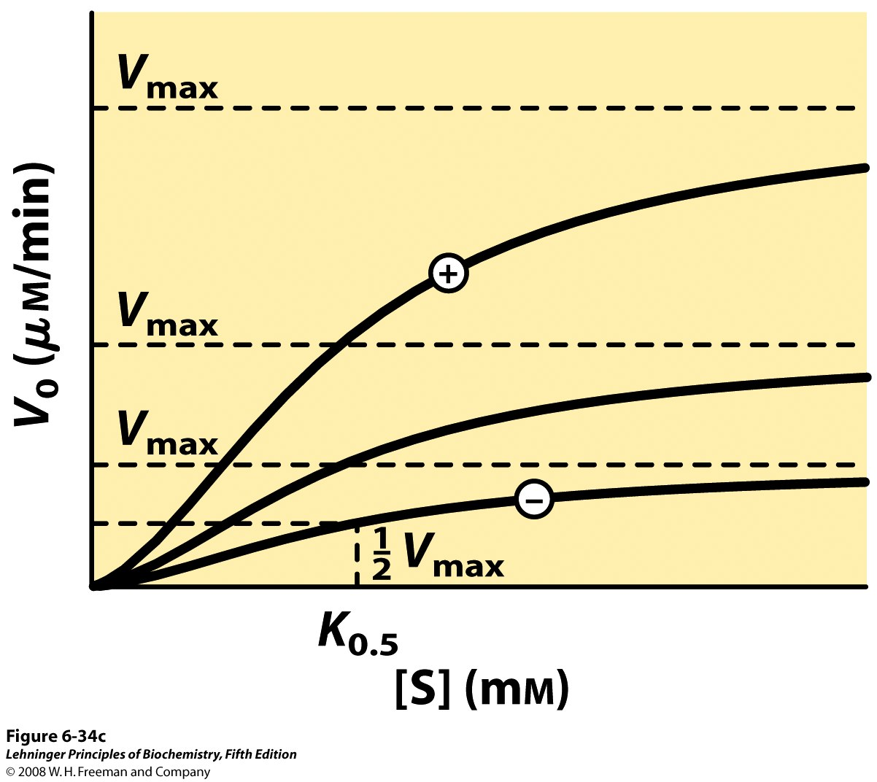
Modulators may affect the enzyme’s V_{max}
Notes:
FIGURE 6-34c Substrate-activity curves for representative allosteric enzymes. Three examples of complex responses of allosteric enzymes to their modulators. (c) A less common type of modulation, in which V_{max} is altered and K_{0.5} is nearly constant.

Slide 6
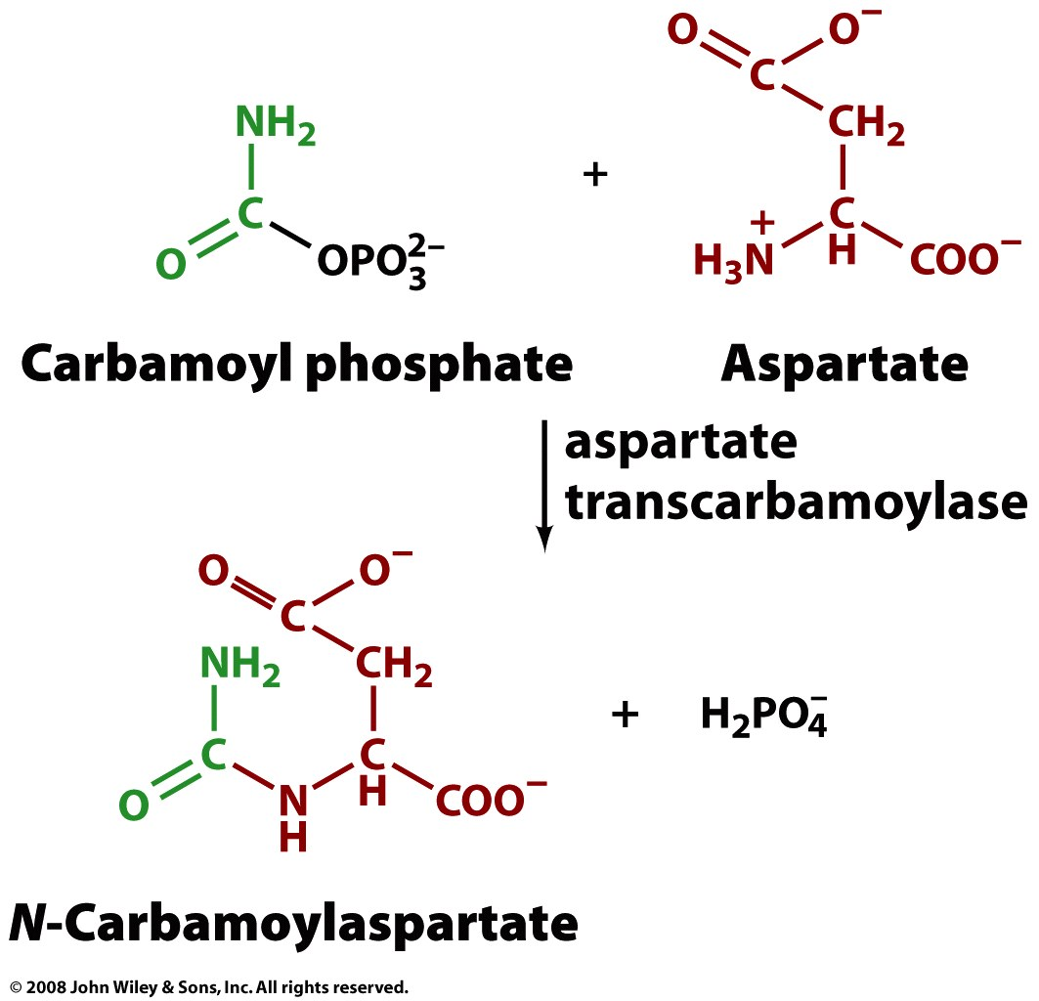
An allosteric enzyme catalyzes the first step of pyrimidine (C, T, U) nucleotide synthesis
(ATCase)

Slide 7
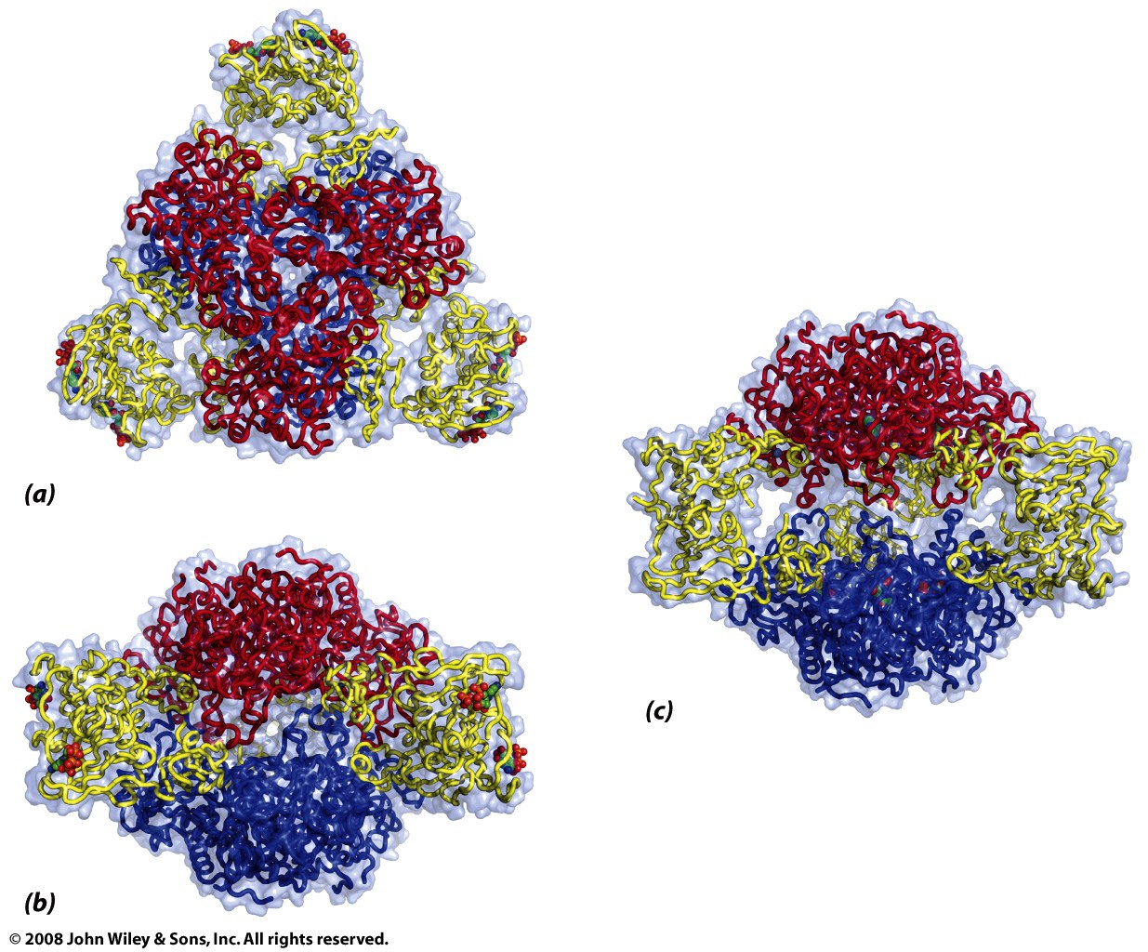
ATCase is composed of six catalytic and six regulatory subunits
2 trimers of catalytic subunits (red, blue)
3 dimers of regulatory subunits (yellow)
R-state
T-state
“the regulatory subunits allosterically reduce the activity of the catalytic subunits in the intact enzyme”

Slide 8
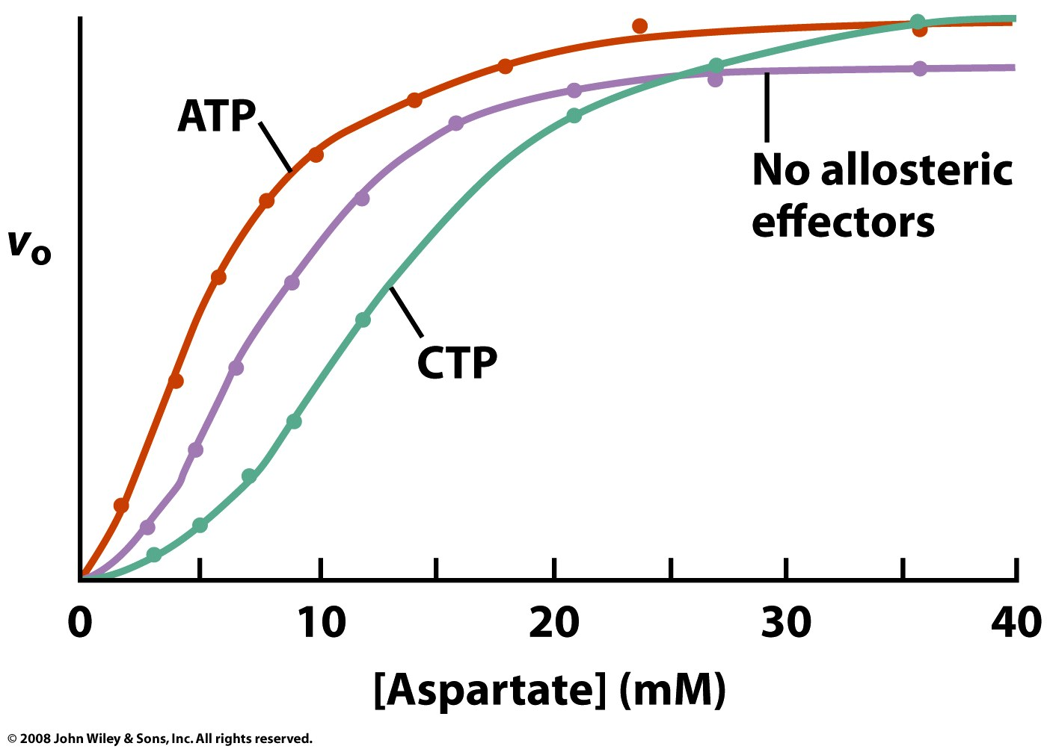
ATCase exhibits both homotropic and heterotropic interactions
Binds regulatory subunits and stabilizes R-state
Binds regulatory subunits and stabilizes T-state

Slide 9
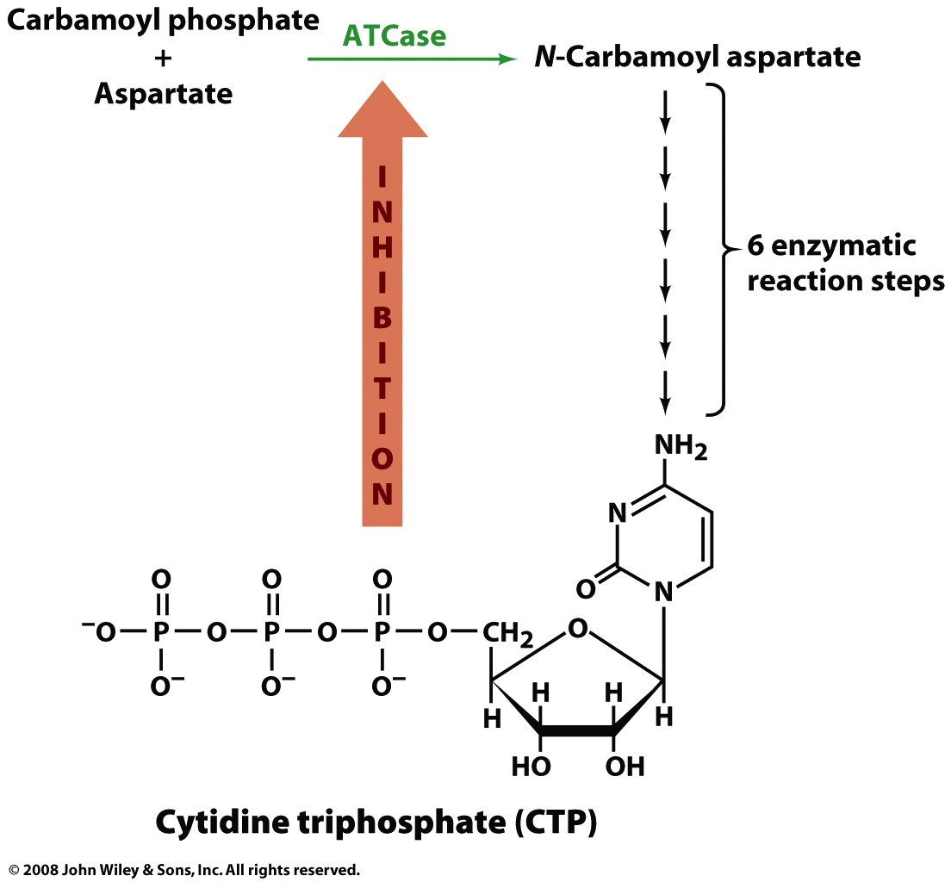
The modulator CTP is a feedback inhibitor

Slide 10
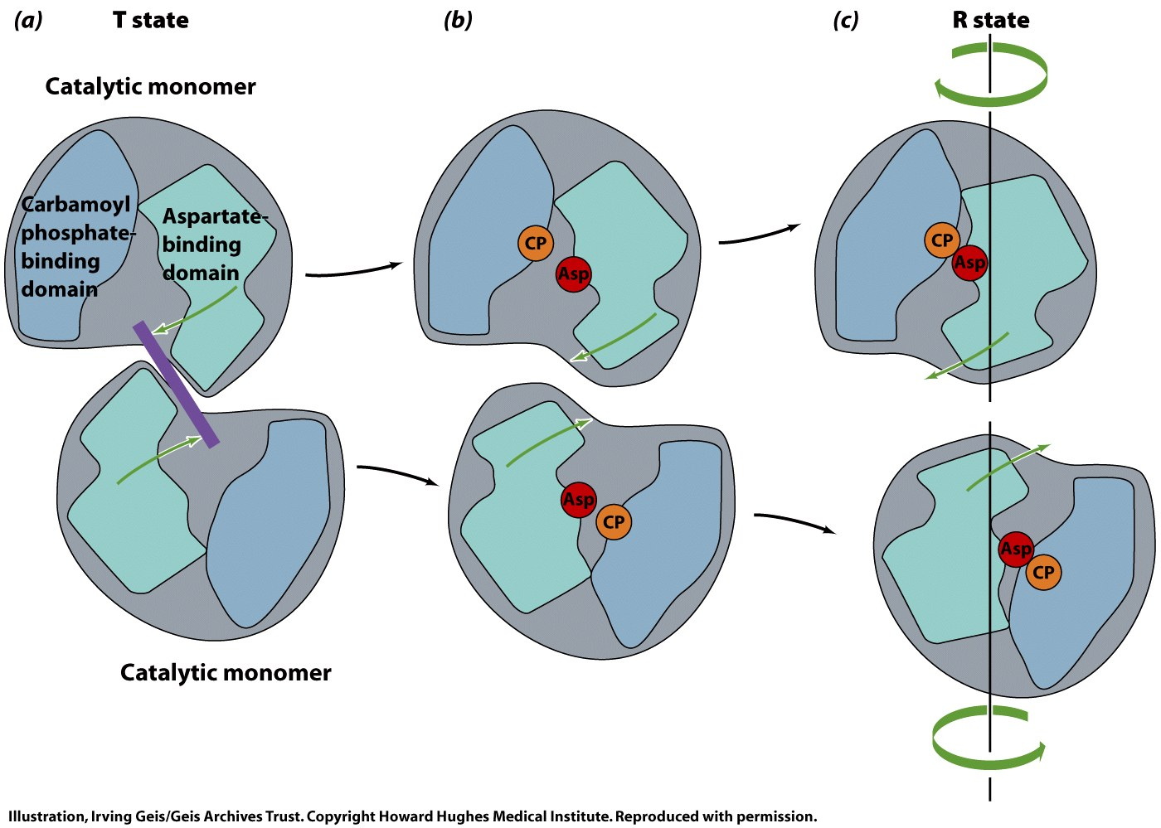
Binding of the substrates to ATCase induces a conformational change from T→R
Domains of active site cannot close because of steric hindrance from neighboring subunit
Substrate binding promotes separation of subunits, allowing domain closure

Slide 11
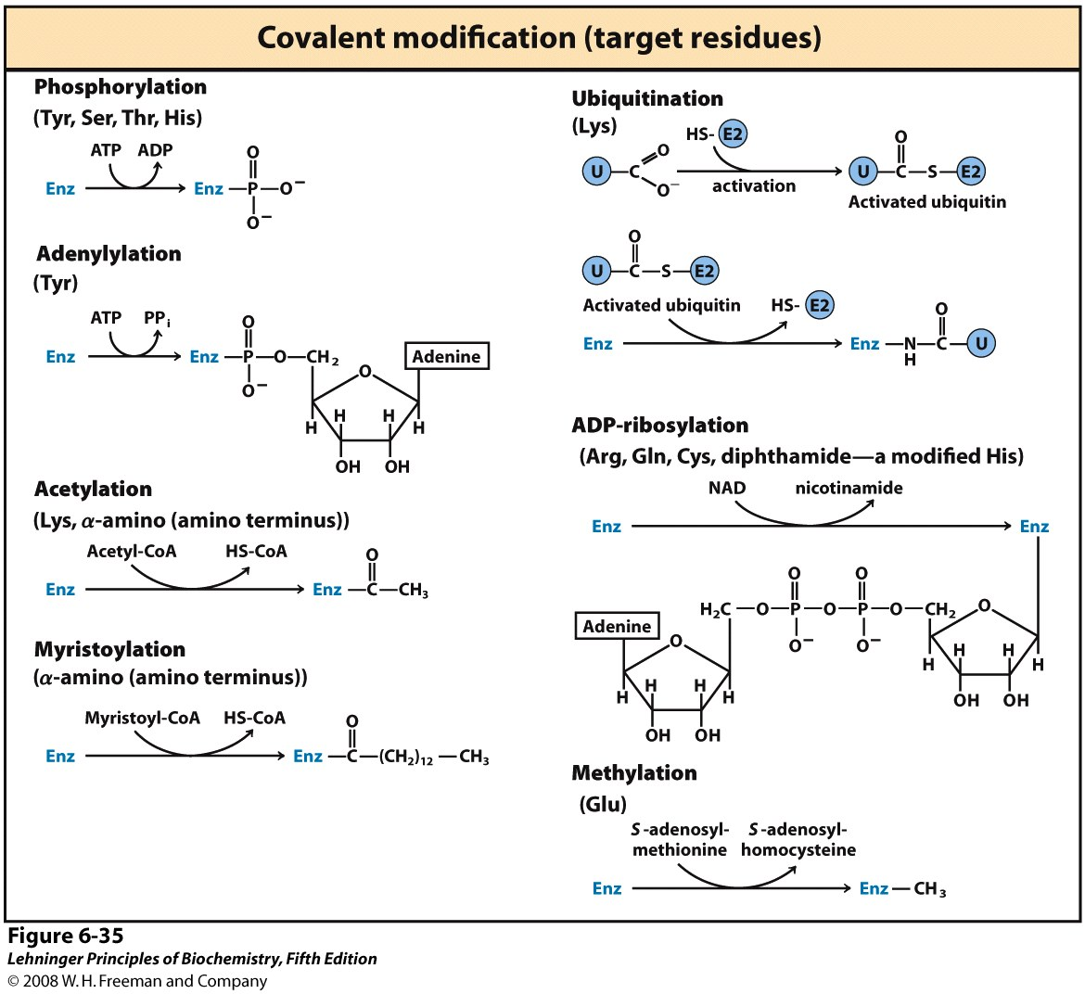
Enzymes may undergo many different types of covalent modification (over 500 possible!)
Notes:
FIGURE 6-35 Some enzyme modification reactions.

Slide 12
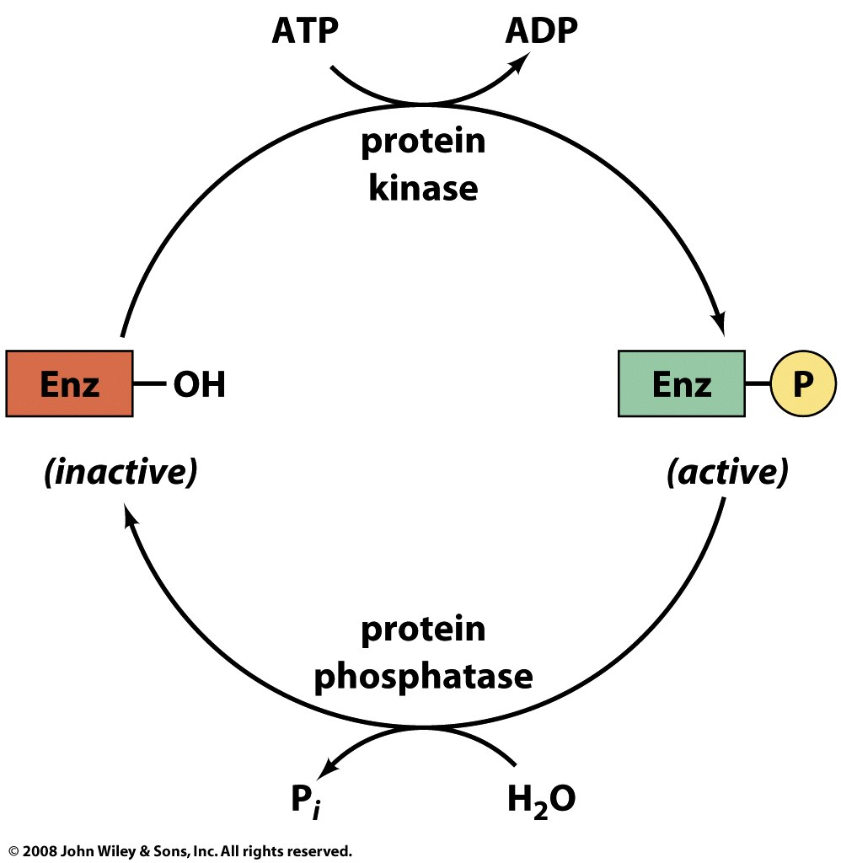
Reversible phosphorylation is a common modification for regulating enzyme activity

Slide 13
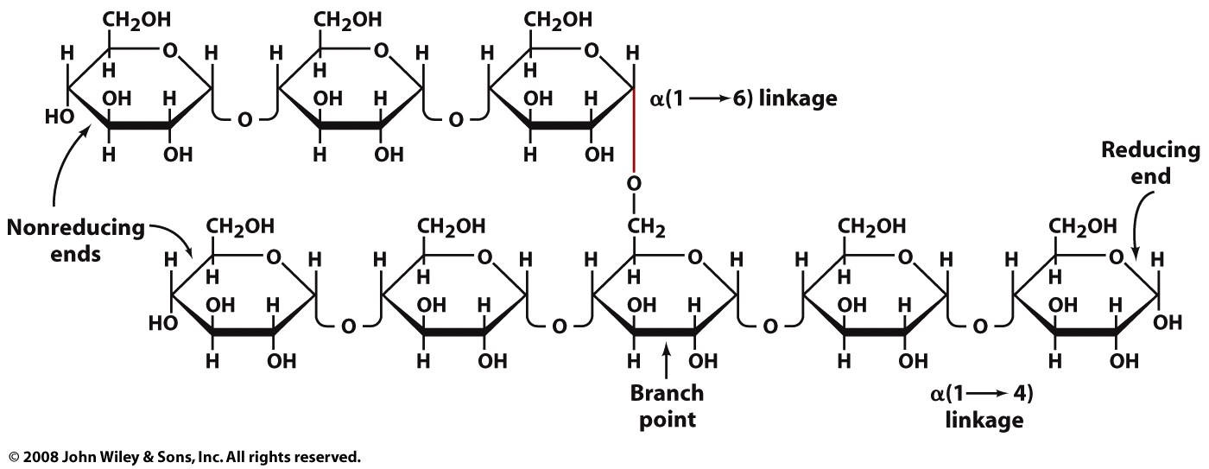
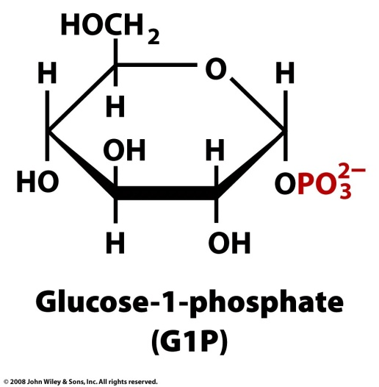
Glycogen phosphorylase catalyzes the rate-controlling step in glycogen breakdown
+ P_{i}
Glycogen_{(n-1)} +

Slide 14
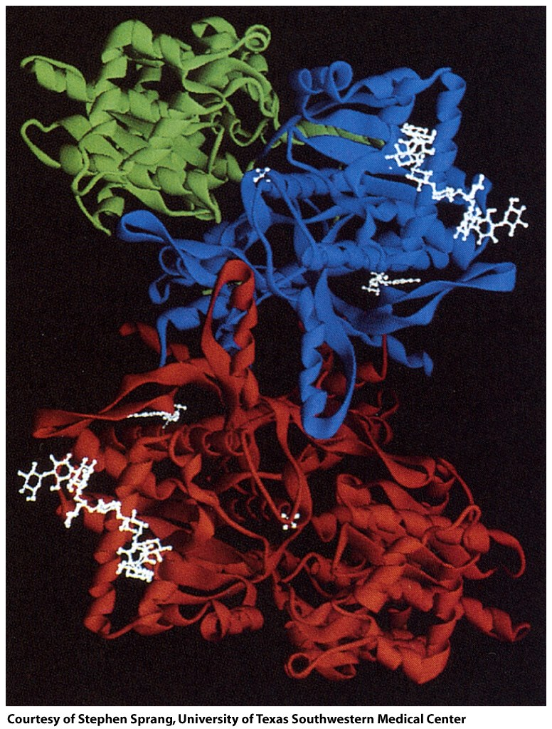
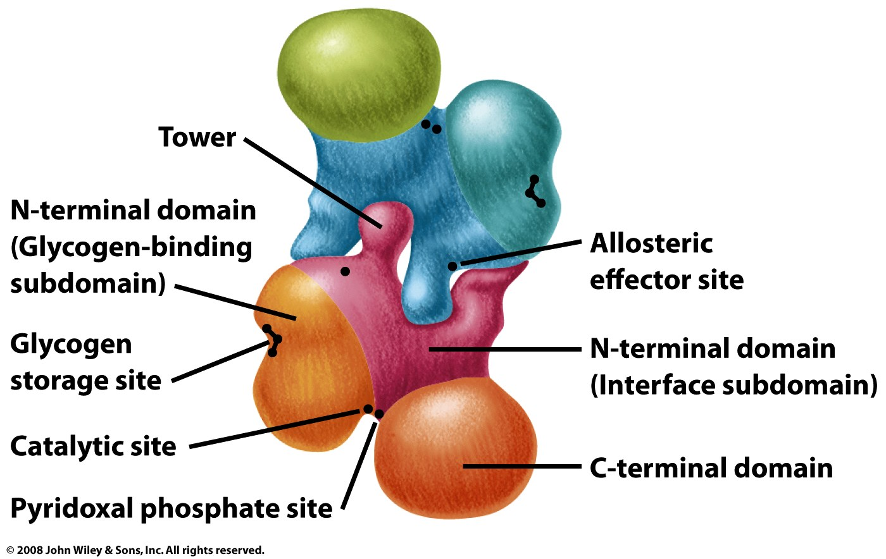
Glycogen phosphorylase is a dimer of two identical subunits

Slide 15
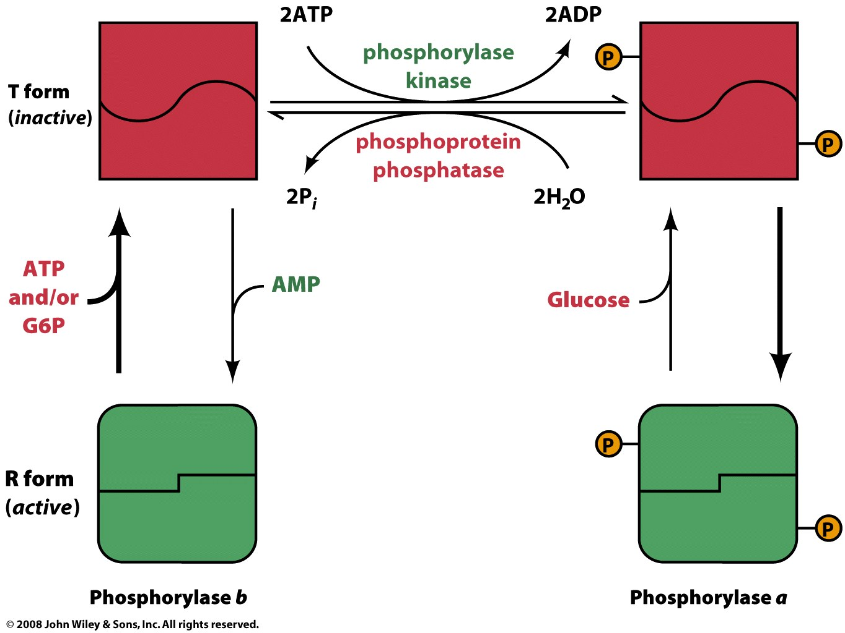
Glycogen phosphorylase is regulated by phosphorylation and binding of modulators

Slide 16
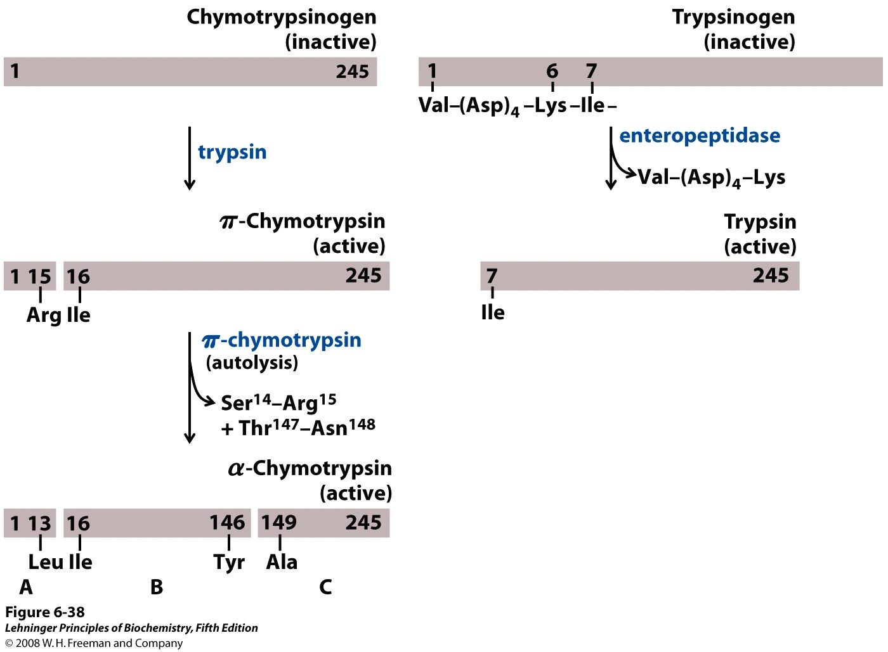
Digestive proteases are regulated through irreversible covalent modification
Notes:
FIGURE 6-38 Activation of zymogens by proteolytic cleavage. Shown here is the formation of chymotrypsin and trypsin from their zymogens, chymotrypsinogen and trypsinogen. The bars represent the amino acid sequences of the polypeptide chains, with numbers indicating the relative positions of the residues (the amino-terminal residue is number 1). Residues at the termini of the polypeptide fragments generated by cleavage are indicated below the bars. Note that in the final active forms, some numbered residues are missing. Recall that the three polypeptide chains (A, B, and C) of chymotrypsin are linked by disulfide bonds (see Figure 6-18).

