Slide 1
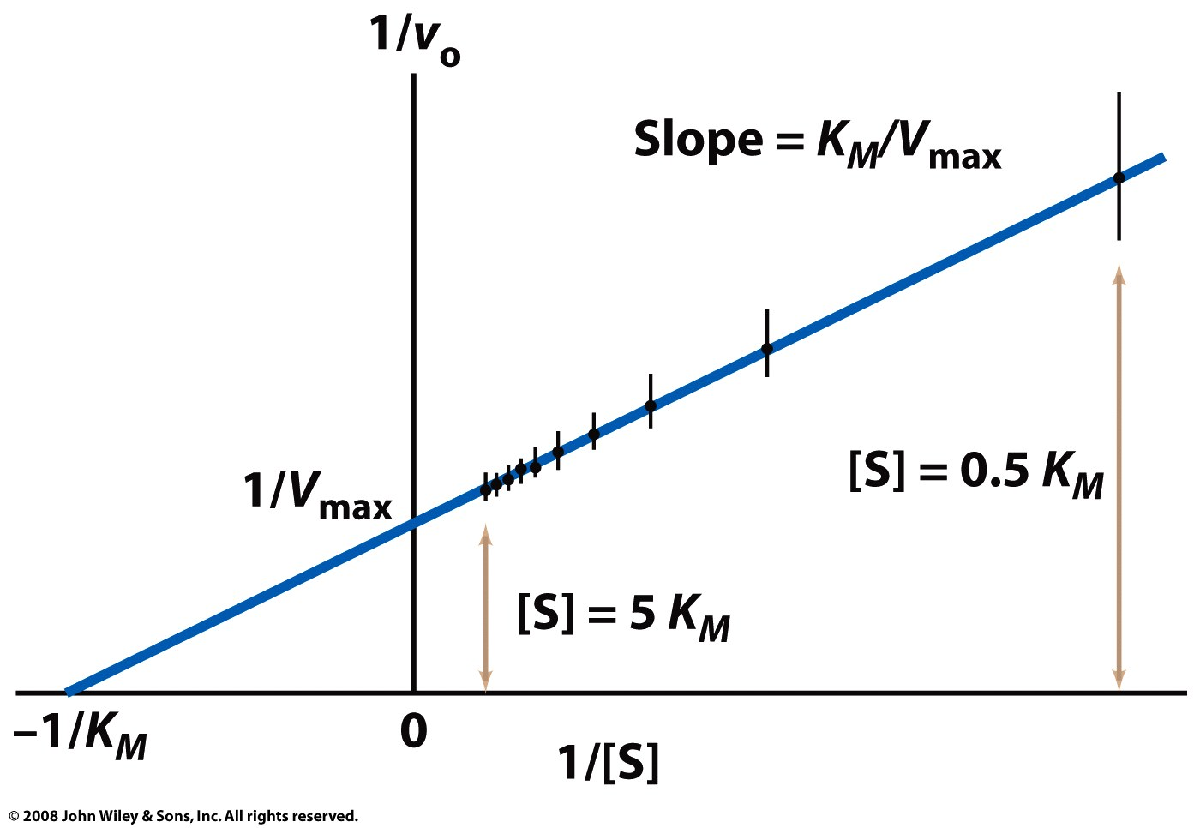
The double-reciprocal (Lineweaver-Burk) plot allows easy calculation of K_{m} and V_{max}

Slide 2
Many factors influence the activity of an enzyme
pH
Temperature
Concentration of molecules that bind to enzyme
Substrate
Reversible inhibitors
Irreversible inhibitors (inactivators)
Allosteric effectors
Covalent modification
Enzyme concentration

Slide 3
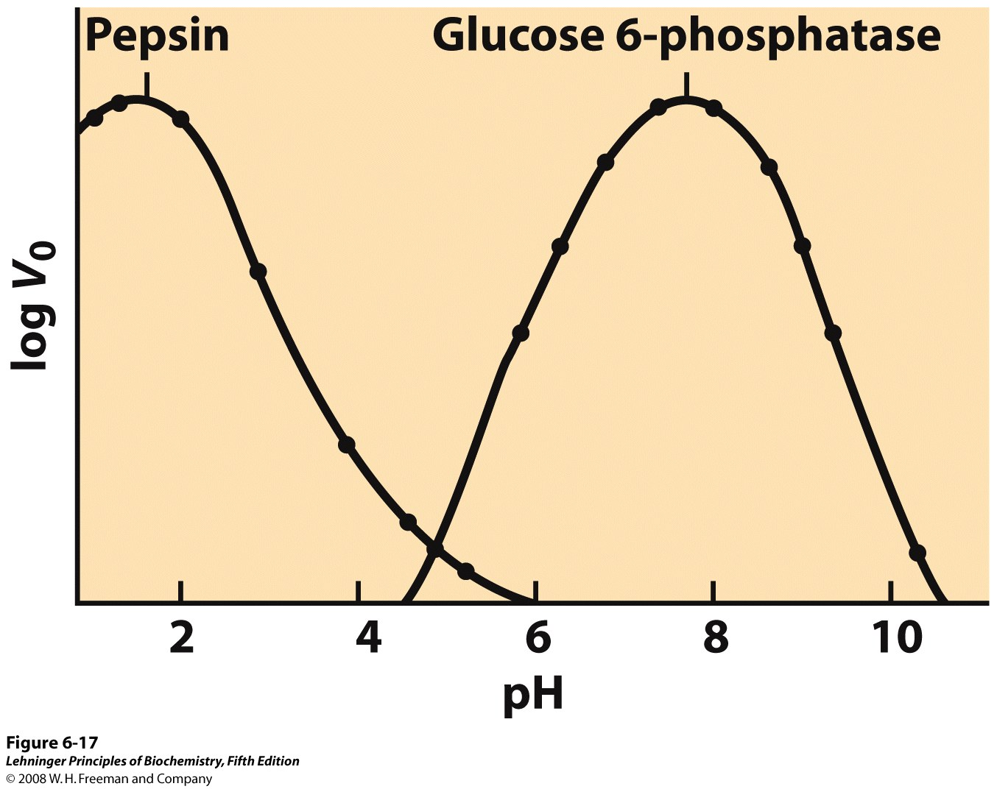
Enzymes show maximum activity at their pH optimum
Notes:
FIGURE 6-17 The pH-activity profiles of two enzymes. These curves are constructed from measurements of initial velocities when the reaction is carried out in buffers of different pH. Because pH is a logarithmic scale reflecting tenfold changes in [H⁺], the changes in V₀ are also plotted on a logarithmic scale. The pH optimum for the activity of an enzyme is generally close to the pH of the environment in which the enzyme is normally found. Pepsin, which hydrolyzes certain peptide bonds of proteins during digestion in the stomach, has a pH optimum of about 1.6. The pH of gastric juice is between 1 and 2. Glucose 6-phosphatase of hepatocytes (liver cells), with a pH optimum of about 7.8, is responsible for releasing glucose into the blood. The normal pH of the cytosol of hepatocytes is about 7.2.

Slide 4
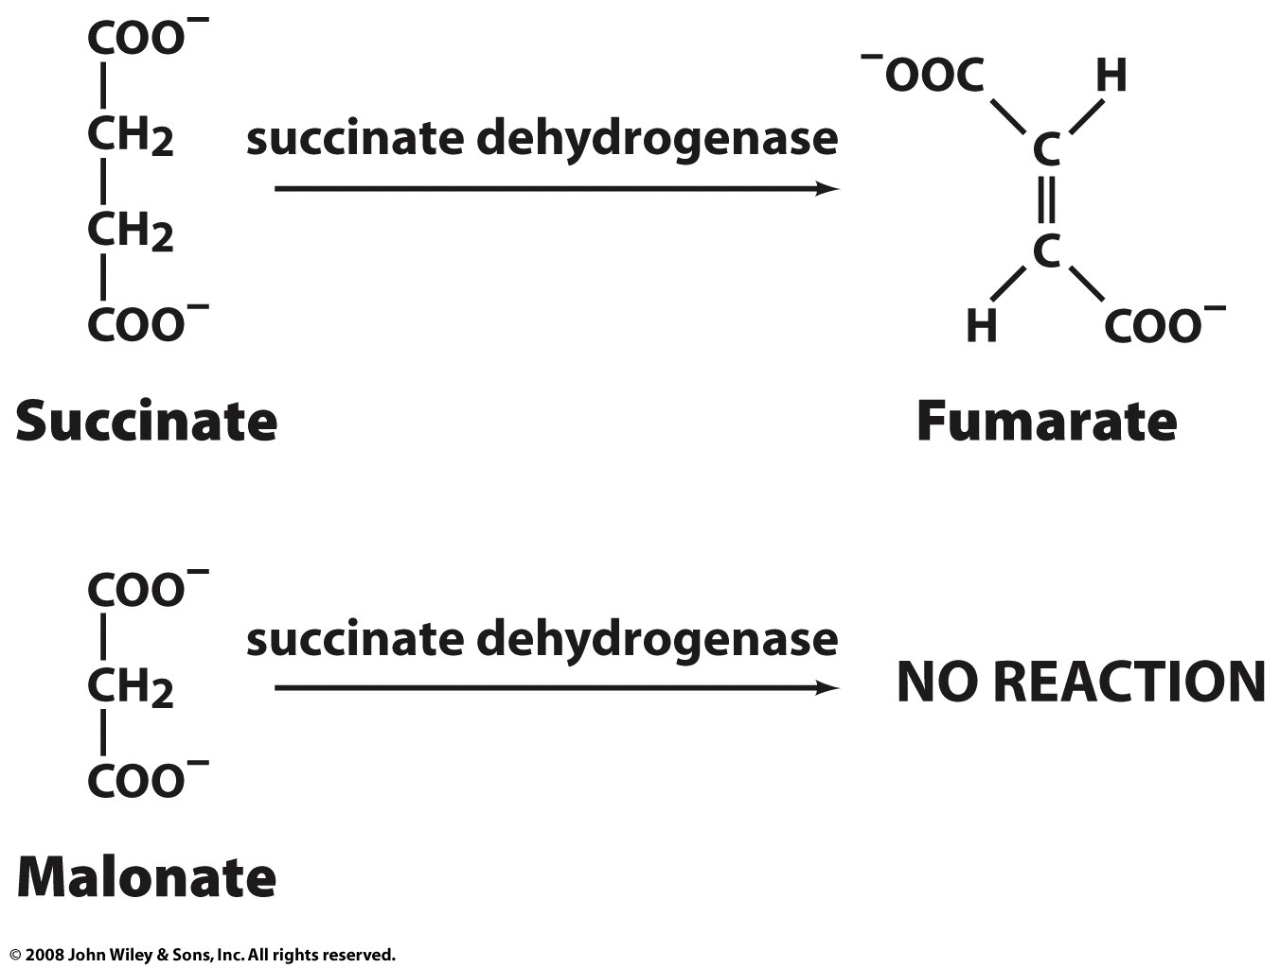
Enzymes can be inhibited by substrate analogs

Slide 5
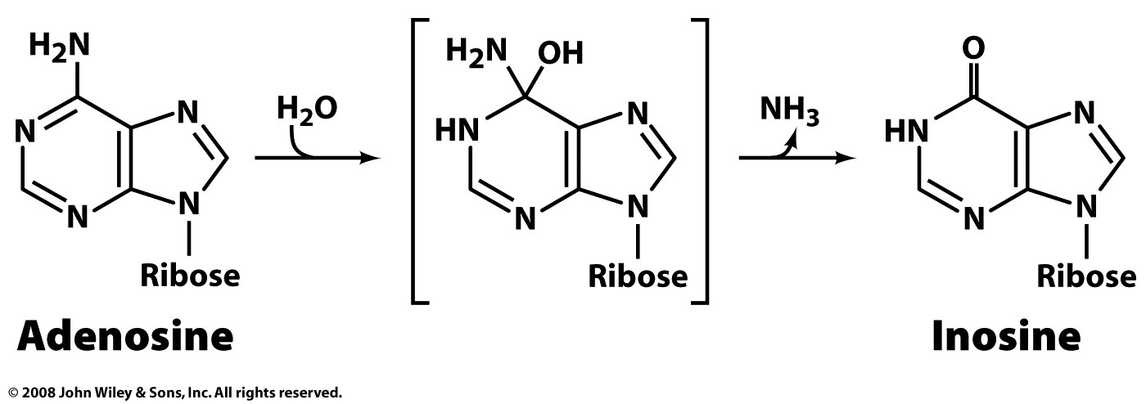
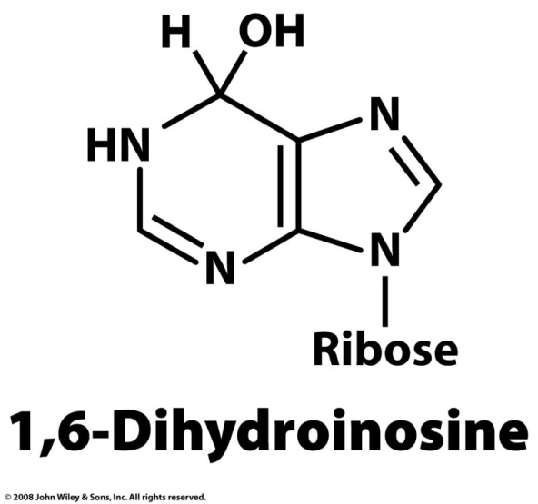
Enzymes are greatly inhibited by transition-state analogs
Adenosine deaminase
Product inhibition:
K_{I} = 3 x 10⁻⁴
K_{m} = 3 x 10⁻⁵
TS analog:
K_{I} = 1.5 x 10⁻¹³

Slide 6
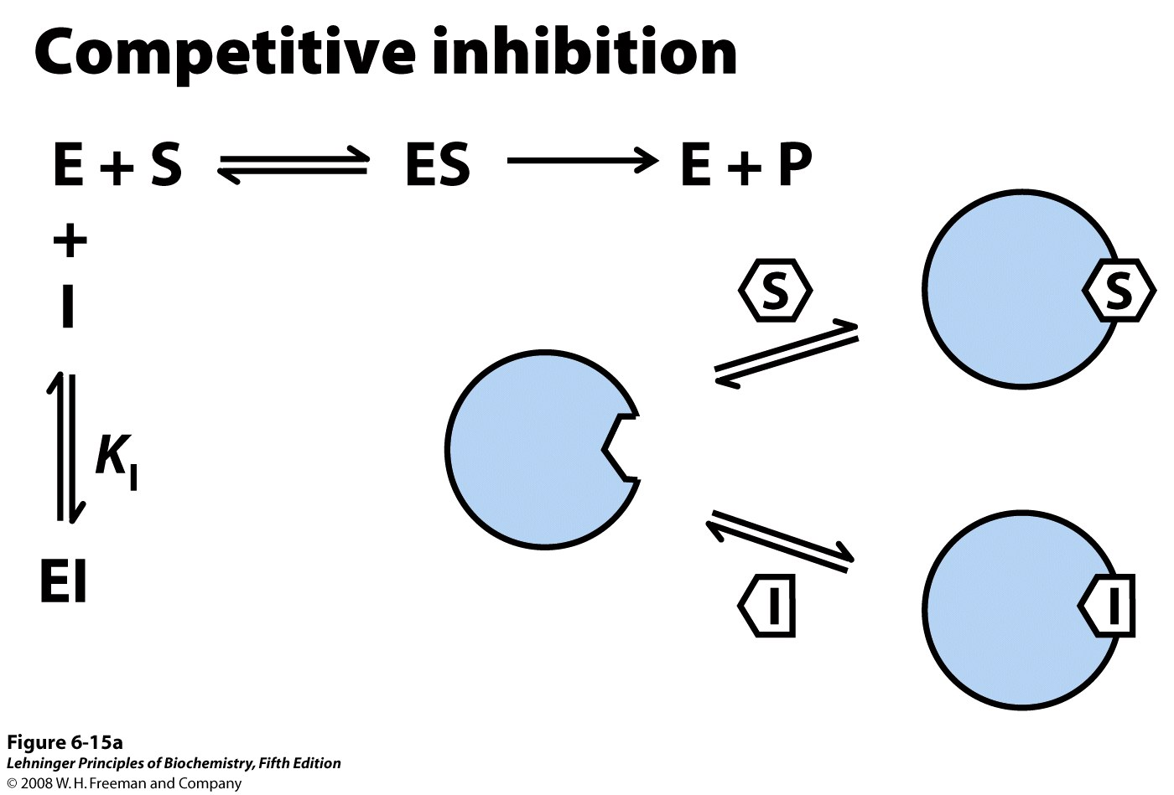
Notes:
FIGURE 6-15a Three types of reversible inhibition. (a) Competitive inhibitors bind to the enzyme's active site; K_{I} is the equilibrium constant for inhibitor binding to E.

Slide 7
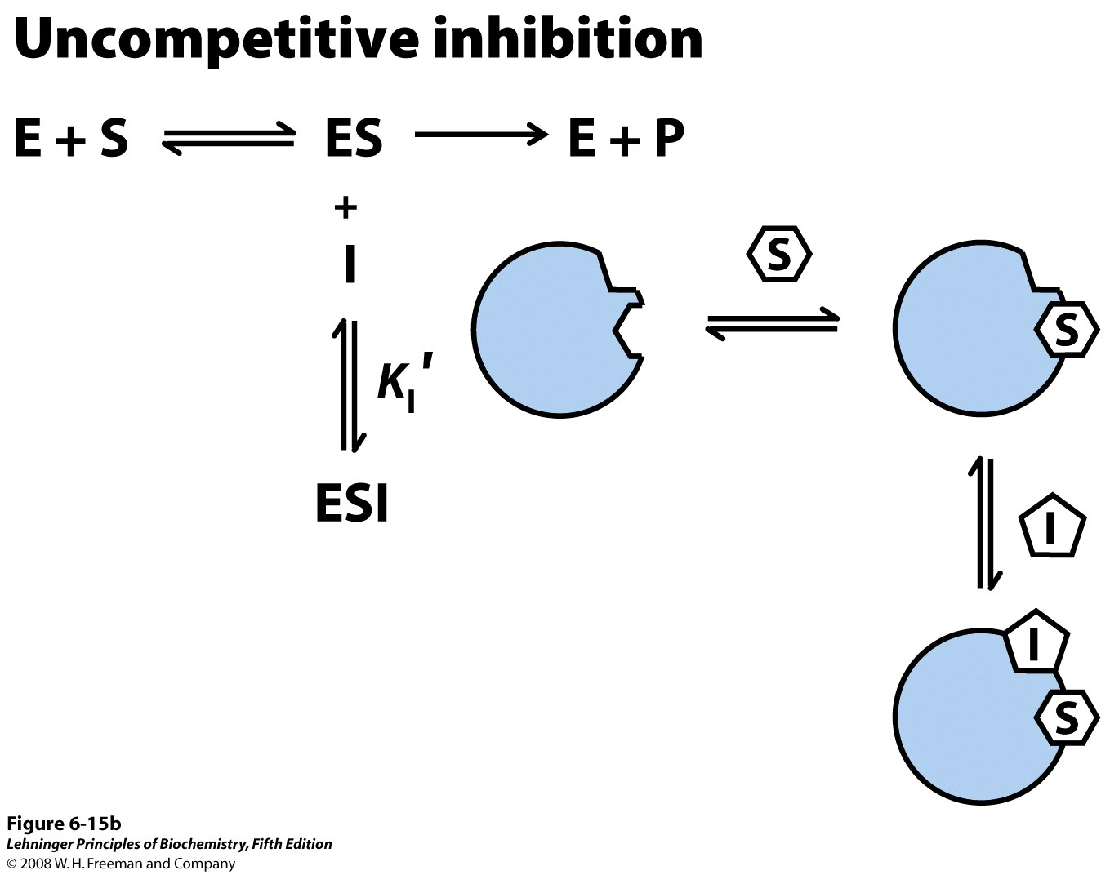
Notes:
FIGURE 6-15b Three types of reversible inhibition. (b) Uncompetitive inhibitors bind at a separate site, but bind only to the ES complex; K_{I}′ is the equilibrium constant for inhibitor binding to ES.

Slide 8
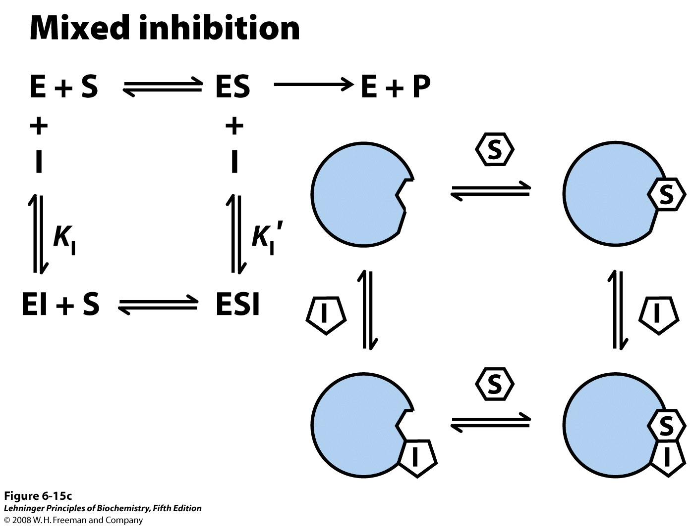
Notes:
FIGURE 6-15c Three types of reversible inhibition. (c) Mixed inhibitors bind at a separate site, but may bind to either E or ES.

Slide 9
Notes:
FIGURE 6-15a Three types of reversible inhibition. (a) Competitive inhibitors bind to the enzyme's active site; K_{I} is the equilibrium constant for inhibitor binding to E.

Slide 10
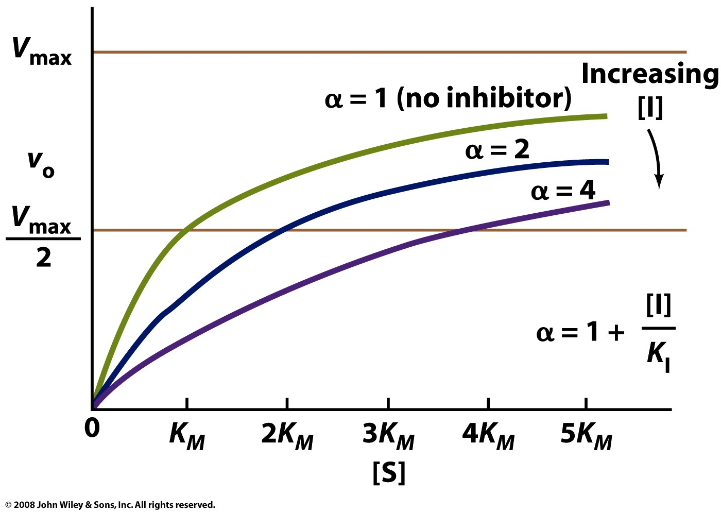
α is the factor by which [S] must be increased to overcome the presence of inhibitor

Slide 11
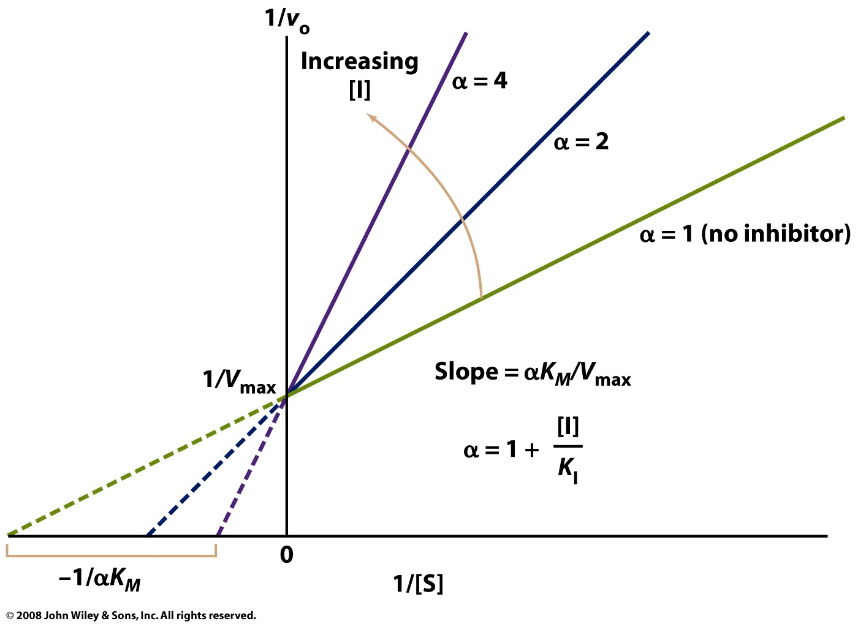

Slide 12
Notes:
FIGURE 6-15b Three types of reversible inhibition. (b) Uncompetitive inhibitors bind at a separate site, but bind only to the ES complex; K_{I}′ is the equilibrium constant for inhibitor binding to ES.

Slide 13
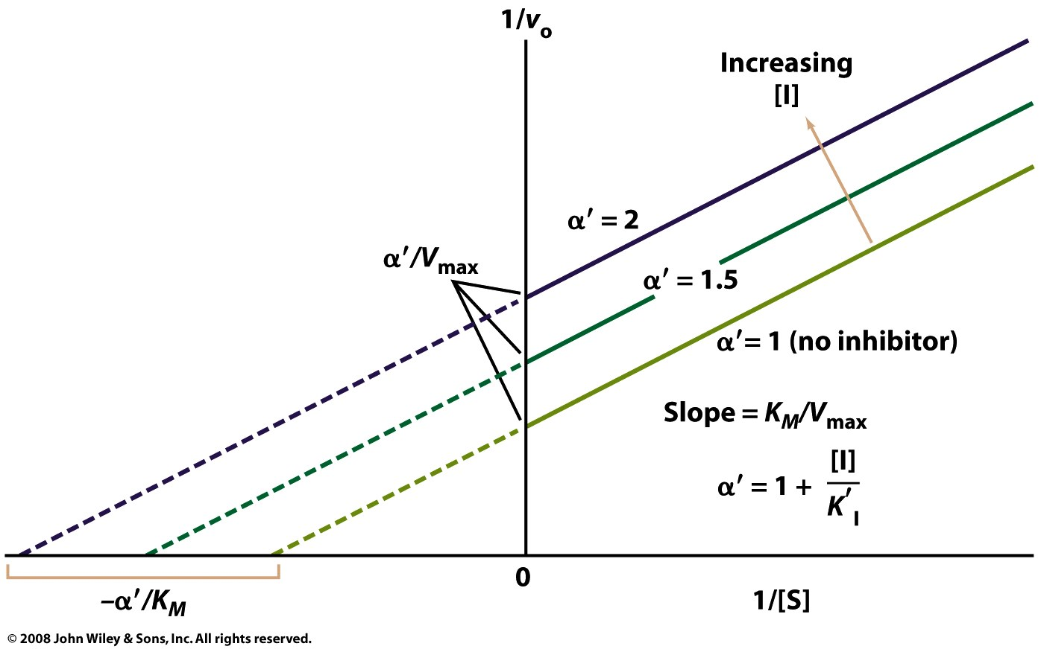

Slide 14
Notes:
FIGURE 6-15c Three types of reversible inhibition. (c) Mixed inhibitors bind at a separate site, but may bind to either E or ES.

Slide 15
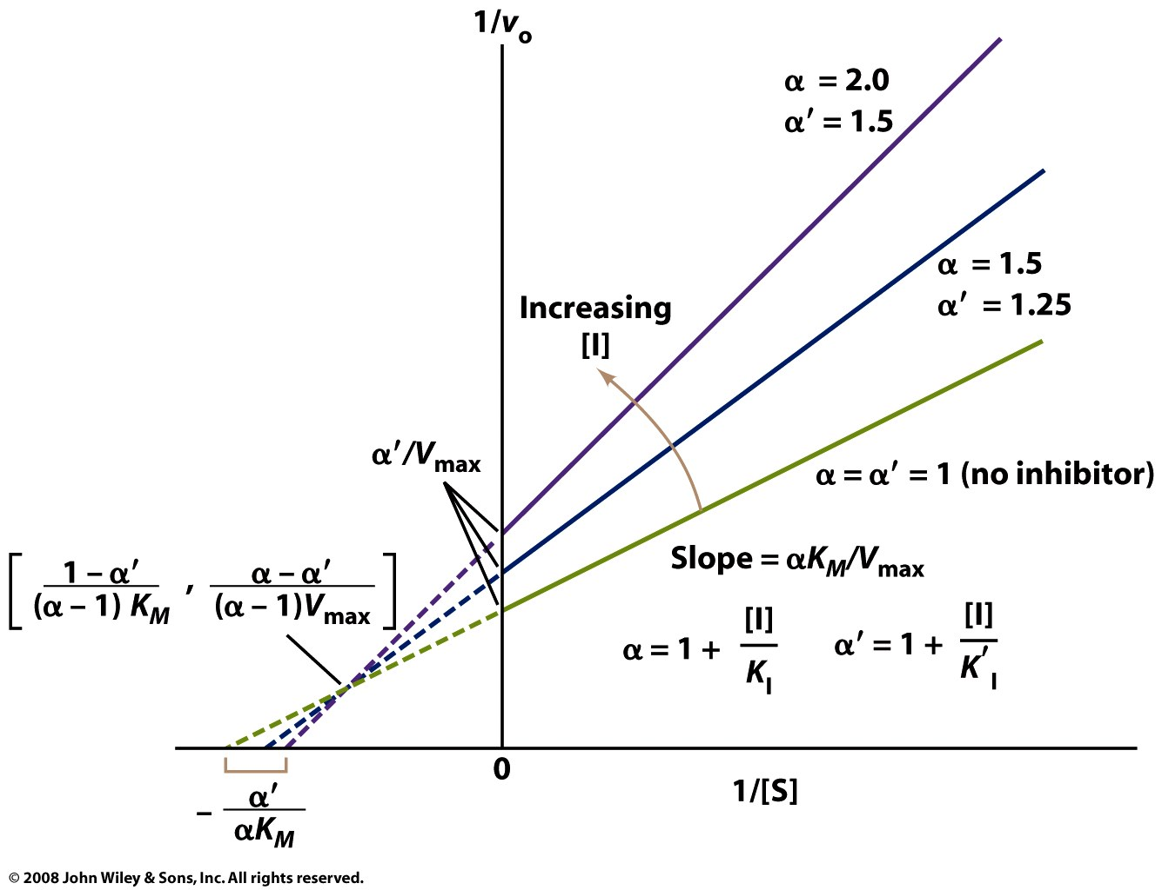

Slide 17
