Slide 1
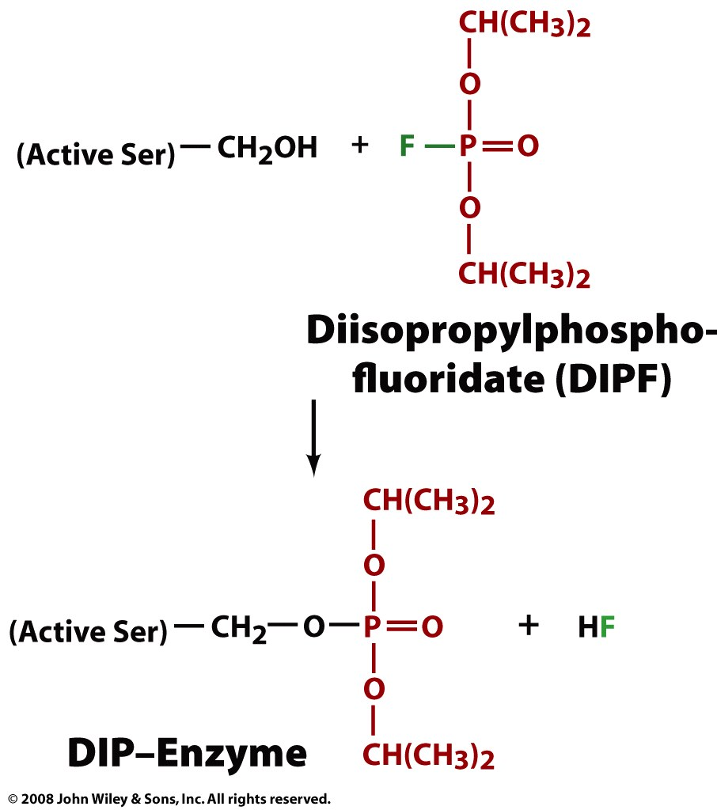
Serine proteases have a reactive serine

Slide 2
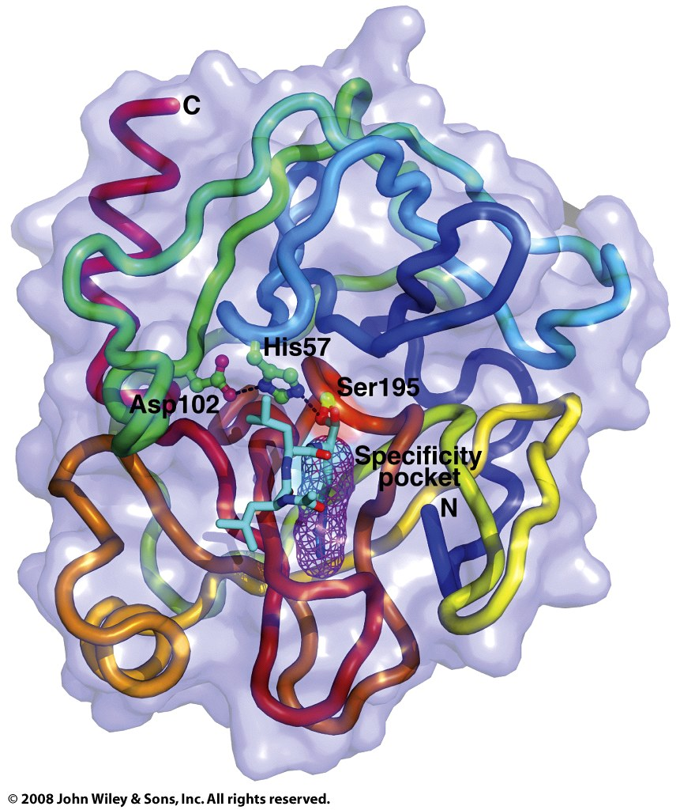
Trypsin is a serine protease

Slide 3
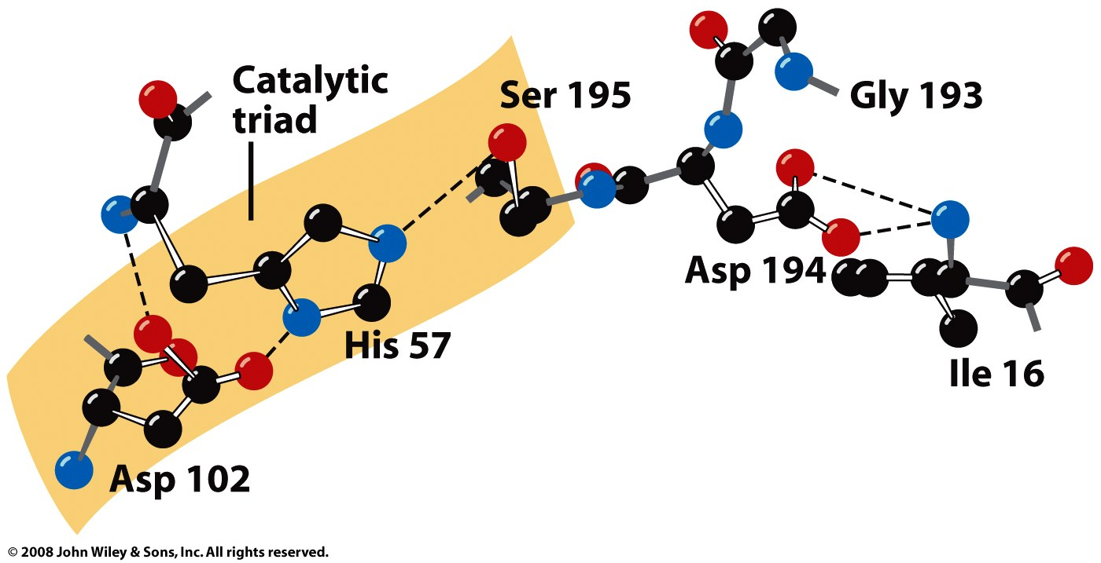
All serine proteases have an active site catalytic triad containing Ser, His, and Asp

Slide 4
Serine proteases differ in their substrate specificity (differing specificity pockets)

Slide 5
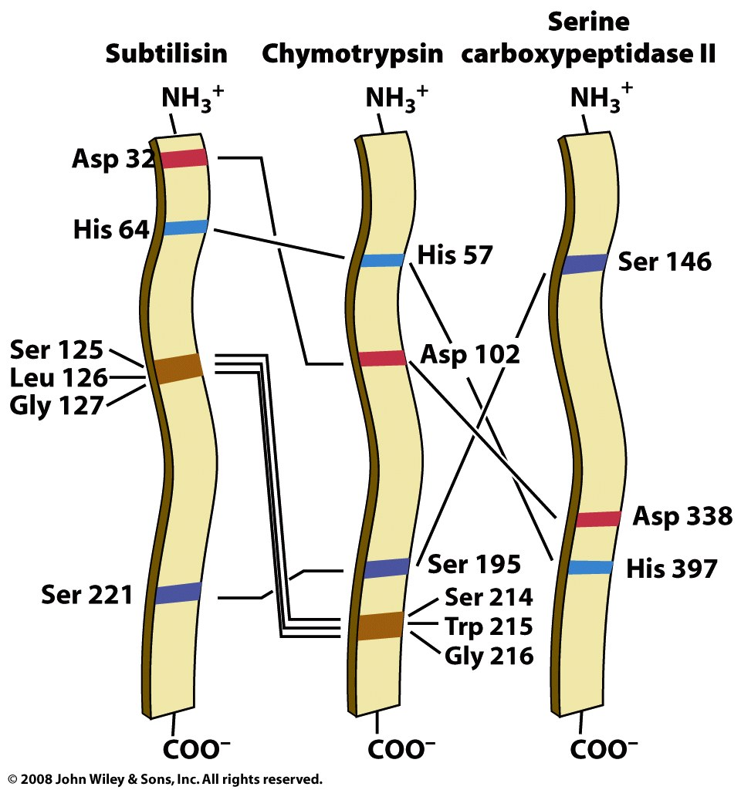
Serine proteases arose through convergent and divergent evolution

Slide 6
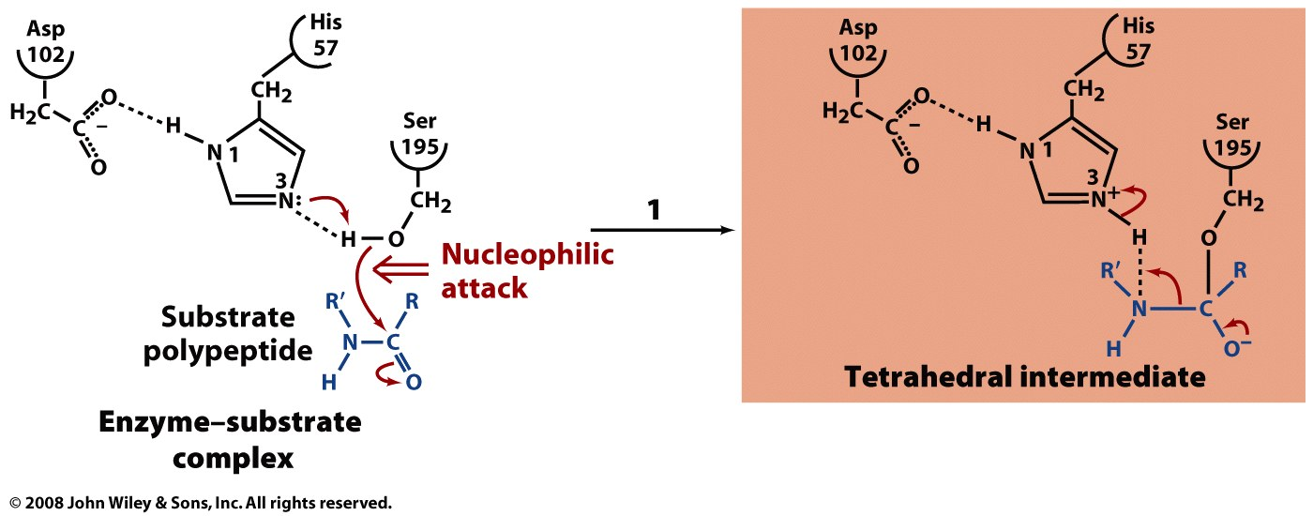
Serine proteases use multiple catalytic mechanisms in the hydrolysis of proteins

Slide 7
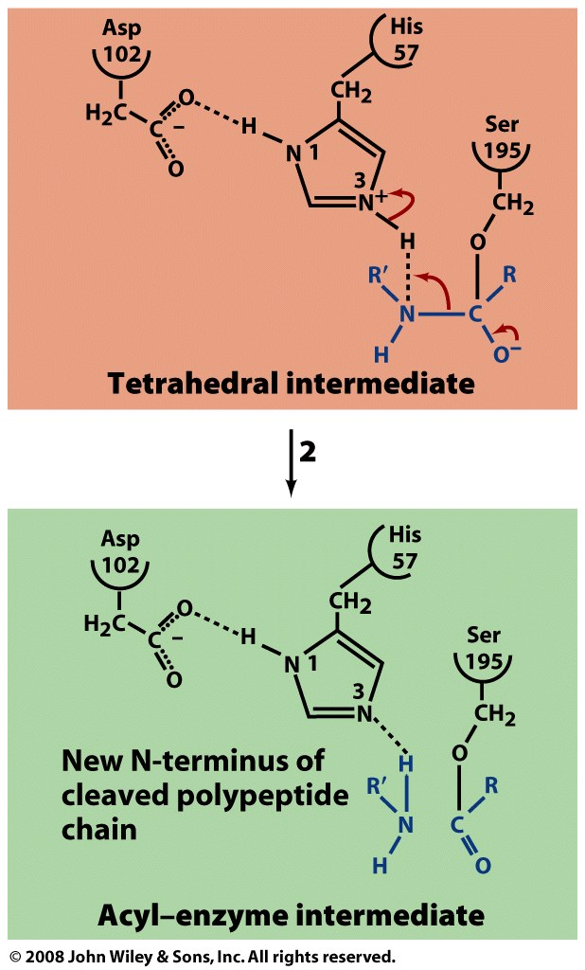

Slide 8
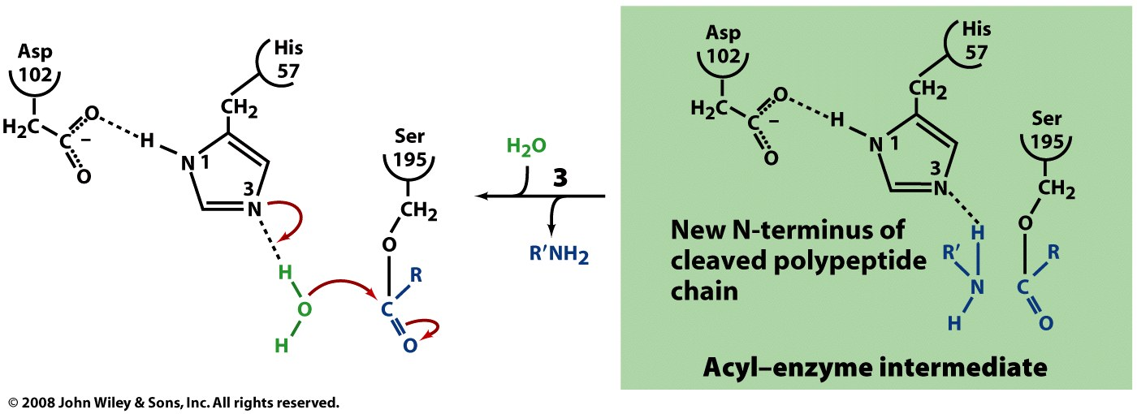

Slide 9
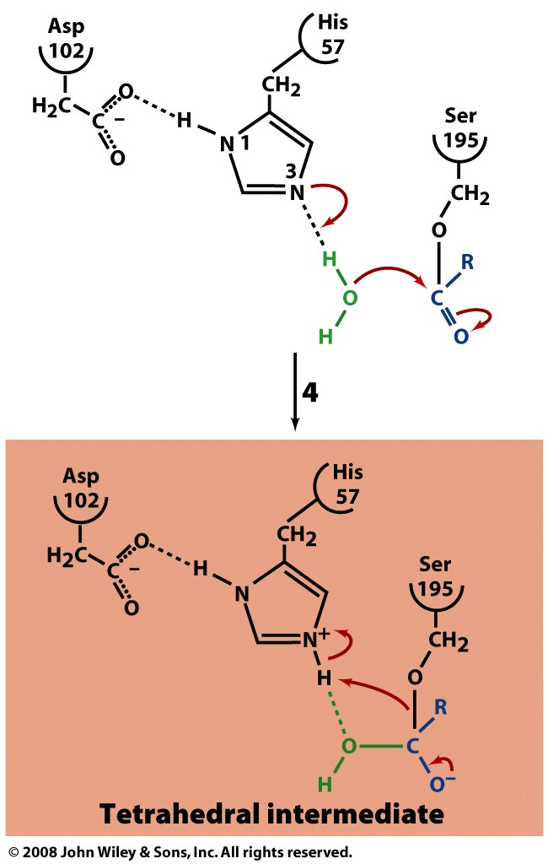

Slide 10
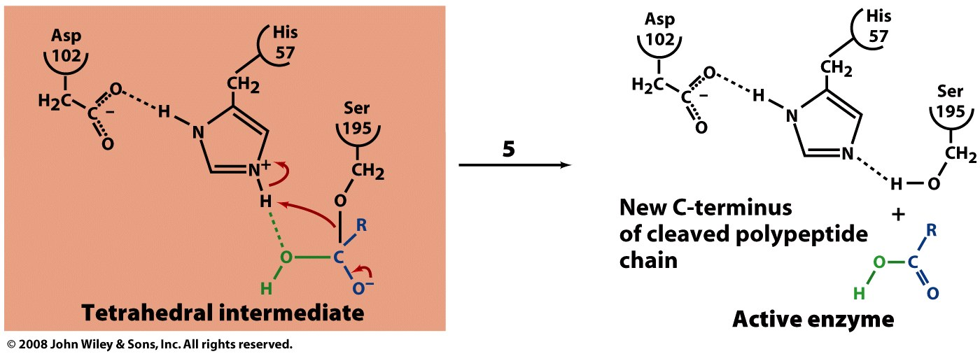

Slide 11
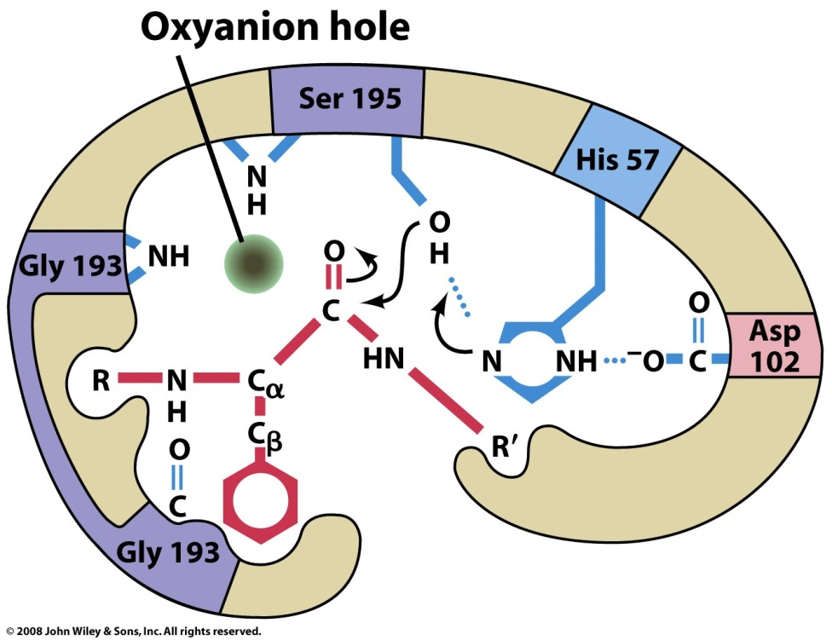
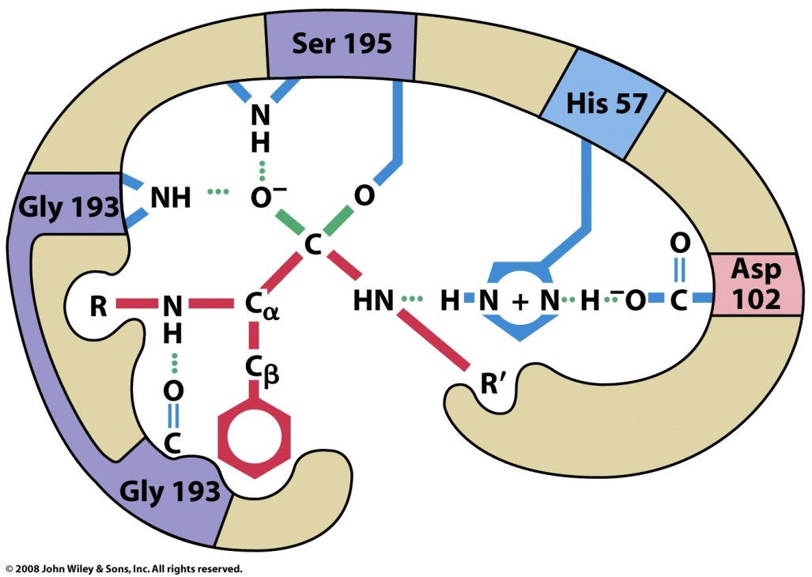
Chymotrypsin preferentially binds the tetrahedral intermediate

Slide 12
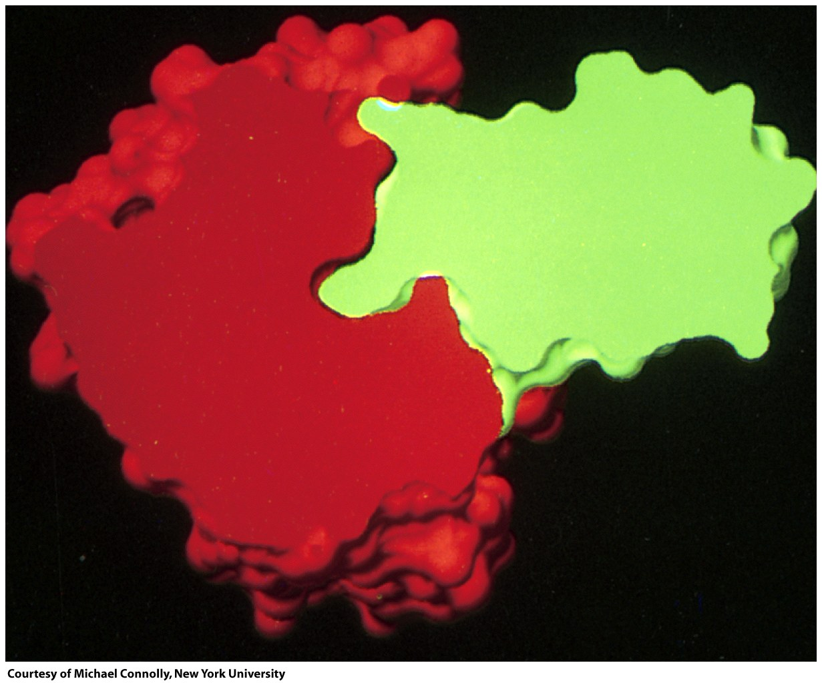
Pancreatic trypsin inhibitor binds tightly to trypsin

Slide 13
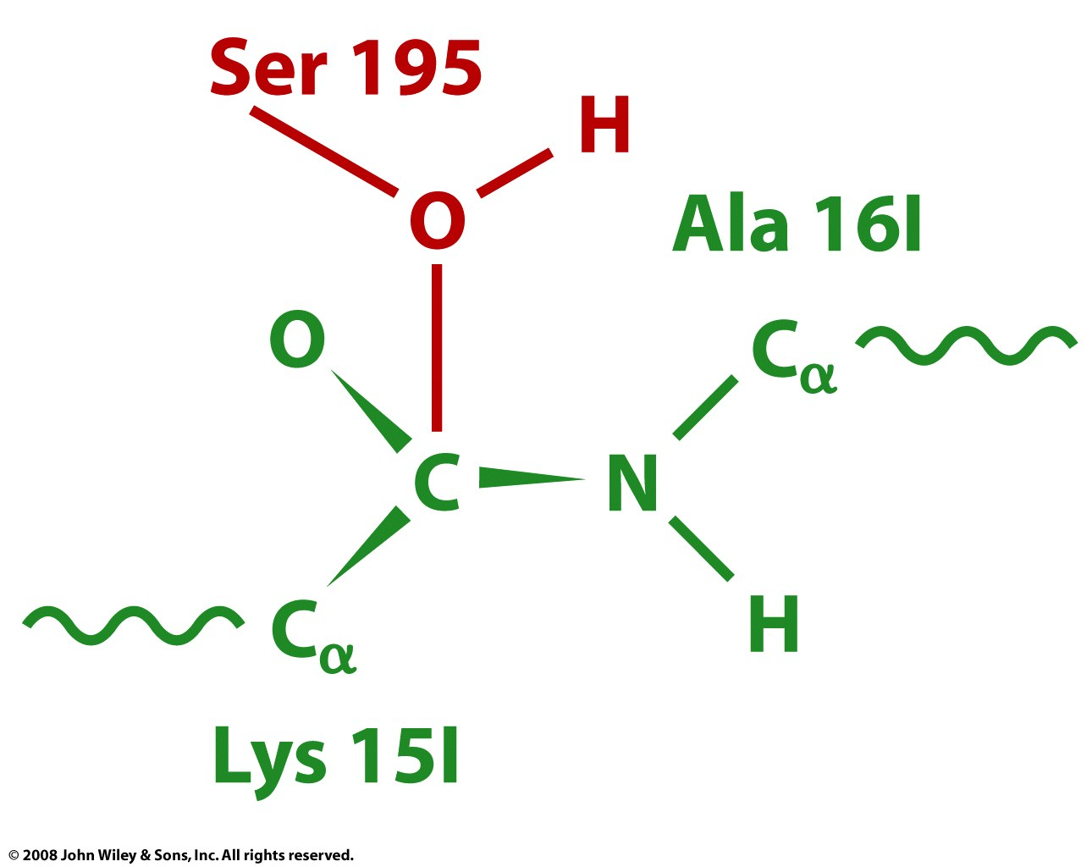
Bound trypsin inhibitor suggests formation of a tetrahedral intermediate

Slide 14
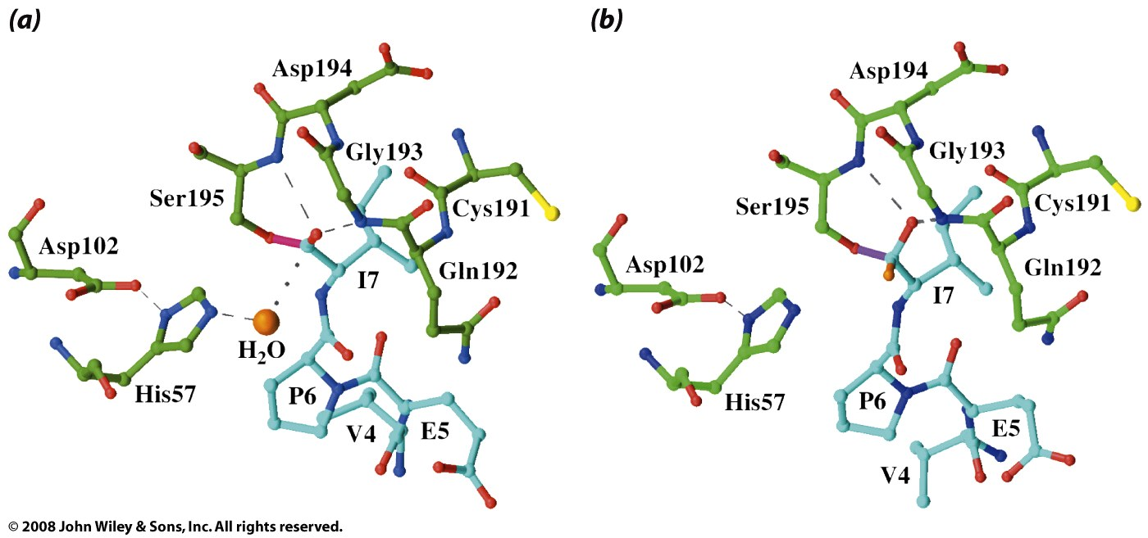
The tetrahedral intermediate was trapped through clever pH manipulation

Slide 15
Summary of important ideas on serine proteases
Hydrolyze peptide bonds using an active site serine
Common structure of active site, including:
Asp-His-Ser catalytic triad
Oxyanion hole
Differ in substrate specificity
Evolved through convergent and divergent evolution
Use a combination of catalytic mechanisms
Studies with inhibitors and under altered conditions can help clarify enzyme mechanisms

