Slide 1
Lysozyme catalyzes the hydrolysis of a glycosidic bond of peptidoglycan
NAG = N-acetylglucosamine
NAM = N-acetylmuramic acid

Slide 2
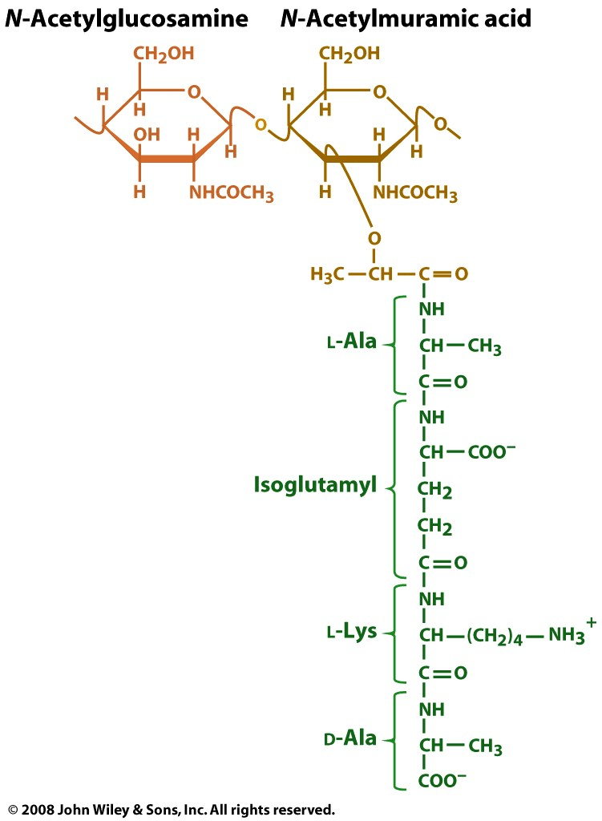
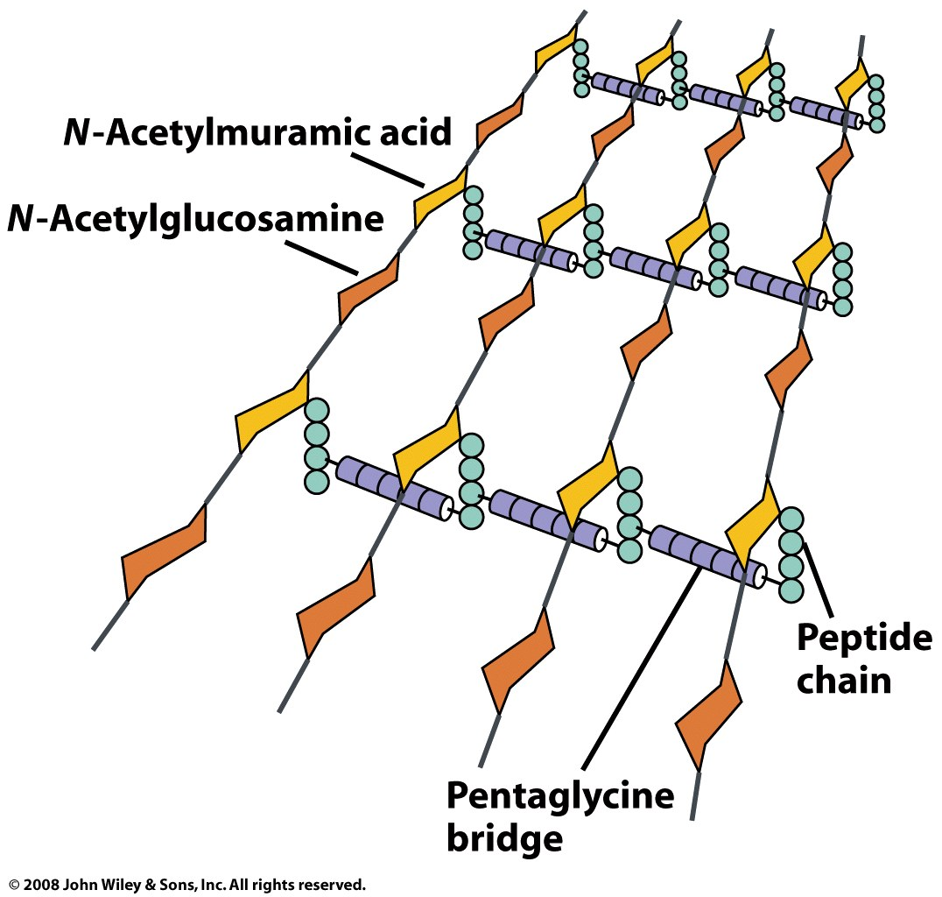
S. aureus peptidoglycan
GlcNAc
Mur2Ac

Slide 3
Using heavy water indicates which side of the glycosidic bond is cleaved
lysozyme
H
H₂¹⁸O

Slide 4
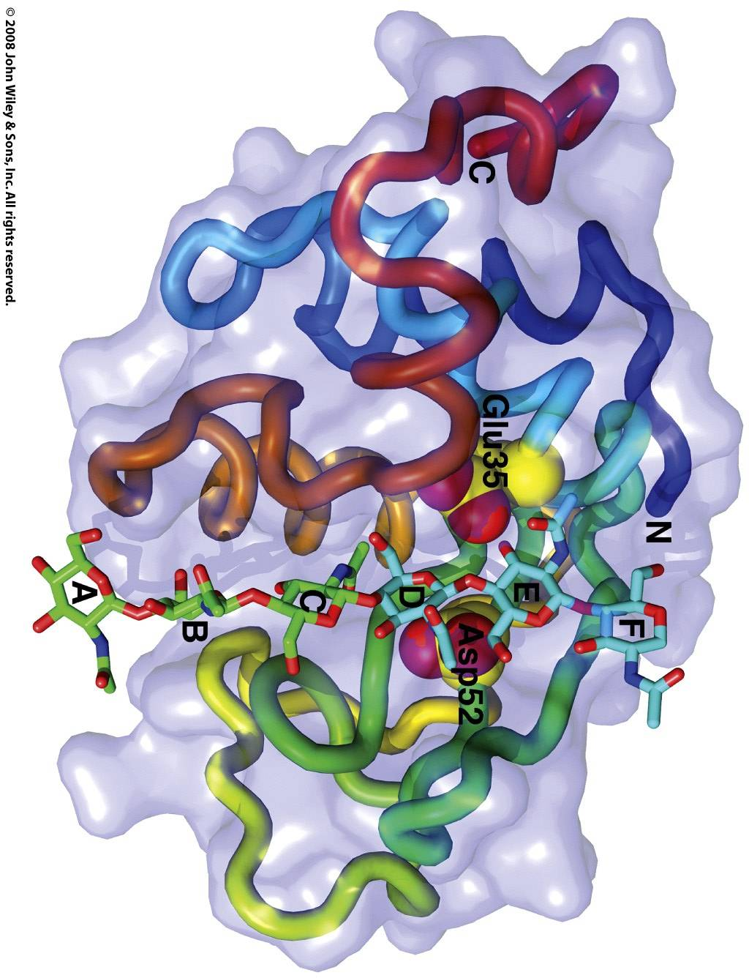
Lysozyme binds a 6-residue stretch of the peptidoglycan polysaccharide in its active site
Binding sites for individual residues are labelled A-F

Slide 5
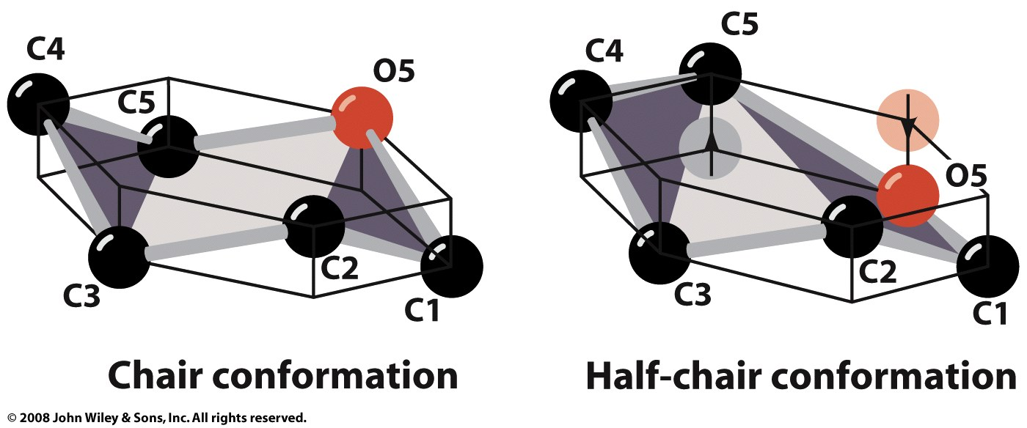
Steric hindrance at the ‘D’ site forces the ring into a strained, half-chair conformation

Slide 6
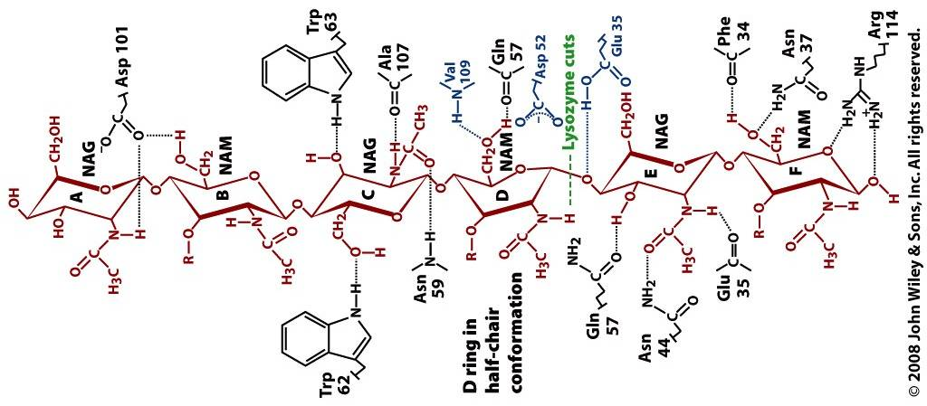
Binding interactions between enzyme and substrate offset strain at the ‘D’ site

Slide 7
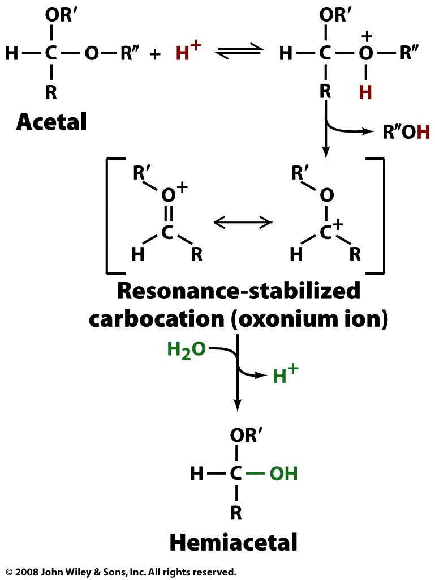
Acid-catalyzed hydrolysis of an acetal produces a carbocation intermediate

Slide 8
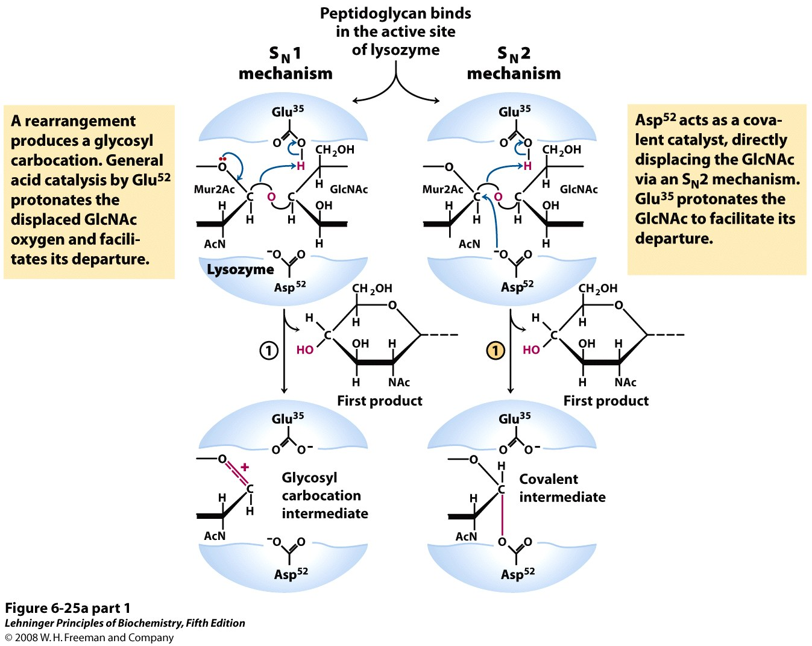
The S_{N}1 mechanism of lysozyme involves the formation of a carbocation intermediate
‒H
Notes:
FIGURE 6-25a (part 1) Lysozyme reaction. In this reaction (described in the text), the water introduced into the product at C-1 of Mur2Ac is in the same configuration as the original glycosidic bond. The reaction is thus a molecular substitution with retention of configuration. (a) Two proposed pathways potentially explain the overall reaction and its properties. The S_{N}1 pathway (left) is the original Phillips mechanism. The S_{N}2 pathway (right) is the mechanism most consistent with current data.

Slide 9
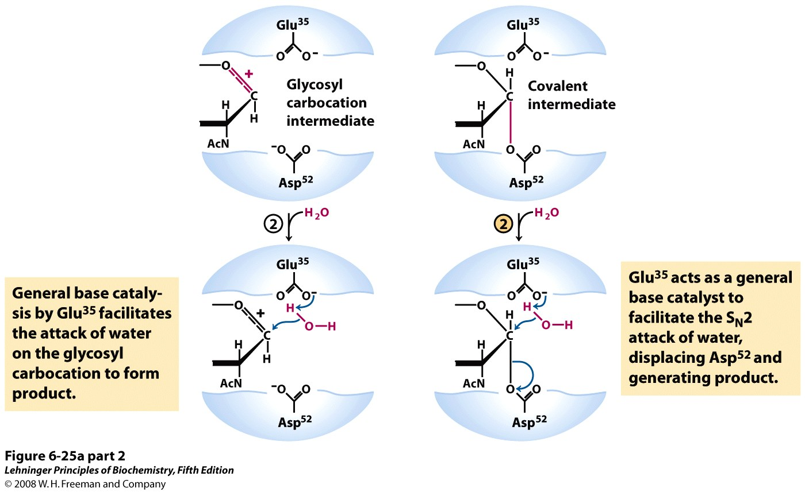
The S_{N}1 mechanism of lysozyme involves the formation of a carbocation intermediate
‒H
‒H
Notes:
FIGURE 6-25a (part 2) Lysozyme reaction. In this reaction (described in the text), the water introduced into the product at C-1 of Mur2Ac is in the same configuration as the original glycosidic bond. The reaction is thus a molecular substitution with retention of configuration. (a) Two proposed pathways potentially explain the overall reaction and its properties. The S_{N}1 pathway (left) is the original Phillips mechanism. The S_{N}2 pathway (right) is the mechanism most consistent with current data.

Slide 10
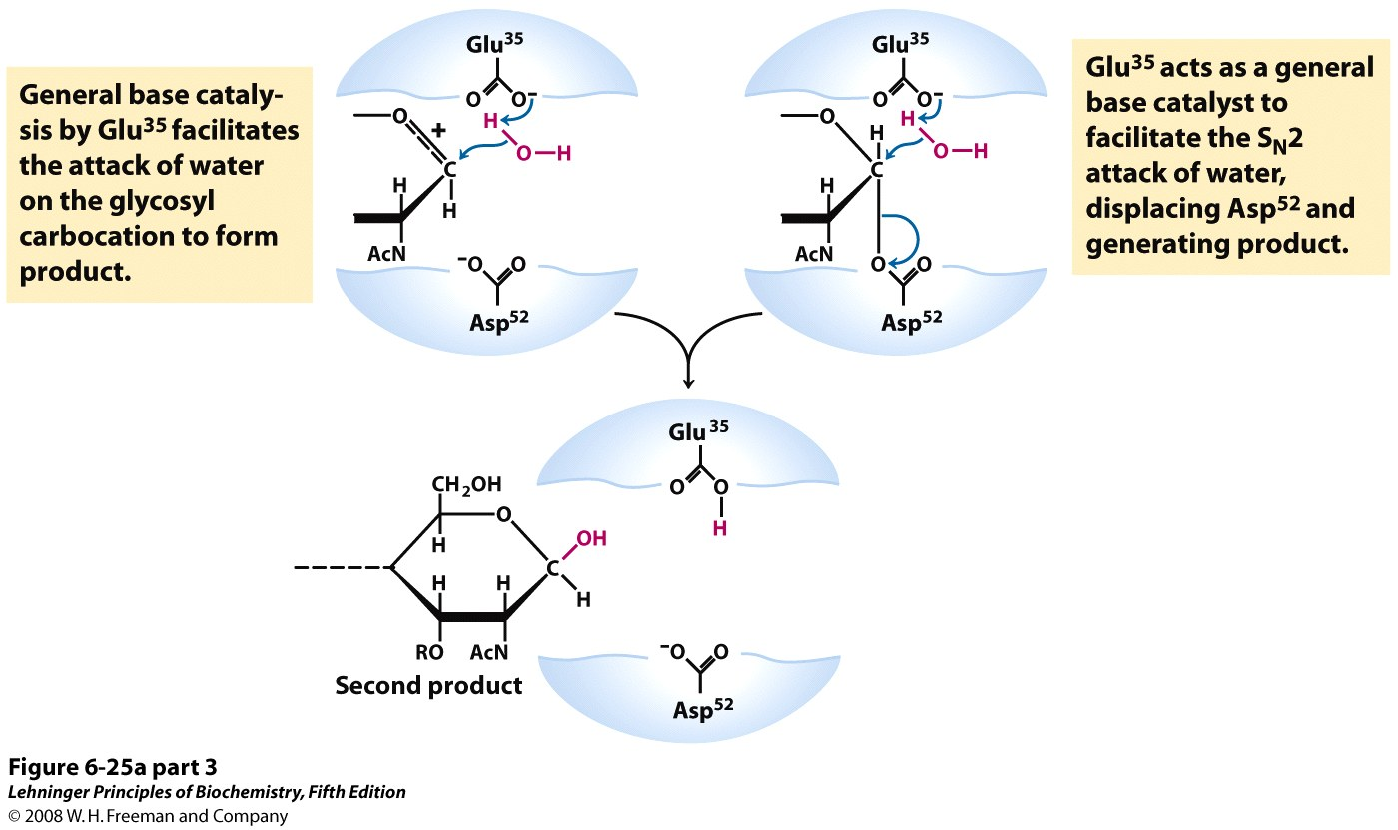
The S_{N}1 mechanism of lysozyme involves the formation of a carbocation intermediate
‒H
Notes:
FIGURE 6-25a (part 3) Lysozyme reaction. In this reaction (described in the text), the water introduced into the product at C-1 of Mur2Ac is in the same configuration as the original glycosidic bond. The reaction is thus a molecular substitution with retention of configuration. (a) Two proposed pathways potentially explain the overall reaction and its properties. The S_{N}1 pathway (left) is the original Phillips mechanism. The S_{N}2 pathway (right) is the mechanism most consistent with current data.

Slide 11
Lysozyme is a retaining glycosidase; products retain the anomeric configuration
β
H
β
Other retaining glycosidases have S_{N}2 mechanism

Slide 12
S_{N}2 mechanism has a covalent intermediate
‒H
Notes:
FIGURE 6-25a (part 1) Lysozyme reaction. In this reaction (described in the text), the water introduced into the product at C-1 of Mur2Ac is in the same configuration as the original glycosidic bond. The reaction is thus a molecular substitution with retention of configuration. (a) Two proposed pathways potentially explain the overall reaction and its properties. The S_{N}1 pathway (left) is the original Phillips mechanism. The S_{N}2 pathway (right) is the mechanism most consistent with current data.

Slide 13
S_{N}2 mechanism has a covalent intermediate
‒H
‒H
Notes:
FIGURE 6-25a (part 2) Lysozyme reaction. In this reaction (described in the text), the water introduced into the product at C-1 of Mur2Ac is in the same configuration as the original glycosidic bond. The reaction is thus a molecular substitution with retention of configuration. (a) Two proposed pathways potentially explain the overall reaction and its properties. The S_{N}1 pathway (left) is the original Phillips mechanism. The S_{N}2 pathway (right) is the mechanism most consistent with current data.

Slide 14
S_{N}2 mechanism has a covalent intermediate
‒H
Notes:
FIGURE 6-25a (part 3) Lysozyme reaction. In this reaction (described in the text), the water introduced into the product at C-1 of Mur2Ac is in the same configuration as the original glycosidic bond. The reaction is thus a molecular substitution with retention of configuration. (a) Two proposed pathways potentially explain the overall reaction and its properties. The S_{N}1 pathway (left) is the original Phillips mechanism. The S_{N}2 pathway (right) is the mechanism most consistent with current data.

Slide 15
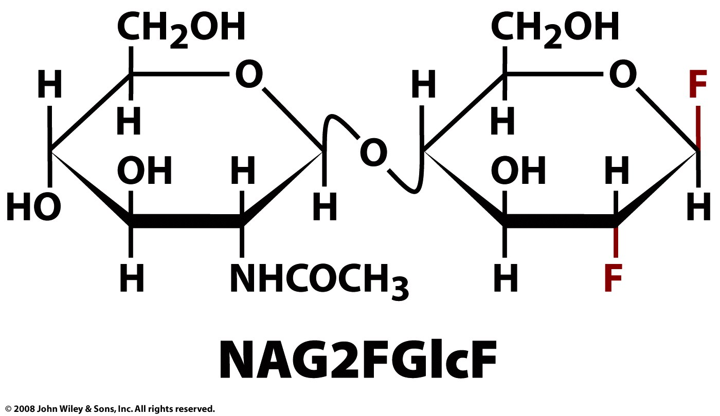
A substrate analog was used to trap the covalent intermediate of lysozyme

Slide 16
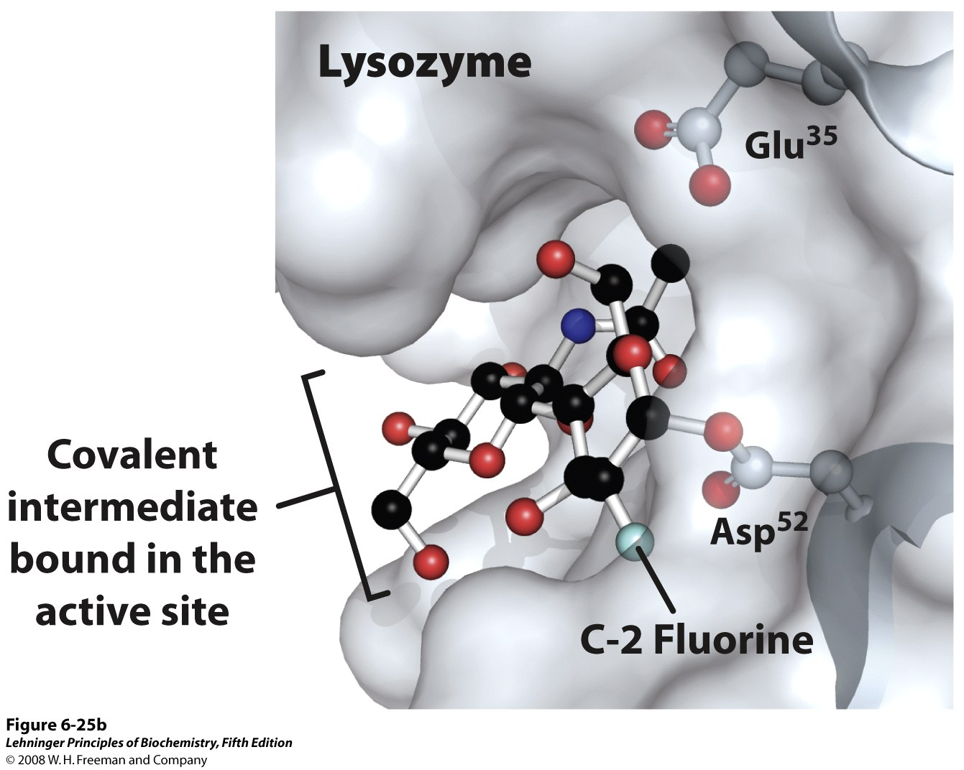
Notes:
FIGURE 6-25b Lysozyme reaction. In this reaction (described in the text), the water introduced into the product at C-1 of Mur2Ac is in the same configuration as the original glycosidic bond. The reaction is thus a molecular substitution with retention of configuration. (b) A surface rendering of the lysozyme active site with the covalent enzymesubstrate intermediate shown as a ball-and-stick structure. Side chains of active-site residues are shown as ball-and-stick structures protruding from ribbons (PDB ID 1H6M).

Slide 17
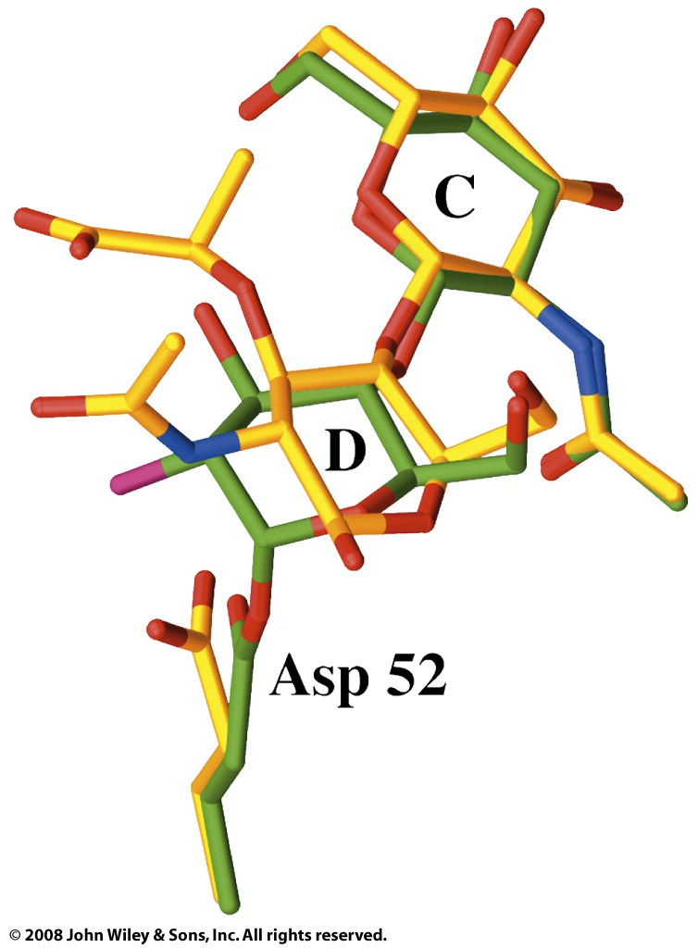
Formation of the covalent intermediate releases strain of the D-site residue
Half-chair conformation
(bound substrate)
Chair conformation
(covalent intermediate)

Slide 18
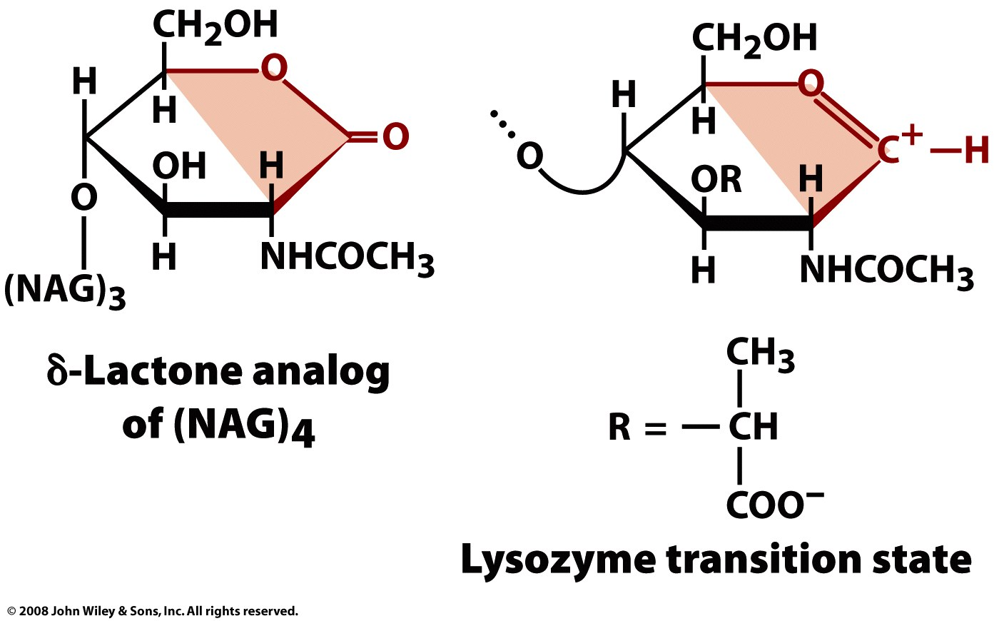
Transition state analogs mimic a transition state and bind more tightly than substrate

