Slide 1
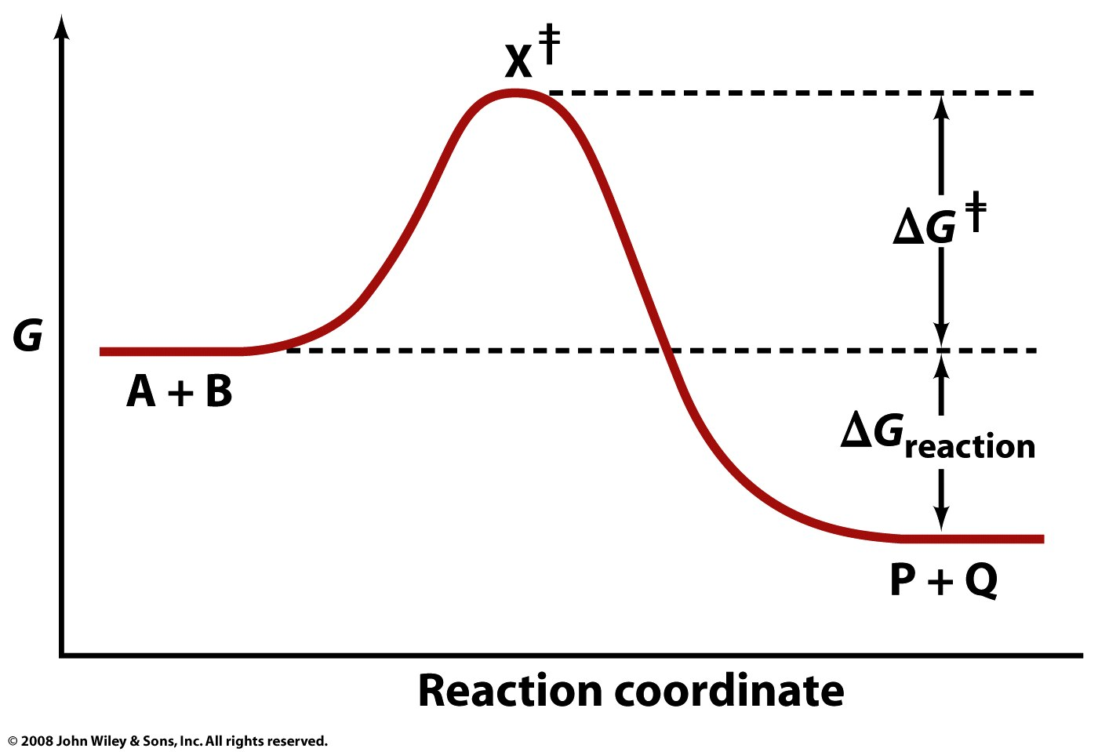

Slide 2
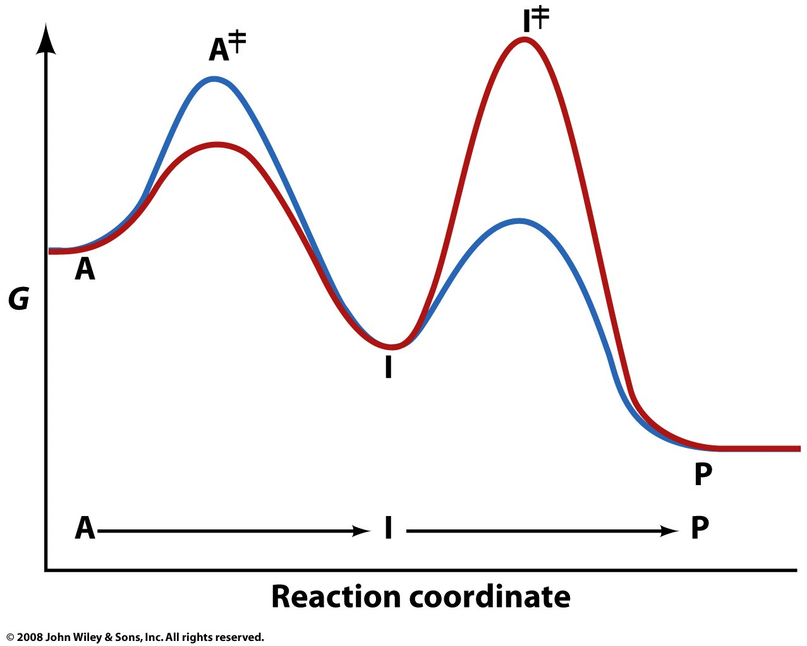

Slide 3
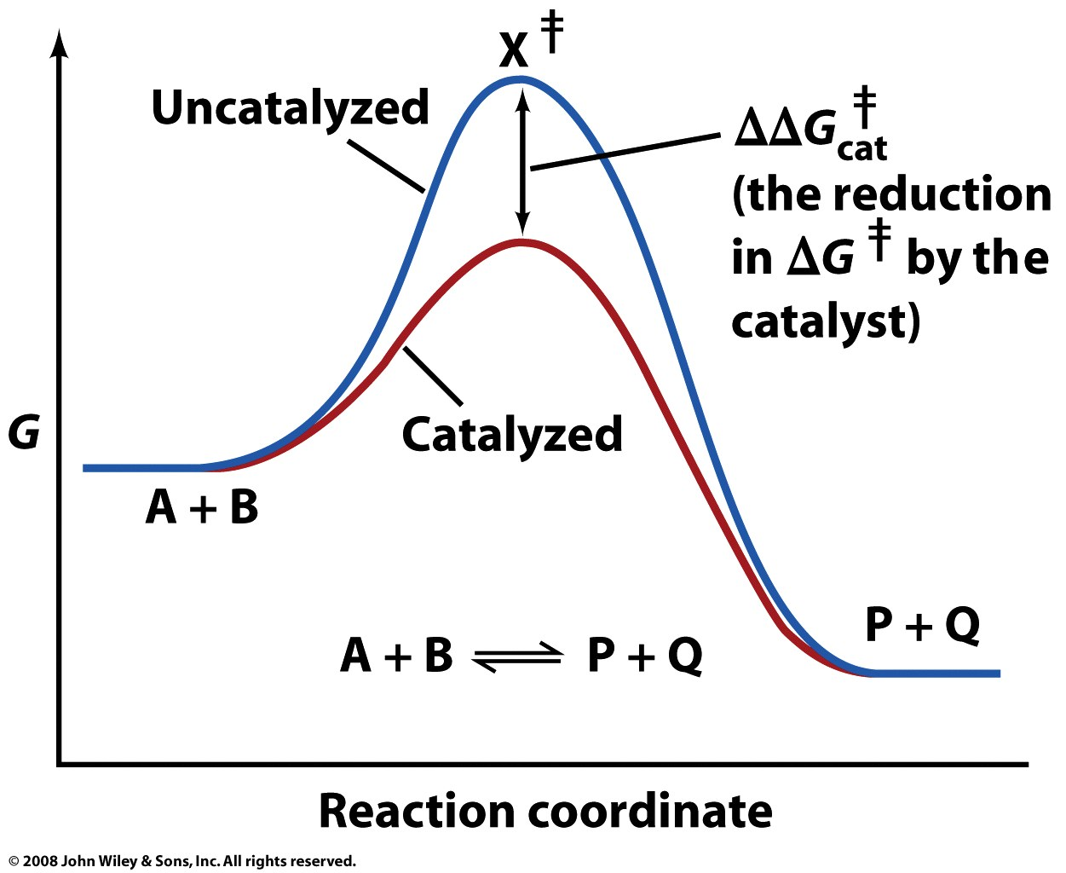

Slide 4
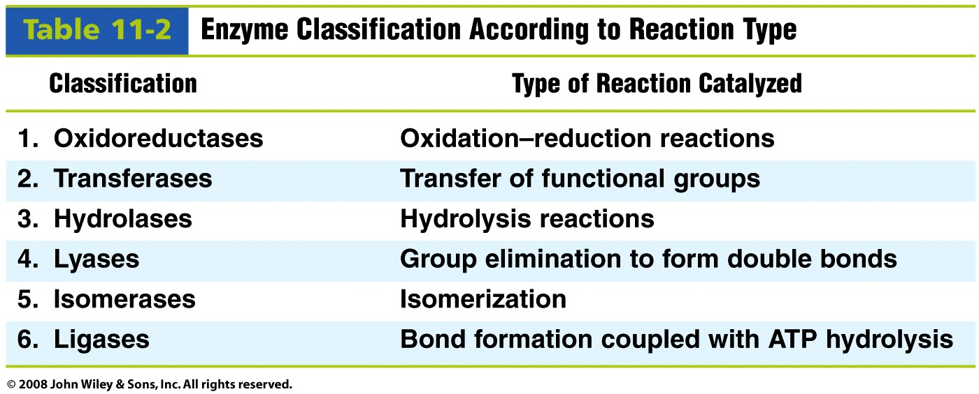

Slide 5
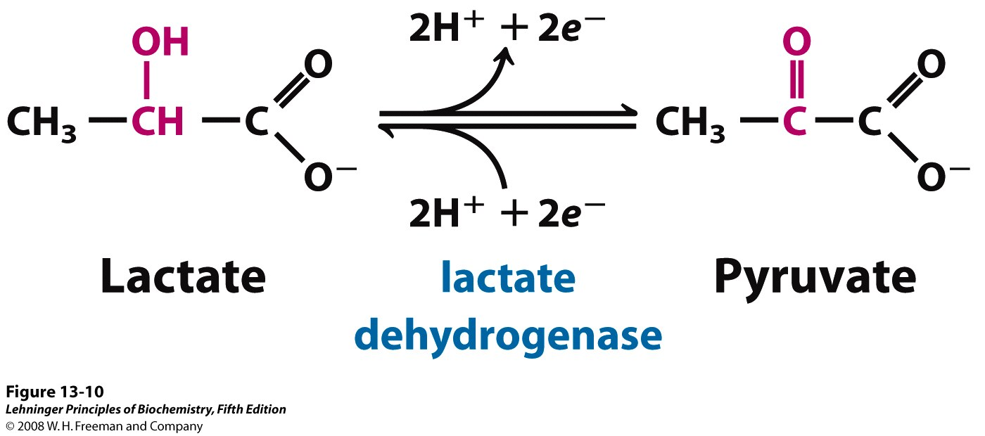
Pyruvate is reduced to lactate in anaerobic metabolism in muscle cells
Notes:
FIGURE 13-10 An oxidation-reduction reaction. Shown here is the oxidation of lactate to pyruvate. In this dehydrogenation, two electrons and two hydrogen ions (the equivalent of two hydrogen atoms) are removed from C-2 of lactate, an alcohol, to form pyruvate, a ketone. In cells the reaction is catalyzed by lactate dehydrogenase and the electrons are transferred to the cofactor nicotinamide adenine dinucleotide (NAD). This reaction is fully reversible; pyruvate can be reduced by electrons transferred from the cofactor.

Slide 6
Transferases and hydrolases catalyze group transfer reactions
Acyl transfer:

Slide 7
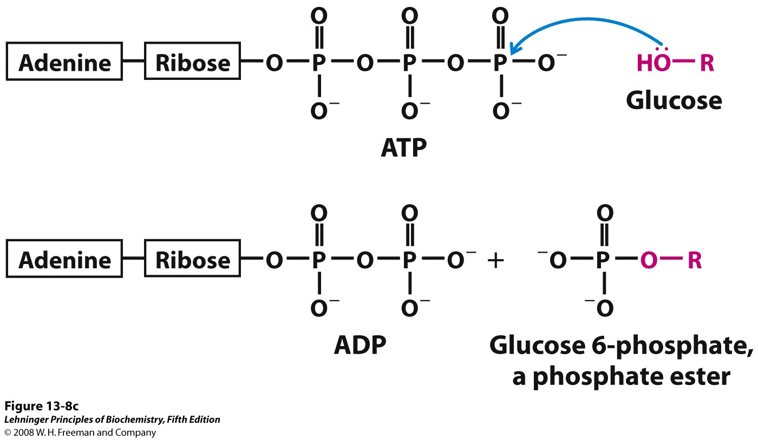
Hexokinase catalyzes a phosphoryl transfer from ATP to glucose
Notes:
FIGURE 13-8c Alternative ways of showing the structure of inorganic orthophosphate. (c) When a nucleophile Z (in this case, the —OH on C-6 of glucose) attacks ATP, it displaces ADP (W). In this S_{N}2 reaction, a pentacovalent intermediate (d) forms transiently.

Slide 8
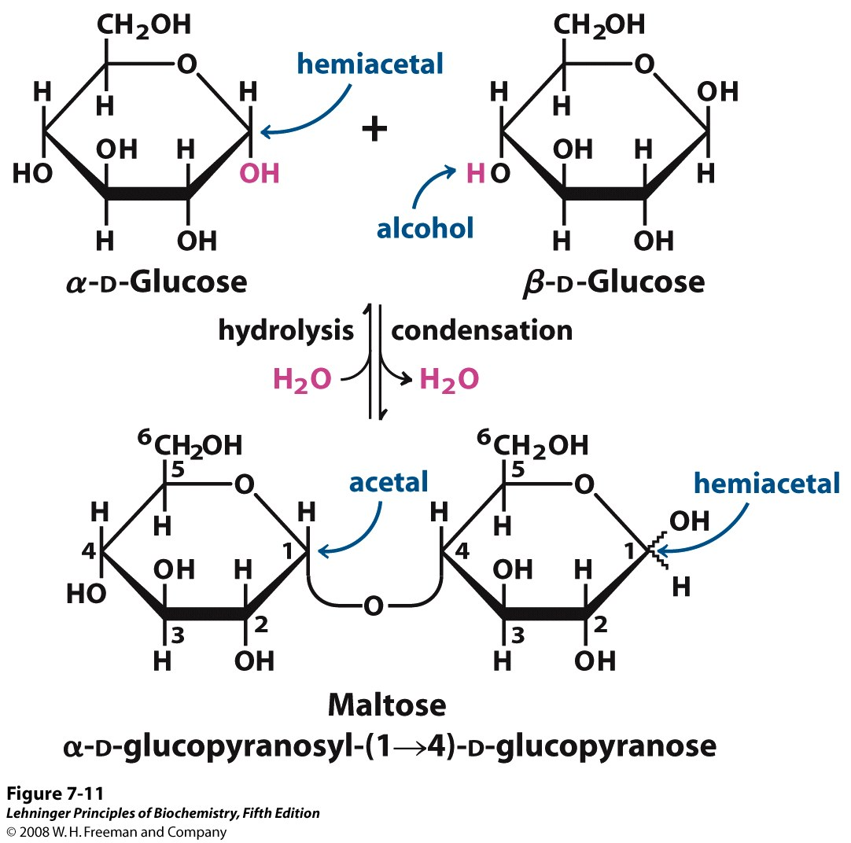
Glycosidases are hydrolases, catalyzing hydrolysis of glycosidic bonds
Notes:
FIGURE 7-11 Formation of maltose. A disaccharide is formed from two monosaccharides (here, two molecules of D-glucose) when an —OH (alcohol) of one glucose molecule (right) condenses with the intramolecular hemiacetal of the other glucose molecule (left), with elimination of H₂O and formation of a glycosidic bond. The reversal of this reaction is hydrolysis—attack by H₂O on the glycosidic bond. The maltose molecule, shown here as an illustration, retains a reducing hemiacetal at the C-1 not involved in the glycosidic bond. Because mutarotation interconverts the α and β forms of the hemiacetal, the bonds at this position are sometimes depicted with wavy lines, as shown here, to indicate that the structure may be either α or β.

Slide 9
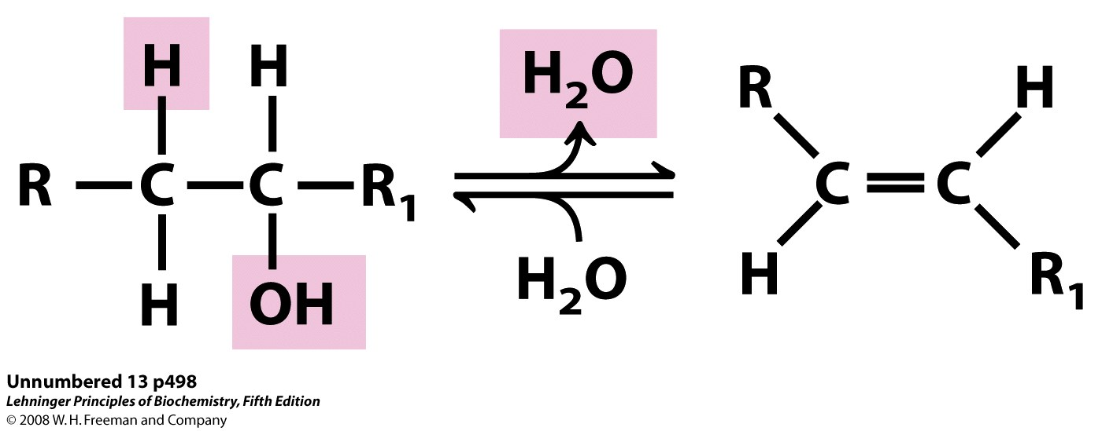
Lyases catalyze eliminations and the formation/breaking of carbon-carbon bonds

Slide 10
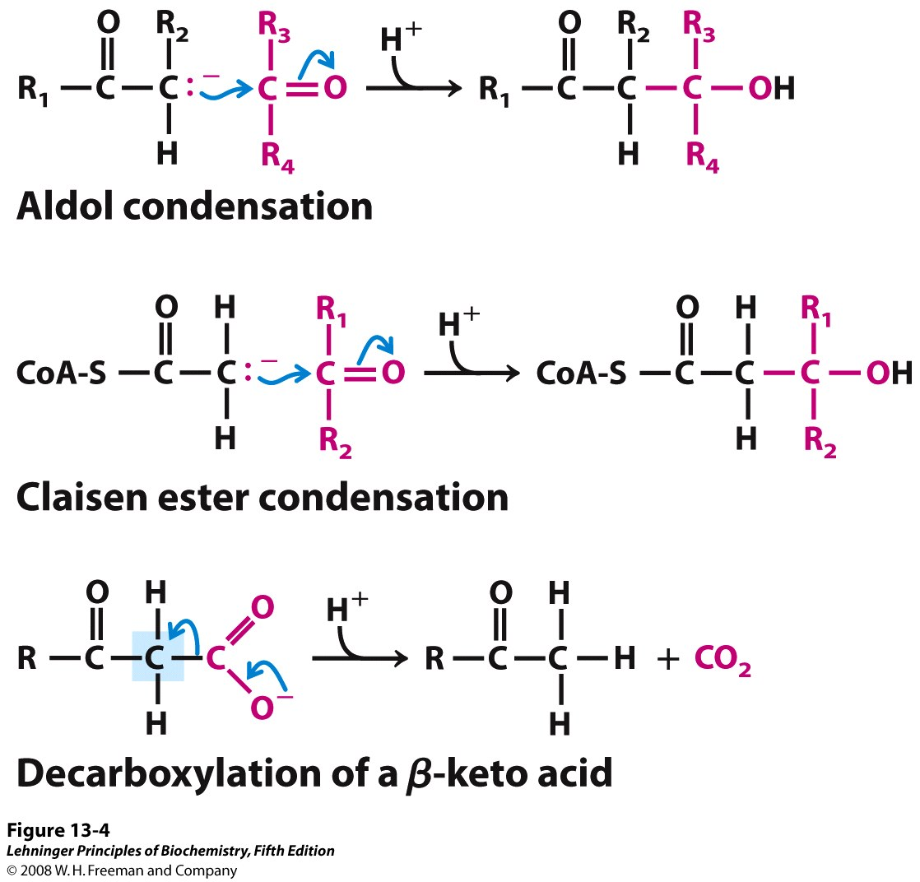
Lyases catalyze eliminations and the formation/breaking of carbon-carbon bonds
Notes:
FIGURE 13-4 Some common reactions that form and break C—C bonds in biological systems. For both the aldol condensation and the Claisen condensation, a carbanion serves as nucleophile and the carbon of a carbonyl group serves as electrophile. The carbanion is stabilized in each case by another carbonyl at the adjoining carbon. In the decarboxylation reaction, a carbanion is formed on the carbon shaded blue as the CO₂ leaves. The reaction would not occur at an appreciable rate without the stabilizing effect of the carbonyl adjacent to the carbanion carbon. Wherever a carbanion is shown, a stabilizing resonance with the adjacent carbonyl, as shown in Figure 13-3b, is assumed. An imine (Figure 13-3c) or other electron-withdrawing group (including certain enzymatic cofactors such as pyridoxal) can replace the carbonyl group in the stabilization of carbanions.

Slide 11
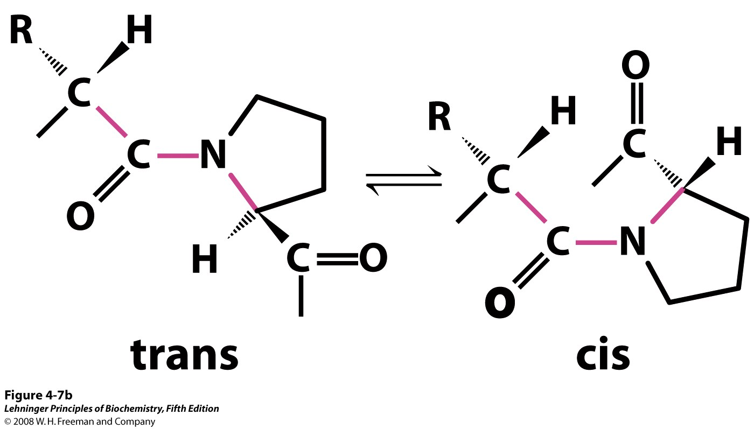
Isomerases catalyze isomerizations or internal rearrangements
prolyl isomerase
Notes:
FIGURE 4-7b Structures of β turns. (b) Trans and cis isomers of a peptide bond involving the imino nitrogen of proline. Of the peptide bonds between amino acid residues other than Pro, more than 99.95% are in the trans configuration. For peptide bonds involving the imino nitrogen of proline, however, about 6% are in the cis configuration; many of these occur at β turns.

Slide 12
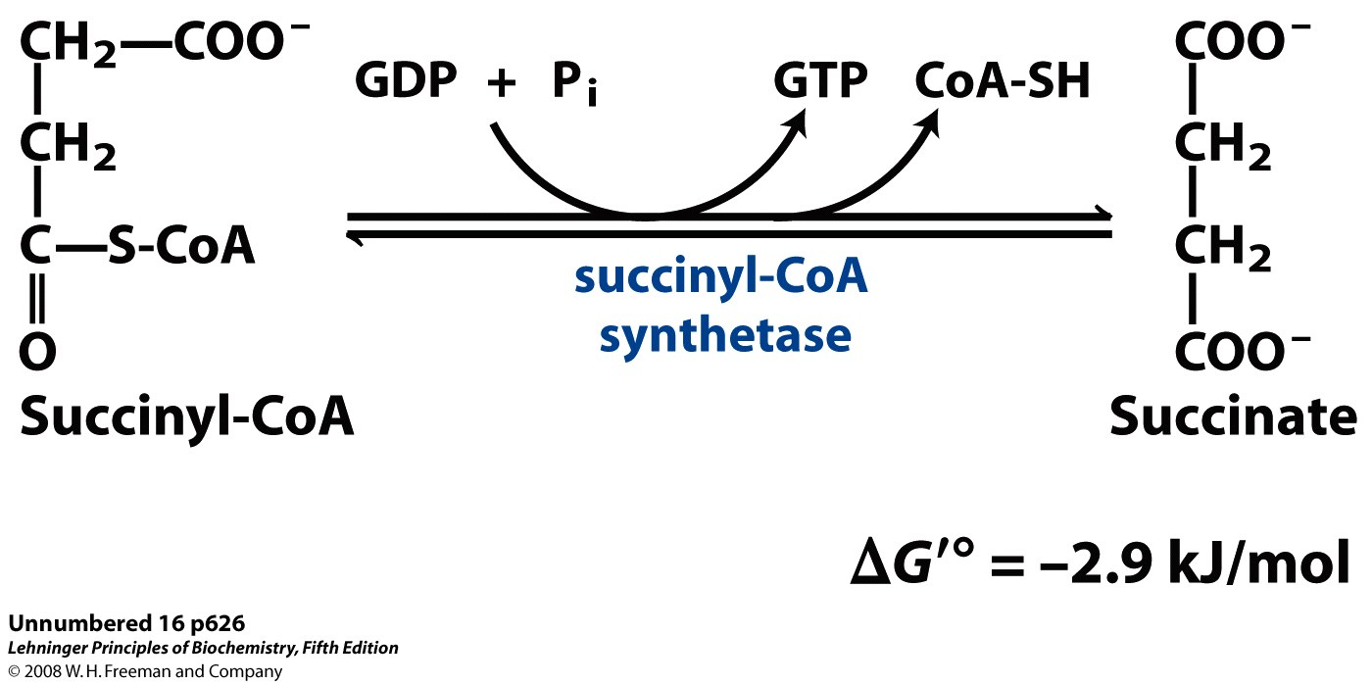
Ligases couple ATP (or NTP) hydrolysis with bond formation

Slide 13
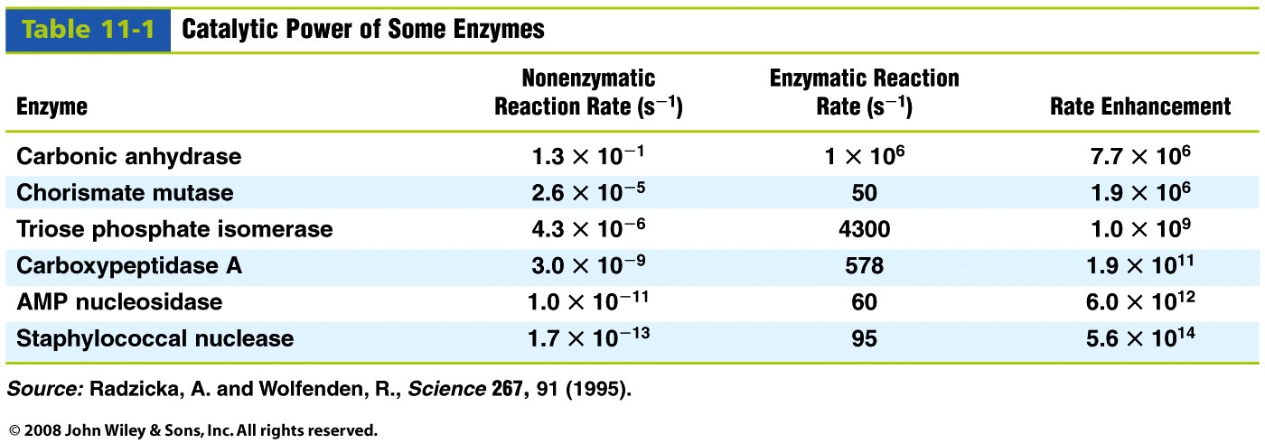
Enzymes can dramatically enhance reaction rates
How do they do it?

Slide 14
Enzymes use several catalytic mechanisms (often together) to enhance reaction rates
Proximity and orientation effects: the enzyme specifically binds and positions substrates (with respect to each other and to enzyme functional groups) to maximize reactivity
Electrostatic catalysis: the enzyme uses charge-charge interactions in catalysis
Preferential binding of transition state: binding interactions between the enzyme and TS are maximized; they are greater than those in the enzyme-substrate or enzyme-product complexes
General acid and general base catalysis: functional groups of the enzyme donate &/or accept protons
Covalent catalysis: the enzyme forms a covalent bond with the substrate
Metal-ion catalysis: the enzyme uses a metal ion to aid catalysis

Slide 15
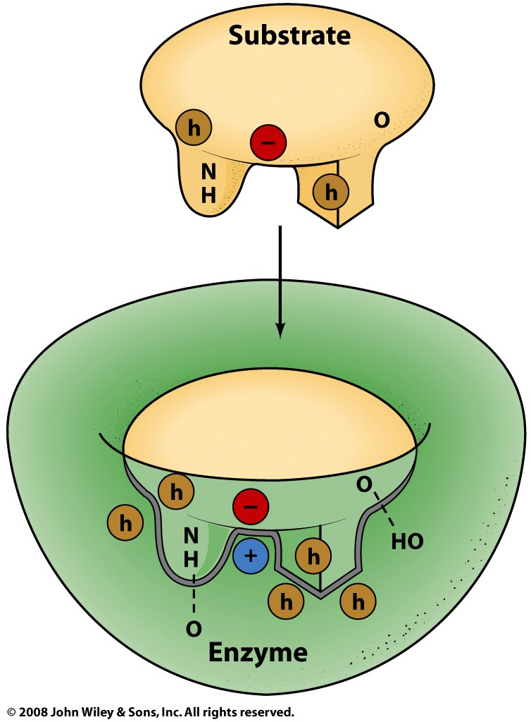
Enzymes bind their substrates with geometric and electronic complementarity

Slide 16
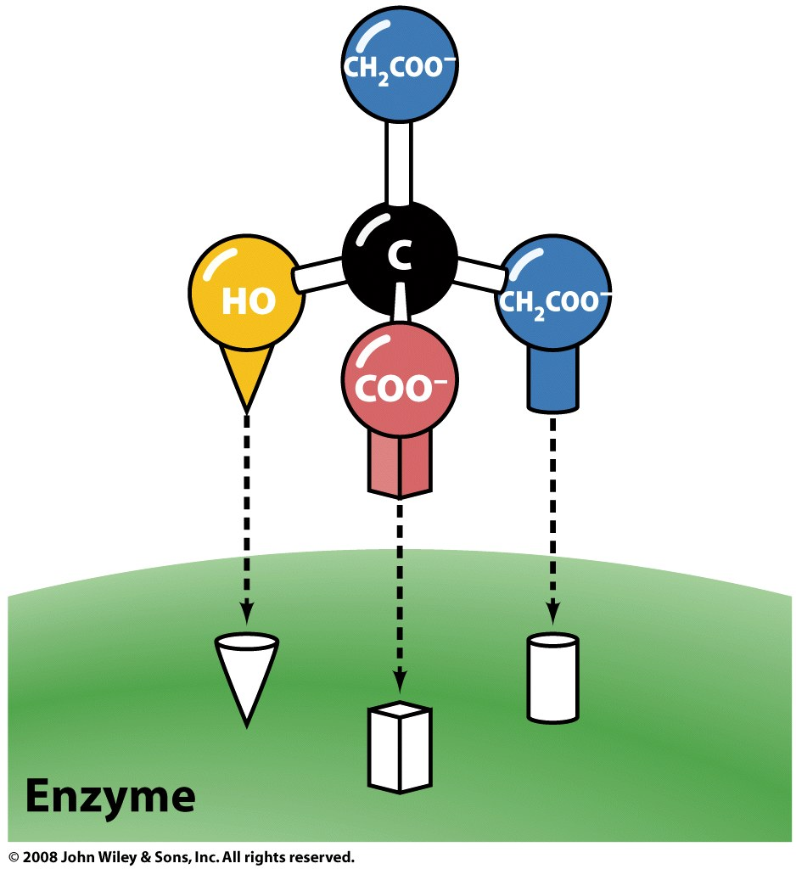
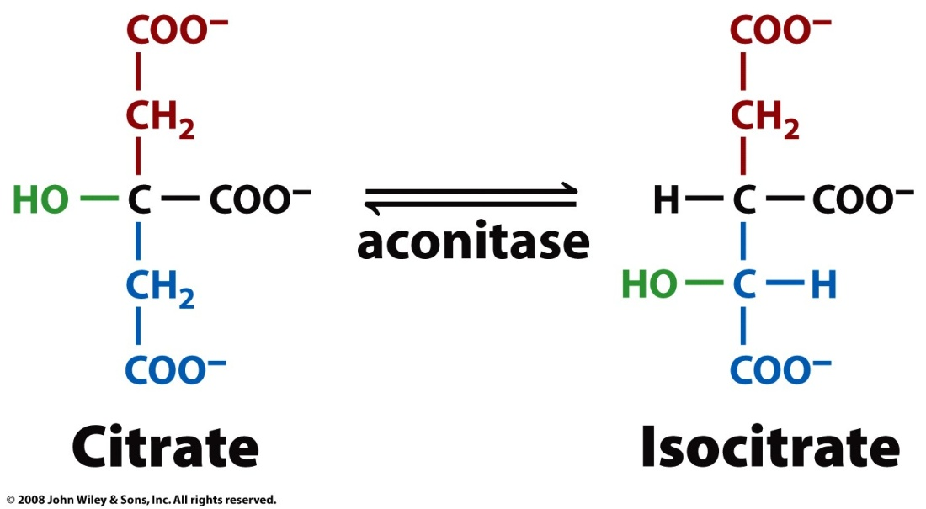
Enzymes are stereoselective (ex: aconitase)

Slide 17
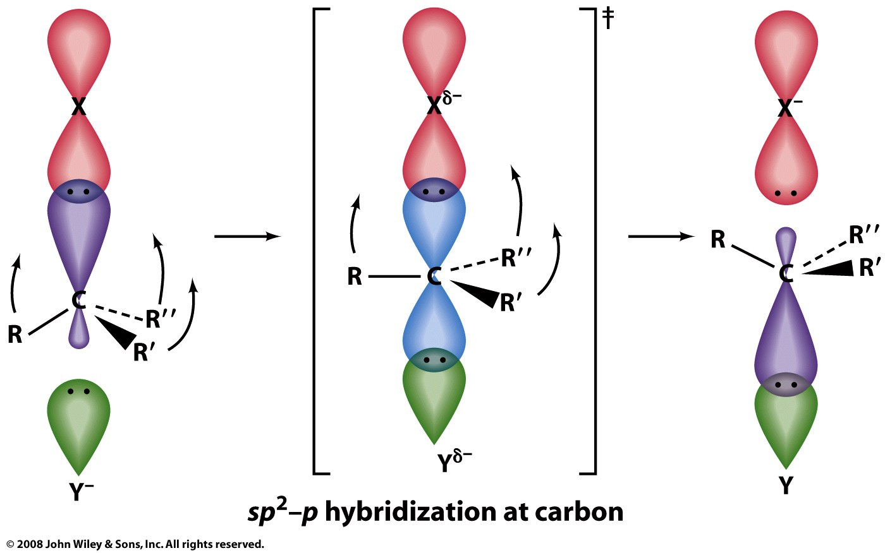
Binding complementarity positions substrates to maximize reaction rates

Slide 18
Enzymes use several catalytic mechanisms (often together) to enhance reaction rates
Proximity and orientation effects: the enzyme specifically binds and positions substrates (with respect to each other and to enzyme functional groups) to maximize reactivity
Electrostatic catalysis: the enzyme uses charge-charge interactions in catalysis
Preferential binding of transition state: binding interactions between the enzyme and TS are maximized; they are greater than those in the enzyme-substrate or enzyme-product complexes
General acid and general base catalysis: functional groups of the enzyme donate &/or accept protons
Covalent catalysis: the enzyme forms a covalent bond with the substrate
Metal-ion catalysis: the enzyme uses a metal ion to aid catalysis

Slide 19
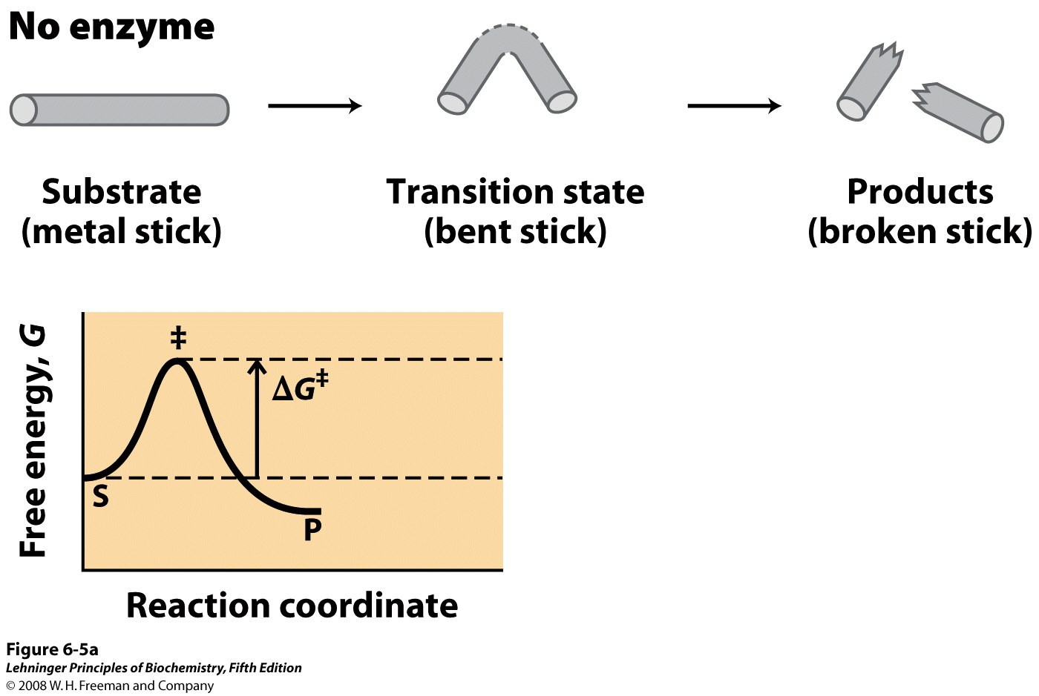
Notes:
FIGURE 6-5a An imaginary enzyme (stickase) designed to catalyze breakage of a metal stick. (a) Before the stick is broken, it must first be bent (the transition state). In both stickase examples, magnetic interactions take the place of weak bonding interactions between enzyme and substrate.

Slide 20
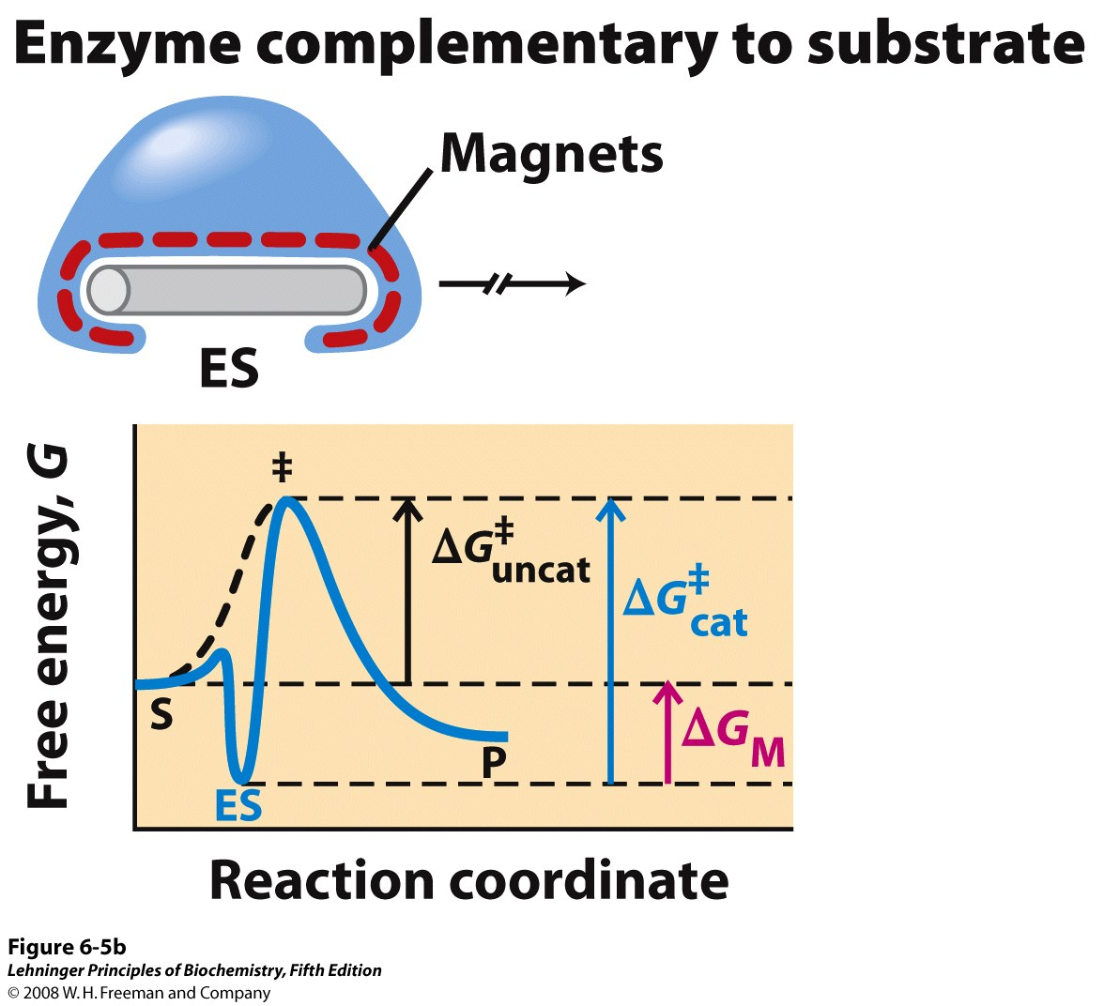
Notes:
FIGURE 6-5b An imaginary enzyme (stickase) designed to catalyze breakage of a metal stick. (b) A stickase with a magnet-lined pocket complementary in structure to the stick (the substrate) stabilizes the substrate. Bending is impeded by the magnetic attraction between stick and stickase.

Slide 21
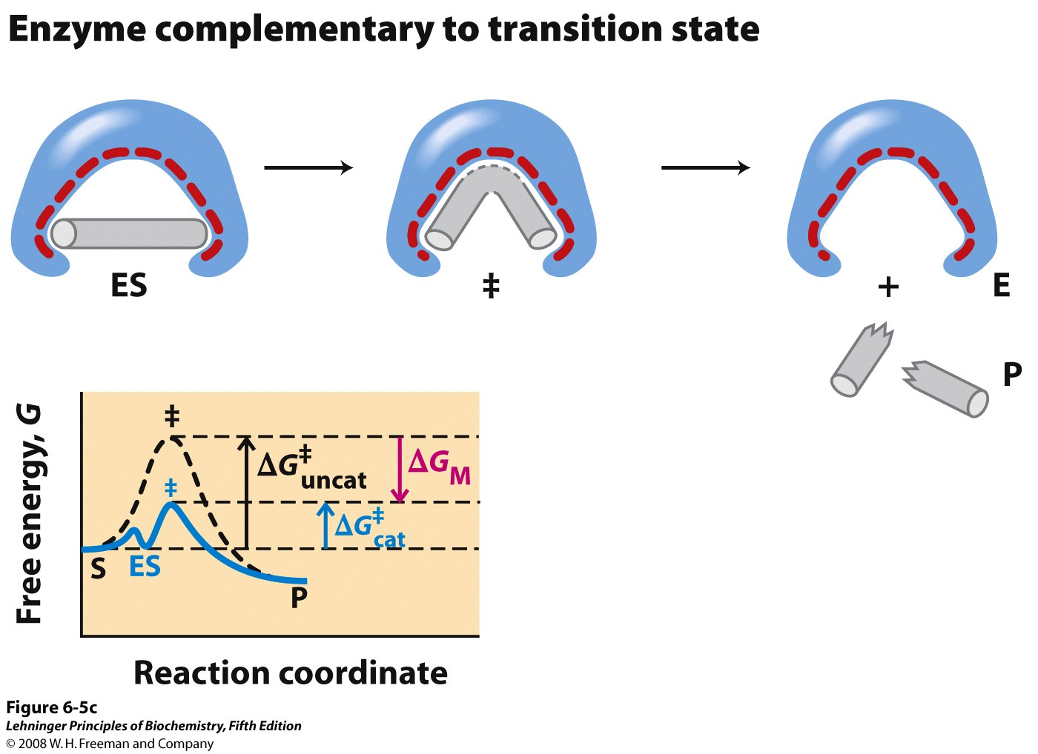
Notes:
FIGURE 6-5c An imaginary enzyme (stickase) designed to catalyze breakage of a metal stick. (c) An enzyme with a pocket complementary to the reaction transition state helps to destabilize the stick, contributing to catalysis of the reaction. The binding energy of the magnetic interactions compensates for the increase in free energy required to bend the stick. Reaction coordinate diagrams (right) show the energy consequences of complementarity to substrate versus complementarity to transition state (EP complexes are omitted). ΔG_{M}, the difference between the transition-state energies of the uncatalyzed and catalyzed reactions, is contributed by the magnetic interactions between the stick and stickase. When the enzyme is complementary to the substrate (b), the ES complex is more stable and has less free energy in the ground state than substrate alone. The result is an increase in the activation energy.

Slide 22
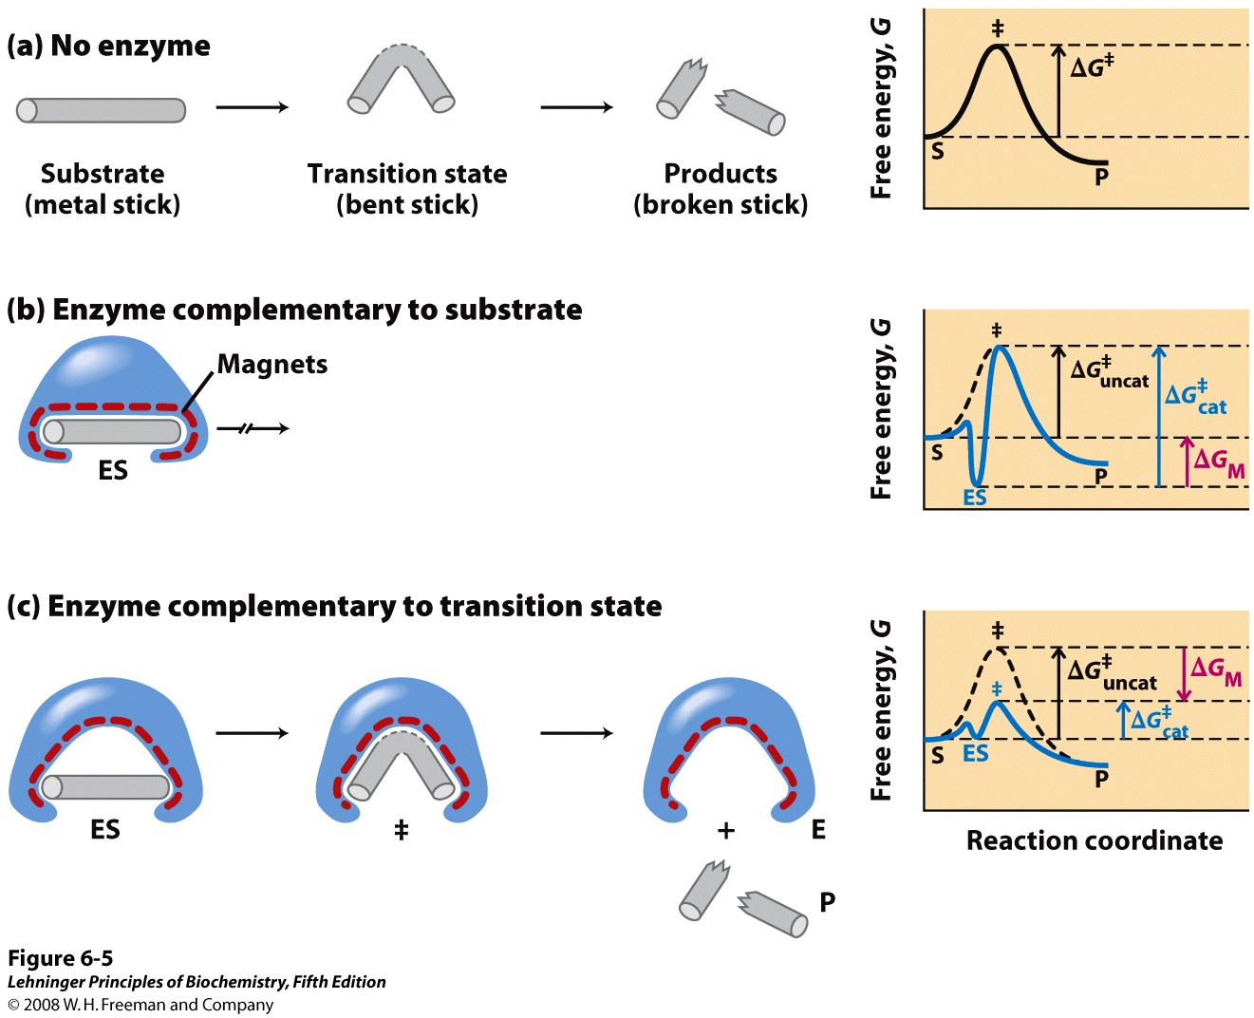
Notes:
FIGURE 6-5 An imaginary enzyme (stickase) designed to catalyze breakage of a metal stick. (a) Before the stick is broken, it must first be bent (the transition state). In both stickase examples, magnetic interactions take the place of weak bonding interactions between enzyme and substrate. (b) A stickase with a magnet-lined pocket complementary in structure to the stick (the substrate) stabilizes the substrate. Bending is impeded by the magnetic attraction between stick and stickase. (c) An enzyme with a pocket complementary to the reaction transition state helps to destabilize the stick, contributing to catalysis of the reaction. The binding energy of the magnetic interactions compensates for the increase in free energy required to bend the stick. Reaction coordinate diagrams (right) show the energy consequences of complementarity to substrate versus complementarity to transition state (EP complexes are omitted). ΔG_{M}, the difference between the transition-state energies of the uncatalyzed and catalyzed reactions, is contributed by the magnetic interactions between the stick and stickase. When the enzyme is complementary to the substrate (b), the ES complex is more stable and has less free energy in the ground state than substrate alone. The result is an increase in the activation energy.

Slide 23
Enzymes use several catalytic mechanisms (often together) to enhance reaction rates
Proximity and orientation effects: the enzyme specifically binds and positions substrates (with respect to each other and to enzyme functional groups) to maximize reactivity
Electrostatic catalysis: the enzyme uses charge-charge interactions in catalysis
Preferential binding of transition state: binding interactions between the enzyme and TS are maximized; they are greater than those in the enzyme-substrate or enzyme-product complexes
General acid and general base catalysis: functional groups of the enzyme donate &/or accept protons
Covalent catalysis: the enzyme forms a covalent bond with the substrate
Metal-ion catalysis: the enzyme uses a metal ion to aid catalysis

Slide 24
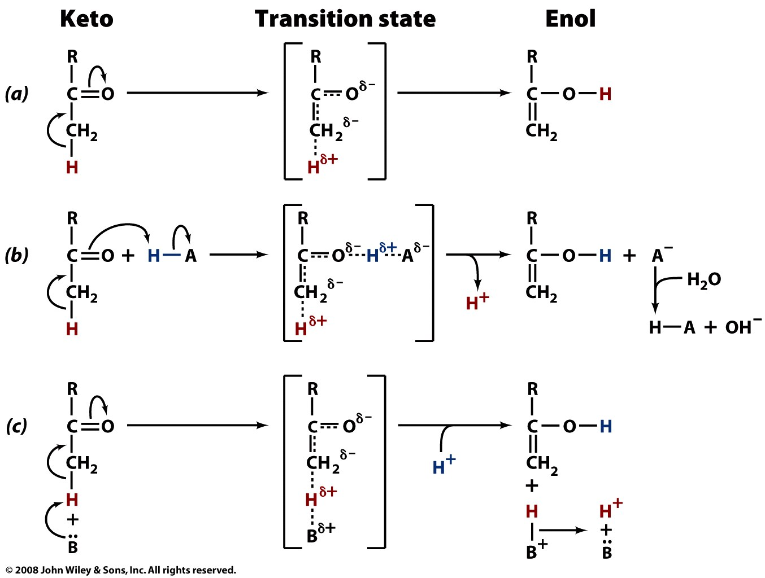

Slide 25
Enzymes use several catalytic mechanisms (often together) to enhance reaction rates
Proximity and orientation effects: the enzyme specifically binds and positions substrates (with respect to each other and to enzyme functional groups) to maximize reactivity
Electrostatic catalysis: the enzyme uses charge-charge interactions in catalysis
Preferential binding of transition state: binding interactions between the enzyme and TS are maximized; they are greater than those in the enzyme-substrate or enzyme-product complexes
General acid and general base catalysis: functional groups of the enzyme donate &/or accept protons
Covalent catalysis: the enzyme forms a covalent bond with the substrate
Metal-ion catalysis: the enzyme uses a metal ion to aid catalysis

Slide 27
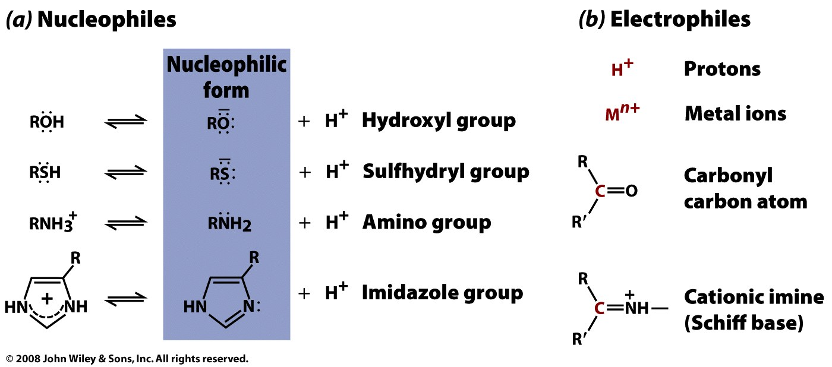
Acid-base and covalent catalysis rely on nucleophile-electrophile chemistry

Slide 28
Enzymes use several catalytic mechanisms (often together) to enhance reaction rates
Proximity and orientation effects: the enzyme positions substrates (with respect to each other and to enzyme functional groups) to maximize reactivity
Electrostatic catalysis: the enzyme uses charge-charge interactions in catalysis
Preferential binding of transition state: binding interactions between the enzyme and TS are maximized; they are greater than those in the enzyme-substrate or enzyme-product complexes
General acid and general base catalysis: functional groups of the enzyme donate &/or accept protons
Covalent catalysis: the enzyme forms a covalent bond with the substrate
Metal-ion catalysis: the enzyme uses a metal ion to aid catalysis

Slide 29
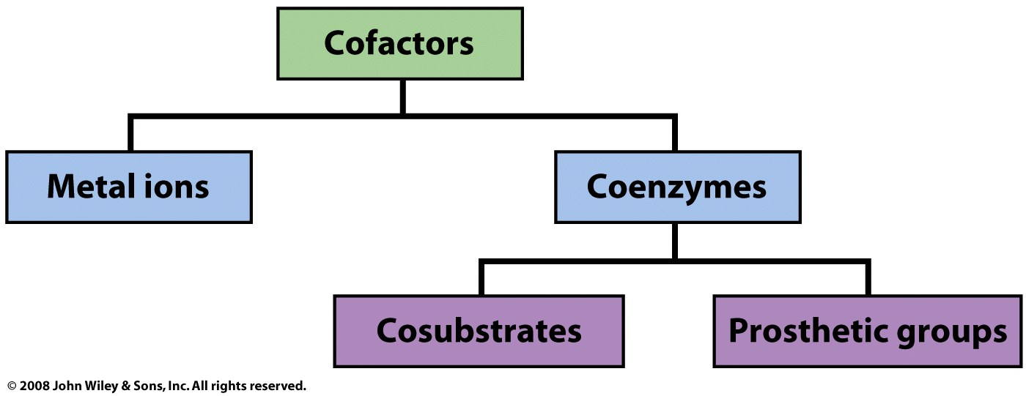
Proteins use cofactors to expand their range of functions

Slide 30
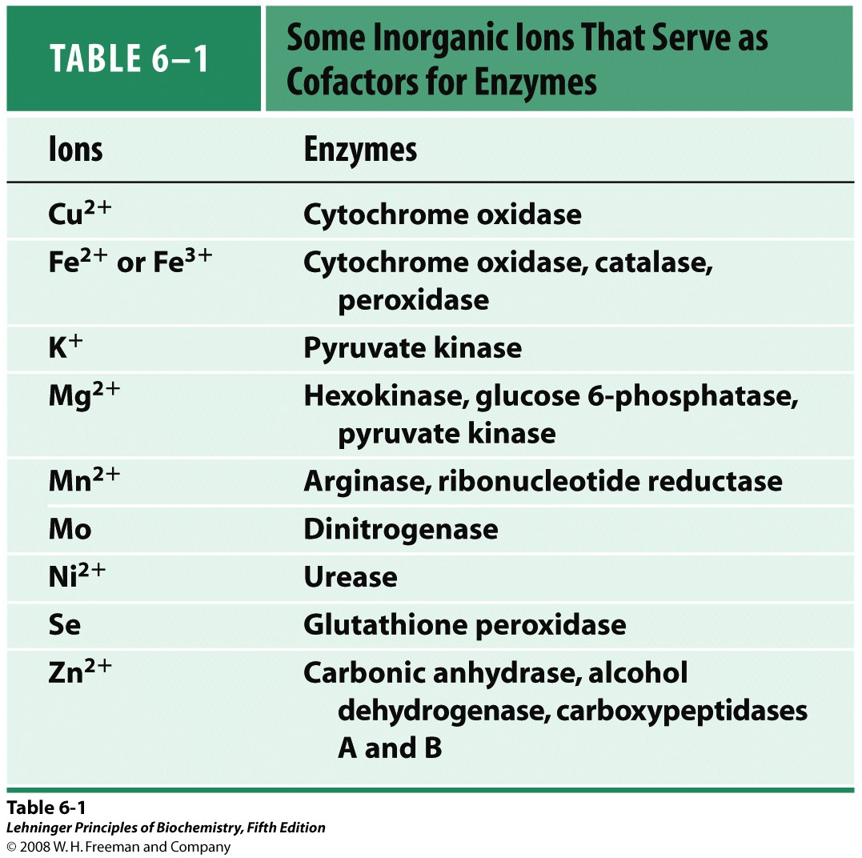

Slide 31
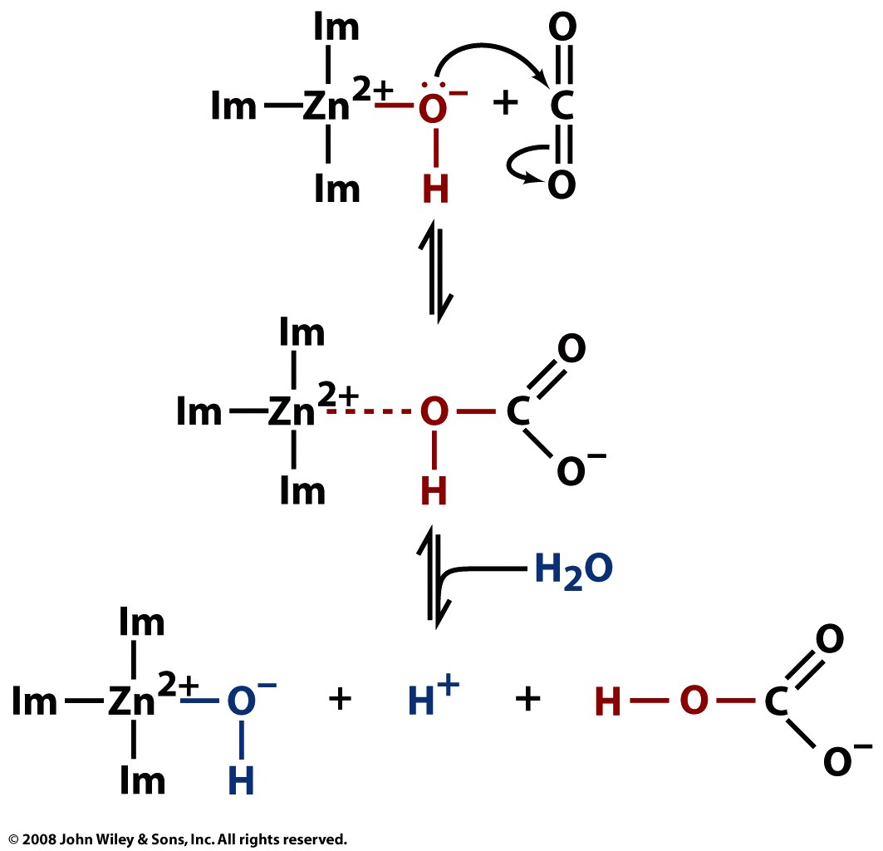
Carbonic anhydrase uses Zn²⁺ for catalysis

Slide 32
Enzymes use several catalytic mechanisms (often together) to enhance reaction rates
Proximity and orientation effects: the enzyme positions substrates (with respect to each other and to enzyme functional groups) to maximize reactivity
Electrostatic catalysis: the enzyme uses charge-charge interactions in catalysis
Preferential binding of transition state: binding interactions between the enzyme and TS are maximized; they are greater than those in the enzyme-substrate or enzyme-product complexes
General acid and general base catalysis: functional groups of the enzyme donate &/or accept protons
Covalent catalysis: the enzyme forms a covalent bond with the substrate
Metal-ion catalysis: the enzyme uses a metal ion to aid catalysis

Slide 33
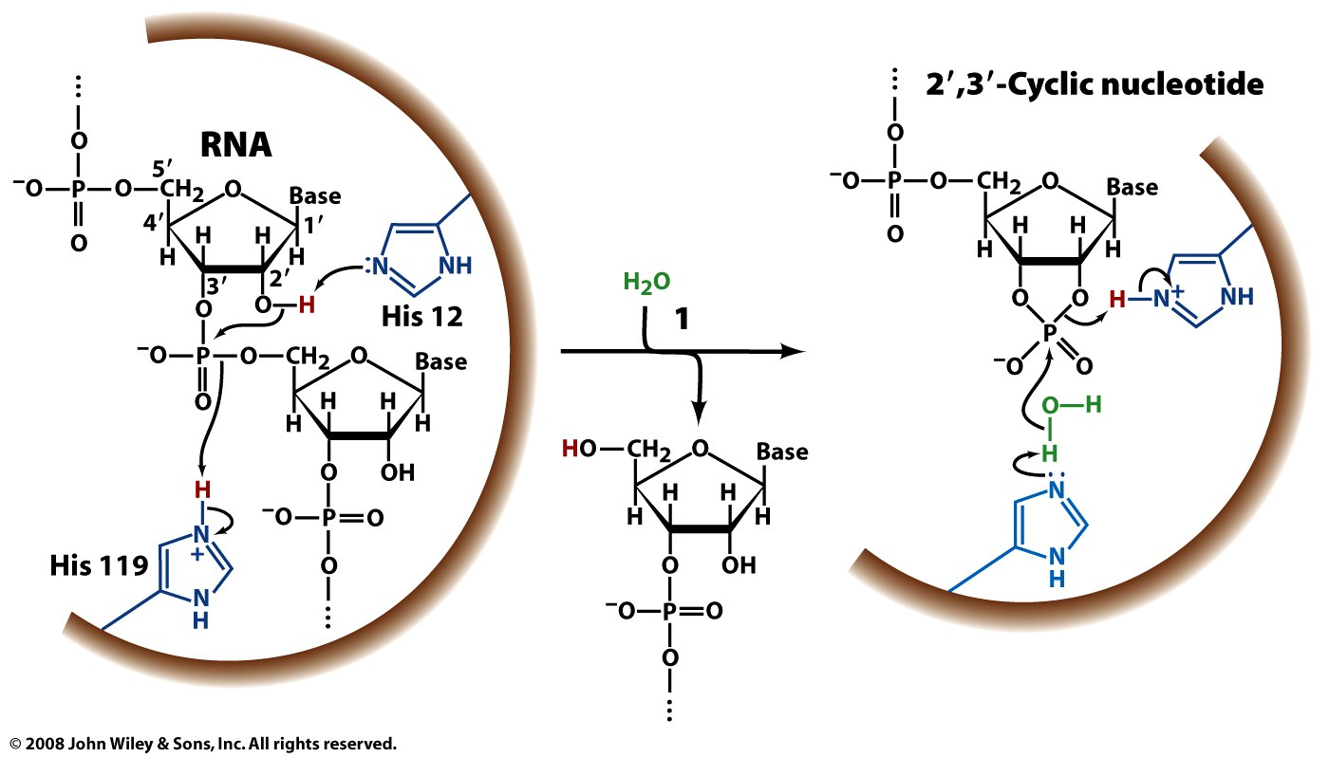
Self test: Identify the enzyme class and catalytic mechanisms used.

Slide 34
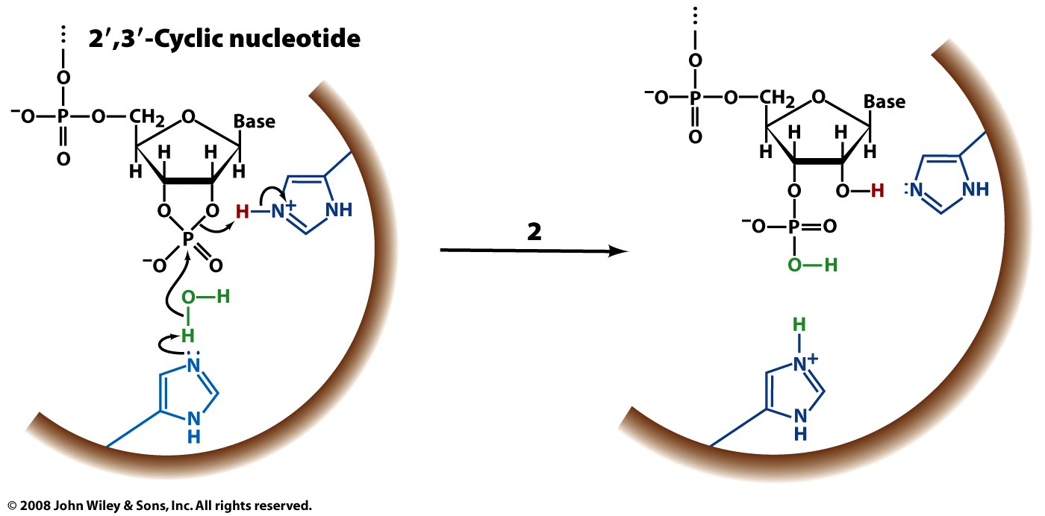
Self test: Identify the enzyme class and catalytic mechanisms used.

Slide 35
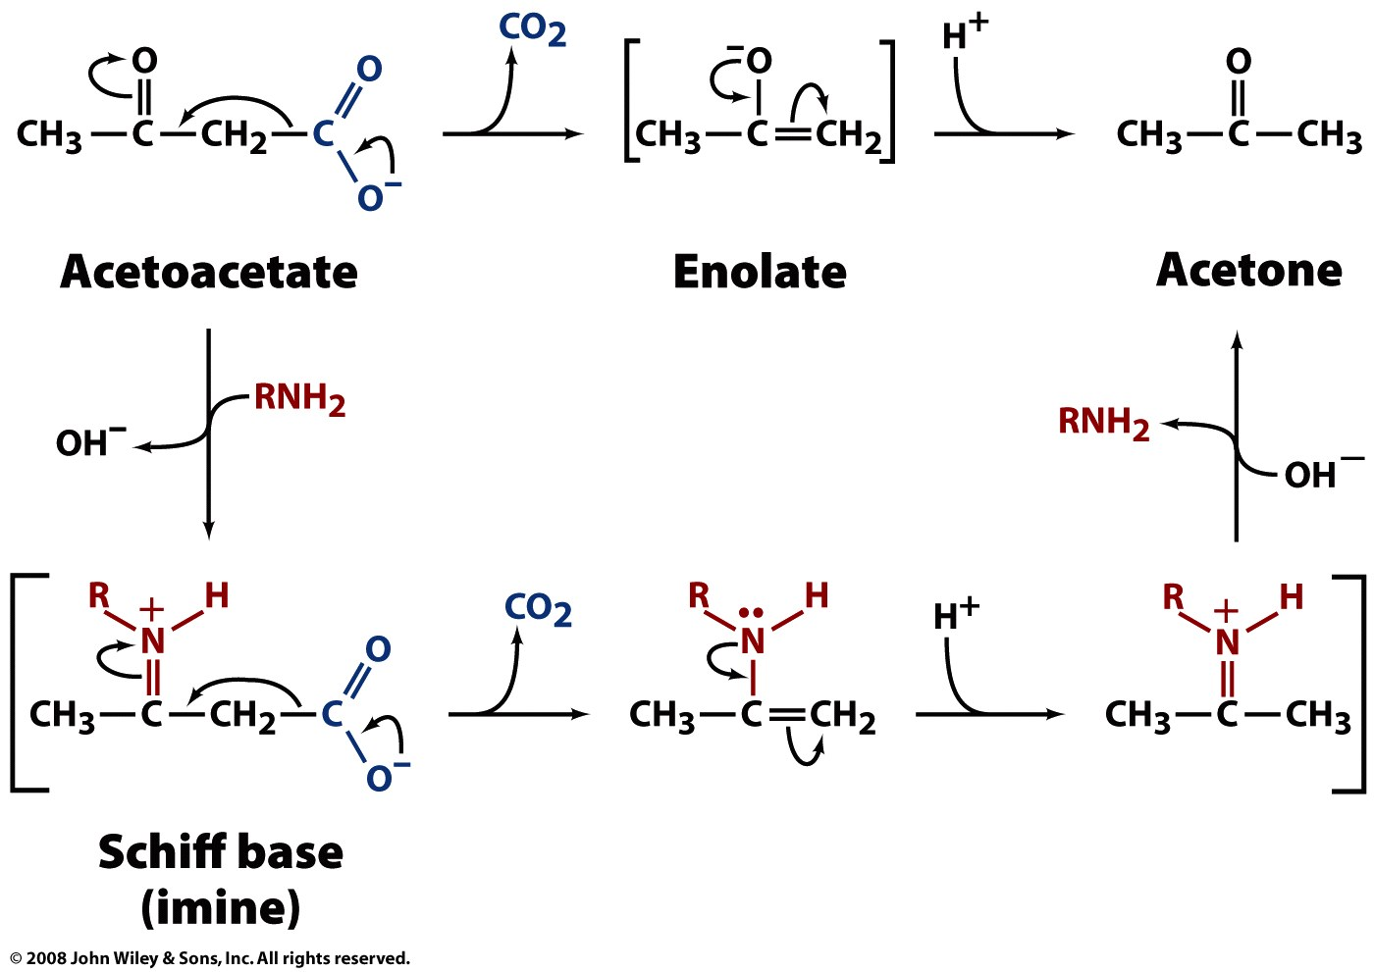
Self test: Identify the enzyme class and catalytic mechanisms used.

Slide 36
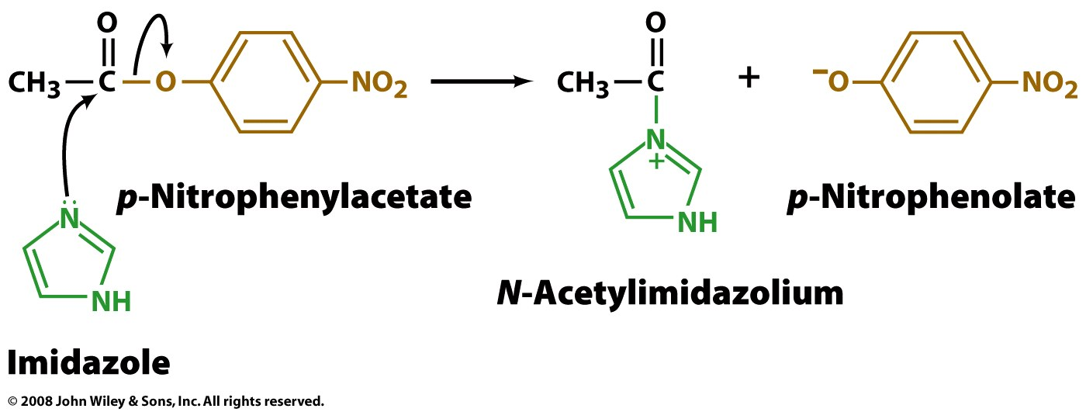
Self test: Identify the enzyme class and catalytic mechanisms used.

Slide 37
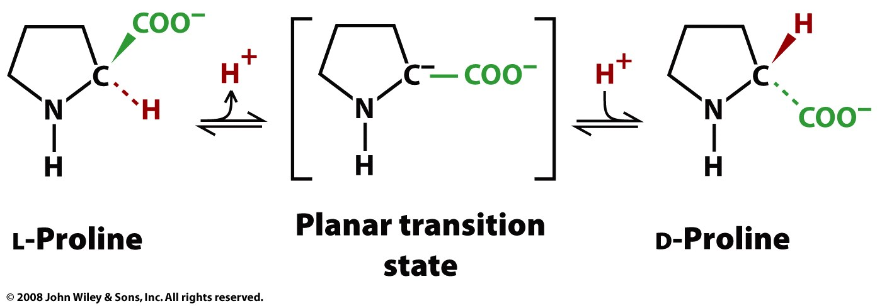
Self test: Identify the enzyme class and catalytic mechanisms used.

