Slide 1
Modulators (effectors) influence oxygen binding to hemoglobin:
Positive effectors stabilize the ‘R’ state:
Oxygen
(Carbon monoxide – CO)
(Nitric oxide – NO)
(Hydrogen sulfide – H₂S)
Negative effectors stabilize the ‘T’ state:
D-2,3-Bisphosphoglycerate (BPG)
H⁺ (low pH) – ‘Bohr effect’
Carbon dioxide (CO₂)
Chloride ion (Cl⁻)

Slide 2
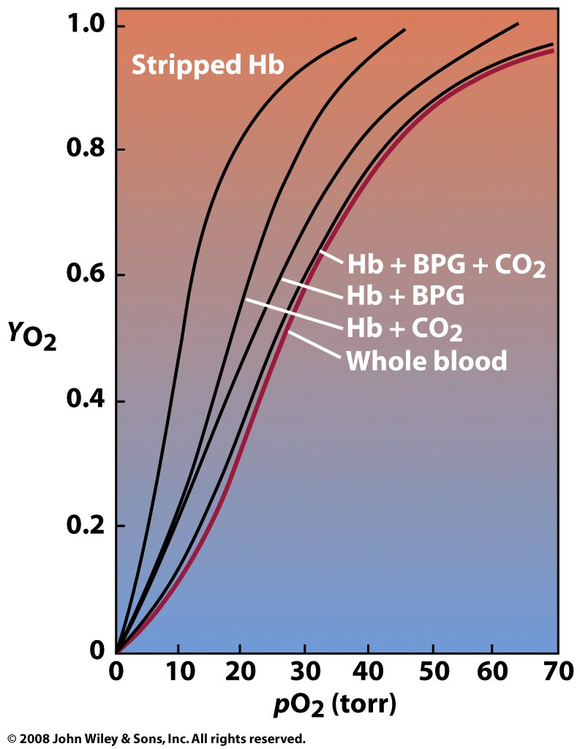
Negative effectors in the blood enhance Hb’s ability to release oxygen

Slide 3
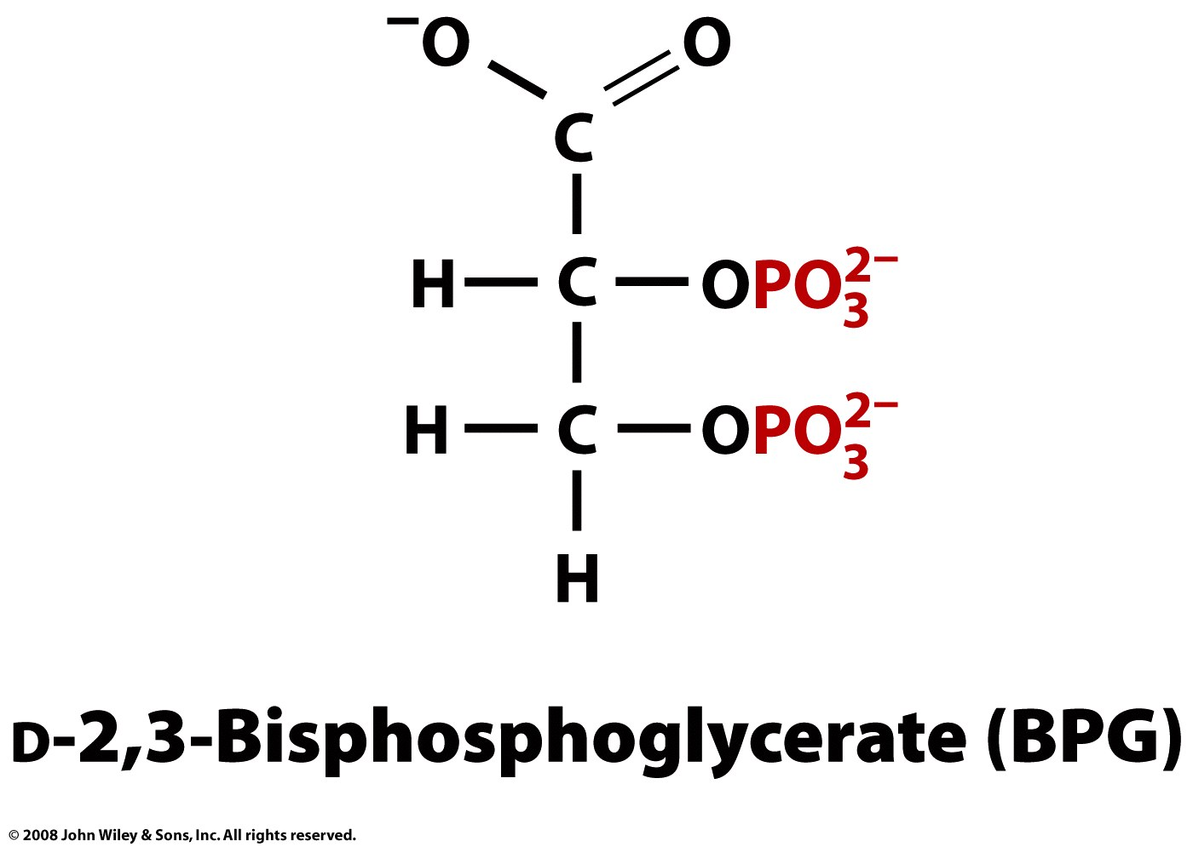

Slide 4
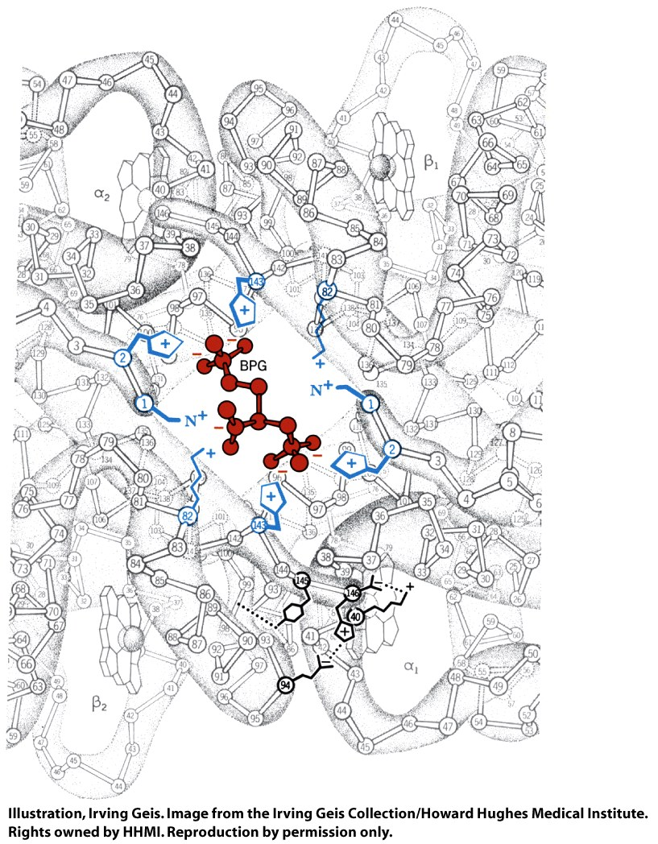
BPG binds in the center of the tetramer, forming salt bridges with + charged groups

Slide 5
The cavity for BPG binding is only present in the T-state tetramer
T-state
R-state
Notes:
FIGURE 5-18 Binding of BPG to deoxyhemoglobin. (a) BPG binding stabilizes the T state of deoxyhemoglobin (PDB ID 1HGA), shown here as a mesh surface image. (b) The negative charges of BPG interact with several positively charged groups (shown in blue in this surface contour image) that surround the pocket between the β subunits in the T state. (c) The binding pocket for BPG disappears on oxygenation, following transition to the R state (PDB ID 1BBB). (Compare (b) and (c) with Figure 5-10.)

Slide 6
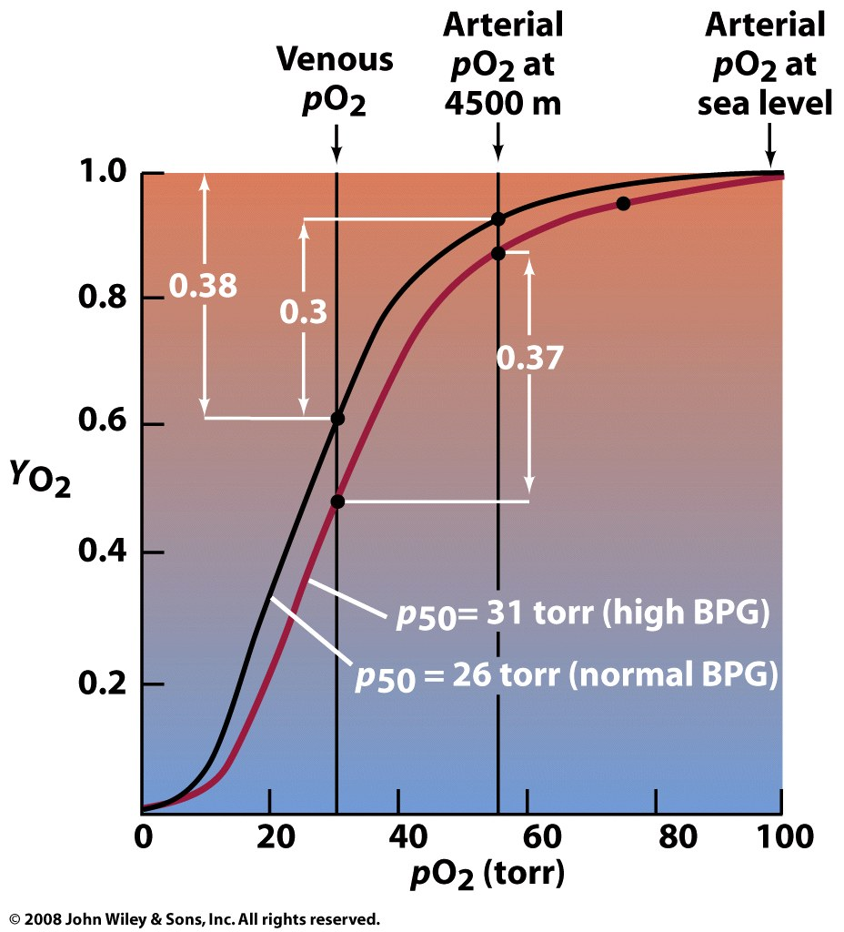
The body can quickly increase BPG levels to enhance oxygen transfer at high altitude
~8 mM
BPG
~4 mM
BPG

Slide 7
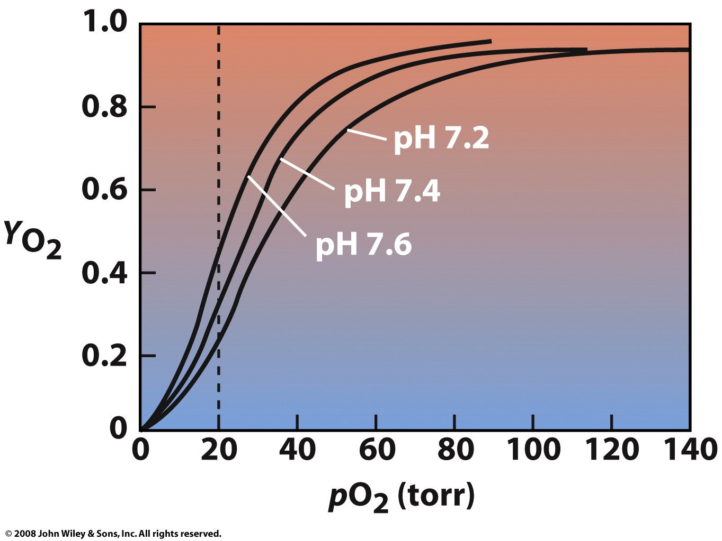
The Bohr effect: Lowering pH reduces Hb’s oxygen-binding affinity

Slide 8
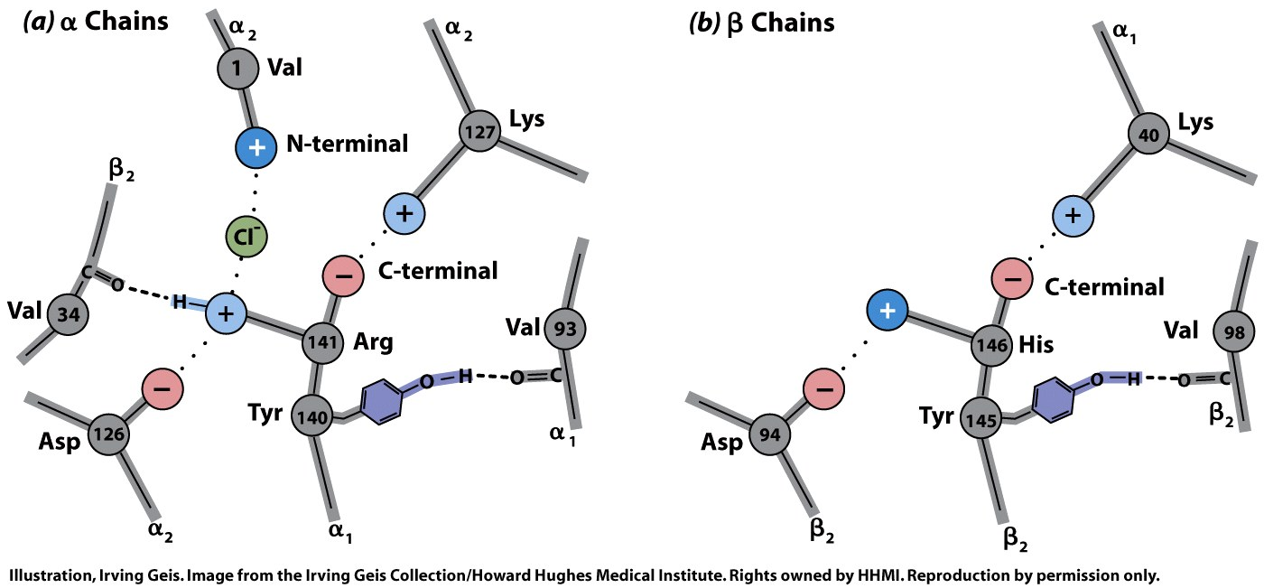
Lower pH increases the liklihood of protonation and salt-bridge formation

Slide 9
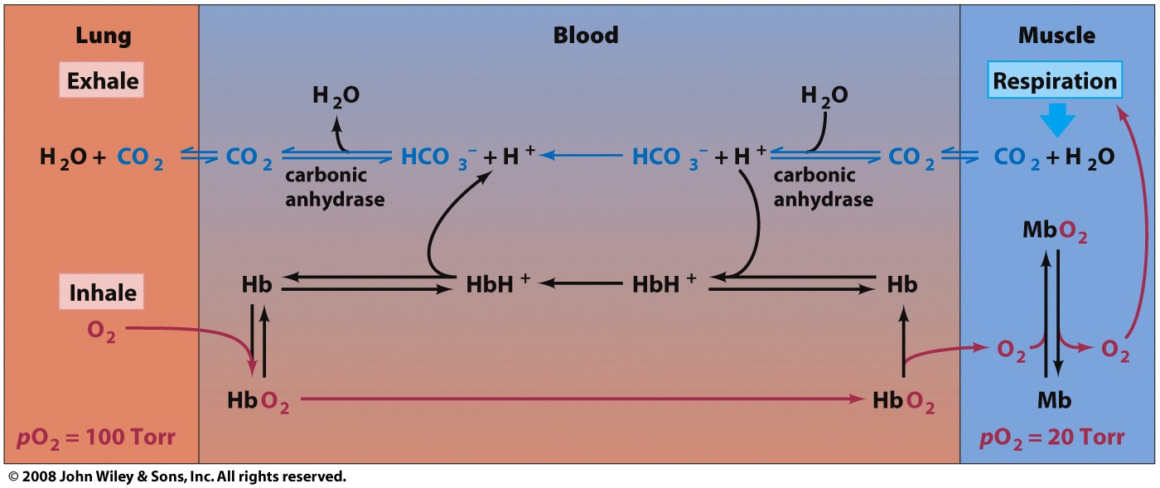
The action of carbonic anhydrase lowers blood pH at the tissues and raises blood pH at the lungs, enhancing O₂ and CO₂ transfer

Slide 10
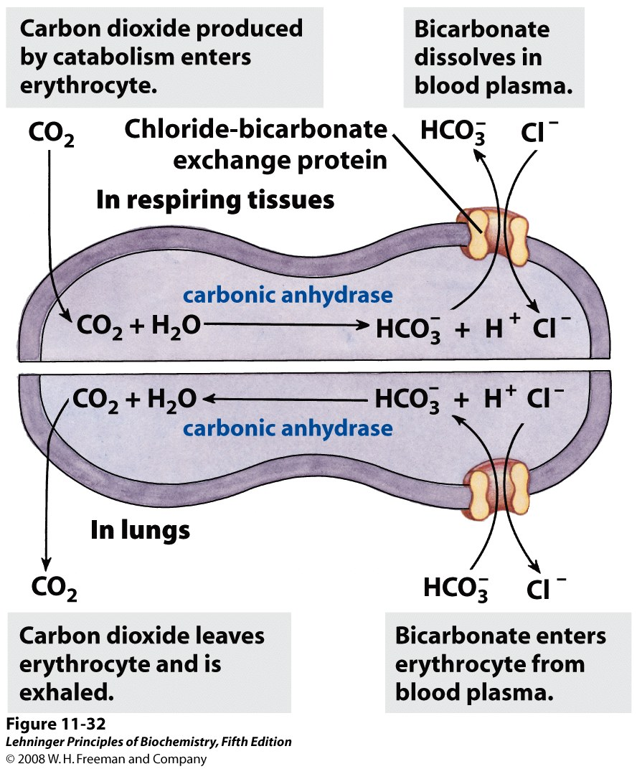
The chloride-bicarbonate exchanger helps increase the CO₂-carrying capacity of blood
Increased [Cl⁻] stabilizes T-state (via salt bridges), thus promoting release of O₂
Notes:
FIGURE 11-32 Chloride-bicarbonate exchanger of the erythrocyte membrane. This cotransport system allows the entry and exit of HCO₃– without changing the membrane potential. Its role is to increase the CO₂-carrying capacity of the blood.

Slide 11
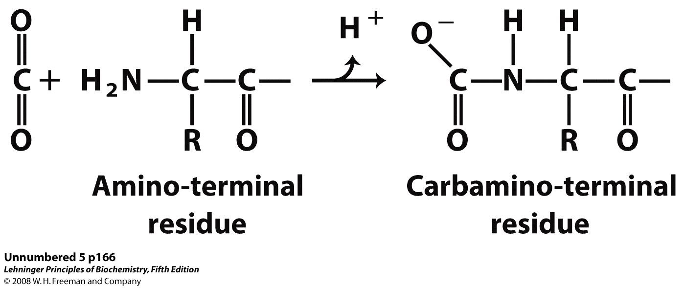
Carbamate formation enhances O₂ and CO₂ transfer between the lungs and tissues

Slide 12
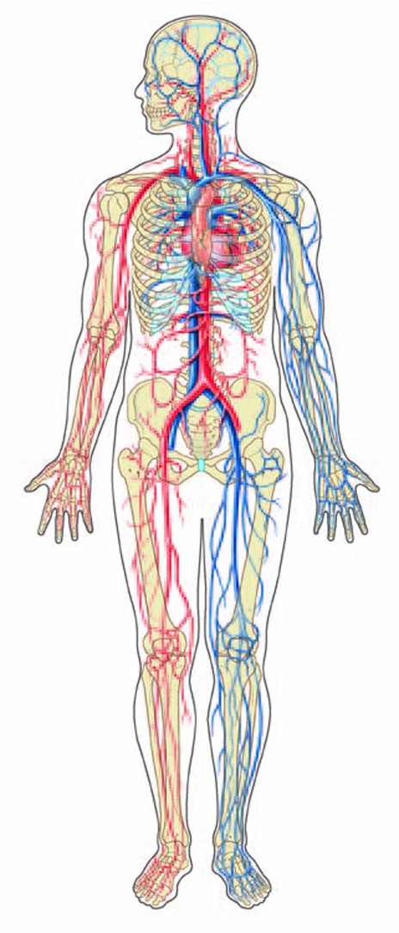
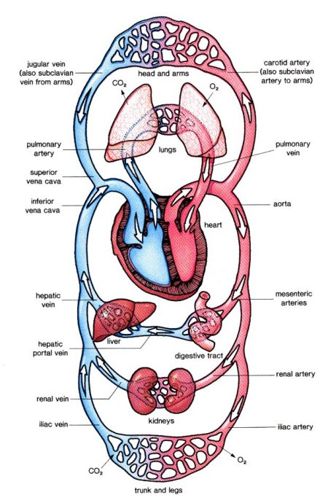

Slide 13
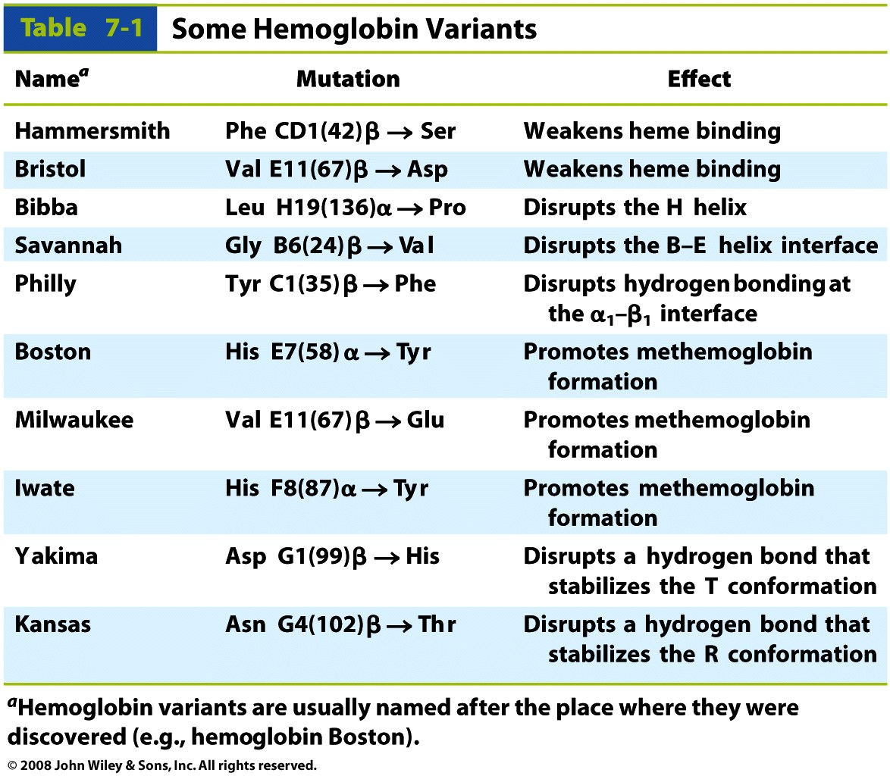
Mutations alter Hb function in different ways

Slide 14
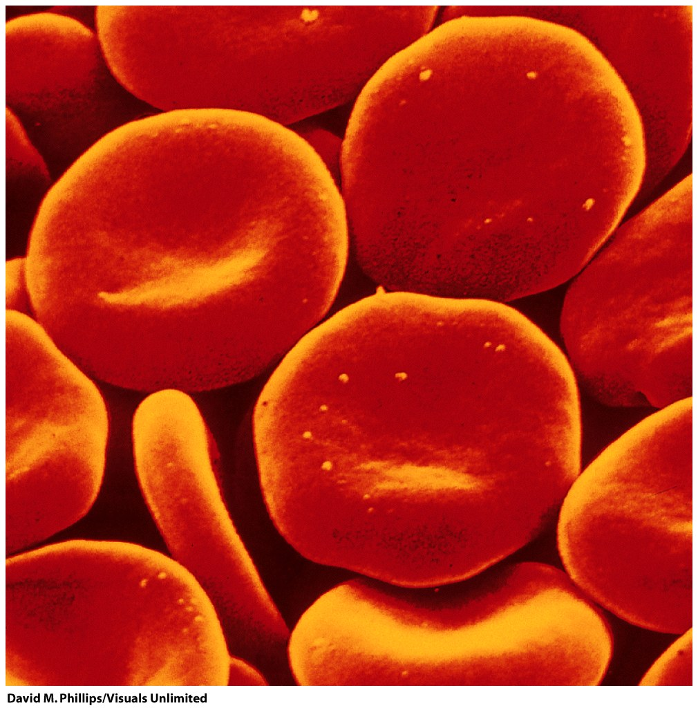
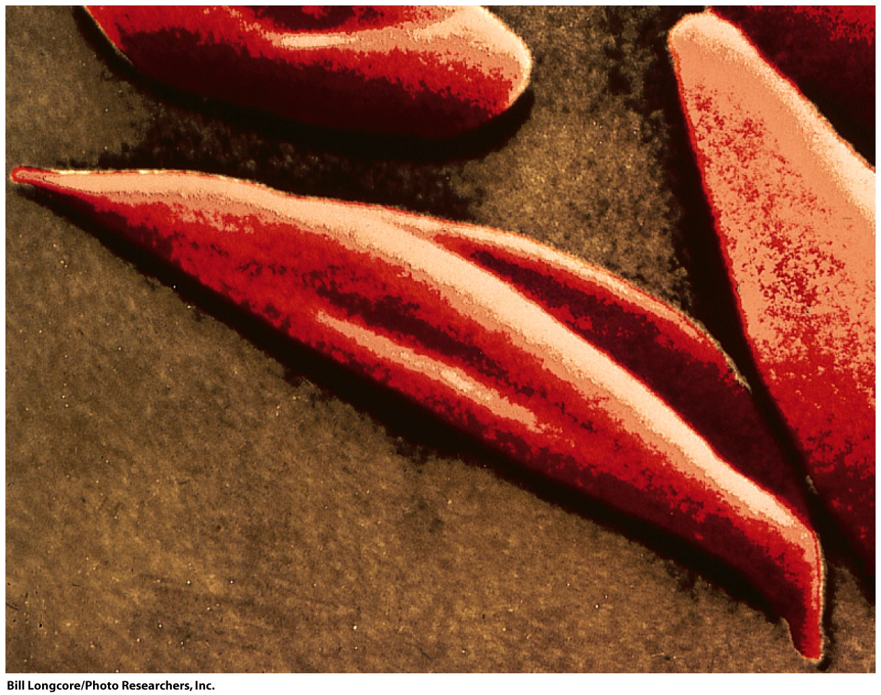
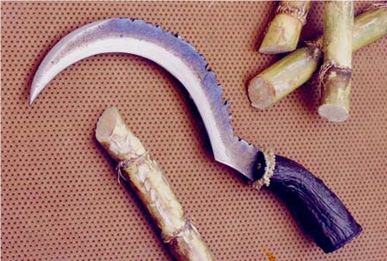
In sickle-cell anemia, mutant Hb can aggregate, leading to sickle-shaped RBCs

Slide 15
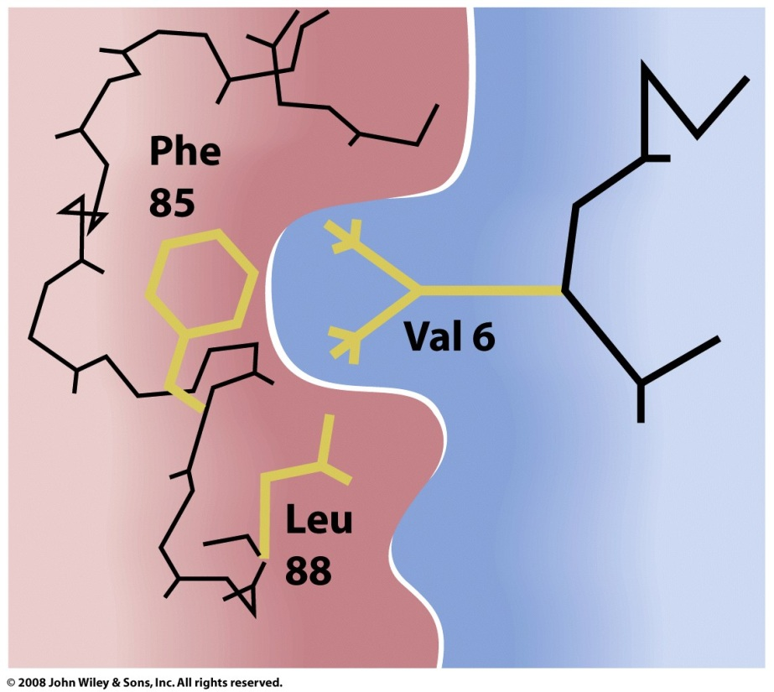
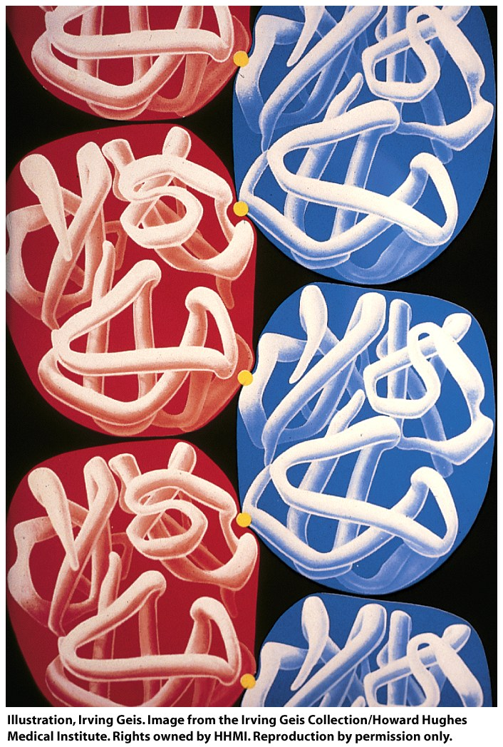
The mutant Val of sickle-Hb can bind in a hydrophobic pocket of a T-state β-chain
Binding of many T-state tetramers results in the formation of long, rigid fibers

Slide 16
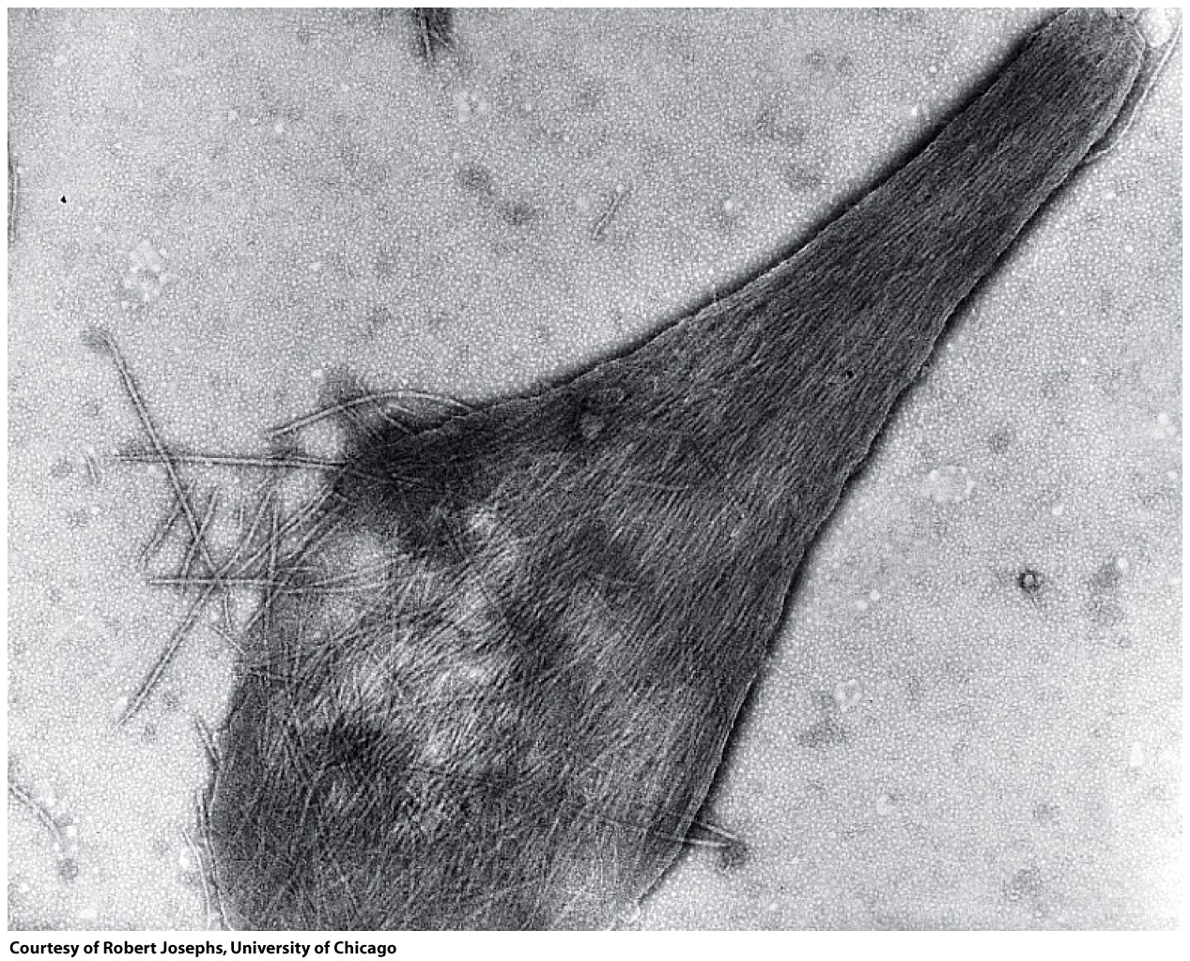
Sickle-hemoglobin fibers can burst the cell

Slide 17
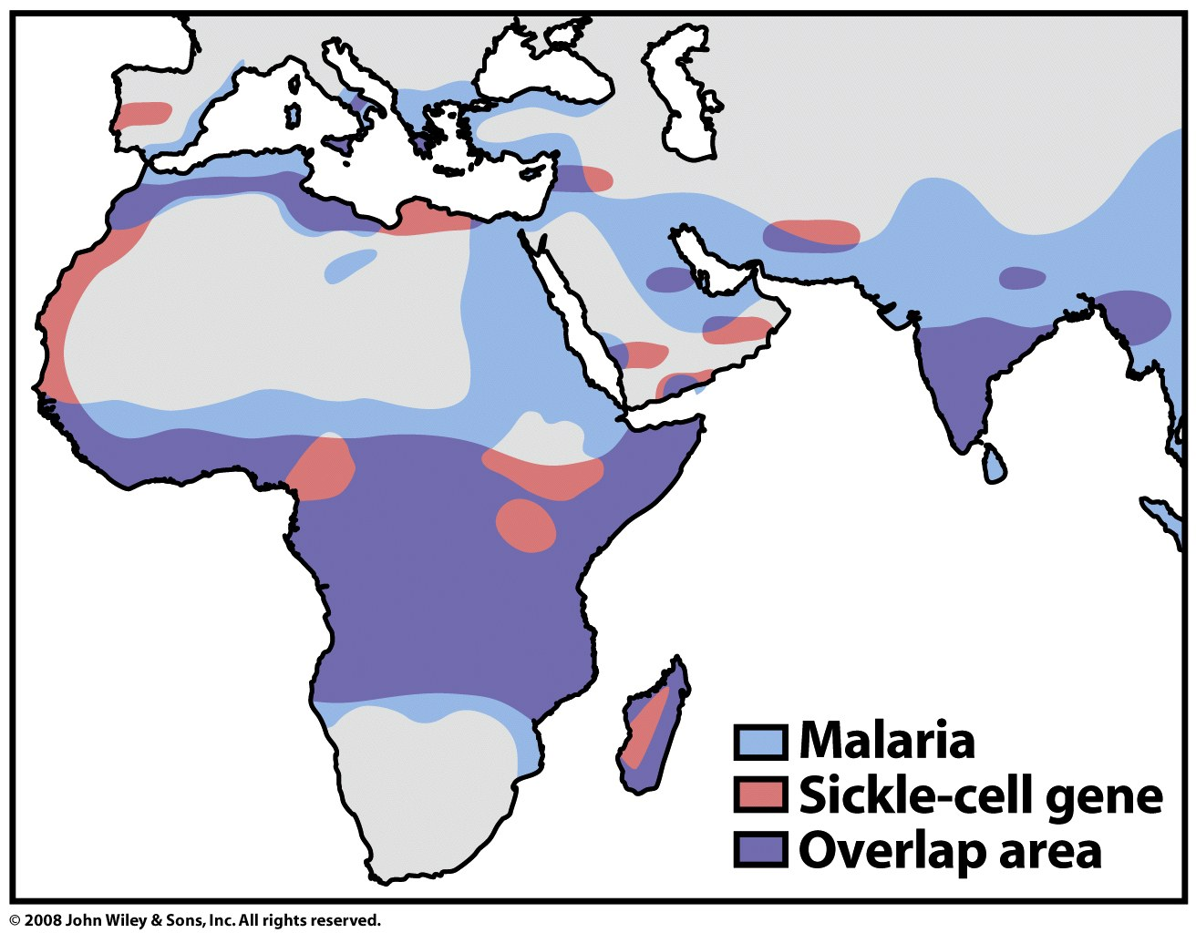
The sickle trait provides resistance to malaria, hence its prevalence in certain populations

