Slide 1
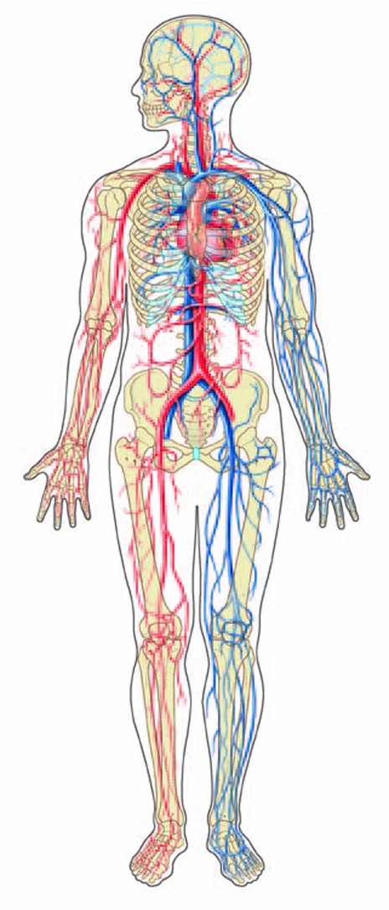
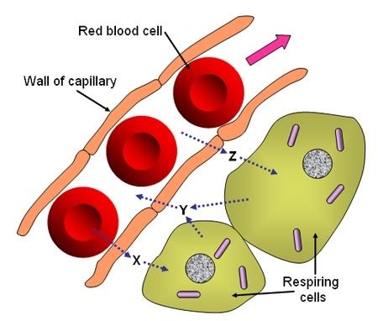
Myoglobin (Mb) and Hemoglobin (Hb) have related, but different, roles in the body
Hemoglobin:
Found in red blood cells
Promotes diffusion of O₂ throughout the body (binds O₂ at lungs, releases at tissues)
Myoglobin:
Found in muscle cells
Promotes diffusion of O₂ into and throughout muscle cell

Slide 2
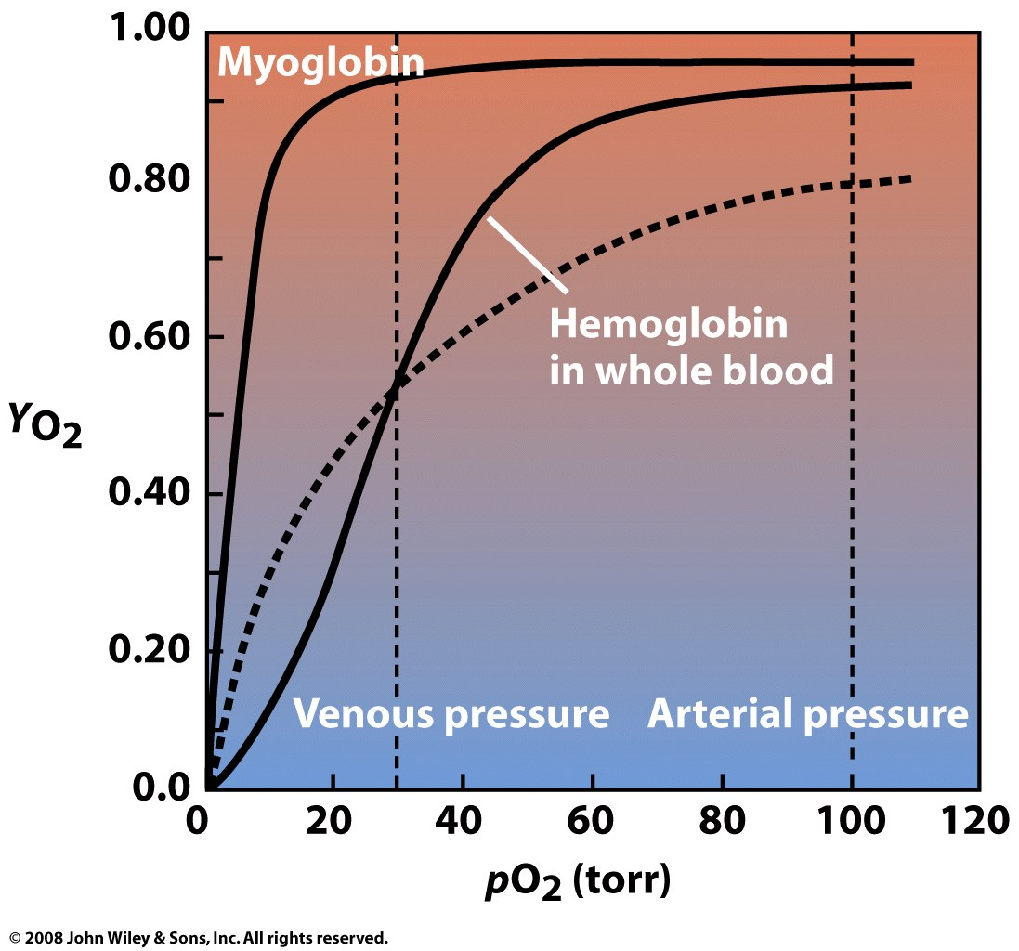
The oxygen-binding curves of Mb and Hb reflect their different functions

Slide 3
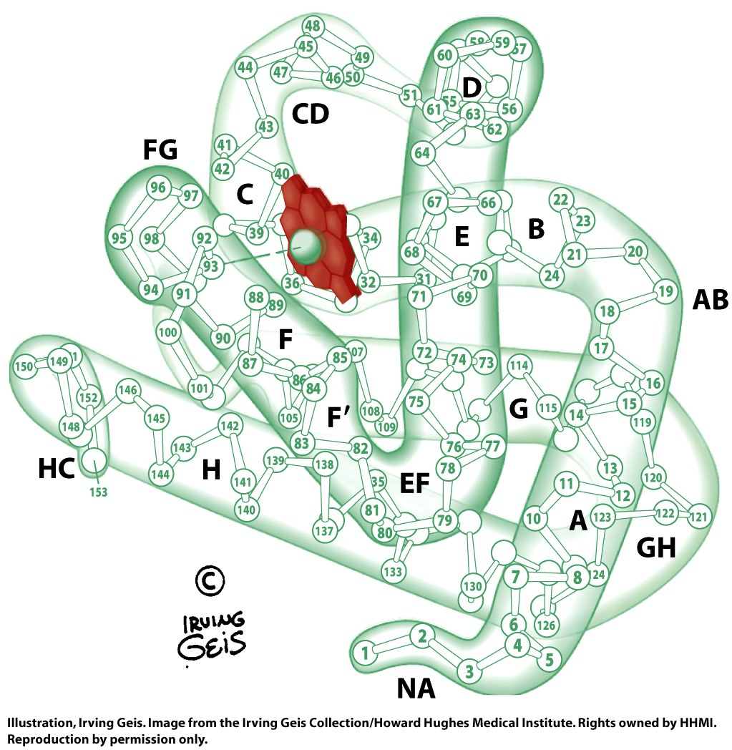
Myoglobin is a single-subunit, α-helical protein, with a heme cofactor that binds O₂

Slide 4
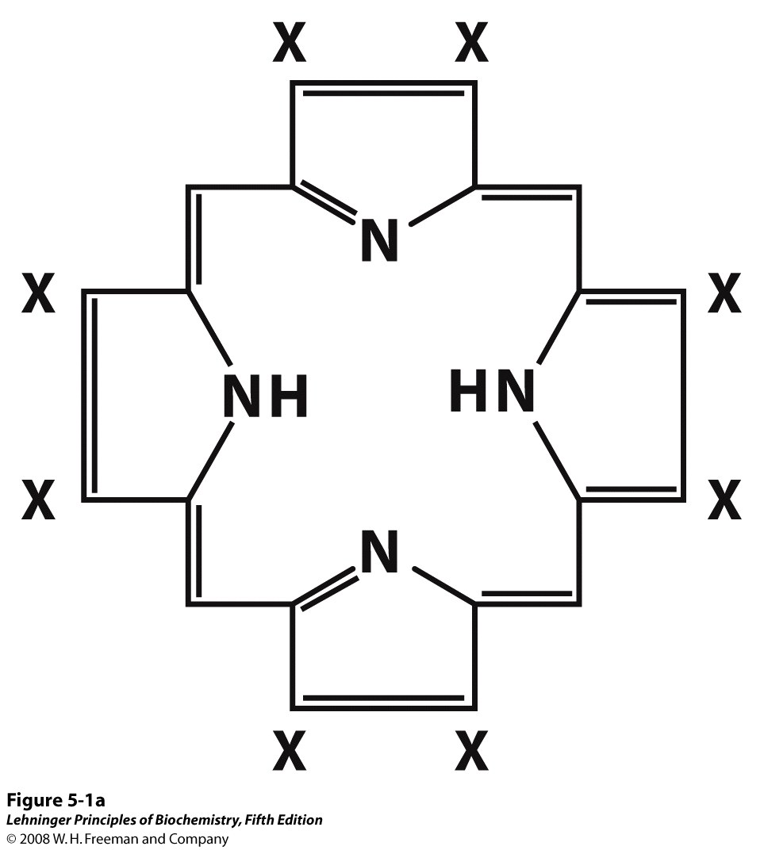
A porphyrin ring forms the base structure of heme (with different hemes differing at X)
Notes:
FIGURE 5-1a Heme. The heme group is present in myoglobin, hemoglobin, and many other proteins, designated heme proteins. Heme consists of a complex organic ring structure, protoporphyrin IX, with a bound iron atom in its ferrous (Fe²⁺) state. (a) Porphyrins, of which protoporphyrin IX is only one example, consist of four pyrrole rings linked by methene bridges, with substitutions at one or more of the positions denoted X.

Slide 5
The heme of myoglobin and hemoglobin is a protoporphyrin IX with a bound Fe²⁺
Notes:
FIGURE 5-1 Heme. The heme group is present in myoglobin, hemoglobin, and many other proteins, designated heme proteins. Heme consists of a complex organic ring structure, protoporphyrin IX, with a bound iron atom in its ferrous (Fe²⁺) state. (a) Porphyrins, of which protoporphyrin IX is only one example, consist of four pyrrole rings linked by methene bridges, with substitutions at one or more of the positions denoted X. (b, c) Two representations of heme (derived from PDB ID 1CCR). The iron atom of heme has six coordination bonds: four in the plane of, and bonded to, the flat porphyrin ring system, and (d) two perpendicular to it.

Slide 6
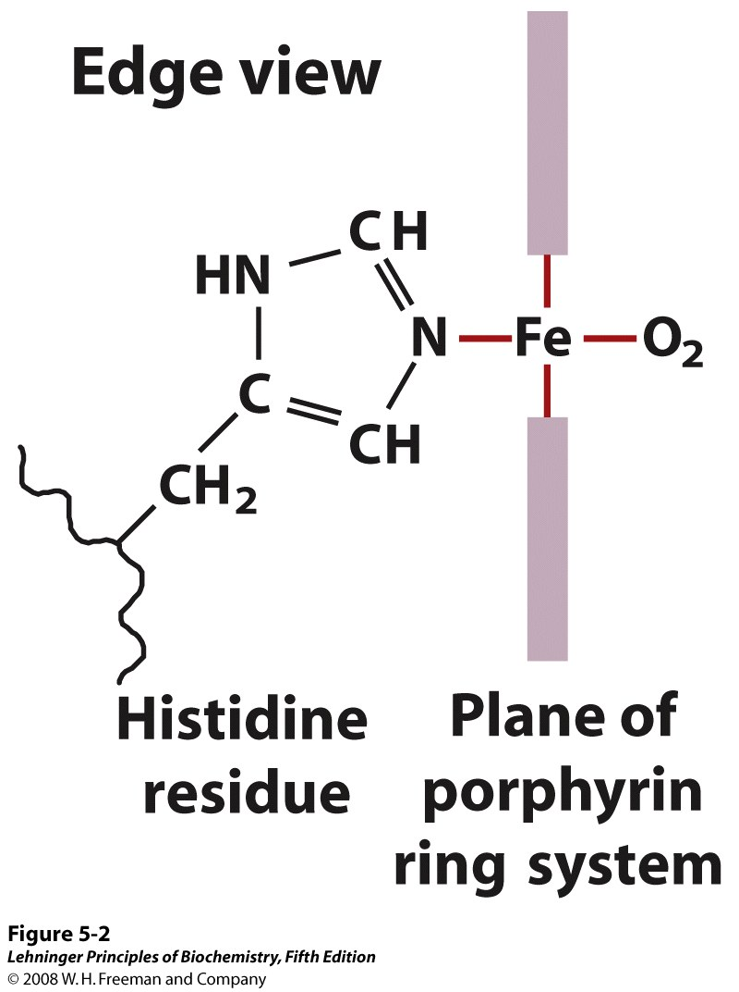
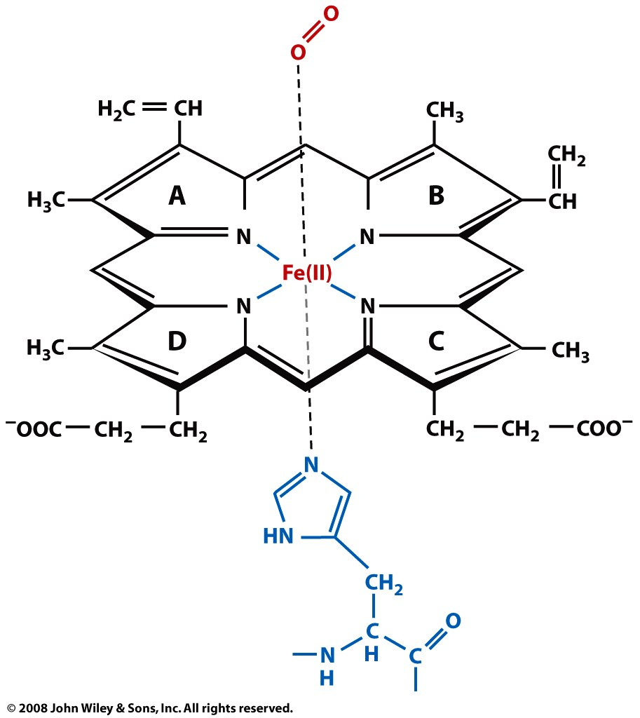
In the globins, the heme iron binds O₂ and the ‘proximal’ histidine of the protein
Notes:
FIGURE 5-2 The heme group viewed from the side. This view shows the two coordination bonds to Fe²⁺ that are perpendicular to the porphyrin ring system. One is occupied by a His residue, sometimes called the proximal His; the other is the binding site for oxygen. The remaining four coordination bonds are in the plane of, and bonded to, the flat porphyrin ring system.

Slide 7
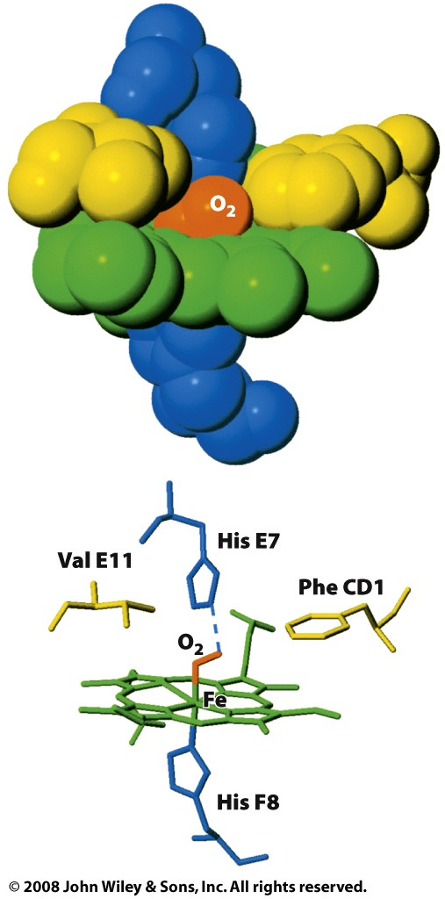
Heme is held in place by the proximal His and by hydrophobic residues
distal
proximal

Slide 8
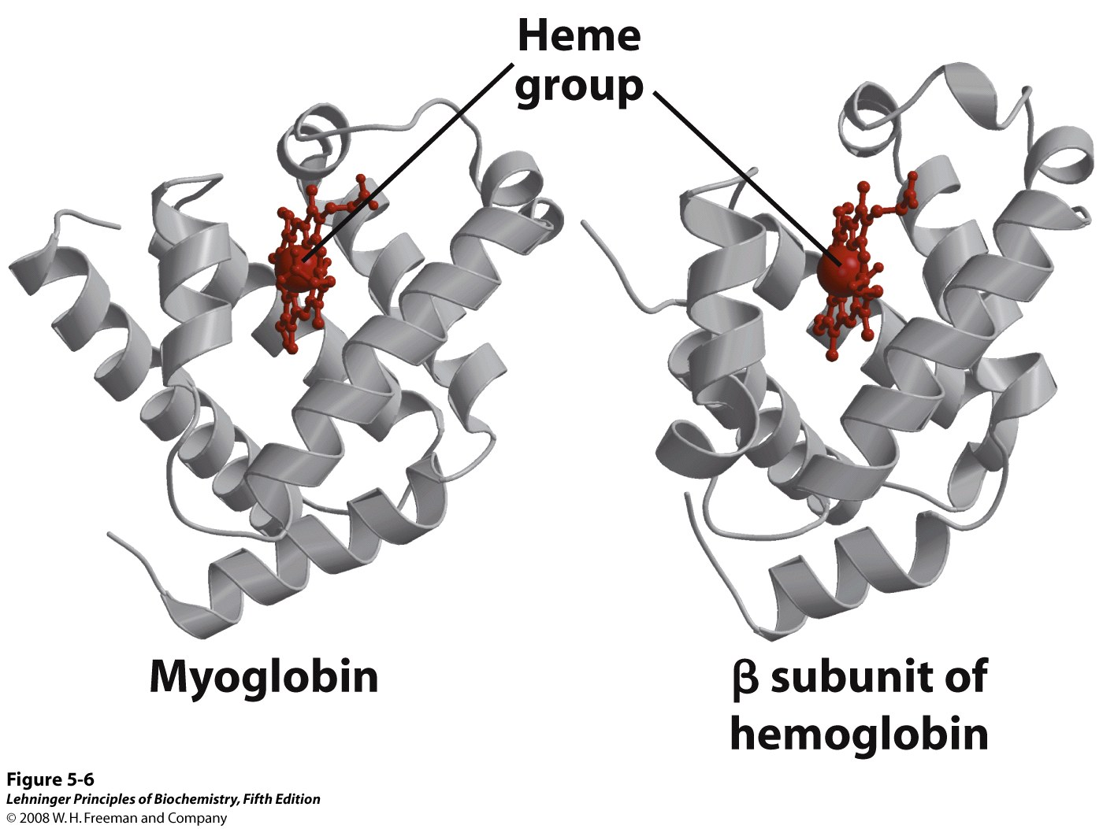
Myoglobin is structurally similar to the subunits of hemoglobin
Notes:
FIGURE 5-6 Comparison of the structures of myoglobin (PDB ID 1MBO) and the β subunit of hemoglobin (derived from PDB ID 1HGA).

Slide 9
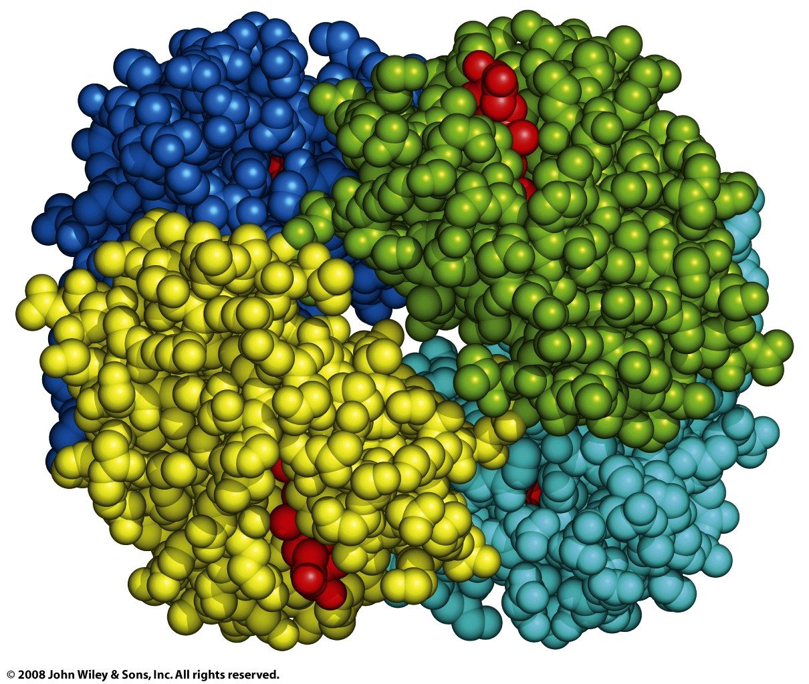
Hemoglobin is a heterotetramer with two α- & two β-subunits (a dimer of αβ protomers)
β₂
α₂
α₁
β₁

Slide 10
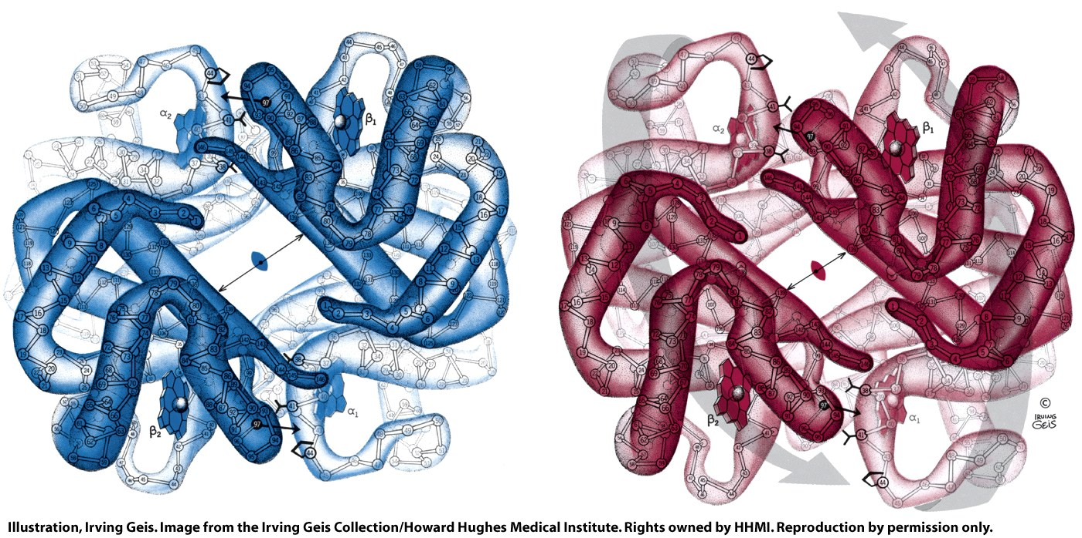
Hemoglobin can adopt two conformations, called ‘deoxyhemoglobin’ & ‘oxyhemoglobin’
α₂
β₁
α₂
β₁
β₂
α₁
β₂
α₁
deoxyhemoglobin
oxyhemoglobin

Slide 11
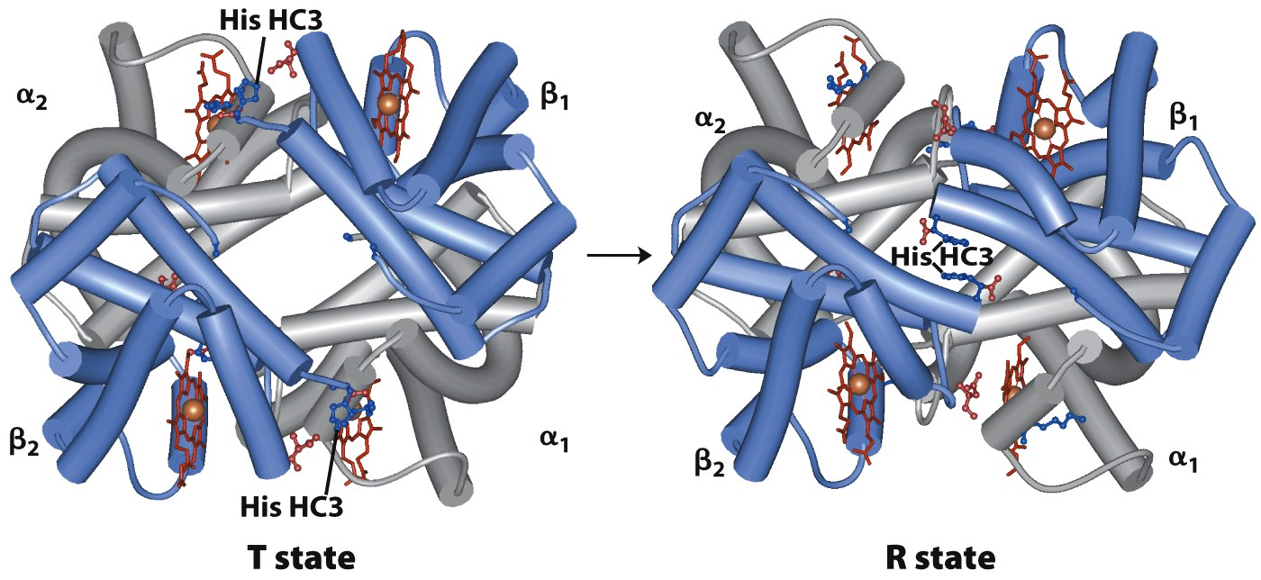
Hb’s conformations are also called ‘T-state’ (for tense) and ‘R-state’ (for relaxed)
(deoxyhemoglobin)
(oxyhemoglobin)
Notes:
FIGURE 5-10 The T → R transition. (PDB ID 1HGA and 1BBB) In these depictions of deoxyhemoglobin, as in Figure 5-9, the α subunits are blue and the β subunits are gray. Positively charged side chains and chain termini involved in ion pairs are shown in blue, their negatively charged partners in red. The Lys C5 of each α subunit and Asp FG1 of each β subunit are visible but not labeled (compare Figure 5-9a). Note that the molecule is oriented slightly differently than in Figure 5-9. The transition from the T state to the R state shifts the subunit pairs substantially, affecting certain ion pairs. Most noticeably, the His HC3 residues at the carboxyl termini of the β subunits, which are involved in ion pairs in the T state, rotate in the R state toward the center of the molecule, where they are no longer in ion pairs. Another dramatic result of the T → R transition is a narrowing of the pocket between the β subunits.

Slide 12
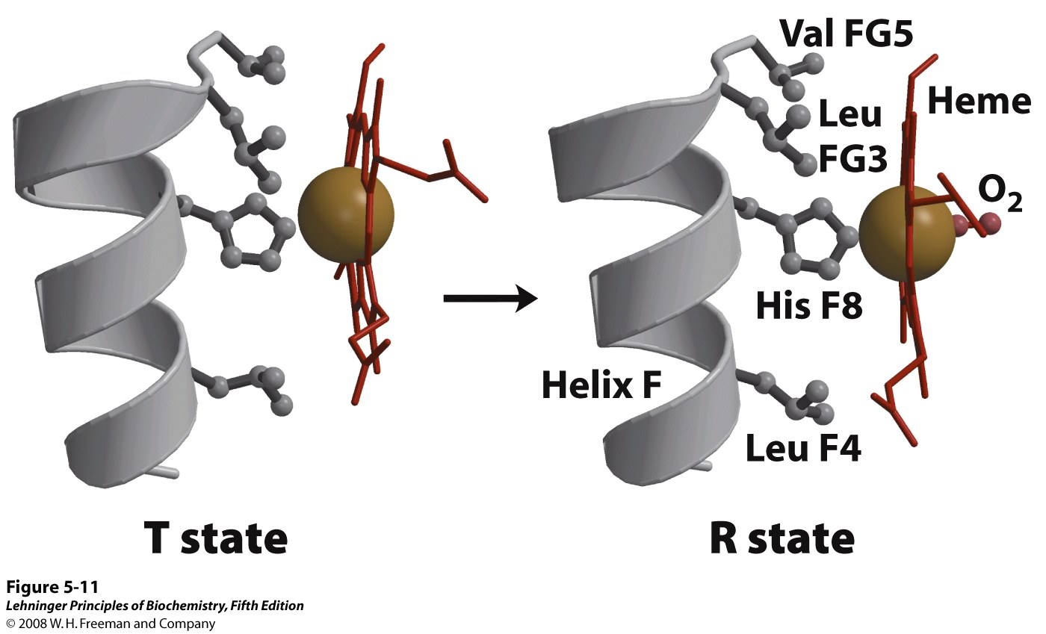
Oxygen binding promotes flattening of the porphyrin ring and shifting of helix F
Notes:
FIGURE 5-11 Changes in conformation near heme on O₂ binding to deoxyhemoglobin. (Derived from PDB ID 1HGA and 1BBB) The shift in the position of helix F when heme binds O₂ is thought to be one of the adjustments that triggers the T → R transition.

Slide 13
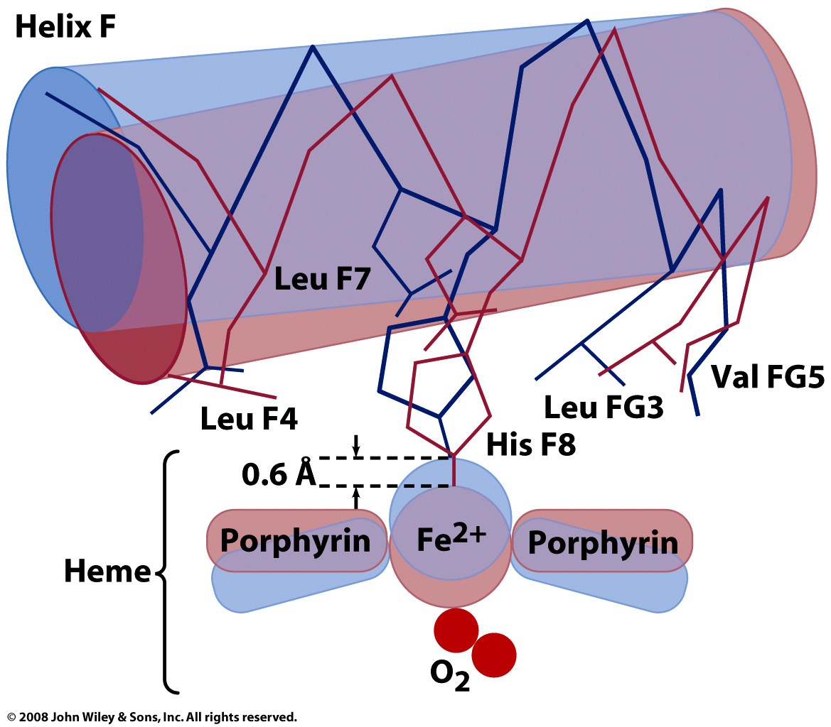
The proximal His links flattening of the heme to shifting of helix F in the T→ R transition

Slide 14
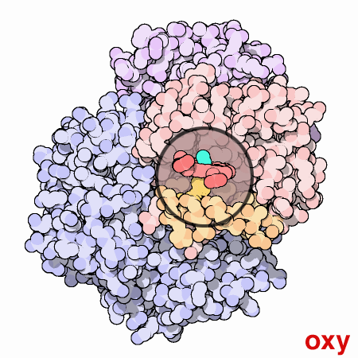
Movement of helix F shifts the entire quaternary structure of hemoglobin

Slide 15
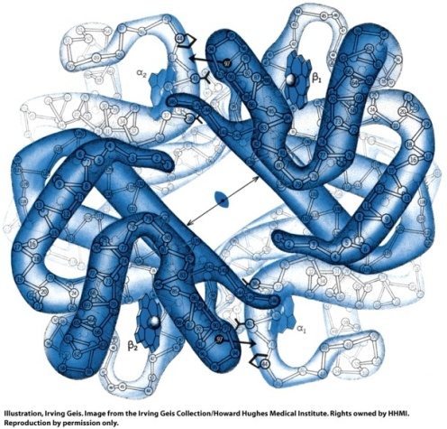
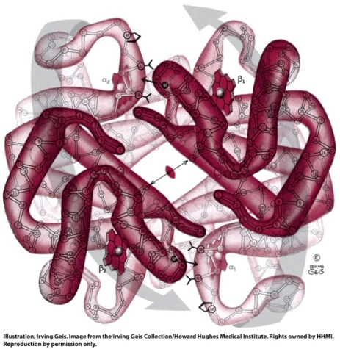
The T and R states have shifted contacts between α & β subunits
T-state
R-state

Slide 16
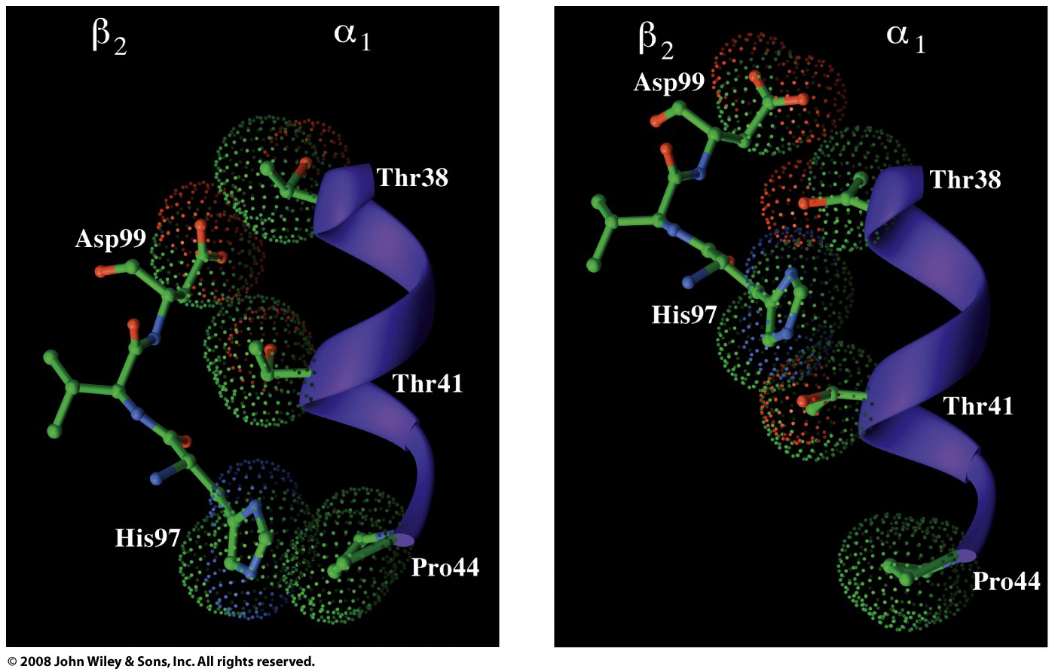
The T and R states have shifted contacts between α & β subunits
T-state
R-state

Slide 17
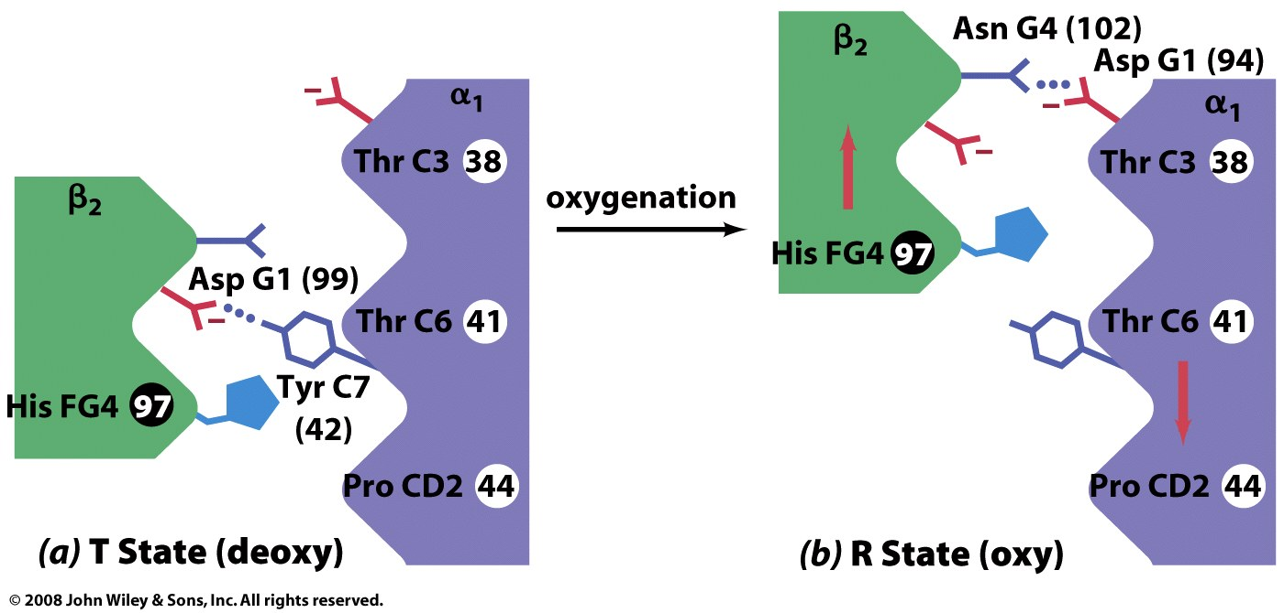
The T and R states have shifted contacts between α & β subunits

Slide 19
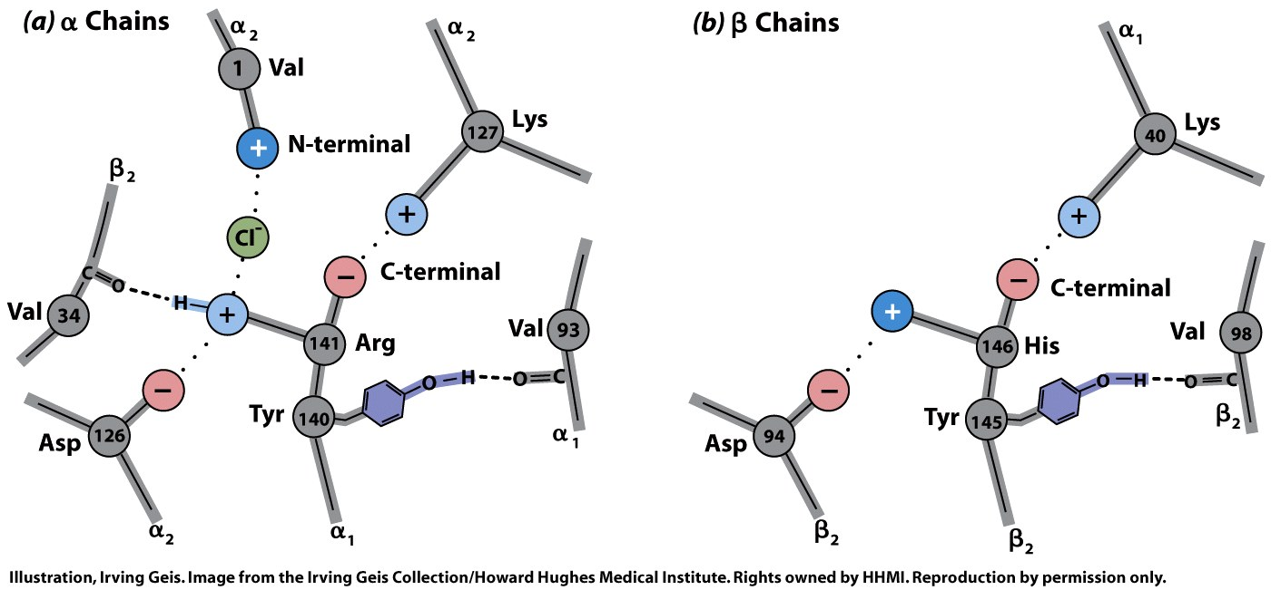
T-state salt bridges are broken in the R-state

Slide 20
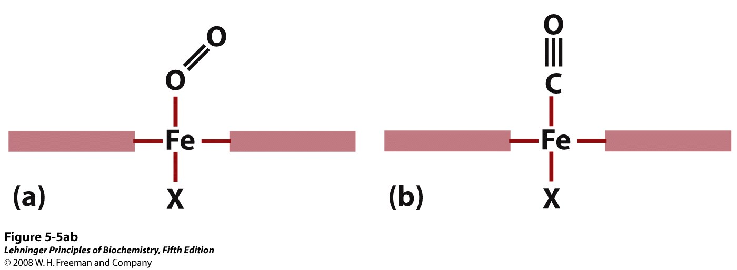
Heme also binds CO, NO, and H₂S (with much higher affinity than O₂)
P₅₀ of CO binding to free heme is ~20,000x lower than P₅₀ of O₂ binding to free heme
Notes:
FIGURE 5-5a,b Steric effects caused by ligand binding to the heme of myoglobin. (a) Oxygen binds to heme with the O₂ axis at an angle, a binding conformation readily accommodated by myoglobin. (b) Carbon monoxide binds to free heme with the CO axis perpendicular to the plane of the porphyrin ring. When binding to the heme in myoglobin, CO is forced to adopt a slight angle because the perpendicular arrangement is sterically blocked by His E7, the distal His. This effect weakens the binding of CO to myoglobin.

Slide 21
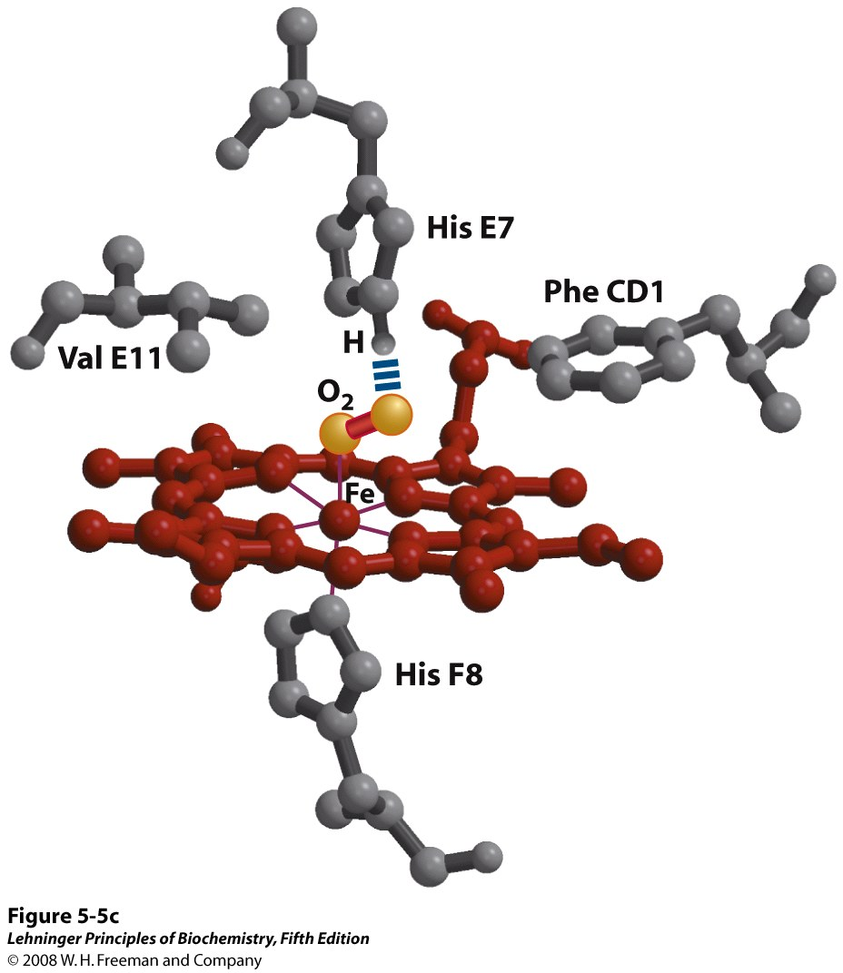
Globin structure reduces heme affinity for CO
P₅₀ of CO binding to globin-bound heme is ~200x lower than P₅₀ of O₂ binding to globin-bound heme
Notes:
FIGURE 5-5c Steric effects caused by ligand binding to the heme of myoglobin. (c) Another view of the heme of myoglobin (derived from PDB ID 1MBO), showing the arrangement of key amino acid residues around the heme. The bound O₂ is hydrogen-bonded to the distal His, His E7 (His⁶⁴), further facilitating the binding of O₂.

Slide 22
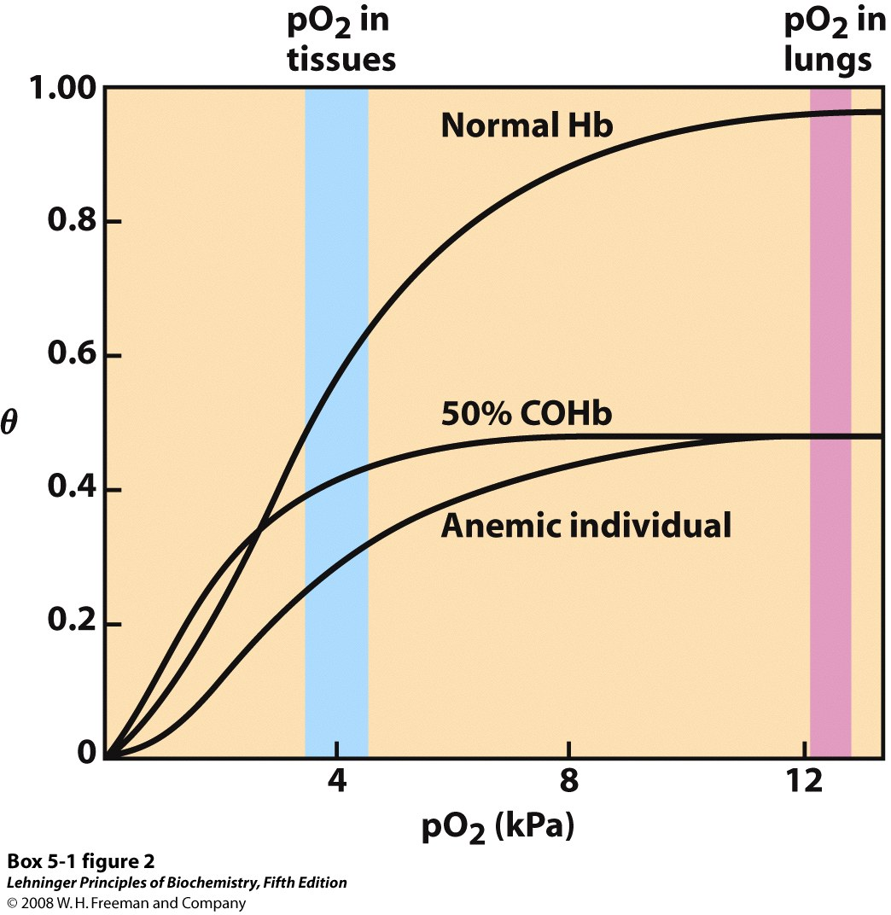
CO is a competitive inhibitor and positive effector of O₂ binding to hemoglobin
Notes:
BOX 5-1 FIGURE 2 Several oxygen-binding curves: for normal hemoglobin, hemoglobin from an anemic individual with only 50% of her hemoglobin functional, and hemoglobin from an individual with 50% of his hemoglobin subunits complexed with CO. The pO₂ in human lungs and tissues is indicated.

