Slide 1
A protein binds a ligand through a specific, reversible interaction
binding
site
Protein-ligand
complex
Protein
Potential ligands:
(any atom or molecule, including a protein)
O⋅⋅⋅⋅H-N
+
-
-
+

Slide 2
Ligand binding may cause a conformational change in the protein that enhances binding
Lock and key model
Induced-fit model
The conformational change may be small (like moving side chains) or large (like shifts in domain position)

Slide 3
The association constant (K_{a}) provides a measure of affinity between protein & ligand
k_{a}
P + L
PL
k_{d}
equilibrium constant
(uppercase K)
rate constants
(lowercase k)
[PL]
k_{a}
Units?
K_{a} = =
Units?
[P][L]
k_{d}
Rate constants are proportionality constants, describing the fraction of the pool that reacts in a given amount of time
Ex: if k_{d} = 0.03 s⁻¹, then 3% of PL dissociates per second

Slide 4
The dissociation constant (K_{d}) is analogous to the association constant (K_{a})
k_{d}
P + L
PL
k_{a}
Units?
[P][L]
k_{d}
1
K_{d} = = =
[PL]
k_{a}
K_{a}
Note: K_{a}, K_{d}, k_{a}, & k_{d} are constant under set conditions; they can change with changes in temperature, pH, [salt], …

Slide 5
The fraction of occupied binding sites (θ) is proportional to the ligand concentration
P + L
PL
When $\left[L\right]≫\left[PL\right]+\left[P\right], [L]$ is constant (usually true for small ligands in cells)
$$θ = \frac{binding sites occupied}{total binding sites} = \frac{[PL]}{\left[PL\right]+[P]}$$
Substitue in $\left[PL\right]=K_{a}\left[L\right][P]$
$θ=\frac{K_{a}\left[L\right][P]}{K_{a}\left[L\right]\left[P\right]+[P]} = \frac{K_{a}\left[L\right]}{K_{a}\left[L\right]+1} = \frac{[L]}{\left[L\right]+\frac{1}{K_{a}}} =$ $\frac{[L]}{\left[L\right]+K_{d}}$

Slide 6
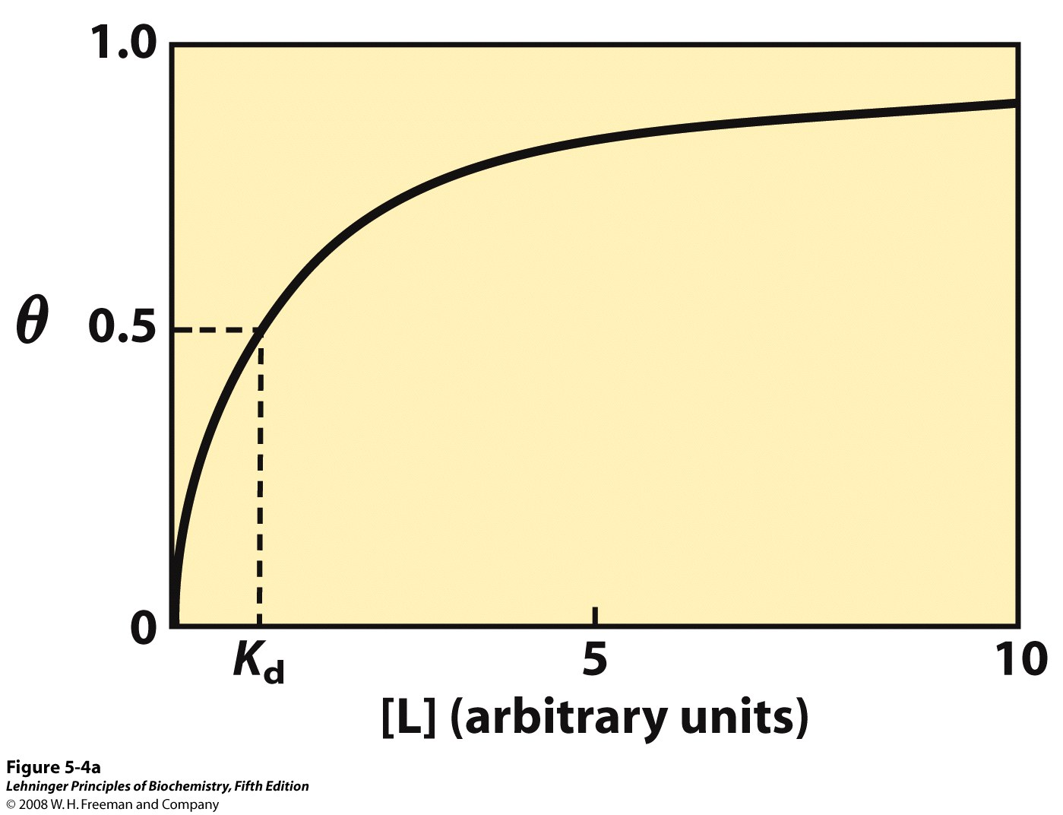
The fraction of occupied ligand-binding sites θ depends on [L] and the binding affinity
$$when{ K}_{d}=\left[L\right]:$$
$$θ=\frac{[L]}{\left[L\right]+K_{d}}=\frac{[L]}{2[L]}=0.5$$
Notes:
FIGURE 5-4a Graphical representations of ligand binding. The fraction of ligand-binding sites occupied, θ, is plotted against the concentration of free ligand. Both curves are rectangular hyperbolas. (a) A hypothetical binding curve for a ligand L. The [L] at which half of the available ligand-binding sites are occupied is equivalent to 1/K_{a}, or K_{d}. The curve has a horizontal asymptote at θ = 1 and a vertical asymptote (not shown) at [L] = –1/K_{a}.

Slide 7
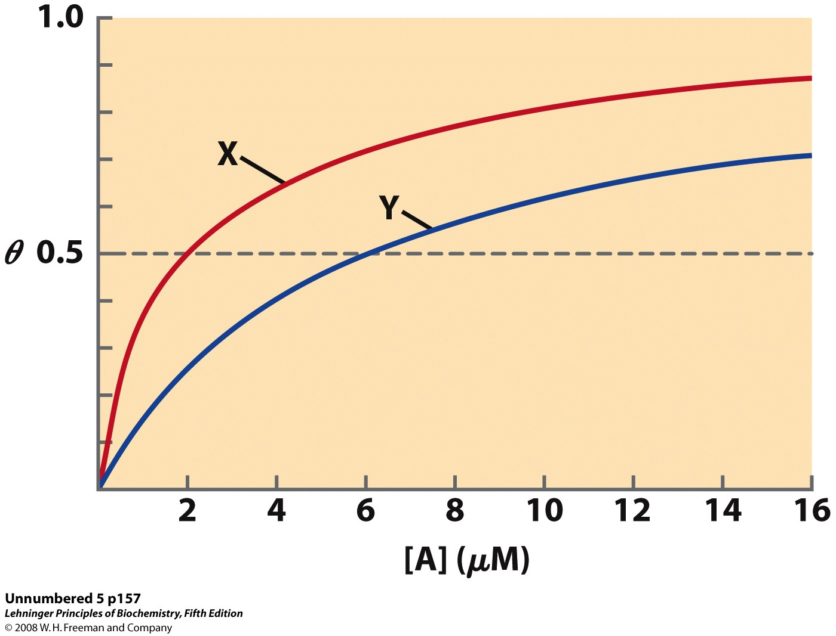
A protein with higher affinity for a ligand has a higher binding curve and lower K_{d}

Slide 8
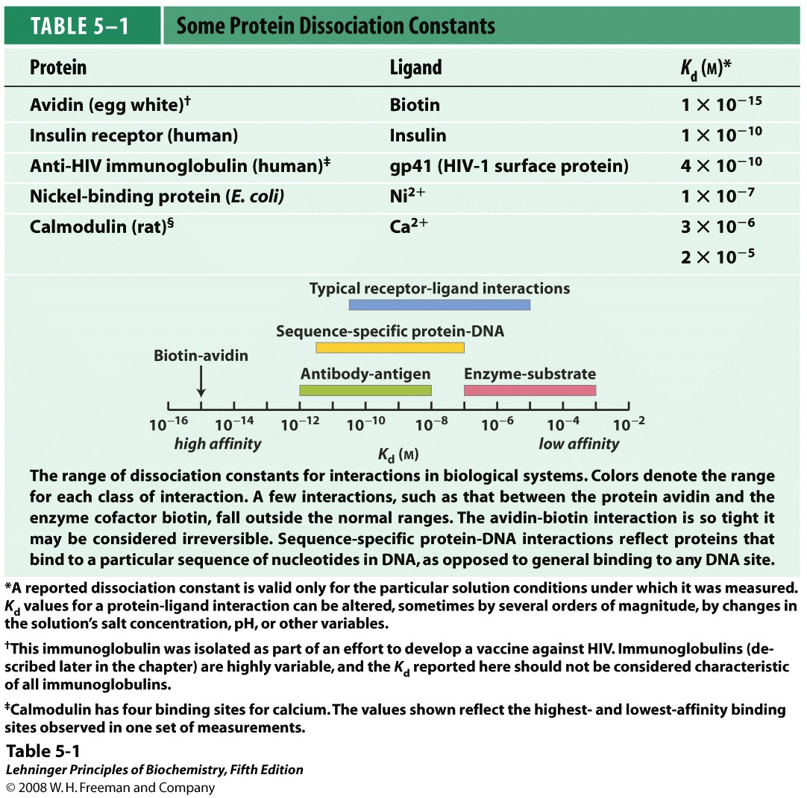
Protein-ligand dissociation constants (K_{d}’s) vary over several orders of magnitude

Slide 9
Some proteins have varying affinity for a ligand, depending on their conformation
Allosteric protein
Binding of a ligand (L₁) to one site affects binding properties of another site (via a conformational change in the protein)
L₁
L₁
L₂
L₂
‘modulator’
or ‘effector’
Modulator (L₁) is an ‘activator’ if it increases affinity at 2nd site (where L₂ binds)
Modulator (L₁) is an ‘inhibitor’ if it decreases affinity at 2nd site (where L₂ binds)

Slide 10
Allostery may involve different ligands, the same ligands, or both
Heterotropic interaction
Modulator and other ligand are different
L₁
L₁
L₂
L₂
Homotropic interaction (cooperativity)
Modulator and other ligand are the same
L
L
L
L

Slide 11
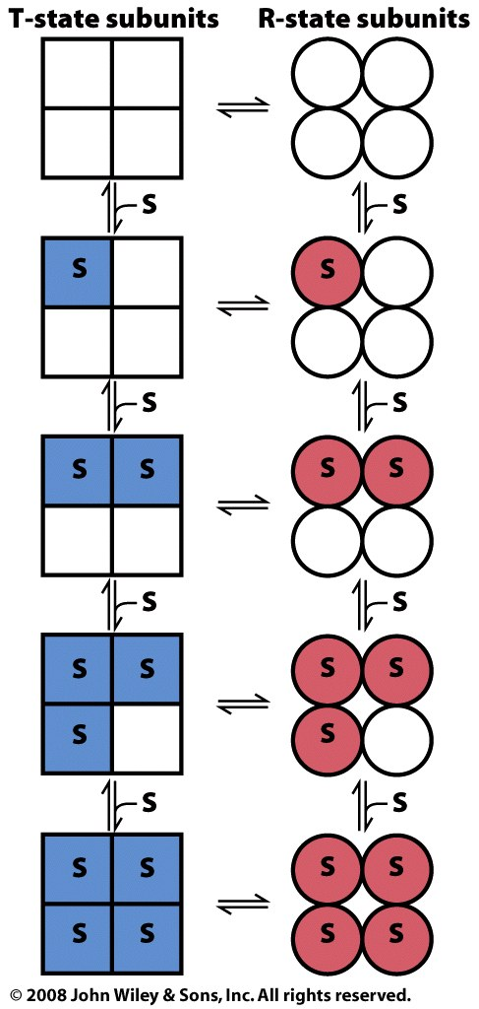
The symmetry (concerted) model of cooperativity requires symmetry of the allosteric protein
Subunits can adopt one of two possible conformations: T or R
All subunits must adopt the same conformation (protein is always symmetric)
Ligand (S) can bind to:
T-state with low affinity
R-state with high affinity
Equilibrium between T and R states is influenced by ligand binding
Switching between T and R is concerted; all subunits transition simultaneously

Slide 12
The sequential model of cooperativity allows multiple conformations for each subunit
Subunits can adopt multiple conformations
Binding of ligand (S) induces conformational changes in the bound subunit and in neighboring subunits
Different subunits may have different conformations, each with different ligand affinities
Bound conformations may have higher or lower affinity for ligand than the free protein

Slide 13
Binding curves for allosteric proteins vary depending on the presence of modulators

