Slide 1
Methods for determining protein structure
Sequence:
Edman degradation
Mass spectrometry
Secondary structure:
Circular Dichroism
FTIR
Tertiary, quaternary structure:
NMR
X-ray crystallography

Slide 2
Protein sequencing approaches depend on what is known and what is the goal
Protein is unknown, from organism with no DNA sequence information – starting from scratch
Purify protein & separate chains (if multimer)
Fragment and sequence each chain
Fragment differently and sequence
Reassemble sequence based on overlapping fragments
Protein is unknown or known, and comes from an organism with known DNA sequence
Purify protein (& separate chains)
Fragment chain(s) and sequence or measure mass
Use sequence database to reassemble sequence

Slide 3
Protein sequencing from scratch
Step 0: Purify the protein
Step 1: Separate the chains (if multimeric)
If needed, reduce disulfides and block free thiols

Slide 4
Protein sequencing from scratch
Step 0: Purify the protein
Step 1: Separate the chains (if multimeric)
Step 2: Fragment each polypeptide
Enzymatically, with endopeptidase, chemically (e.g. with cyanogen bromide), or physically (e.g. through collision in MS)

Slide 5
Step 2: Fragment each polypeptide
Cyanogen bromide (CNBr): R_{n-1} = Met

Slide 6
Protein sequencing from scratch
Step 0: Purify the protein
Step 1: Separate the chains (if multimeric)
Step 2: Fragment each polypeptide
Step 3: Sequence the fragments
Via, e.g., Edman degradation or Mass spectrometry

Slide 7
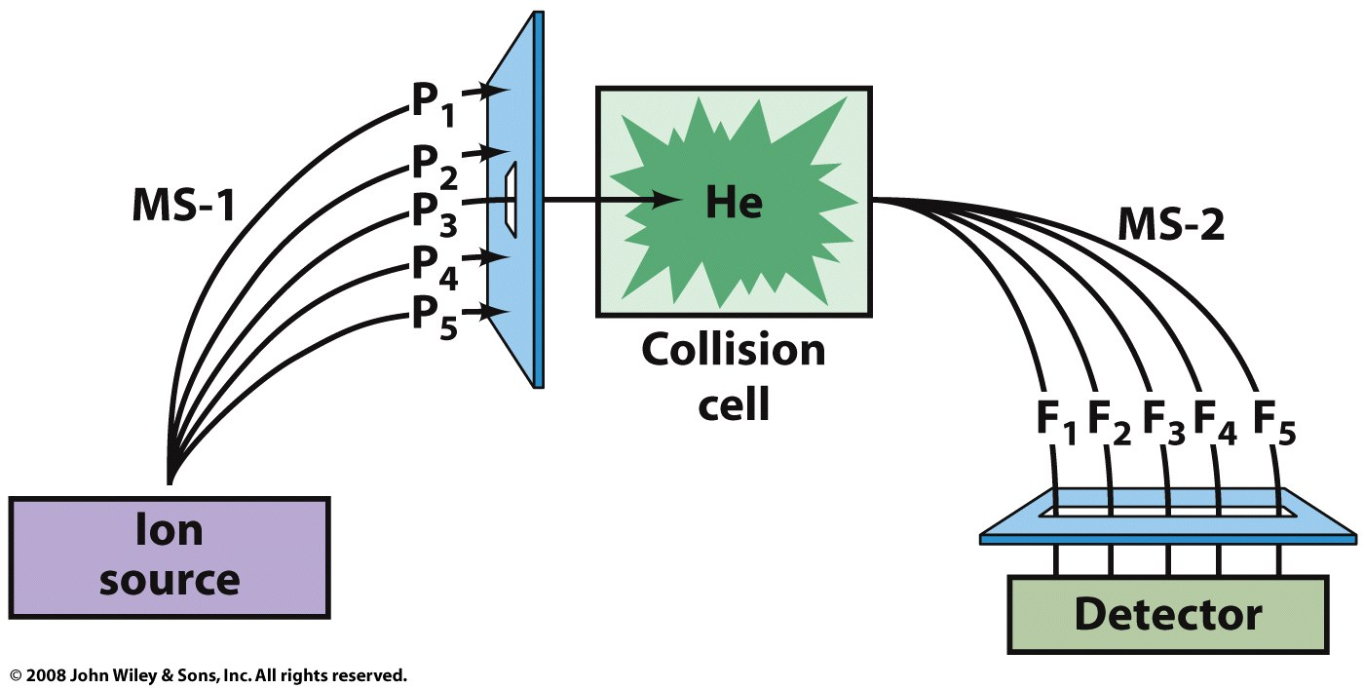
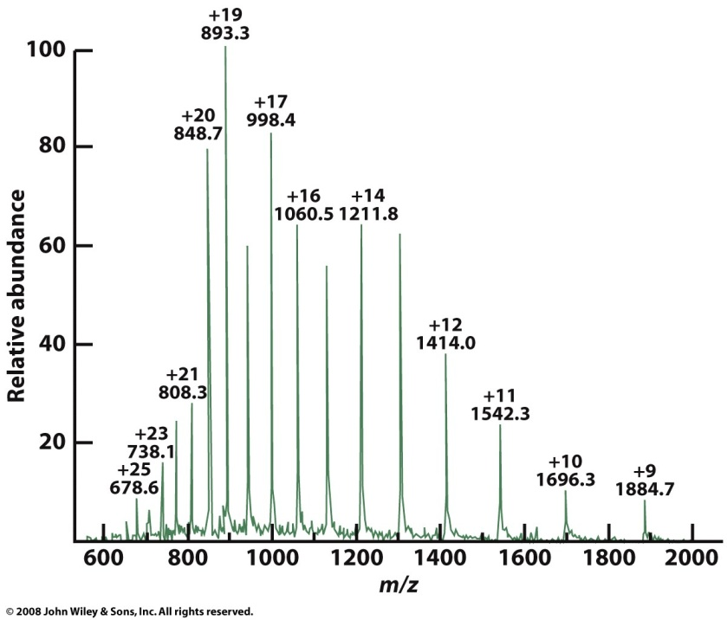
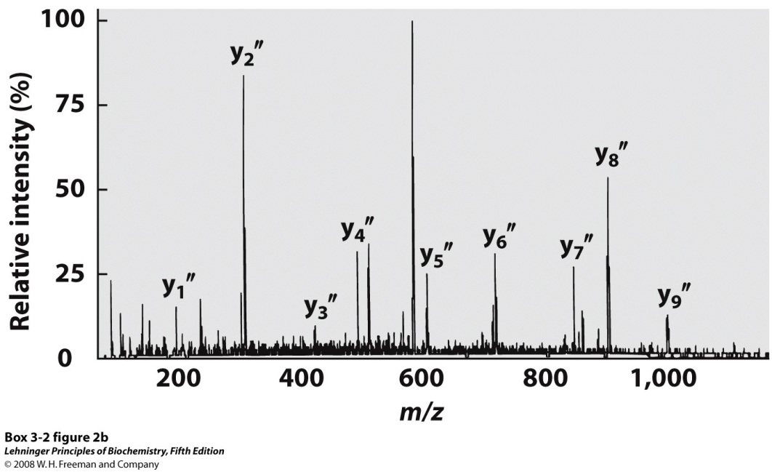
Sequence peptides with mass spectrometry (MS/MS)

Slide 8
MS cleavage occurs mainly at peptide bonds, and charge is retained in one product
Notes:
BOX 3-2 FIGURE 2a Obtaining protein sequence information with tandem MS. (a) After proteolytic hydrolysis, a protein solution is injected into a mass spectrometer (MS-1). The different peptides are sorted so that only one type is selected for further analysis. The selected peptide is further fragmented in a chamber between the two mass spectrometers, and m/z for each fragment is measured in the second mass spectrometer (MS-2). Many of the ions generated during this second fragmentation result from breakage of the peptide bond, as shown. These are called b-type or y-type ions, depending on whether the charge is retained on the amino- or carboxyl-terminal side, respectively.

Slide 9
Protein sequencing from scratch
Step 0: Purify the protein
Step 1: Separate the chains (if multimeric)
Step 2: Fragment each polypeptide
Step 3: Sequence the fragments
Step 4: Reconstruct the sequence

Slide 10
Protein sequencing approaches depend on what is known and what is the goal
Protein is unknown, from organism with no DNA sequence information – starting from scratch
Purify protein & separate chains (if multimer)
Fragment and sequence each chain
Fragment differently and sequence
Reassemble sequence based on overlapping fragments
Protein is unknown or known, and comes from an organism with known DNA sequence
Purify protein (& separate chains)
Fragment chain(s) and sequence or measure mass
Use sequence database to reassemble sequence

Slide 11
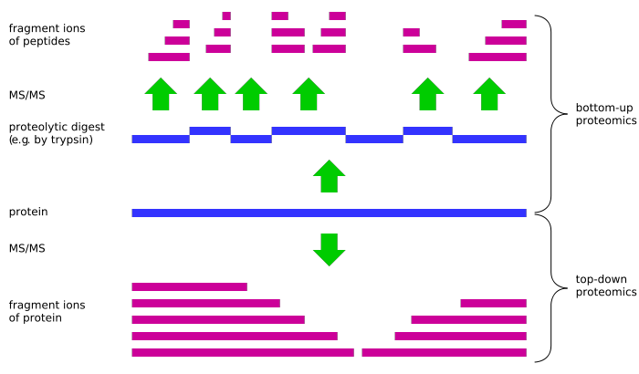
There are different approaches for using mass spectrometry to sequence a protein
Bottom-Up Proteomics
Fragment protein (e.g. enzymatically) and separate fragments
Ionize fragments, trap in the spectrometer, and measure m/z
Select one m/z peak and fragment (e.g. by collision)
Measure m/z of the smaller fragments and use a database to match the peaks to known sequences

Slide 12
There are different approaches for using mass spectrometry to sequence a protein
Top-Down Proteomics
Ionize whole protein(s), trap in the spectrometer, and measure m/z
Use the instrument to select one m/z peak and fragment the protein (e.g. by collision)
Measure m/z ratios of the fragments and use a database to match the peaks to known sequences
OR Select a peak and fragment again, then match to sequence (Selection and fragmentation may be repeated over and over)

Slide 13
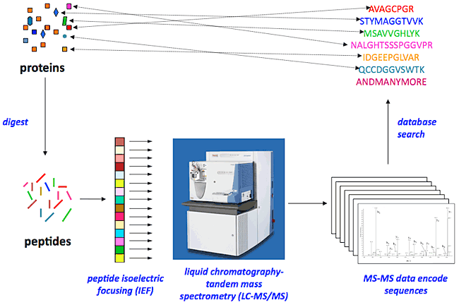
In shotgun proteomics, mass spec. is used to sequence mixtures of proteins
Mixture of many proteins
Matched sequences
Enzymatic digest
Separation of peptides,
Ionization in MS, Fragmentation
Submit peaks to database
Mixture of peptides from different proteins

Slide 14
Methods for determining protein structure
Sequence:
Edman degradation
Mass spectrometry
Secondary structure:
Circular Dichroism
FTIR
Tertiary, quaternary structure:
NMR
X-ray crystallography

Slide 15
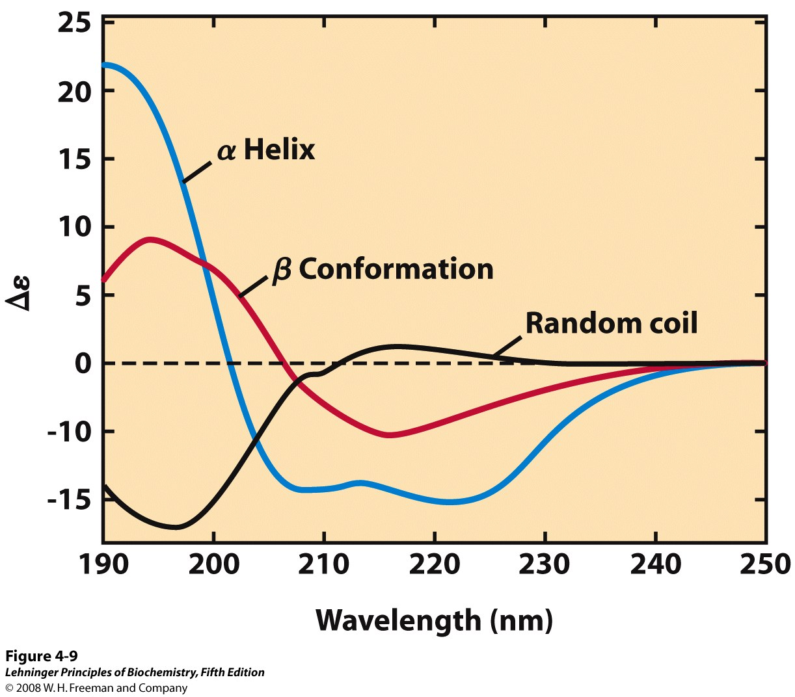
Circular dichroism (CD) measures amide absorption of circularly polarized UV light
Ellipticity (Δε) is the difference in absorption of left-handed and right-handed circularly polarized light
Different secondary structures show different patterns of ellipticity
Protein’s CD spectrum is ‘deconvoluted’ to estimate fractional contribution of helix, sheet, turn, and coil
Notes:
FIGURE 4-9 Circular dichroism spectroscopy. These spectra show polylysine entirely as alpha; helix, as β conformation, or as a denatured, random coil. The y axis unit is a simplified version of the units most commonly used in CD experiments. Since the curves are different for alpha; helix, β conformation, and random coil, the CD spectrum for a given protein can provide a rough estimate for the fraction of the protein made up of the two most common secondary structures. The CD spectrum of the native protein can serve as a benchmark for the folded state, useful for monitoring denaturation or conformational changes brought about by changes in solution conditions.

Slide 16
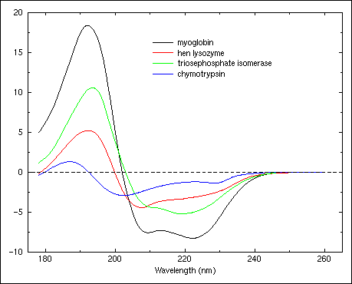
Proteins with different compositions of 2° structure give different CD spectra

Slide 17
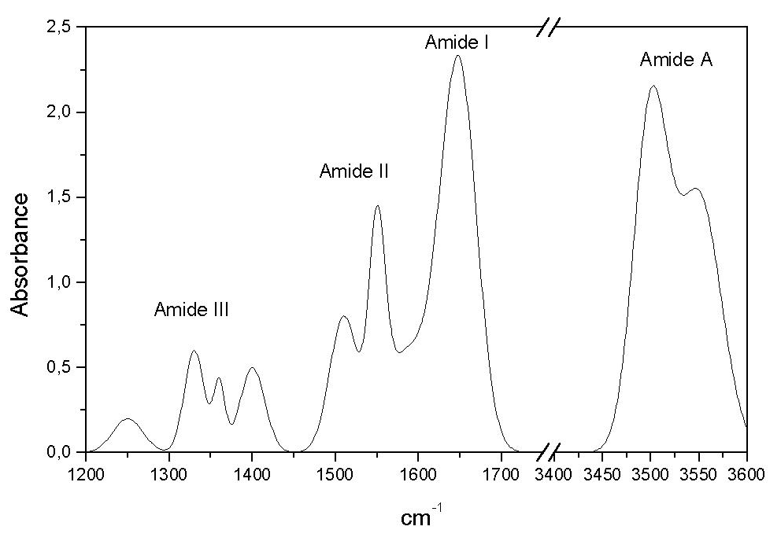
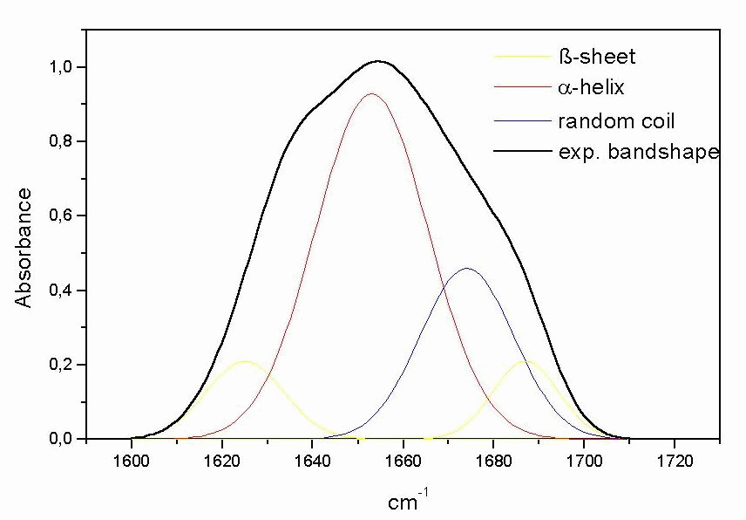
Fourier transform infrared (FTIR) spectra show amide absorption of infrared light
Peak frequencies show bond stretching and bending, which vary with protein conformation
C=O stretching frequency of amide I band correlates with secondary structure
Protein’s FTIR spectrum is ‘deconvoluted’ to estimate fractional contribution of helix, sheet, and coil

Slide 18
Methods for determining protein structure
Sequence:
Edman degradation
Mass spectrometry
Secondary structure:
Circular Dichroism
FTIR
Tertiary, quaternary structure:
NMR
X-ray crystallography

Slide 19
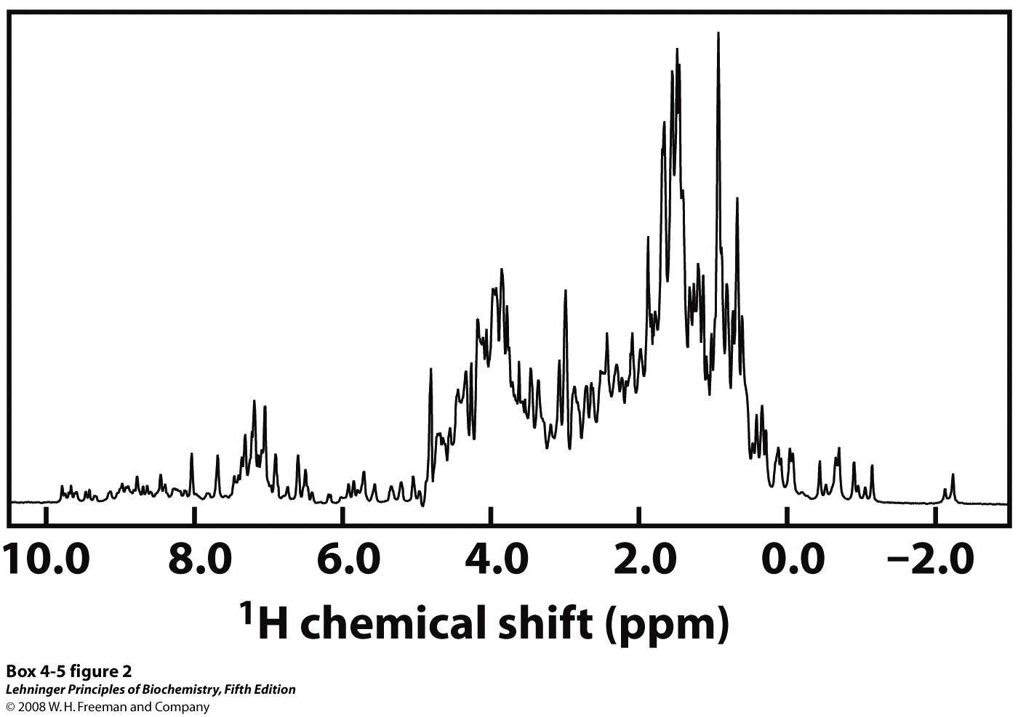
Proteins have too many protons to be resolved by one-dimensional NMR
Notes:
BOX 4-5 FIGURE 2 One-dimensional NMR spectrum of a globin from a marine blood worm. This protein and sperm whale myoglobin are very close structural analogs, belonging to the same protein structural family and sharing an oxygen-transport function.

Slide 20
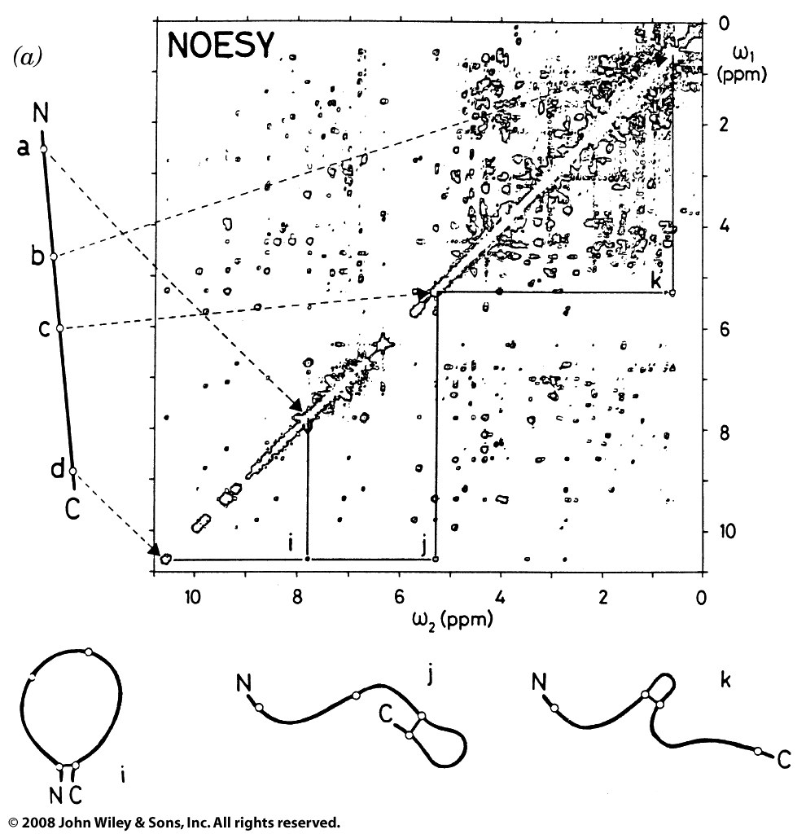
2D NMR separates proton peaks and can reveal approximate distances between nearby atoms
a
b
c
d
Cross-peaks indicate protons are within 5Å of each other

Slide 21
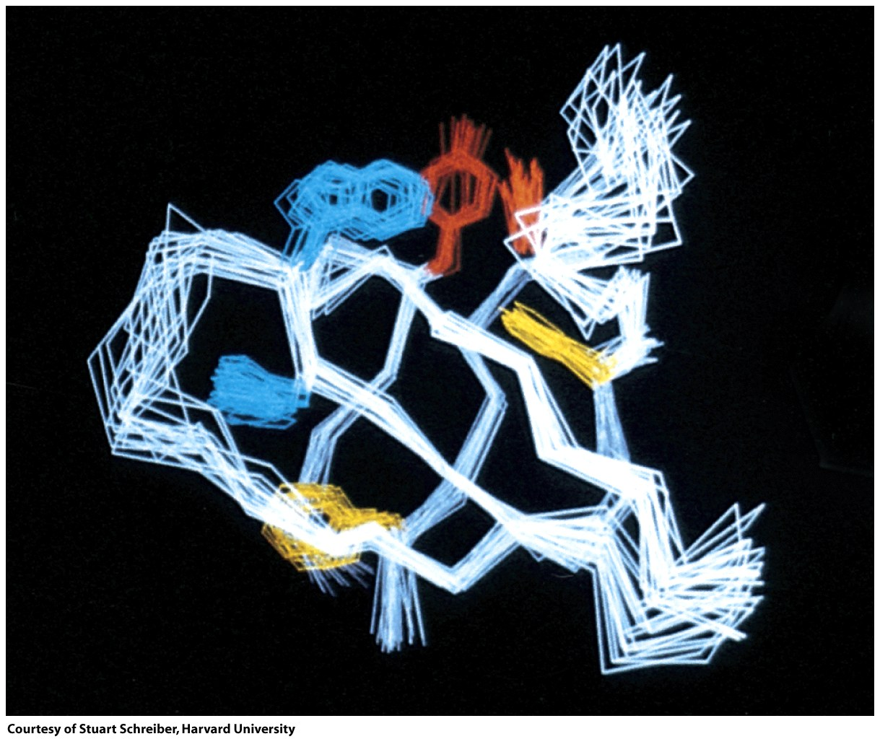
NMR-derived distance constraints are used to calculate likely protein conformations

Slide 22
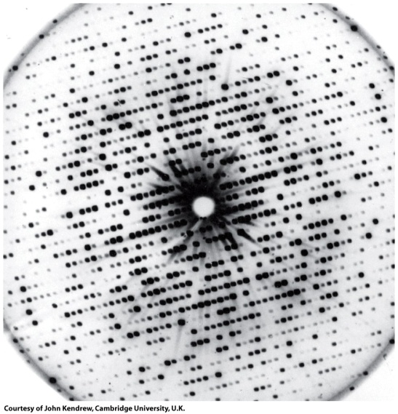
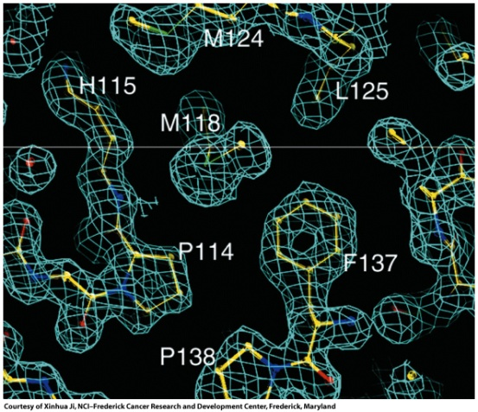
X-ray crystallography reveals the layout of repeating electron density
Diffracted
X-rays
Data processing
X-rays
Protein crystal
Diffraction pattern
Electron density map

Slide 23
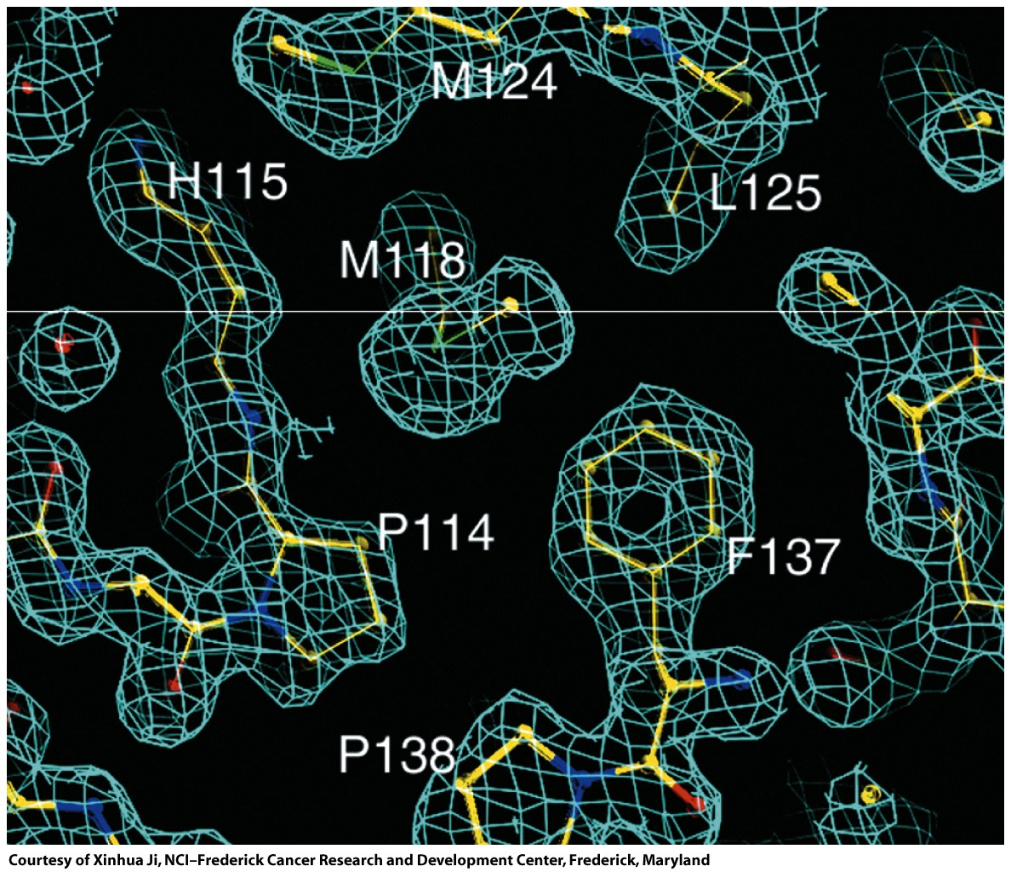
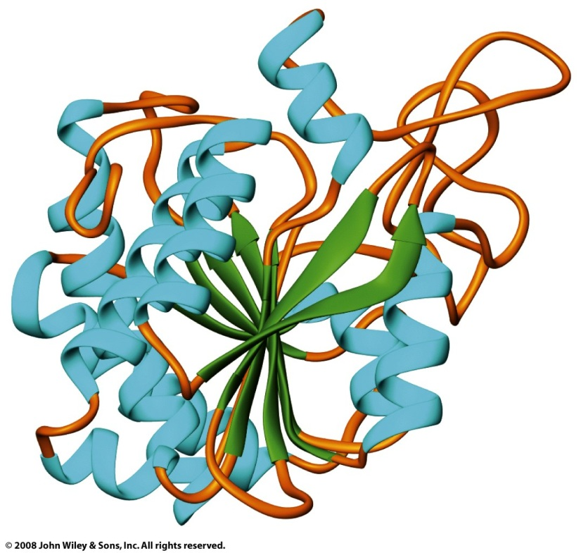
Electron density map allows for positioning of protein atoms, revealing structure

