Slide 1
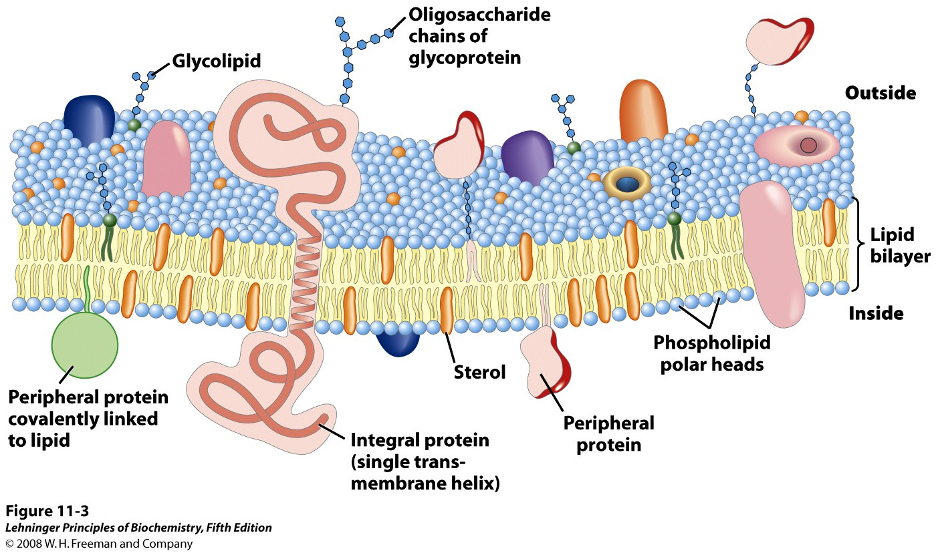
Biological membranes are heterogeneous lipid bilayers with proteins
Notes:
FIGURE 11-3 Fluid mosaic model for membrane structure. The fatty acyl chains in the interior of the membrane form a fluid, hydrophobic region. Integral proteins float in this sea of lipid, held by hydrophobic interactions with their nonpolar amino acid side chains. Both proteins and lipids are free to move laterally in the plane of the bilayer, but movement of either from one leaflet of the bilayer to the other is restricted. The carbohydrate moieties attached to some proteins and lipids of the plasma membrane are exposed on the extracellular surface of the membrane.

Slide 2
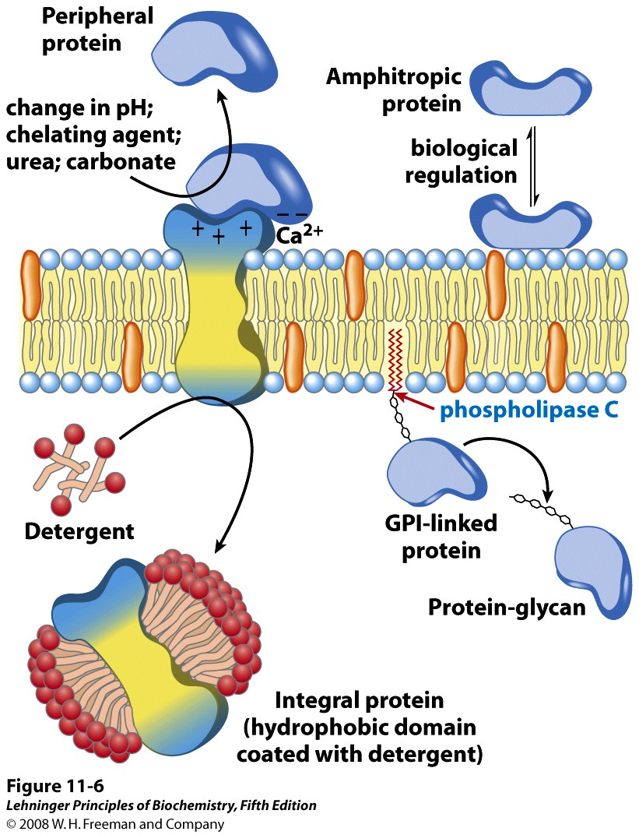
Different types of mb proteins require different conditions for mb release
Notes:
FIGURE 11-6 Peripheral, integral, and amphitropic proteins. Membrane proteins can be operationally distinguished by the conditions required to release them from the membrane. Most peripheral proteins are released by changes in pH or ionic strength, removal of Ca²⁺ by a chelating agent, or addition of urea or carbonate. Integral proteins are extractable with detergents, which disrupt the hydrophobic interactions with the lipid bilayer and form micelle-like clusters around individual protein molecules. Integral proteins covalently attached to a membrane lipid, such as a glycosyl phosphatidylinositol (GPI; see Figure 11-14), can be released by treatment with phospholipase C. Amphitropic proteins are sometimes associated with membranes and sometimes not, depending on some type of regulatory process such as reversible palmitoylation.

Slide 3
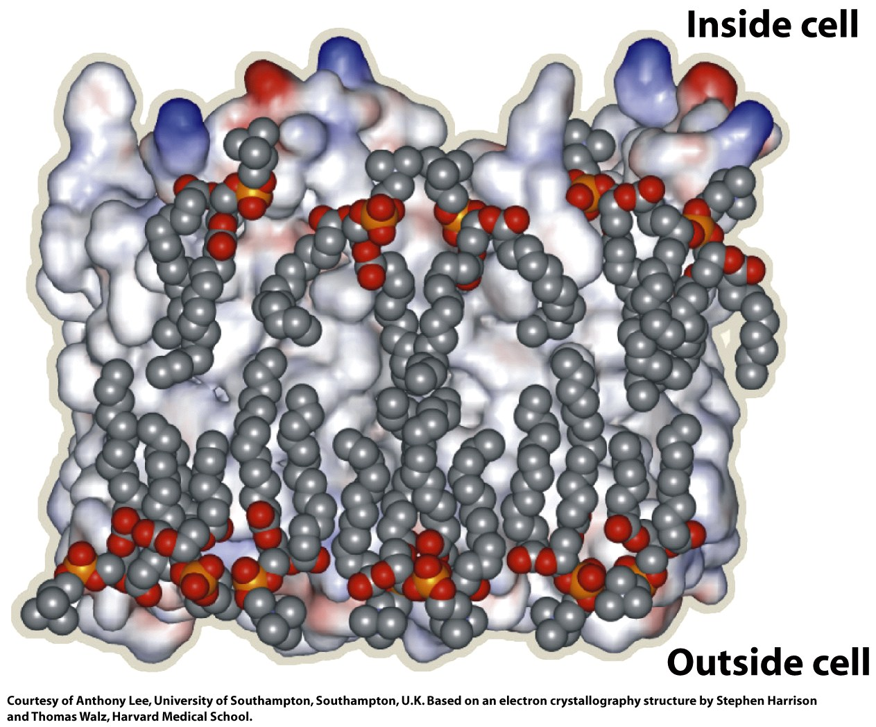
Integral membrane proteins directionally insert in the membrane bilayer
Outside cell
Inside cell

Slide 4
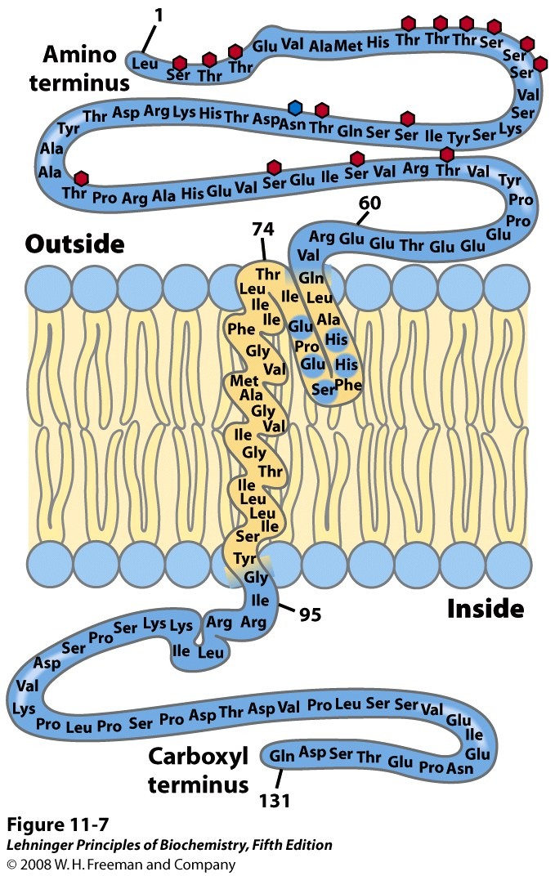
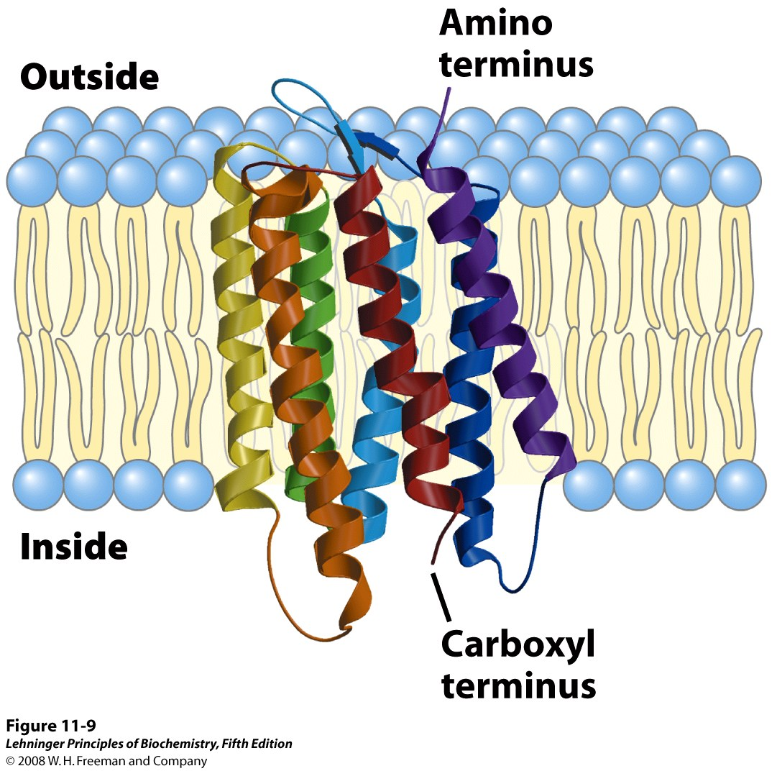
Glycophorin and bacteriorhodopsin are integral proteins that span (cross) the bilayer
= transmembrane proteins
transmembrane
helices
Notes:
FIGURE 11-7 Transbilayer disposition of glycophorin in an erythrocyte. One hydrophilic domain, containing all the sugar residues, is on the outer surface, and another hydrophilic domain protrudes from the inner face of the membrane. Each red hexagon represents a tetrasaccharide (containing two Neu5Ac (sialic acid), Gal, and GalNAc) Olinked to a Ser or Thr residue; the blue hexagon represents an oligosaccharide N-linked to an Asn residue. The relative size of the oligosaccharide units is larger than shown here. A segment of 19 hydrophobic residues (residues 75 to 93) forms an α helix that traverses the membrane bilayer (see Figure 11-11a). The segment from residues 64 to 74 has some hydrophobic residues and probably penetrates the outer face of the lipid bilayer, as shown.
FIGURE 11-9 Bacteriorhodopsin, a membrane-spanning protein. (PDB ID 2AT9) The single polypeptide chain folds into seven hydrophobic α helices, each of which traverses the lipid bilayer roughly perpendicular to the plane of the membrane. The seven transmembrane helices are clustered, and the space around and between them is filled with the acyl chains of membrane lipids. The light-absorbing pigment retinal (see Figure 10-21) is buried deep in the membrane in contact with several of the helical segments (not shown). The helices are colored to correspond with the hydropathy plot in Figure 11-11b.

Slide 5
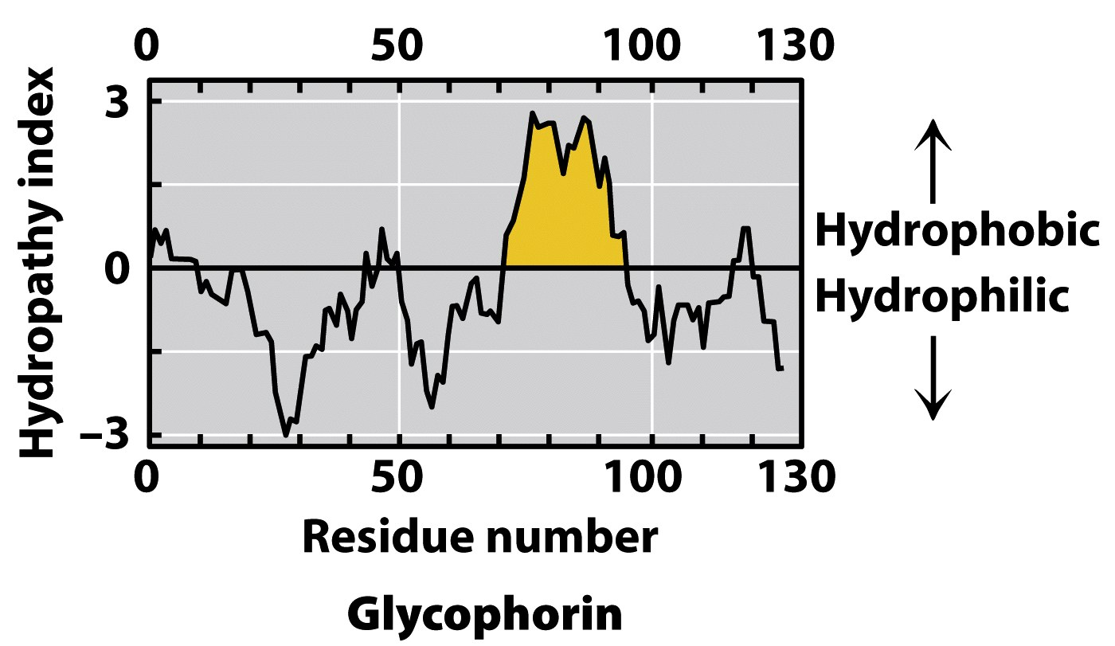
Transmembrane helices are predicted by hydrophobic stretches of 20-25 aa residues
Notes:
FIGURE 11-11a Hydropathy plots. Hydropathy index (see Table 3-1) is plotted against residue number for two integral membrane proteins. The hydropathy index for each amino acid residue in a sequence of defined length, or "window," is used to calculate the average hydropathy for that window. The horizontal axis shows the residue number in the middle of the window. (a) Glycophorin from human erythrocytes has a single hydrophobic sequence between residues 75 and 93 (yellow); compare this with Figure 11-7.

Slide 6
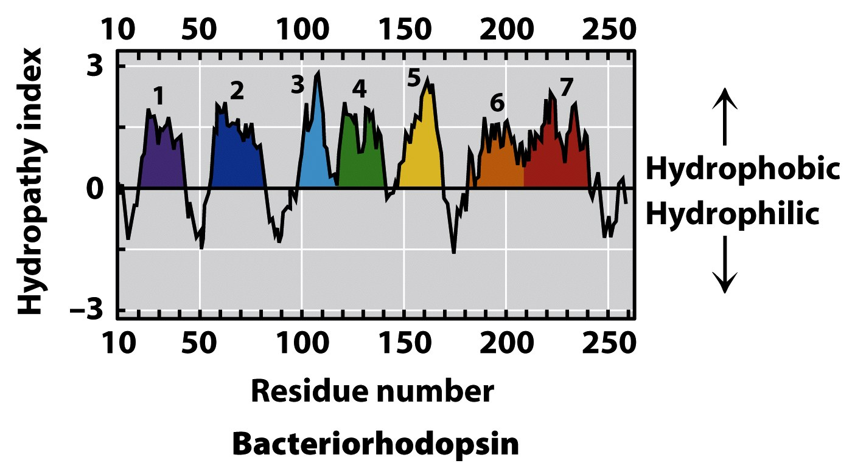
Transmembrane helices are predicted by hydrophobic stretches of 20-25 aa residues
Notes:
FIGURE 11-11b Hydropathy plots. Hydropathy index (see Table 3-1) is plotted against residue number for two integral membrane proteins. The hydropathy index for each amino acid residue in a sequence of defined length, or "window," is used to calculate the average hydropathy for that window. The horizontal axis shows the residue number in the middle of the window. (b) Bacteriorhodopsin, known from independent physical studies to have seven transmembrane helices (see Figure 11-9), has seven hydrophobic regions. Note, however, that the hydropathy plot is ambiguous in the region of segments 6 and 7. X-ray crystallography has confirmed that this region has two transmembrane segments.

Slide 7
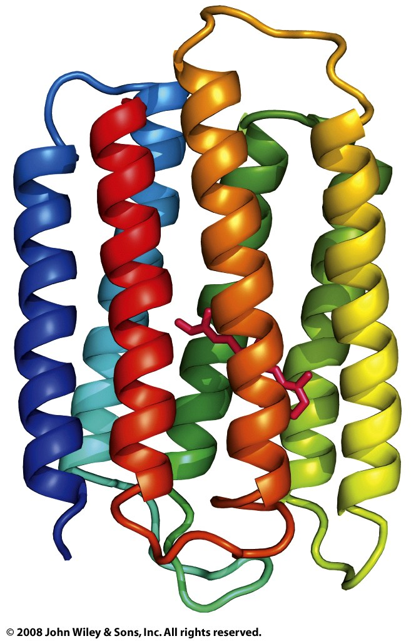
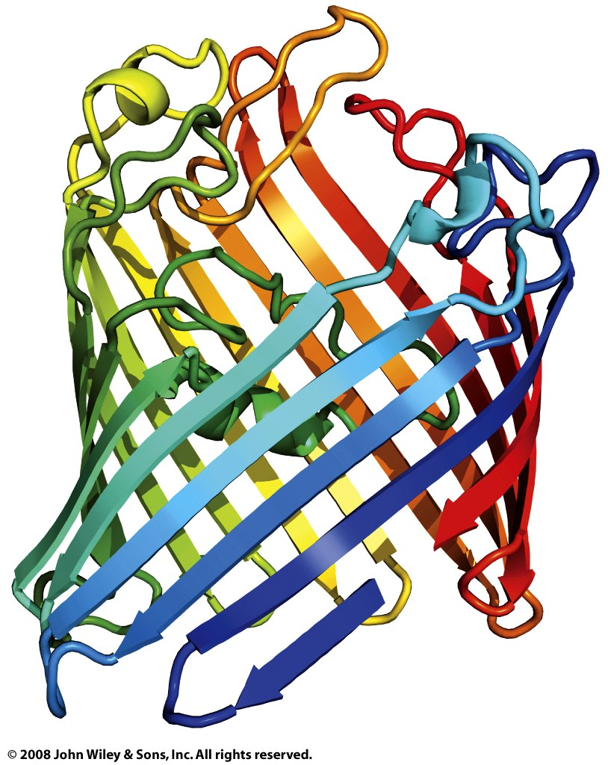
Transmembrane regions are usually α-helices or continuous β-sheets (β-barrels)
Bacteriorhodopsin:
a light-driven proton pump
Porin:
a pore-forming protein

Slide 8
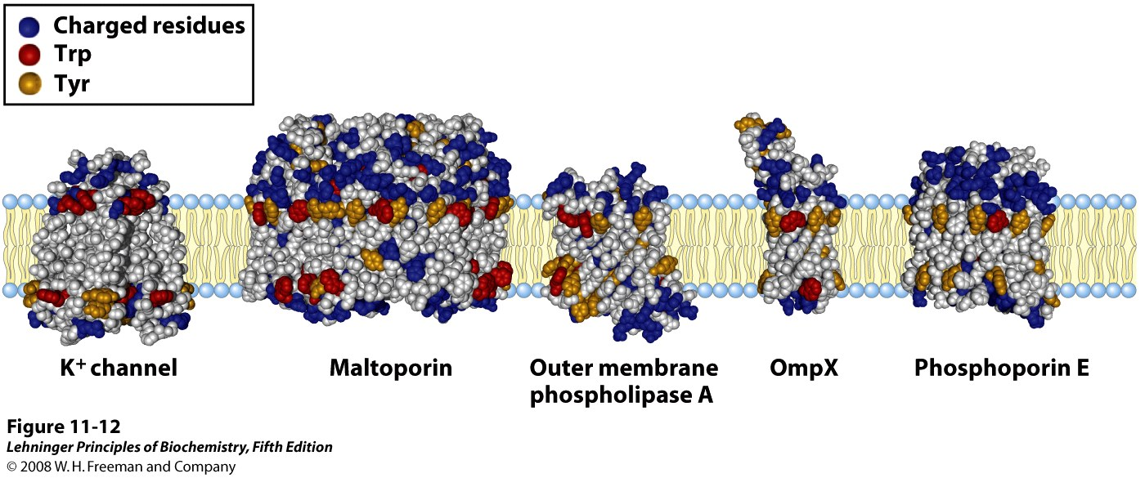
A protein’s surface polarity corresponds to its environment
Tyr and Trp exhibit ‘snorkeling’ – pointing their polar group toward mb exterior
Also, often ‘positive inside’ – positively charged aa’s facing cytoplasmic region
Notes:
FIGURE 11-12 Tyr and Trp residues of membrane proteins clustering at the water-lipid interface. The detailed structures of these five integral membrane proteins are known from crystallographic studies. The K⁺ channel (PDB ID 1BL8) is from the bacterium Streptomyces lividans (see Figure 11-48); maltoporin (PDB ID 1AF6), outer membrane phospholipase A (PDB ID 1QD5), OmpX (PDB ID 1QJ9), and phosphoporin E (PDB ID 1PHO) are proteins of the outer membrane of E. coli. Residues of Tyr (orange) and Trp (red) are found predominantly where the nonpolar region of acyl chains meets the polar head group region. Charged residues (Lys, Arg, Glu, Asp; shown in blue) are found almost exclusively in the aqueous phases.

Slide 9
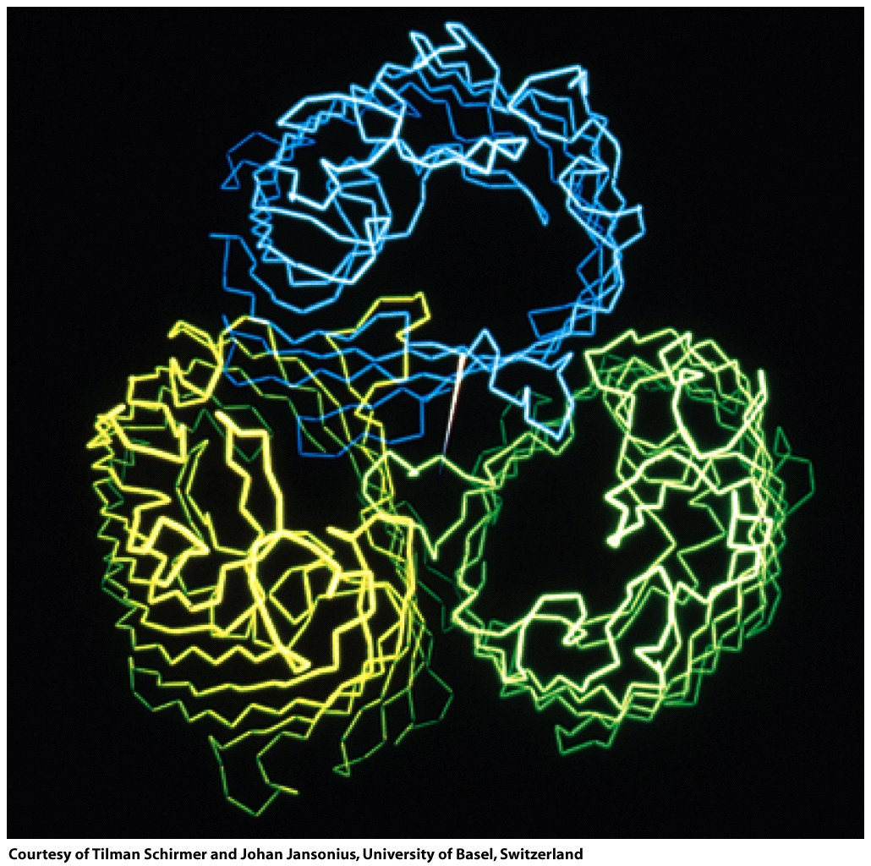
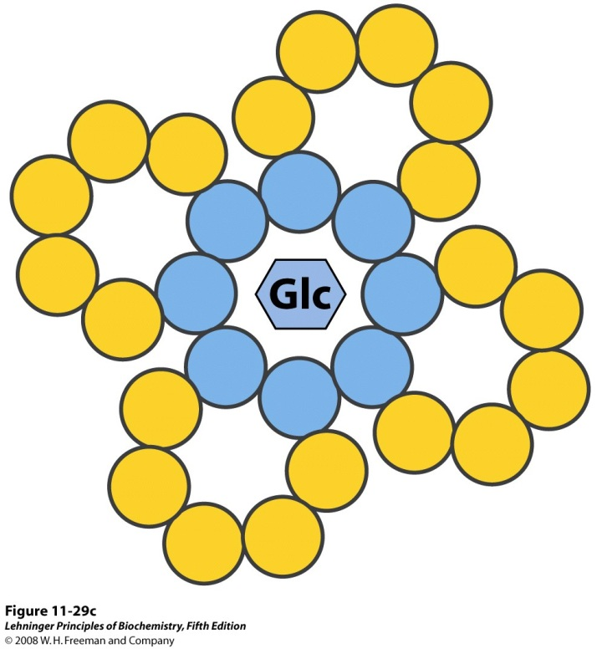
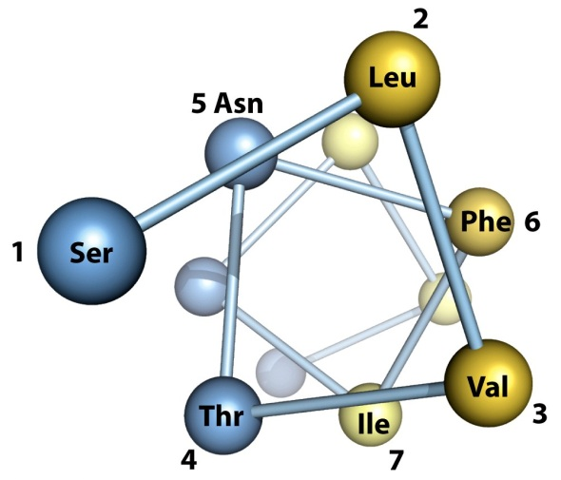
In integral transport proteins, interiors are hydrophilic and exteriors are hydrophobic
Porin trimer
Glucose transporter
4 of its TM helices
Notes:
FIGURE 11-29b Proposed structure of GLUT1. (b) A helical wheel diagram shows the distribution of polar and nonpolar residues on the surface of a helical segment. The helix is diagrammed as though observed along its axis from the amino terminus. Adjacent residues in the linear sequence are connected, and each residue is placed around the wheel in the position it occupies in the helix; recall that 3.6 residues are required to make one complete turn of the α helix. In this example, the polar residues (blue) are on one side of the helix and the hydrophobic residues (yellow) on the other. This is, by definition, an amphipathic helix. FIGURE 11-29c Proposed structure of GLUT1. (c) Side-by-side association of four amphipathic helices, each with its polar face oriented toward the central cavity, can produce a transmembrane channel lined with polar (and charged) residues. This channel provides many opportunities for hydrogen bonding with glucose as it moves through.

Slide 10
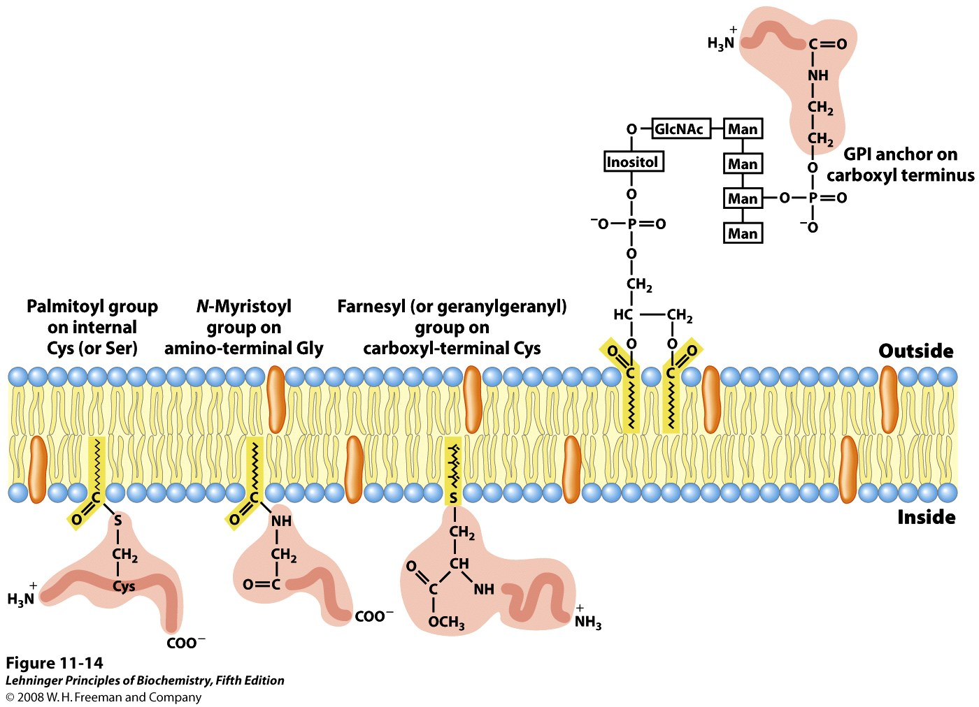
Some integral membrane proteins contain covalently-linked lipids
= Lipid-linked proteins (lipoproteins)
Notes:
FIGURE 11-14 Lipid-linked membrane proteins. Covalently attached lipids anchor membrane proteins to the lipid bilayer. A palmitoyl group is shown attached by thioester linkage to a Cys residue; an N-myristoyl group is generally attached to an amino-terminal Gly; the farnesyl and geranylgeranyl groups attached to carboxyl-terminal Cys residues are isoprenoids of 15 and 20 carbons, respectively. These three lipid-protein assemblies are found only on the inner face of the plasma membrane. Glycosyl phosphatidylinositol (GPI) anchors are derivatives of phosphatidylinositol in which the inositol bears a short oligosaccharide covalently joined to the carboxyl-terminal residue of a protein through phosphoethanolamine. GPI-linked proteins are always on the extracellular face of the plasma membrane.

Slide 11
Some lipid-linked proteins are fatty-acylated
Myristic acid (14:0) is attached to N-terminal α-amino group of Gly (via an amide linkage)
Permanent modification
Myristoylated proteins are found in many subcellular compartments
Palmitic acid (16:0) is attached to a specific Cys (via a thioester linkage)
Reversible modification; may be removed by a palmitoyl thioesterase
Palmitoylated proteins are found
on the cytoplasmic face of the
plasma membrane

Slide 12
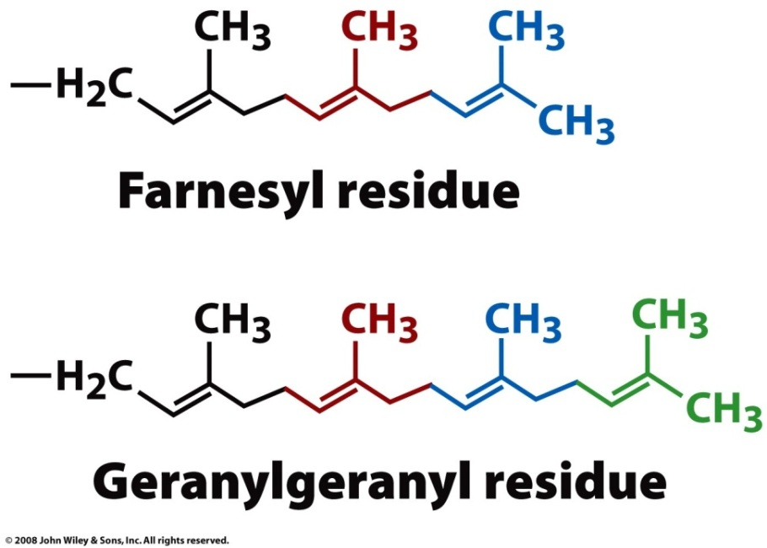
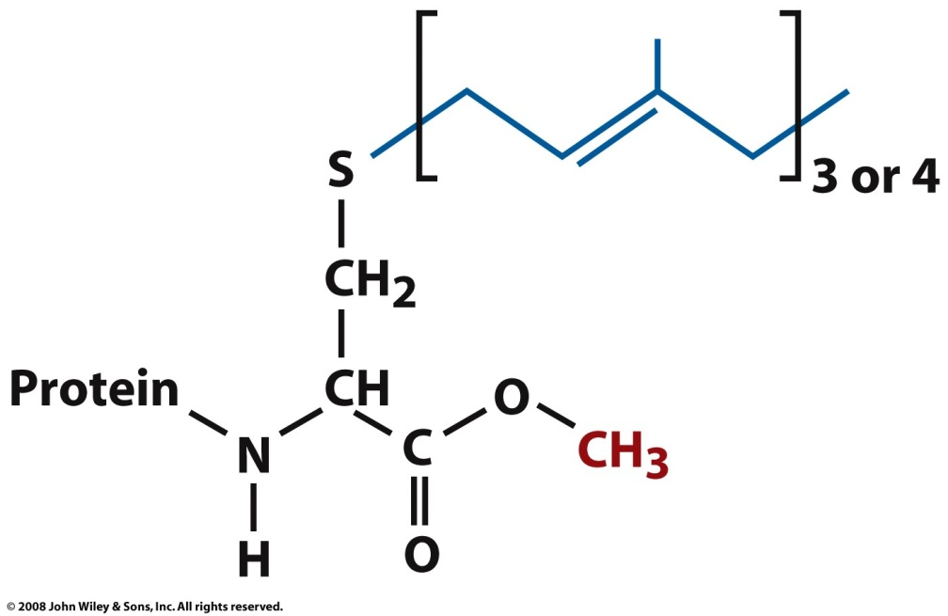
Some lipid-linked proteins are “prenylated”
Isoprene units are linked to a C-terminal Cys
C-terminal C-X-X-Y motif determines which type of lipid will be attached

Slide 13
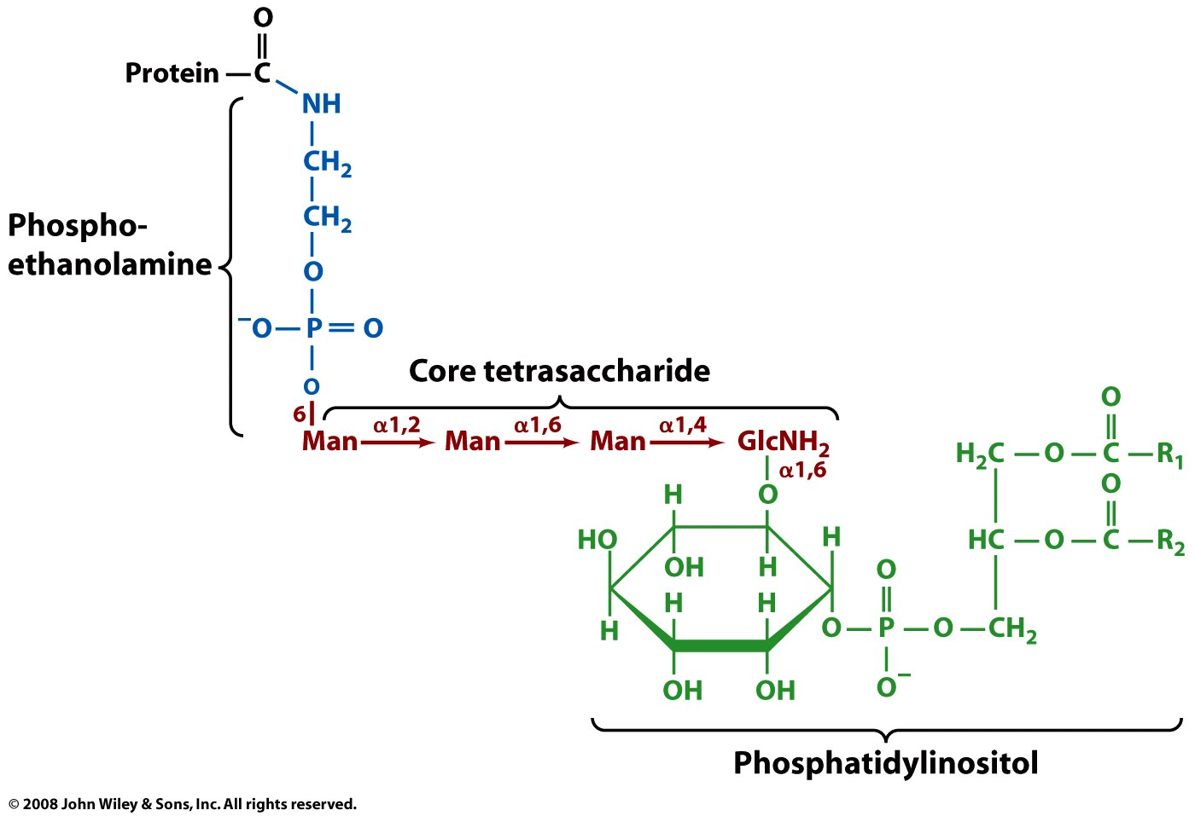
Some lipid-linked proteins have GPI anchors
(C-terminus)
GPI-linked proteins are found on the exterior surface of the plasma membrane
Glycosylphosphatidylinositol anchor

Slide 14
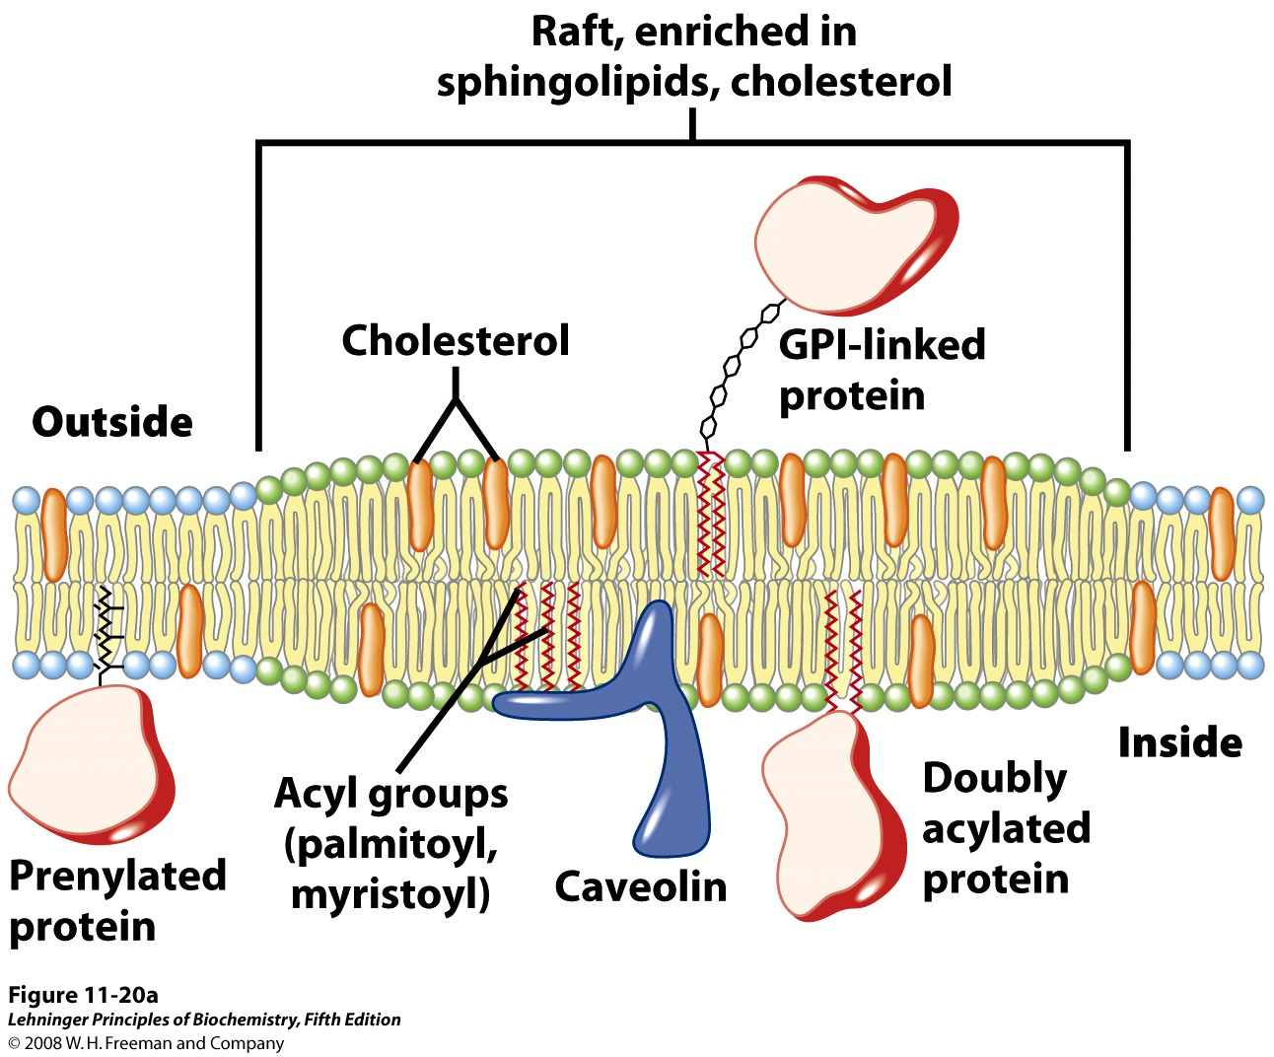
Lipid-linked proteins cluster in or outside of rafts based on their linked lipid
Notes:
FIGURE 11-20a Membrane microdomains (rafts). (a) Stable associations of sphingolipids and cholesterol in the outer leaflet produce a microdomain, slightly thicker than other membrane regions, that is enriched with specific types of membrane proteins. GPI-linked proteins are common in the outer leaflet of these rafts, and proteins with one or several covalently attached long-chain acyl groups are common in the inner leaflet. Caveolin is especially common in inwardly curved rafts called caveolae (see Figure 11-21). Proteins with attached prenyl groups (such as Ras; see Box 12-2) tend to be excluded from rafts.

Slide 15
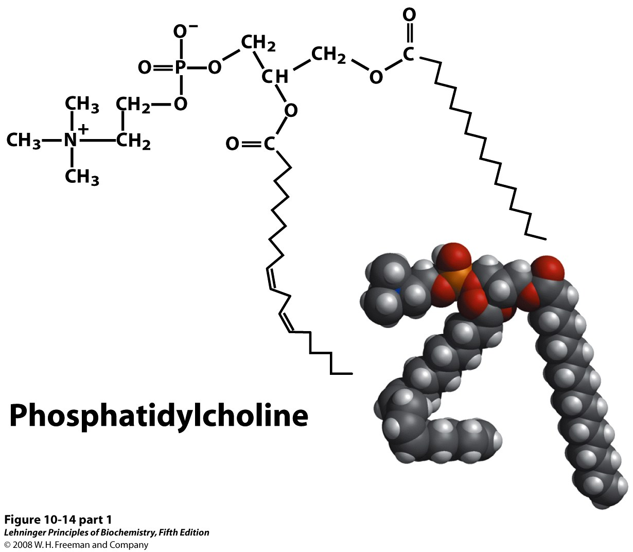
Peripheral membrane proteins bind to the surface of the membrane
Common interaction: ion pairs

Slide 16
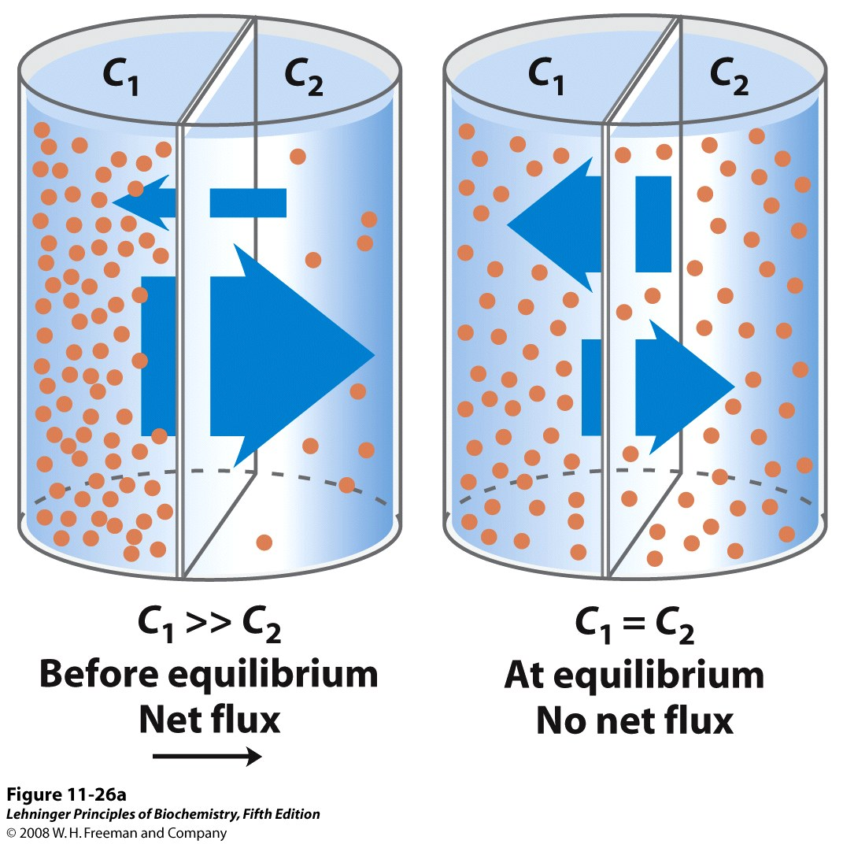
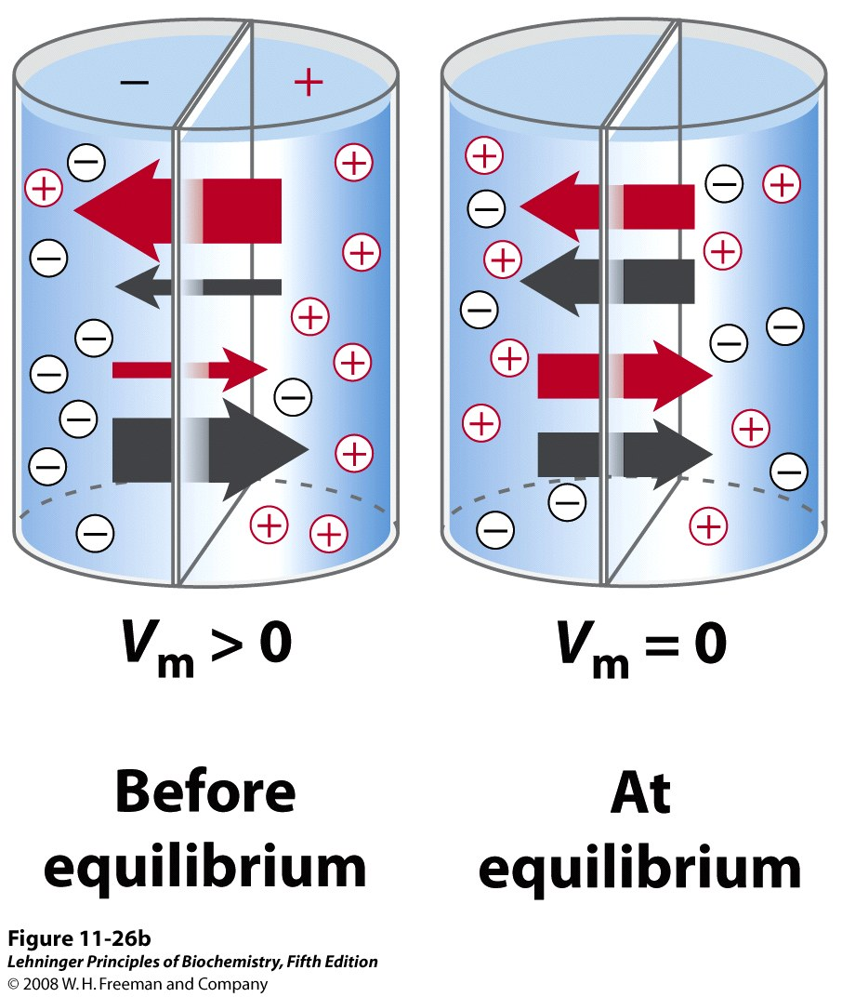
Solutes move across a permeable mb to equalize concentration and charge
Notes:
FIGURE 11-26a Movement of solutes across a permeable membrane. (a) Net movement of an electrically neutral solute is toward the side of lower solute concentration until equilibrium is achieved. The solute concentrations on the left and right sides of the membrane are designated C₁ and C₂. The rate of transmembrane movement (indicated by the arrows) is proportional to the concentration gradient, C₂/C₁.

Slide 17
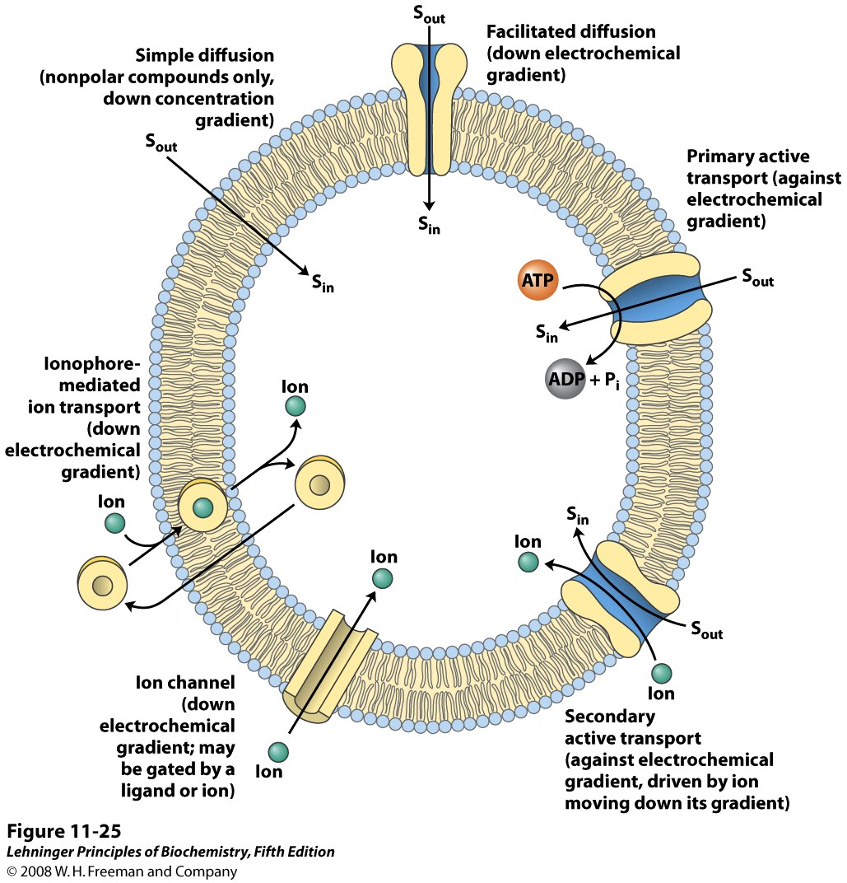
Transporters catalyze passage through the membrane
Carriers:
Transport slower than free diffusion
Stereospecific
Channels:
Transport near rate of free diffusion
Less stereospecific
Notes:
FIGURE 11-25 Summary of transport types.

Slide 18
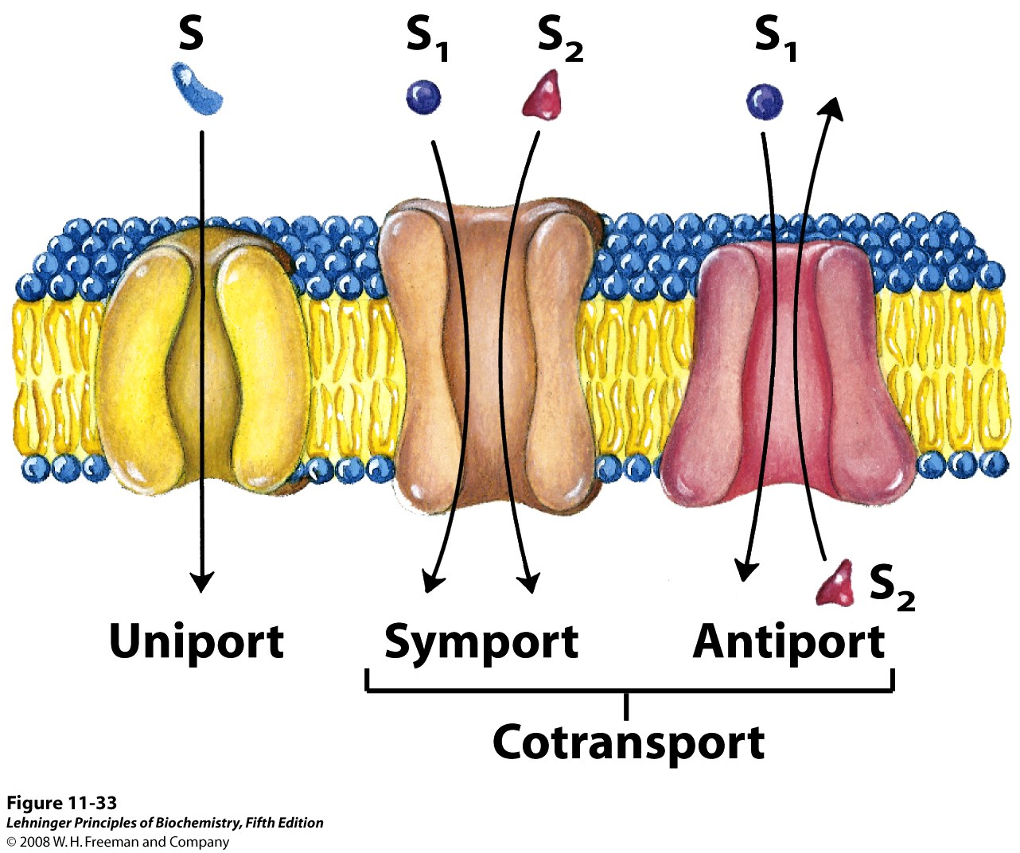
Notes:
FIGURE 11-33 Three general classes of transport systems. Transporters differ in the number of solutes (substrates) transported and the direction in which each solute moves. Examples of all three types of transporters are discussed in the text. Note that this classification tells us nothing about whether these are energy-requiring (active transport) or energy-independent (passive transport) processes.

Slide 19
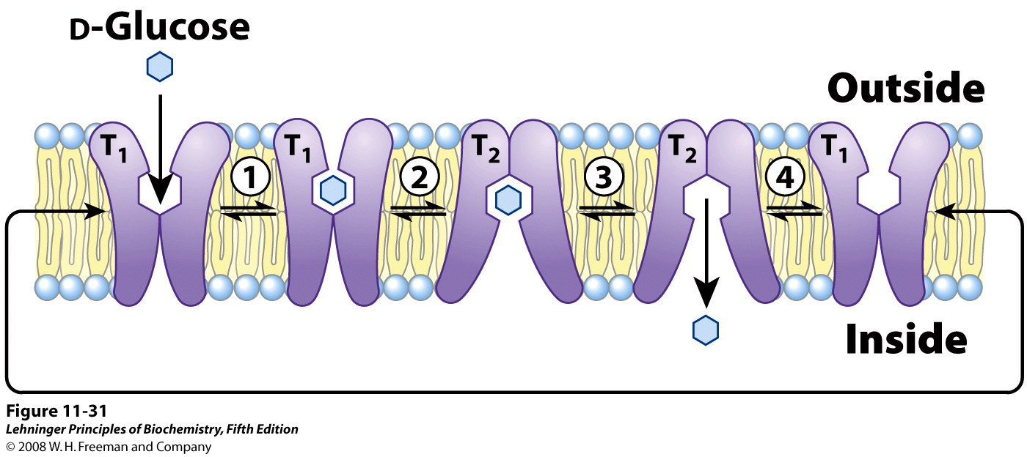
Glucose enters the cell via passive transport (through a uniporter)
Notes:
FIGURE 11-31 Model of glucose transport into erythrocytes by GLUT₁. The transporter exists in two conformations: T₁, with the glucose-binding site exposed on the outer surface of the plasma membrane, and T₂, with the binding site exposed on the inner surface. Glucose transport occurs in four steps. 1 Glucose in blood plasma binds to a stereospecific site on T₁; this lowers the activation energy for 2 a conformational change from glucose_{out} • T₁ to glucose_{in} • T₂, effecting the transmembrane passage of the glucose. 3 Glucose is released from T₂ into the cytoplasm, and 4 the transporter returns to the T₁ conformation, ready to transport another glucose molecule.

Slide 20
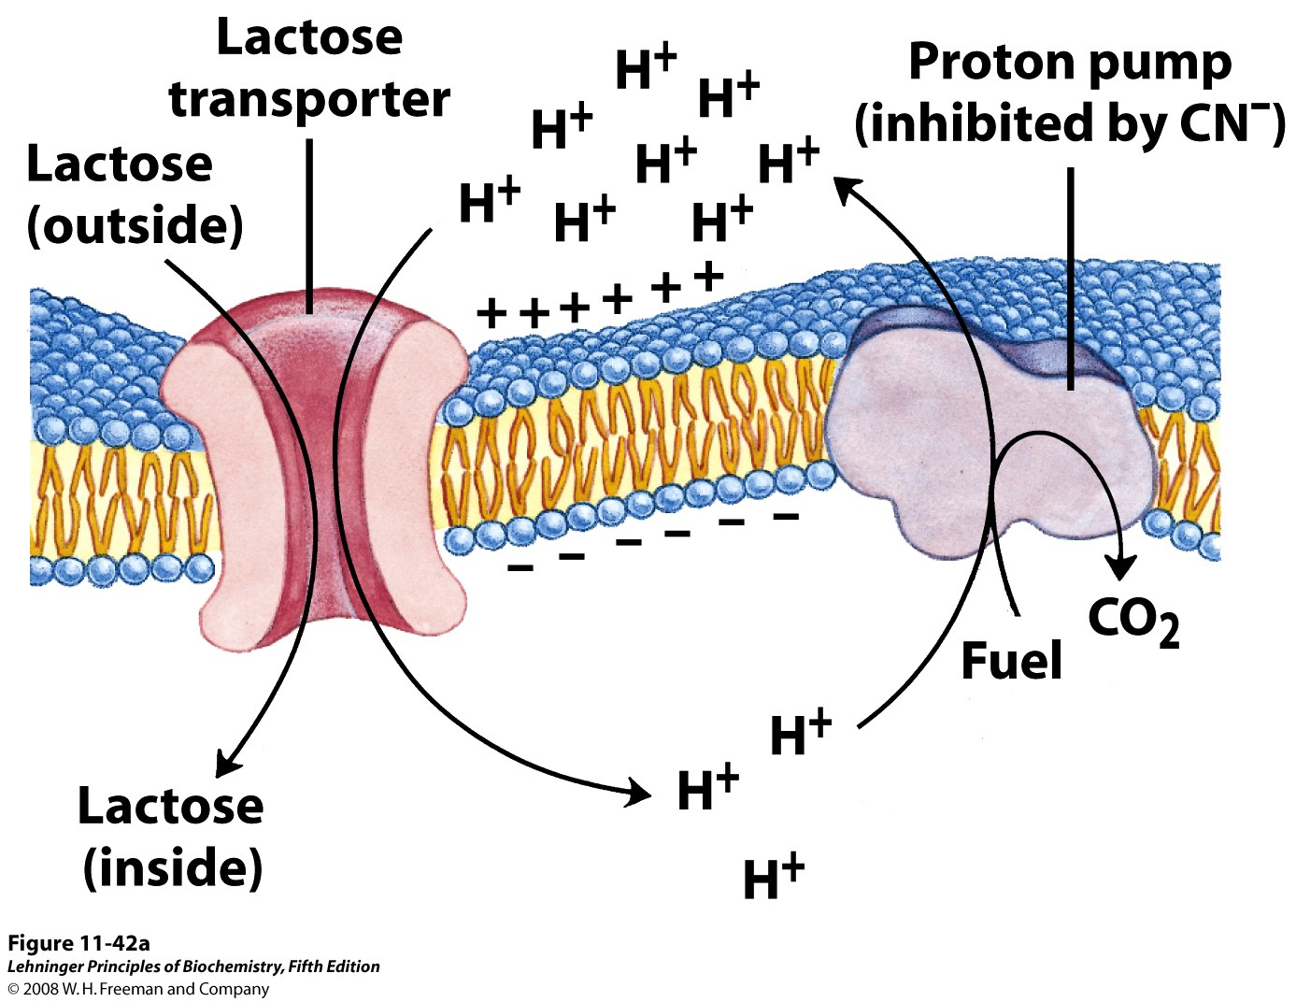
Lactose enters E. coli cells via secondary active transport (through a symporter)
Proton pump
Notes:
FIGURE 11-42a Lactose uptake in E. coli. (a) The primary transport of H⁺ out of the cell, driven by the oxidation of a variety of fuels, establishes both a proton gradient and an electrical potential (inside negative) across the membrane. Secondary active transport of lactose into the cell involves symport of H⁺ and lactose by the lactose transporter. The uptake of lactose against its concentration gradient is entirely dependent on this inflow of protons driven by the electrochemical gradient.

