Slide 1
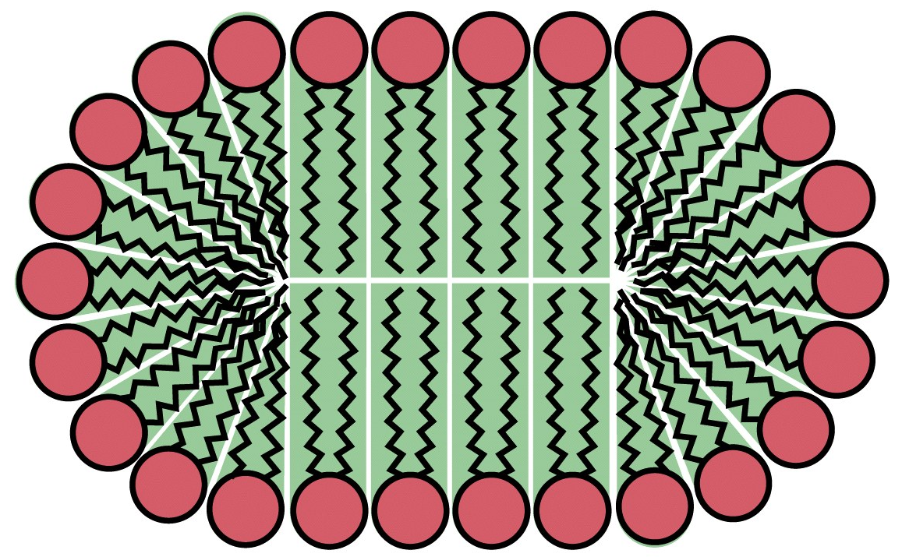
The hydrophobic effect drives the aggregation of amphiphilic lipids in water
Polar head groups
Hydrophobic tails

Slide 2
The shape of the lipid determines the structural features of the aggregate
Notes:
FIGURE 11-4 Amphipathic lipid aggregates that form in water. (a) In micelles, the hydrophobic chains of the fatty acids are sequestered at the core of the sphere. There is virtually no water in the hydrophobic interior. (b) In an open bilayer, all acyl side chains except those at the edges of the sheet are protected from interaction with water. (c) When a two-dimensional bilayer folds on itself, it forms a closed bilayer, a three-dimensional hollow vesicle (liposome) enclosing an aqueous cavity.

Slide 3
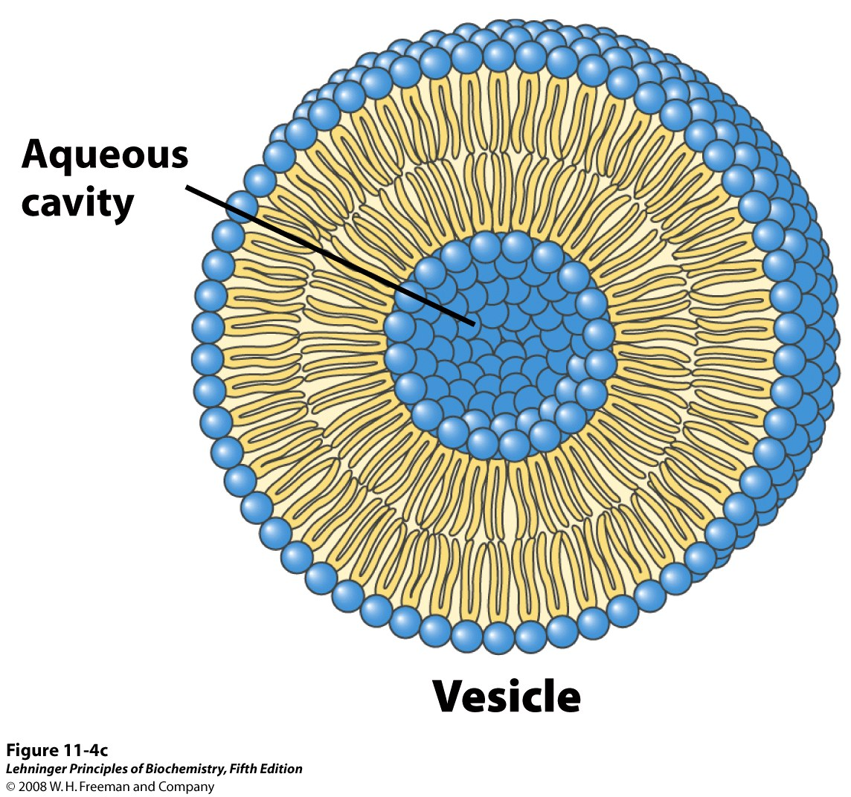
Packing at bilayer edges is crowded, so bilayers merge their edges to form vesicles
bilayer
crowded edges
The bilayer separates the internal cavity from the external aqueous environment
Notes:
FIGURE 11-4c Amphipathic lipid aggregates that form in water. (c) When a two-dimensional bilayer folds on itself, it forms a closed bilayer, a three-dimensional hollow vesicle (liposome) enclosing an aqueous cavity.

Slide 4
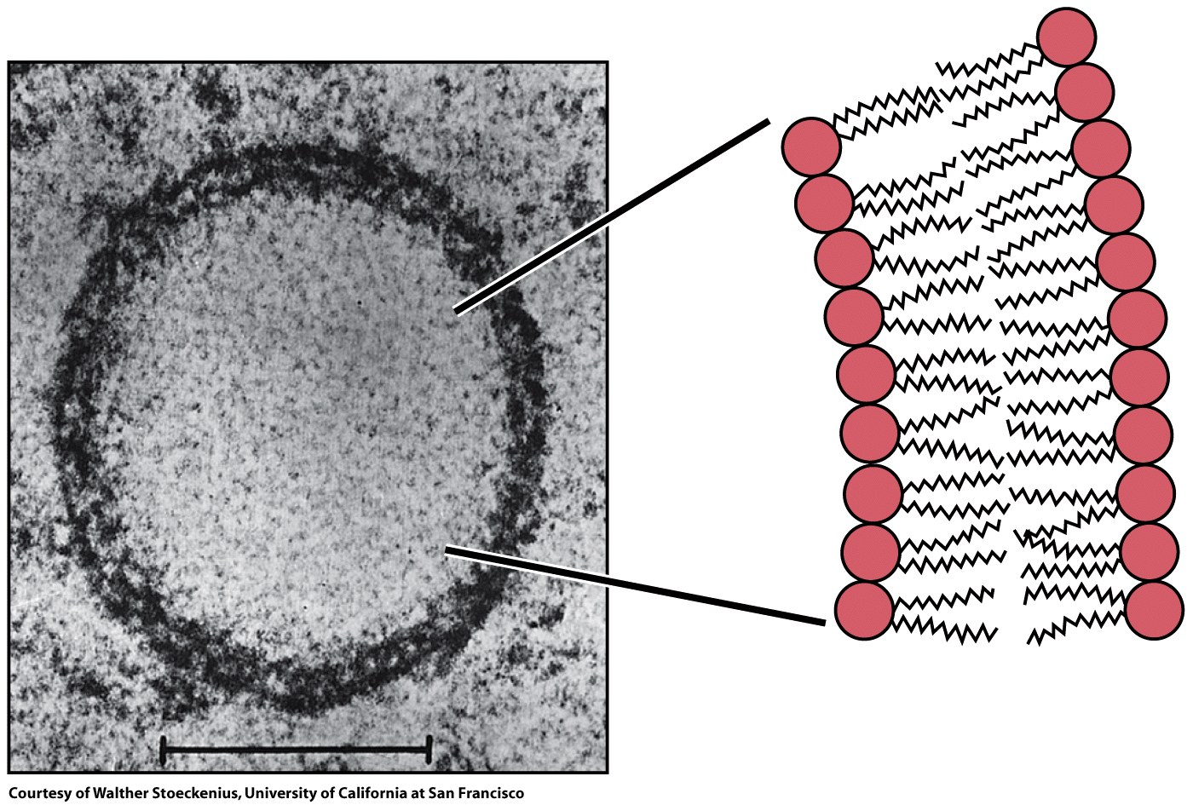
Liposomes (vesicles) are bilayer-enclosed aqueous environments
bilayer
leaflet
leaflet

Slide 5
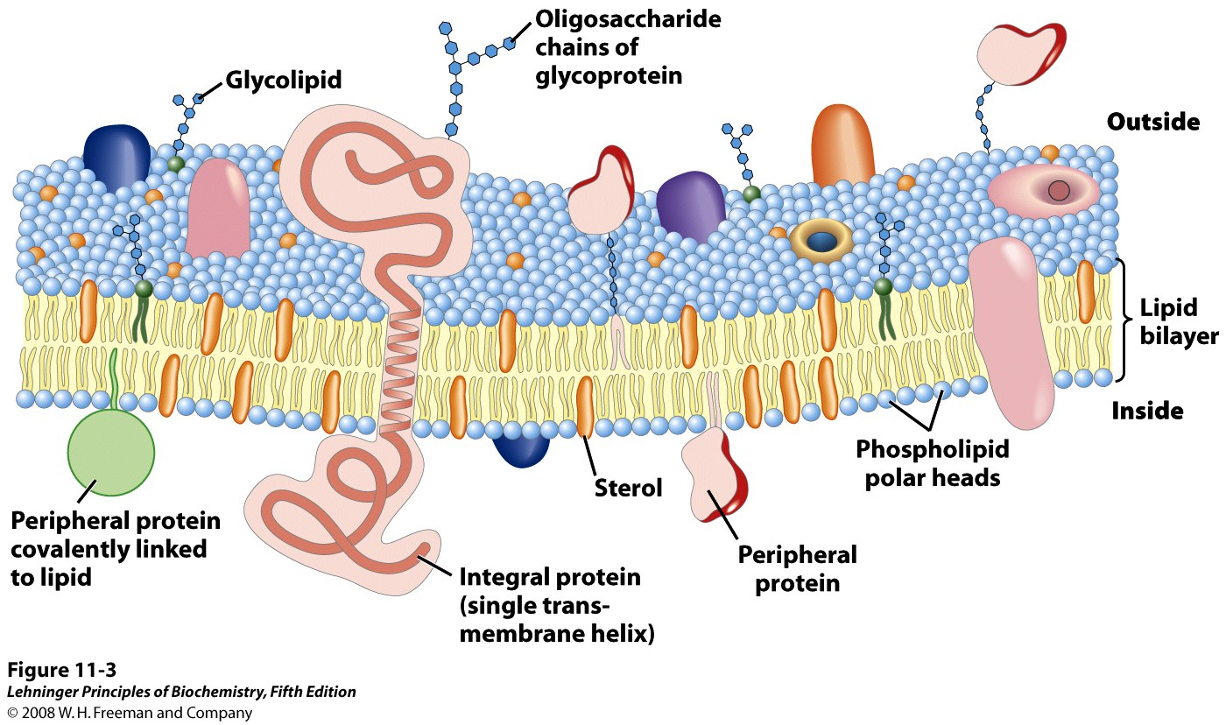
Biological membranes are heterogeneous lipid bilayers with proteins
Notes:
FIGURE 11-3 Fluid mosaic model for membrane structure. The fatty acyl chains in the interior of the membrane form a fluid, hydrophobic region. Integral proteins float in this sea of lipid, held by hydrophobic interactions with their nonpolar amino acid side chains. Both proteins and lipids are free to move laterally in the plane of the bilayer, but movement of either from one leaflet of the bilayer to the other is restricted. The carbohydrate moieties attached to some proteins and lipids of the plasma membrane are exposed on the extracellular surface of the membrane.

Slide 6
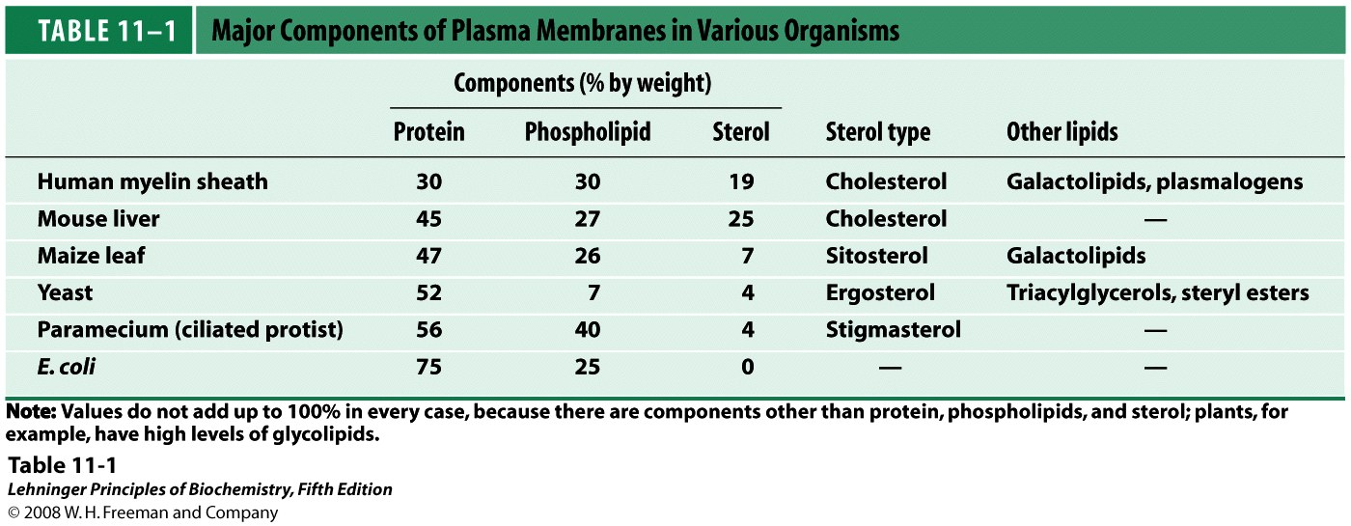
Protein and lipid content of biological membranes varies between species

Slide 7
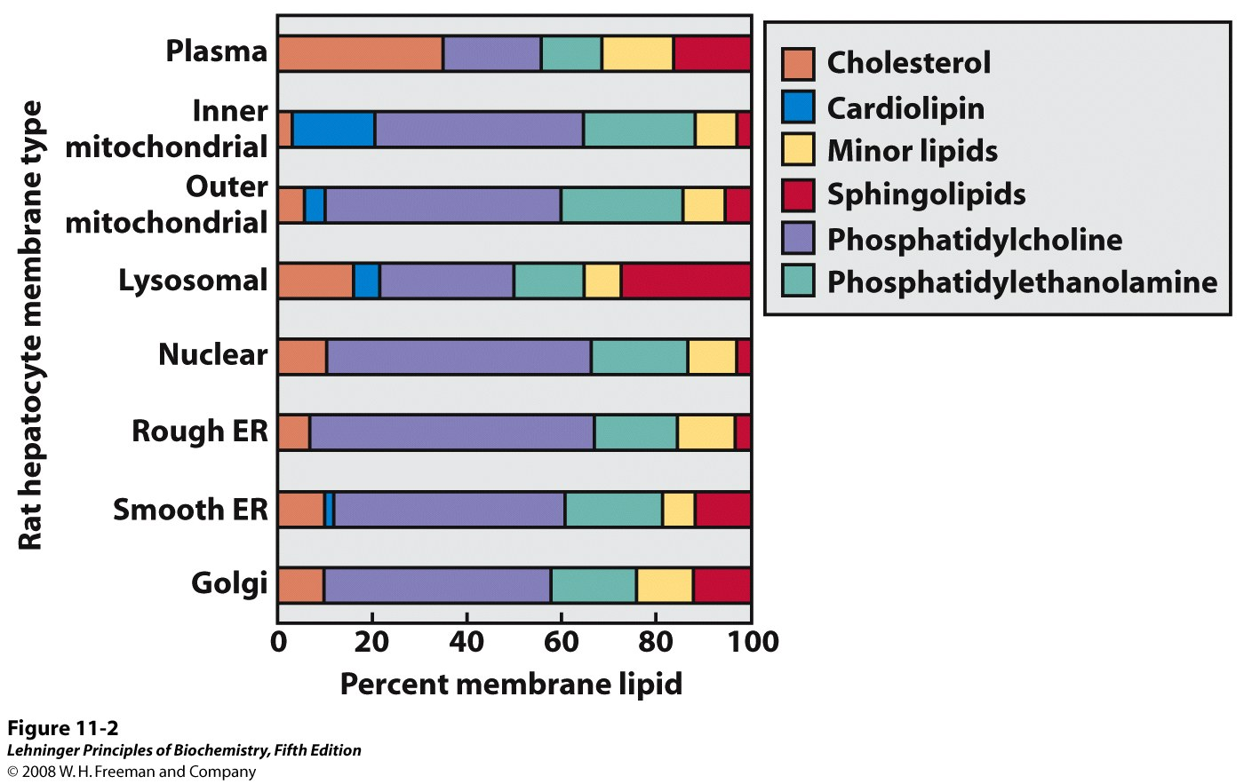
Membrane lipid composition varies within a cell
Notes:
FIGURE 11-2 Lipid composition of the plasma membrane and organelle membranes of a rat hepatocyte. The functional specialization of each membrane type is reflected in its unique lipid composition. Cholesterol is prominent in plasma membranes but barely detectable in mitochondrial membranes. Cardiolipin is a major component of the inner mitochondrial membrane but not of the plasma membrane. Phosphatidylserine, phosphatidylinositol, and phosphatidylglycerol are relatively minor components (yellow) of most membranes but serve critical functions; phosphatidylinositol and its derivatives, for example, are important in signal transductions triggered by hormones. Sphingolipids, phosphatidylcholine, and phosphatidylethanolamine are present in most membranes, but in varying proportions. Glycolipids, which are major components of the chloroplast membranes of plants, are virtually absent from animal cells.

Slide 8
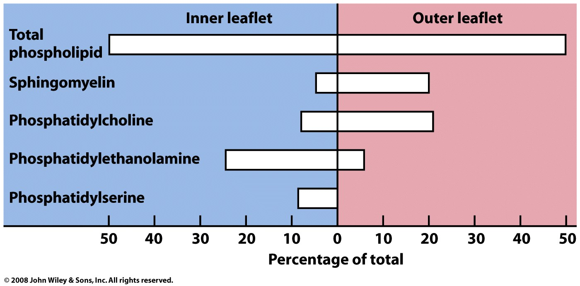
Membrane lipid composition varies between leaflets

Slide 9
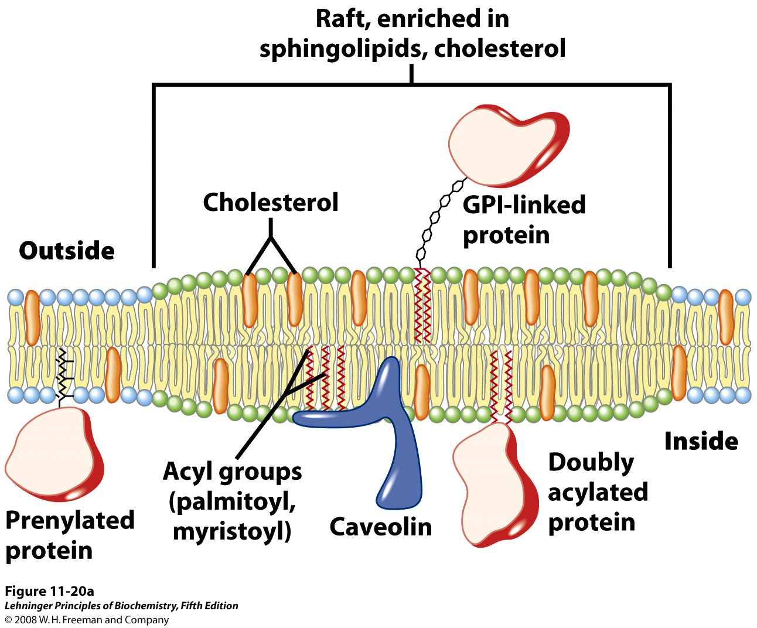
Membrane composition even varies within each leaflet! (non-random distribution)
Membrane microdomain (raft)
Notes:
FIGURE 11-20a Membrane microdomains (rafts). (a) Stable associations of sphingolipids and cholesterol in the outer leaflet produce a microdomain, slightly thicker than other membrane regions, that is enriched with specific types of membrane proteins. GPI-linked proteins are common in the outer leaflet of these rafts, and proteins with one or several covalently attached long-chain acyl groups are common in the inner leaflet. Caveolin is especially common in inwardly curved rafts called caveolae (see Figure 11-21). Proteins with attached prenyl groups (such as Ras; see Box 12-2) tend to be excluded from rafts.

Slide 10
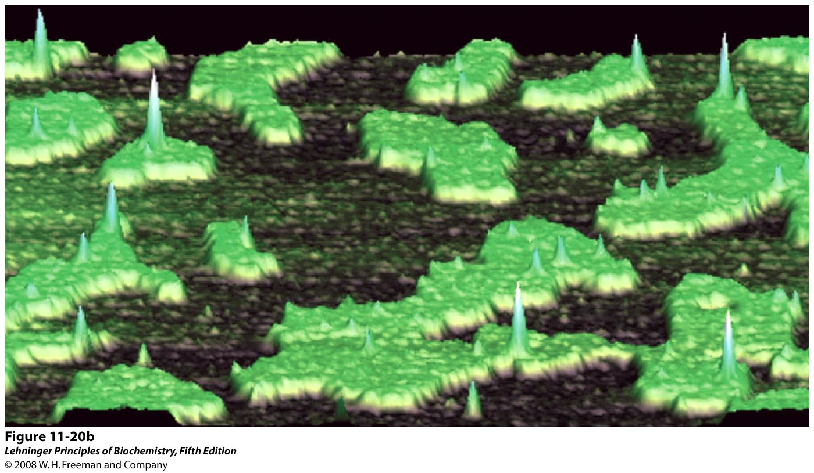
Atomic force microscopy reveals the presence of membrane microdomains (rafts)
Notes:
FIGURE 11-20b Membrane microdomains (rafts). (b) In this artificial membrane—reconstituted (on a mica surface) from cholesterol, synthetic phospholipid (dioleoylphosphatidylcholine), and the GPI-linked protein placental alkaline phosphatase—the greater thickness of raft regions is visualized by atomic force microscopy (see Box 11-1). The rafts protrude from a lipid bilayer ocean (the black surface is the top of the upper monolayer); sharp peaks represent GPI-linked proteins. Note that these peaks are found almost exclusively in the rafts.

Slide 11
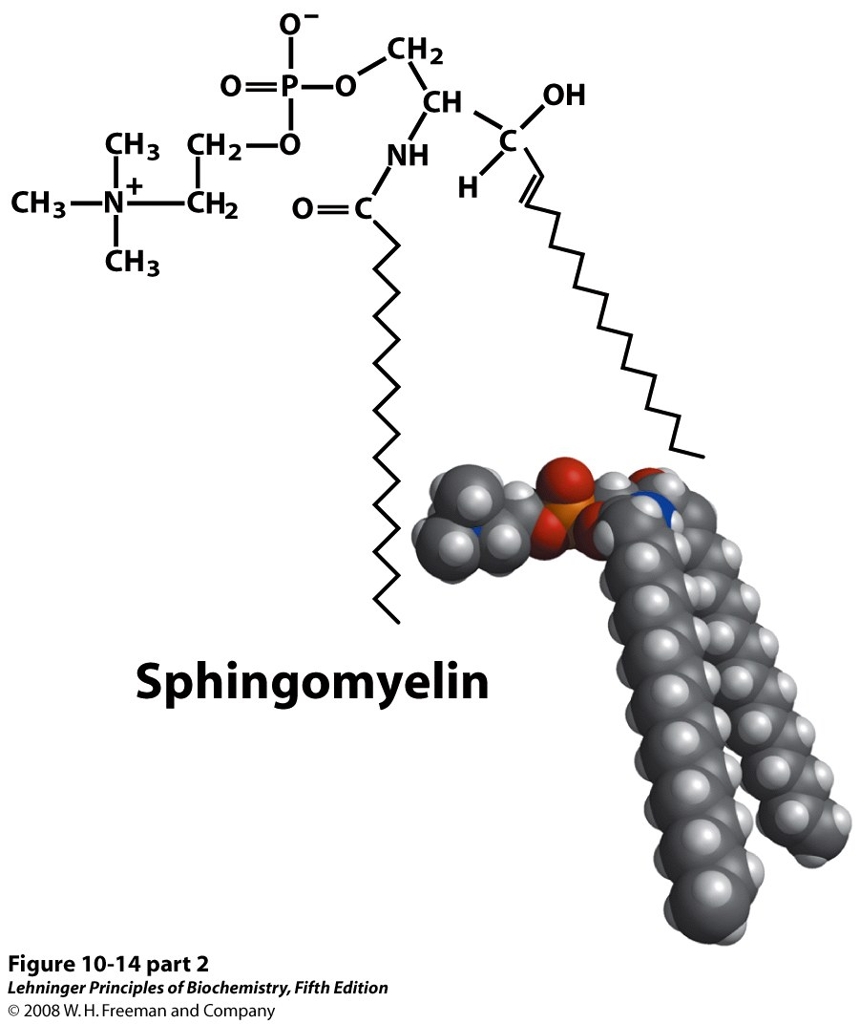
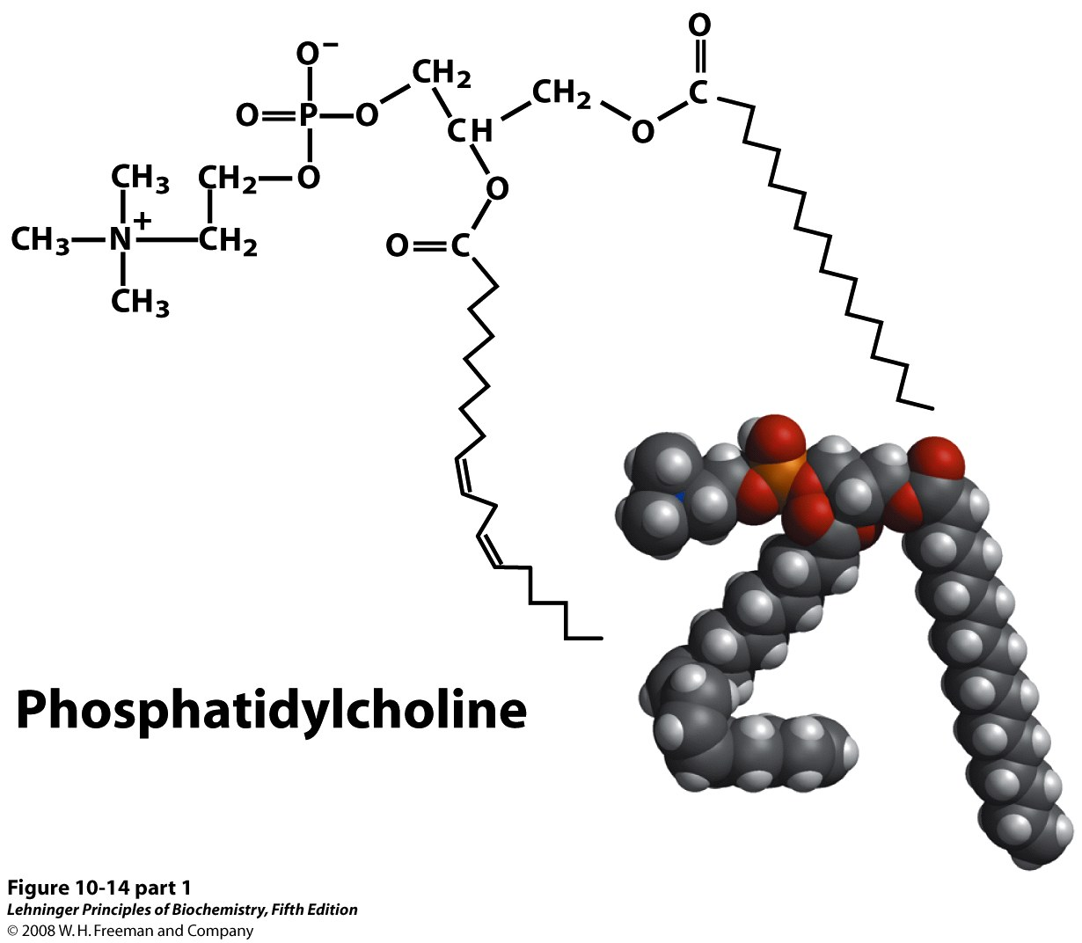
Different lipid composition leads to different properties of the membrane, like fluidity
Notes:
FIGURE 10-14 (part 1) The similarities in shape and molecular structure of phosphatidylcholine (a glycerophospholipid) and sphingomyelin (a sphingolipid) are clear when their space-filling and structural formulas are drawn as here.

Slide 12
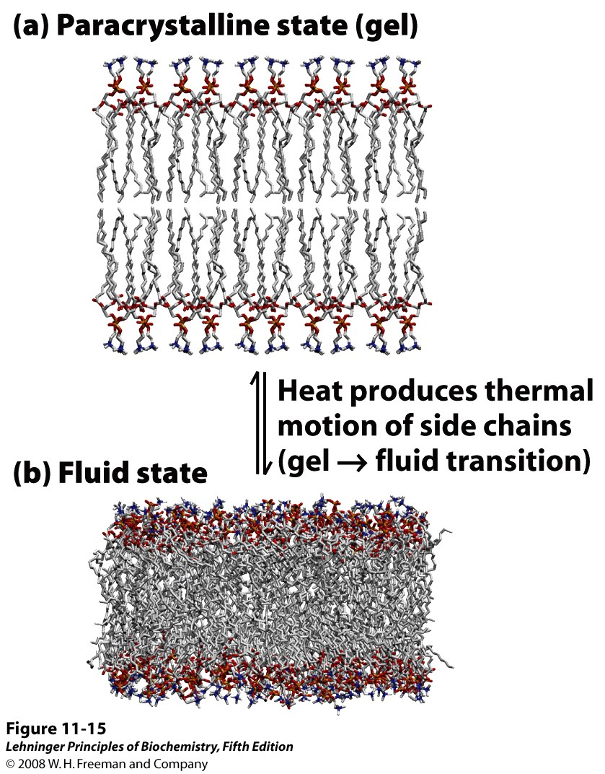
Temperature also affects bilayer fluidity
Notes:
FIGURE 11-15 Two extreme states of bilayer lipids. (a) In the paracrystalline state, or gel phase, polar head groups are uniformly arrayed at the surface, and the acyl chains are nearly motionless and packed with regular geometry. (b) In the liquid-disordered state, or fluid state, acyl chains undergo much thermal motion and have no regular organization. Intermediate between these extremes is the liquid-ordered state, in which individual phospholipid molecules can diffuse laterally but the acyl groups remain extended and more or less ordered.

Slide 13
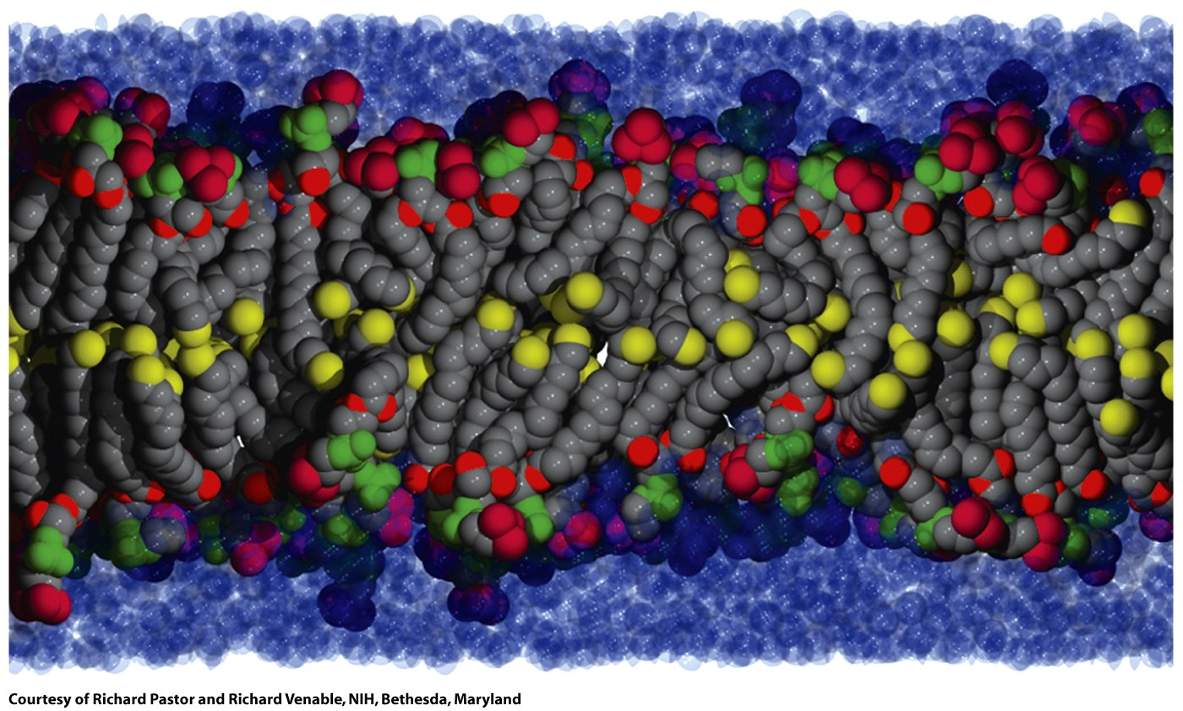
At physiological temperatures, membrane bilayers are (and must be) quite fluid

Slide 14
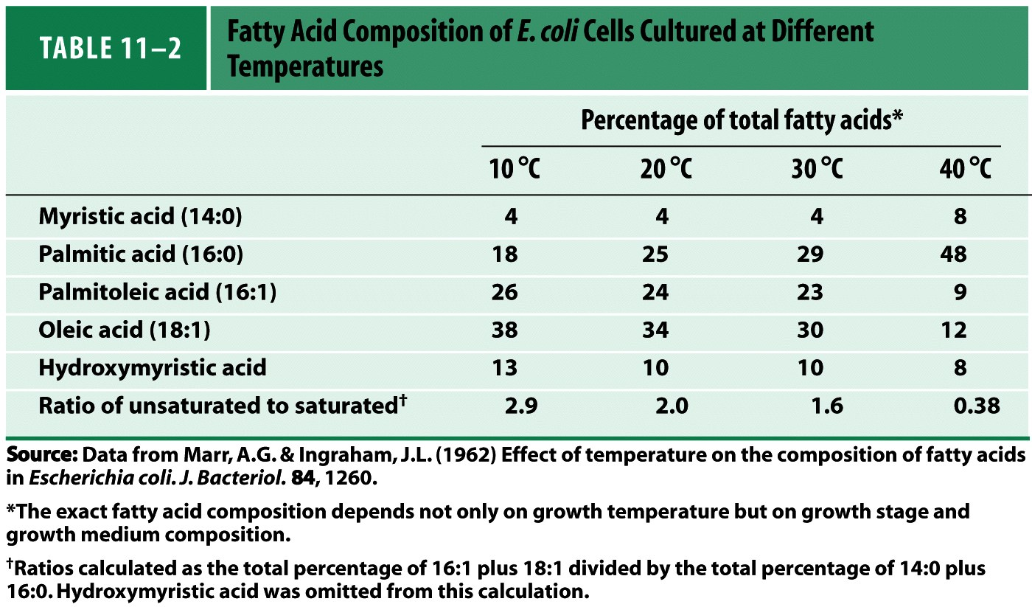
E. coli can change its lipid composition to achieve ideal fluidity of its membrane

Slide 15
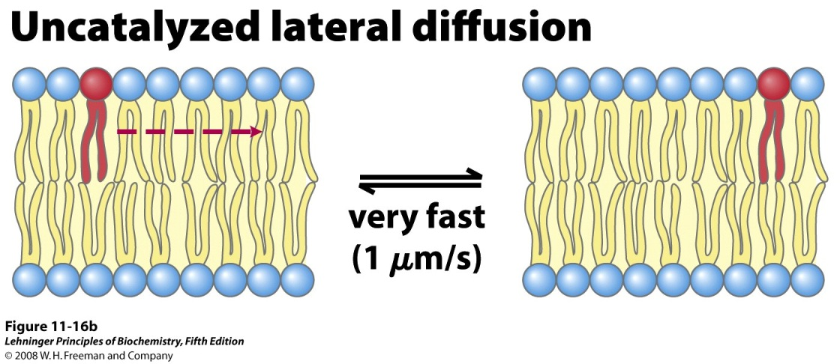
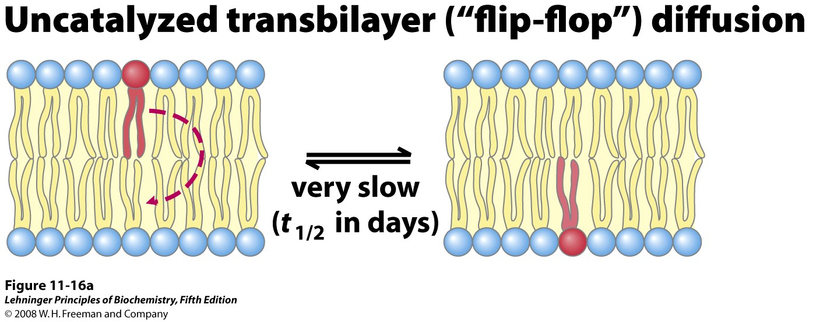
Lipids diffuse readily within one leaflet of the bilayer, but not between leaflets
Notes:
FIGURE 11-16 Motion of single phospholipids in a bilayer. (a) Uncatalyzed movement from one leaflet to the other is very slow, but (b) lateral diffusion within the leaflet is very rapid, requiring no catalysis. (c) Three types of phospholipid translocaters in the plasma membrane. Flippases translocate primarily aminophospholipids (phosphatidylethanolamine (PE), phosphatidylserine (PS)) from the outer (exoplasmic) leaflet to the inner (cytosolic) leaflet; they require ATP and are members of the P-type ATPase family. Floppases move phospholipids from the cytosolic to the outer leaflet, require ATP, and are members of the ABC transporter family. Scramblases equilibrate phospholipids across both leaflets; they do not require ATP but are activated by Ca²⁺.

Slide 16
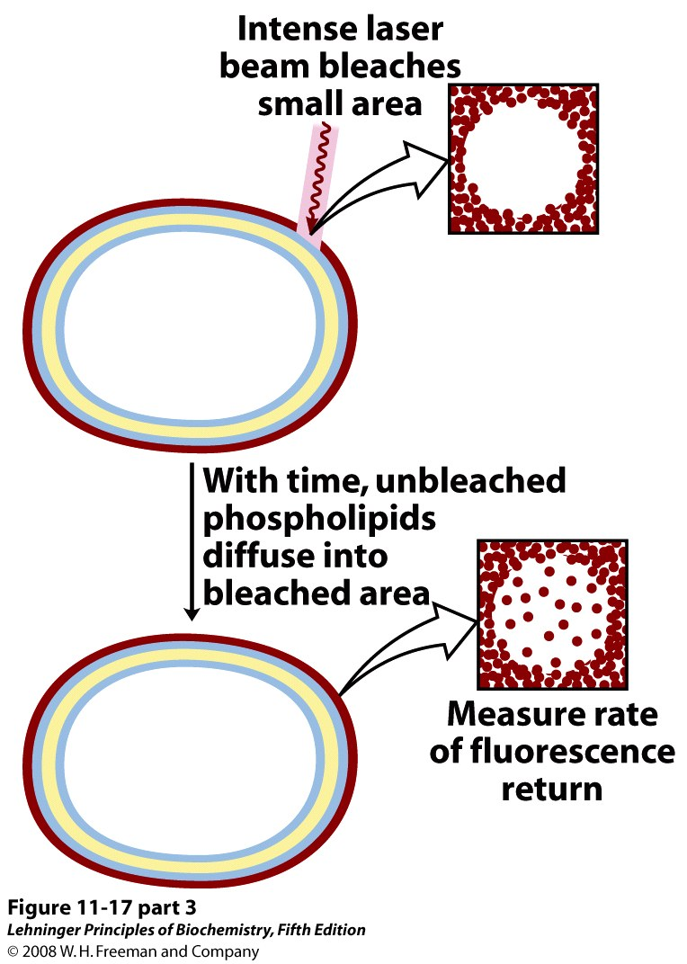
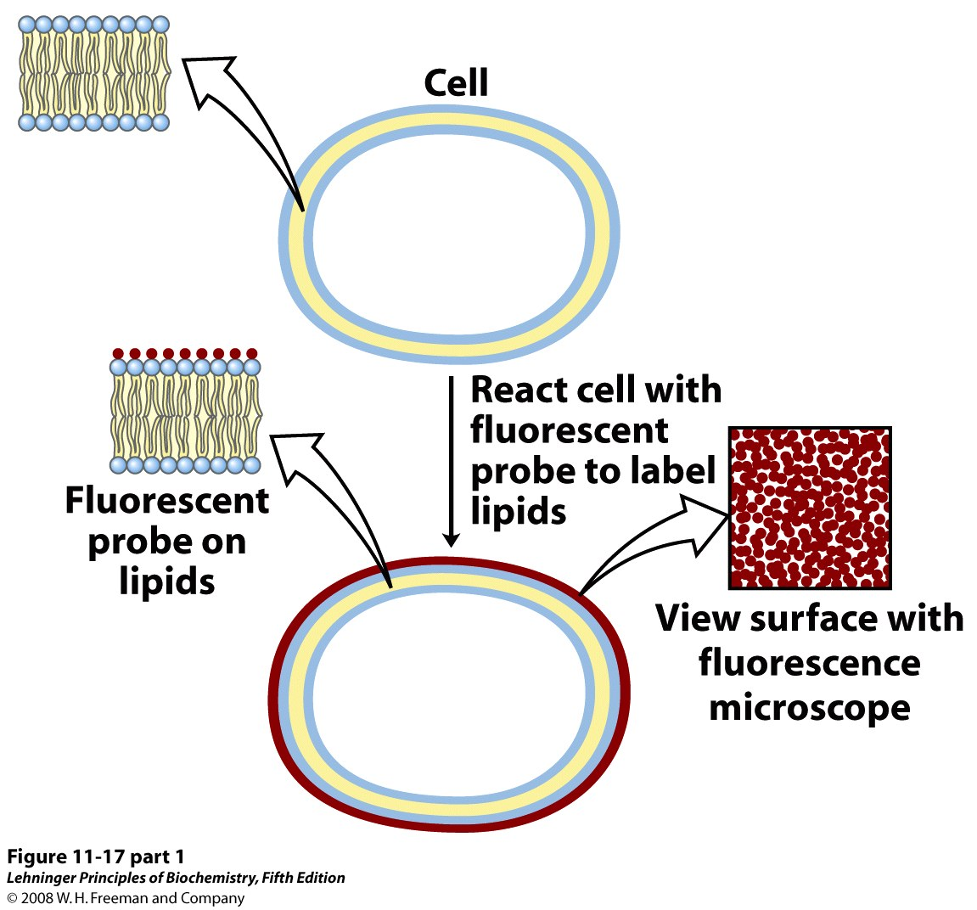
Biological membranes are ‘fluid mosaics’ – proteins and lipids diffuse laterally
Photobleaching allows measurement of diffusion rates in the membrane
Notes:
FIGURE 11-17 Measurement of lateral diffusion rates of lipids by fluorescence recovery after photobleaching (FRAP). Lipids in the outer leaflet of the plasma membrane are labeled by reaction with a membrane-impermeant fluorescent probe (red), so the surface is uniformly labeled when viewed with a fluorescence microscope. A small area is bleached by irradiation with an intense laser beam and becomes nonfluorescent. With the passage of time, labeled lipid molecules diffuse into the bleached region, and it again becomes fluorescent. Researchers can track the time course of fluorescence return and determine a diffusion coefficient for the labeled lipid. The diffusion rates are typically high; a lipid moving at this speed could circumnavigate an E. coli cell in one second. (The FRAP method can also be used to measure lateral diffusion of membrane proteins.)

Slide 17
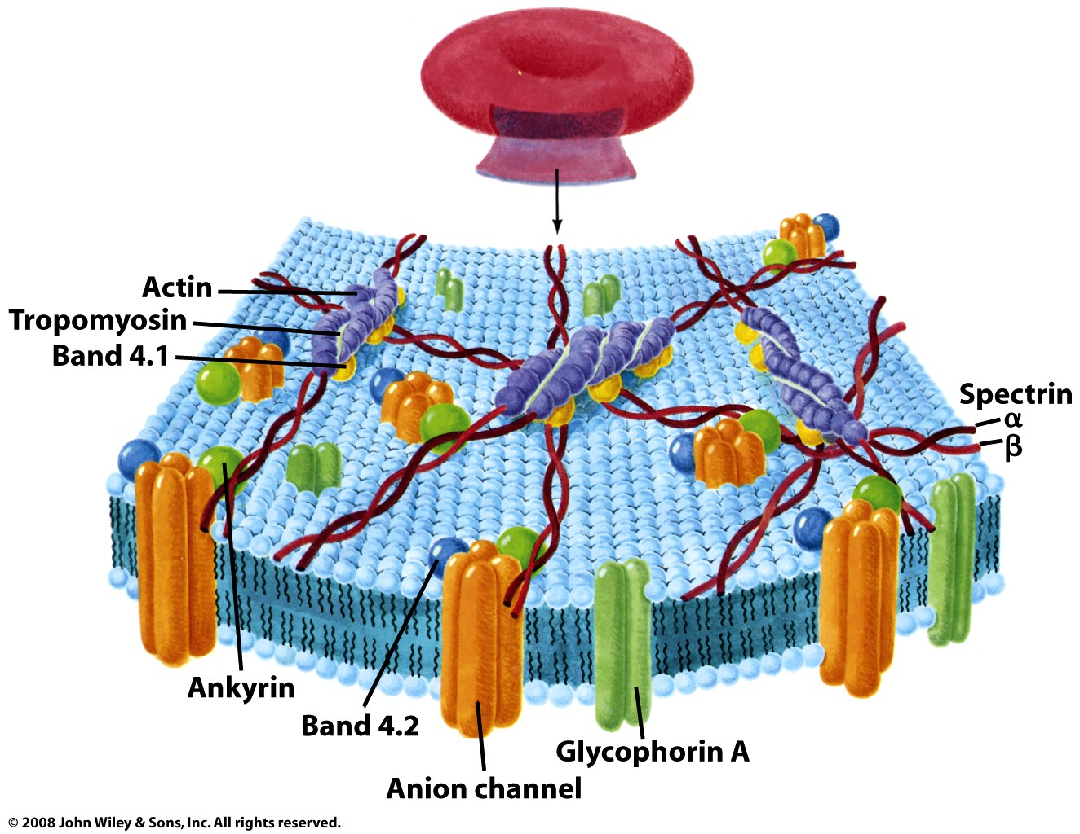
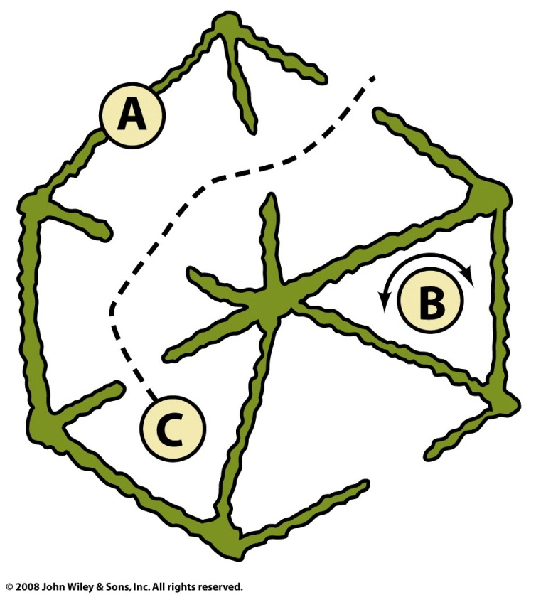
The membrane ‘skeleton,’ which shapes the cell, limits movement of proteins and lipids

Slide 18
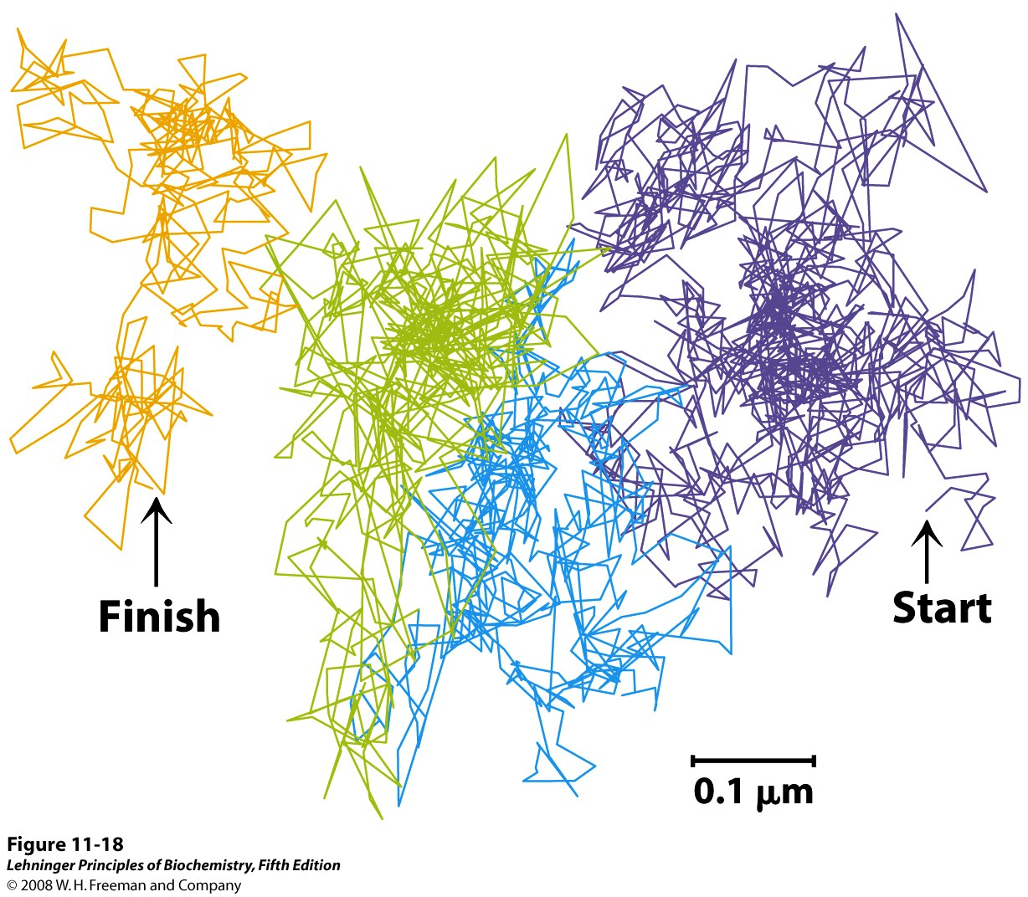
The ‘fencing-in’ and diffusion of lipids can be observed using fluorescent microscopy
Notes:
FIGURE 11-18 Hop diffusion of individual lipid molecules. The motion of a single fluorescently labeled lipid molecule in a cell surface is recorded on video by fluorescence microscopy, with a time resolution of 25 µs (equivalent to 40,000 frames/s). The track shown here represents a molecule followed for 56 ms (2,250 frames); the trace begins in the purple area and continues through blue, green, and orange. The pattern of movement indicates rapid diffusion within a confined region (about 250 nm in diameter, shown by a single color), with occasional hops into an adjoining region. This finding suggests that the lipids are corralled by molecular fences that they occasionally jump

