Slide 1
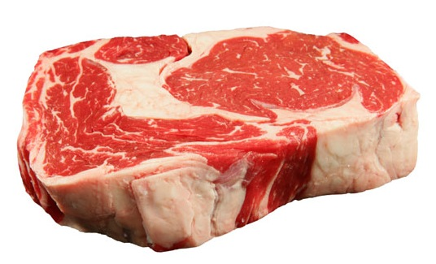
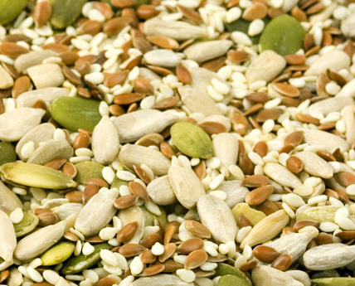
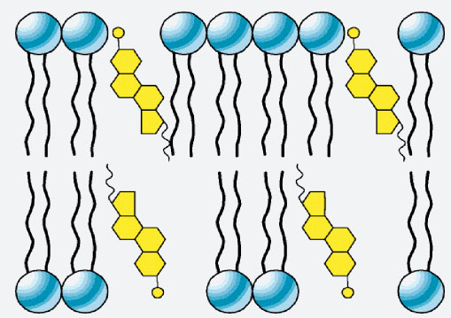
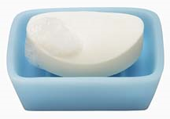
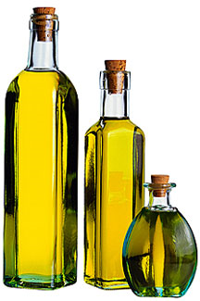
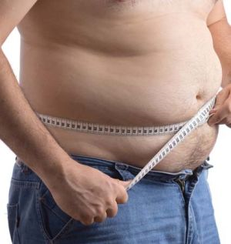
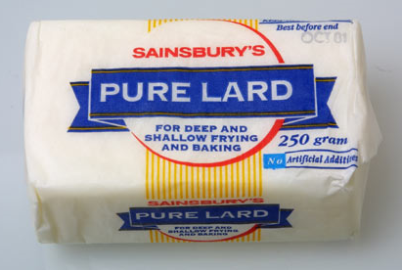
Lipids

Slide 2
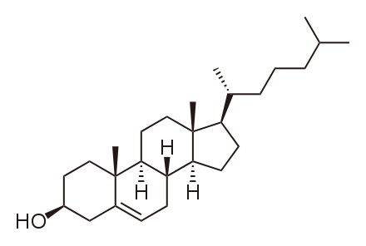
Lipids are hydrophobic or amphiphilic molecules with widely varying structures
Rich in hydrocarbon
Polar group (usually small)
Cholesterol
Oleic acid

Slide 3
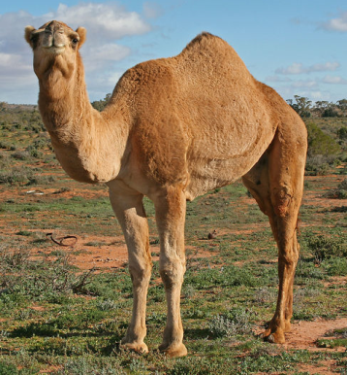
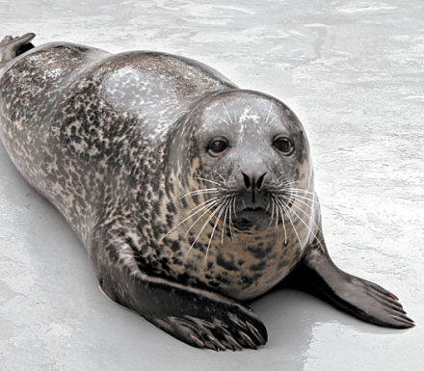
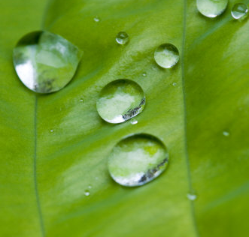
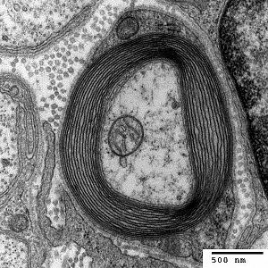
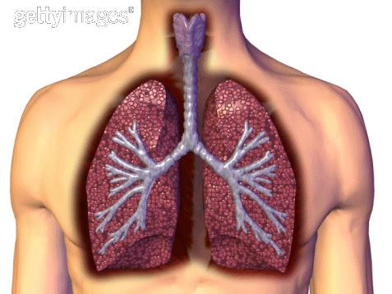
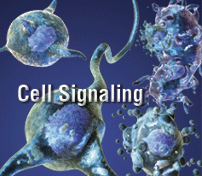
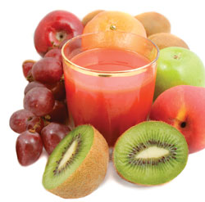
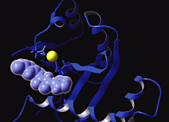
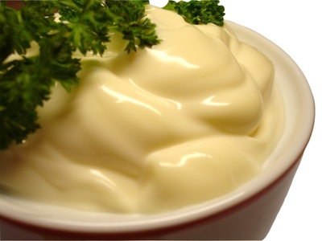
Lipids serve a wide variety of functions
Insulation
Membrane
components
Energy storage
Protection
Triacylglycerols
Triacylglycerols
Waxes
Phospholipids
Surfactants
Hormones
Antioxidants
Dipalmitoyl-
phosphatidylcholine
Eicosanoids
Vitamin E
Estrogens
Enzyme cofactors
Light-absorbing
pigments
Emulsifiers
Electron carriers
Vitamin K
Coenzyme Q
Chlorophyll
Bile acids

Slide 4
Fatty acids (soaps) vary in chain length and degree of unsaturation

Slide 5
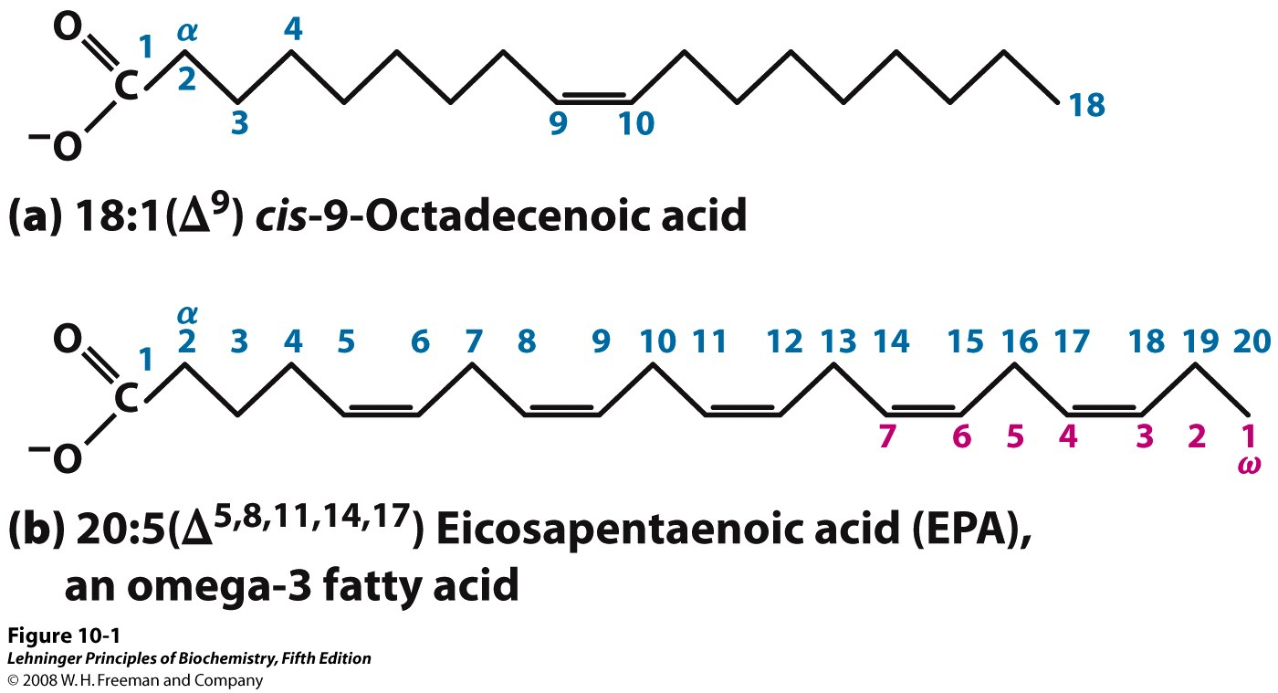
Fatty acids can be named from either the carboxyl (standard; Δ) or methyl (ω) end
Notes:
FIGURE 10-1 Two conventions for naming fatty acids. (a) Standard nomenclature assigns the number 1 to the carboxyl carbon (C-1), and α to the carbon next to it. The position of any double bond(s) is indicated by Δ followed by a superscript number indicating the lower-numbered carbon in the double bond. (b) For polyunsaturated fatty acids (PUFAs), an alternative convention numbers the carbons in the opposite direction, assigning the number 1 to the methyl carbon at the other end of the chain; this carbon is also designated ω (omega; the last letter in the Greek alphabet). The positions of the double bonds are indicated relative to the ω carbon.

Slide 6
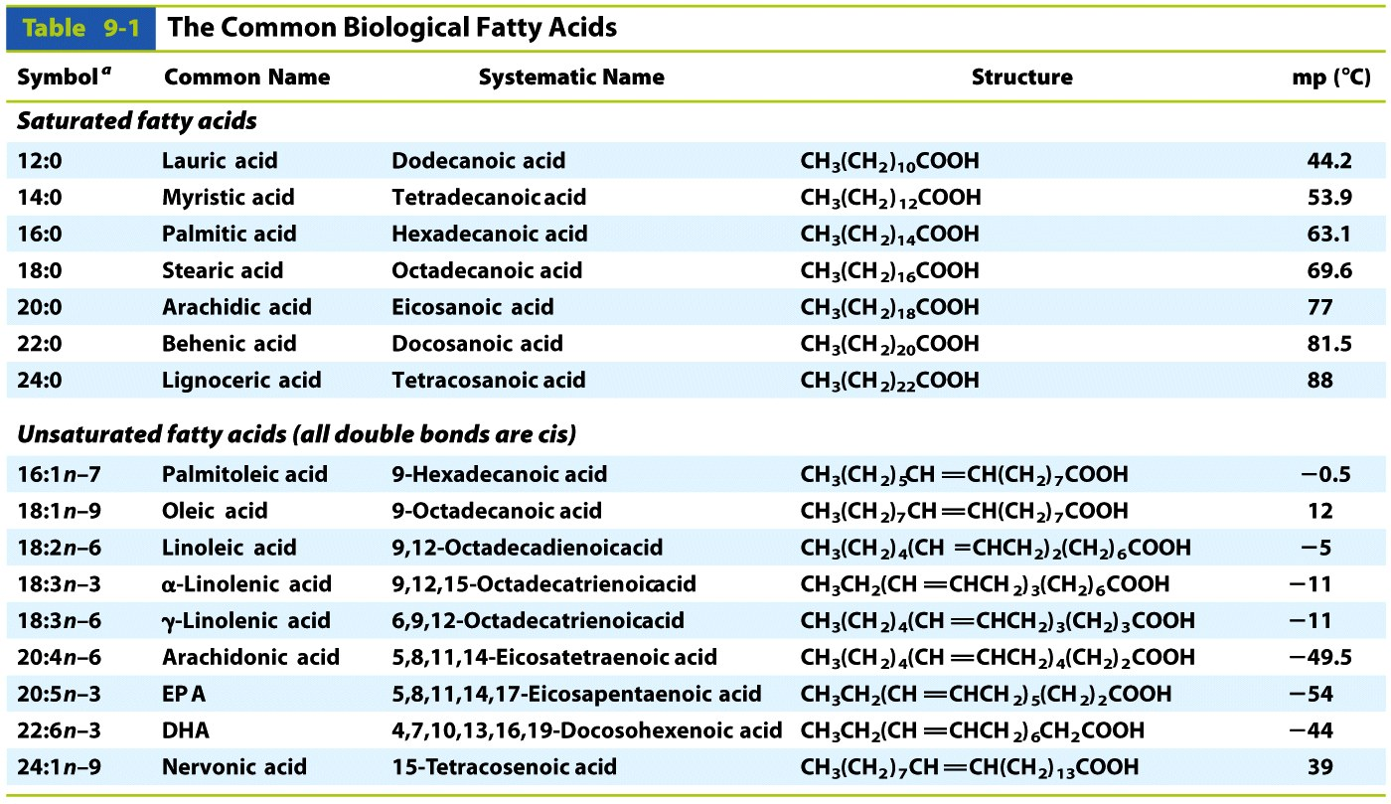
Fatty acid melting point increases with chain length and increasing saturation

Slide 7
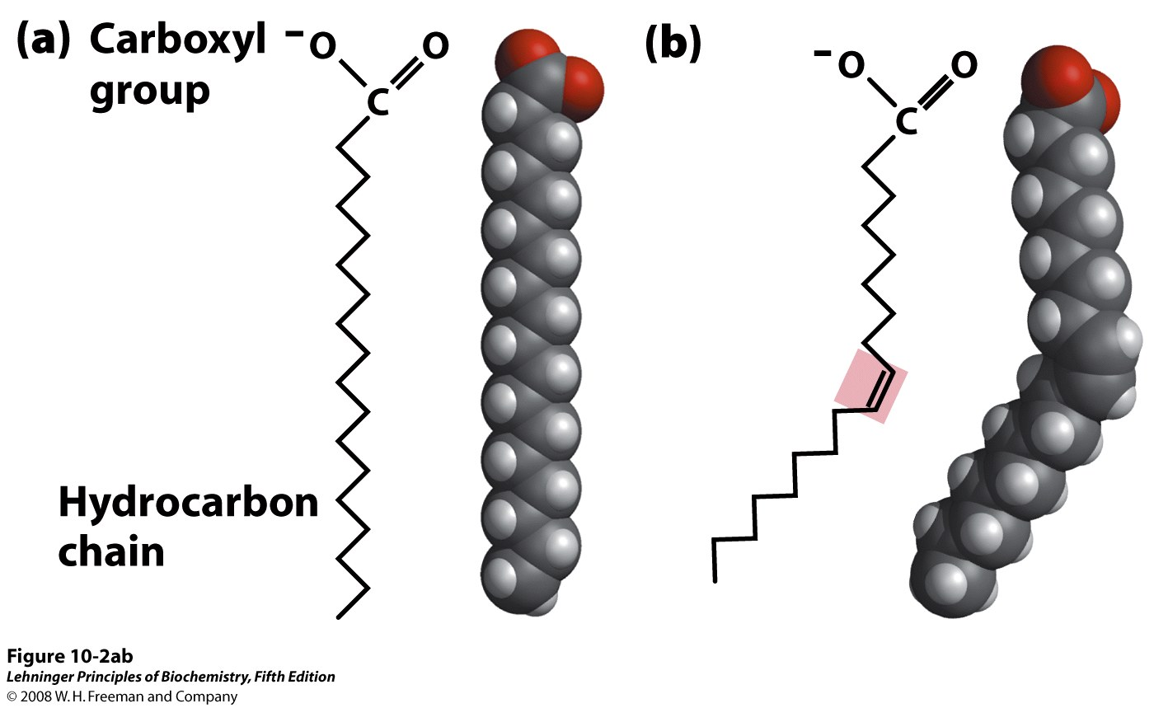
Cis-double bonds (normal for fatty acids) kink the hydrocarbon chain
Notes:
FIGURE 10-2ab The packing of fatty acids into stable aggregates. The extent of packing depends on the degree of saturation. (a) Two representations of the fully saturated acid stearic acid, 18:0 (stearate at pH 7), in its usual extended conformation. Each line segment of the zigzag represents a single bond between adjacent carbons. (b) The cis double bond (shaded) in oleic acid, 18:1(Δ⁹) (oleate), restricts rotation and introduces a rigid bend in the hydrocarbon tail. All other bonds in the chain are free to rotate.

Slide 8
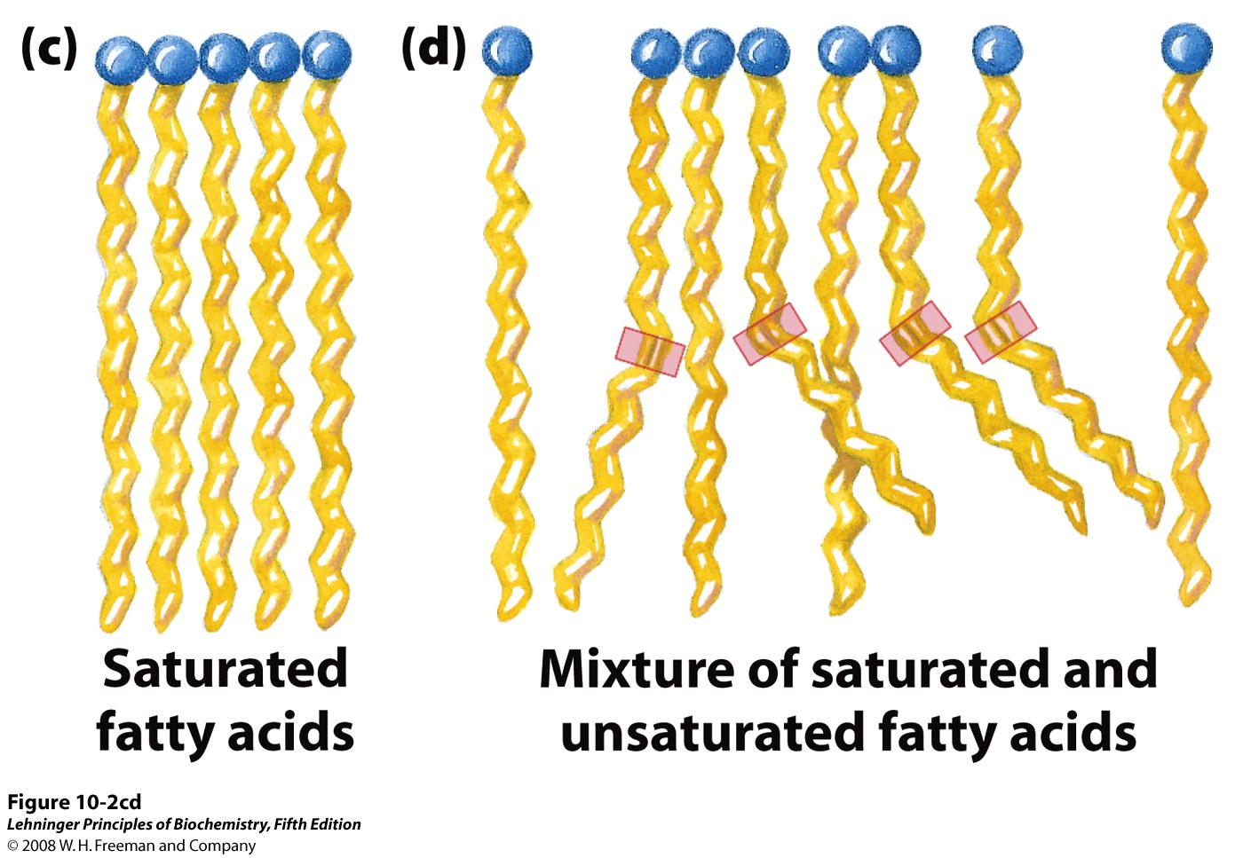
Unsaturations prevent close packing and lower the melting point (increase fluidity)
Notes:
FIGURE 10-2cd The packing of fatty acids into stable aggregates. The extent of packing depends on the degree of saturation. (c) Fully saturated fatty acids in the extended form pack into nearly crystalline arrays, stabilized by many hydrophobic interactions. (d) The presence of one or more fatty acids with cis double bonds interferes with this tight packing and results in less stable aggregates.

Slide 9
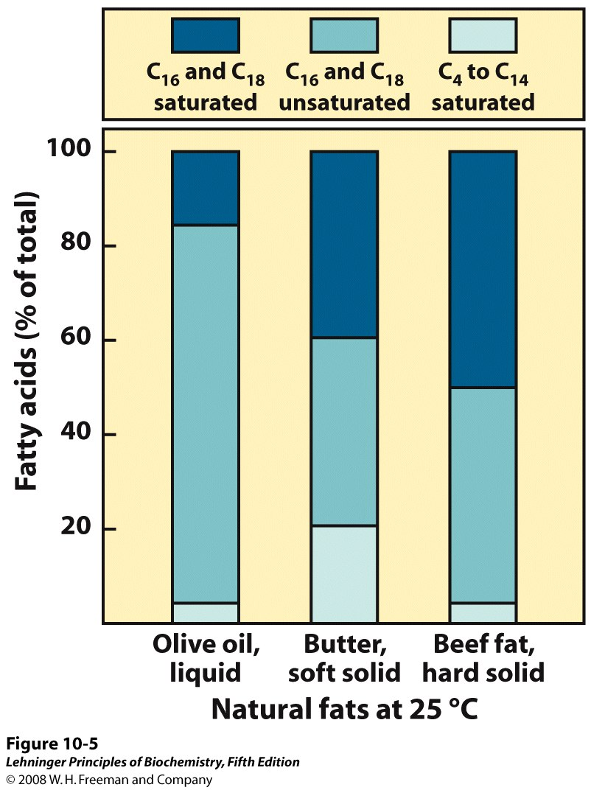
The FA composition of natural fats explains their consistency at room temperature
Notes:
FIGURE 10-5 Fatty acid composition of three food fats. Olive oil, butter, and beef fat consist of mixtures of triacylglycerols, differing in their fatty acid composition. The melting points of these fats—and hence their physical state at room temperature (25˚C)—are a direct function of their fatty acid composition. Olive oil has a high proportion of long-chain (C₁₆ and C₁₈) unsaturated fatty acids, which accounts for its liquid state at 25˚C. The higher proportion of long-chain (C₁₆ and C₁₈) saturated fatty acids in butter increases its melting point, so butter is a soft solid at room temperature. Beef fat, with an even higher proportion of long-chain saturated fatty acids, is a hard solid.

Slide 10
Lipids are used for energy storage

Slide 11
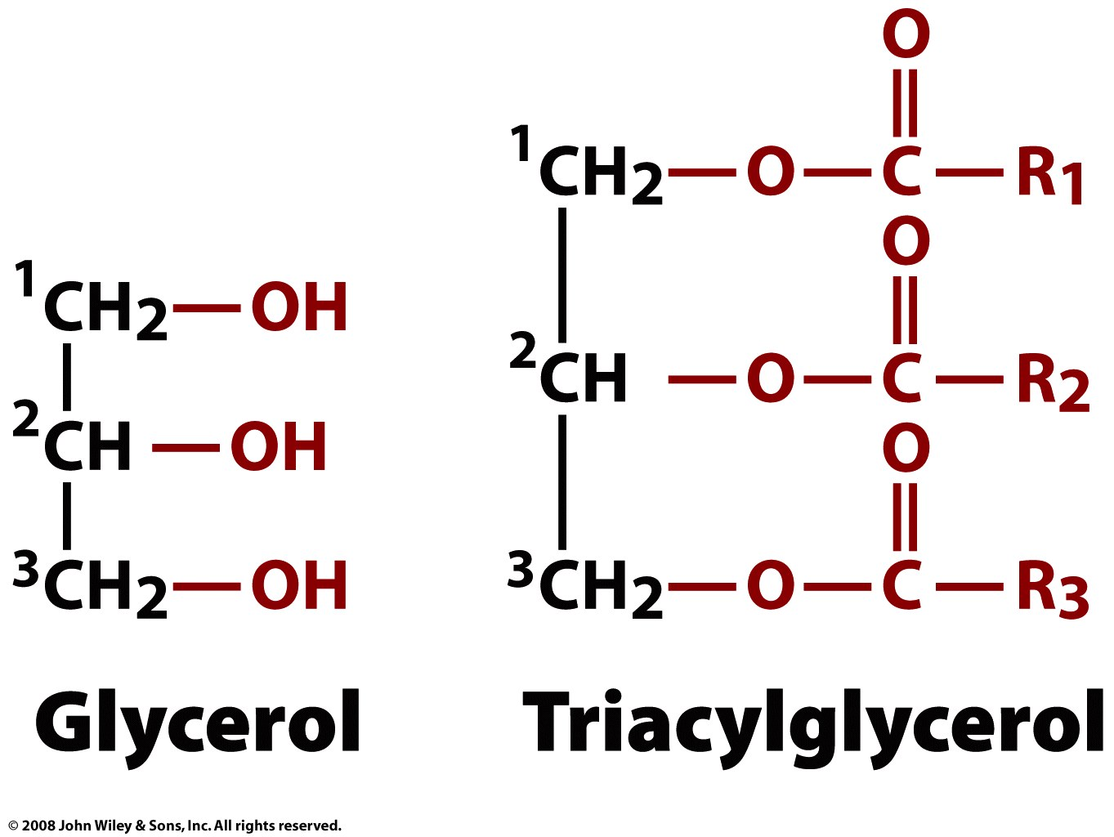
Triacylglycerols (triglycerides), composed of glycerol and FAs, are energy-storage lipids

Slide 12
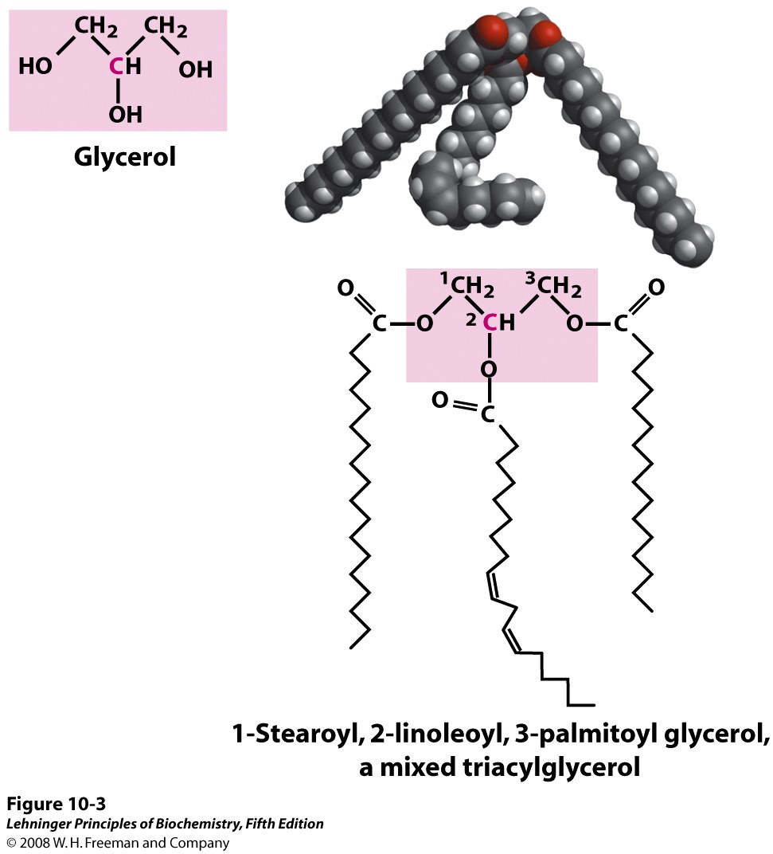
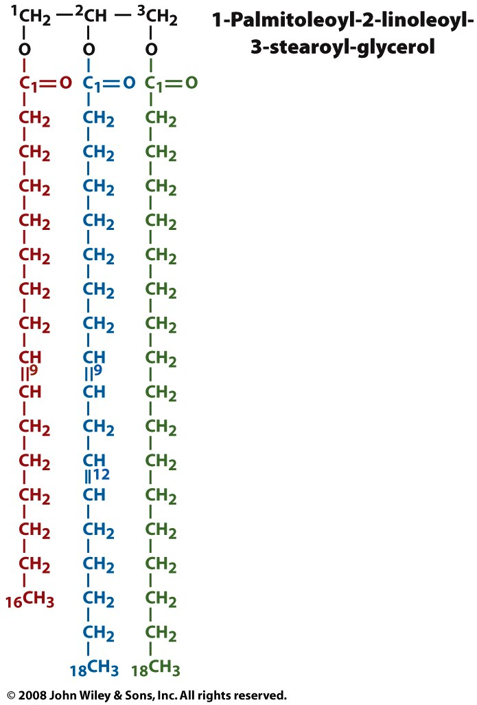

Slide 13
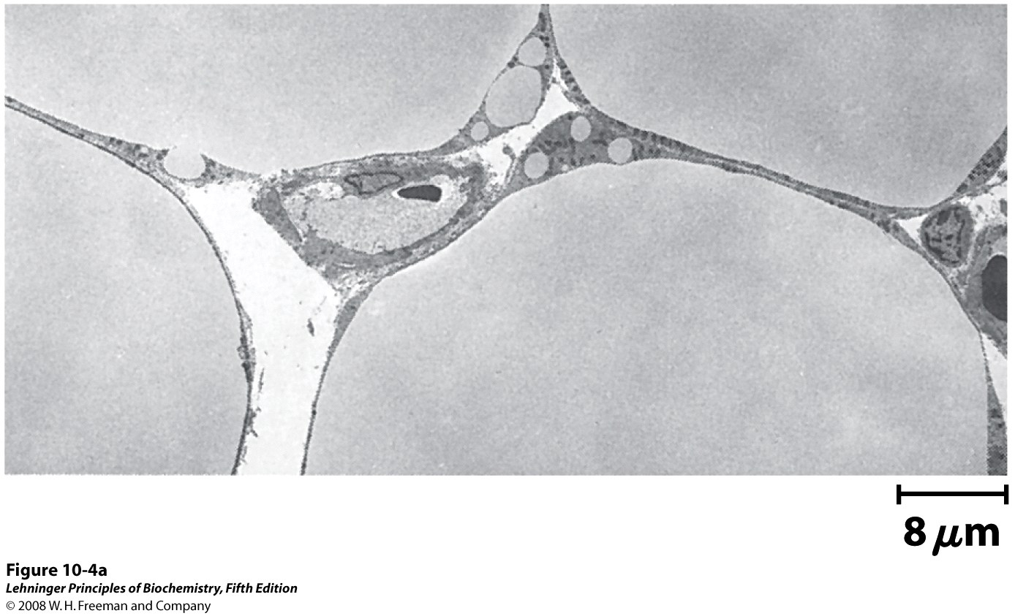
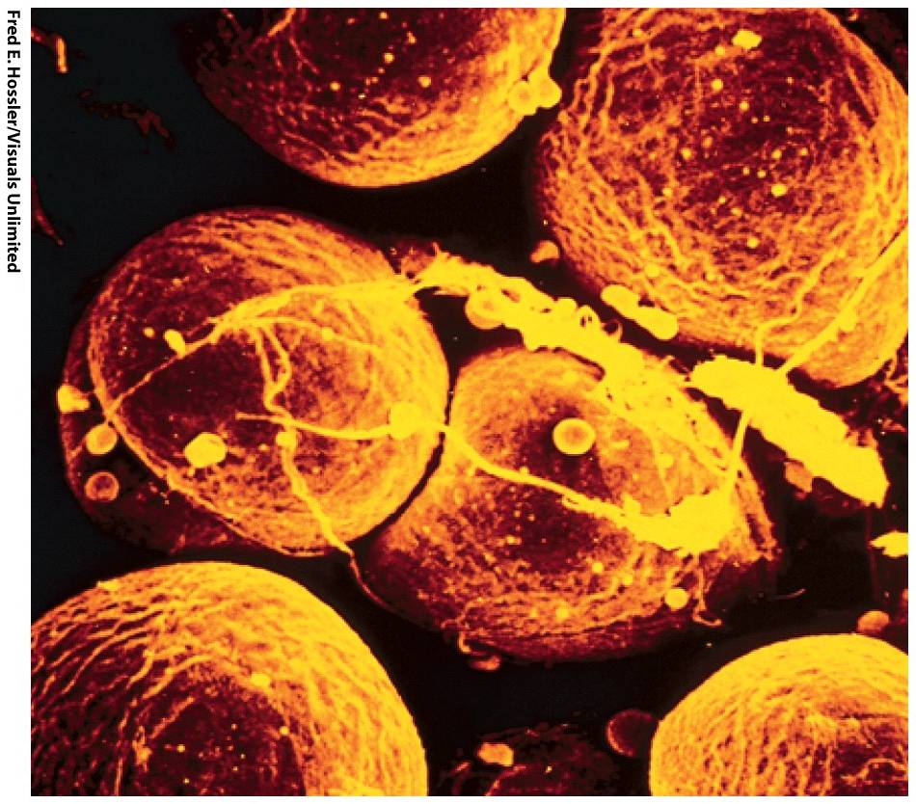
Adipocytes are filled with fat (triacylglycerols)

Slide 14
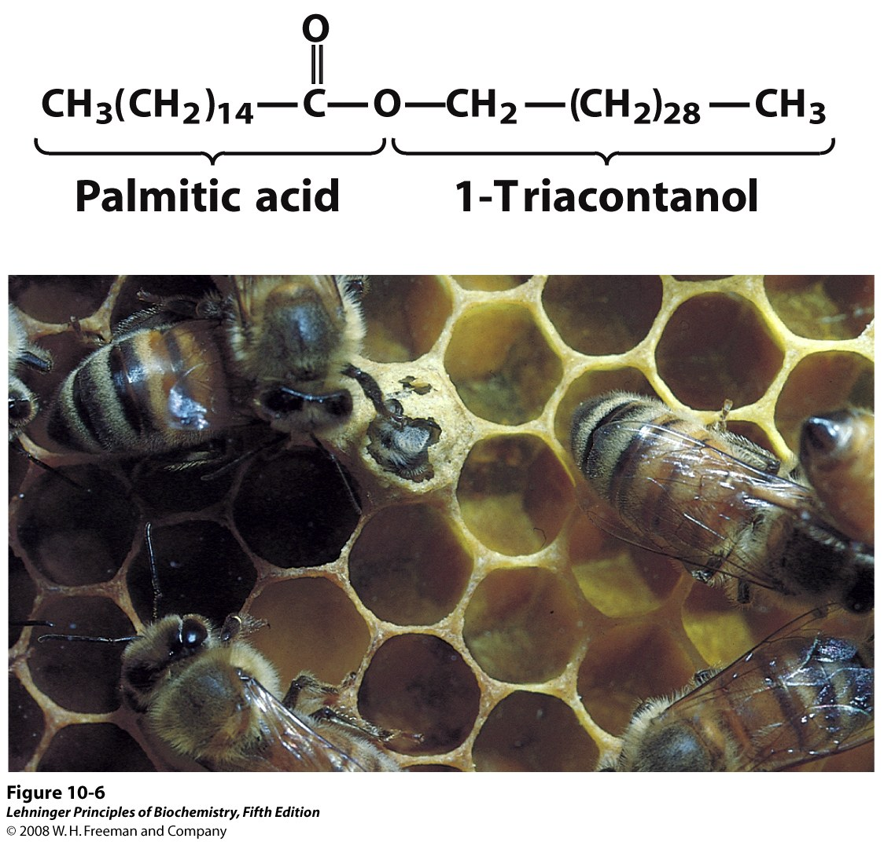
Waxes combine a fatty acid and an alcohol
Notes:
FIGURE 10-6 Biological wax. (a) Triacontanoylpalmitate, the major component of beeswax, is an ester of palmitic acid with the alcohol triacontanol. (b) A honeycomb, constructed of beeswax, is firm at 25˚C and completely impervious to water. The term "wax" originates in the Old English weax, meaning "the material of the honeycomb."

Slide 15
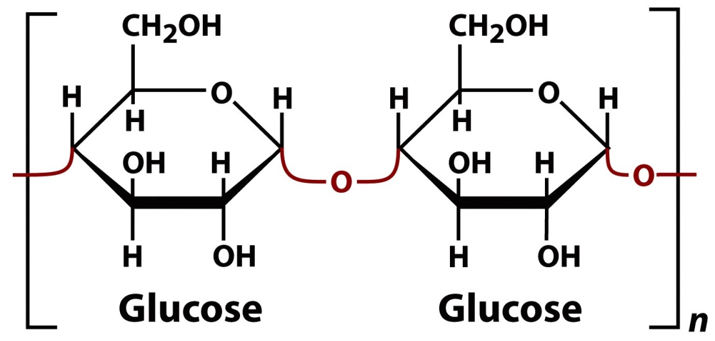
Lipids provide a more efficient form of energy storage than carbohydrates
Carbohydrates are:
More oxidized
Hydrated

Slide 16
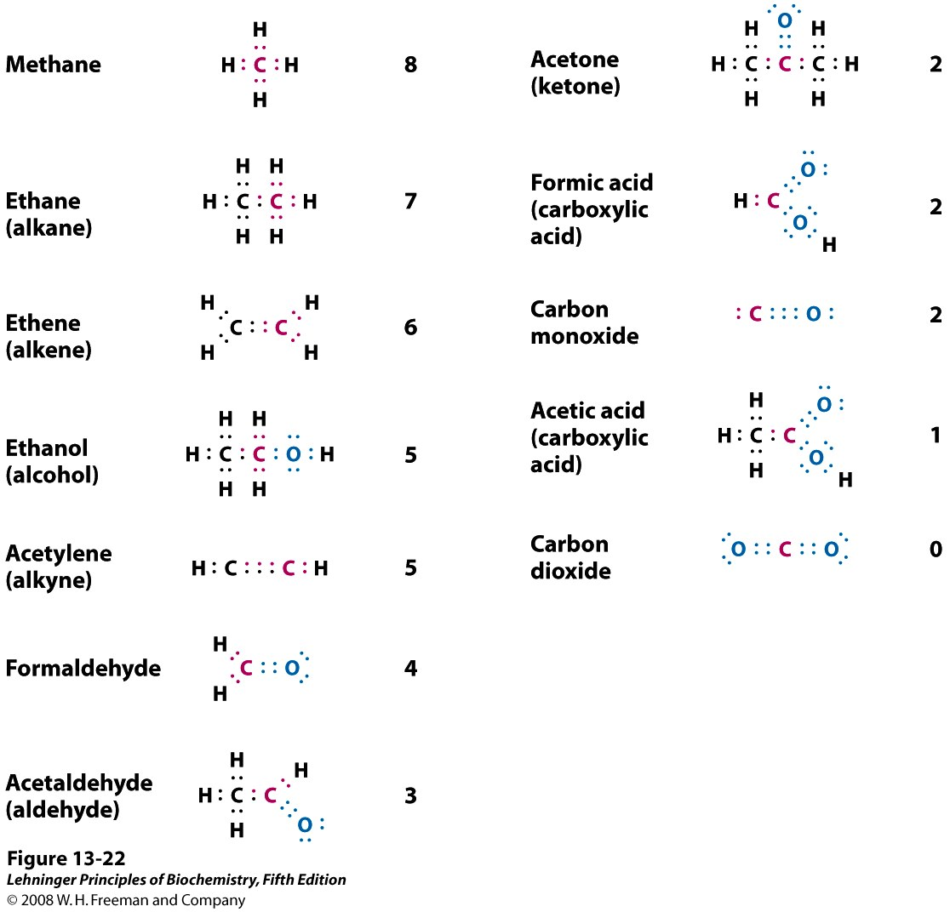
Oxidation states of carbon in the biosphere. Focus on the red carbon atom and its bonding electrons. When this carbon is bonded to the less electronegative H atom, both bonding electrons (red) are assigned to the carbon. When carbon is bonded to another carbon, bonding electrons are shared equally, so one of the two electrons is assigned to the red carbon. When the red carbon is bonded to the more electronegative O atom, the bonding electrons are assigned to the oxygen. The number to the right of each compound is the number of electrons "owned" by the red carbon, a rough expression of the oxidation state of that carbon. As the red carbon undergoes oxidation (loses electrons), the number gets smaller. Thus the oxidation state increases from top lwft to bottom right of the figure.
Notes:
FIGURE 13-22 Oxidation states of carbon in the biosphere. The oxidation states are illustrated with some representative compounds. Focus on the red carbon atom and its bonding electrons. When this carbon is bonded to the less electronegative H atom, both bonding electrons (red) are assigned to the carbon. When carbon is bonded to another carbon, bonding electrons are shared equally, so one of the two electrons is assigned to the red carbon. When the red carbon is bonded to the more electronegative O atom, the bonding electrons are assigned to the oxygen. The number to the right of each compound is the number of electrons "owned" by the red carbon, a rough expression of the oxidation state of that carbon. As the red carbon undergoes oxidation (loses electrons), the number gets smaller. Thus the oxidation state increases from top to bottom of the list.

Slide 17
Lipids are a major component of biological membranes

Slide 18
Membrane lipids can be divided into groups based on their parent compound
phospholipids
glycolipids
Glycerol-based lipids
(glycerolipids)
glycerophospholipids
galactolipids & sulfolipids
P
glycerol + 2 fatty acids + …
phosphate + alcohol
sugar(s)
Sphingosine-based lipids
(sphingolipids or ceramides)
cerebrosides, globosides, & gangliosides
sphingomyelins
P
sphingosine + 1 fatty acid + …
phosphate + alcohol
sugar(s)
Cyclopentanoperhydrophen-anthrene-based lipids (sterols)

Slide 19
Glycerophospholipids vary in the alcohol of their ‘head group’
P
Polar head group
Hydrophobic tails
Notes:
FIGURE 10-9 (part 1) Glycerophospholipids. The common glycerophospholipids are diacylglycerols linked to head-group alcohols through a phosphodiester bond. Phosphatidic acid, a phosphomonoester, is the parent compound. Each derivative is named for the head-group alcohol (X), with the prefix "phosphatidyl-." In cardiolipin, two phosphatidic acids share a single glycerol (R¹ and R² are fatty acyl groups).

Slide 20
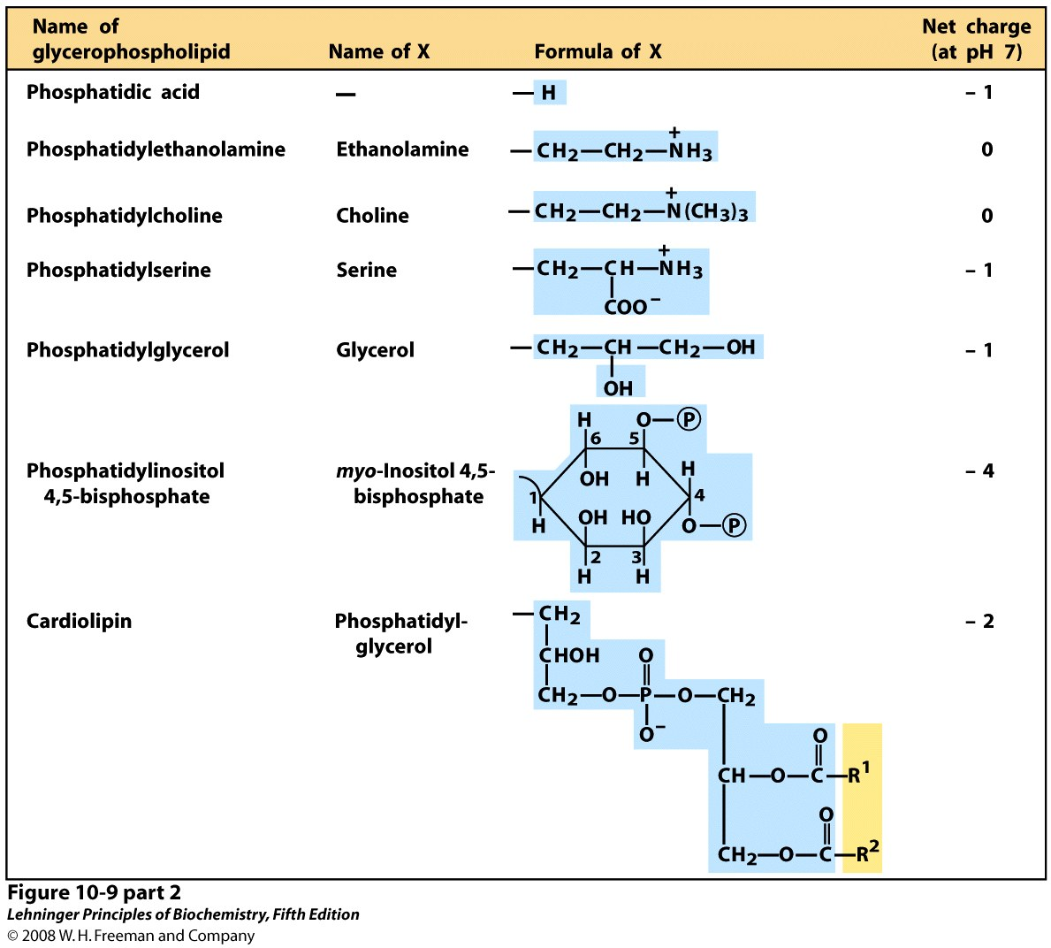
P
Notes:
FIGURE 10-9 (part 2) Glycerophospholipids. The common glycerophospholipids are diacylglycerols linked to head-group alcohols through a phosphodiester bond. Phosphatidic acid, a phosphomonoester, is the parent compound. Each derivative is named for the head-group alcohol (X), with the prefix "phosphatidyl-." In cardiolipin, two phosphatidic acids share a single glycerol (R¹ and R² are fatty acyl groups).

Slide 21
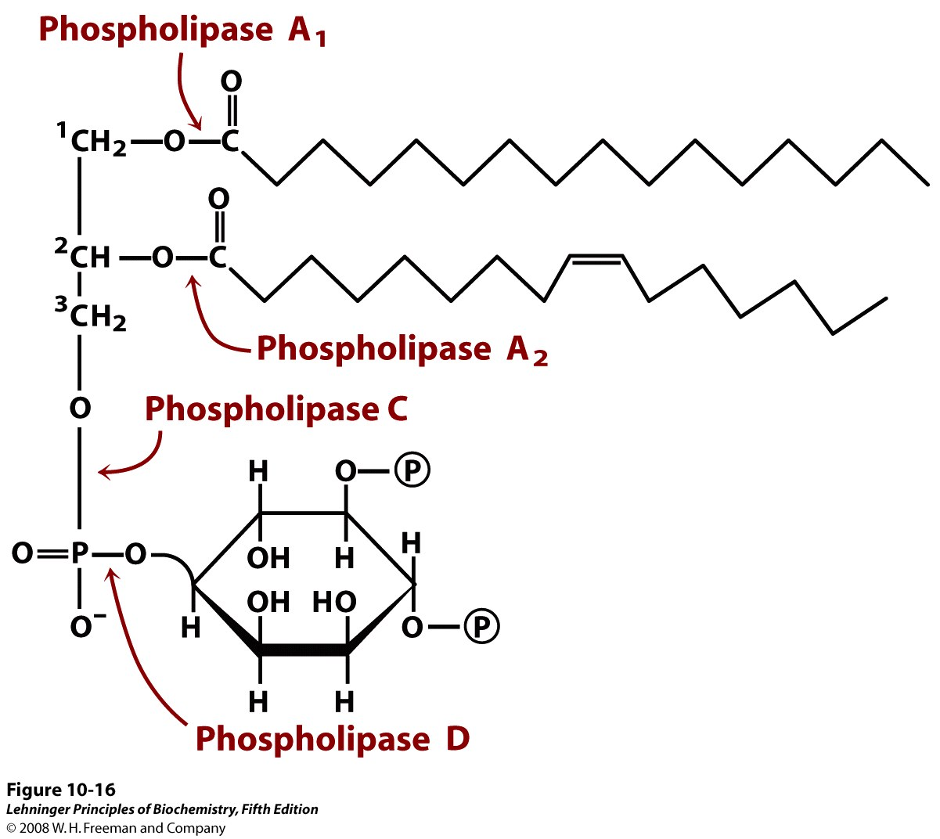
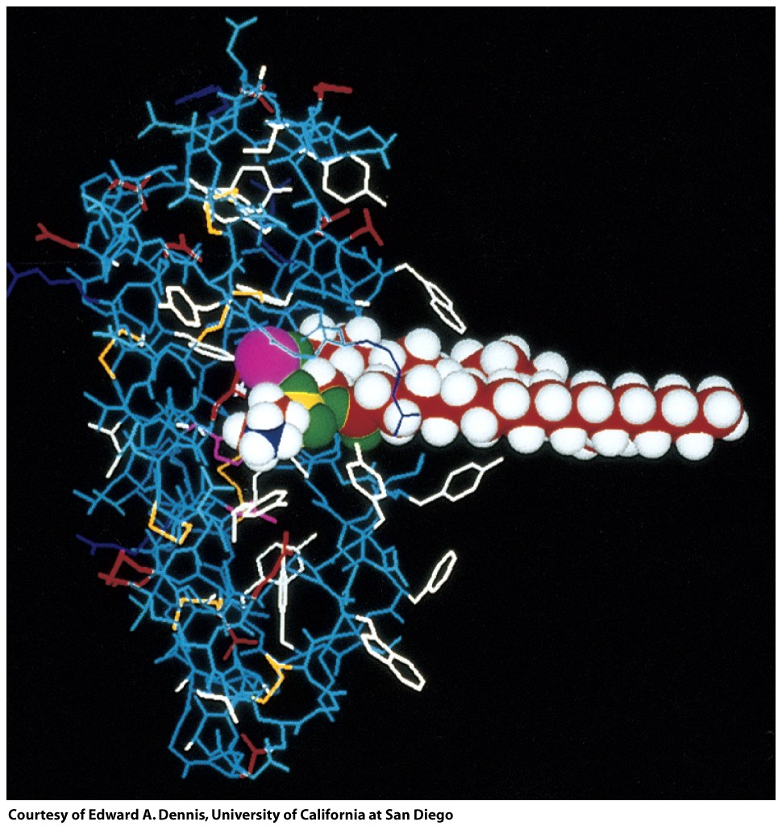
Phospholipases are enzymes that hydrolyze glycerophospholipids
Notes:
FIGURE 10-16 The specificities of phospholipases. Phospholipases A₁ and A₂ hydrolyze the ester bonds of intact glycerophospholipids at C-1 and C-2 of glycerol, respectively. When one of the fatty acids has been removed by a type A phospholipase, the second fatty acid is removed by a lysophospholipase (not shown). Phospholipases C and D each split one of the phosphodiester bonds in the head group. Some phospholipases act on only one type of glycerophospholipid, such as phosphatidylinositol 4,5-bisphosphate (shown here) or phosphatidylcholine; others are less specific

Slide 22
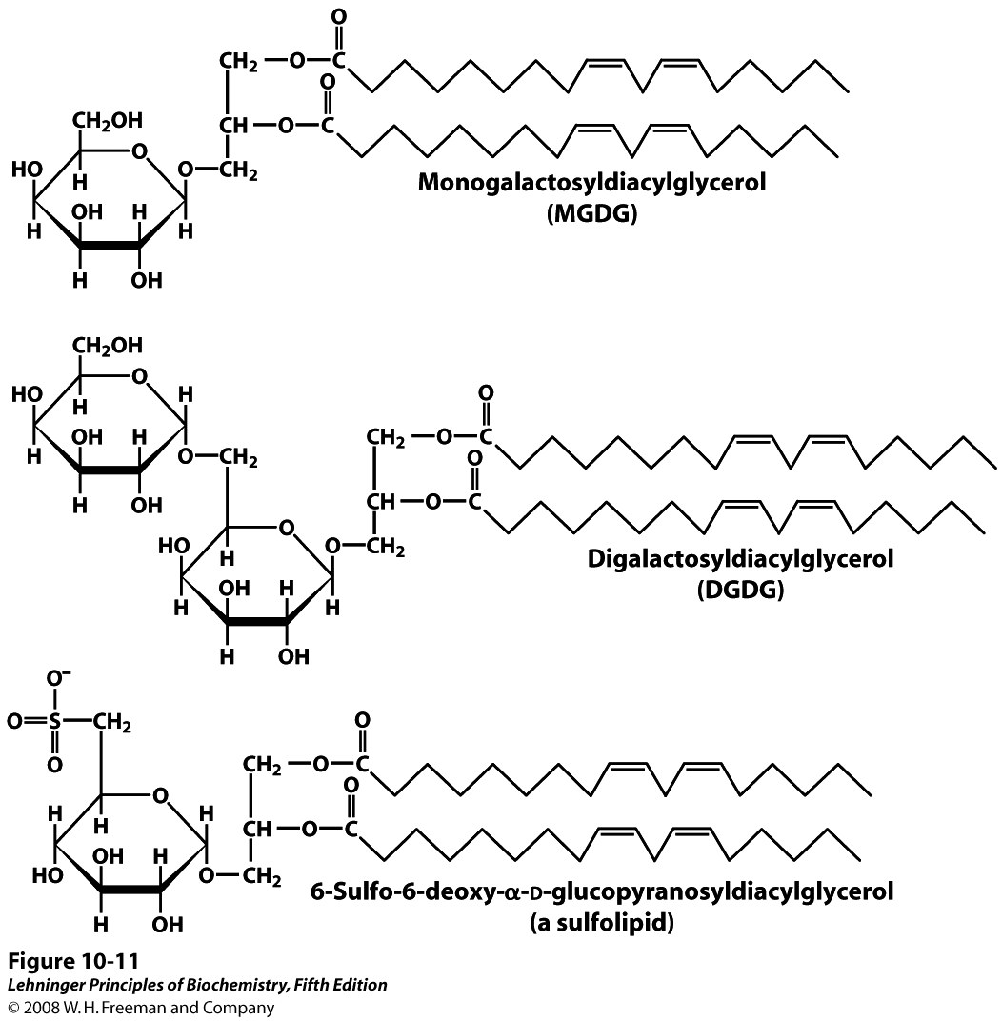
Chloroplast (plant) membranes contain glycerol-based glycolipids
galactolipids
sulfolipid
Notes:
FIGURE 10-11 Three glycolipids of chloroplast thylakoid membranes. In monogalactosyldiacylglycerols (MGDGs) and digalactosyldiacylglycerols (DGDGs), almost all the acyl groups are derived from linoleic acid, 18:2(Δ^{9,12}), and the head groups are uncharged. In the sulfolipid 6-sulfo-6-deoxy-α-D-glucopyranosyldiacylglycerol, the sulfonate carries a fixed negative charge.

Slide 23
Sphingolipids contain sphingosine, a fatty acid, and a variable polar head group
P
Sphingomyelins – phosphocholine or phosphoethanolamine
Cerebrosides – neutral monosaccharide
Globosides – neutral di/tri/tetrasaccharide
Gangliosides – charged oligosaccharide
Notes:
FIGURE 10-13 Sphingolipids. The first three carbons at the polar end of sphingosine are analogous to the three carbons of glycerol in glycerophospholipids. The amino group at C-2 bears a fatty acid in amide linkage. The fatty acid is usually saturated or monounsaturated, with 16, 18, 22, or 24 carbon atoms. Ceramide is the parent compound for this group. Other sphingolipids differ in the polar head group (X) attached at C-1. Gangliosides have very complex oligosaccharide head groups. Standard symbols for sugars are used in this figure, as shown in Table 7-1.

Slide 24
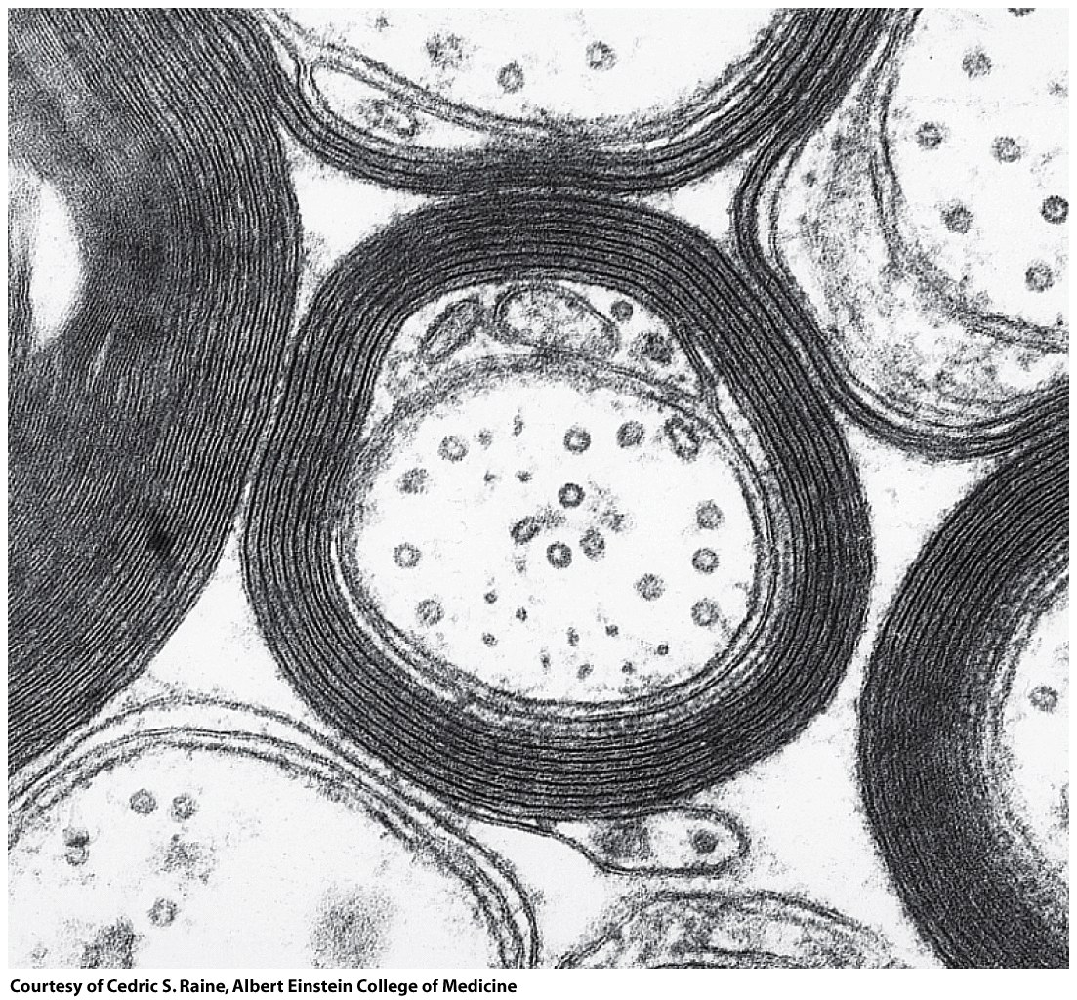
Sphingomyelins are enriched in the myelin sheath of neurons

Slide 25
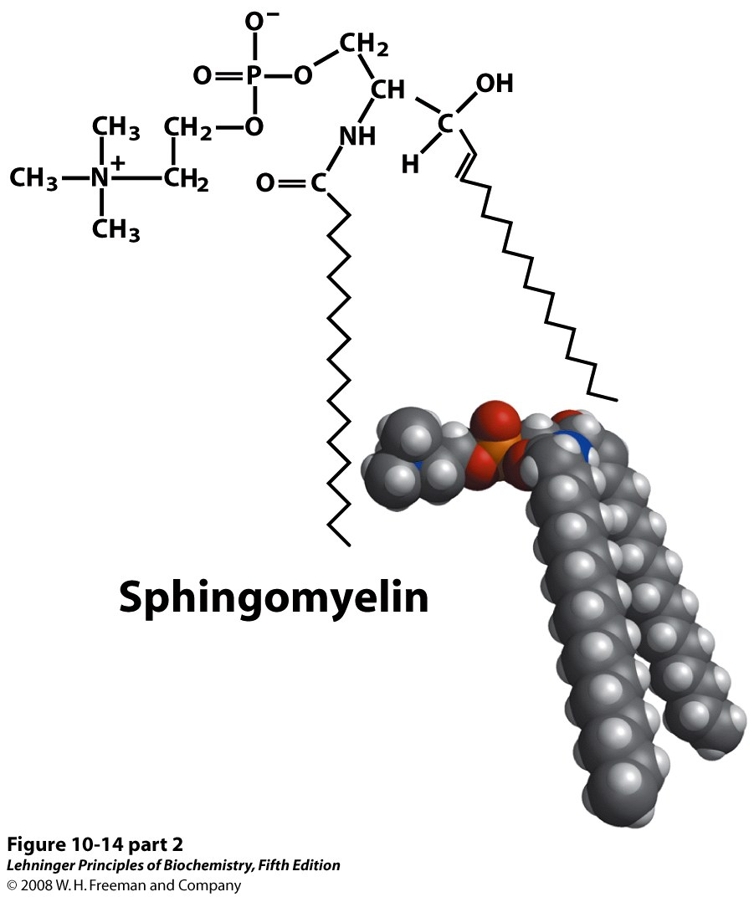
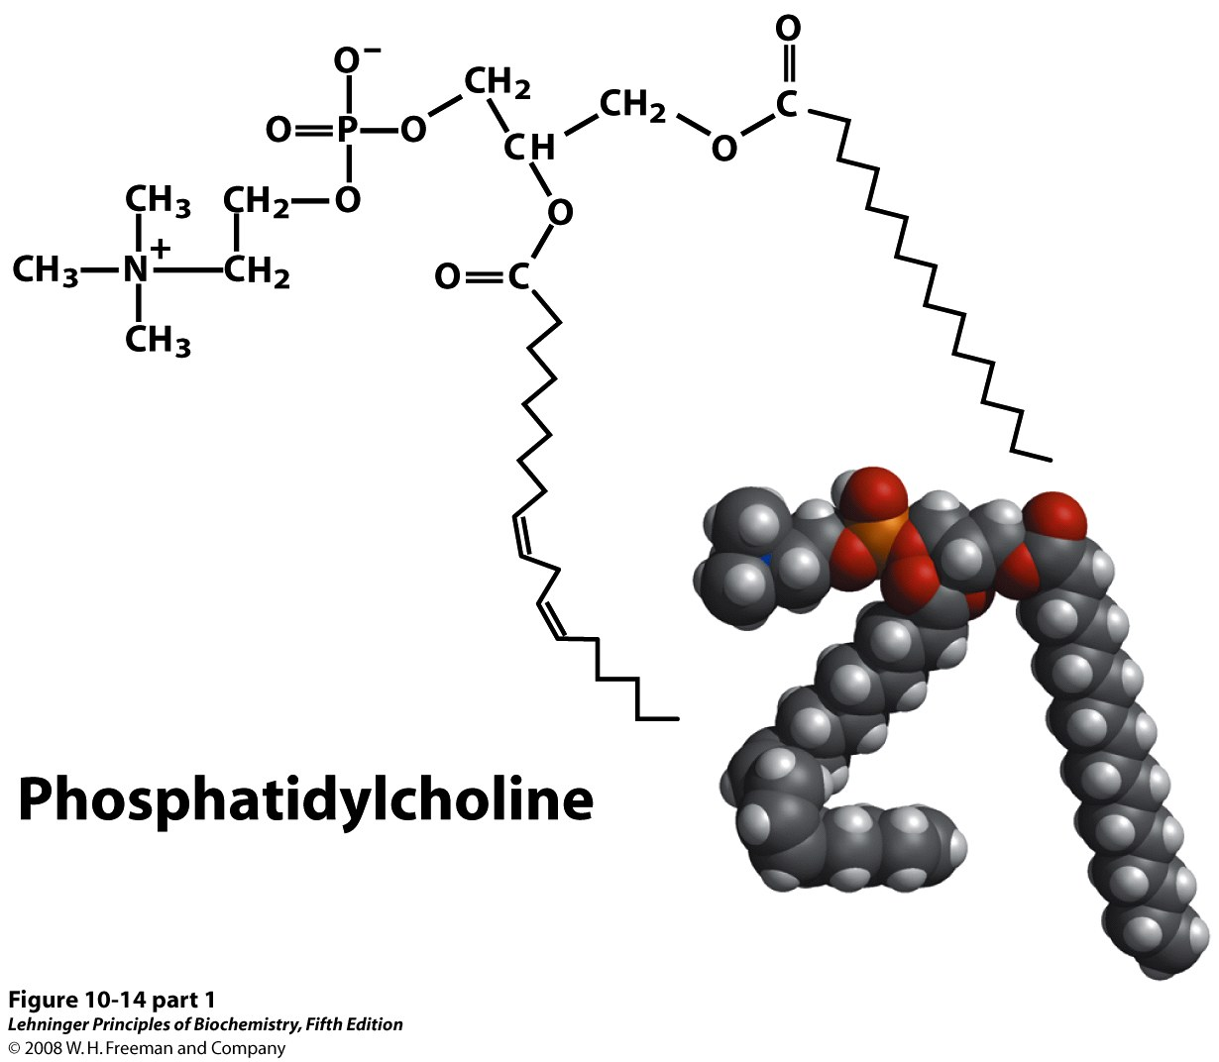
Glycerophospholipids and sphingo-myelins have similar structures
P
P
Notes:
FIGURE 10-14 (part 1) The similarities in shape and molecular structure of phosphatidylcholine (a glycerophospholipid) and sphingomyelin (a sphingolipid) are clear when their space-filling and structural formulas are drawn as here.

Slide 26
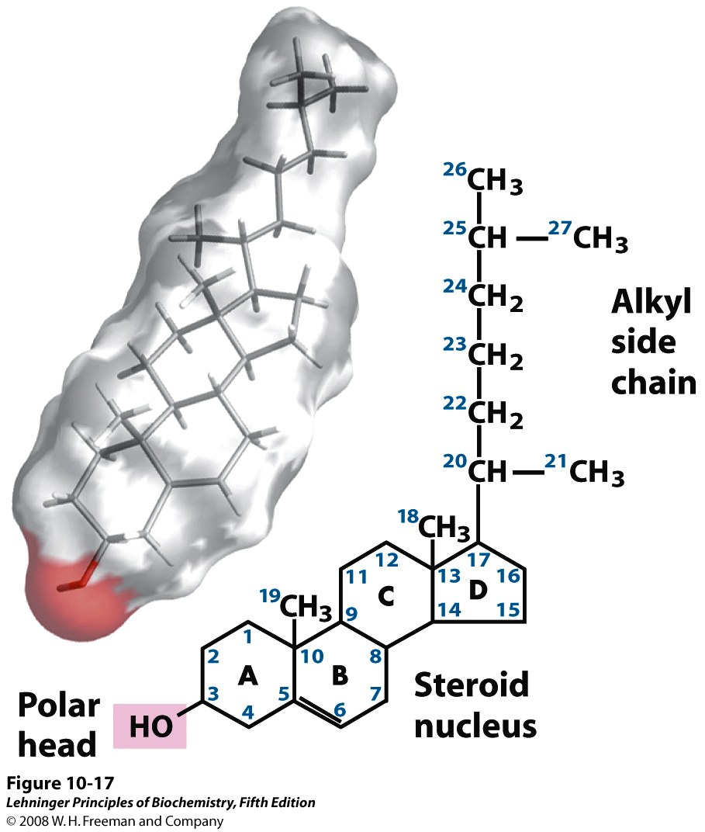
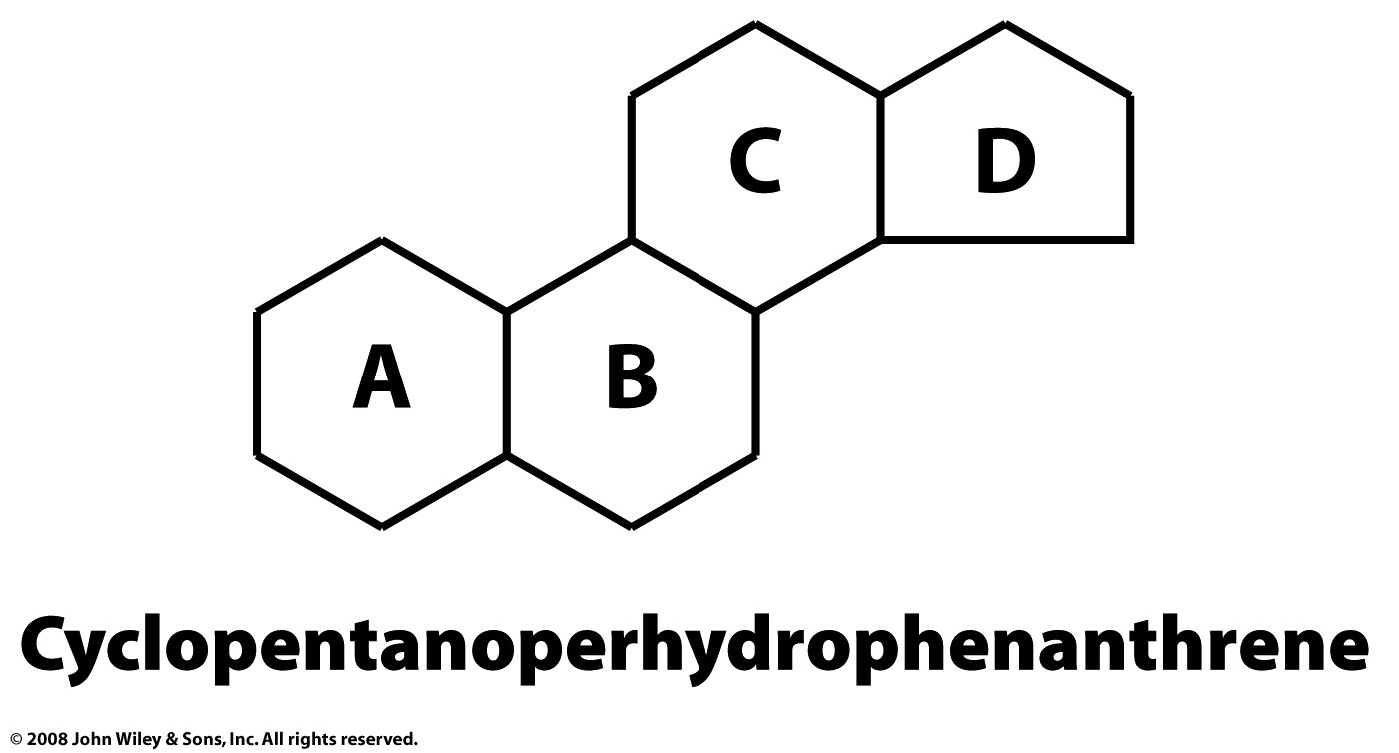
Steroids and sterols are derivatives of a non-planar fused-ring compound
Stigmasterol – found in plants
Cholesterol – found in animals

