Slide 1
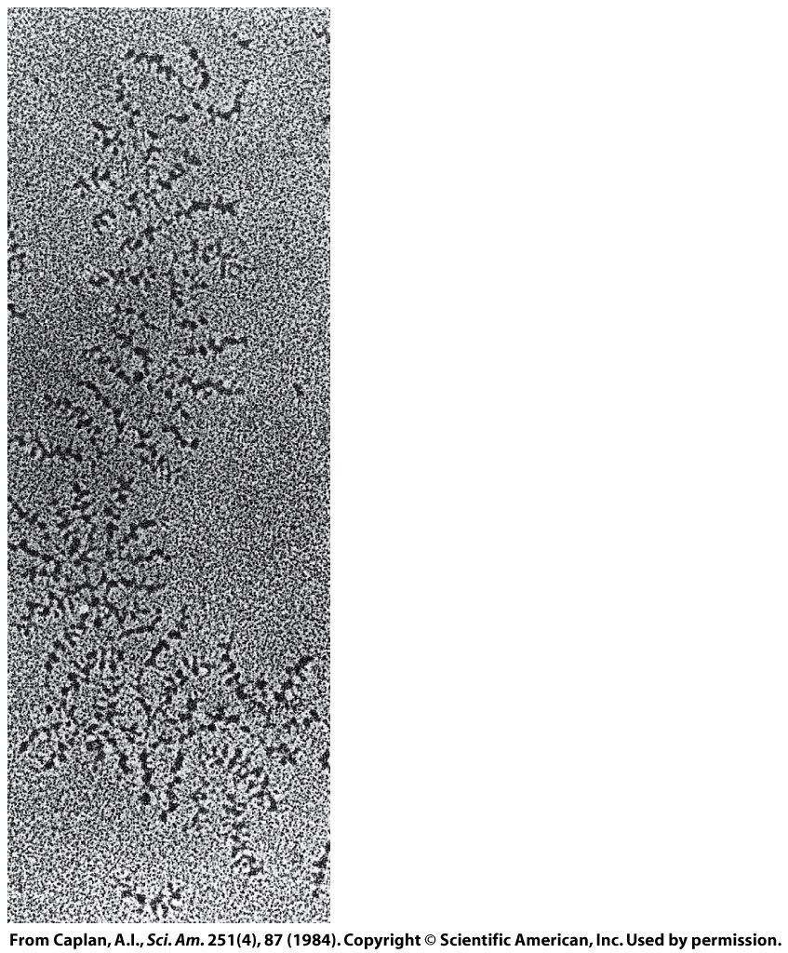
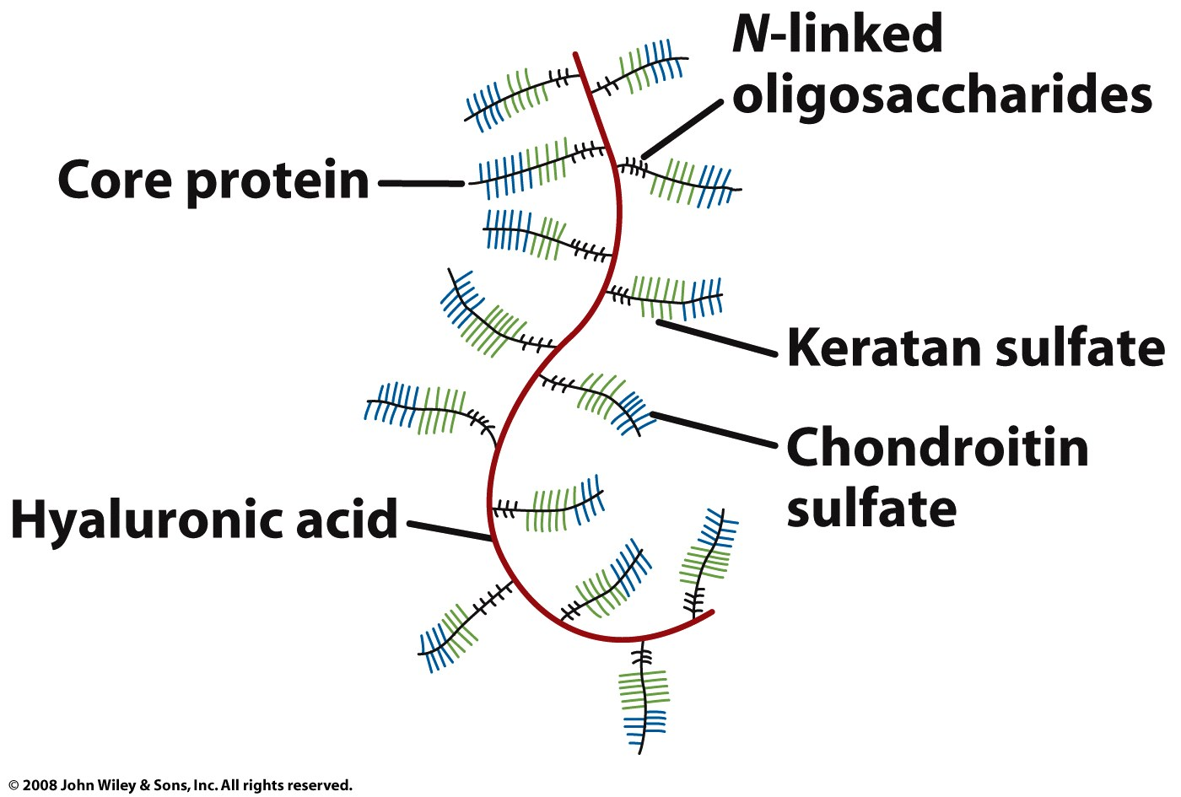
Proteoglycans are conjugates of proteins and glycosaminoglycans
Proteoglycans are major components of connective tissue

Slide 2
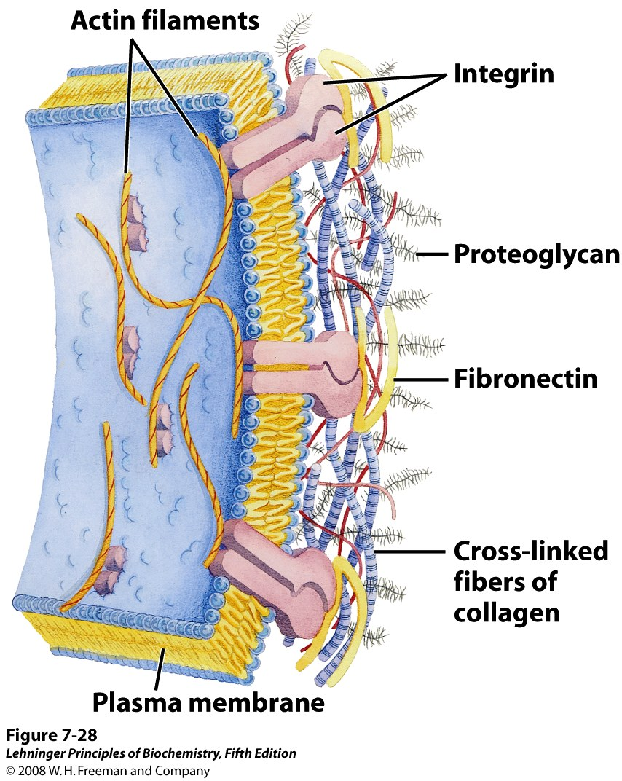
Networks of protein and carbohydrate inter-actions fix a cell to the extracellular matrix
Notes:
FIGURE 7-28 Interactions between cells and the extracellular matrix. The association between cells and the proteoglycan of the extracellular matrix is mediated by a membrane protein (integrin) and by an extracellular protein (fibronectin in this example) with binding sites for both integrin and the proteoglycan. Note the close association of collagen fibers with the fibronectin and proteoglycan.

Slide 3
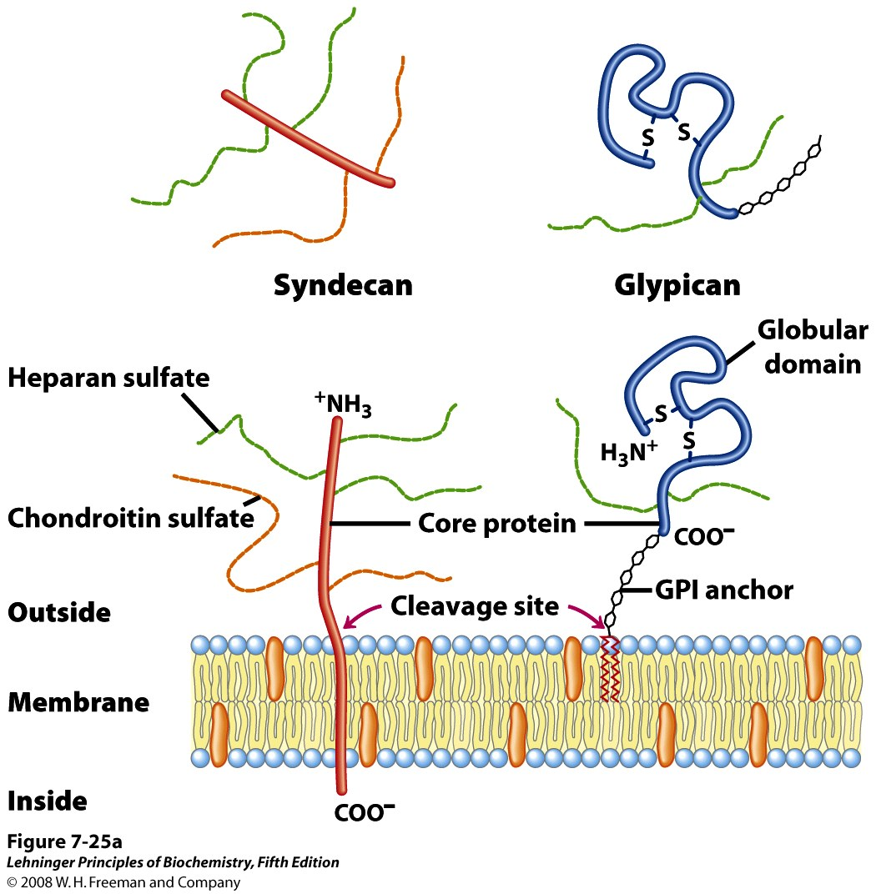
Some proteoglycans are components of cell membranes & influence surface interactions
Notes:
FIGURE 7-25a Two families of membrane proteoglycans. (a) Schematic diagrams of a syndecan and a glypican in the plasma membrane. Syndecans are held in the membrane by hydrophobic interactions between a sequence of nonpolar amino acid residues and plasma membrane lipids; they can be released by a single proteolytic cut near the membrane surface. In a typical syndecan, the extracellular aminoterminal domain is covalently attached (by tetrasaccharide linkers such as those in Figure 7-24) to three heparan sulfate chains and two chondroitin sulfate chains. Glypicans are held in the membrane by a covalently attached membrane lipid (GPI anchor; see Chapter 11), and are shed if the lipid-protein bond is cleaved by a phospholipase. All glypicans have 14 conserved Cys residues, which form disulfide bonds to stabilize the protein moiety, and either two or three glycosaminoglycan chains attached near the carboxyl terminus, close to the membrane surface.

Slide 4
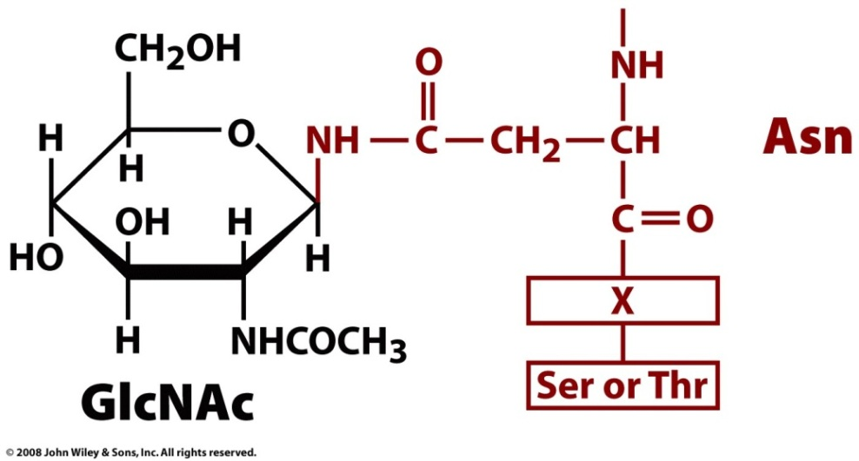
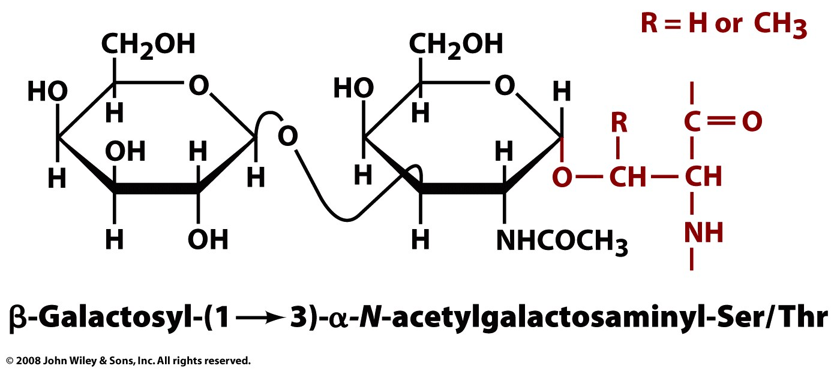
Glycoproteins (glycosylated proteins) are proteins with oligosaccharides attached
N-linked to Asn
(attached during synthesis)
O-linked to Ser or Thr (attached after folding)

Slide 5
Glycosylation adds great diversity to proteins
Diversity in the sequence of the attached sugar (microheterogeneity)
and in patterns of attachment to proteins (glycoforms)
Notes:
FIGURE 7-29 Oligosaccharide linkages in glycoproteins. (a) O-linked oligosaccharides have a glycosidic bond to the hydroxyl group of Ser or Thr residues (pink), illustrated here with GalNAc as the sugar at the reducing end of the oligosaccharide. One simple chain and one complex chain are shown. (b) N-linked oligosaccharides have an N-glycosyl bond to the amide nitrogen of an Asn residue (green), illustrated here with GlcNAc as the terminal sugar. Three common types of oligosaccharide chains that are N-linked in glycoproteins are shown. A complete description of oligosaccharide structure requires specification of the position and stereochemistry (α or β) of each glycosidic linkage.

Slide 6
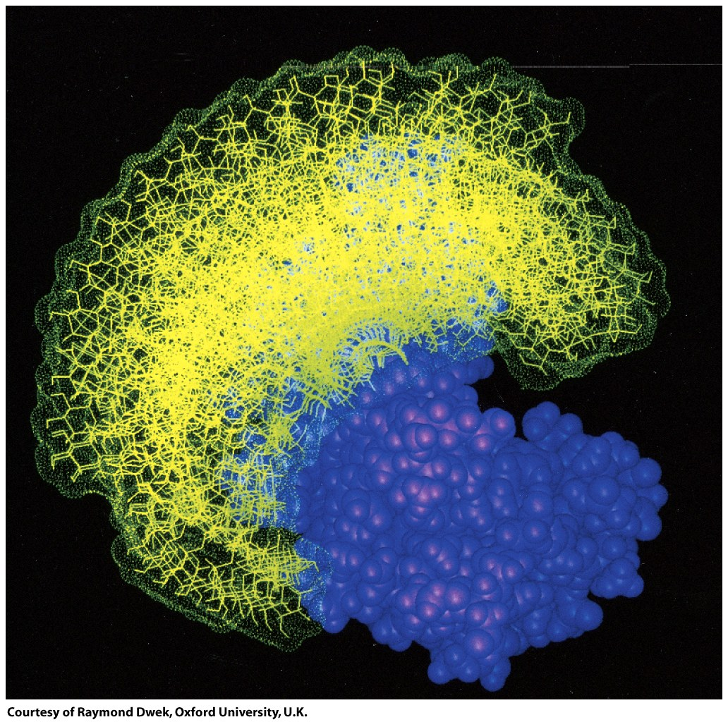
Glycosylations can influence protein structure

Slide 7
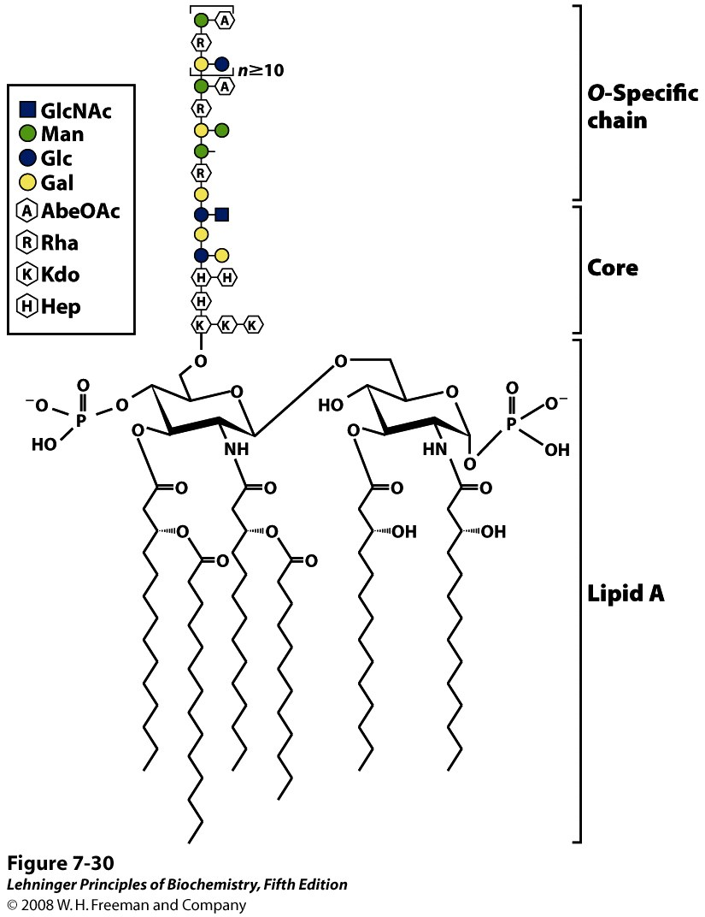
Glycolipids are usually found on the cell surface and are important in recognition
Notes:
FIGURE 7-30 Bacterial lipopolysaccharides. Schematic diagram of the lipopolysaccharide of the outer membrane of Salmonella typhimurium. Kdo is 3-deoxy-D-manno-octulosonic acid (previously called ketodeoxyoctonic acid); Hep is L-glycero-D-manno-heptose; AbeOAc is abequose (a 3,6-dideoxyhexose) acetylated on one of its hydroxyls. There are six fatty acid residues in the lipid A portion of the molecule. Different bacterial species have subtly different lipopolysaccharide structures, but they have in common a lipid region (lipid A), a core oligosaccharide also known as endotoxin, and an "O-specific" chain, which is the principal determinant of the serotype (immunological reactivity) of the bacterium. The outer membranes of the gram-negative bacteria S. typhimurium and E. coli contain so many lipopolysaccharide molecules that the cell surface is virtually covered with O-specific chains.

Slide 8
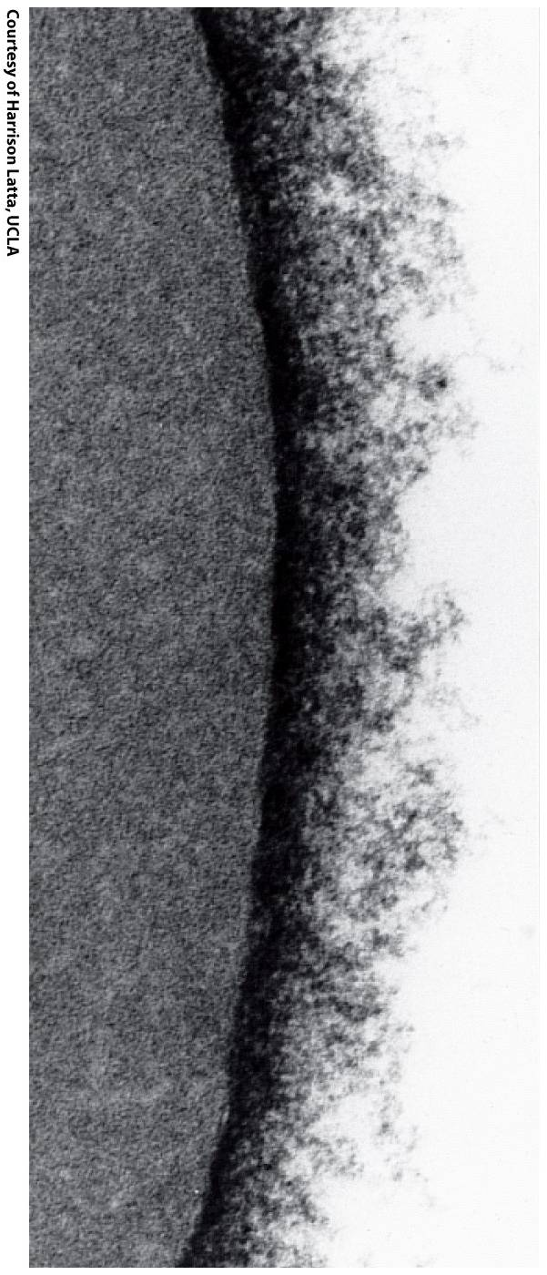
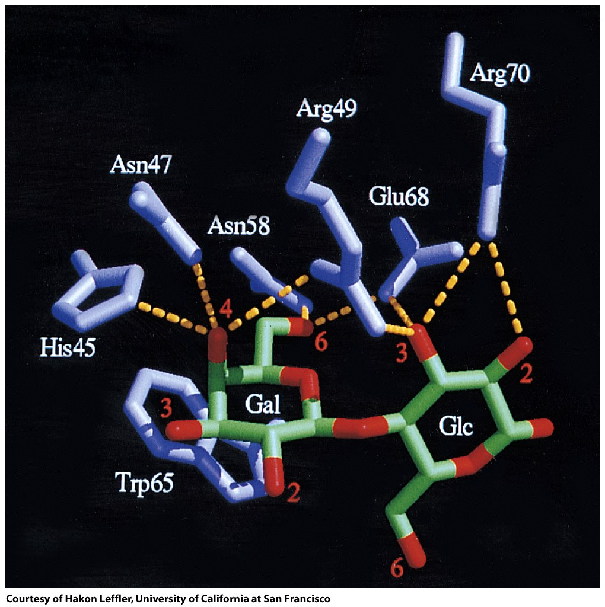
Glycoproteins and glycolipids are recognized and bound by lectins

Slide 9
