Slide 1
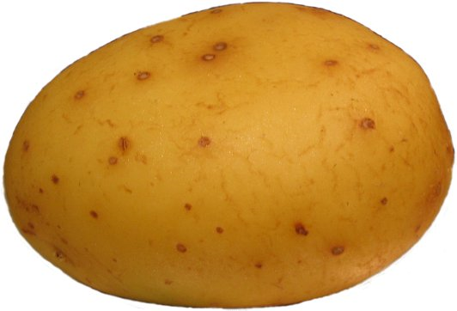
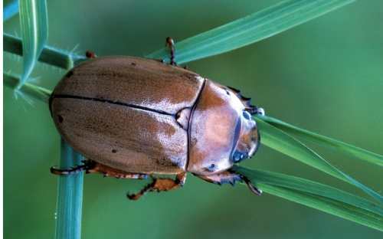
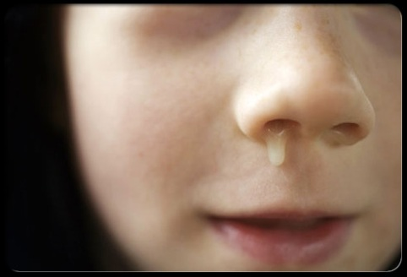
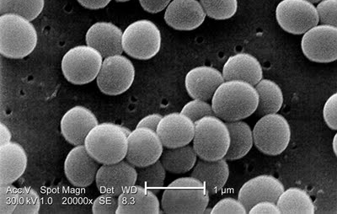
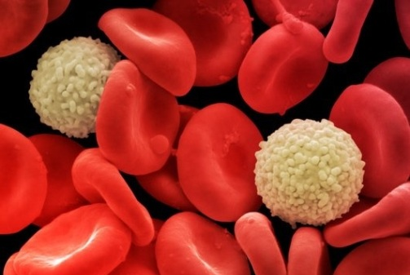
Carbohydrates serve a variety of functions
Energy storage and food
Structure and support
Lubrication
Protection
Recognition and signaling
Component of nucleotides
starch
chitin and cellulose
mucin (glycoprotein)
cell wall peptidoglycan
surface glycoproteins
2-deoxyribose

Slide 2
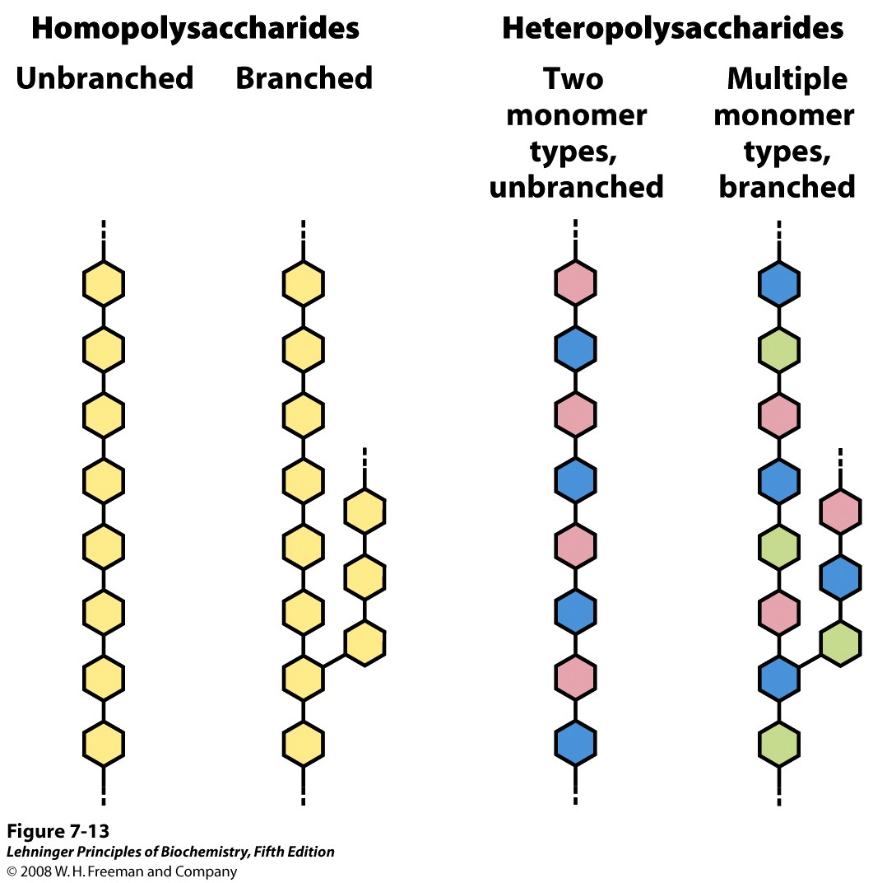
Notes:
FIGURE 7-13 Homo- and heteropolysaccharides. Polysaccharides may be composed of one, two, or several different monosaccharides, in straight or branched chains of varying length.

Slide 3
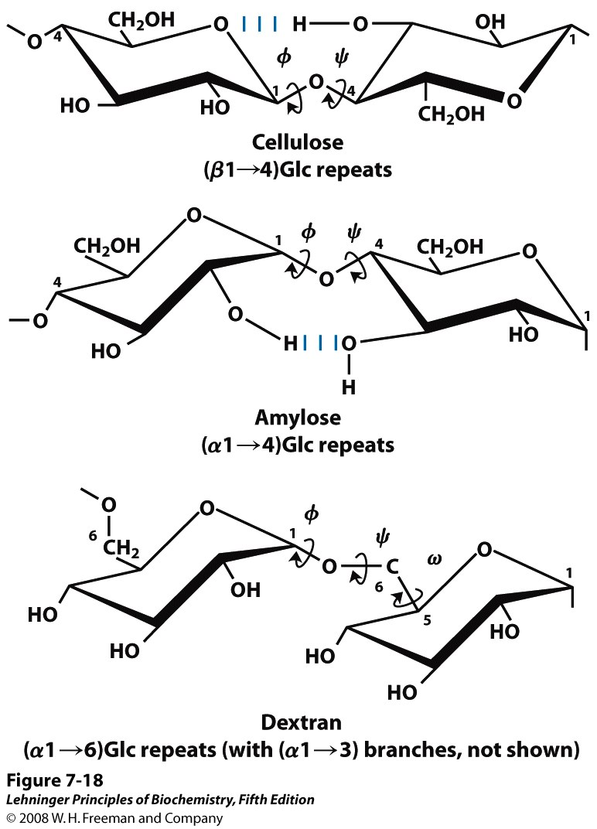
As for polypeptides, torsion angles describe the conformations of polysaccharides
Notes:
FIGURE 7-18 Conformation at the glycosidic bonds of cellulose, amylose, and dextran. The polymers are depicted as rigid pyranose rings joined by glycosidic bonds, with free rotation about these bonds. Note that in dextran there is also free rotation about the bond between C-5 and C-6 (torsion angle ω (omega)).

Slide 4
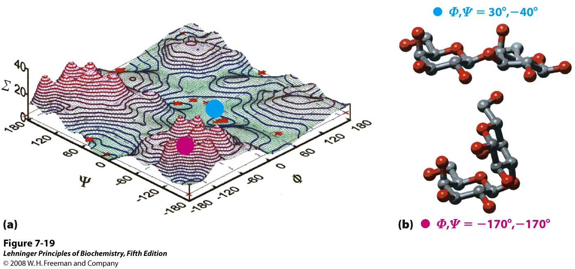
Certain conformations (values of φ and ψ) are more energetically favored than others
Both the identity of the monosaccharide units and how (where) they are linked will determine which conformations are preferred
Notes:
FIGURE 7-19 A map of favored conformations for oligosaccharides and polysaccharides. The torsion angles ψ and φ (see Figure 7-18), which define the spatial relationship between adjacent rings, can in principle have any value from 0˚ to 360˚. In fact, some of the torsion angles would give conformations that are sterically hindered, whereas others give conformations that maximize hydrogen bonding. (a) When the relative energy (Σ) is plotted for each value of φ and ψ, with isoenergy ("same energy") contours drawn at intervals of 1 kcal/mol above the minimum energy state, the result is a map of preferred conformations. This is analogous to the Ramachandran plot for peptides (see Figure 4-3, 4-8). (b) Two energetic extremes for the disaccharide Gal(β1→3)Gal; these values fall on the energy diagram (a) as shown by the red and blue dots. The red dot indicates the least favored conformation, the blue dot the most favored conformation. The known conformations of the three polysaccharides shown in Figure 7-18 have been determined by x-ray crystallography, and all fall within the lowest-energy regions of the map.

Slide 5
We will cover 4 groups of polysaccharides:
Polysaccharides
Energy storage
Structure & protection
amylose
cellulose, chitin
glycogen, amylopectin
glycosaminoglycans
Glycoconjugates
Structure & protection
Recognition & adhesion
proteoglycans
protein
protein
peptides
glycoproteins
lipid
peptidoglycan
proteoglycans
glycolipids

Slide 6
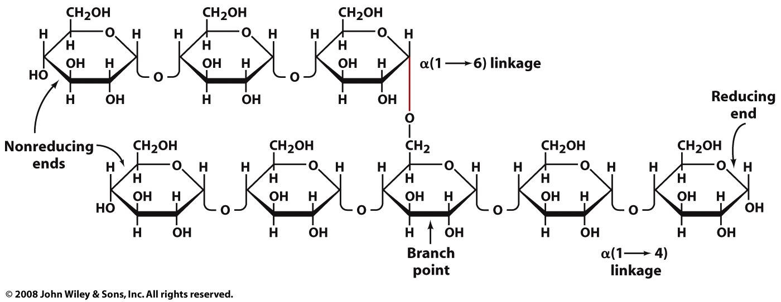
Energy storage polysaccharides of animals and plants are α-linked polymers of glucose
Animals store glycogen, a branched homopolysaccharide with α1→4 and α1→6 linkages

Slide 7
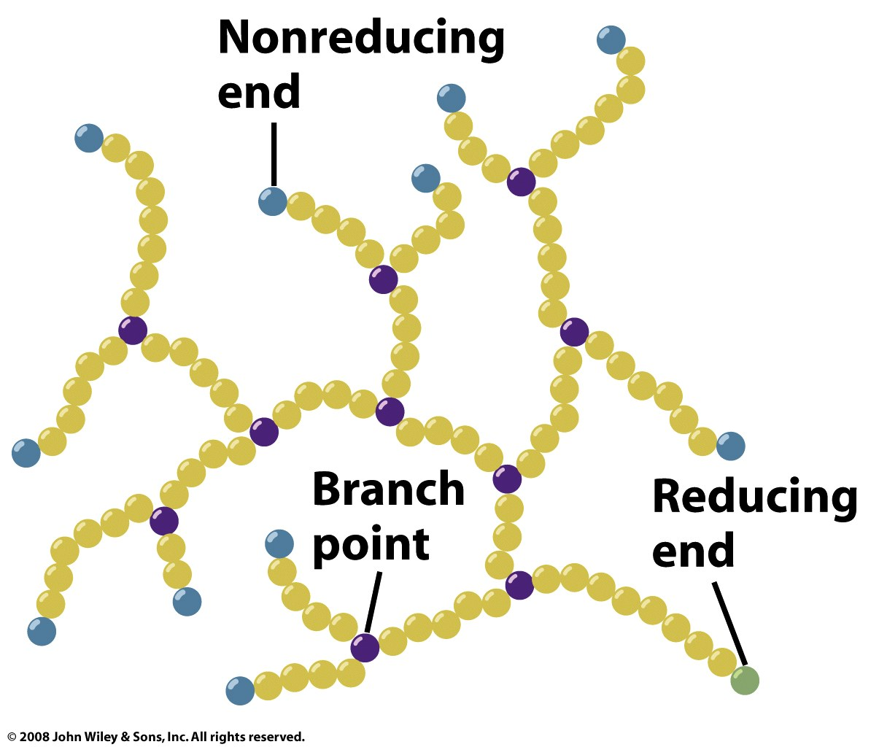
Energy storage polysaccharides of animals and plants are α-linked polymers of glucose
Animals store glycogen, a branched homopolysaccharide with α1→4 and α1→6 linkages

Slide 8
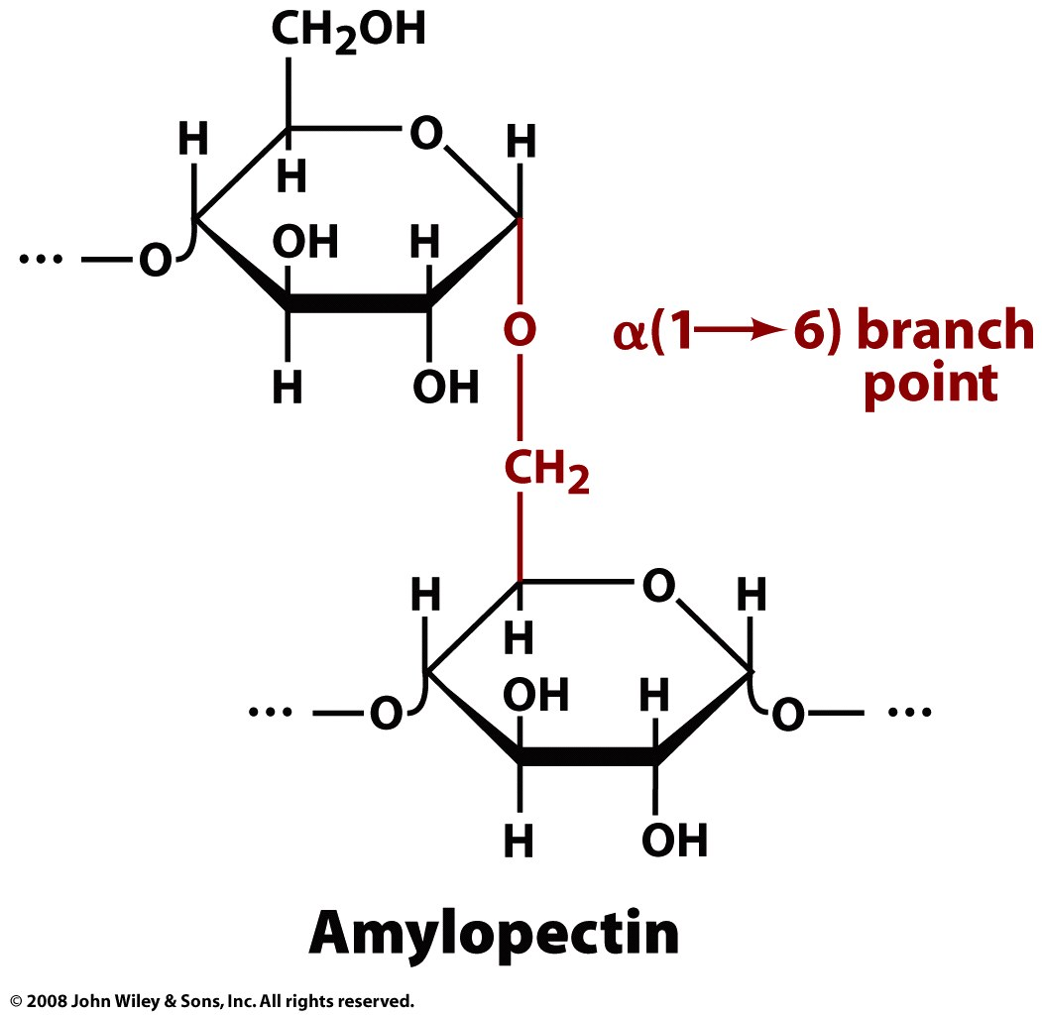
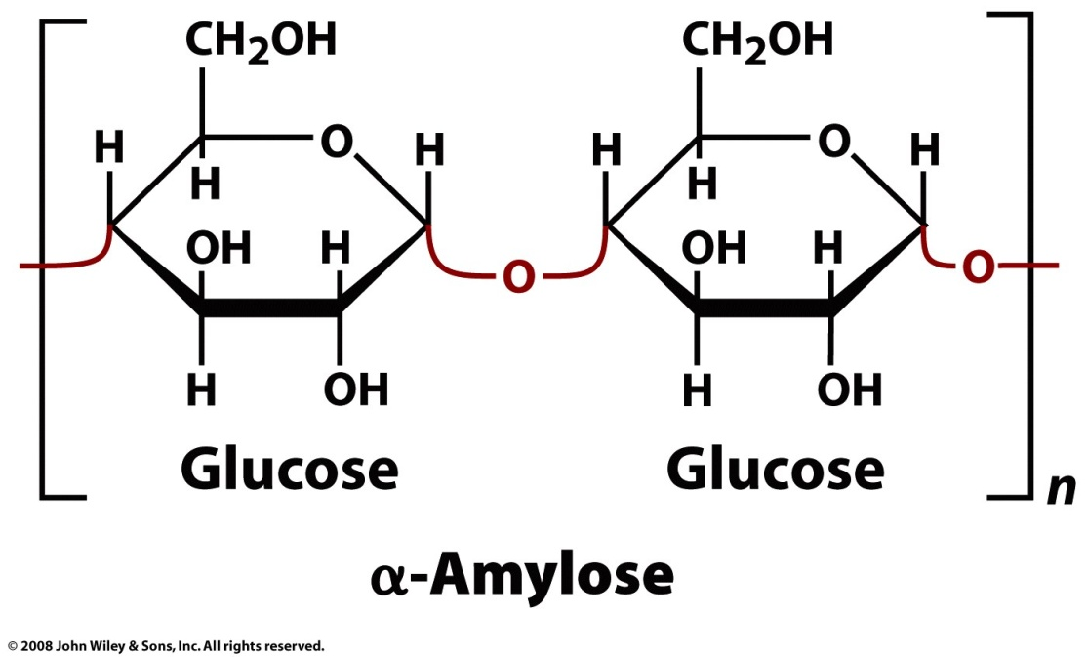
Energy storage polysaccharides of animals and plants are α-linked polymers of glucose
Plants store starch, an aggregate of amylose (linear) and amylopectin (branched)

Slide 9
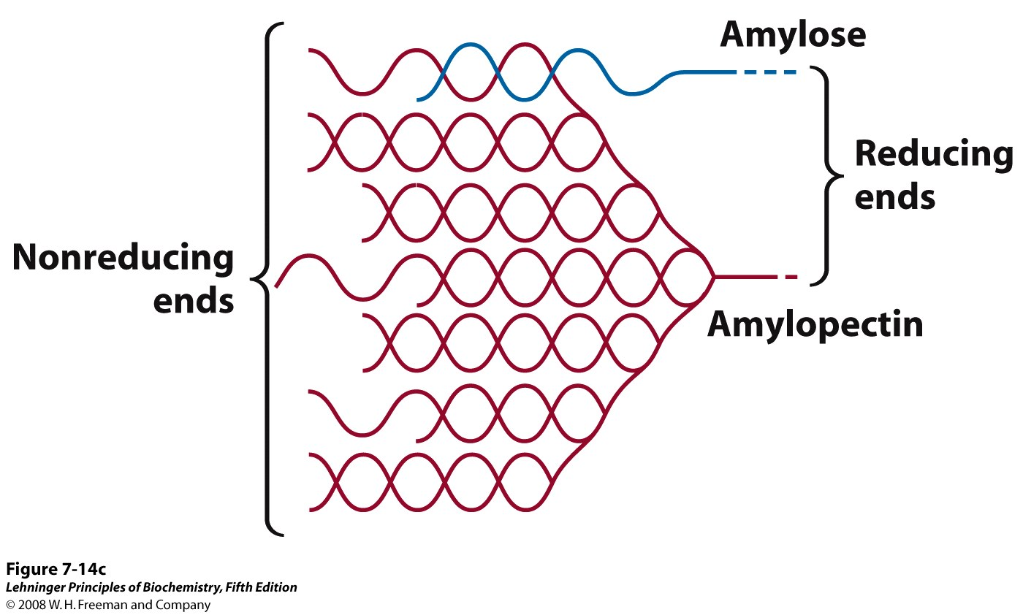
Animals and plants use α-linked glucose polymers for energy storage
Plants store starch, an aggregate of amylose (linear) and amylopectin (branched)

Slide 10
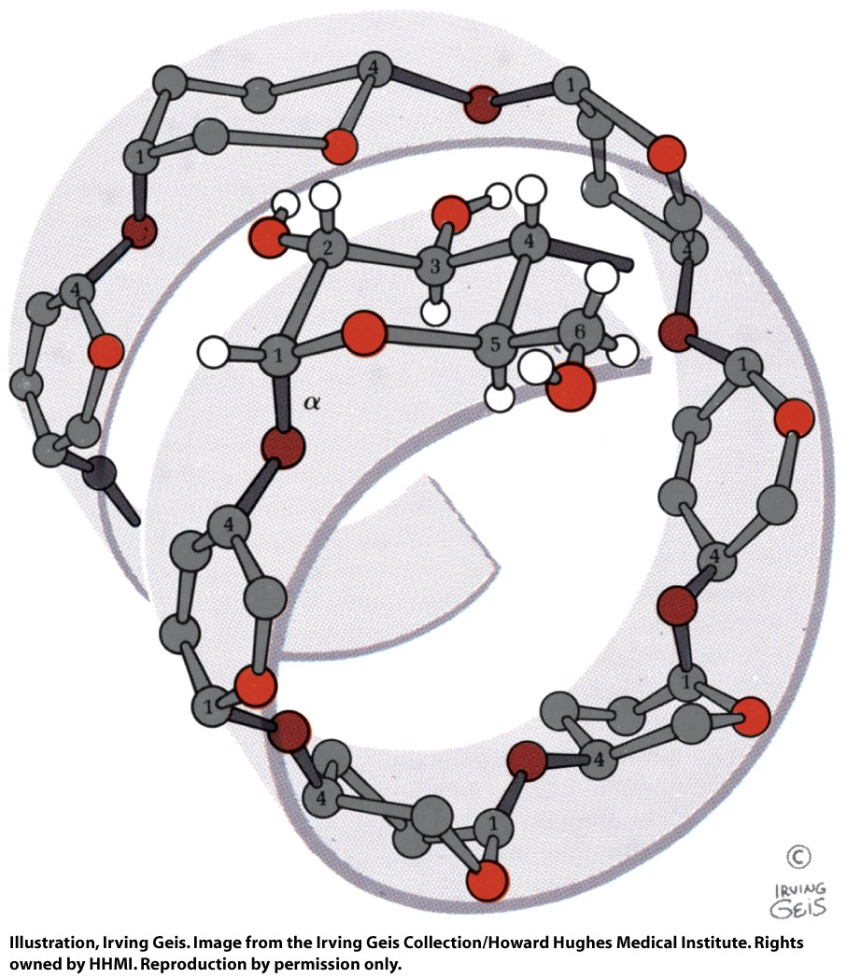
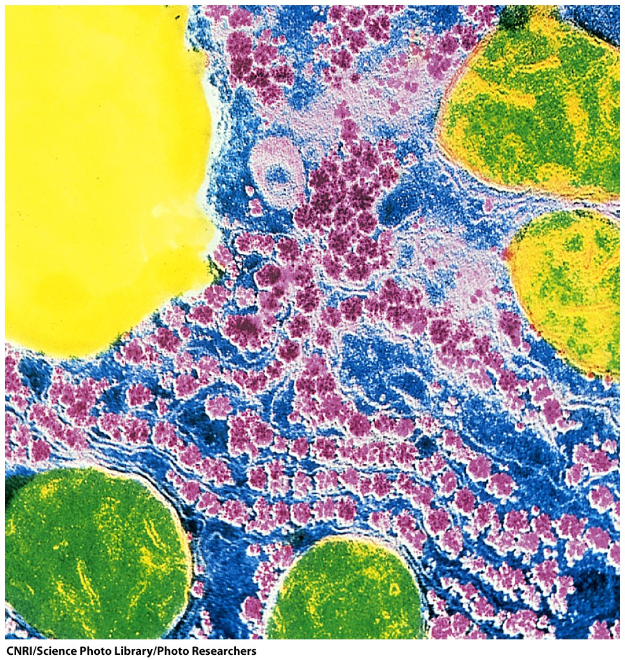
Glycogen and starch adopt loose, hydrated, helical structures that pack into granules

Slide 11
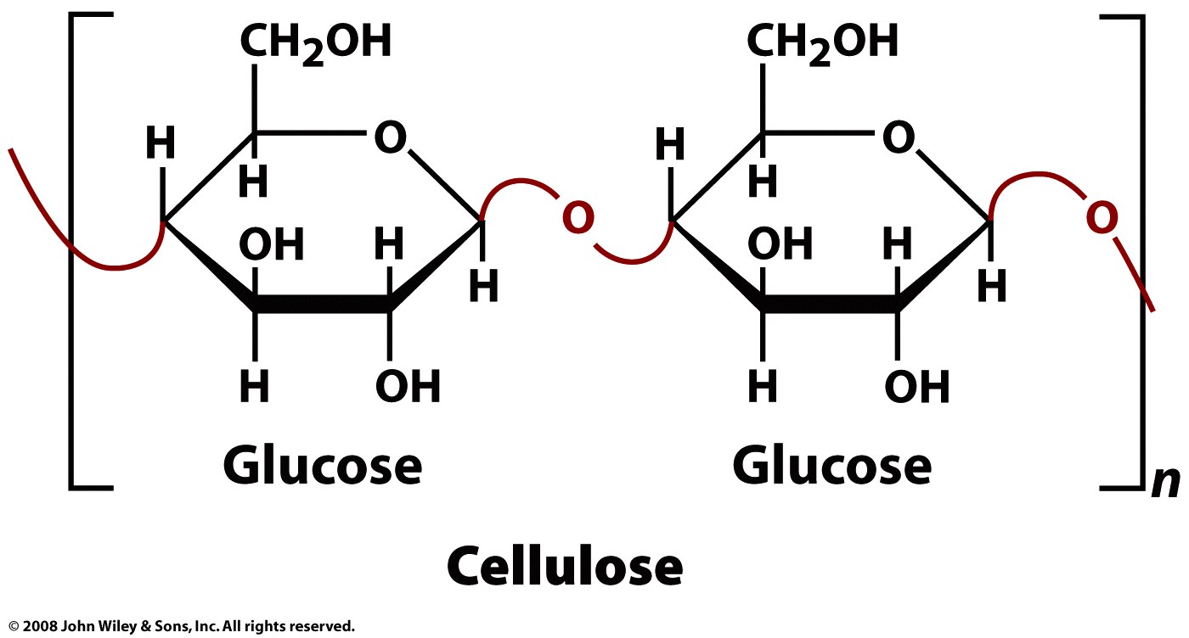
Most structural polysaccharides are unbranched, β-linked polymers
Cellulose, an unbranched glucose homopolymer, provides support and rigidity to plant cell walls

Slide 12
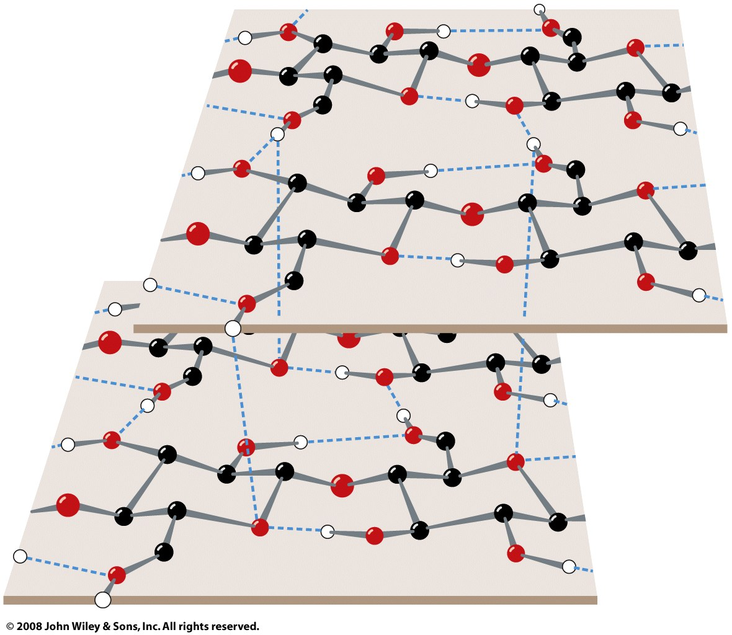
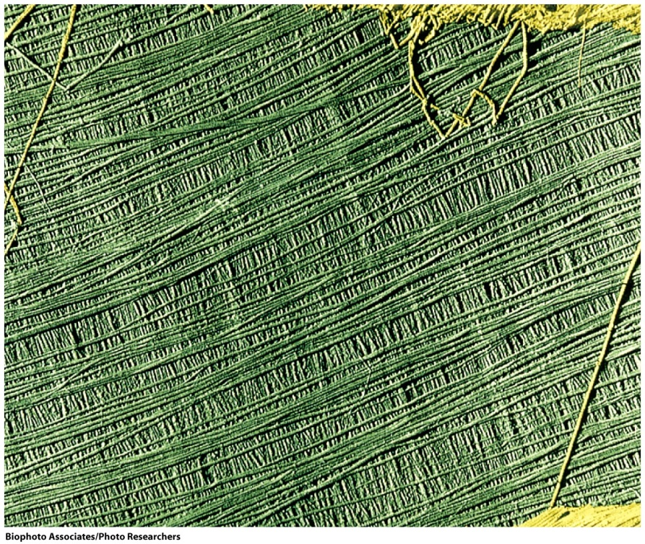
Most structural polysaccharides are unbranched, β-linked polymers
Cellulose chains form intra- and intermolecular H-bonds, stacking to form cohesive and rigid fibers

Slide 13
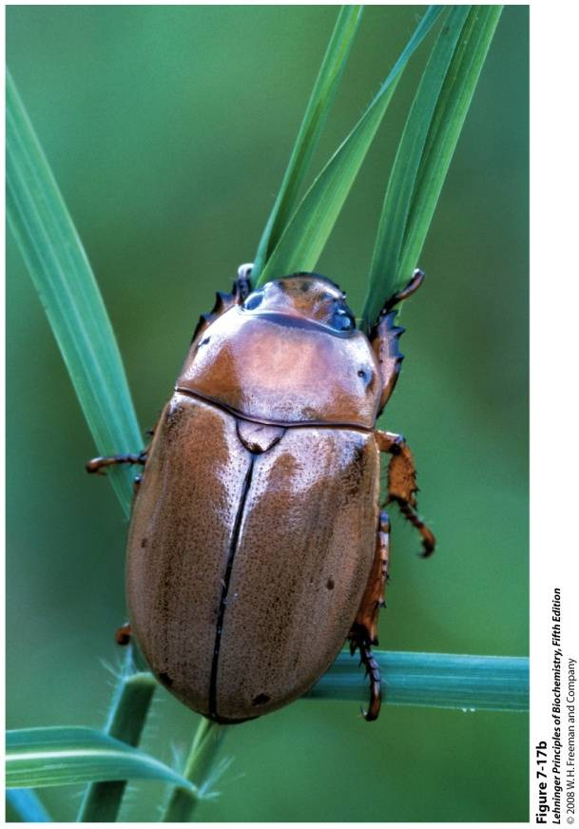
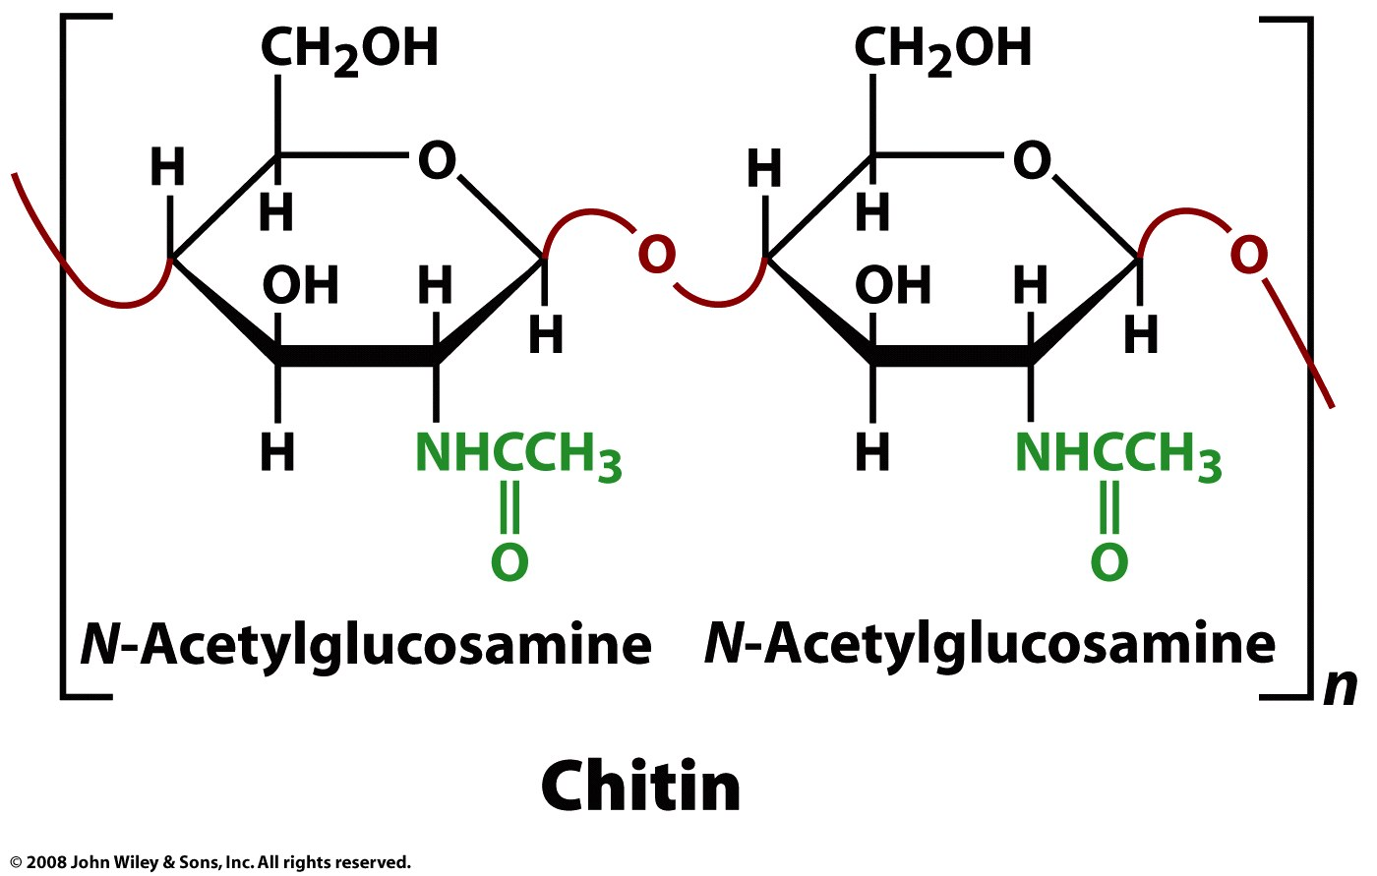
Most structural polysaccharides are unbranched, β-linked polymers
Chitin gives rigidity to crustacean and insect exoskeletons and to the cell walls of fungi and algae
Linear homopolymer of GlcNAc; packing is similar to cellulose

Slide 14
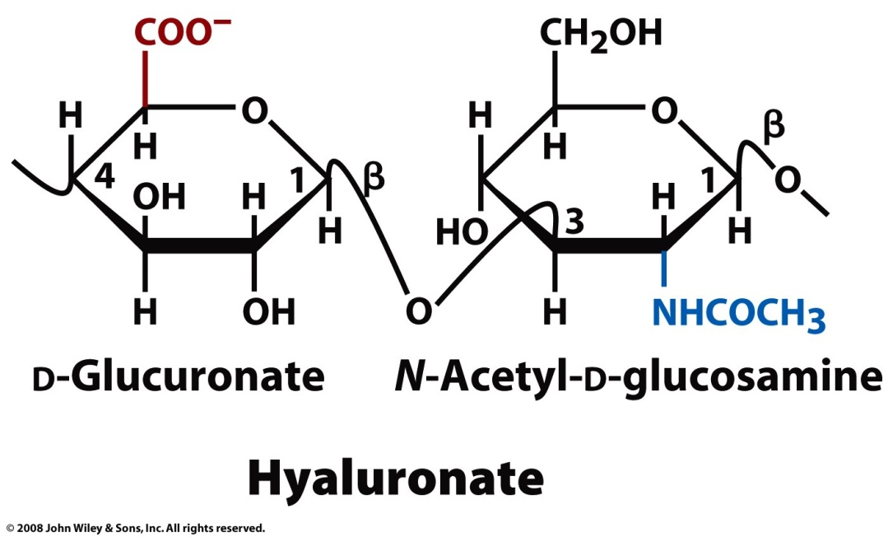
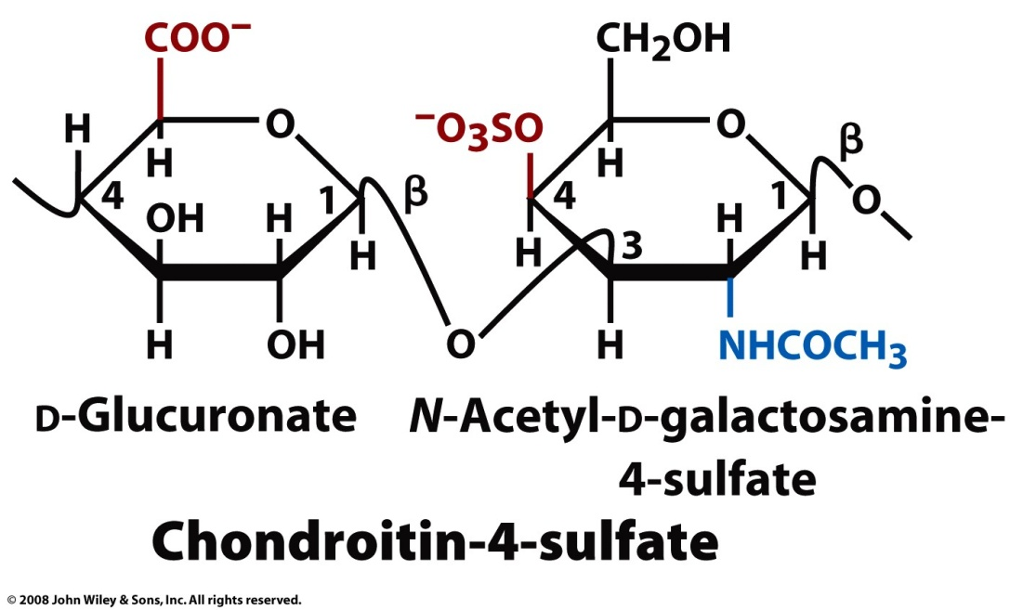
Most structural polysaccharides are unbranched, β-linked polymers
Glycosaminoglycans act as shock absorbers and lubricants in the extracellular spaces of tissues

Slide 15
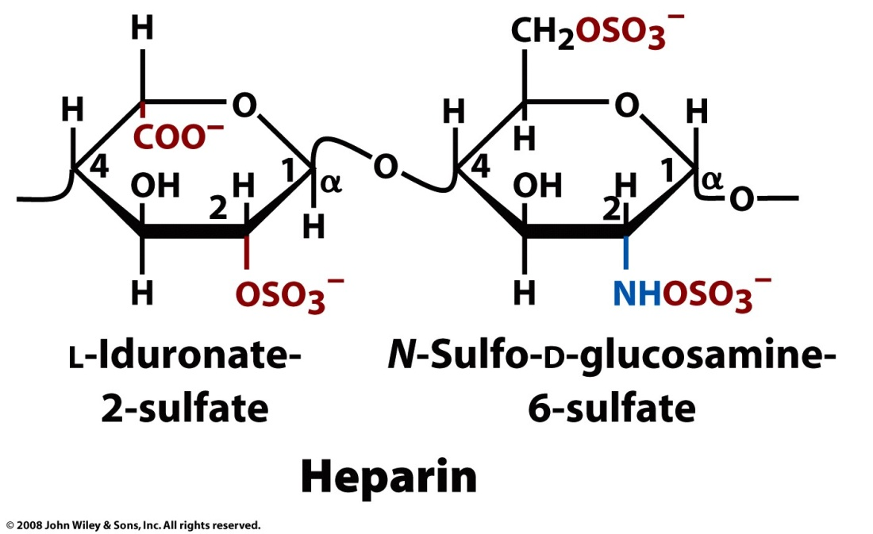
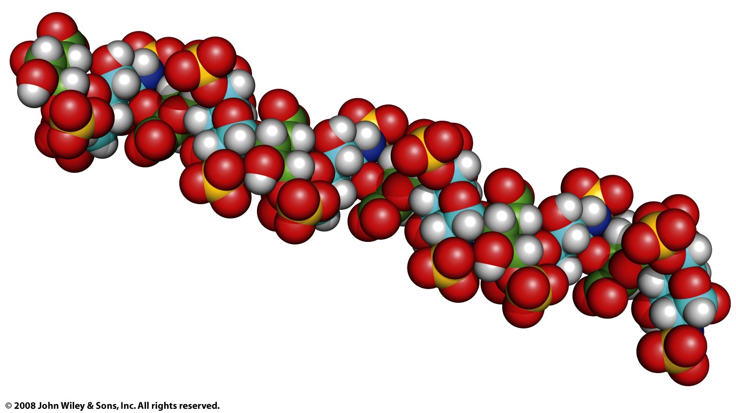
Most structural polysaccharides are unbranched, β-linked polymers
Abundance of negative charge keeps glycosamino-glycan chains extended, separated, and hydrated

Slide 16
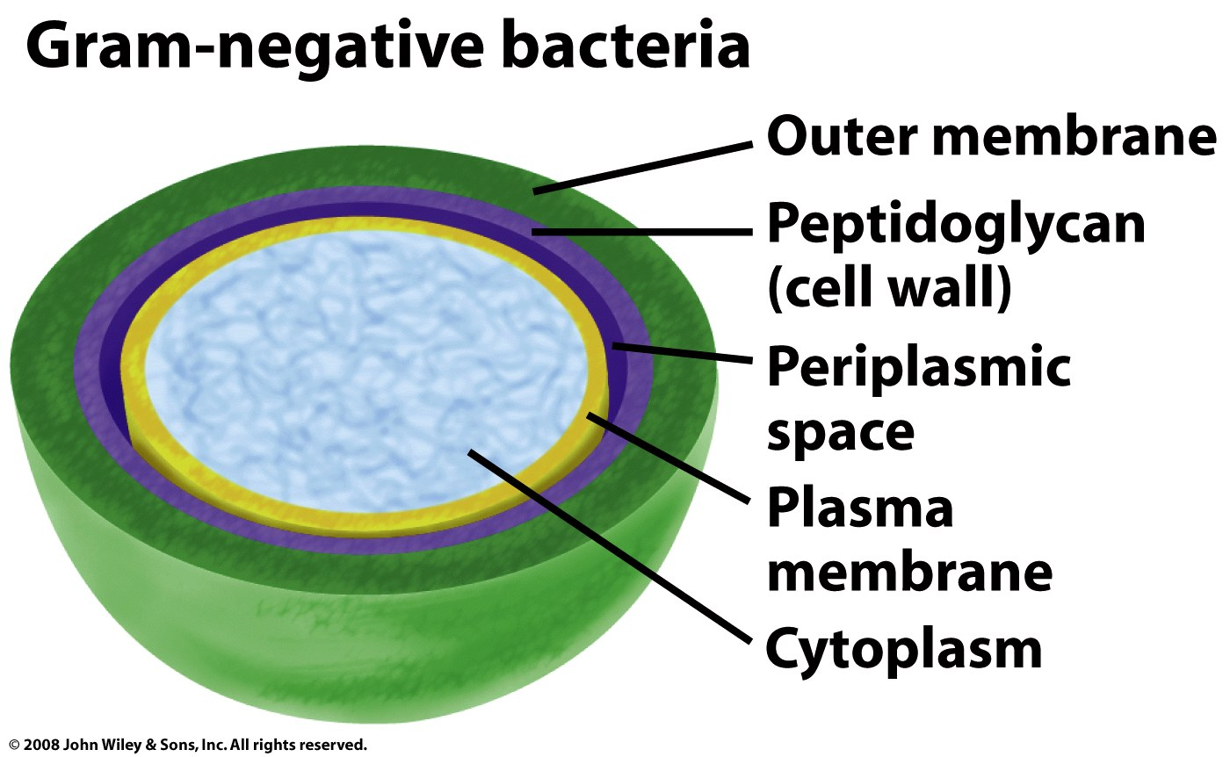
Glycoconjugates have polysaccharides covalently bonded to other molecule types
Peptidoglycan, composed of polysaccharides linked by peptides, comprises the bacterial cell wall

Slide 17
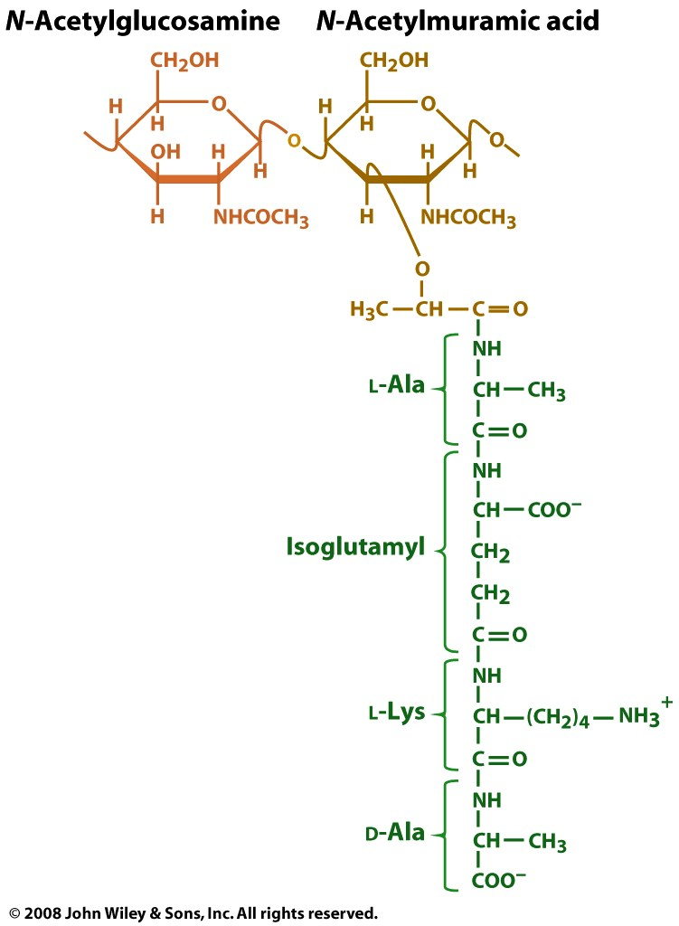
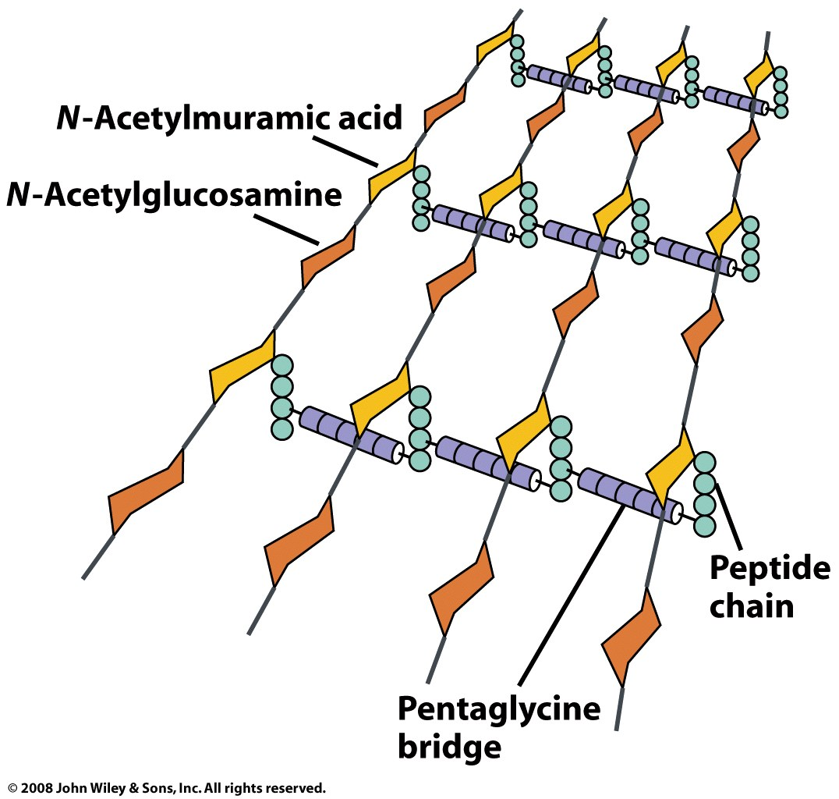
S. aureus peptidoglycan
GlcNAc
Mur2Ac

Slide 18
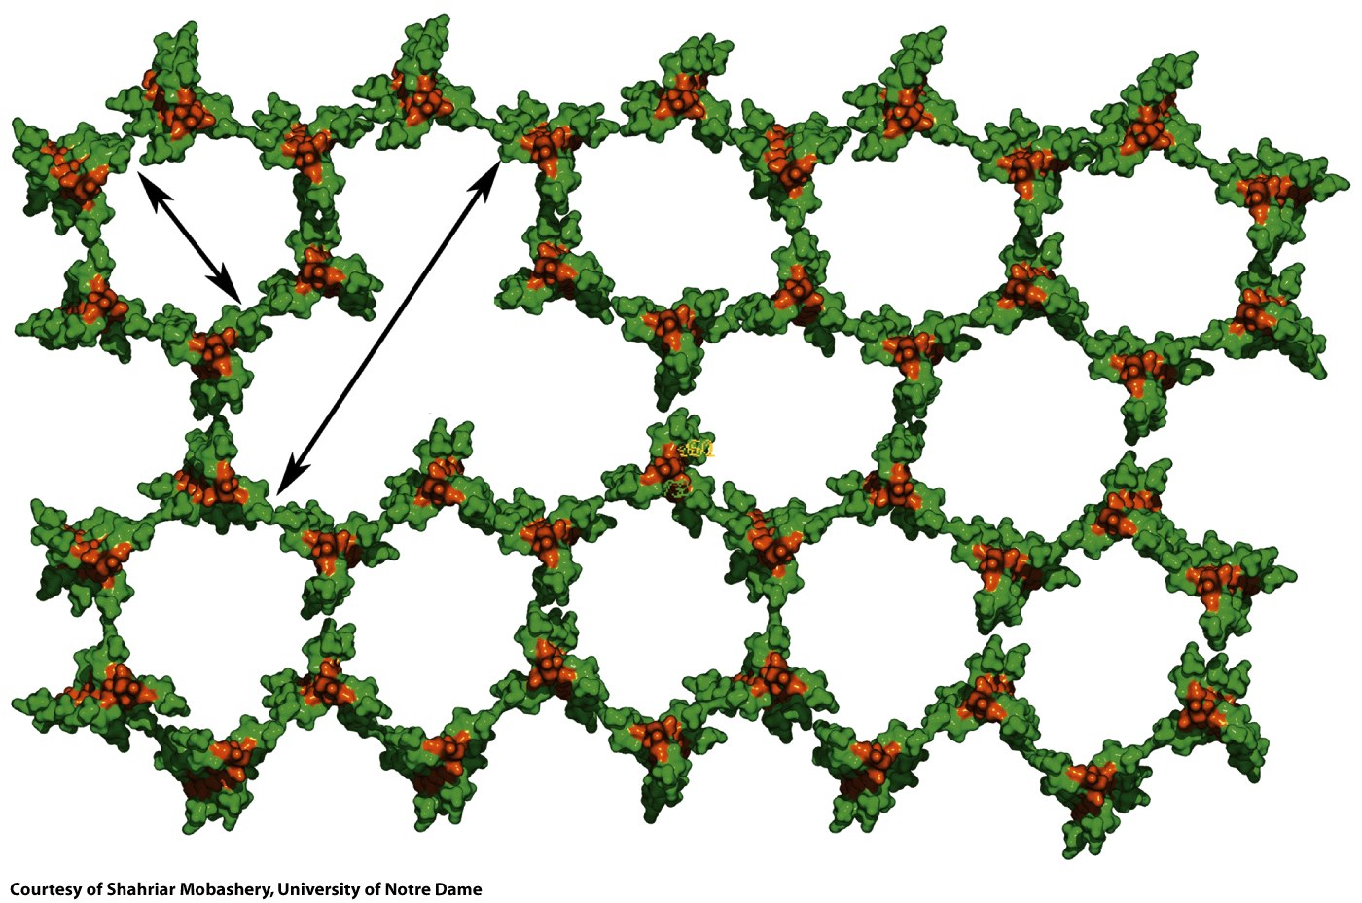
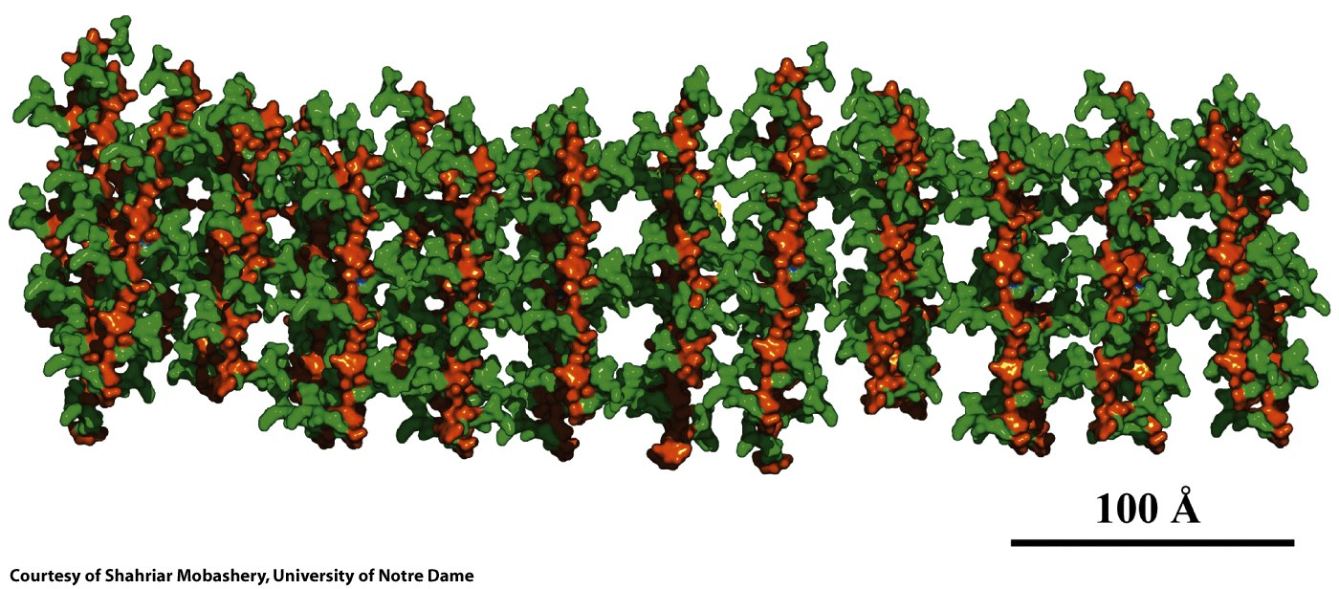

Slide 19
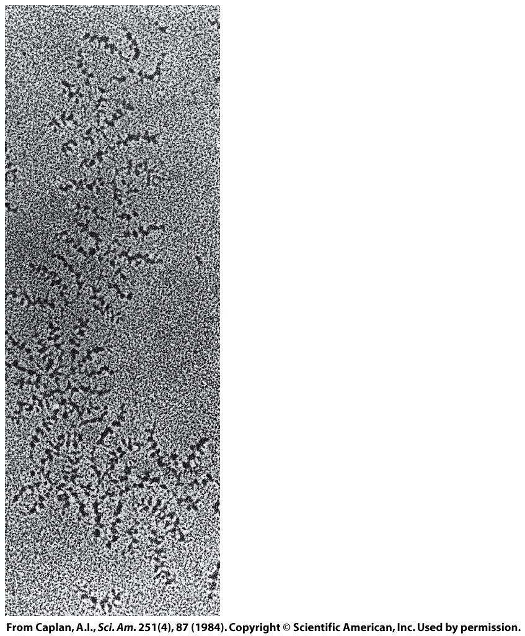
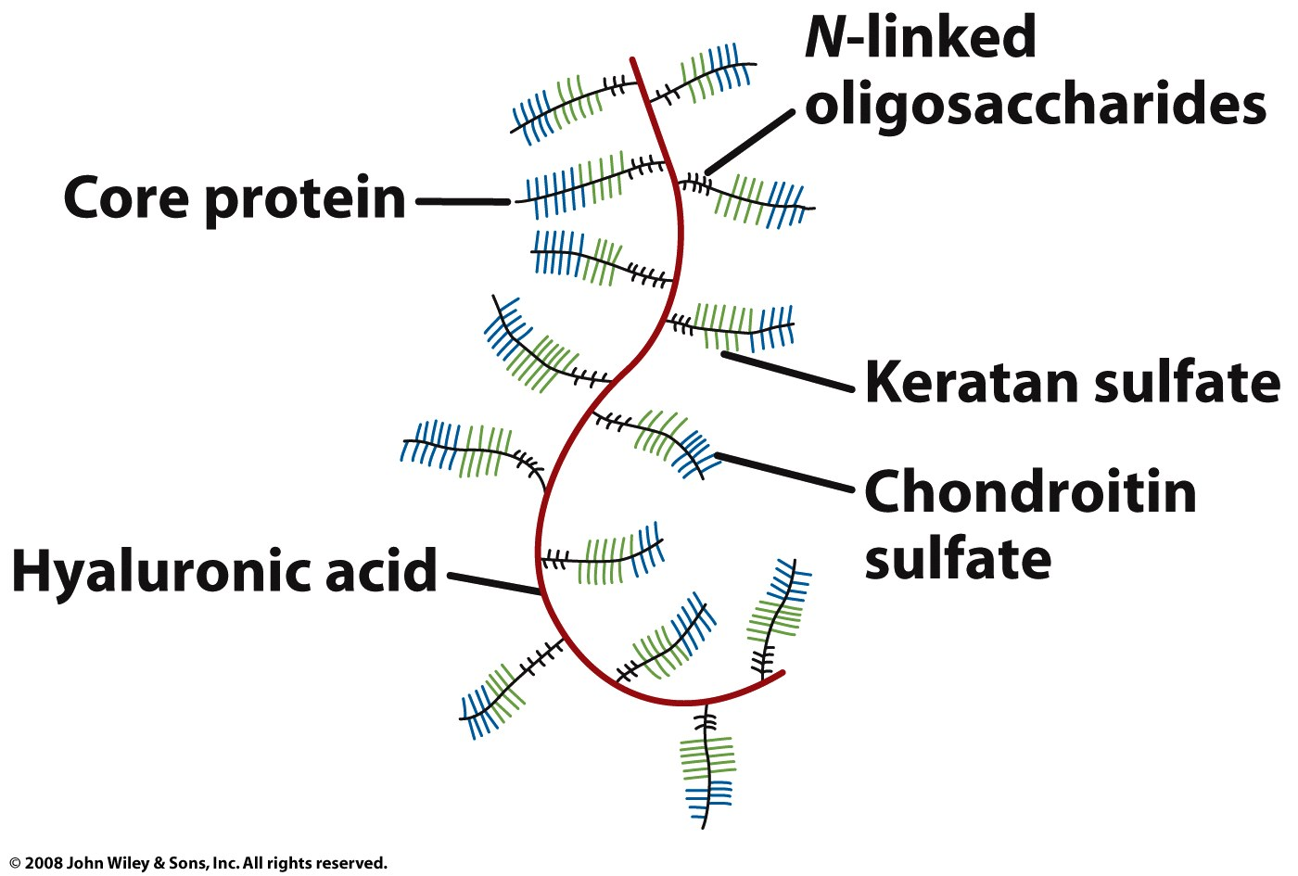
Proteoglycans are conjugates of proteins and glycosaminoglycans
Proteoglycans are major components of connective tissue

