Slide 1
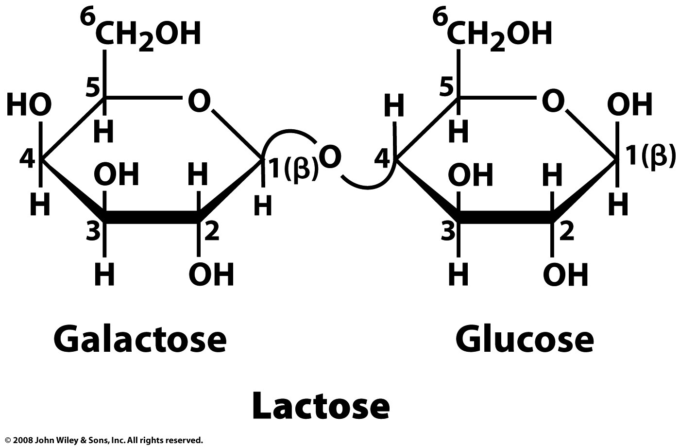
Glycosidic bonds link monosaccharides into disaccharides (and polysaccharides)
β-D-galactopyranosyl-(1→4)-β-D-glucopyranose
(non-reducing end) (reducing end)
Page 227

Slide 2
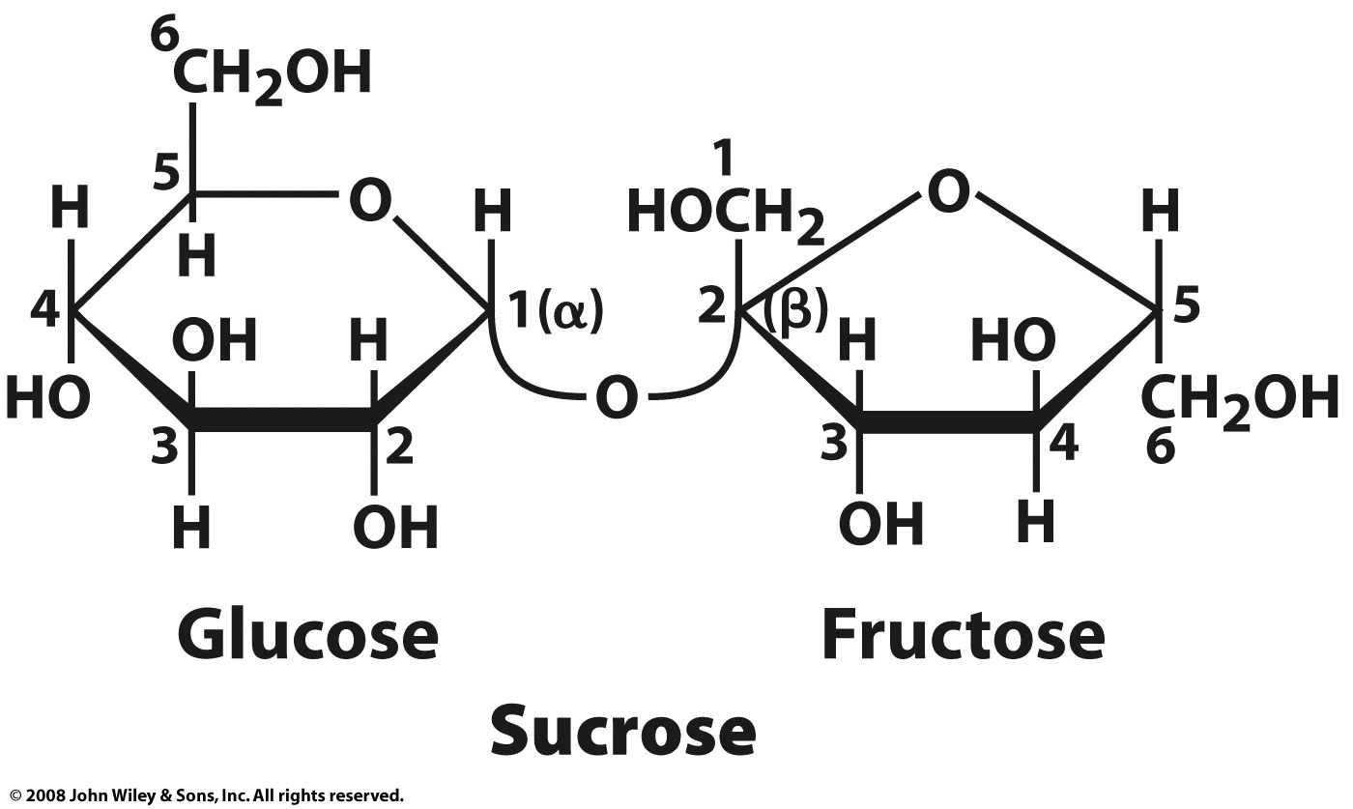
α-D-glucopyranosyl β-D-fructofuranoside
(α-D-glucopyranosyl-(1→2)-β-D-fructofuranoside)
(non-reducing end) (non-reducing end)
β-D-fructofuranosyl α-D-glucopyranoside
(β-D-fructofuranosyl-(2→1)-α-D-glucopyranoside)
Page 227

Slide 3
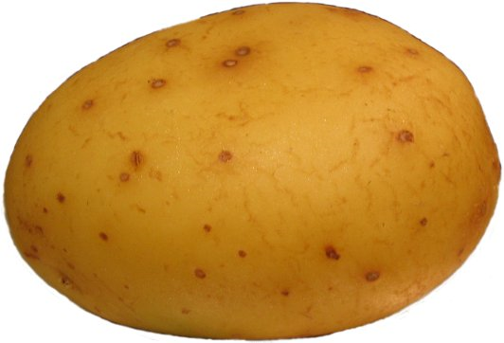
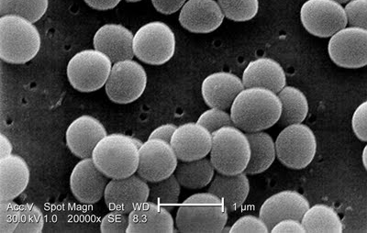
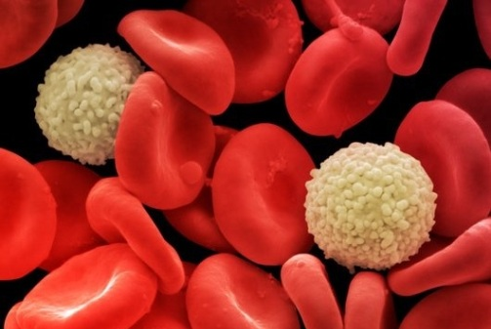
Carbohydrates serve a variety of functions
Energy storage and food
Structure and support
Lubrication
Protection
Recognition and signaling
Component of nucleotides
starch
chitin and cellulose
mucin (glycoprotein)
cell wall peptidoglycan
surface glycoproteins
2-deoxyribose

Slide 4
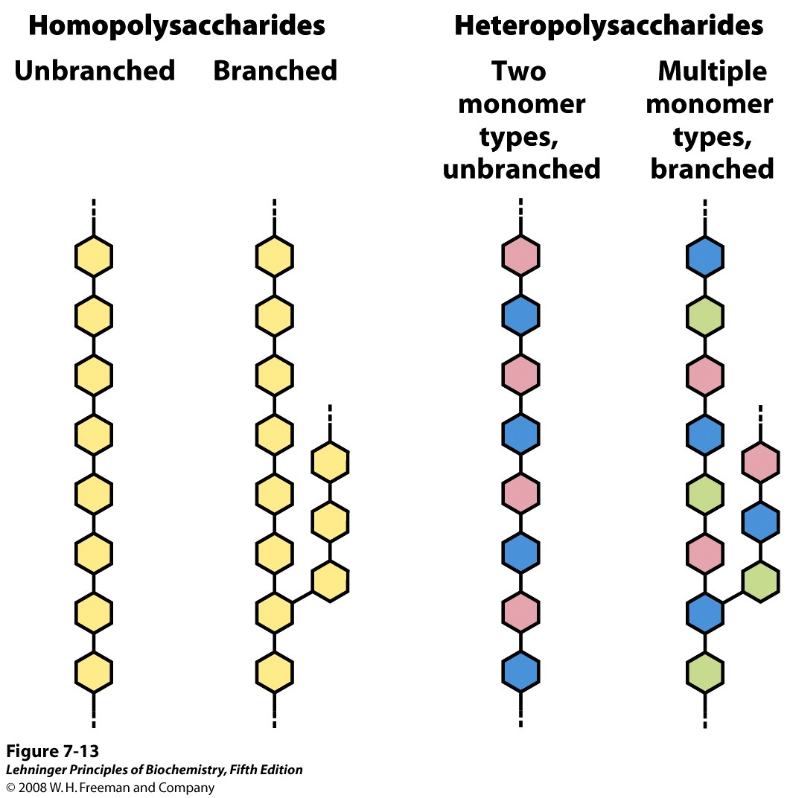
Notes:
FIGURE 7-13 Homo- and heteropolysaccharides. Polysaccharides may be composed of one, two, or several different monosaccharides, in straight or branched chains of varying length.

Slide 5
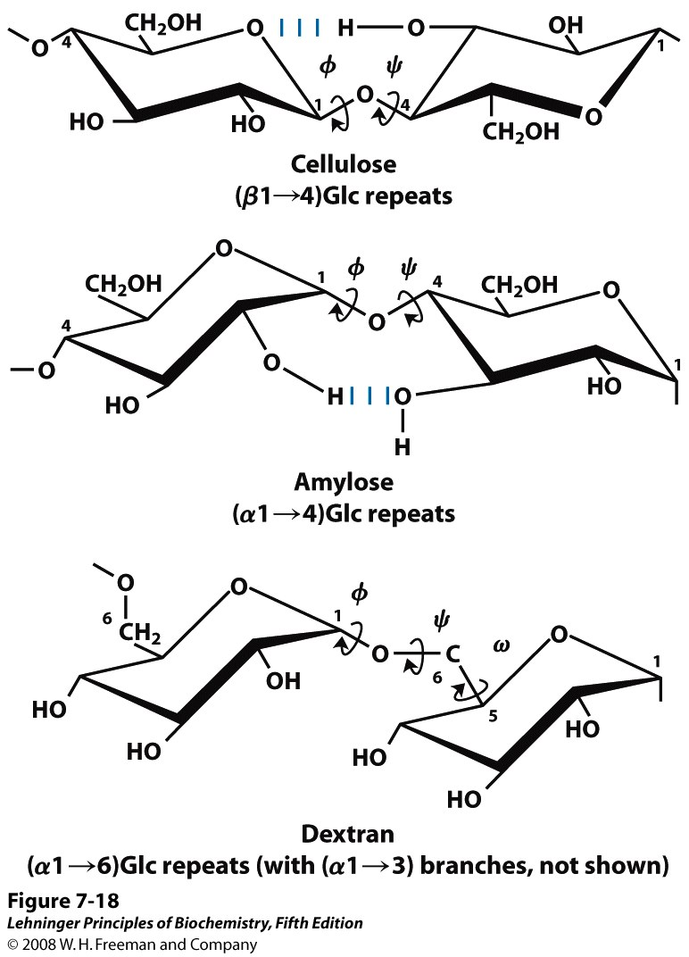
As for polypeptides, torsion angles describe the conformations of polysaccharides
Notes:
FIGURE 7-18 Conformation at the glycosidic bonds of cellulose, amylose, and dextran. The polymers are depicted as rigid pyranose rings joined by glycosidic bonds, with free rotation about these bonds. Note that in dextran there is also free rotation about the bond between C-5 and C-6 (torsion angle ω (omega)).

Slide 6
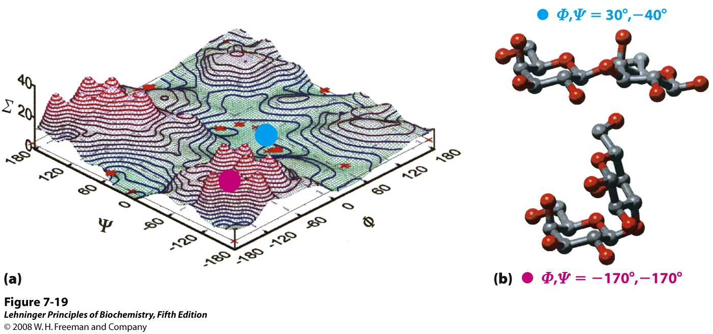
Certain conformations (values of φ and ψ) are more energetically favored than others
Both the identity of the monosaccharide units and how (where) they are linked will determine which conformations are preferred
Notes:
FIGURE 7-19 A map of favored conformations for oligosaccharides and polysaccharides. The torsion angles ψ and φ (see Figure 7-18), which define the spatial relationship between adjacent rings, can in principle have any value from 0˚ to 360˚. In fact, some of the torsion angles would give conformations that are sterically hindered, whereas others give conformations that maximize hydrogen bonding. (a) When the relative energy (Σ) is plotted for each value of φ and ψ, with isoenergy ("same energy") contours drawn at intervals of 1 kcal/mol above the minimum energy state, the result is a map of preferred conformations. This is analogous to the Ramachandran plot for peptides (see Figure 4-3, 4-8). (b) Two energetic extremes for the disaccharide Gal(β1→3)Gal; these values fall on the energy diagram (a) as shown by the red and blue dots. The red dot indicates the least favored conformation, the blue dot the most favored conformation. The known conformations of the three polysaccharides shown in Figure 7-18 have been determined by x-ray crystallography, and all fall within the lowest-energy regions of the map.

