Slide 1
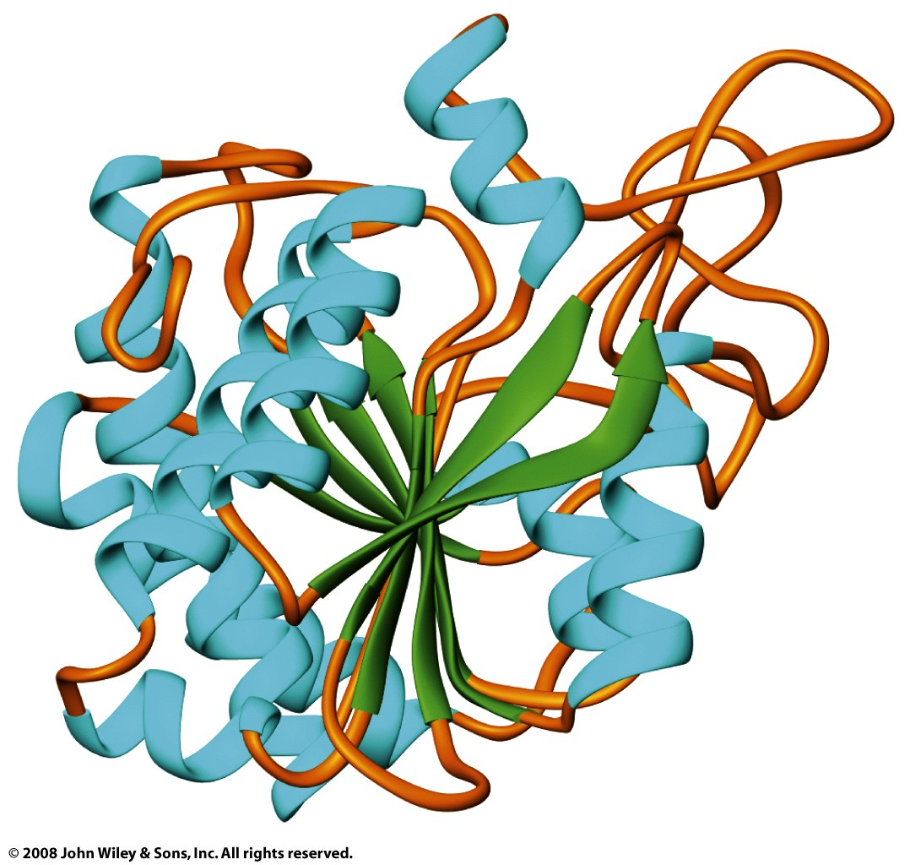
Tertiary structure combines regular secondary structures and loops (coil)
Bovine carboxypeptidase A

Slide 2
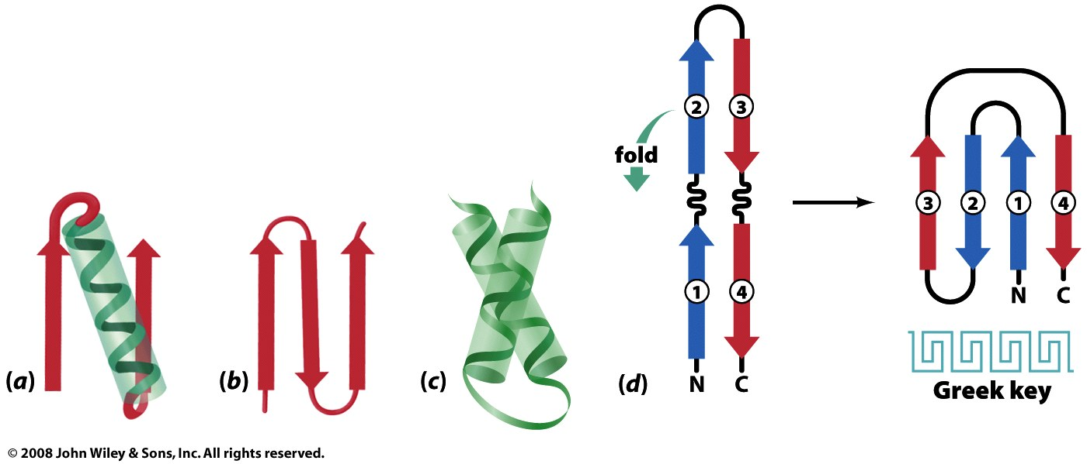
Tertiary structures may contain common patterns, or motifs, of secondary structures (= supersecondary structures)
αα
(coiled-coil)
βαβ
β-hairpins
Figure 6-28

Slide 3
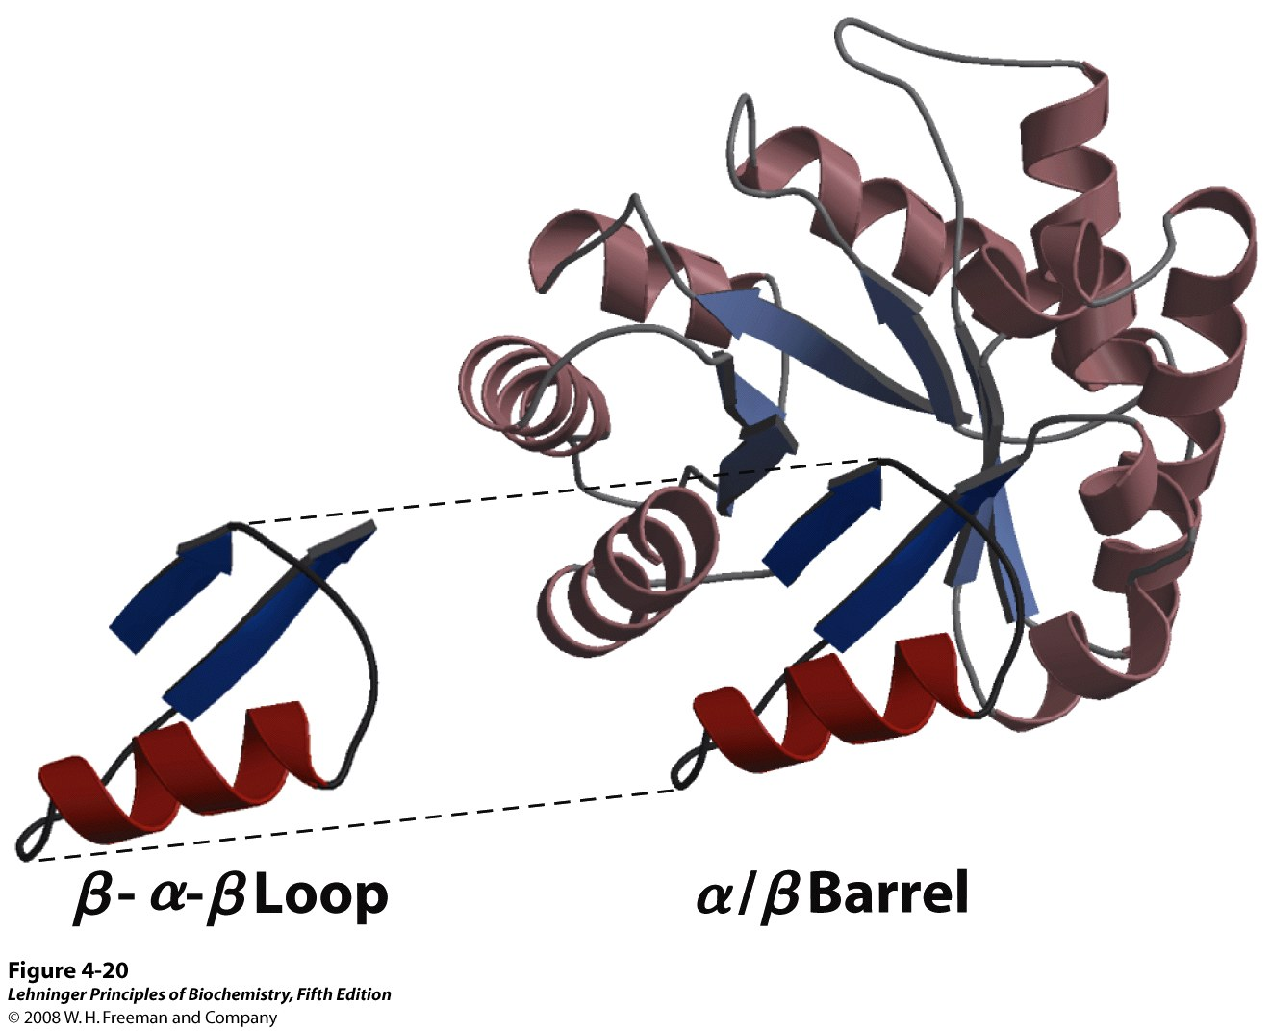
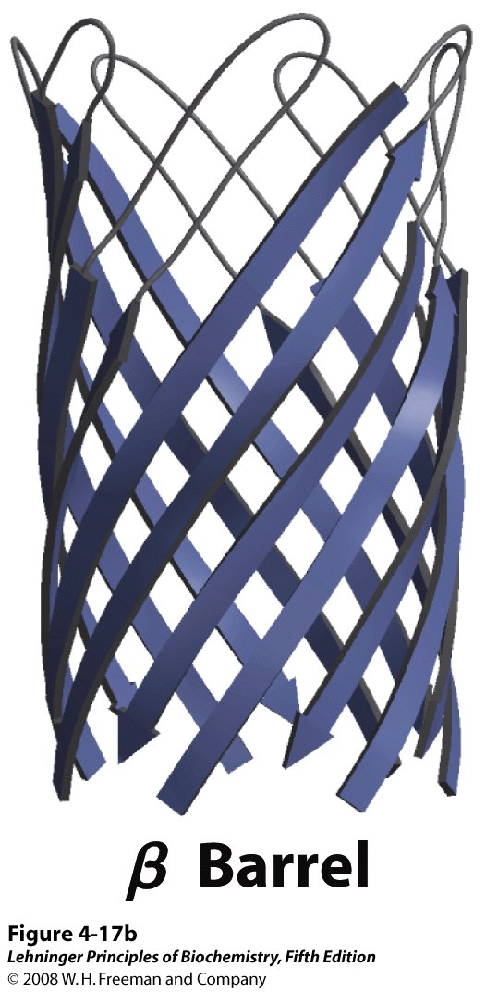
Some ‘folds’ are built up from smaller motifs
Notes:
FIGURE 4-20 Constructing large motifs from smaller ones. The α/β barrel is a commonly occurring motif constructed from repetitions of the α-β-α loop motif. This α/β barrel is a domain of pyruvate kinase (a glycolytic enzyme) from rabbit (derived from PDB ID 1PKN).

Slide 4
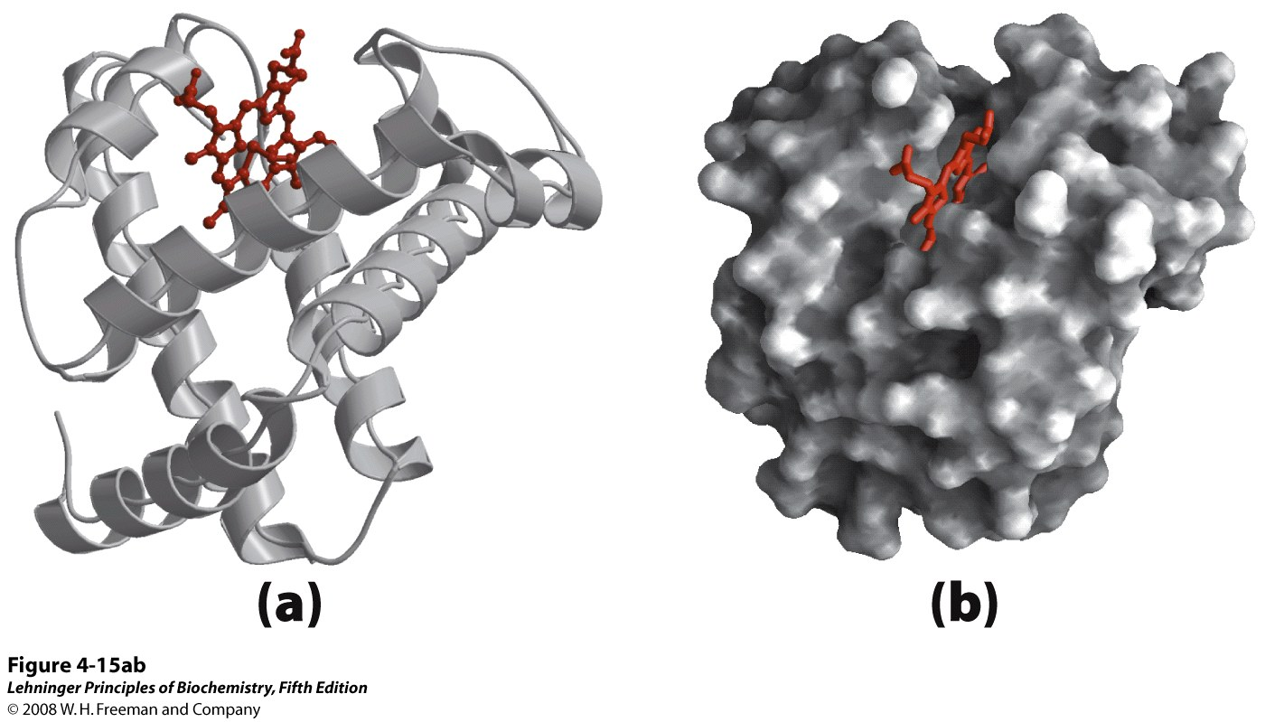
Other folds are not built up from smaller motifs
Sperm whale myoglobin, the first protein structure to be determined
Notes:
FIGURE 4-15a,b Tertiary structure of sperm whale myoglobin. (PDB ID 1MBO) Orientation of the protein is similar in (a) through (d); the heme group is shown in red. In addition to illustrating the myoglobin structure, this figure provides examples of several different ways to display protein structure. (a) The polypeptide backbone in a ribbon representation of a type introduced by Jane Richardson, which highlights regions of secondary structure. The α-helical regions are evident. (b) Surface contour image; this is useful for visualizing pockets in the protein where other molecules might bind. (c) Ribbon representation including side chains (blue) for the hydrophobic residues Leu, Ile, Val, and Phe. (d) Space-filling model with all amino acid side chains. Each atom is represented by a sphere encompassing its van der Waals radius. The hydrophobic residues are again shown in blue; most are buried in the interior of the protein and thus not visible.

Slide 5
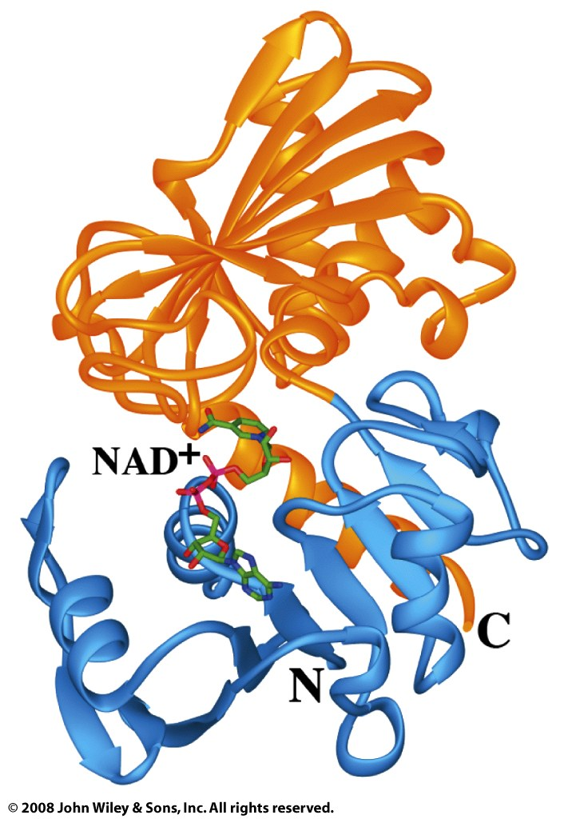
Multiple folds may combine as domains of a tertiary structure
Domains: independently folding units
(often with distinct functions)
Protein:
Glyceraldehyde-3-phosphate dehydrogenase (GAPDH), an enzyme of glycolysis

Slide 6
There are ~1,000 different protein folds, which can be classified by structure and homology
For example: CATH – a system for categorizing protein folds (at the level of domains)
Class – general description of predominant secondary structures (α, β, α/β)
Architecture – arrangement of secondary structure elements
Topology – connectivity of secondary structure elements
Homologous superfamily – evolutionary relationship

Slide 7
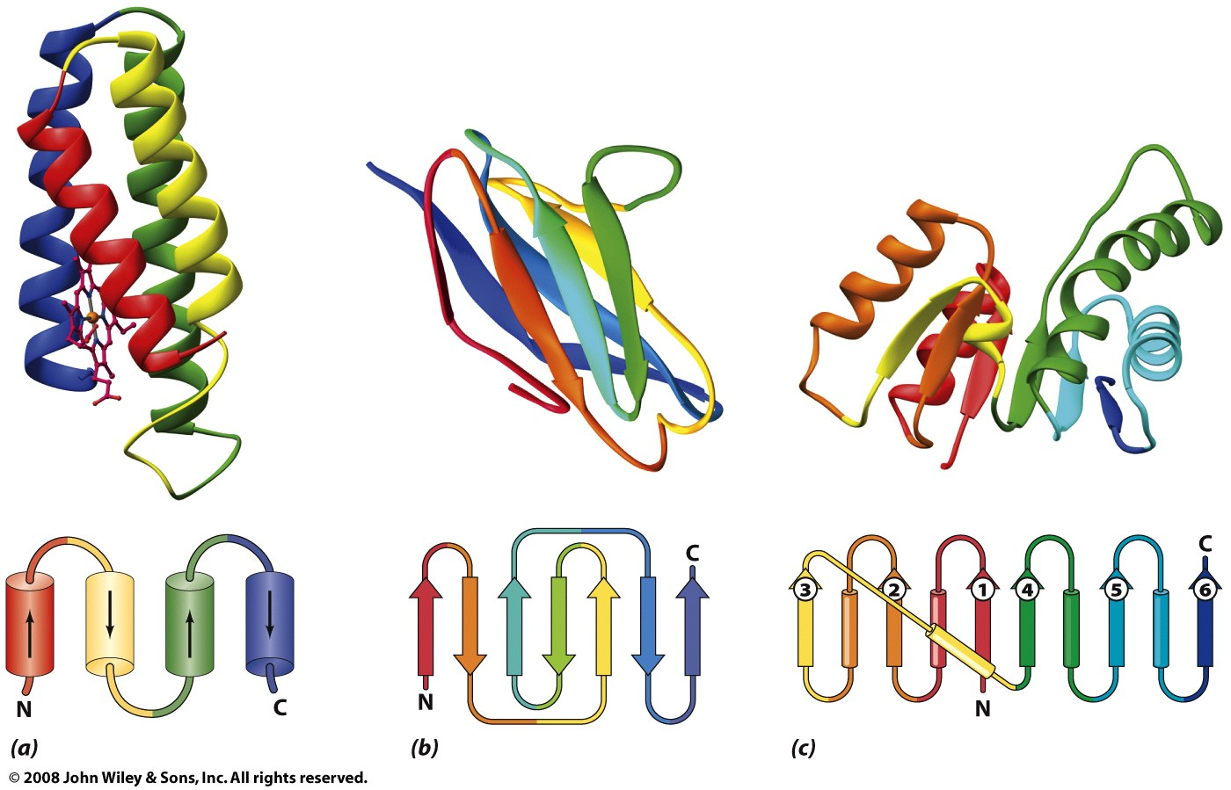
Class: folds can be grouped by predominant secondary structure(s)
α
β
α/β

Slide 8
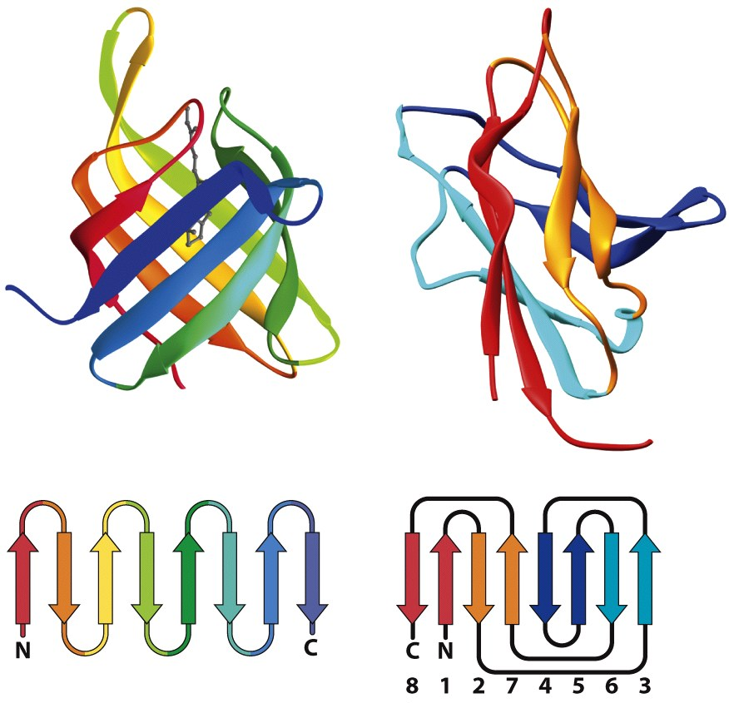
Architecture: arrangement of 2° structures Topology: connectivity of 2° structures
These β-barrels have similar architecture…
but different topology

Slide 9
There are ~1,000 different protein folds, which can be classified by structure and homology
For example: CATH – a system for categorizing protein folds (at the level of domains)
Class – general description of predominant secondary structures (α, β, α/β)
Architecture – arrangement of secondary structure elements
Topology – connectivity of secondary structure elements
Homologous superfamily – evolutionary relationship

Slide 10
Protein structure is conserved more than sequence
c-type cytochromes from different species have little sequence similarity

Slide 11
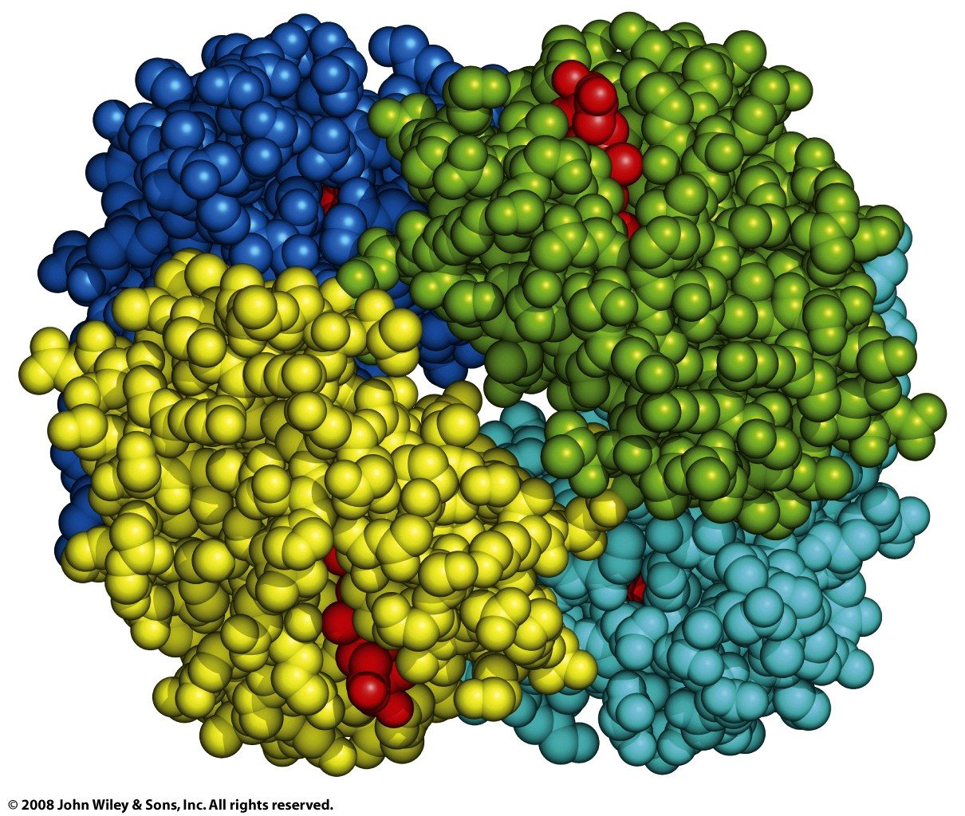
Quaternary structure combines multiple subunits, often in a symmetric arrangement
Oligomeric protein, multimeric protein, oligomer, multimer (if large, protein complex):
Protein composed of multiple polypeptide chains
Ex: hemoglobin tetramer
Subunit:
One polypeptide chain of an oligomer
Ex: α₁ subunit
Protomer:
Repeating structural unit
Ex: one αβ dimer
β₂
α₂
α₁
β₁
Hemoglobin tetramer (dimer of dimers)
Rotational symmetry: 2-fold cyclic (C₂)
(Pseudosymmetry: 2-fold dihedral, D₂)

Slide 12
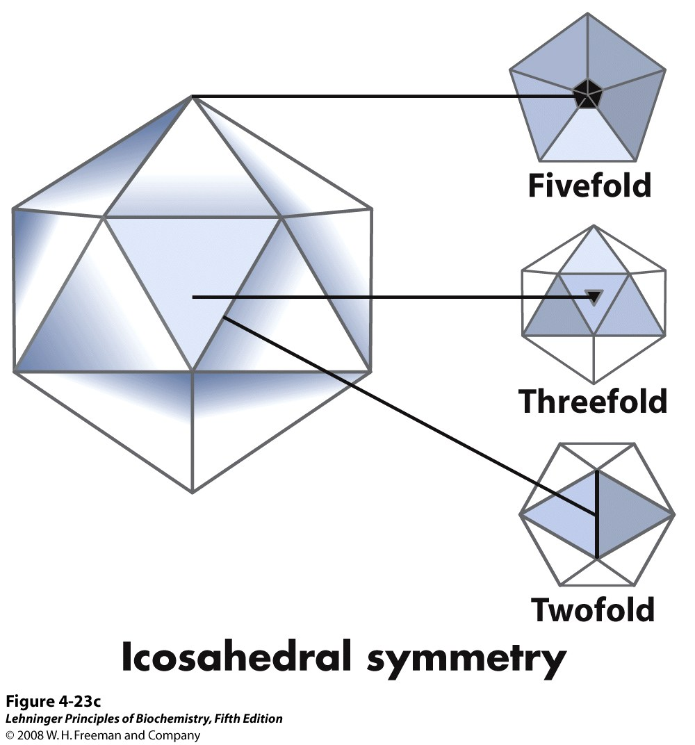
Virus capsids are generally highly symmetric
(rotational symmetry)
Notes:
FIGURE 4-24a Viral capsids. (a) Poliovirus (derived from PDB ID 2PLV) as rendered in the VIPER relational database for structural virology. The coat proteins of poliovirus assemble into an icosahedron 300 Å in diameter. Icosahedral symmetry is a type of rotational symmetry (see Figure 4-23c). On the left is a surface contour image of the poliovirus capsid. The image at right was rendered at lower resolution, and the coat protein subunits were colored to show the icosahedral symmetry.

Slide 13
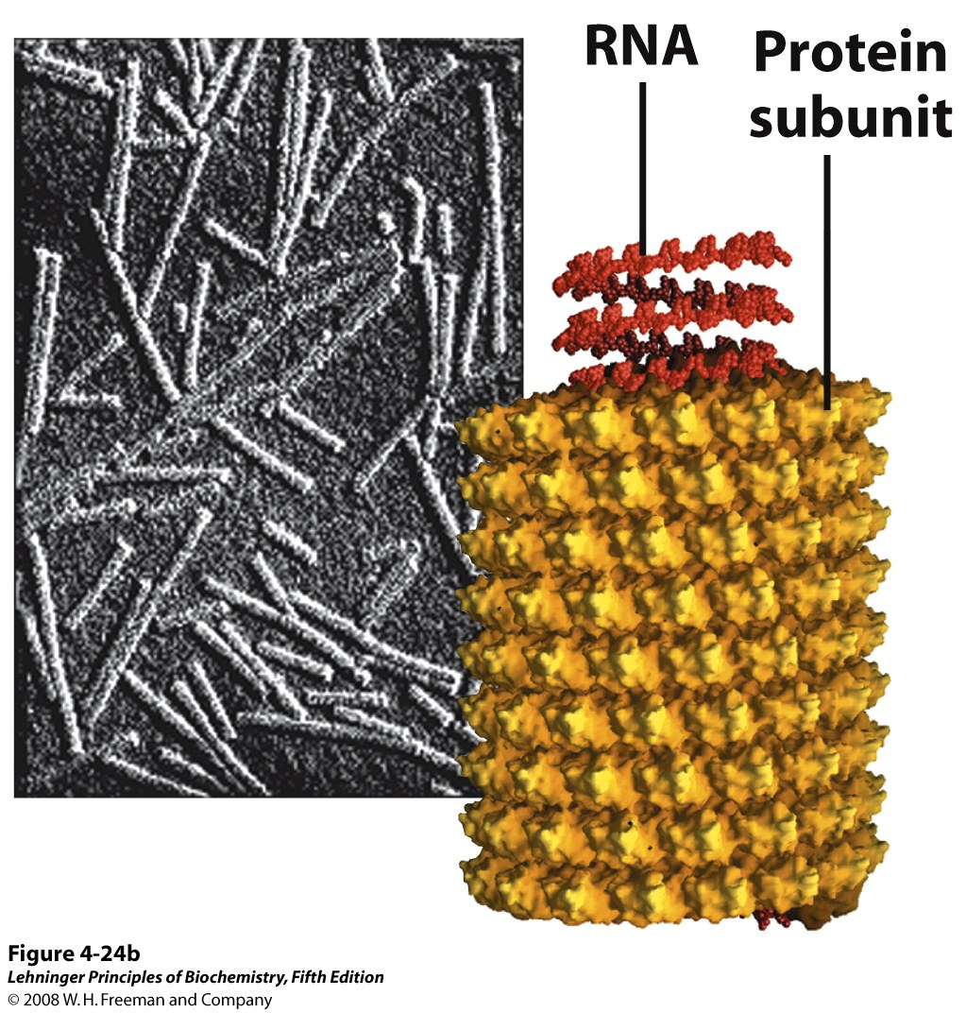
Virus capsids are generally highly symmetric
(helical symmetry)
Notes:
FIGURE 4-24b Viral capsids. (b) Tobacco mosaic virus (derived from PDB ID 1VTM). This rod-shaped virus (as shown in the electron micrograph) is 3,000 Å long and 180 Å in diameter; it has helical symmetry.

