Slide 1
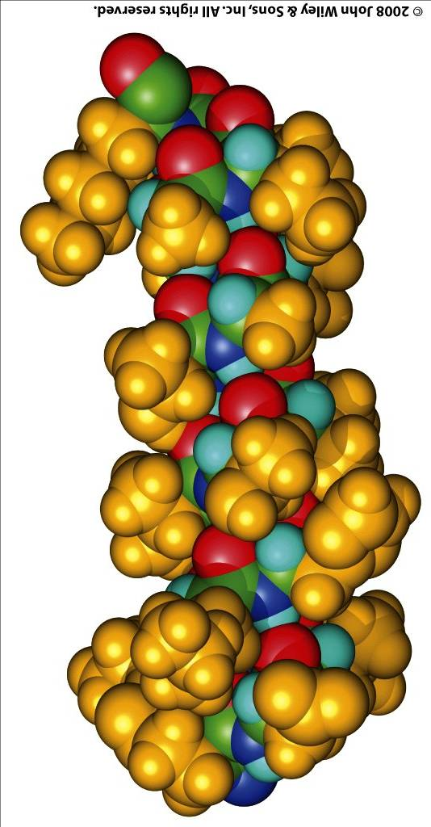
The α-helix forms within a continuous strech of the polypeptide chain
N-term
prototypical
φ = -57°
ψ = -47°
5.4 Å rise,
3.6 aa/turn
∴ 1.5 Å/aa
C-term

Slide 2
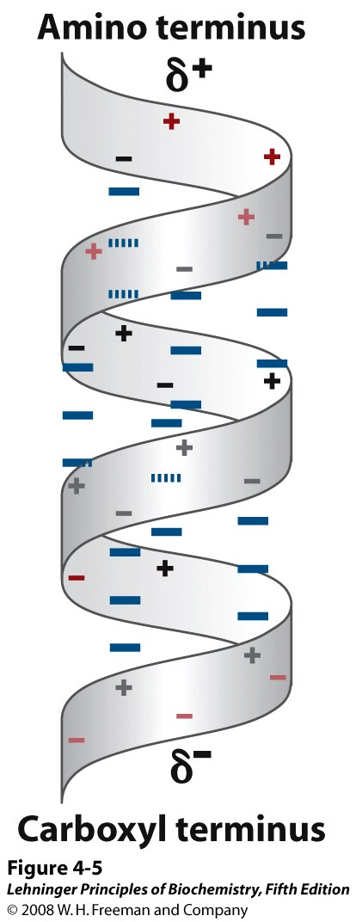
α-Helices have a dipole moment, due to unbonded and aligned N-H and C=O groups
Notes:
FIGURE 4-5 Helix dipole. The electric dipole of a peptide bond (see Figure 4-2a) is transmitted along an α-helical segment through the intrachain hydrogen bonds, resulting in an overall helix dipole. In this illustration, the amino and carbonyl constituents of each peptide bond are indicated by + and – symbols, respectively. Non-hydrogen-bonded amino and carbonyl constituents of the peptide bonds near each end of the α-helical region are shown in red.

Slide 3
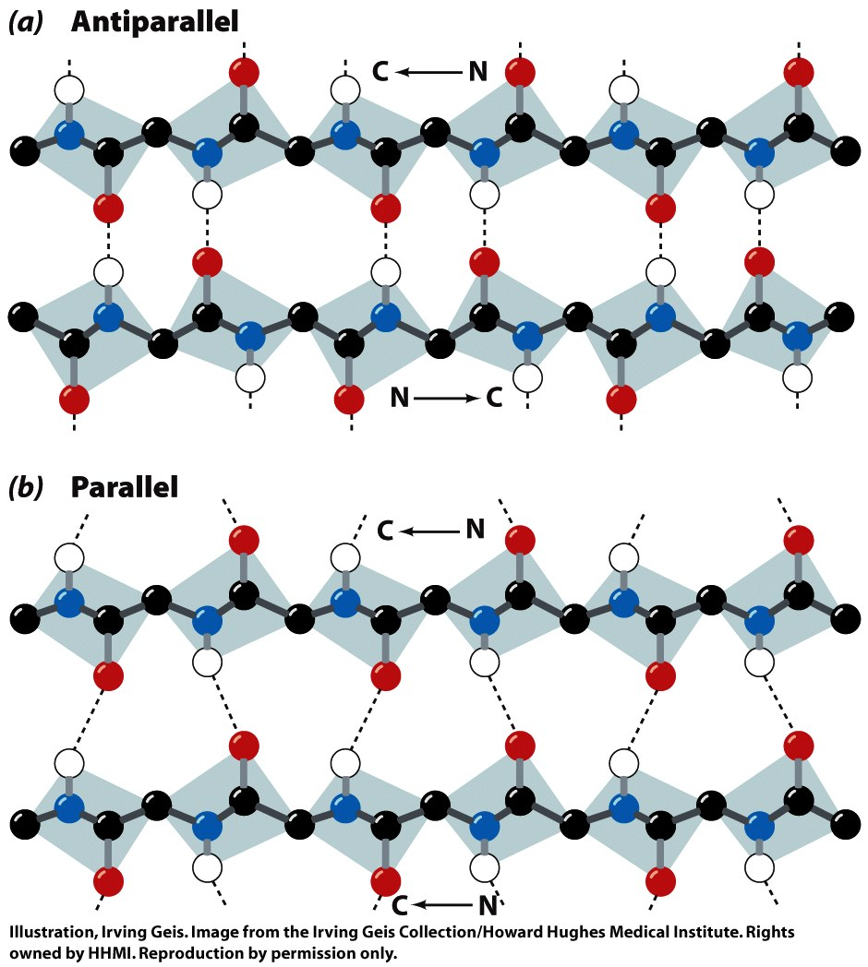
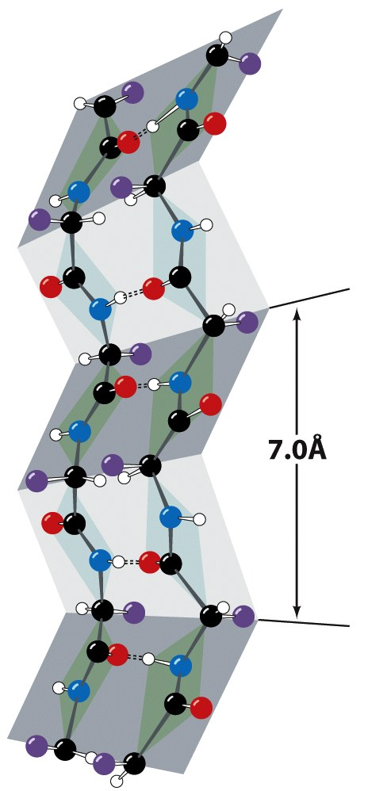
β-Sheets contain extended (β-strand) segments from separate regions of a protein
prototypical φ = -139°, ψ = +135°
prototypical φ = -119°, ψ = +113°
(6.5Å repeat length in parallel sheet)

Slide 4
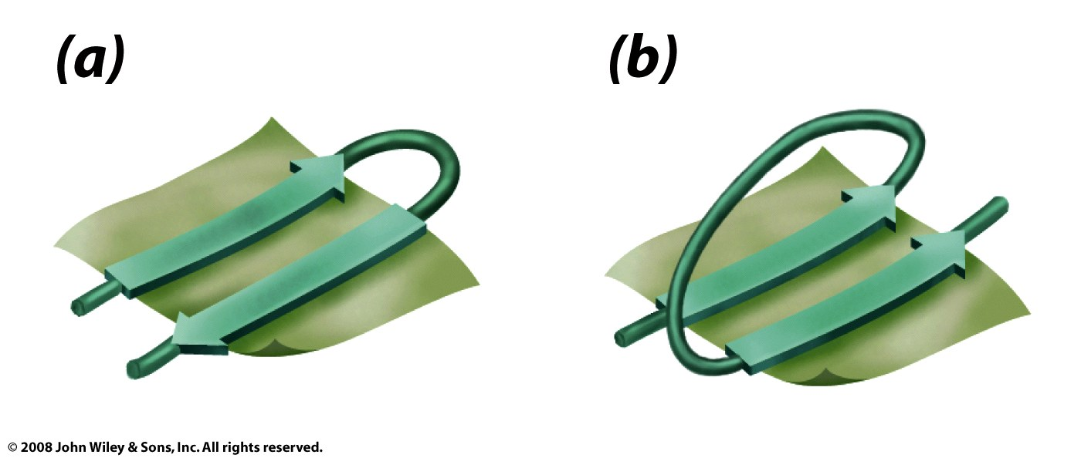
Antiparallel β-sheets may be formed by closer regions of sequence than parallel
Beta turn
Figure 6-13

Slide 5
The stability of helices and sheets depends on their sequence of amino acids
Intrinsic propensity of an amino acid to adopt a helical or extended (strand) conformation

Slide 6
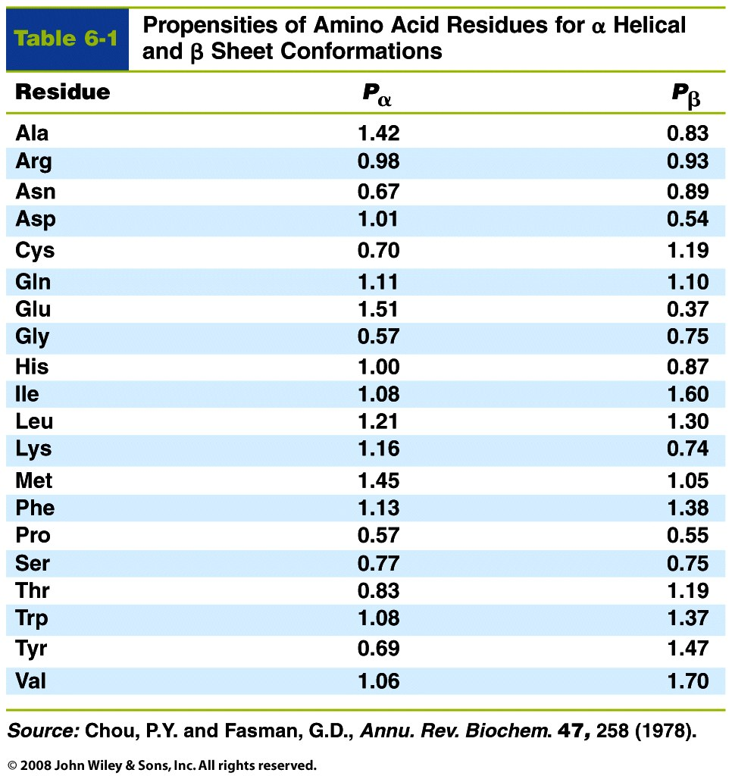
The stability of helices and sheets depends on their sequence of amino acids
Intrinsic propensity of an amino acid to adopt a helical or extended (strand) conformation

Slide 7
The stability of helices and sheets depends on their sequence of amino acids
Intrinsic propensity of an amino acid to adopt a helical or extended (strand) conformation
Interactions between adjacent R-groups
Ionic attraction or repulsion
Steric hindrance of adjacent bulky groups
Helix wheel

Slide 8
The stability of helices and sheets depends on their sequence of amino acids
Intrinsic propensity of an amino acid to adopt a helical or extended (strand) conformation
Interactions between adjacent R-groups
Ionic attraction or repulsion
Steric hindrance of adjacent bulky groups
Occurrence of proline and glycine
Interactions between ends of helix and aa R-groups
N-term
δ⁺
C-term
δ⁻
His
Lys
Arg
Glu
Asp

Slide 9
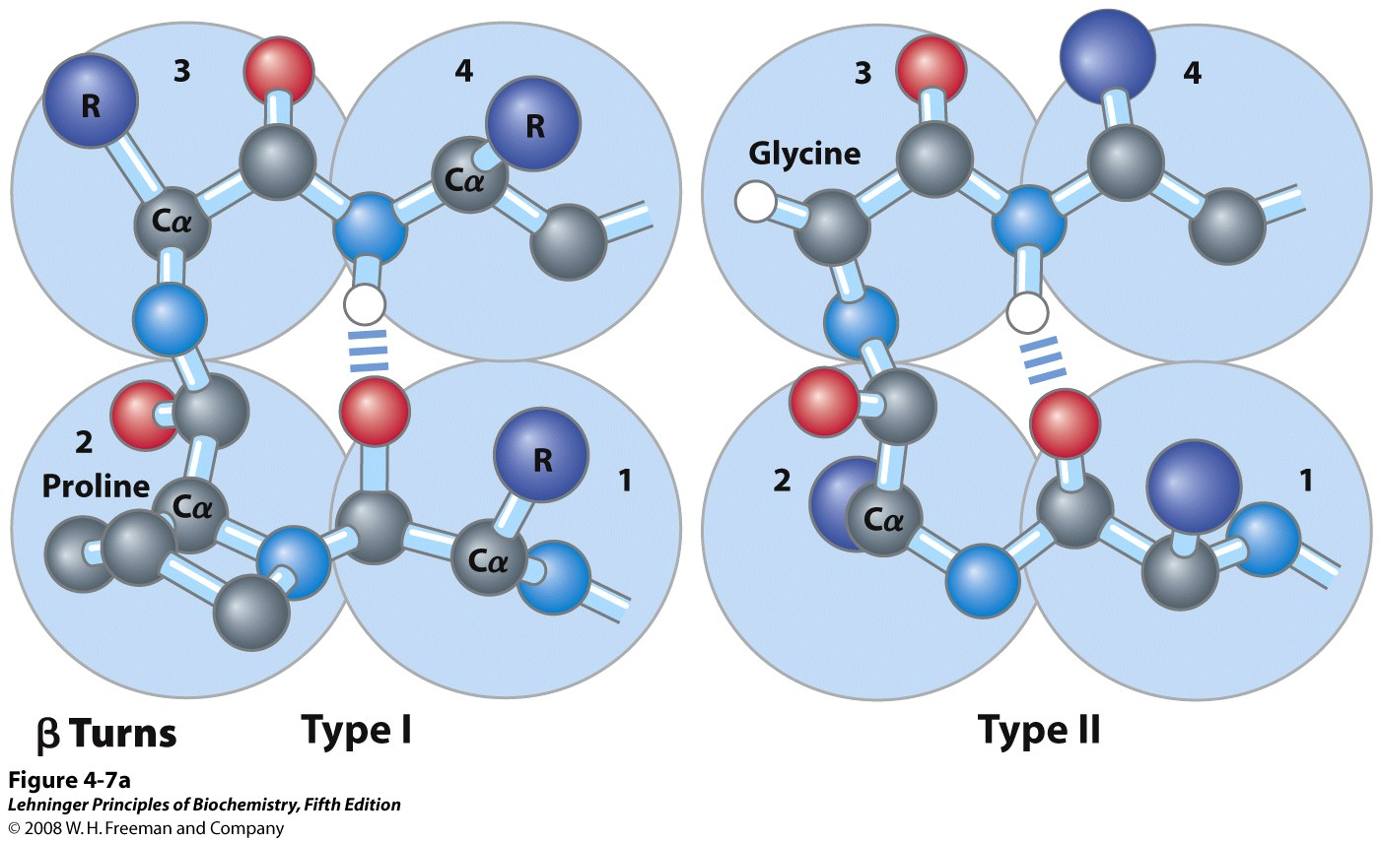
Turns are important secondary structures that change the direction of the chain
Notes:
FIGURE 4-7a Structures of β turns. (a) Type I and type II β turns are most common; type I turns occur more than twice as frequently as type II. Type II β turns usually have Gly as the third residue. Note the hydrogen bond between the peptide groups of the first and fourth residues of the bends. (Individual amino acid residues are framed by large blue circles.)

Slide 10
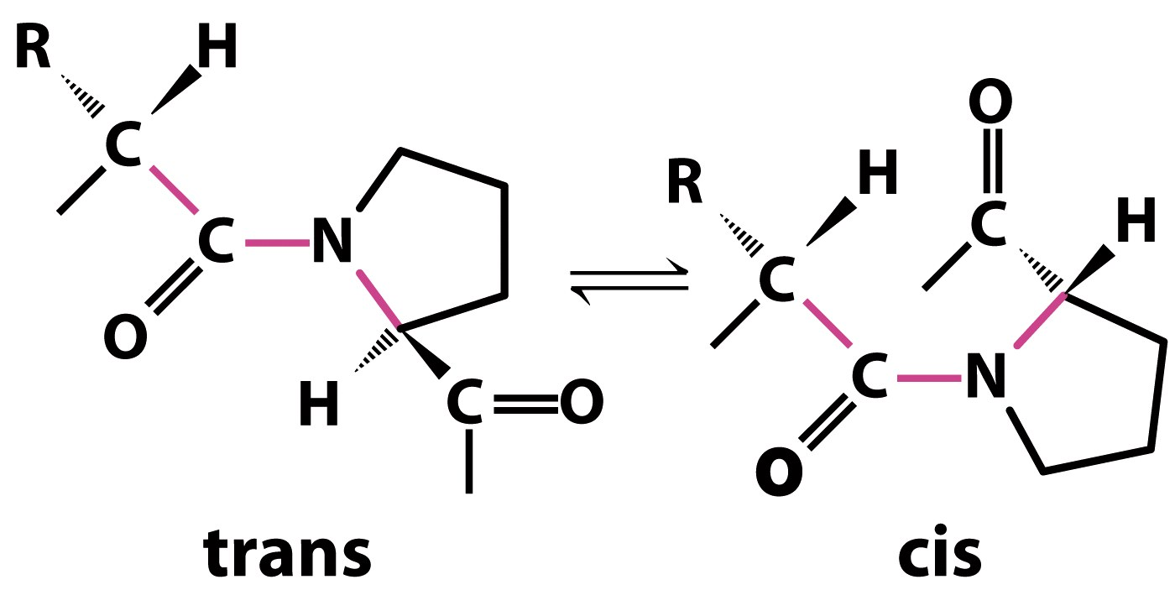
Backbones are usually trans at the peptide bond, but cis-Pro is found in some β-turns
Notes:
FIGURE 4-7b Structures of β turns. (b) Trans and cis isomers of a peptide bond involving the imino nitrogen of proline. Of the peptide bonds between amino acid residues other than Pro, more than 99.95% are in the trans configuration. For peptide bonds involving the imino nitrogen of proline, however, about 6% are in the cis configuration; many of these occur at β turns.

Slide 11
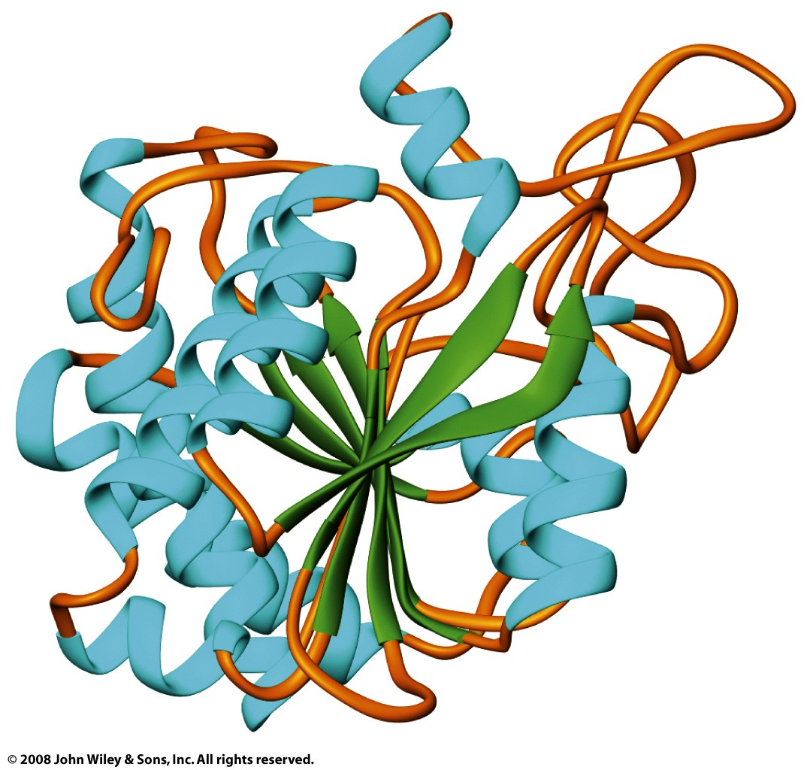
Tertiary structure combines regular secondary structures and loops
Bovine carboxypeptidase A

Slide 12
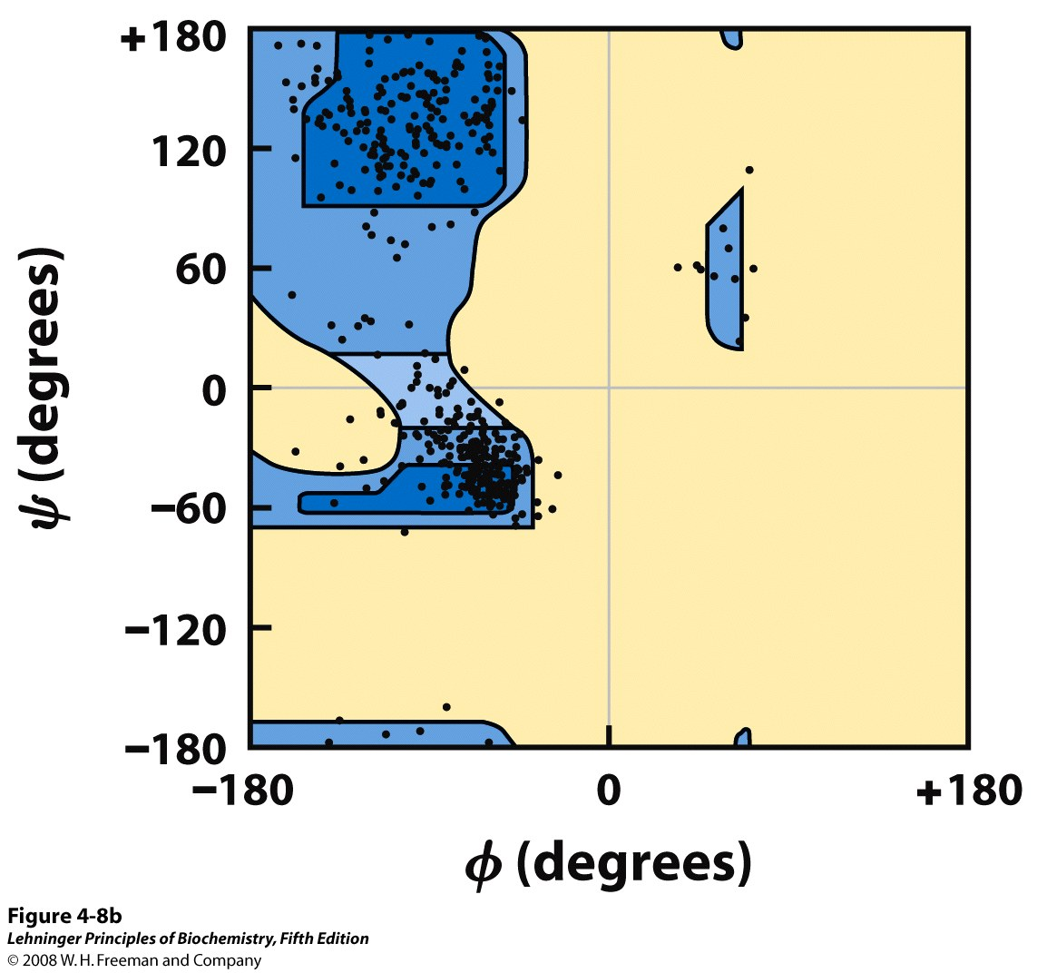
Most dihedral angles of a protein’s tertiary structure are “allowed”
Structure:
pyruvate kinase
Note: glycine
not shown
Notes:
FIGURE 4-8b Ramachandran plots showing a variety of structures. (b) The values of Φ and Ψ for all the amino acid residues except Gly in the enzyme pyruvate kinase (isolated from rabbit) are overlaid on the plot of theoretically allowed conformations (Figure 4-3). The small, flexible Gly residues were excluded because they frequently fall outside the expected (blue) ranges.

Slide 13
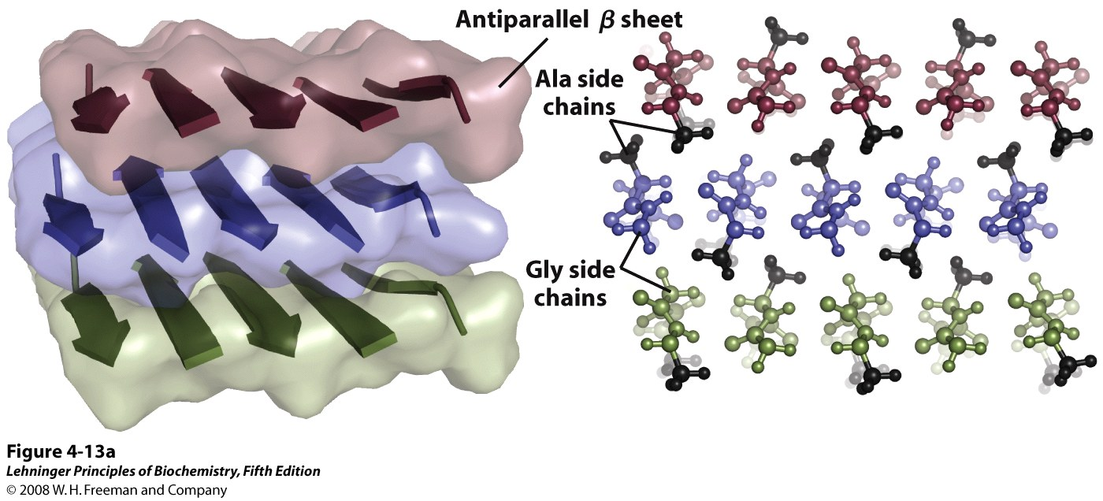
Fibrous proteins are dominated by secondary (and quaternary) structure
Silk fibroin forms stacked, antiparallel β-sheets
Notes:
FIGURE 4-13a Structure of silk. The fibers in silk cloth and in a spider web are made up of the protein fibroin. (a) Fibroin consists of layers of antiparallel β sheets rich in Ala and Gly residues. The small side chains interdigitate and allow close packing of the sheets, as shown in the ball and stick view.

Slide 14
Fibrous proteins are dominated by secondary (and quaternary) structure
α-Keratin forms an α-helical coiled-coil
Collagen forms a triple-helix
Figure 6-15b

Slide 15
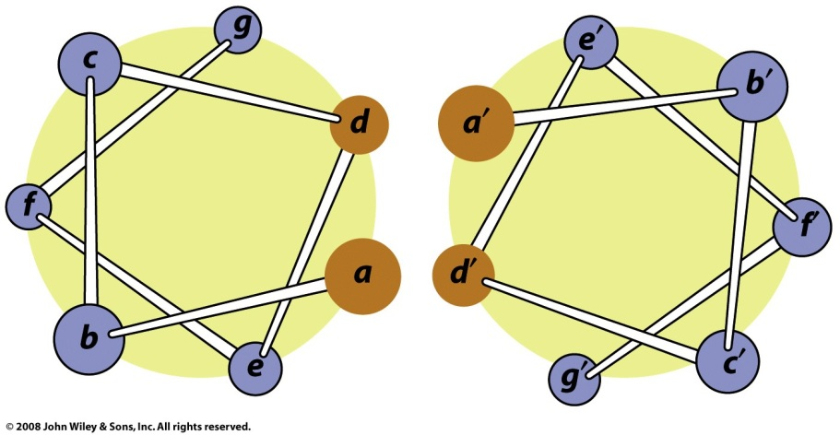
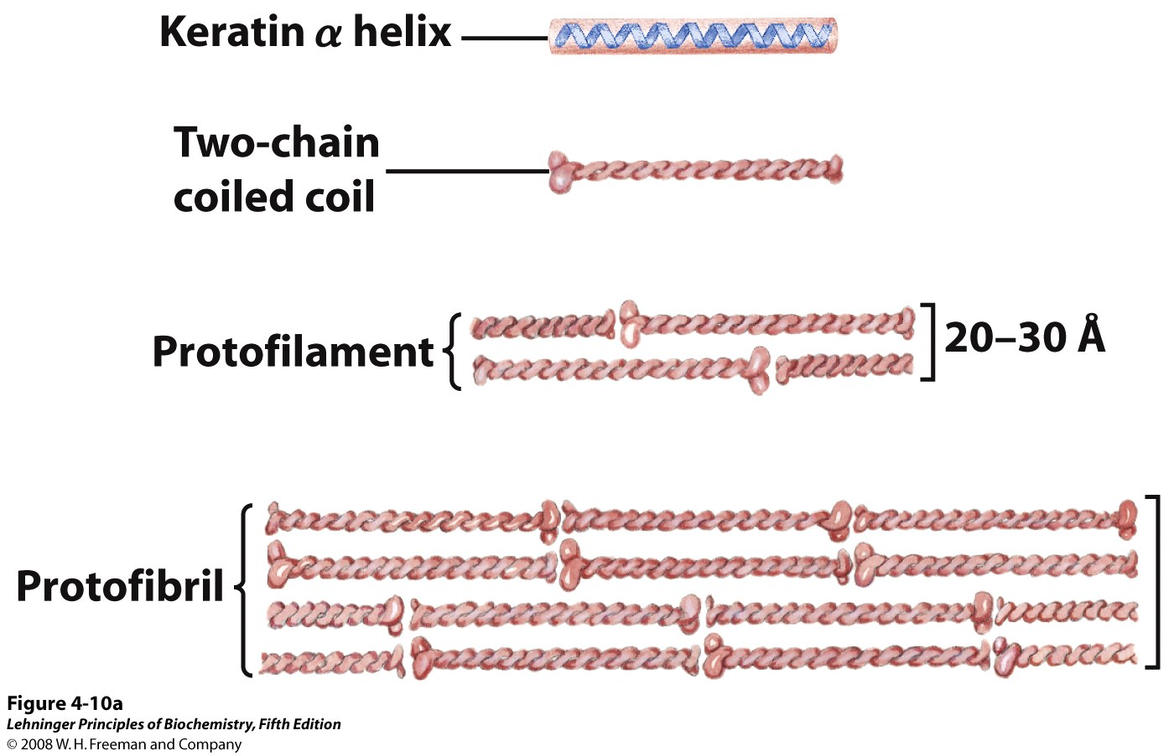
Regular spacing of hydrophobic aa’s in α-keratin promotes quaternary interactions
Notes:
FIGURE 4-10a Structure of hair. (a) Hair α-keratin is an elongated α helix with somewhat thicker elements near the amino and carboxyl termini. Pairs of these helices are interwound in a left-handed sense to form two-chain coiled coils. These then combine in higher-order structures called protofilaments and protofibrils. About four protofibrils—32 strands of α-keratin in all—combine to form an intermediate filament. The individual two-chain coiled coils in the various substructures also seem to be interwound, but the handedness of the interwinding and other structural details are unknown.

Slide 16
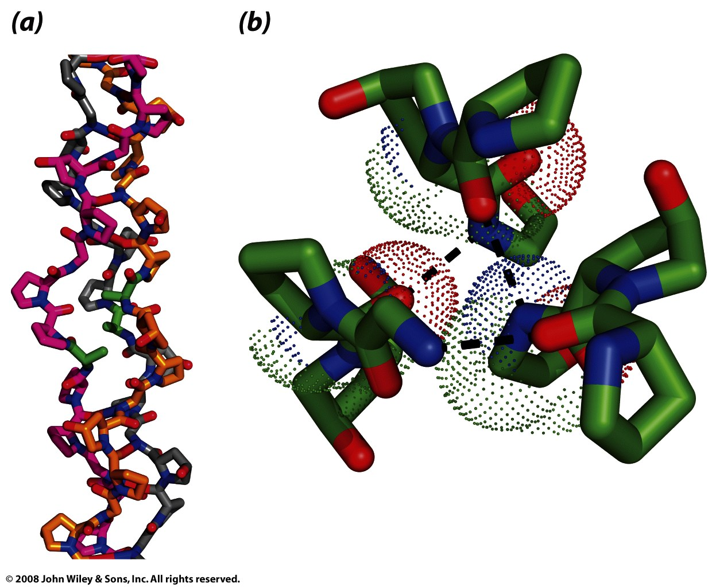
Gly-X-Y motif and hydroxylated aa’s of collagen allow for tight coiling and packing
Figure 6-18

Slide 17
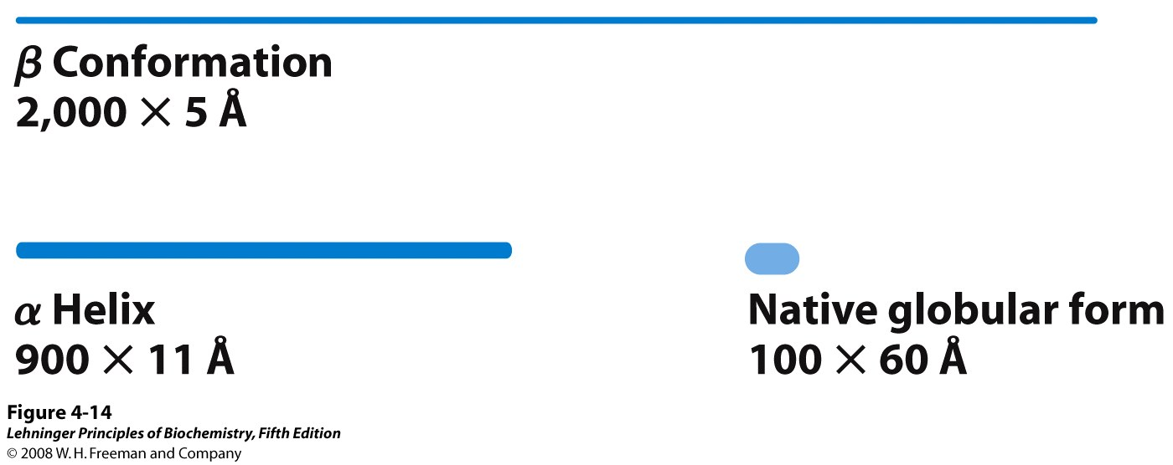
Globular proteins are compact and often combine multiple secondary structures
Notes:
FIGURE 4-14 Globular protein structures are compact and varied. Human serum albumin (M_{r} 64,500) has 585 residues in a single chain. Given here are the approximate dimensions its single polypeptide chain would have if it occurred entirely in extended β conformation or as an α helix. Also shown is the size of the protein in its native globular form, as determined by x-ray crystallography; the polypeptide chain must be very compactly folded to fit into these dimensions.

Slide 18
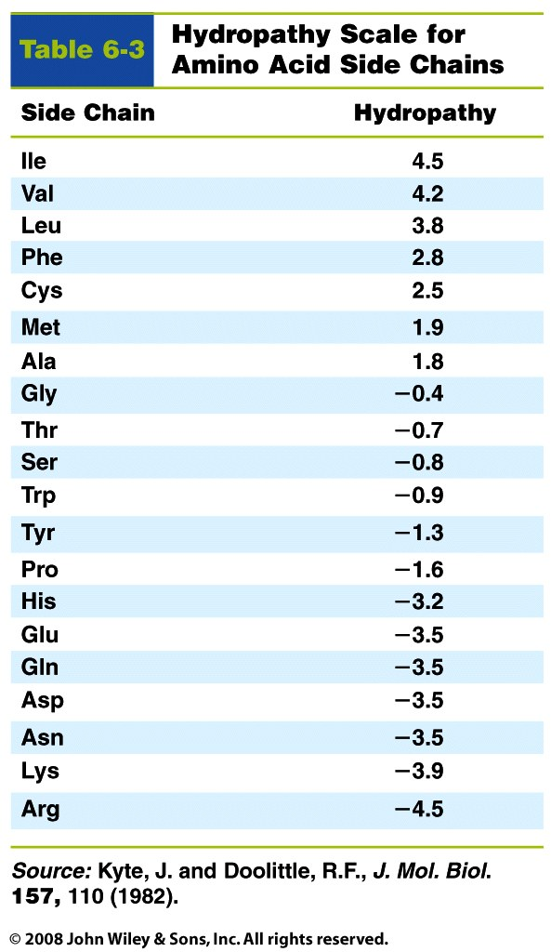
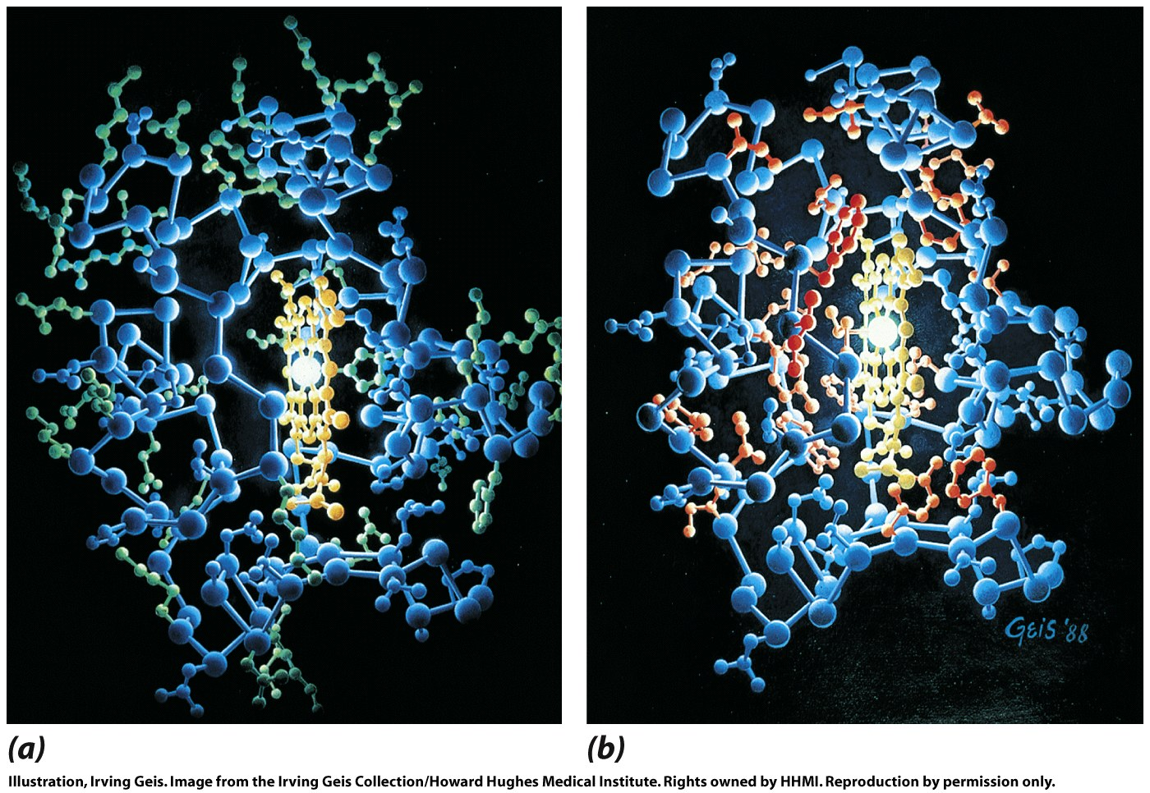
Globular proteins have hydrophobic groups inside and hydrophilic groups on the surface
aa side chains: green=hydrophilic; orange=hydrophobic
Horse heart cytochrome C

Slide 19
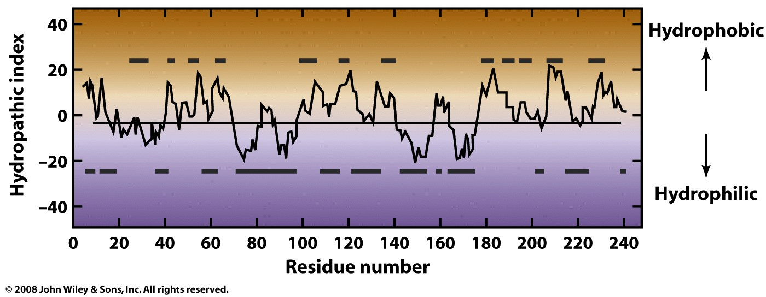
Hydropathic index can be plotted for a protein, to predict internal & external zones

Slide 20
Particular arrangements of polar and apolar residues can form amphipathic helices

Slide 21
An alternating sequence of polar and apolar residues can form an amphipathic sheet

Slide 22
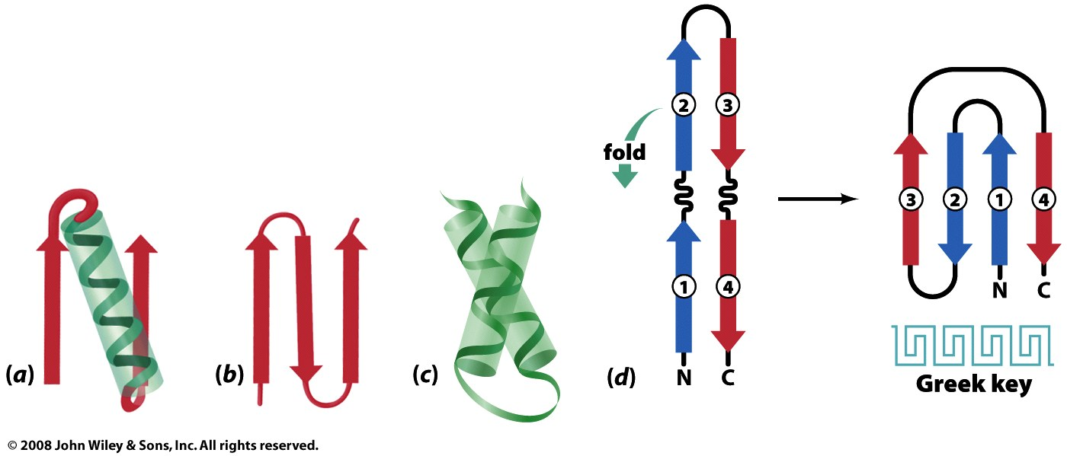
Some tertiary structures contain common patterns, or motifs, of secondary structures (= supersecondary structures)
αα
(coiled-coil)
βαβ
β-hairpins
Figure 6-28

Slide 23
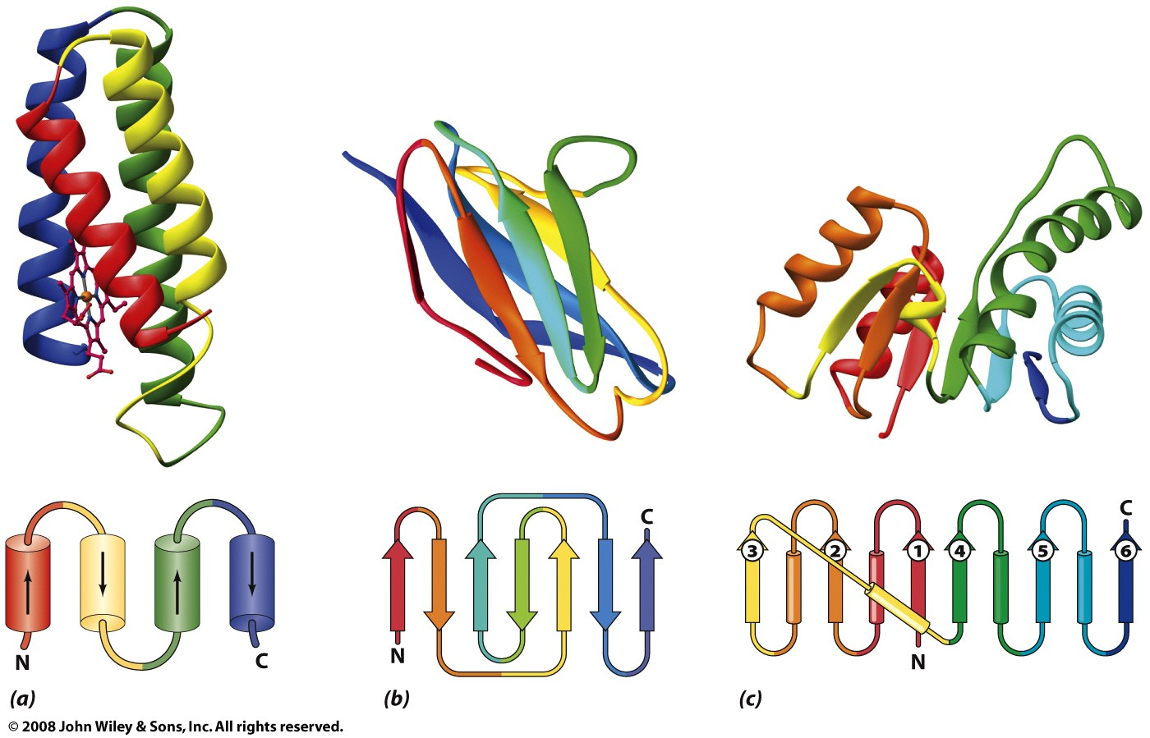
Proteins folds can be grouped by predominant secondary structure(s)
α
β
α/β

