Slide 1
Carbohydrates

Slide 2
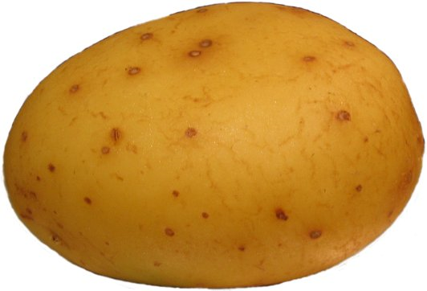
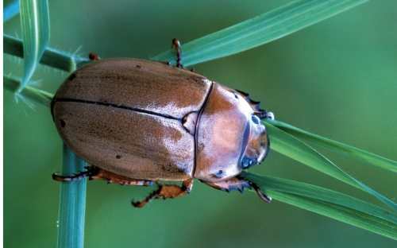
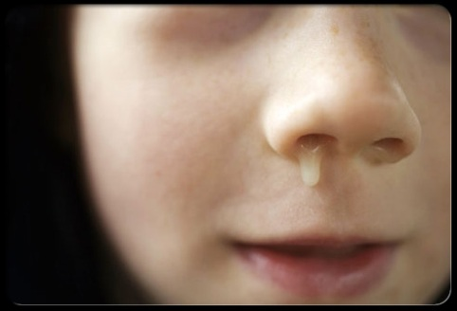
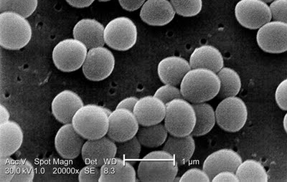
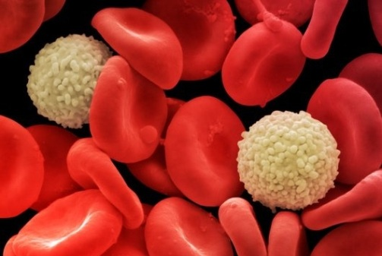
Carbohydrates serve a variety of functions
Energy storage and food
Structure and support
Lubrication
Protection
Recognition and signaling
Component of nucleotides
starch
chitin and cellulose
mucin (glycoprotein)
cell wall peptidoglycan
surface glycoproteins
2-deoxyribose

Slide 3
Carbohydrates are polyhydroxylated aldehydes (aldoses) and ketones (ketoses)
Base formula: C_{n}H_{2n}O_{n}
triose tetrose pentose
# of carbons
‘-ose’ suffix indicates carbohydrate
Monosaccharides (sometimes called ‘simple sugars’)
also, Oligosaccharides (disaccharides, trisaccharides, …)
and Polysaccharides (sometimes called ‘complex carbohydrates’)
Saccharide: from Greek sakcharon = sugar
Formed from monosaccharides linked via a condensation reaction
‘glyc’ (from Greek glykys = sweet) also designates carbohydrate
ex: glycoside, glycolysis, peptidoglycan

Slide 4
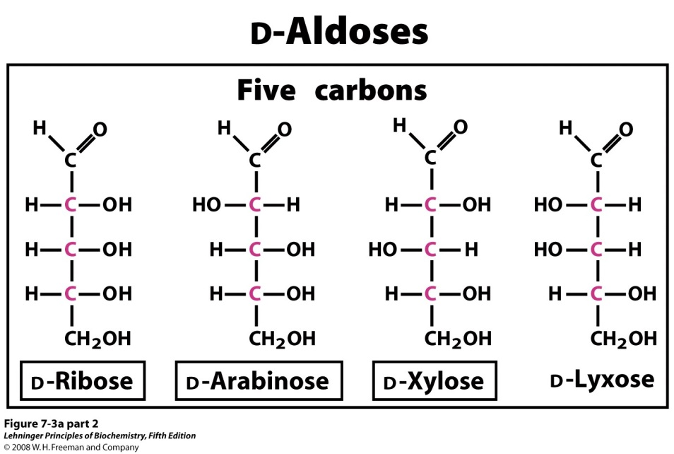
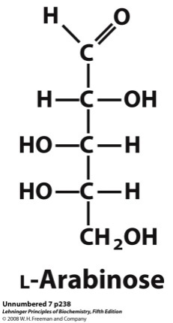
Most carbohydrates are chiral, and their configuration is a major distinguishing feature
Base formula: C_{n}H_{2n}O_{n}
Chiral carbons:
#C - 2 for aldoses
#C - 3 for ketoses
Number of stereoisomers: 2^{x}, where x is # of chiral carbons
d-aldopentoses are diastereomers
d- and l- arabinose are enantiomers

Slide 5
A carbonyl and an alcohol will readily react to form a new chiral center
This is how monosaccharides spontaneously cyclize
Notes:
FIGURE 7-5 Formation of hemiacetals and hemiketals. An aldehyde or ketone can react with an alcohol in a 1:1 ratio to yield a hemiacetal or hemiketal, respectively, creating a new chiral center at the carbonyl carbon. Substitution of a second alcohol molecule produces an acetal or ketal. When the second alcohol is part of another sugar molecule, the bond produced is a glycosidic bond (p. 243).

Slide 6
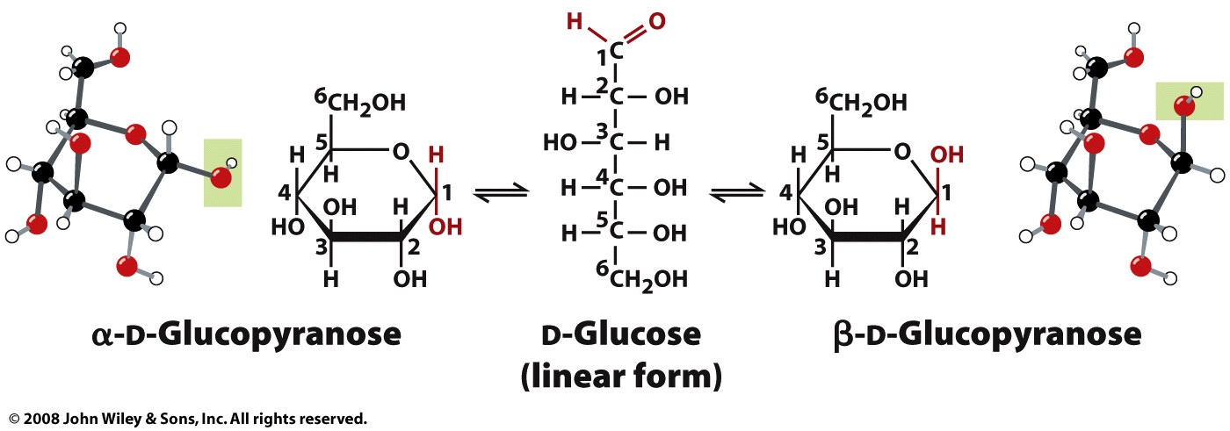
Mutarotation is the interconversion of anomers
Figure 8-4

Slide 7
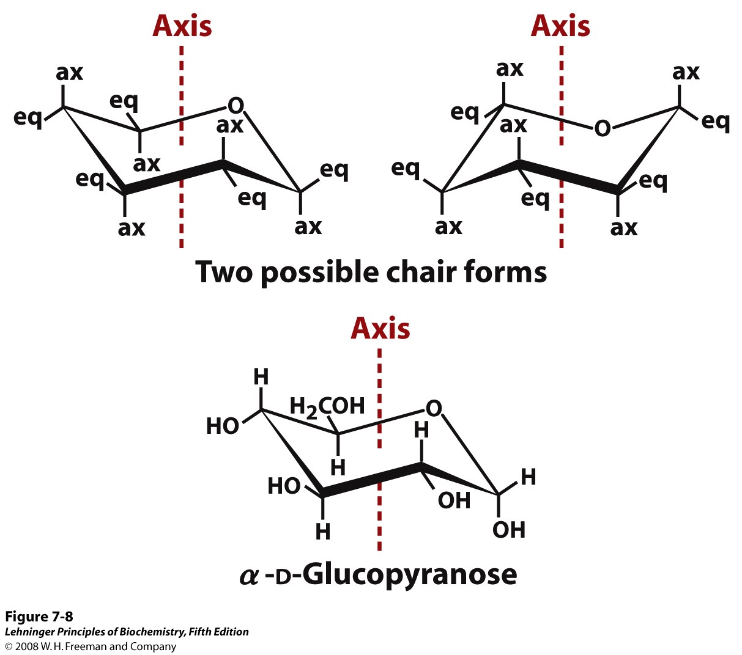
A six-membered sugar ring, like glucopyranose, adopts one of two chair conformations
Notes:
FIGURE 7-8 Conformational formulas of pyranoses. (a) Two chair forms of the pyranose ring. Bonds to substituents and hydrogen atoms on the ring carbons may be either axial (ax), projecting parallel to the vertical axis through the ring, or equatorial (eq), projecting roughly perpendicular to this axis. Two conformers such are these are not readily interconvertible without breaking the ring. However, when the molecule is "stretched" (by atomic force microscopy; see Box 11-1), an input of about 46 kJ of energy per mole of sugar can force the interconversion of chair forms. Generally, substituents in the equatorial positions are less sterically hindered by neighboring substituents, and conformers with bulky substituents in equatorial positions are favored. Another conformation, the "boat" (not shown), is seen only in derivatives with very bulky substituents. (b) The preferred chair conformation of α-D-glucopyranose.

Slide 8
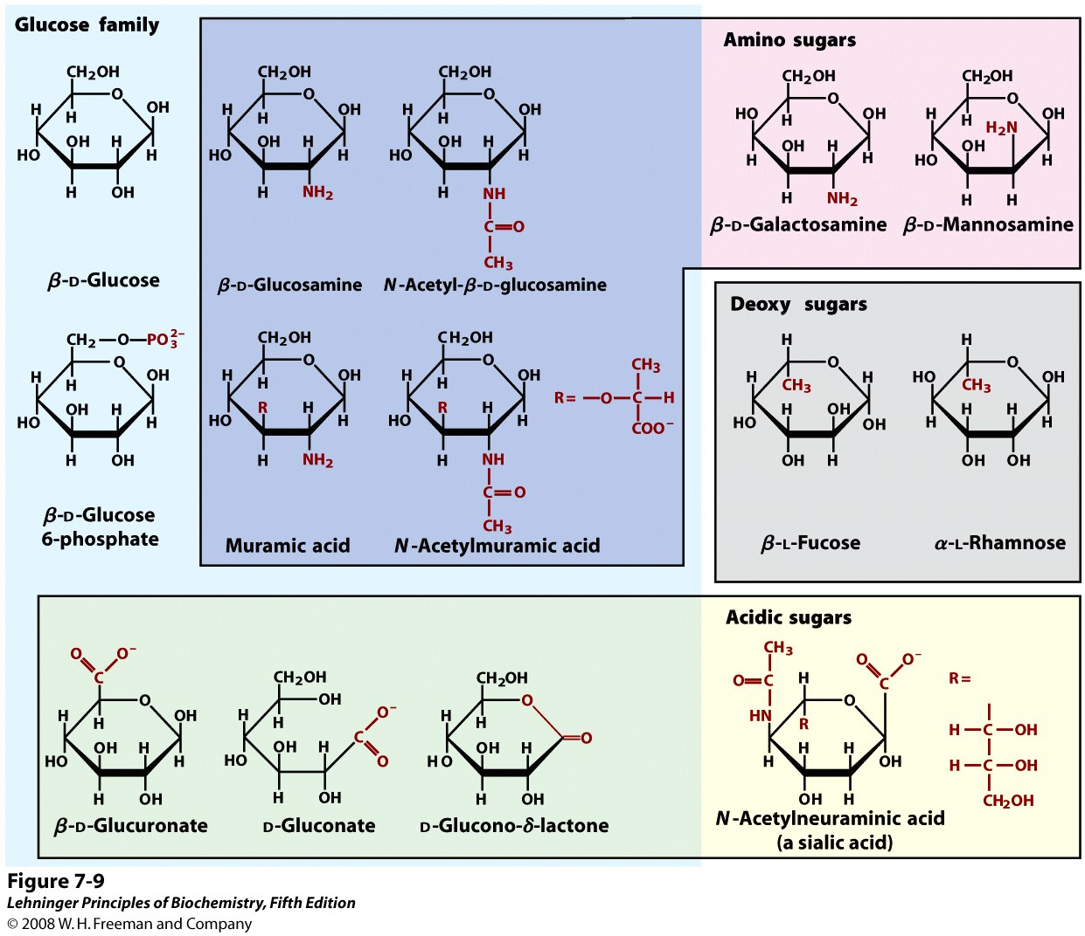
Modified sugars are important in biochemistry
Notes:
FIGURE 7-9 Some hexose derivatives important in biology. In amino sugars, an —NH₂ group replaces one of the —OH groups in the parent hexose. Substitution of —H for —OH produces a deoxy sugar; note that the deoxy sugars shown here occur in nature as the L isomers. The acidic sugars contain a carboxylate group, which confers a negative charge at neutral pH. D-Glucono-δ-lactone results from formation of an ester linkage between the C-1 carboxylate group and the C-5 (also known as the δ carbon) hydroxyl group of D-gluconate.

Slide 9
A hemiacetal or hemiketal may condense with an alcohol to form an acetal or ketal
Notes:
FIGURE 7-5 Formation of hemiacetals and hemiketals. An aldehyde or ketone can react with an alcohol in a 1:1 ratio to yield a hemiacetal or hemiketal, respectively, creating a new chiral center at the carbonyl carbon. Substitution of a second alcohol molecule produces an acetal or ketal. When the second alcohol is part of another sugar molecule, the bond produced is a glycosidic bond (p. 243).

Slide 10
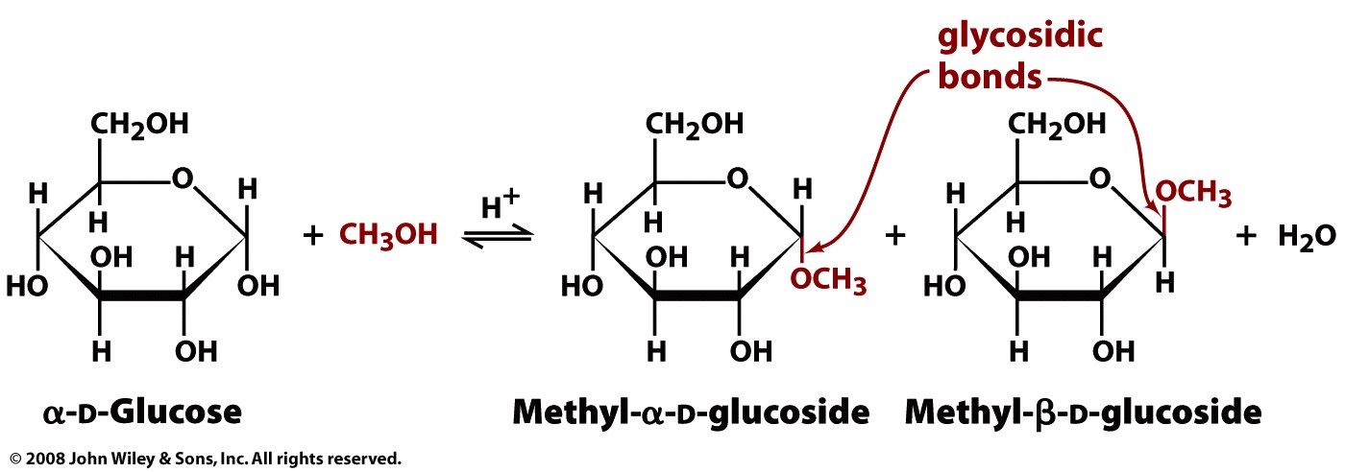
Glycosidic bonds link the anomeric carbon to other compounds, to form ‘glycosides’
O-glycosidic (or O-glycosyl) bonds (or linkages)
Can these sugars interconvert?
Figure 8-7

Slide 11
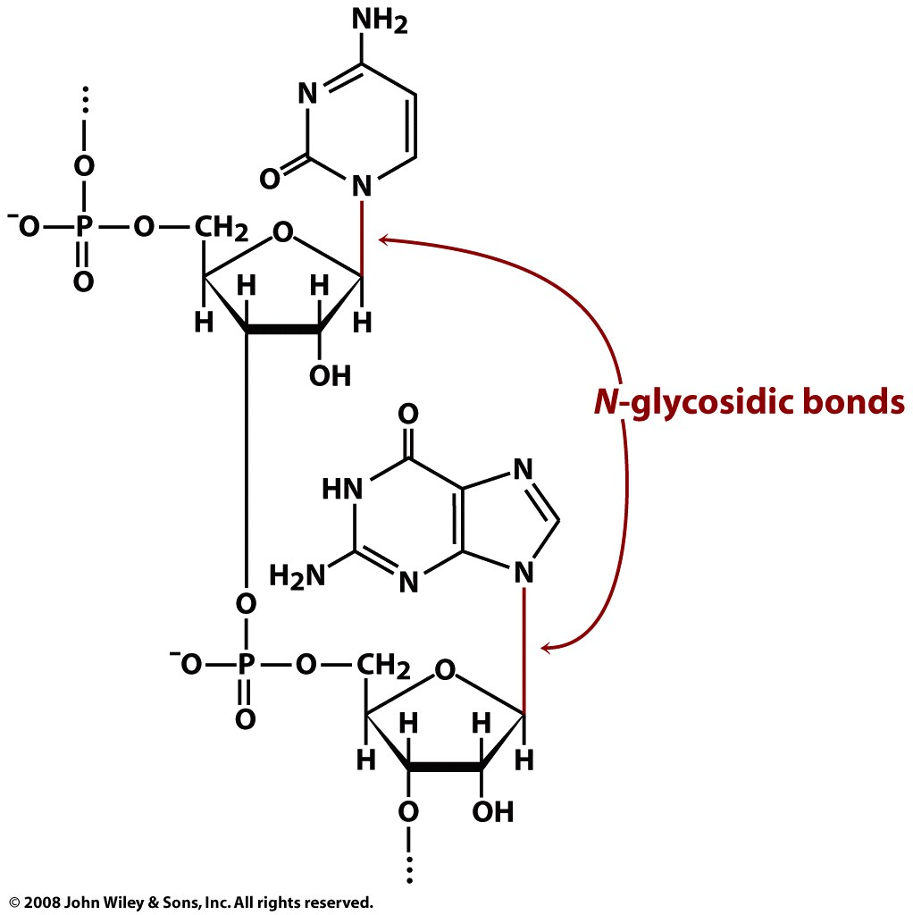
Page 226

Slide 12
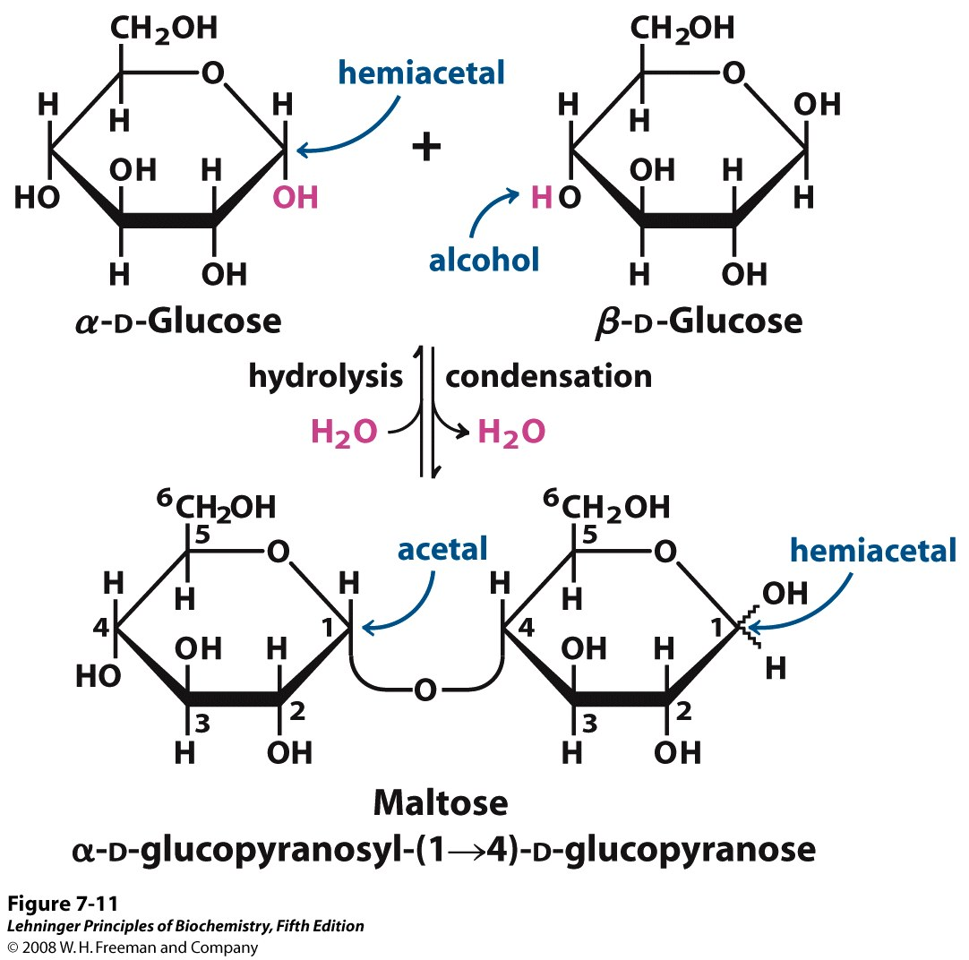
Condensation reactions link monosaccharides into disaccharides (and polysaccharides)
non-reducing end
reducing end
Notes:
FIGURE 7-11 Formation of maltose. A disaccharide is formed from two monosaccharides (here, two molecules of D-glucose) when an —OH (alcohol) of one glucose molecule (right) condenses with the intramolecular hemiacetal of the other glucose molecule (left), with elimination of H₂O and formation of a glycosidic bond. The reversal of this reaction is hydrolysis—attack by H₂O on the glycosidic bond. The maltose molecule, shown here as an illustration, retains a reducing hemiacetal at the C-1 not involved in the glycosidic bond. Because mutarotation interconverts the α and β forms of the hemiacetal, the bonds at this position are sometimes depicted with wavy lines, as shown here, to indicate that the structure may be either α or β.

