Slide 1
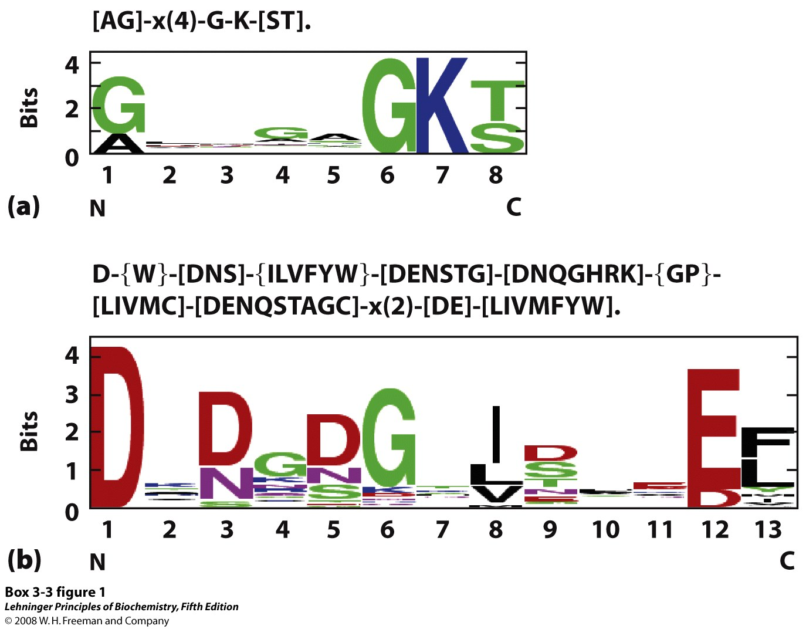
Consensus sequences, showing conserved sites, may be represented in different ways
Notes:
BOX 3-3 FIGURE 1 Representations of two consensus sequences. (a) P loop, an ATP-binding structure; (b) EF hand, a Ca²⁺-binding structure.

Slide 2
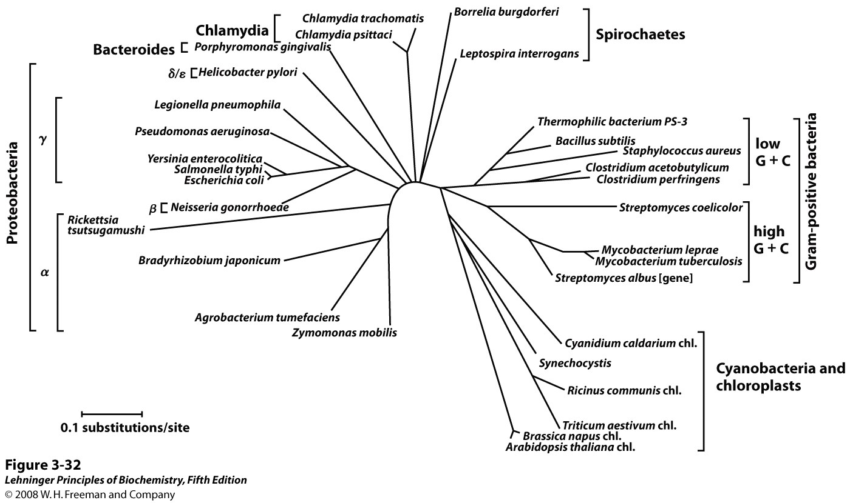
Differences between orthologous sequences suggest phylogenetic relationships
Tree calculated by comparing bacterial GroEL sequences
Notes:
FIGURE 3-32 Evolutionary tree derived from amino acid sequence comparisons. A bacterial evolutionary tree, based on the sequence divergence observed in the GroEL family of proteins. Also included in this tree (lower right) are the chloroplasts (chl.) of some nonbacterial species.

Slide 3
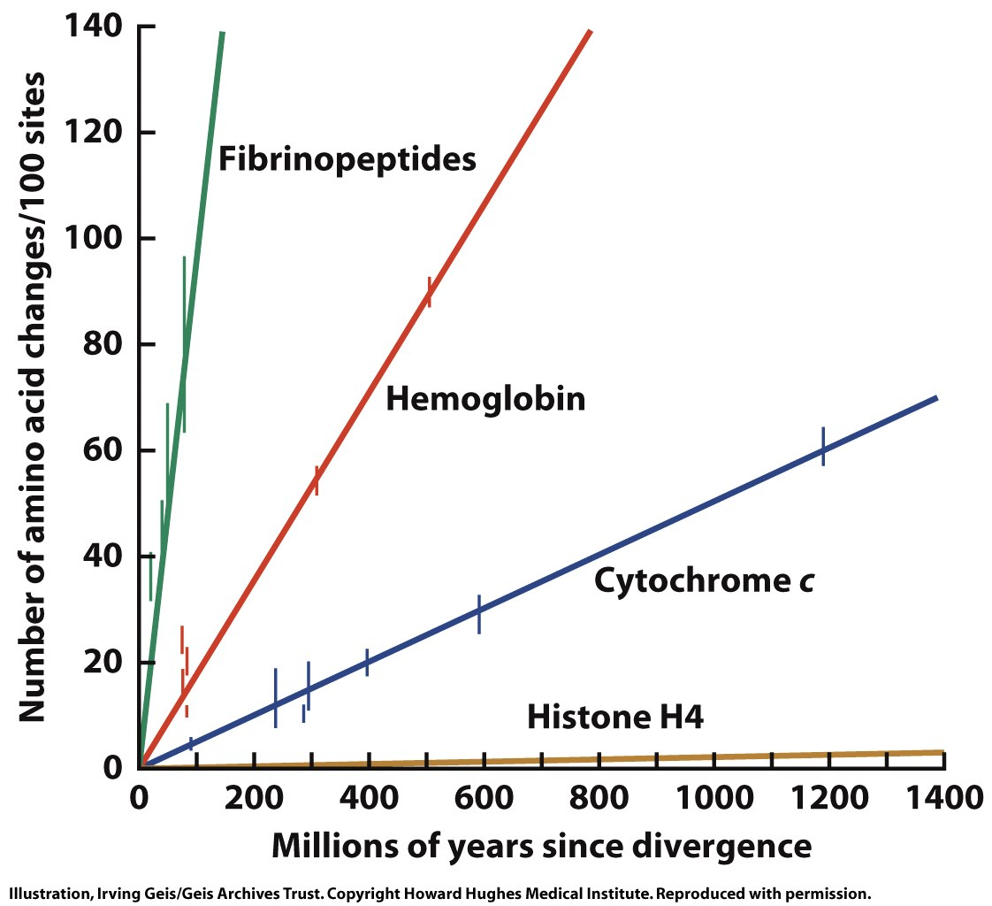
Different proteins have different sequence requirements and evolve at different rates
Figure 5-23

Slide 4
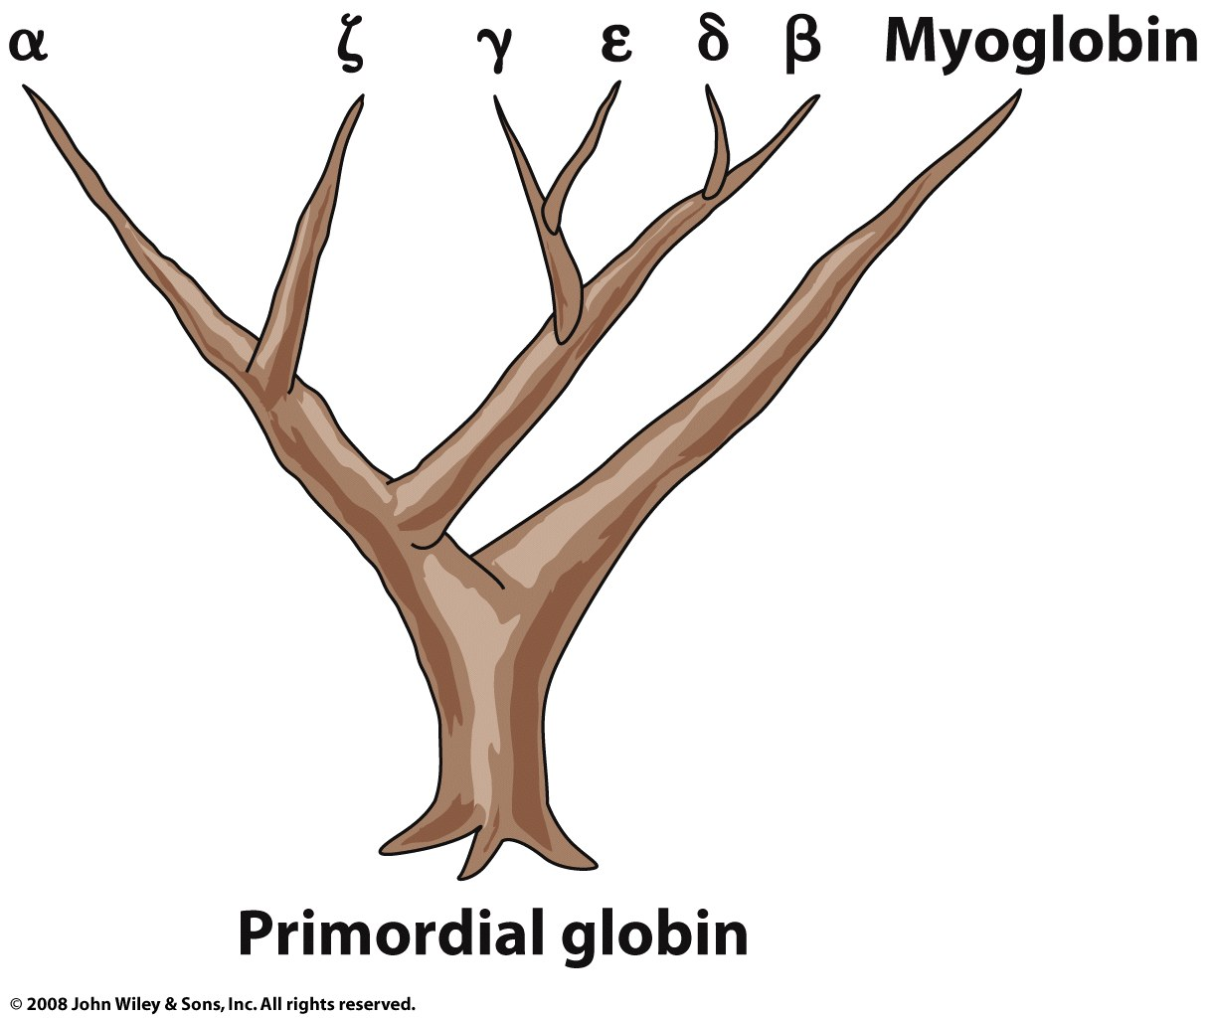
Differences between paralogous sequences predict gene duplication events
Figure 5-22

Slide 5
The connectivity of functional groups in the protein backbone directs its conformations
R-group direction disfavors certain conformations due to steric clashes
Amide groups love to form H-bonds

Slide 6
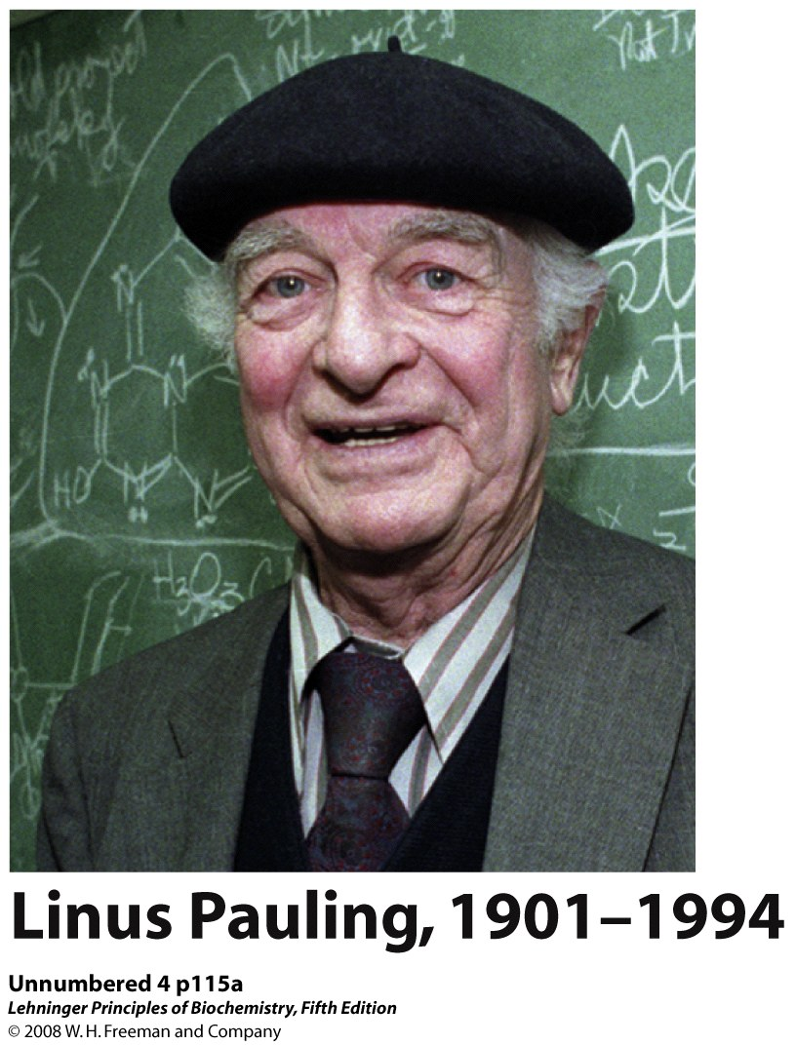
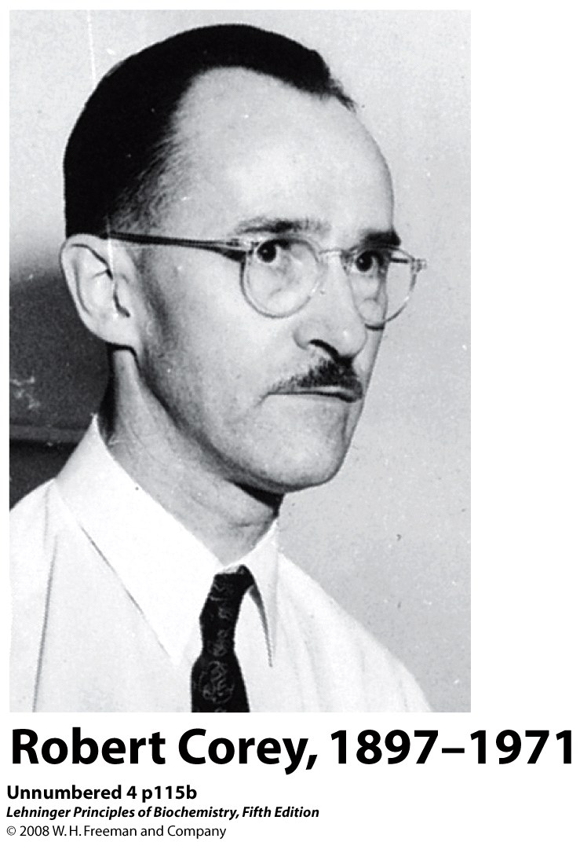
Pauling & Corey’s studies of oligopeptides revealed structural requirements of proteins

Slide 7
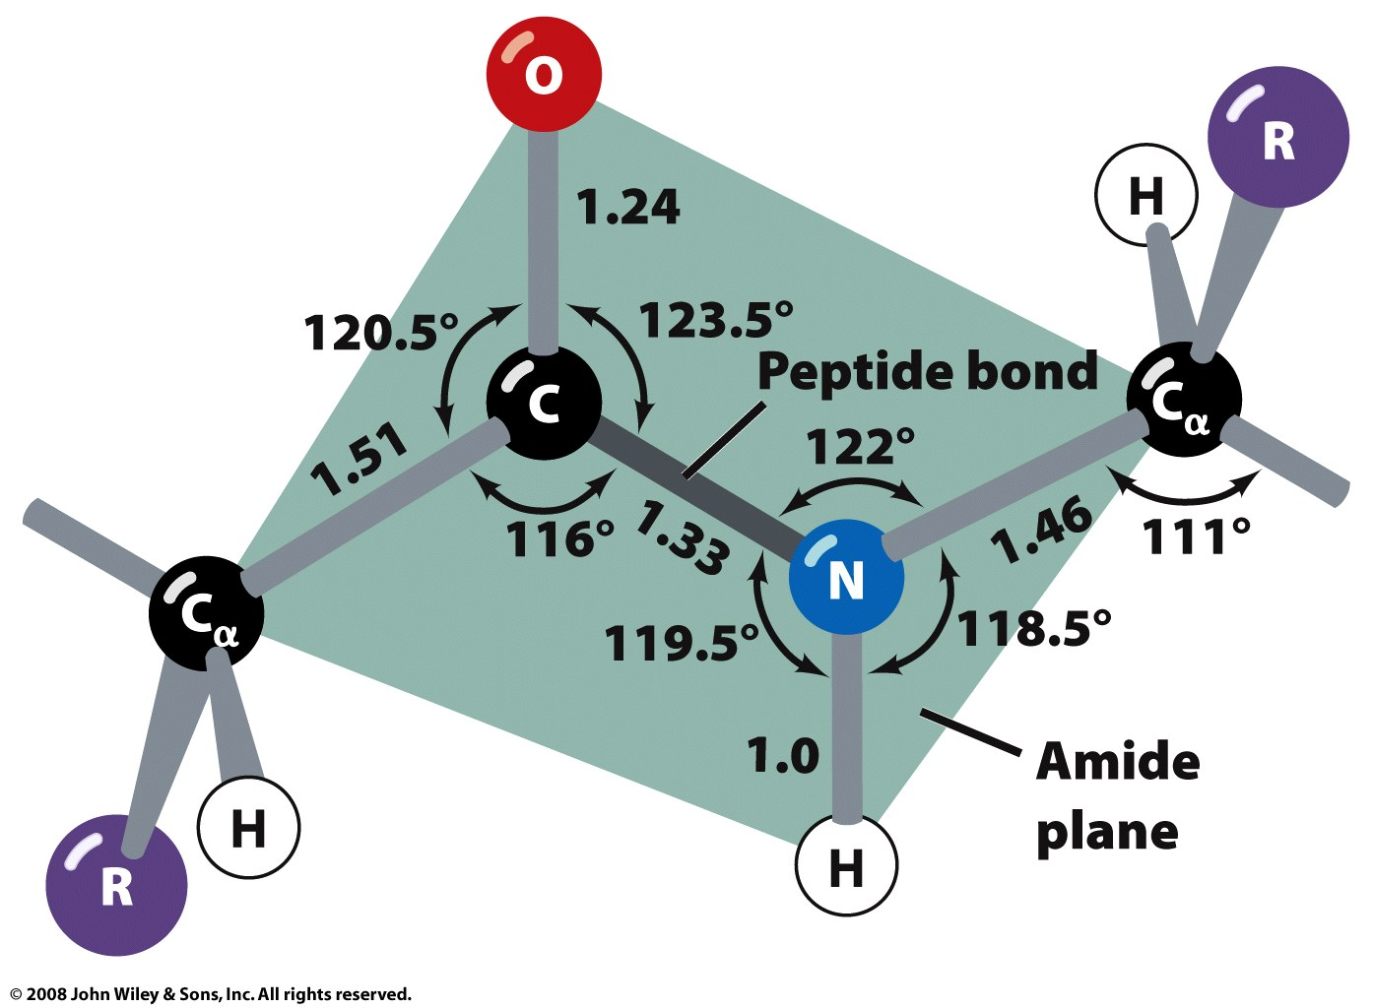
Structural studies of peptides revealed a planar amide group with a short C-N bond
Figure 6-2

Slide 8
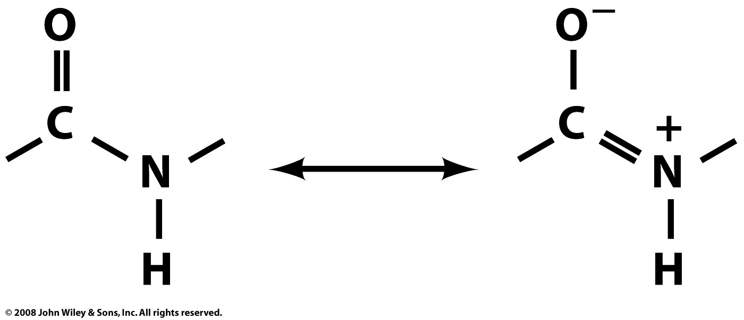
Resonance explains the double-bond character of the C-N amide bond
Page 127

Slide 9
The protein backbone (main chain) is a connected series of peptide planes
Figure 6-3

Slide 10
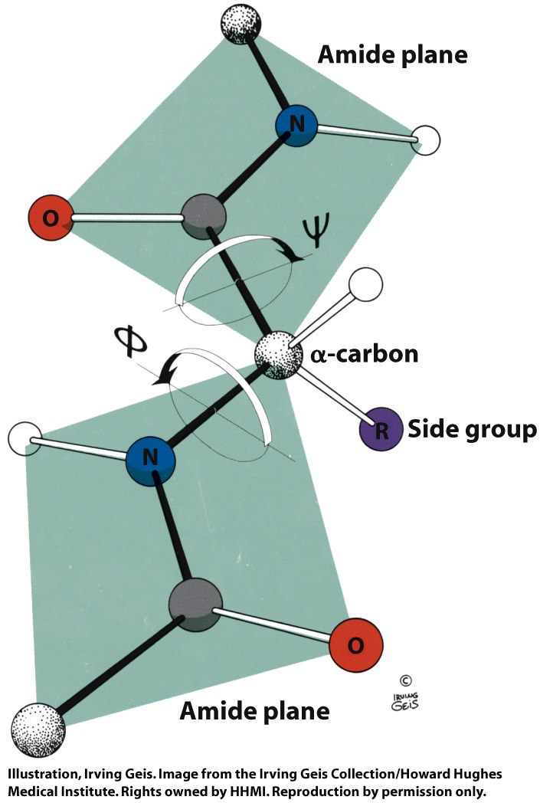
Although fixed along the amide bond, the backbone may rotate about the other bonds
Dihedral angle: the angle between two planes
Figure 6-4

Slide 11
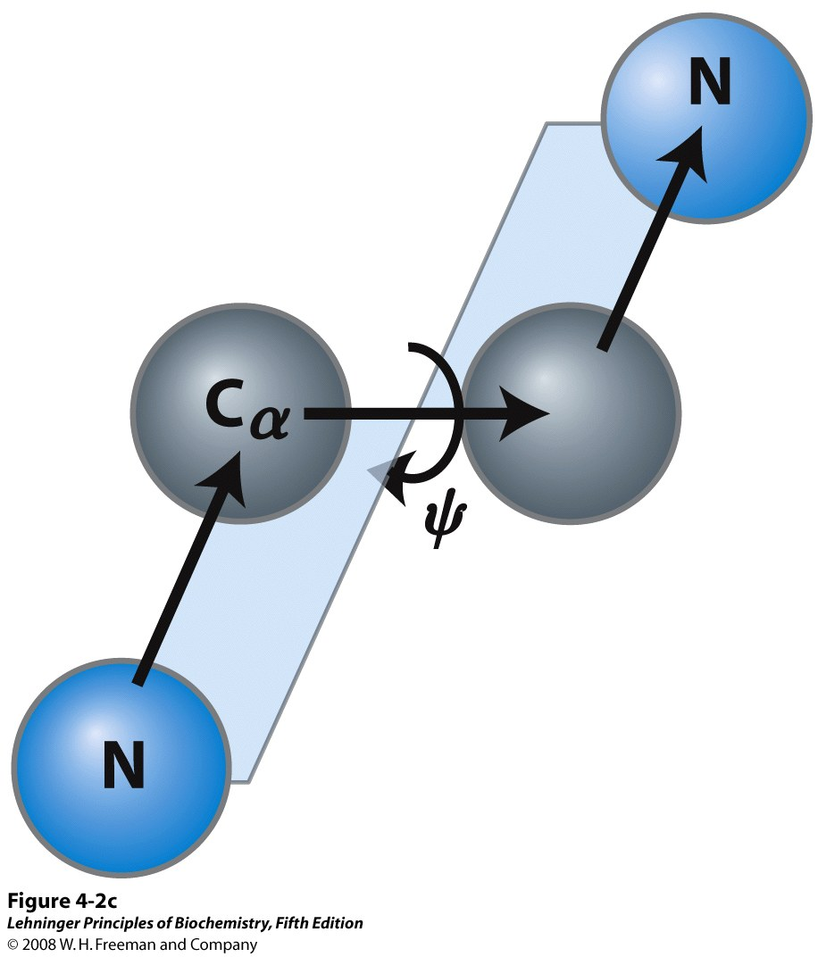
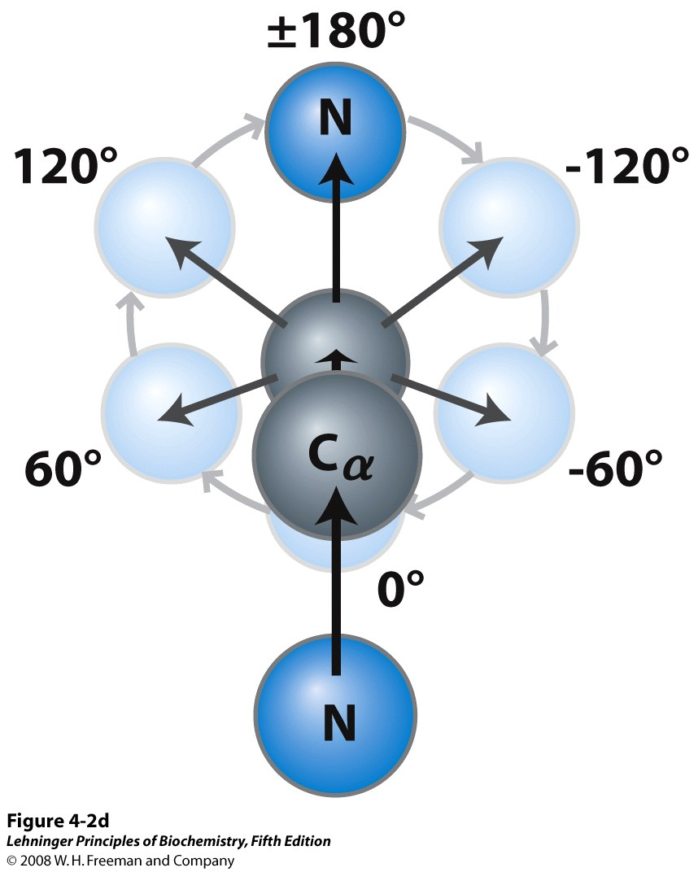
Looking down the C_{α}-X bond, the value of φ or ψ increases as the rear group rotates CW
Notes:
FIGURE 4-2c The planar peptide group. (c) The atoms and planes defining Ψ.

Slide 12
Some values of φ and ψ correspond to overlap of atoms (steric clashes)
Ex: Backbone-backbone clash
0°, 180°
Ex: Backbone-side chain clash
120°, 180°

Slide 13
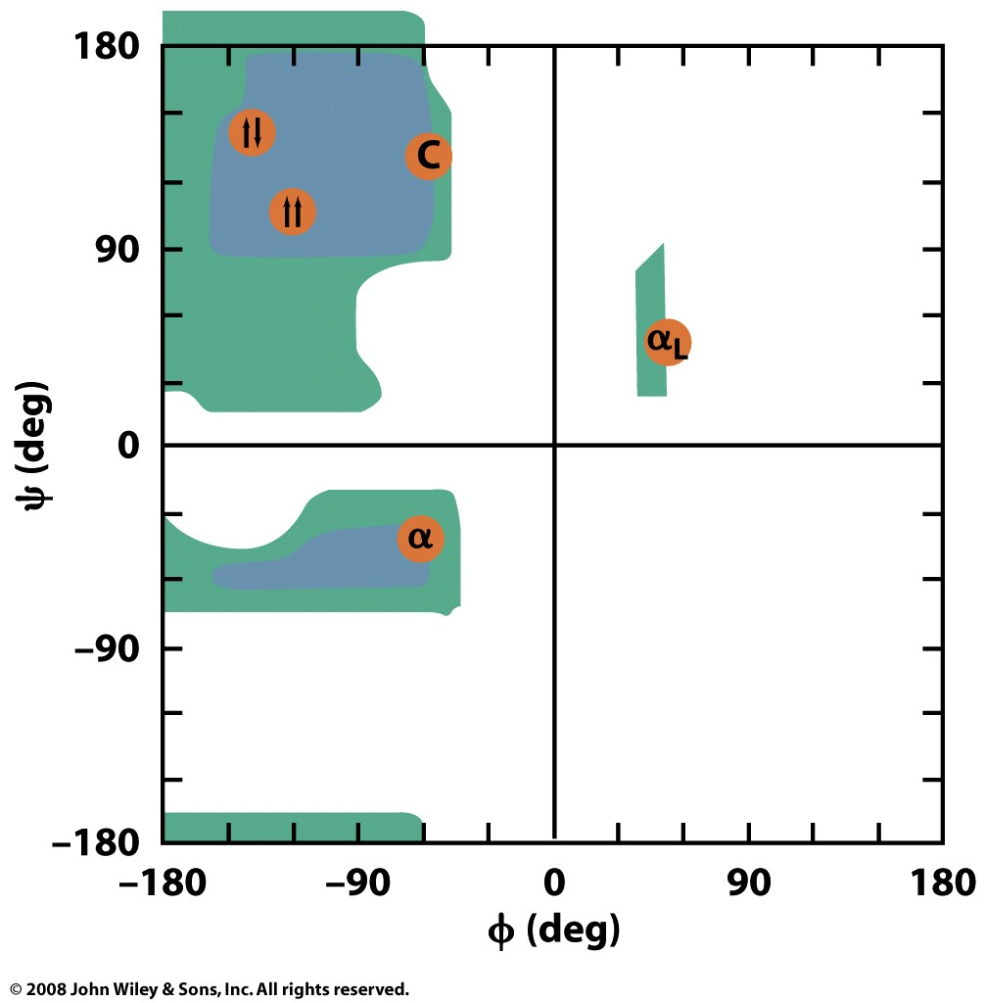
The Ramachandran plot depicts favorable, allowed, and disallowed backbone angles
Figure 6-6

Slide 14
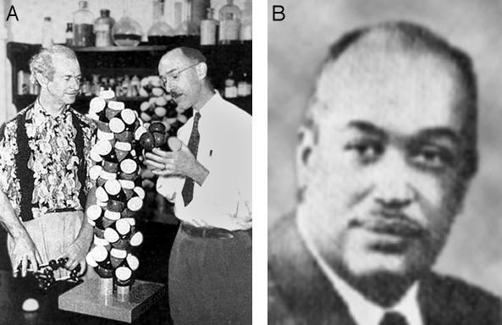
Pauling, Corey, and Herman Branson predicted the major secondary structures
They considered:
Planarity of peptide bond
Measured bond lengths and angles within the peptide plane
Allowed φ and ψ dihedral angles
Favorable hydrogen-bonding arrangements of backbone groups

Slide 15
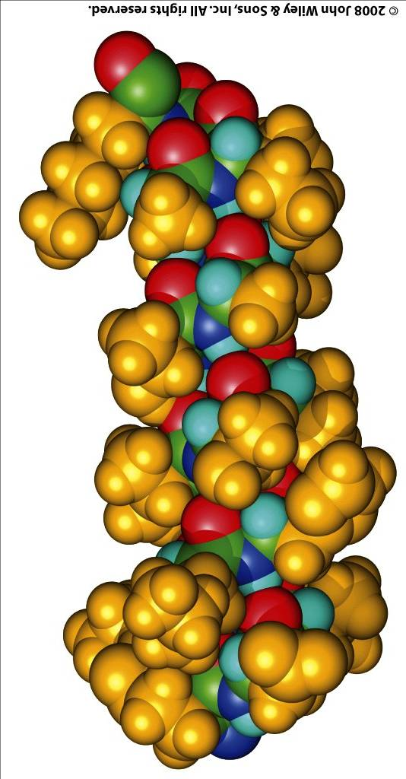
The α-helix forms within a continuous strech of the polypeptide chain
N-term
prototypical
φ = -57°
ψ = -47°
5.4 Å rise,
3.6 aa/turn
∴ 1.5 Å/aa
C-term

Slide 16
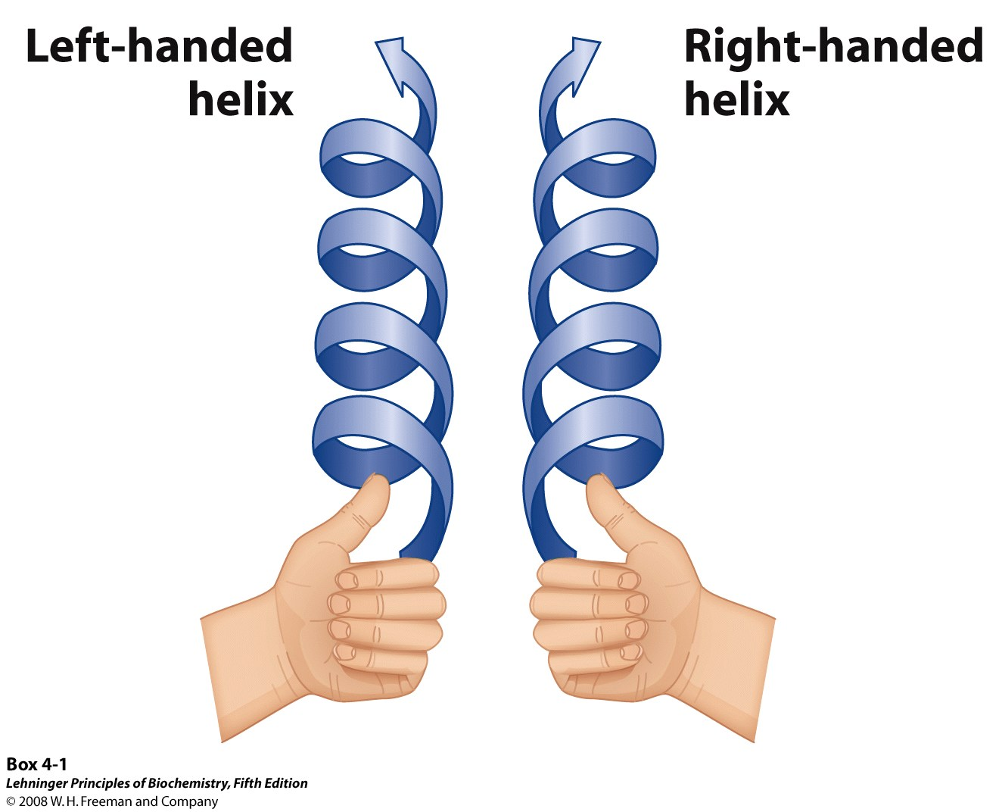
The α-helix is a right-handed helix

Slide 17
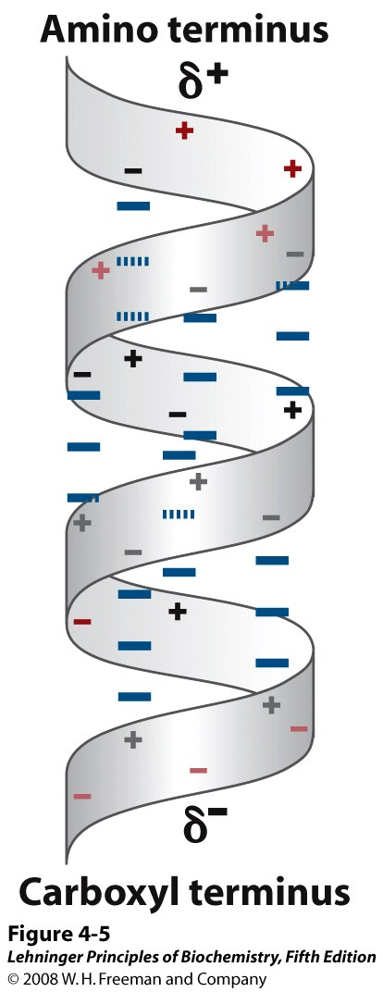
α-Helices have a dipole moment, due to unbonded and aligned N-H and C=O groups
Notes:
FIGURE 4-5 Helix dipole. The electric dipole of a peptide bond (see Figure 4-2a) is transmitted along an α-helical segment through the intrachain hydrogen bonds, resulting in an overall helix dipole. In this illustration, the amino and carbonyl constituents of each peptide bond are indicated by + and – symbols, respectively. Non-hydrogen-bonded amino and carbonyl constituents of the peptide bonds near each end of the α-helical region are shown in red.

