Slide 1
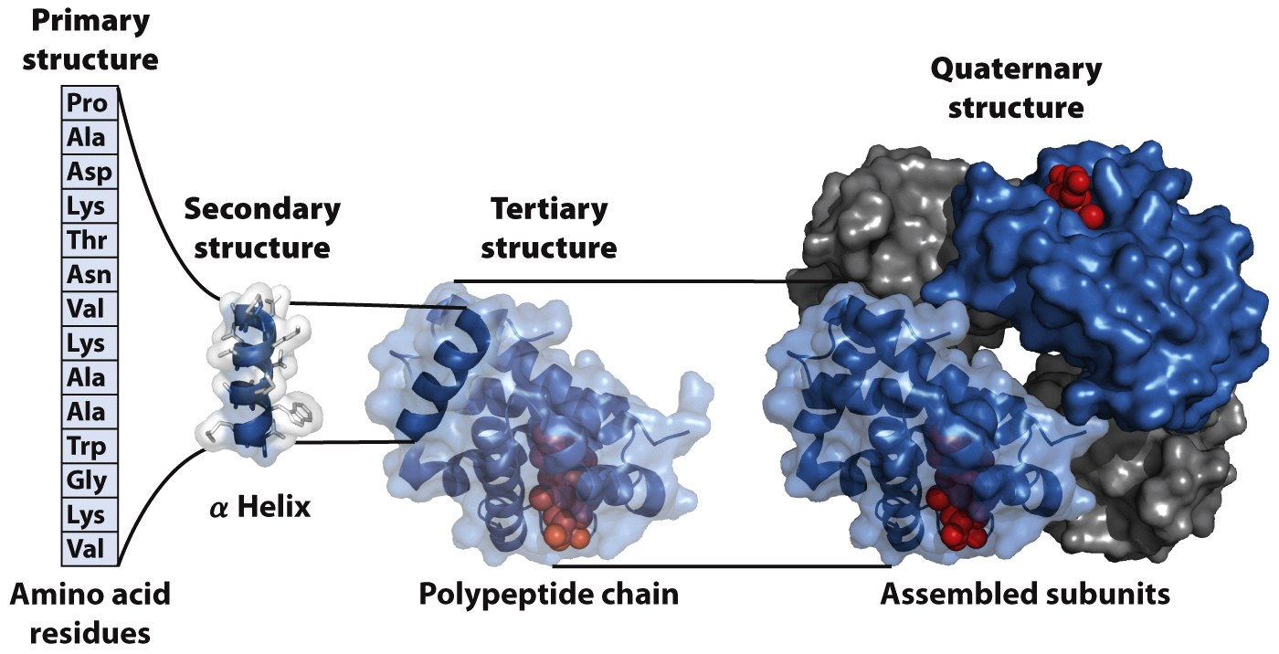
There are four levels of structure in proteins
We know that sequence → structure, but we can’t (yet) predict a structure from a sequence. So what good is knowing the sequence?
Notes:
FIGURE 3-23 Levels of structure in proteins. The primary structure consists of a sequence of amino acids linked together by peptide bonds and includes any disulfide bonds. The resulting polypeptide can be arranged into units of secondary structure, such as an α helix. The helix is a part of the tertiary structure of the folded polypeptide, which is itself one of the subunits that make up the quaternary structure of the multisubunit protein, in this case hemoglobin.

Slide 2
We can learn about proteins by comparing their sequences:
Structure – similar sequences form similar structures
Function – motifs (sequence patterns) can indicate particular functions
Location – signal sequences (at the protein’s N-terminus) direct proteins to specific locations in the cell, or to be excreted
Modification – signal sequences or motifs can indicate sites for modification
Evolution – differences in related sequences reflect evolutionary distance
Dysfunction – changes in sequence can lead to disease

Slide 3
How do we determine a protein’s sequence?
Directly from the protein
Chemical sequencing
Physical methods for analyzing structure
From the gene sequence
Notes:
FIGURE 3–28 Correspondence of DNA and amino acid sequences.
Each amino acid is encoded by a specific sequence of three nucleotides
in DNA. The genetic code is described in detail in Chapter 27.

Slide 4
Important protein sequence databases
RefSeq (NCBI) – “Reference Sequence”
Non-redundant database of well-annotated sequences (gene, transcript, protein)
http://www.ncbi.nlm.nih.gov/projects/RefSeq/
Can also use ‘Entrez’ at NCBI site to search multiple sequence databases
UniProt (EBI) – “Universal Protein Resource”
Protein sequences and annotations, plus links to other databases
http://www.uniprot.org/

Slide 5
Proteins are aligned for comparison
Sequence alignments:
Notes:
FIGURE 3-31 A signature sequence in the EF-1α/EF-Tu protein family. The signature sequence (boxed) is a 12-residue insertion near the amino terminus of the sequence. Residues that align in all species are shaded yellow. Both archaea and eukaryotes have the signature, although the sequences of the insertions are quite distinct for the two groups. The variation in the signature sequence reflects the significant evolutionary divergence that has occurred at this site since it first appeared in a common ancestor of both groups.

Slide 6
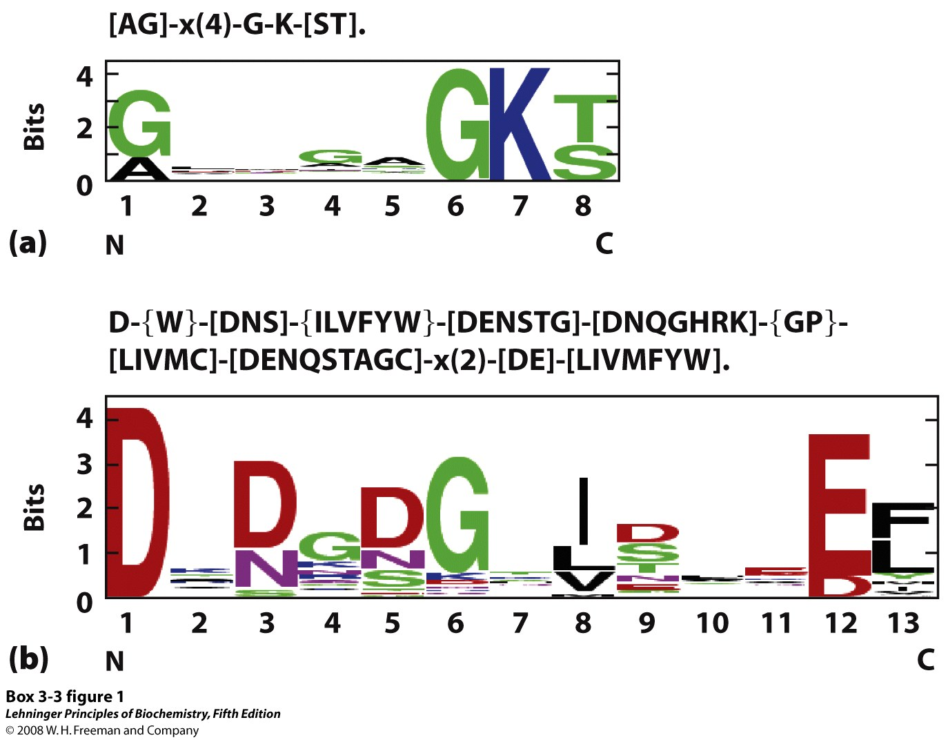
Consensus sequences, showing conserved sites, may be represented in different ways
Notes:
BOX 3-3 FIGURE 1 Representations of two consensus sequences. (a) P loop, an ATP-binding structure; (b) EF hand, a Ca²⁺-binding structure.

