Slide 1
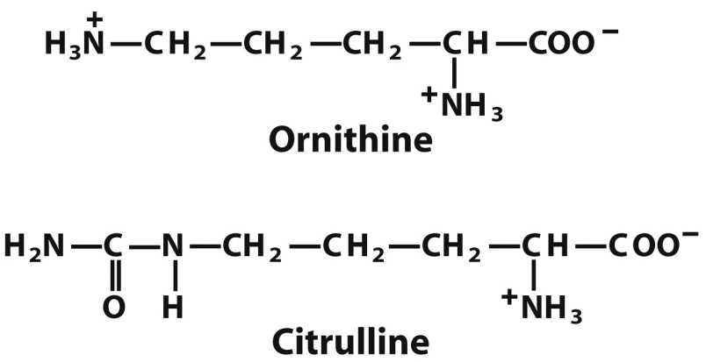
Nonstandard amino acids are found in modified proteins and as free metabolites
Notes:
FIGURE 3-8a Uncommon amino acids. (a) Some uncommon amino acids found in proteins. All are derived from common amino acids. Extra functional groups added by modification reactions are shown in red. Desmosine is formed from four Lys residues (the four carbon backbones are shaded in yellow). Note the use of either numbers or Greek letters to identify the carbon atoms in these structures.

Slide 2
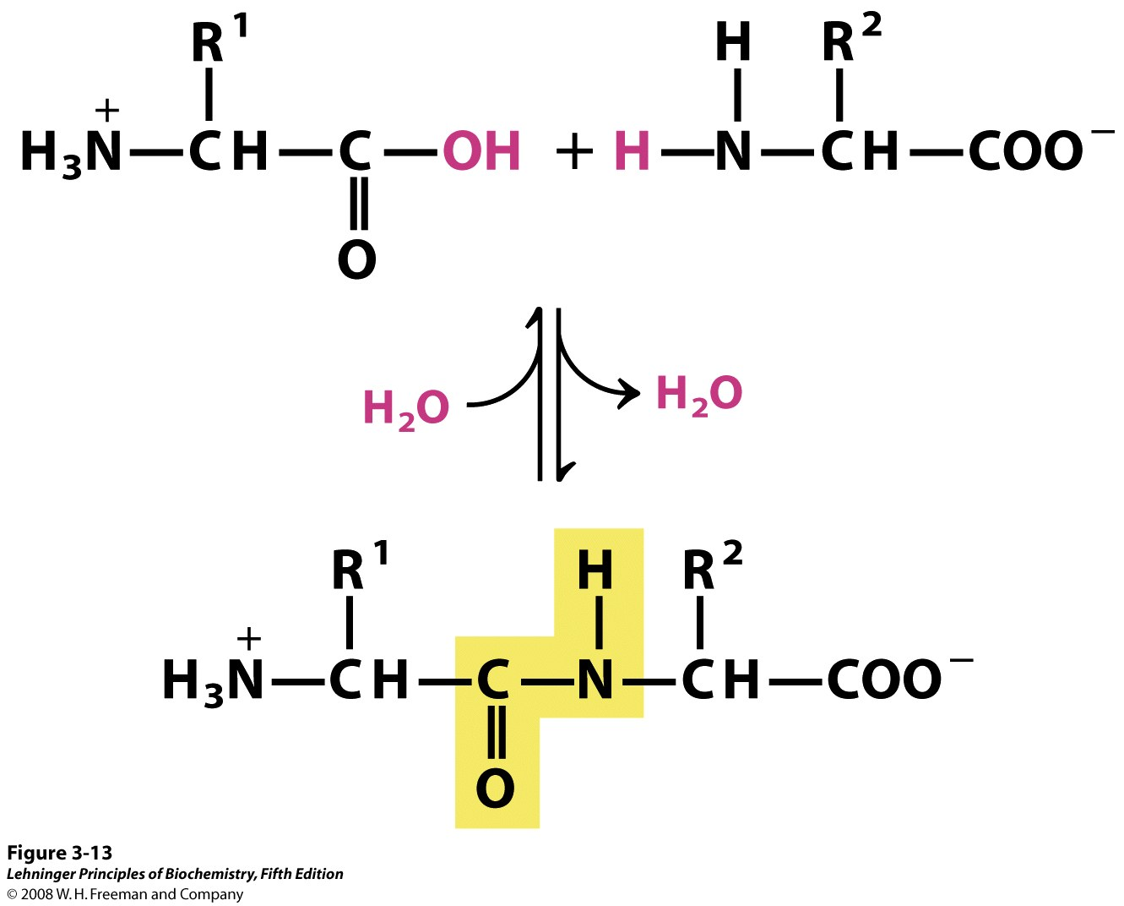
Amino acids connect via amide linkages (releasing water – a condensation reaction) to form peptides
In polymers formed through condensation, subunits are often called ‘residues,’ due to loss of water
dipeptide (2 aa’s)
oligopeptide (few aa’s)
amide linkage or
peptide linkage
amide bond or
peptide bond
Notes:
FIGURE 3-13 Formation of a peptide bond by condensation. The α-amino group of one amino acid (with R² group) acts as a nucleophile to displace the hydroxyl group of another amino acid (with R¹ group), forming a peptide bond (shaded in yellow). Amino groups are good nucleophiles, but the hydroxyl group is a poor leaving group and is not readily displaced. At physiological pH, the reaction shown here does not occur to any appreciable extent.

Slide 3
How to draw a peptide with correct stereochemistry
12 points (11 lines) for a tetrapeptide
Draw the backbone, 3 points per amino acid
Add in nitrogen: 1st point and every 3rd following
Add hydrogens and oxygens to complete the backbone
Add side chains: draw “up and out, down and back” for l-amino acids (opposite for d)
Usually on left
Up & out
Down & back

Slide 4
There are several ways to name a peptide’s sequence, but all start from the N-terminus
“Carboxyl terminus”
“C-terminus”
“Carboxyl-terminal end”
“C-terminal end”
“C-term”
“Amino terminus”
“N-terminus”
“Amino-terminal end”
“N-terminal end”
“N-term”
Name amino acids as substituents of C-terminal amino acid: Cysteinyl-histidinyl-glutamyl-methionine (rare, except dipeptides)
Write three-letter abbreviations : Cys-His-Glu-Met (common)
Write one-letter abbreviations : CHEM (most common)
Names imply l stereochemistry; any d must be indicated (ex: Gly-d-Ala-Pro)

Slide 5
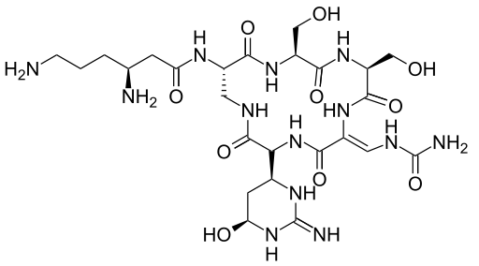
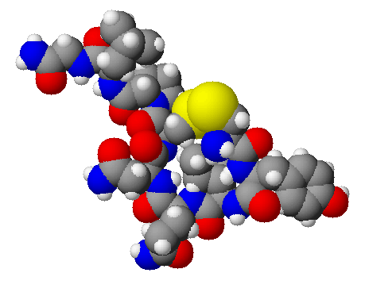
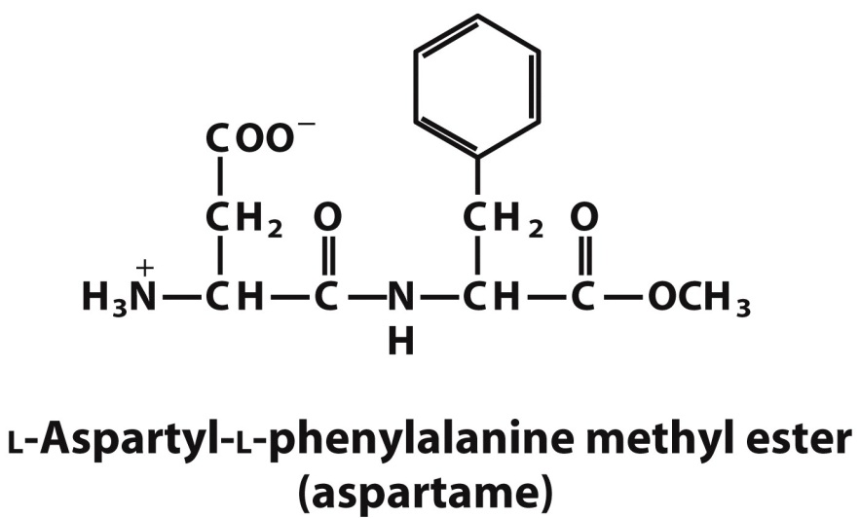
Small peptides are important in biochemistry
Peptide hormones
Ex: oxytocin (the love hormone)
Causes uterine contractions
Important for forming connections
Peptide antibiotics
Ex: viomycin – Used in a drug cocktail against M. tuberculosis
Nutrasweet
Cys-Tyr-Ile-Gln-Asn-Cys-Pro-Leu-Gly-NH₂

Slide 6
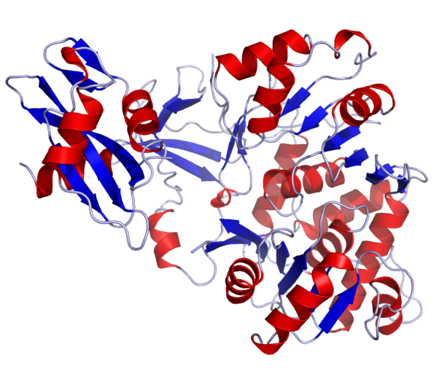
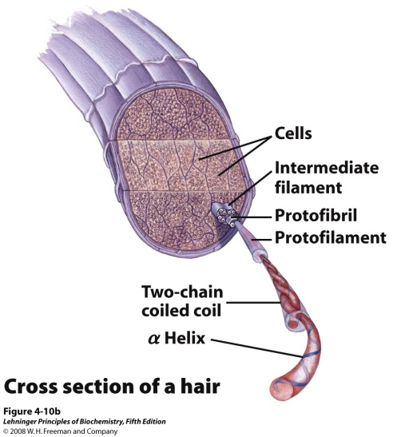
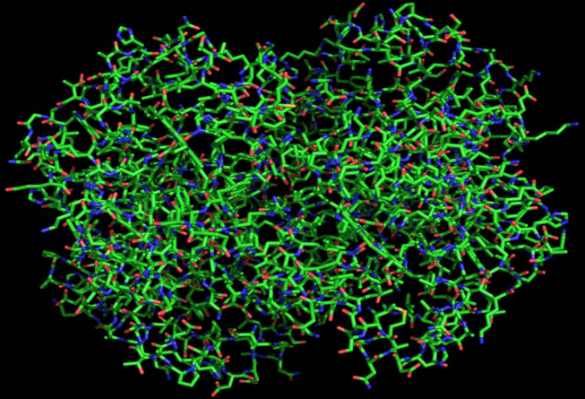
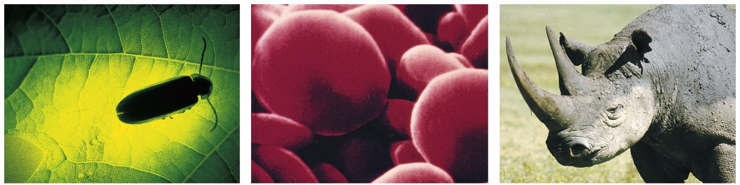
Proteins are essential components of all organisms and carry out a diversity of functions
Luciferase (an enzyme) – catalyzes a light-producing reaction in fireflies
Hemoglobin – binds O₂ and carries it throughout the blood stream
α-Keratin – provides structure to animal horns, hooves, hair, and nails
Notes:
FIGURE 3-1 Some functions of proteins. (a) The light produced by fireflies is the result of a reaction involving the protein luciferin and ATP, catalyzed by the enzyme luciferase (see Box 13-1). (b) Erythrocytes contain large amounts of the oxygen-transporting protein hemoglobin. (c) The protein keratin, formed by all vertebrates, is the chief structural component of hair, scales, horn, wool, nails, and feathers. The black rhinoceros is nearing extinction in the wild because of the belief prevalent in some parts of the world that a powder derived from its horn has aphrodisiac properties. In reality, the chemical properties of powdered rhinoceros horn are no different from those of powdered bovine hooves or human fingernails.

Slide 7
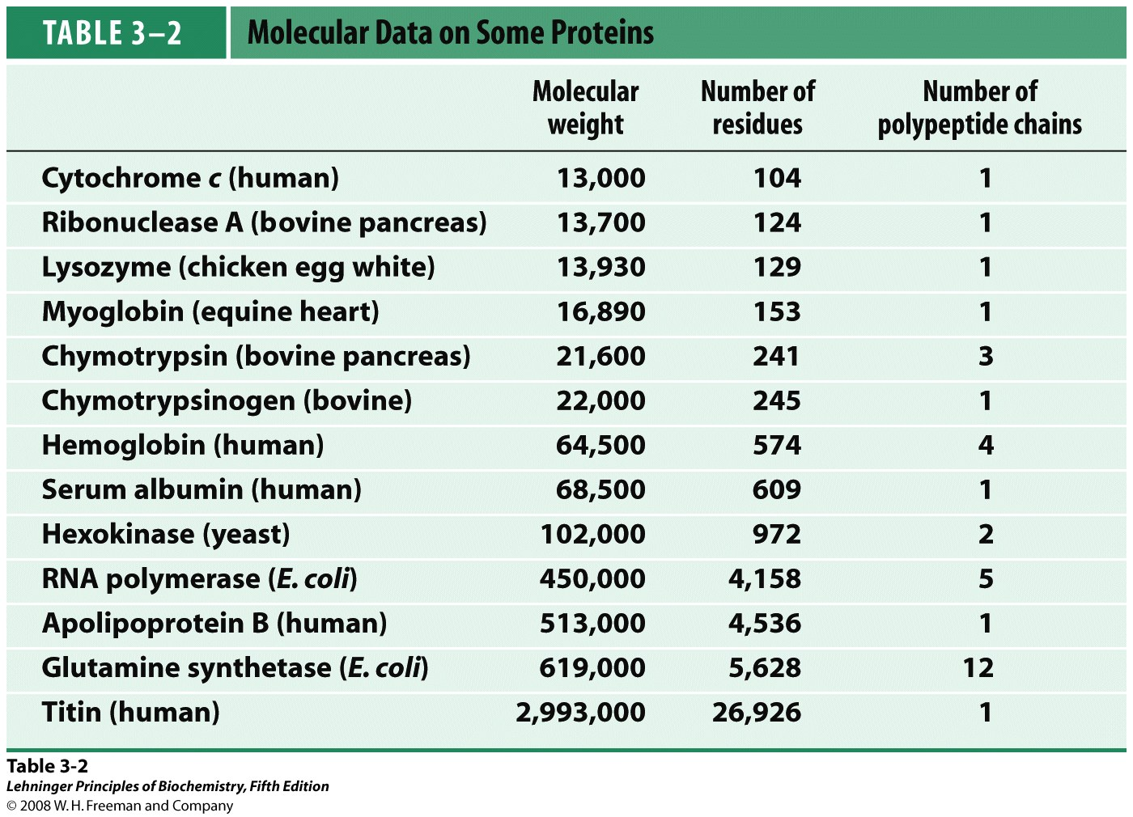
Proteins vary in size and in number of chains

Slide 8
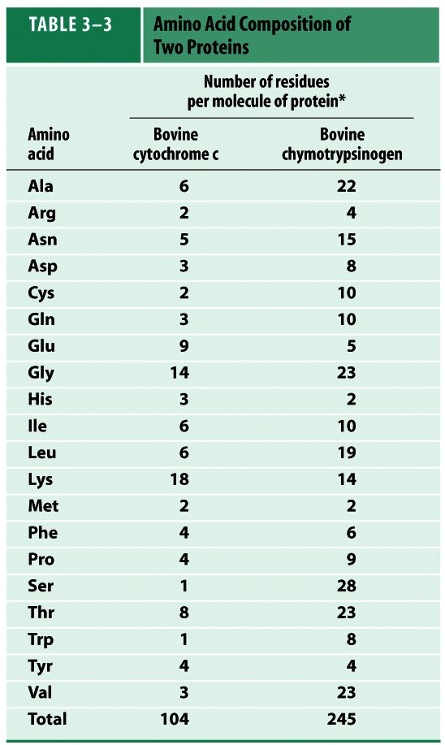
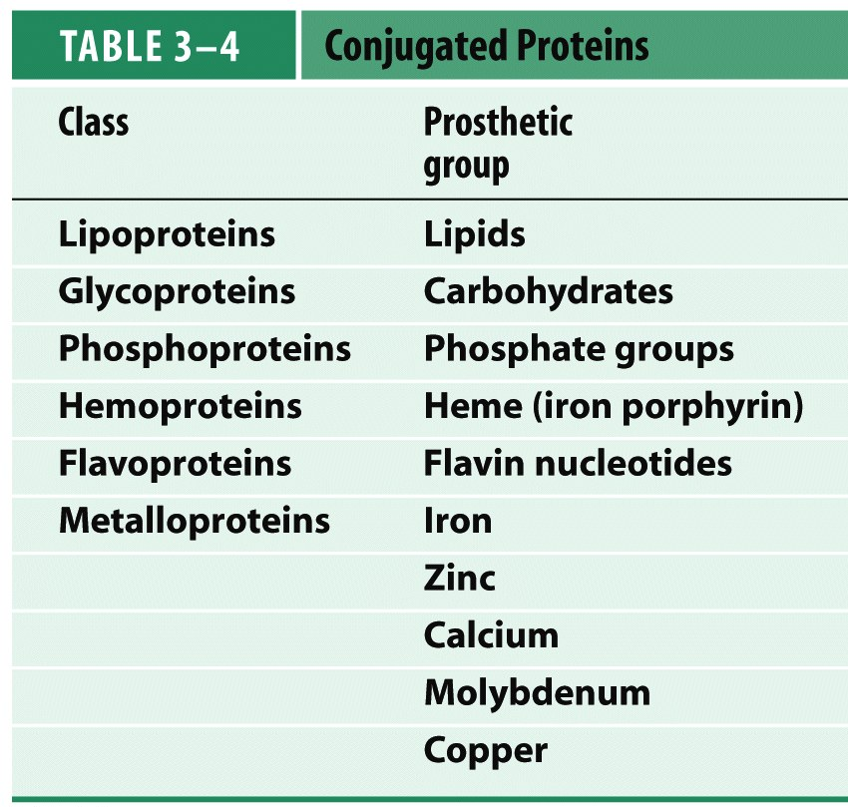
Proteins vary in composition
Varying proportions of amino acids
%
6
2
5
3
2
3
9
13
3
6
6
17
2
4
4
1
8
1
4
3
100
%
9
2
6
3
4
4
2
9
1
4
8
6
1
2
4
11
9
3
2
9
100
Variability in use of additional compounds

Slide 9
Protein variability is theoretically limitless (although realistically limited)
1 2 3 4 5 …
Met-Ala-Phe-Gly-Ala-Pro-Gly-Asp-Gln-His-…
20 x 20 x 20 x 20 x 20 x …
For a protein with 100 aa, number of possible aa sequences = 20¹⁰⁰ ≈ 10¹³⁰
For comparison, there are ~10⁸⁰ atoms in the (observable) universe!
Additional variability can come from:
Variation in chain length
Variation in number of chains
Protein modifications
Binding of prosthetic groups
A protein is a folded, functional polypeptide (not just any polymer of amino acids)
Realistic limitations:
Length limited by ability and fidelity of synthesis
Parameters limited by functionality, usefulness – Does it fold? Does it provide a needed, useful function?
Parameters of natural proteins are limited by evolution – Did nature find & keep it?
There are maybe 10⁷ proteins on earth

Slide 10
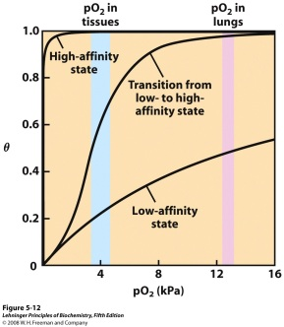
A protein’s function derives from its structure, and its structure is determined by its sequence.
Val-His-Leu-Thr…
Sequence
Structure
(Conformation)
(Fold)
Function
How?
The properties of the amino acids determine which can interact and how.
The connectivity (sequence) limits the possible interactions and directs the position of the polypeptide chain.

Slide 11
Non-covalent interactions and reversible bonds are important in the structure of proteins
Electrostatic interactions
Other interactions
Ionic interactions
(also called ion pairs or salt bridges)
Hydrophobic effect
Hydrogen bonds
Disulfide bonds
van der Waals forces
- Dipole-dipole interactions
- Dipole-induced dipole interactions
- London dispersion forces

Slide 12
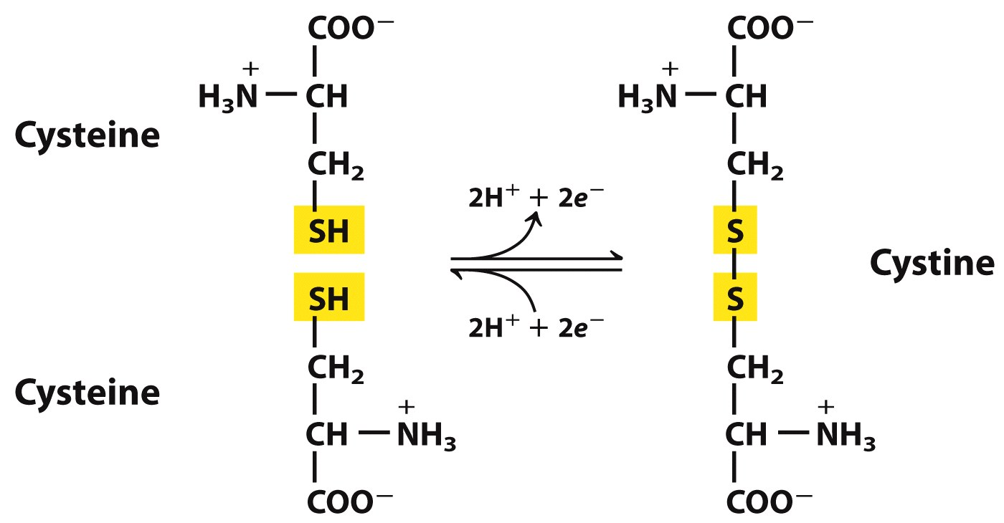
Disulfide bonds form when two sulfhydryl groups are oxidized (give up electrons)
Cannot participate in acid-base rxns
Can participate in acid-base rxns
Notes:
FIGURE 3-7 Reversible formation of a disulfide bond by the oxidation of two molecules of cysteine. Disulfide bonds between Cys residues stabilize the structures of many proteins.

Slide 13
A protein’s function derives from its structure, and its structure is determined by its sequence.
Val-His-Leu-Thr…
Sequence
Structure
(Conformation)
(Fold)
Function
How?
The properties of the amino acids determine which can interact and how.
The connectivity (sequence) limits the possible interactions and directs the position of the polypeptide chain.

Slide 14
A protein’s function derives from its structure, and its structure is determined by its sequence.
Val-His-Leu-Thr…
Sequence
Structure
(Conformation)
(Fold)
Function
To understand a protein’s function, we need to know its structure (and sequence)

