Slide 1
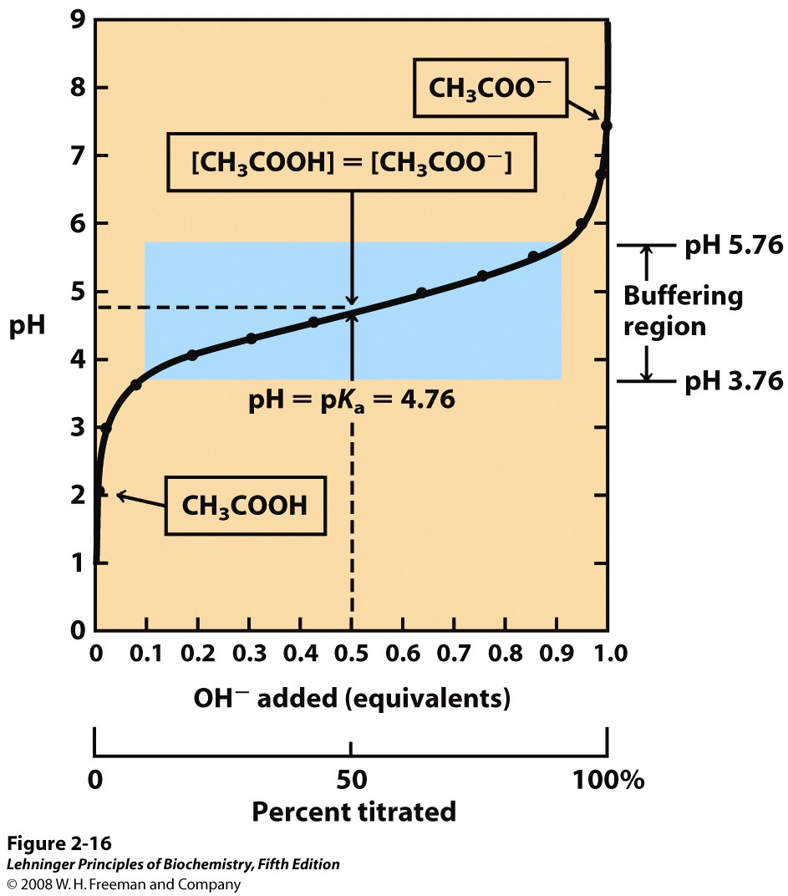
Titration of a weak acid acetic acid, CH₃COOH, pKa = 4.8
1.0
0.8
OH⁻
equivalents
0.6
pH: 1.8
= pK_{a}–3.0
pH:
0.4
0.2
A
H
A⁻
H⁺
[A⁻] : [HA] = 1 : 1000

Slide 2
Titration of a weak acid acetic acid, CH₃COOH, pKa = 4.8
1.0
0.8
OH⁻
equivalents
0.6
pH: 2.8
= pK_{a}–2.0
0.4
0.2
A
H
A⁻
H⁺
OH⁻ + H⁺ → H₂O
OH⁻ + HA → H₂O + A⁻
[A⁻] : [HA] = 1 : 100

Slide 3
Titration of a weak acid acetic acid, CH₃COOH, pKa = 4.8
1.0
0.8
OH⁻
equivalents
0.6
pH: 3.8
= pK_{a}–1.0
0.4
0.2
A
H
A⁻
H⁺
OH⁻ + H⁺ → H₂O
OH⁻ + HA → H₂O + A⁻
[A⁻] : [HA] = 1 : 10

Slide 4
Titration of a weak acid acetic acid, CH₃COOH, pKa = 4.8
1.0
0.8
OH⁻
equivalents
0.6
pH: 4.2
= pK_{a}–0.6
0.4
0.2
A
H
A⁻
H⁺
OH⁻ + H⁺ → H₂O
OH⁻ + HA → H₂O + A⁻
[A⁻] : [HA] = 1 : 4

Slide 5
Titration of a weak acid acetic acid, CH₃COOH, pKa = 4.8
1.0
0.8
OH⁻
equivalents
0.6
pH: 4.4
= pK_{a}–0.4
0.4
0.2
A
H
A⁻
H⁺
OH⁻ + H⁺ → H₂O
OH⁻ + HA → H₂O + A⁻
[A⁻] : [HA] = 1 : 2.3

Slide 6
Titration of a weak acid acetic acid, CH₃COOH, pKa = 4.8
1.0
0.8
OH⁻
equivalents
0.6
pH: 4.6
= pK_{a}–0.2
0.4
0.2
A
H
A⁻
H⁺
OH⁻ + H⁺ → H₂O
OH⁻ + HA → H₂O + A⁻
[A⁻] : [HA] = 1 : 1.5

Slide 7
Titration of a weak acid acetic acid, CH₃COOH, pKa = 4.8
1.0
0.8
OH⁻
equivalents
0.6
pH: 4.8
= pK_{a}
0.4
0.2
A
H
A⁻
H⁺
OH⁻ + H⁺ → H₂O
OH⁻ + HA → H₂O + A⁻
[A⁻] : [HA] = 1 : 1

Slide 8
Titration of a weak acid acetic acid, CH₃COOH, pKa = 4.8
1.0
0.8
OH⁻
equivalents
0.6
pH: 5.8
= pK_{a}+1.0
0.4
0.2
A
H
A⁻
H⁺
OH⁻ + H⁺ → H₂O
OH⁻ + HA → H₂O + A⁻
[A⁻] : [HA] = 10: 1

Slide 9
Titration of a weak acid acetic acid, CH₃COOH, pKa = 4.8
1.0
0.8
OH⁻
equivalents
0.6
pH: 6.8
= pK_{a}+2.0
0.4
0.2
A
H
A⁻
H⁺
OH⁻ + H⁺ → H₂O
OH⁻ + HA → H₂O + A⁻
[A⁻] : [HA] = 100: 1

Slide 10
Titration of a weak acid acetic acid, CH₃COOH, pKa = 4.8
1.0
0.8
OH⁻
equivalents
0.6
pH: 7.8
= pK_{a}+3.0
0.4
0.2
A
H
A⁻
H⁺
OH⁻ + H⁺ → H₂O
OH⁻ + HA → H₂O + A⁻
[A⁻] : [HA] = 1000: 1

Slide 11
~80% of acid dissociation occurs within 1 pH unit of pKa
OH- eq. added | pH | = pKa + ___ | [A-] : [HA]
0.0 | 1.8 | -3.0 | 1:1000
~0.01 | 2.8 | -2.0 | 1:100
0.1 | 3.8 | -1.0 | 1:10
0.2 | 4.2 | -0.6 | 1:4
0.3 | 4.4 | -0.4 | 1:2.3
0.4 | 4.6 | -0.2 | 1:1.5
0.5 | 4.8 | 0.0 | 1:1
0.6 | 5.0 | 0.2 | 1.5:1
0.7 | 5.2 | 0.4 | 2.3:1
0.8 | 5.4 | 0.6 | 4:1
0.9 | 5.8 | 1.0 | 10:1
~0.99 | 6.8 | 2.0 | 100:1
1.0 | 7.8 | 3.0 | 1000:1

Slide 12
In this buffering region (±1 pH unit of pKa), dissociation of the weak acid slows the rise in pH
Notes:
FIGURE 2-16 The titration curve of acetic acid. After addition of each increment of NaOH to the acetic acid solution, the pH of the mixture is measured. This value is plotted against the amount of NaOH added, expressed as a fraction of the total NaOH required to convert all the acetic acid (CH₃COOH) to its deprotonated form, acetate (CH₃COO–). The points so obtained yield the titration curve. Shown in the boxes are the predominant ionic forms at the points designated. At the midpoint of the titration, the concentrations of the proton donor and proton acceptor are equal, and the pH is numerically equal to the pK_{a}. The shaded zone is the useful region of buffering power, generally between 10% and 90% titration of the weak acid.

Slide 13
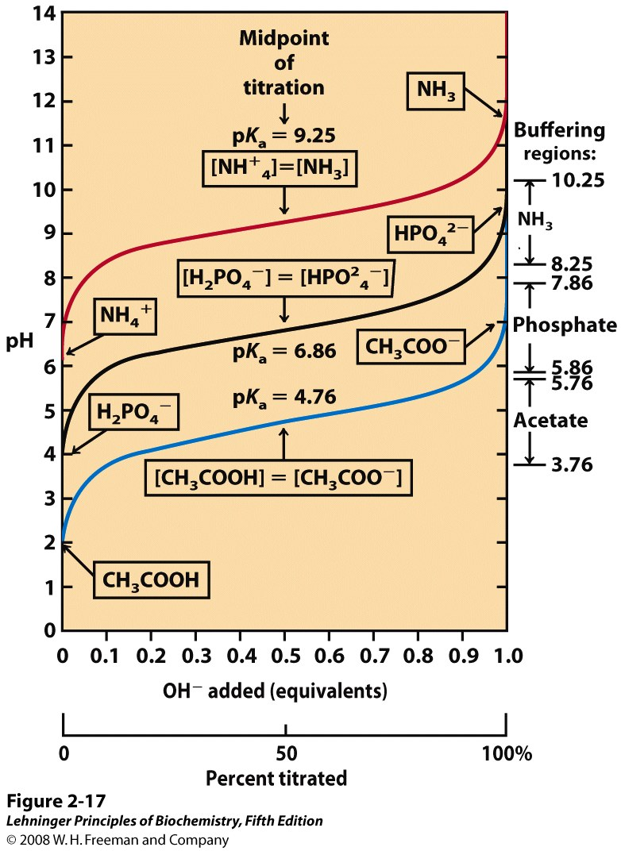
Titration of other acids gives the same curve, just shifted along the pH axis (based on pKa)
Notes:
FIGURE 2-17 Comparison of the titration curves of three weak acids. Shown here are the titration curves for CH₃COOH, H₂PO₄–, and NH₄⁺. The predominant ionic forms at designated points in the titration are given in boxes. The regions of buffering capacity are indicated at the right. Conjugate acid-base pairs are effective buffers between approximately 10% and 90% neutralization of the proton-donor species.

Slide 14
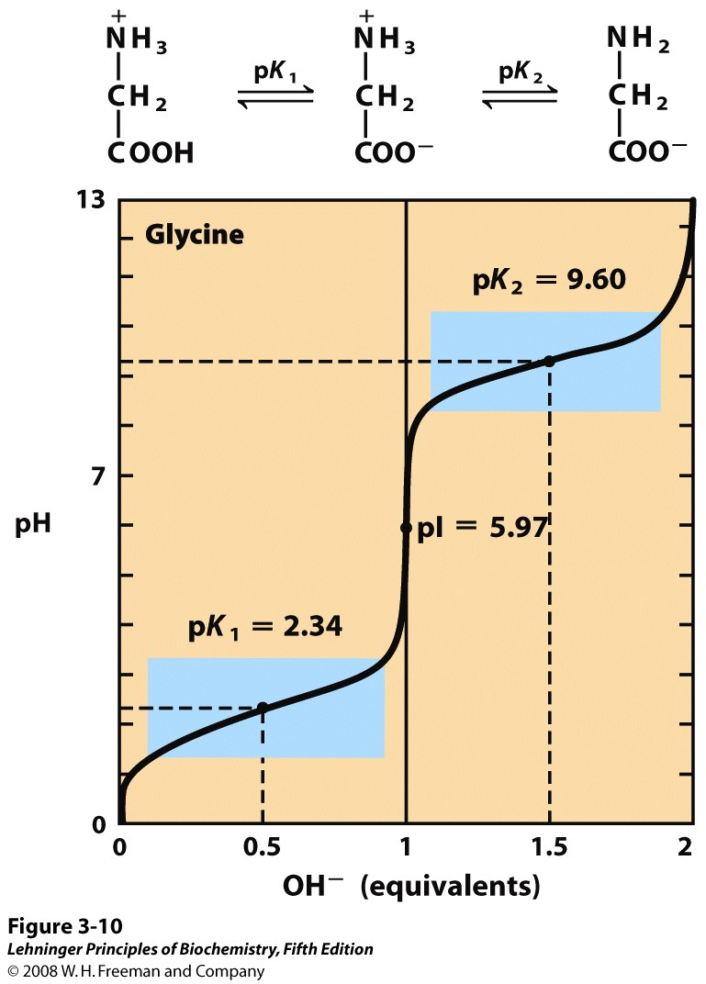
Some weak acids (like amino acids) are polyprotic and can buffer over multiple pH ranges
With 2 acidic groups, there are 3 charge states
Isoelectric point (pI):
pH of highest occurrence of zero charge state
and
pH at which average charge on molecules is zero
For simple cases,
pI = (pKa_{i} + pKa_{j})/2
Notes:
FIGURE 3-10 Titration of an amino acid. Shown here is the titration curve of 0.1 M glycine at 25°C. The ionic species predominating at key points in the titration are shown above the graph. The shaded boxes, centered at about pK₁ = 2.34 and pK₂ = 9.60, indicate the regions of greatest buffering power. Note that 1 equivalent of OH– = 0.1 M NaOH added.

Slide 15
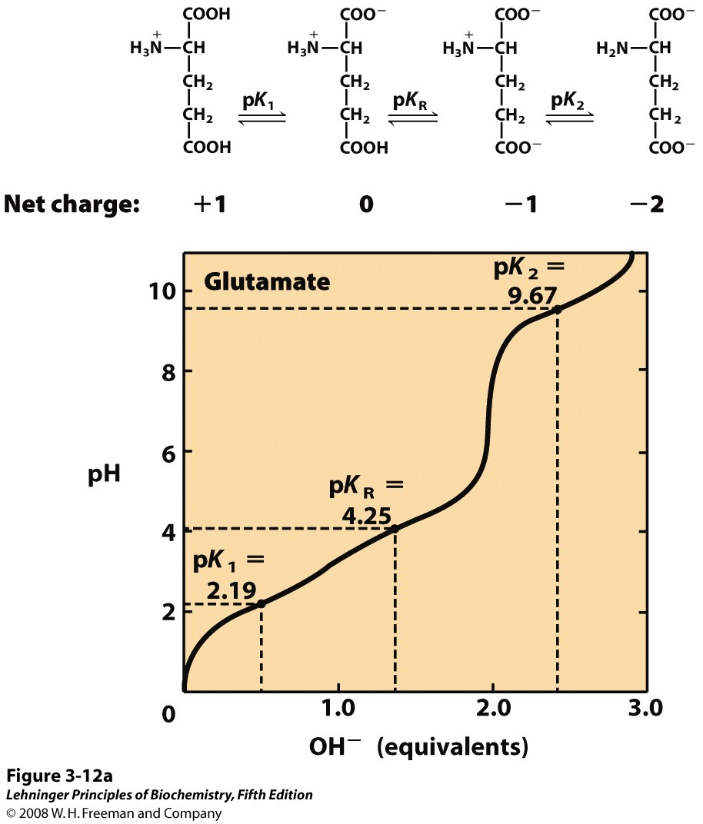
The amino acid glutamate has an acidic R group
With 3 acidic groups, there are 4 charge states
To calculate pI, use pKa’s that relate to neutral charge state
Neutral charge state predominates in this region of titration
pI
= (pK₁ + pK_{R})/2
= 3.22
Notes:
FIGURE 3-12a Titration curves for (a) glutamate and (b) histidine. The pK_{a} of the R group is designated here as pK_{R}.

