Slide 1
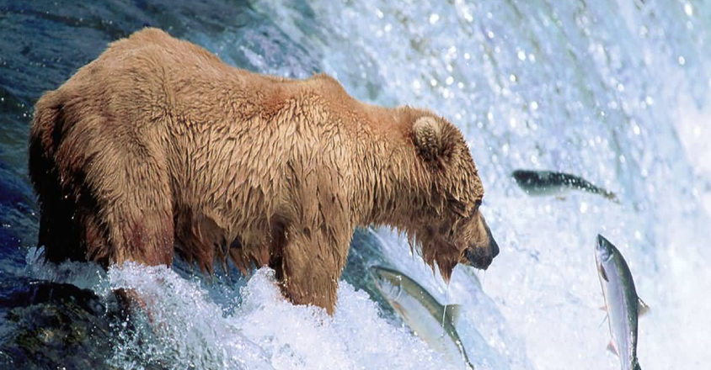
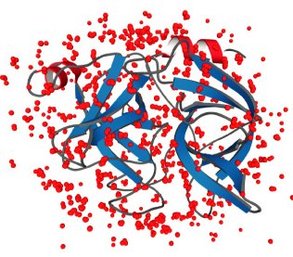
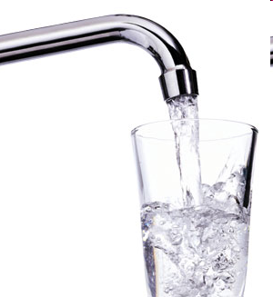
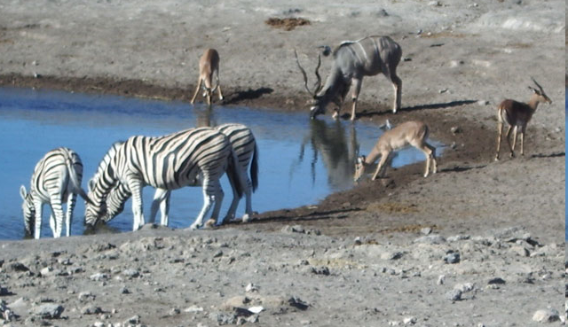
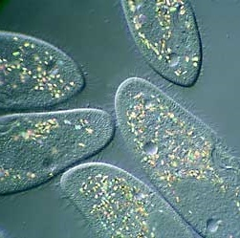
Water
The solvent of life

Slide 2
Why is water essential for life?
How does water influence life (at the molecular level)?

Slide 3
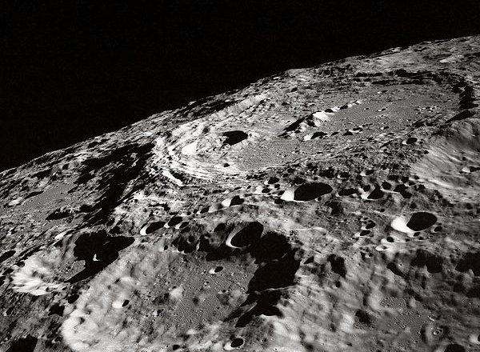
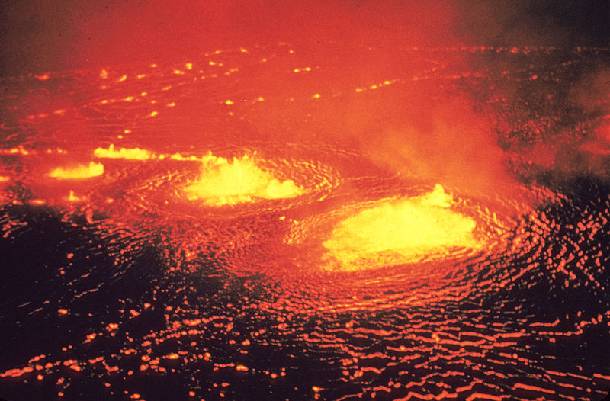
Which environment is best suited to the development of life?
Too unstable
Too limited
Just
right!

Slide 4
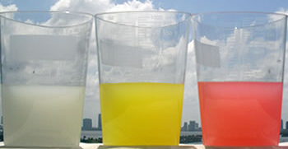
Liquid water is essential for life because it provides stability and richness
Why?
How?
Stability of temperature
High heat capacity
Large heat of fusion
Large heat of vaporization
H-bonding!
Large liquid range
Floating ice insulates water below; large bodies stay liquid
Stability of state (liquid)
Richness of dissolved cpds and chemistry
Good solvent
Protic, amphoteric

Slide 5
Many of water’s unique properties are due to the extent of its hydrogen bonding
Water contains only H-bonding groups
Compare with methanol, ethanol
Water has 2 H-bond donors and 2 acceptors
Compare with ammonia

Slide 6
Why is water essential for life?
How does water influence life (at the molecular level)?

Slide 7
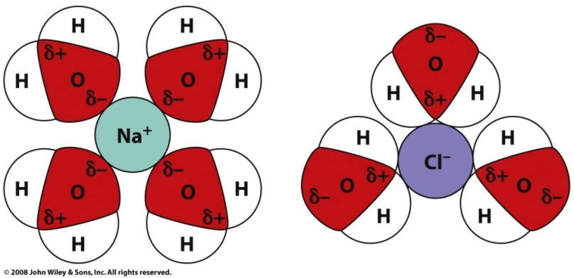
Water interacts with biomolecules, influcencing their chemistry
Solvation shell
Water dissolves polar and ionic compounds
Adds richness, hinders access
Water forms electrostatic or H-bonding interactions with polar & ionic groups
May stabilize structure, link interactors
Water pushes nonpolar compounds together
Creates ‘order’

Slide 8
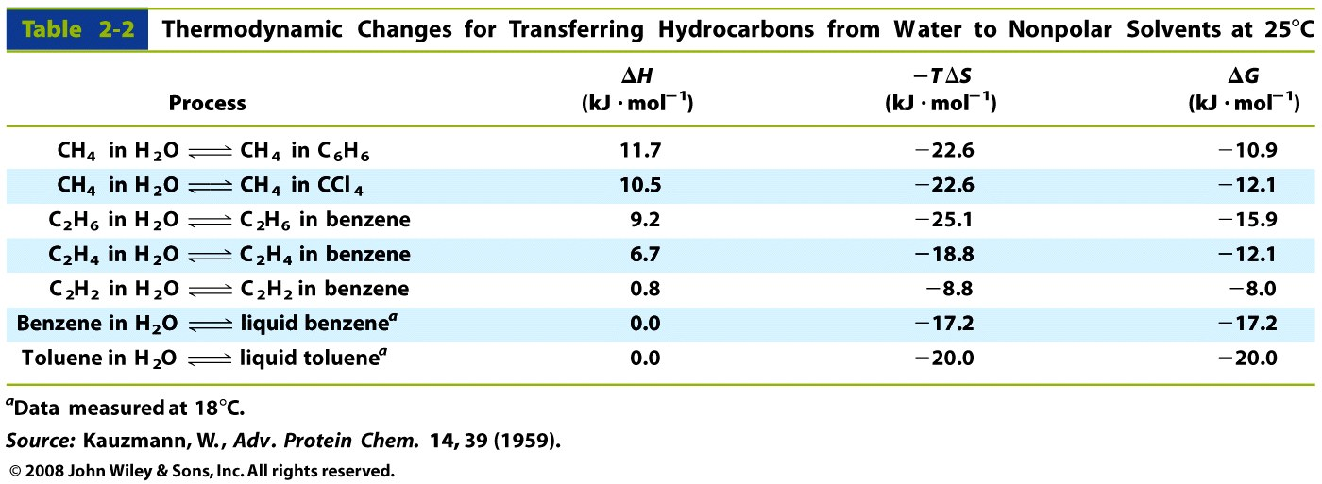
The hydrophobic effect is driven by changes in entropy

Slide 9
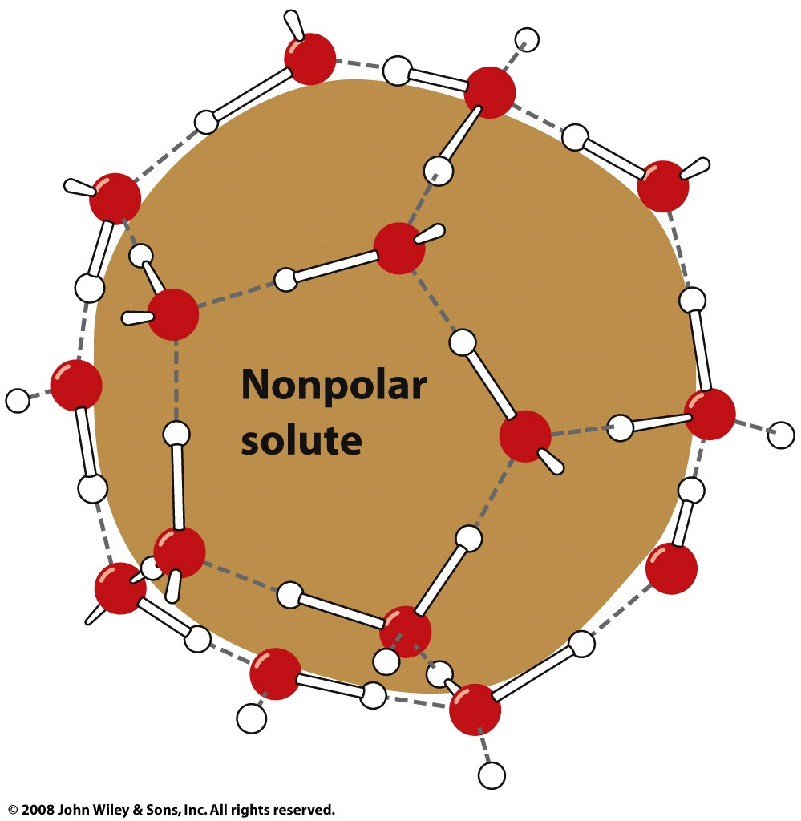
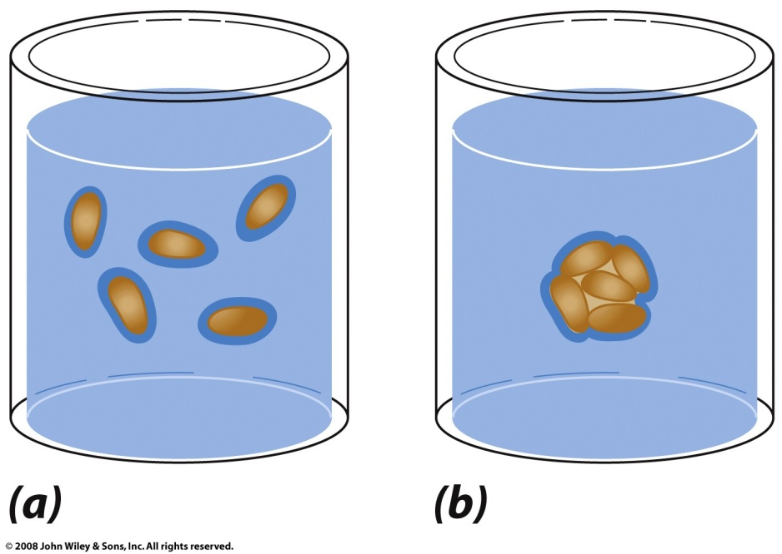
Water entropy is the major contributor to the hydrophobic effect
Reduction in nonpolar surface area
= reduction in ordered water
Figure 2-8

Slide 10
Water also participates in biochemical reactions
ATP hydrolysis drives muscle contraction
ATP + H₂O → ADP + HPO₄²⁻
Proteins and polysaccharides are hydrolyzed into component amino acids or sugars
Water adds to alkenes to form alcohols
Ex: fumarase reaction of citric acid cycle
⁻OOC-CH=CH-COO⁻ + H₂O → ⁻OOC-CHOH-CH₂-COO⁻

