Slide 1
153A Winter 2011 Review session for Final Exam
Thursday, March 10
5-7 pm in Dodd 147
Theresa and Megan

Slide 2
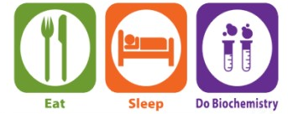
Inhibitor kinetics
Mixed inhibition
Enzyme Regulation
Allosteric regulation
Covalent modification
Metabolism overview
Glycolysis
Fates of Pyruvate
Gluconeogenesis and anapleurotic reactions
Homolactic and alcohol fermentation
PDH complex
TCA Cycle
Reduction potentials
Electron Transport Chain
ATP Synthase
Metabolic ATP yield
Old exam questions
Q&A!

Slide 3
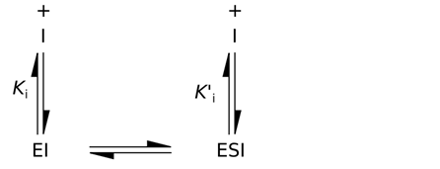
Mixed inhibitors can bind both to E_{F} and ES
Inhibitor Kinetics
Binding (fast)
Catalysis (slow)
F
F
Competitive
Uncompetitive
Inhibitor binds active site on E_{F}
Inhibitor binds
ES complex
Notes:
Add animations

Slide 4
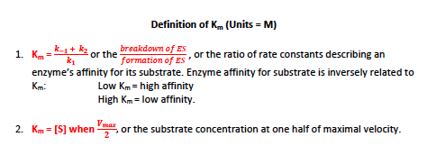
What is K_{m}?
Inhibitor Kinetics
K_{m} is characteristic of the enzyme and is not affected by [E] or [S].
In the presence of enzyme inhibitors, K_{m} may look to increase (competitive inhibition) or decrease (uncompetitive inhibition) but this is only an apparent change.

Slide 5
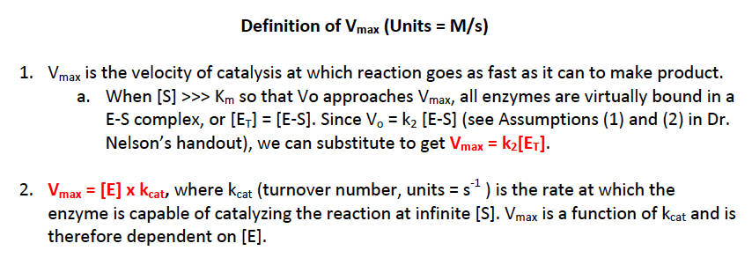
What is V_{max}?
Inhibitor Kinetics
V_{max} depends on [E], so increasing [E] will increase V_{max}.
In uncompetitive inhibition, not all E will become E-S; you will always have some small amount of E-S-I even at high [S] that does not make product. Therefore, you will be a little lower than true V_{max.} It will look like V_{max} has an apparent decrease in uncompetitive inhibition, and also mixed inhibition (mixed inhibitors have some affinity for E-S, will make unproductive E-S-I) .

Slide 6
Inhibitor terminology
Inhibitor Kinetics
α and α’ describe how competitive (α) or how uncompetitive (α’) an inhibitor is. The higher the α or α’, the higher the [substrate] must be to overcome inhibition. (Arbitrary units?)
K_{I} or K_{I’} describe the affinity of inhibitor to enzyme. Like K_{M} and K_{d} and p₅₀ and K_{0.5}, K_{I} or K_{I’} are inversely related to enzyme affinity. (Units: M)
Low K_{I} or K_{I’} = high affinity of enzyme to inhibitor
High K_{I of} K_{I’} = low affinity of enzyme to inhibitor
Low K_{I} or K_{I’} comes from having a large [EI] or large [ESI]

Slide 7
Mixed inhibition kinetics can be observed as a spectrum of competitive and uncompetitive properties
Inhibitor Kinetics
Mixed Inhibition
α’ < α | α’ = α | α’ > α
K_{I} < K_{I’} | K_{I} = K_{I’} | K_{I} > K_{I’}
K_{M}^{app} increases | K_{m} stays same | K_{m}^{app} decreases
V_{max}^{app} decrease | V_{max}^{app} decrease | V_{max}^{app} decrease
More competitive
Equal
Noncompetitive
More uncompetitive
+Inhibitor
1/V_{o}
1/V_{o}
+Inhibitor
1/V_{o}
+Inhibitor
1/V_{max}^{app}
1/V_{max}^{app}
1/V_{max}^{app}
1/V_{max}
1/V_{max}
1/V_{max}
-1/K_{m}^{app}
-1/K_{m}
1/[S]
-1/K_{m}
1/[S]
-1/K_{m}^{app}
-1/K_{m}
1/[S]

Slide 8
Inhibitor Kinetics
From Review Session 2 with Dan and Han:
Summary of kinetic effects of enzyme inhibition: M-M & Lineweaver-Burk plots from Exam 2
1/v₀
E only
increasing [inhibitor]
Competitive inhibition (α’=1)
α = 3
v₀
E + I
α = 2
α = 1
(no inhibitor)
[S]
1/[S]
1/v₀
α'= 2
increasing [inhibitor]
***parallel = uncompetitive
α' = 1.5
E only
α' = 1
(no inhibitor)
Uncompetitive inhibition (α=1)
v₀
E + I
1/[S]
[S]
1/v₀
α’ < α +inhibitor and -inhibitor lines cross
K_{M}^{app} increases α’ > α lines do not cross K_{M}^{app} decreases
α’ = α lines intersect at x-int K_{M}^{app} no change
α' < α
[increasing] +inhibitor
Mixed inhibition
α' = α
α' > α
α = α' = 1
(-inhibitor)
1/[S]

Slide 9
How can enzymes be regulated?
Regulation
Control the concentration of enzyme
Genetic repression or activation of synthesis of enzyme
Control availability of substrate
Production, degradation or compartmentalization of substrate
Production of competitive inhibitors that limit substrate availability by binding to enzyme active site
Control activity of enzyme
Allosteric regulation (Review session example: PFK-1 from glycolysis)
Covalent modification
Irreversible (e.g. serine proteases’ zymogens)
Reversible (e.g. glycogen phosphorylase’s phosphorylation and dephosphorylation; Review session example: eukaryotic PDH complex)

Slide 10
Regulation
Example of allosteric enzyme regulation
PFK-1 in glycolysis is regulated by multiple positive and negative effectors/modulators

Slide 11
Allosteric effectors can regulate enzymes
Regulation
Because we love hemoglobin, every time we hear “allosteric” we think of…
More than one binding site
Binding induces conformational change (e.g. positive effector CO or negative effector Cl⁻)
T state = inactive, deoxy
R state = active, oxy
Binding curves are sigmodial (not like myoglobin’s hyperbolic) to show that Hb is great at picking up and dropping off O₂
In addition to catalytic subunits, allosteric enzymes have additional regulatory subunits
Binding of effectors to regulatory subunit changes conformation to promote or inhibit catalysis
T state = inactive
R state = active
Kinetic curves are sigmodial (not like Michaelis-Menten’s hyperbolic) to show that enzyme can be activated and inactivated
Allosteric regulatory enzymes are analogous to allosteric proteins!

Slide 12
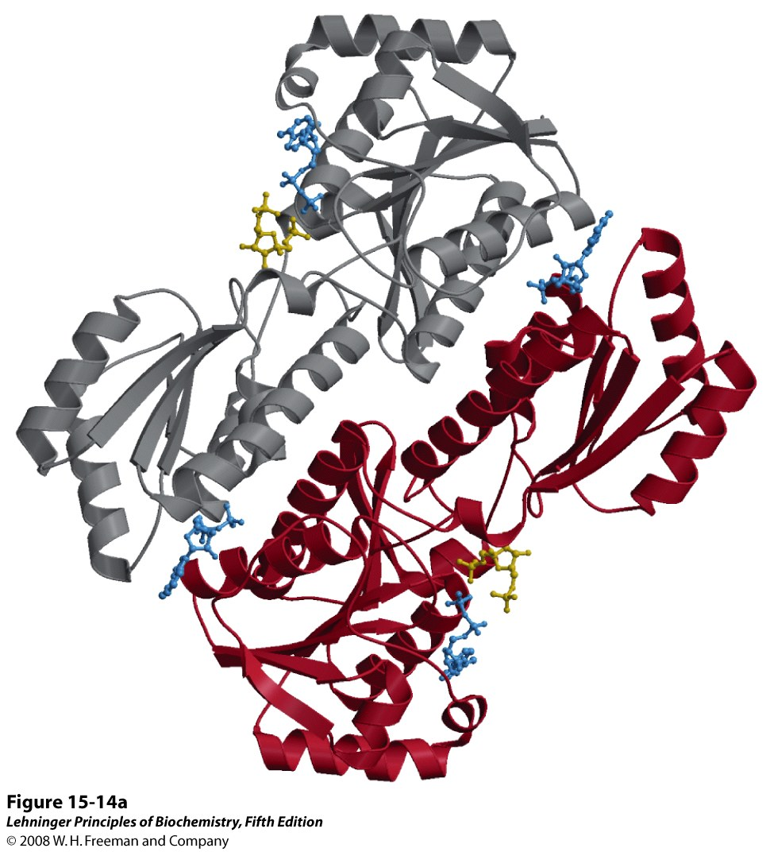
Allosteric effectors can regulate enzymes
Regulation
In addition to active sites, allosteric enzymes have additional regulatory sites
Binding of effectors to regulatory subunit changes conformation to promote or inhibit catalysis
T state = inactive
R state = active
Kinetic curves are sigmodial (not like Michaelis-Menten’s hyperbolic) to show that enzyme can be activated and inactivated
Catalytic active site:
F-1,6-BP & ADP bound
Regulatory site: ADP bound

Slide 13
Allosteric effectors can regulate enzymes
Regulation
Positive effectors increase enzyme activity:
F6P (substrate)
ADP, AMP
F-2,6-BP
Negative effectors decrease enzyme activity:
ATP (feedback inhibition)
Citrate (feedback inhibition)
In addition to active sites, allosteric enzymes have additional regulatory sites
Binding of effectors to regulatory subunit changes conformation to promote or inhibit catalysis
T state = inactive
R state = active
Kinetic curves are sigmodial (not like Michaelis-Menten’s hyperbolic) to show that enzyme can be activated and inactivated
What are possible negative effectors of Enzyme 1?
Feedback inhibition
X
Enzyme 3
Enzyme 4
Enzyme 1
Enzyme 2
A B C D E
X
Product inhibition
Is product inhibition necessarily allosteric regulation?

Slide 14
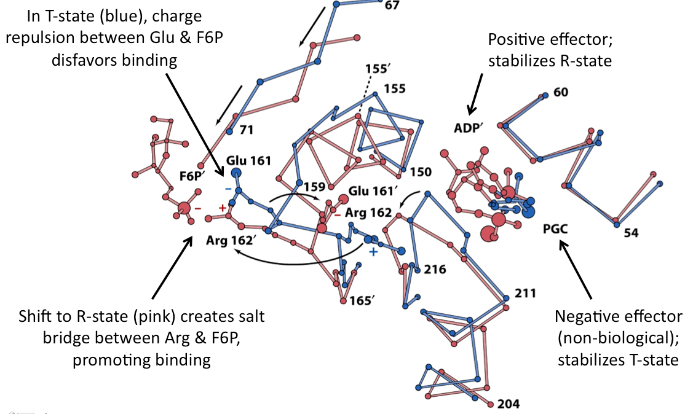
Allosteric effectors can regulate enzymes
Regulation
In addition to active sites, allosteric enzymes have additional regulatory sites
Binding of effectors to regulatory subunit changes conformation to promote or inhibit catalysis
T state = inactive
R state = active
Kinetic curves are sigmodial (not like Michaelis-Menten’s hyperbolic) to show that enzyme can be activated and inactivated

Slide 15
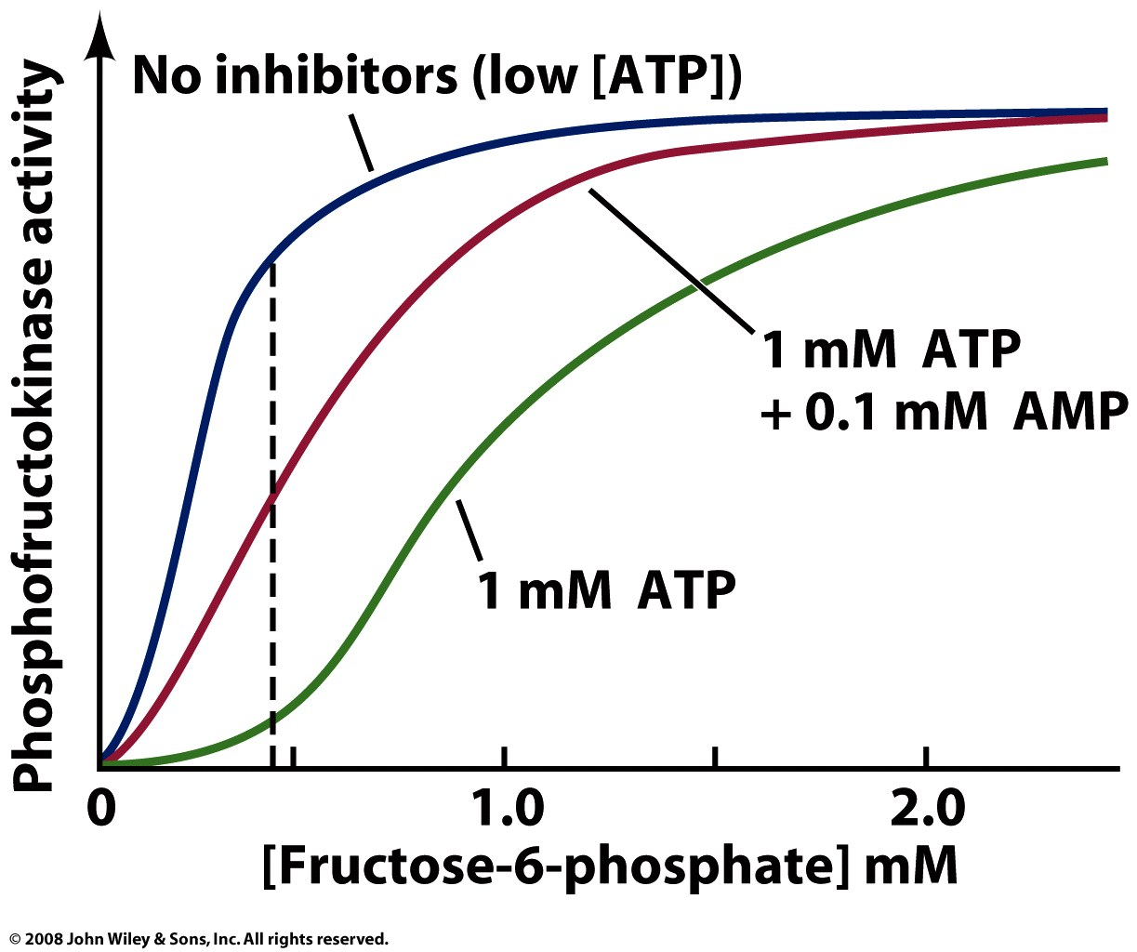
Allosteric effectors can regulate enzymes
Regulation
In addition to active sites, allosteric enzymes have additional regulatory sites
Binding of effectors to regulatory subunit changes conformation to promote or inhibit catalysis
T state = inactive
R state = active
Kinetic curves are sigmodial (not like Michaelis-Menten’s hyperbolic) to show that enzyme can be activated and inactivated (not called a K_{m} but a K_{0.5})

Slide 16
Regulation
Example of covalent modification for enzyme regulation
Pyruvate dehydrogenase complex is regulated by phosphorylation and dephosphorylation

Slide 17
Regulation
Covalent modification only in Eukaryotic PDH complex
PDH complex
PDH complex
Phosphatase activated by insulin (high [glc]) and Ca²⁺
Kinase activated by NADH and acetyl-CoA
What kind of effector are Ca²⁺ and glucose?
They are allosteric positive effectors of pyruvate dhase phosphatase, not the PDH complex. They do not act on PDH complex directly, but on the phosphatase that turns on PDH complex. Always ask yourself, “which enzyme is the effector affecting?” If you sort out which enzyme, you will understand the activity and overall effect.
Does dephosphorylation activate all enzymes?
No! Activation/deactivation by covalent modification varies in each regulatory enzyme. Read the context carefully! E.g., dephosphorylation turned off glycogen phosphorylase

Slide 18
Metabolism Overview
Living cells and organisms must preform work to stay alive, to grow, and to produce
Thus, the necessity to harness energy and channel it into biological work is a fundamental property of ALL living organisms
These organisms have evolved countless interconnected pathways that combine biosynthetic (anabolic) and degradative (catabolic) pathways with complex multilayered regulatory mechanisms all in the effort to obtain a dynamic steady state of life

Slide 19
Metabolism Overview
What to study for metabolic pathways
Thermodynamics
Which direction is favored (ΔG°’ vs. ΔG)? Why?
Coupling by pushing and pulling of reactions (Q or [products]/[reactants]) or coupling by hydrolysis of high energy compound?
Is it reversible or irreversible?
Energy currencies (e.g. ATP, NADH, FADH₂)
What currency is used? What currency is made? How is that currency made?
Regulation
Is the step a good point of regulation?
Why? First committed step, slow step, initial step?
How? Allosteric effectors, covalent modification, non-allosteric product inhibition?
Mechanism
Know the basic, general mechanism and not arrow-pushing
If mechanism includes covalent attack, what is the nucleophile and what is the electrophile?
Know unique aspects of mechanisms
E.g. Are there metal ions, cofactors, unique intermediates, important residues (e.g. TCA’s succinyl-CoA synthetase and glycolysis’s phosphogycerate mutase (PGM) phospho-His ?
Enzyme
What is the class (and, if possible, subclass)?
Know unique aspects of enzymes
Carbon tracing
If you label carbons from glucose, where does it end up after each step in glycolysis? Each step in TCA cycle? Each round in the TCA cycle?
Requires knowledge of reactants’ and products’ structure

Slide 20
Thermodynamics in metabolism
Metabolism Overview
 | ΔG | Direction
Q < K_{eq} | Negative | Forward; to the right; spontaneous
Q = K_{eq} | 0 | Can go either way, equilibrium
Q > K_{eq} | Positive | Backwards; to the left; not spontaneous
Q = [products]
[reactants]
Irreversible = |ΔG| > 10 kJ/mol
Reversible = |ΔG| < 10 kJ/mol
Equilibrium is reached when the rate of conversion is equal.
Far from equilibrium
K_{eq} = [products] _{eq}
[reactants] _{eq}
Near equilibrium
Coupling refers to the additive property of ΔG or ΔG’° for successive reactions and allows high ΔG’° reactions to occur biologically:
If ΔG’° is small positive value:
Coupling by adjusting concentration of products and reactants (Q) to push and pull reactions to change Q
Can make reaction favorable by quick utilization of product (pulling)
Can make reaction favorable by having a lot of reactant feed into reaction (pushing)
If ΔG’° is large positive value:
Coupling by hydrolysis of high-energy compound, like ATP or thioester

Slide 21
Glycolysis
Catabolism
Breakdown
Oxidation
GLUCOSE
2 PYRUVATE
2 ADP +2 P_{i} +2 NAD+
2 ATP
“Reducing agent” donates electrons…e.g. donate to ETC!
Great energy currency in aerobic respiration
+ 2 H₂O + 2 H⁺
2 NADH
“Oxidizing agent” needed to oxidize
“Oxidizer” accepts electrons

Slide 22
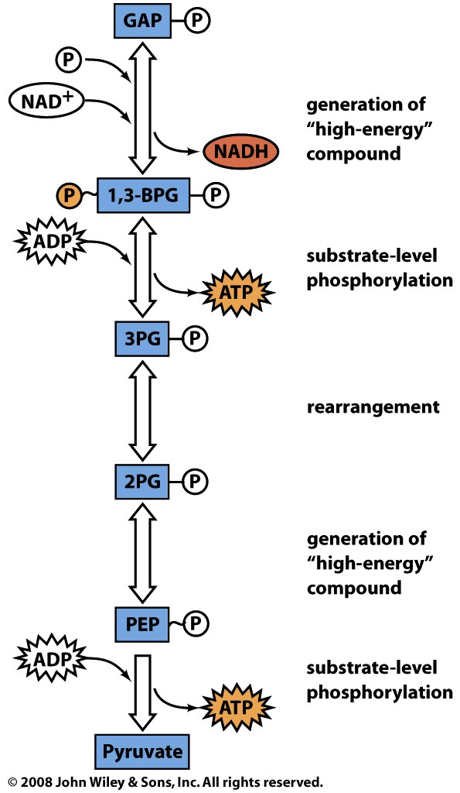
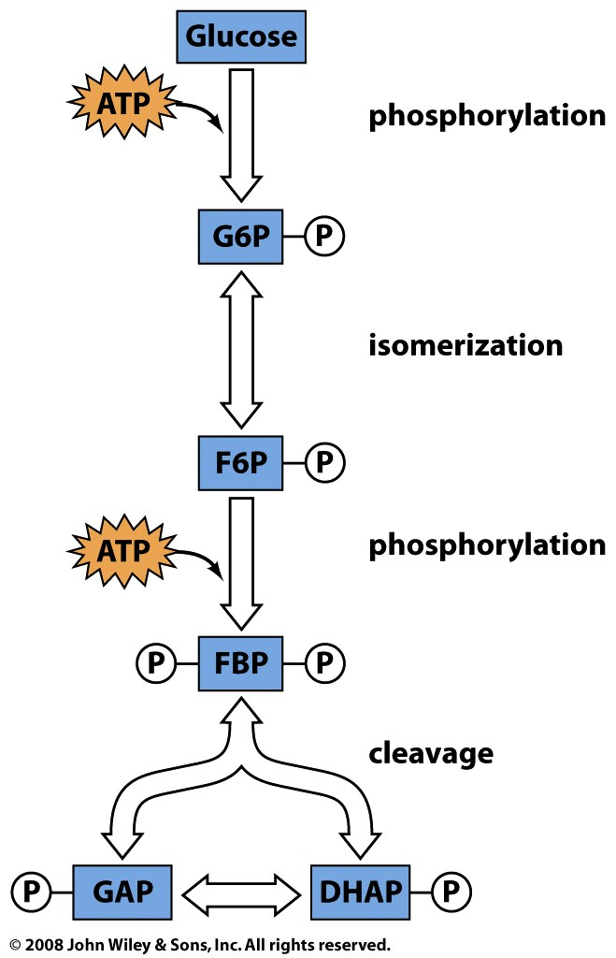
Glycolysis
PAYOFF PHASE
PREPARATORY PHASE
isomerization

Slide 23
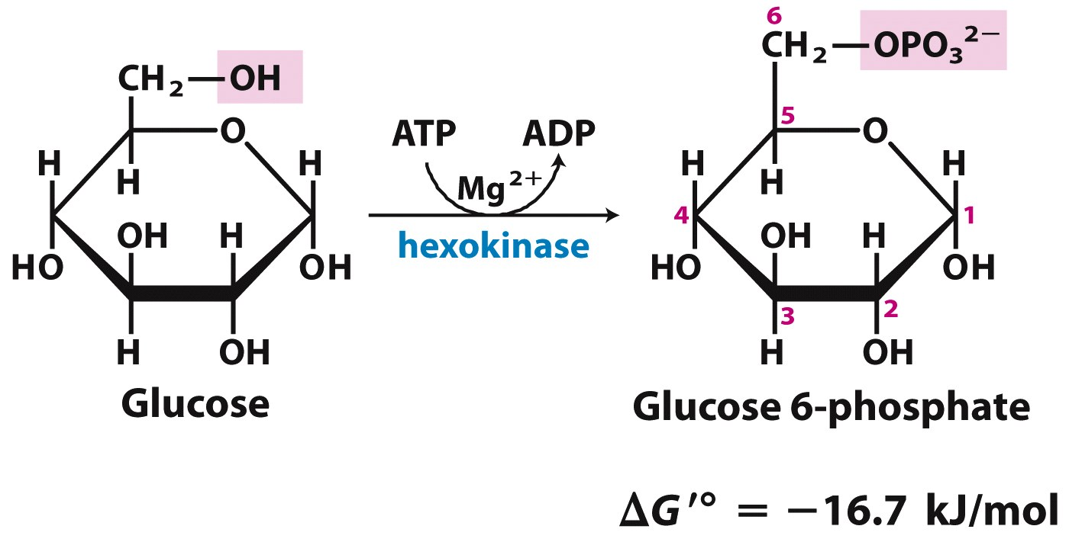
1. Hexokinase
Glycolysis
+ H⁺
Why expend 1 ATP to phosphorylate glucose?
To keep [glucose] levels low, so glucose moves down its gradient into cell. Also phosphorylated glucose cannot leave the cell
What is the Mg²⁺ ion for?
Mg²⁺ forms an electrostatically stable complex with negative ATP
What good is a “Pac-Man” enzyme?
Induced fit when both substrates bind, also excludes water.
What would the products look like if a hydrolase were performing the reaction?
Water would be doing the nucleophilic attack, so water would accept the phosphoryl group.
Notes:
Keeps [glucose] low in the cell, so glucose can always move down its gradient into the cell

Slide 24
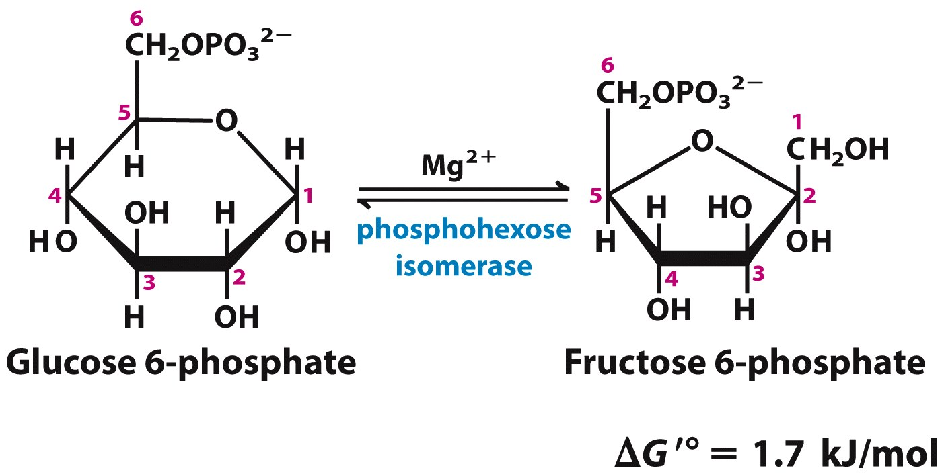
2. Phosphofructose Isomerase (PGI)
Glycolysis
phosphoglucose
isomerase
What’s the purpose of this isomerization?
Going from aldose (Glc) to ketose (Frc) prepares for steps 3 and step 4
Alcohol at C1 is better for PFK phosphorylation in step 3
C2 carbonyl and C4 alcohol is better for aldol cleavage at C3-C4 in step 4
Notes:
Moving the carbonyl to C2 prepares the molecule for cleavage in step 4

Slide 25
3. Phosphofructose Kinase (PFK-1)
Glycolysis
+ H⁺
Why is this step considered the rate-determining step of glycolysis?
F1,6BP is a dedicated glycolysis intermediate, so its production commits initial glucose to finish pathway
What is the nucleophile in this mechanism? The electrophile? Why?
The nucleophile is the C1 alcohol that attacks the electrophilic gamma phosphorus of ATP. We know the sugar is the nucleophile because the reaction is to transfer a phosphoryl group onto the sugar.
Notes:
Further ‘activates’ the sugar
This step ‘commits’ the hexose to being broken down
Phosphorylations become even: at both ends of the molecule

Slide 26
3. Phosphofructose Kinase (PFK)
Glycolysis
+ H⁺
Which enzyme(s) of glycolysis is/are regulated?
PFK-1! See slides on Regulation: Allosteric at the beginning of the review. In brief:
Positive effectors
Signal ATP supply is low, thereby increasing PFK-1 activity
(+) ADP
(+) AMP
(+) F6P
(+)F2,6BP
Negative effectors
Signal ATP supply is high, thereby decreasing PFK-1 activity
(-) ATP
(-) Citrate
Notes:
Further ‘activates’ the sugar
This step ‘commits’ the hexose to being broken down
Phosphorylations become even: at both ends of the molecule

Slide 27
4. Aldolase
Glycolysis
Glucose numbering
a
1
2
3
Dihydroxyacetone
Phosphate
DHAP
aldolase
4
5
6
Glyceraldehyde
3-Phosphate
GAP
The ΔG°’ is very large and positive, but ΔG is negative. How?
Reaction proceeds because cellular [F-1,6-BP] is cleaved into two products that are utilized very quickly (low Q). Therefore, the dG is slightly negative under physiological conditions as long as the concentrations of products [DHAP] and [G3P] is kept low by utilization (coupling)

Slide 28
4. Aldolase
Glycolysis
Glucose numbering
a
1
2
3
Dihydroxyacetone
Phosphate
DHAP
aldolase
4
5
6
Glyceraldehyde
3-Phosphate
GAP
What is the purpose of a Schiff base intermediate?
Nucleophile Lys on enzyme attacks C2 carbonyl and forms Schiff base, which stabilizes the carbanion (negative carbon, C⁻) formed when the first triose GAP (C4-C5-C6) is released.
What other mechanisms stabilize carbanions?
TPP, the prosthetic group cofactor of decarboxylation enzymes like pyruvate decarboxylase, pyruvate dehydrogenase complex (E1) and a-KG dehydrogenase complex (E1). Both TPP and Schiff base intermediate act as electron withdrawing sinks, stabilizing the carbanion

Slide 29
4. Aldolase
Glycolysis
Which triose is released first?
GAP! Nucleophile Lys on enzyme attacks C2 carbonyl of ketose, forming Schiff base intermediate. General base then general acid catalysis releases first triose, GAP, which is the bottom 3 carbons of glucose (C4-C5-C6)
Correction on Glycolysis handout highlighted in green!

Slide 30
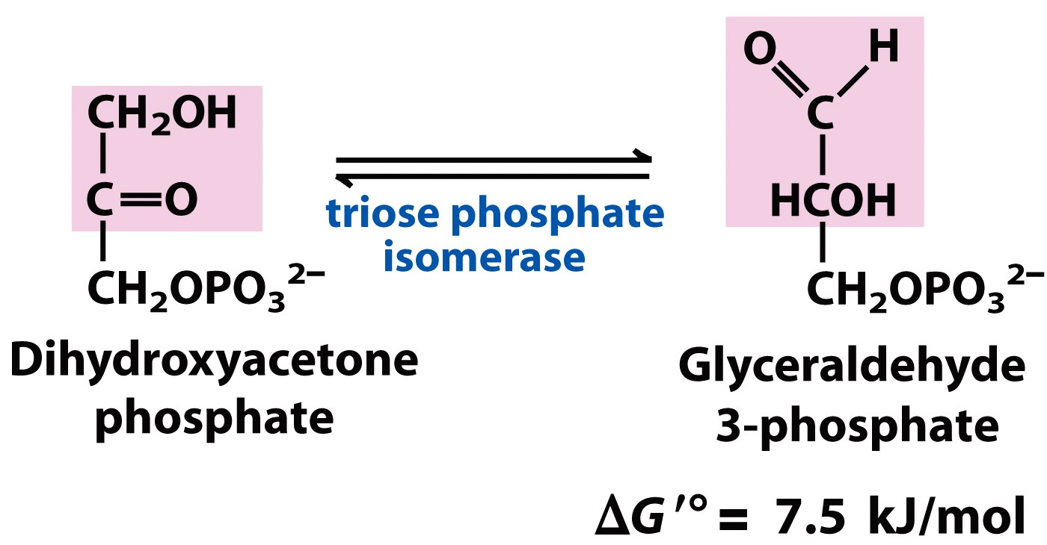
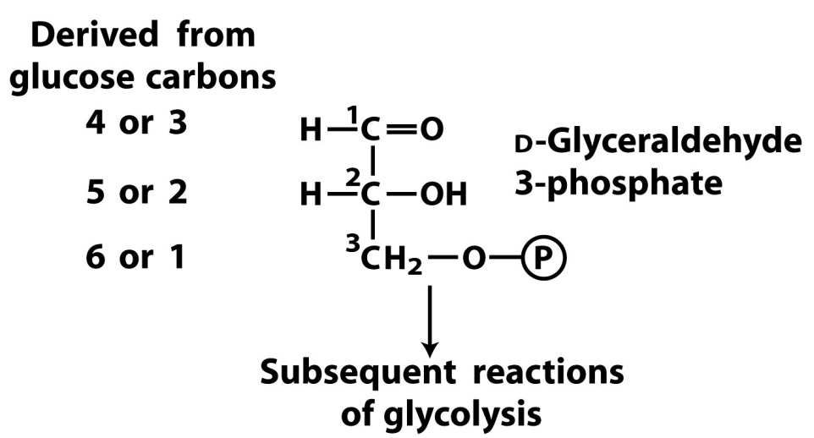
5. Triose Phosphate Isomerase (TIM)
Glycolysis
Glucose numbering
A
3
2
1
4
5
6
What is k_{cat} of this enzyme?
Very high because it’s “catalytically perfect”—every binding results in product
Where is the isomeration occurring?
Move Glucose C2 carbonyl to C3. Produce 2 GAPs, where C1 and C6 are now triose carbon number 3
Why do we want two of the same compounds?
More efficient pathway
Derived from
glucose carbons
Triose
numbering
Notes:
Two of the same molecule can continue through glycolysis: more efficient than two different

Slide 31
6. Glyceraldehyde-3-phosphate Dehydrogenase (GAPDH)
Glycolysis
High-energy compound!
How is the high-energy 1,3BPG formed?
Energy from aldehyde oxidation is conserved in synthesis of thioester. Because thioester hydrolysis releases much energy, O⁻ of Pi can attack thioester and phosphorylate the triose making high-energy 1,3BPG. The normally unfavorable phosphorylation is coupled to hydrolysis of thioester (analogous to Hexokinase, PFK-1, except oxidation power and not ATP is used to drive reaction)
Notes:
This step provides for the net synthesis of ATP in glycolysis
The oxidation yields NADH, which can be used to make more ATP via aerobic metabolism

Slide 32
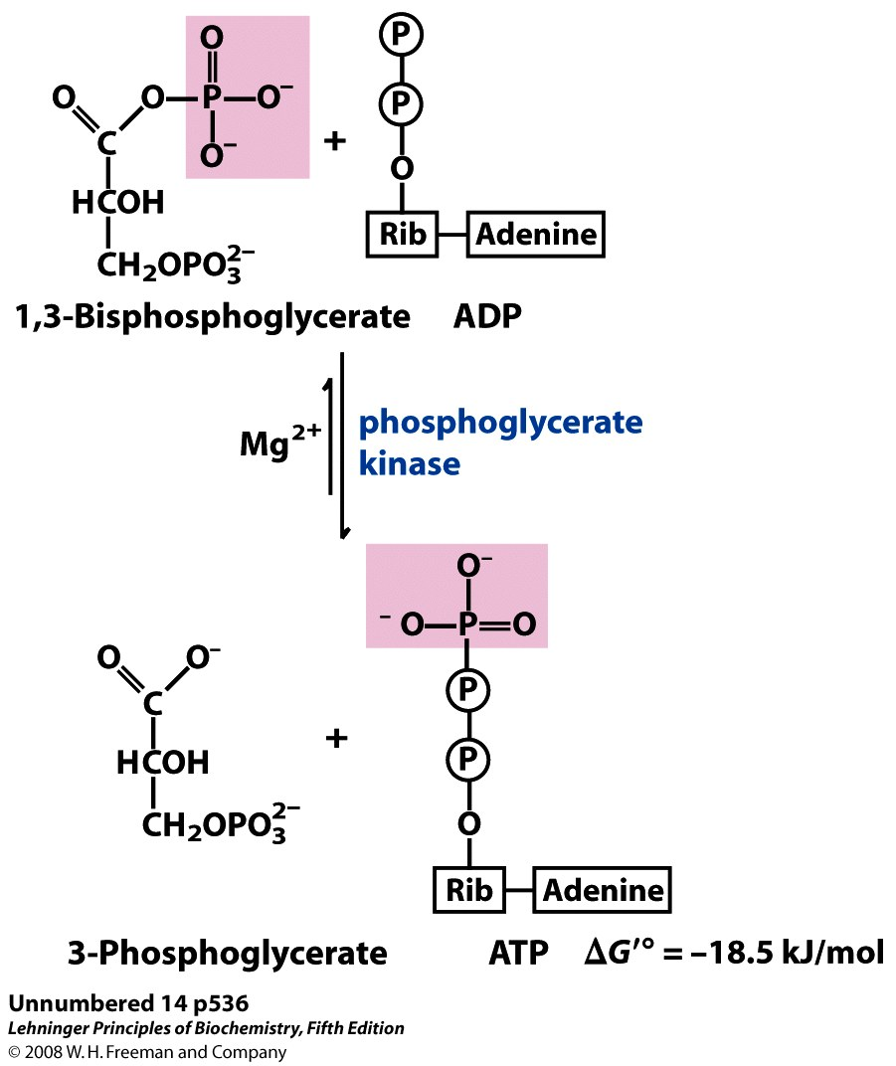
7. Phosphoglycerate Kinase (PK)
Glycolysis
Since high-energy 1,3BPG was made in step 6, the immediate next step is to cash in!
1 ATP made
per GAP
Why is this called “substrate-level phosphorylation”?
The substrate transfers its phosphoryl group to ADP. Compare to “oxidative phosphorylation” where H⁺ gradient drives Pi to directly combine with ADP.
Why is the ΔG°’ so negative, but the ΔG near equilibrium?
Breaking of high-energy cmpd is favorable, but is coupled to pull step 6 forward. Also, Q is large ([ATP]_{high}/[1,3-BPG]_{low})
Notes:
This step replaces the two ATPs used in the preparatory phase

Slide 33
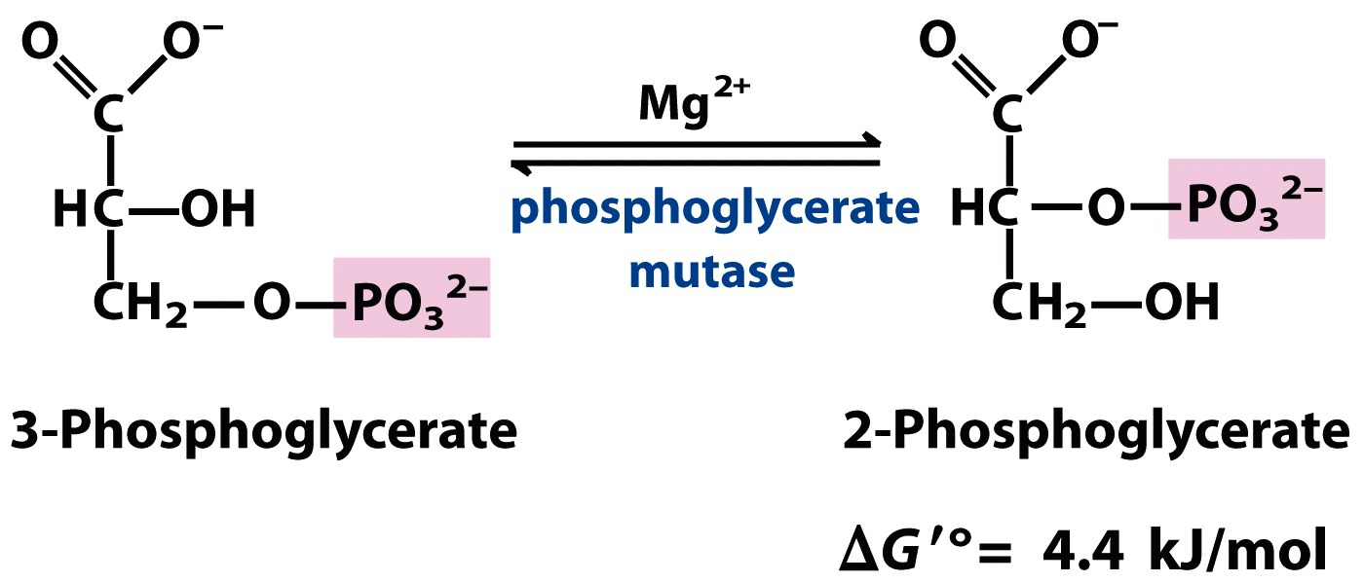
8. Phosphoglycerate Mutase (PGM)
Glycolysis
Why is the isomerization necessary?
It is easier to make the high-energy compound PEP in step 9 with 2-PG than with 3-PG
We’ve seen isomerases that move carbonyls, so how do you move phosphates?
Substrate takes on extra phosphate from the enzyme at its carbon 2 to become 2,3-BPG. Then substrate gives phosphoryl group on carbon 3 back to enzyme. Swapping phosphate groups!
Where does the enzyme get the phosphate in the first place?
From 2,3-BPG—the negative effector of hemoglobin ☺

Slide 34
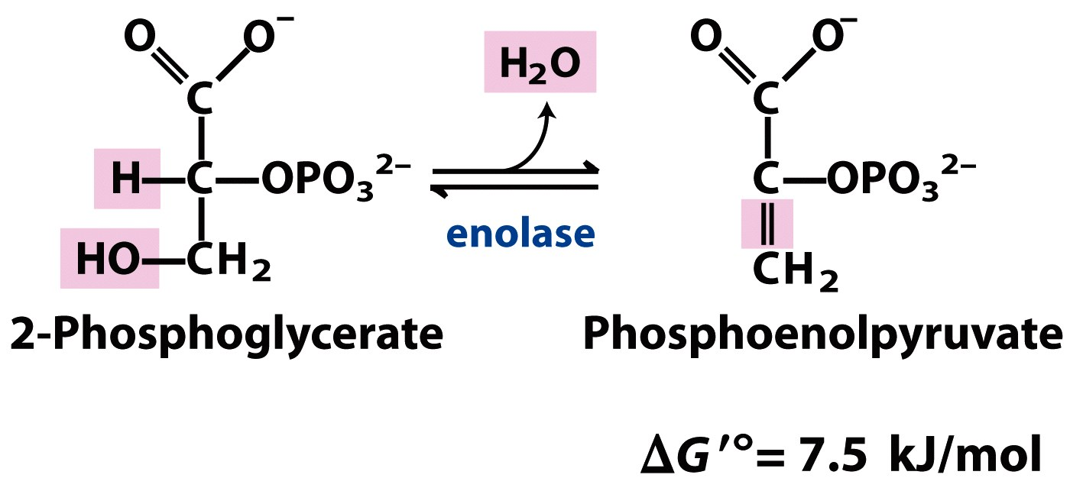
9. Enolase
Glycolysis
High-energy compound!
How is high-energy PEP formed?
Enolase is a lyase, and removal of water increases the standard free energy of hydrolysis of the phosphate

Slide 35
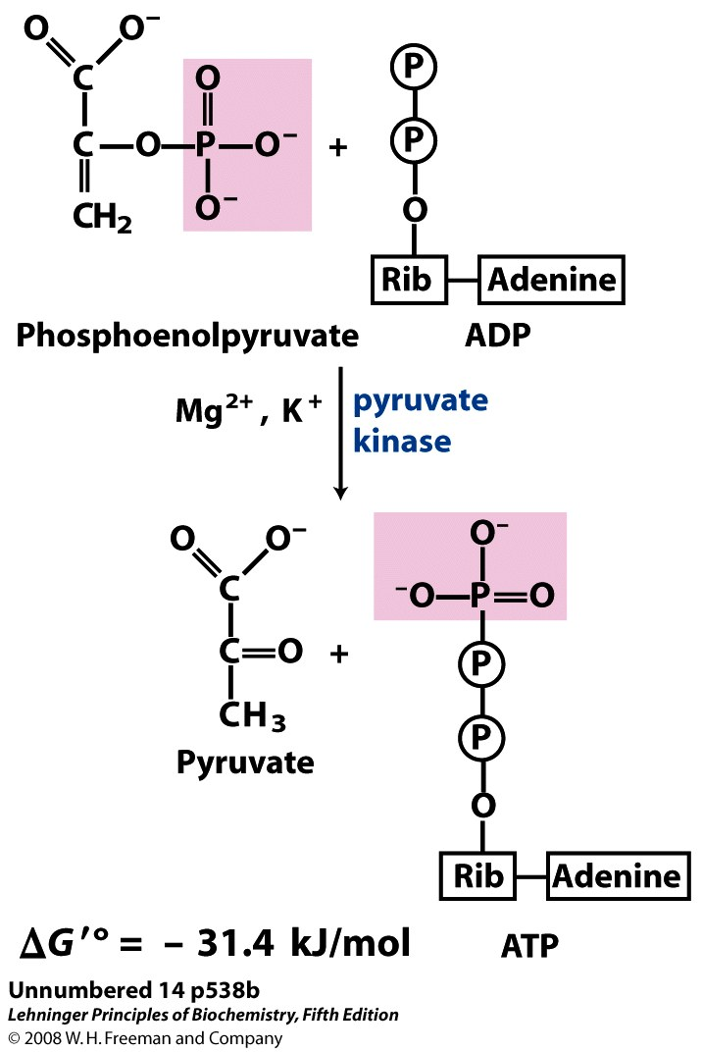
10. Pyruvate Kinase (PK)
Glycolysis
Since high-energy PEP was made in step 9, the immediate next step is to cash in!
1 ATP made
per GAP
+ H⁺
What is the nucleophile and the electrophile in this substrate-level phosphorylation step?
Just like in step 7, the nucleophile is the O⁻ on the ADP that attacks the phosphoryl group on the triose, PEP.
What is Mg²⁺ and K⁺ doing?
Mg²⁺ stabilizes the O⁻ on PEP and ADP
K⁺ stabilizes carbonyl of PEP
Note: Hydrolysis of PEP is not sufficient to drive transfer of PEP’s phosphate onto ADP. However, the tatutomerization of enolpyruvate (one C=O, one C=C bond) to ketopyruvate (two C=O) can power substrate-level phosphorylation.

Slide 36
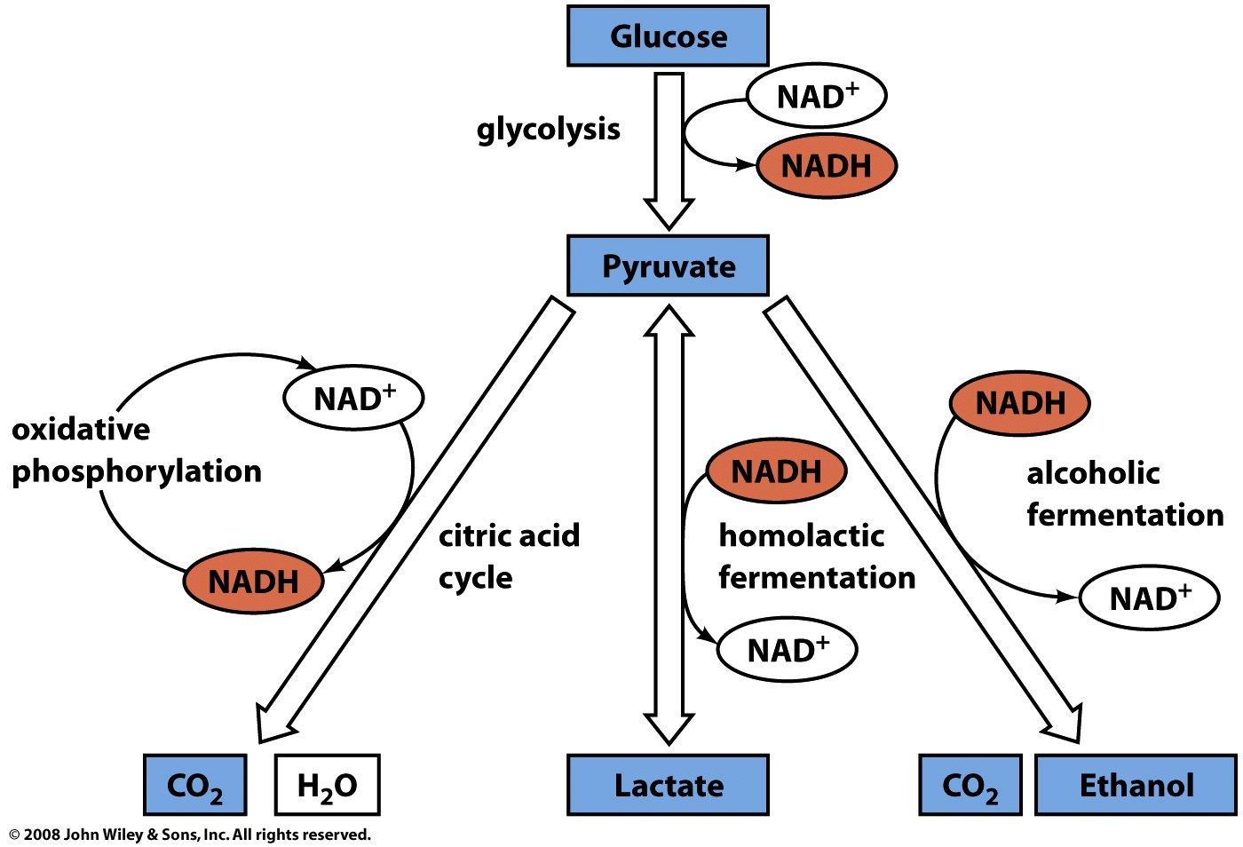
Immediate fates of pyruvate
Gluconeogenesis and Anapleuorotic reaction: Pyruvate carboxylase
first step in remaking glucose via gluconeogenesis
Anapleurotic reaction to replenish OAA for TCA
Homolactic Fermentation (e.g. in mammals): Lactate dehydrogenase
Reduce and Regenerate NAD+
Alcohol Fermentation (e.g. in yeast): Pyruvate decarboxylate
Decarboxylate and then reduce into ethanol, regenerating NAD+
1
4
2
3
Preparation for TCA Cycle: Pyruvate dehydrogenase complex
To make into acetyl-CoA to feed into TCA cycle

Slide 37
Pyruvate can be carboxylated to replenish OAA pools
Pyruvate in Anapleurotic reactions
Biotin
What are anapleurotic reactions?
Reactions that replenish intermediates of TCA cycle. We know all acetyl-CoA put into TCA cycle is oxidized off as CO₂—there is not net gain of carbons. So need pyruvate carboxylase to replenish supply of OAA via pyruvate, or transaminases to replenish supply of alpha-KG via amino acid degradation.
We saw a lot of taking off CO₂ using the cofactor TPP. Here, we add on CO_{2.} How?
Pyruvate carboxylase uses the prosthetic cofactor biotin. ATP activates CO₂ and biotin’s N attacks carboxyl and holds CO₂ for deprotonated pyruvate to attack and take CO₂ .
Notes:
Pyruvate carboxylase is activated by acetyl-CoA, and can generate more OAA to enhance flux

Slide 38
Pyruvate can start the gluconeogenesis to make glucose
Pyruvate in Gluconeogenesis
Why are we carboxylating Pyr and then decarboxylating OAA?
The end goal is to make PEP, a high-energy compound. We carboxylate to prime Pyr for PEP carboxylkinase (PEPCK) and also to make more OAA (see anapleurotic rxn). The decarboxylation catalyzed by PEP carboxylkinase does release energy, but we still need two energy currencies to make PEP (1 ATP, 1 GTP)—these first two reactions are that expensive!

Slide 39
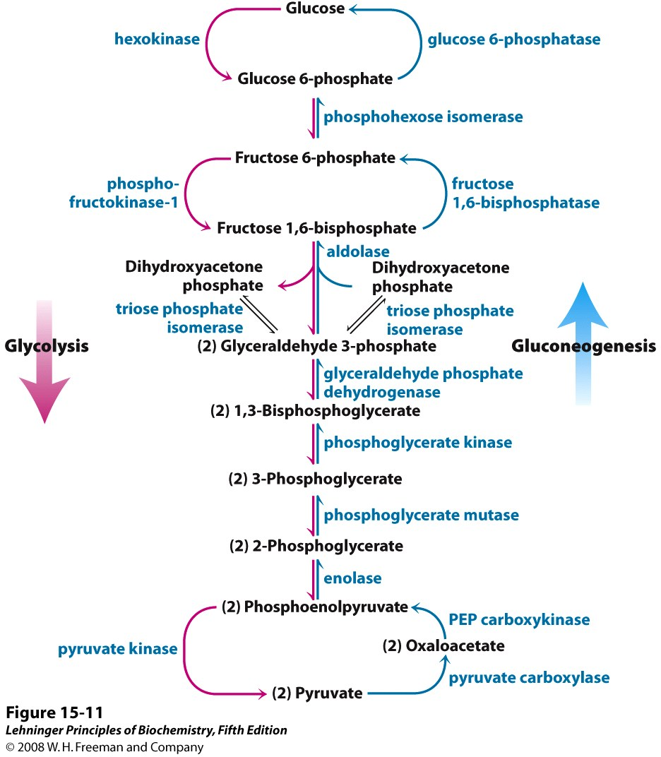
Gluconeogenesis
Side note: Gluconeogenesis is the reverse of glycolysis.
The 7 reversible enzymes are the same, but 4 gluconeogeneic enzymes are needed to catalyze the opposite of the 3 irrevesible glycolytic enzymes.
To get back to glucose, cells liberate
2 phosphate groups. Why use hydrolyases (glucose-6-phosphatase and fructose 1,6-bisphosphotase) instead of kinases? Can’t we make ATP via substrate-level phosphorylation?
Substrate-level phosphorylation is only possible with high-energy compounds like 1,3-BPG and PEP. F1,6BP or G6P do not have high hydrolysis potential, therefore we cannot make ATP.
Notes:
FIGURE 15-11 Glycolysis and gluconeogenesis. Opposing pathways of glycolysis (pink) and gluconeogenesis (blue) in rat liver. Three steps are catalyzed by different enzymes in gluconeogenesis (the "bypass reactions") and glycolysis; seven steps are catalyzed by the same enzymes in the two pathways. Cofactors have been omitted for simplicity.

Slide 40
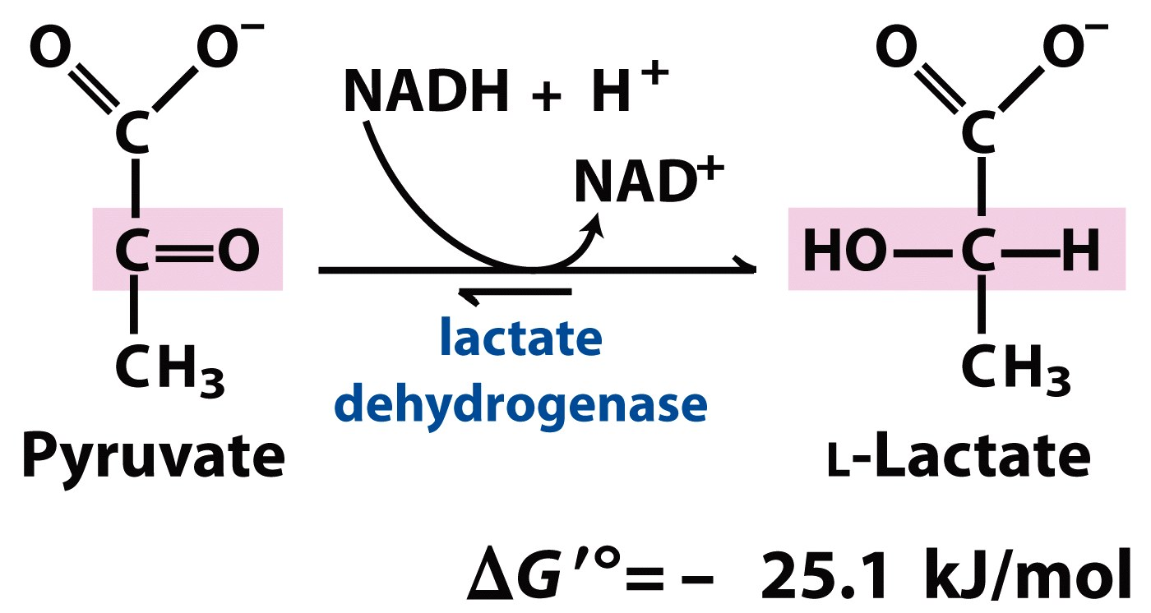
Pyruvate can be reduced to regenerate NAD⁺
Pyruvate in Homolactic Fermentation
Why do we need NAD+?
To use as oxidizer for glycolysis
Isn’t it better to completely oxidize pyruvate through TCA cycle? That is, isn’t aerobic respiration is better than anaerobic respiration?
While we do get more energy from aerobic respiration than anaerobic (30-32 ATP vs. 2 ATP!), aerobic respiration is much slower. Additionally, O₂ needs to be present to be the final e⁻ acceptor. If our tissues are depleted in O₂ (because of rigorous activity), pyruvate from glycolysis is made into lactate to replenish NAD+ for more glycolysis.
What happens to all that lacate?
Does it really cause muscle soreness? Hmm, check out: http://en.wikipedia.org/wiki/Lactic_acid#Exercise_and_lactate. But certainly lactate can be reversed into pyruvate in liver to make glucose via gluconeogenesis.

Slide 41
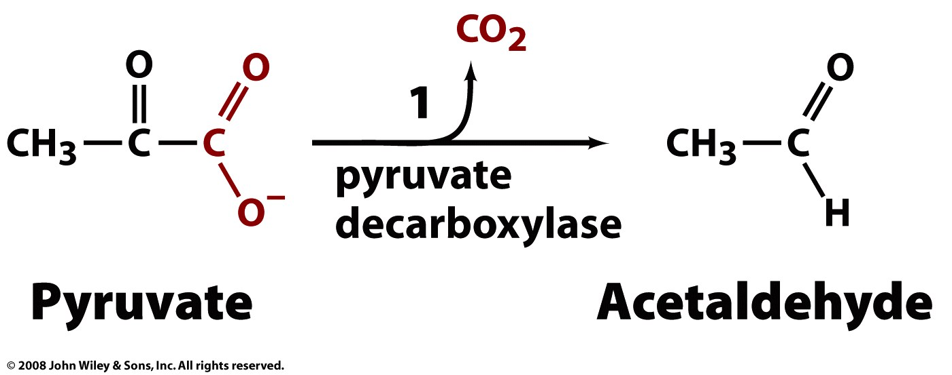
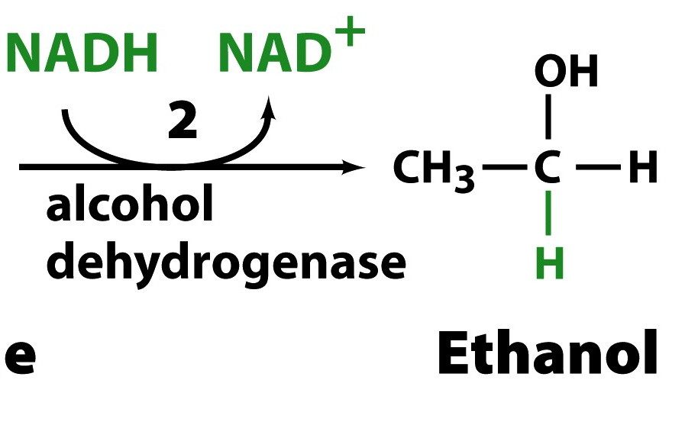
Pyruvate can be decarboxylated and then reduced to form Ethanol and NAD⁺
Pyruvate in
Alcohol Fermentation
What other enzymes decarboxylate?
PEPCK, PDH complex, isocitrate Dhase, and a-KG Dhase.
Are their mechanisms exactly the same?
No, but pyruvate decarboxylase, PDH complex and a-KG Dhase all use TPP (but pyruvate decarboxylase catalyzes only decarboxylation, nothing fancy with CoA).
Again, TPP is the prosthetic cofactor that covalent attacks to kick off CO₂ and then because of its great resonance, acts as electron withdrawing sink to stabilize the carbanion formed when a-keto acids like a-KG or pyruvate are decarboxylated.

Slide 42
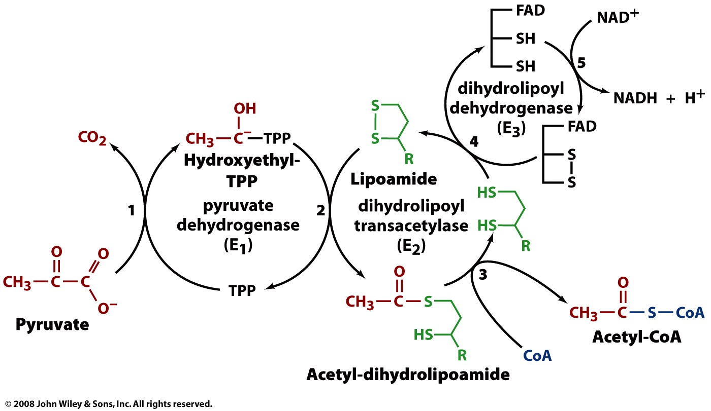
Pyruvate can converted into Acetyl-CoA by the PDH complex, the bridge from glycolysis to TCA cycle
Pyruvate in
Pyruvate Dehydrogenase Complex

Slide 43
Pyruvate can decarboxylated and given a CoA group for preparation to be furthered oxidized as CO₂
Pyruvate Dehydrogenase Complex
Enzyme | Name | Cofactors (*cosubstrates) | Reactions | Product
E1 | Pyruvate DH | TPP | 1. Decarboxylate pyruvate with TPP 2. Transfer substrate to lipoamide, which oxidizes substrate into acetyl group and reduces lipoamide into dihydrolipamide | CO₂
E2 | Dihydrolipoyl transacetylase | Lipoic acid, Coenzyme A* | 3. CoAS⁻ attacks acetyl substrate, product is released | Acetyl-CoA
E3 | Dihydrolipoyl DH | FAD, NAD⁺* | 4. Reoxidize dihydrolipoamide into lipoamide with FAD 5. Reoxidize FADH₂ into FAD by NAD⁺ | NADH
Is Acetyl-CoA considered a high-energy compound?
Yes, it has a thioester that has a high hydrolysis potential
Is PDH complex apart of glycolysis or TCA cycle?
Neither, it is the bridge between the two and is located in the mito matrix
How is it regulated?
By phos/dephos of E₁ (see review slides Regulation: covalent modification) and by product inhibition: Acetyl-CoA binds and inhibits E₂ and NADH binds and inhibits E₃ at active sites (not allosteric)

Slide 44
TCA Cycle
Overall Reaction:
Acetyl-CoA + 3 NAD⁺ + FAD +GDP + P_{i} + 2 H₂O → 2 CO₂ + 3 NADH + FADH₂ + GTP + 3 H⁺ + CoASH
Function:
Oxidizes Acetyl-CoA into CO­­₂ releasing energy, which is harnessed in the reduction of NAD⁺ and FAD to become NADH and FADH₂, respectively
Location:
Mitochondrial matrix (eukaryotes) or cytoplasm (bacteria)
Rate Limiting Step:
Acetyl-CoA + OAA → CoA-SH + Citrate (Catalyzed by Citrate Synthase)

Slide 45
TCA Cycle
1. Citrate Synthase
Catalyzes the C-C bond formation (condensation reaction) between acetate and oxaloacetate to form citrate
Positive effector:
ADP
Negative effectors:
ATP, NADH, Citrate, Succinyl CoA
ΔG = -8.0 kJ/mol
Why is this enzyme regulated?
Hydrolysis of high energy thioester intermediate, citroyl CoA, make the forward reaction highly exergonic (Large negative ΔG’⁰)
The large neg. ΔG’⁰ is needed to keep the TCA cycle going, Why?
Remember that this pathway is CYCLICAL. The previous reaction (#8) from malate to oxaloacetate is so endergonic that [OAA] are low. The high exergonic nature of this rxn allows citrate to be formed even at low [OAA]

Slide 46
TCA Cycle
2. Aconitase
The stereospecific conversion of citrate to isocitrate
ΔG = +1.5 kJ/mol
At pH 7 and 25⁰C, the equilibrium mixture is < 10% isocitrate. Why is this reaction pulled in the forward direction?
Isocitrate is rapidly used in the next step (#3 isocitrate DH). Thus its steady state concentration is lowered.
REMEMBER: KNOW THE DIFFERENCE BETWEEN STEADY STATE AND EQUILIBRIUM!

Slide 47
TCA Cycle
3. Isocitrate Dehydrogenase
Catalyzes the oxidative decarboxylation of isocitrate to release CO₂ and form α-Ketogluterate
Positive effectors:
ADP, NAD⁺, Ca²⁺
Negative effectors:
ATP, NADH
ΔG'°= -21 kJ/mol
ΔG = -1.7 kJ/mol
What is the purpose of Mn²⁺ is the active site?
The Mn²⁺ interacts with the newly formed carbonyl (C=0) intermediate (oxalosuccinate) to facilitate decarboxylation by e⁻ withdrawing. It also stabilizes the enol formed transiently before finally α-KG is formed
Where is the released CO₂ is from?
Oxaloacetate NOT Acetyl-CoA

Slide 48
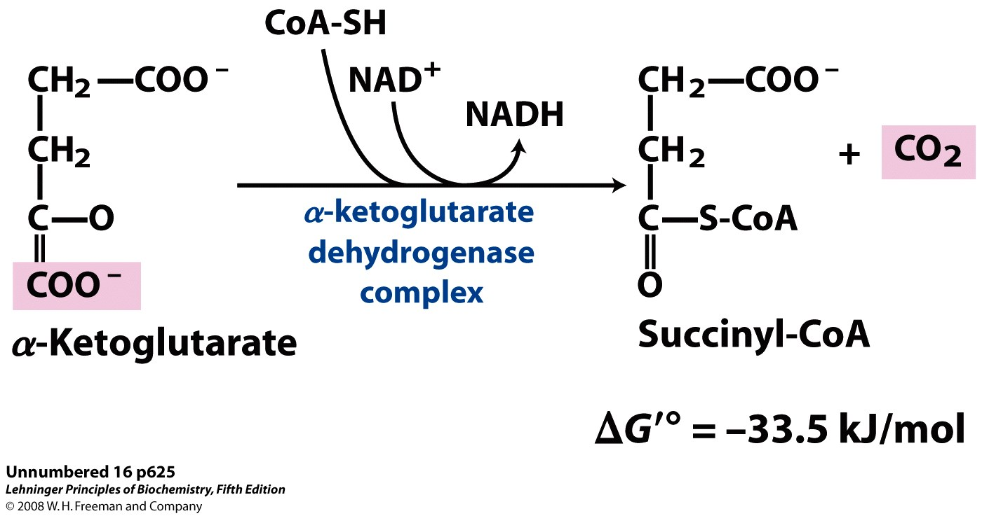
TCA Cycle
4. α-Ketogluterate Dehydrogenase
Catalyzes the oxidation of α-Ketogluterate to release CO₂ and form Succinyl-CoA
Positive effector:
Ca²⁺
Negative effectors:
ATP, NADH, Succinyl-CoA
ΔG = -8.0 kJ/mol
What enzyme that we’ve seen before has a virtually identical mechanism to α-KG DH?
Pyruvate Dehydrogenase
(uses TPP, lipoamide, CoA-SH, FAD, NAD⁺)
What substance serves as the last e⁻ acceptor?
NAD⁺
Is the CO₂ released from the 1st cycle of Acetyl-CoA?
No

Slide 49
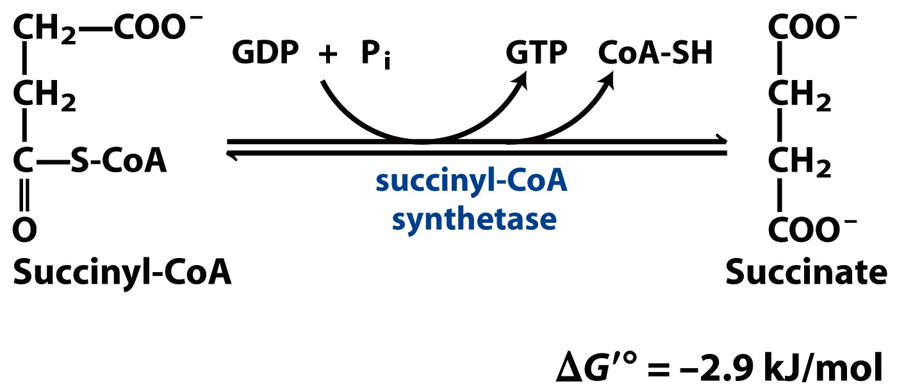
TCA Cycle
5. Succinyl-CoA Synthetase
Catalyzes the conversion of succinyl-CoA to succinate and the substrate-level phosphorylation of GTP
ΔG = -0.8 kJ/mol
Why is the conversion of Succinyl-CoA to succinate coupled to the formation of GTP?
Succinyl-CoA is a thioester, which is a high energy intermediate with its hydrolysis having a ΔG’⁰ ≈ -36 kJ/mol. GTP is an ATP equivalent with its synthesis having a ΔG’⁰ ≈ +33 kJ/mol. By coupling these steps the overall ΔG’⁰ = -2.9 kJ/mol making the forward direction favored
What is the order in which these processes are coupled?
Succinyl-CoA + P_{i} → CoA-SH + Succinyl-phosphate + His_{enzyme} →
Succinate + phospho-His_{enzyme} + GDP → His_{enzyme} + GTP

Slide 50
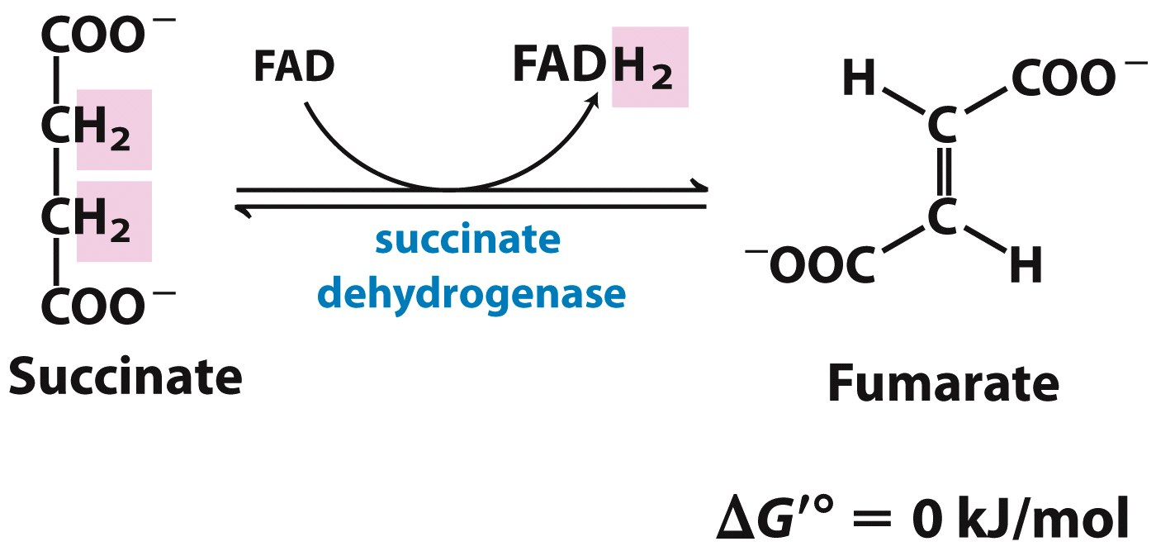
TCA Cycle
6. Succinate Dehydrogenase
Catalyzes the oxidation of succinate to fumerate
(tightly bound in enzyme)
ΔG ≈ 0
Where is this enzyme located in the cell and what other process is it a part of?
Succinate DH is tightly-bound to the inner mitochondrial membrane (eukaryotes) or plasm membrane (bacteria). It is also Complex II in the electron transport chain and is involved in oxidative phosphorylation
What type of inhibitor is malonate, which only differs from succinate by a -CH₂?
Competitive
How would the addition of malonate affect the V_{max} and K_{m} of succinate DH?
The V_{max} would be unchanged (V_{max} = V_{max}^{app}), while the K_{m} increases with [I]
K_{m} < K_{m}^{app}

Slide 51
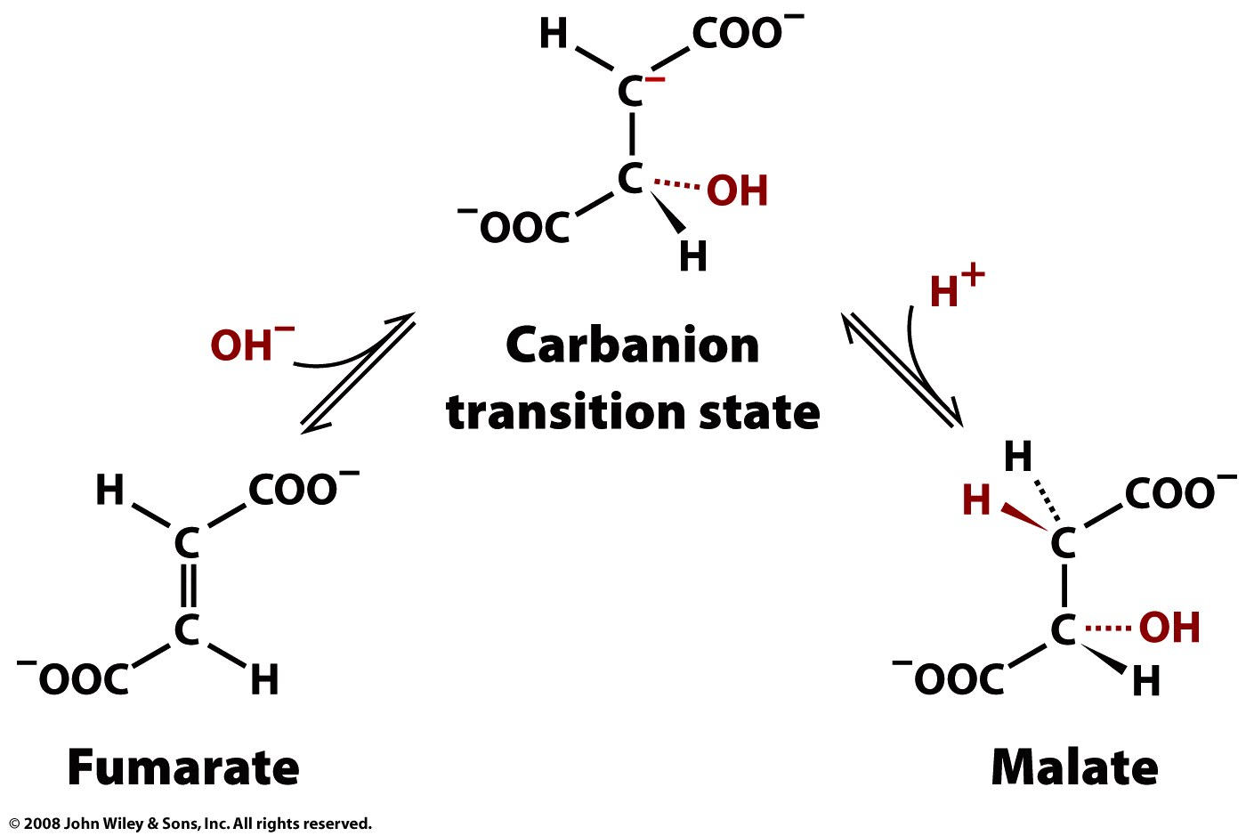
TCA Cycle
7. Fumerase
Catalyzes the hydration of fumerate to L-Malate
ΔG = - 0.9 kJ/mol
+ H₂O
- H₂O
What does the transition state look like?
The transition state has a carbanion
True or False:
Fumerase cannot differentiate between cis or trans isomers
FALSE. Fumerase is highly stereospecific. It catalyzes the hydration of the trans isomer (fumerate) and NOT the cis isomer (maleate). In the reverse direction, D-malate is NOT a substrate while L-malate is.

Slide 52
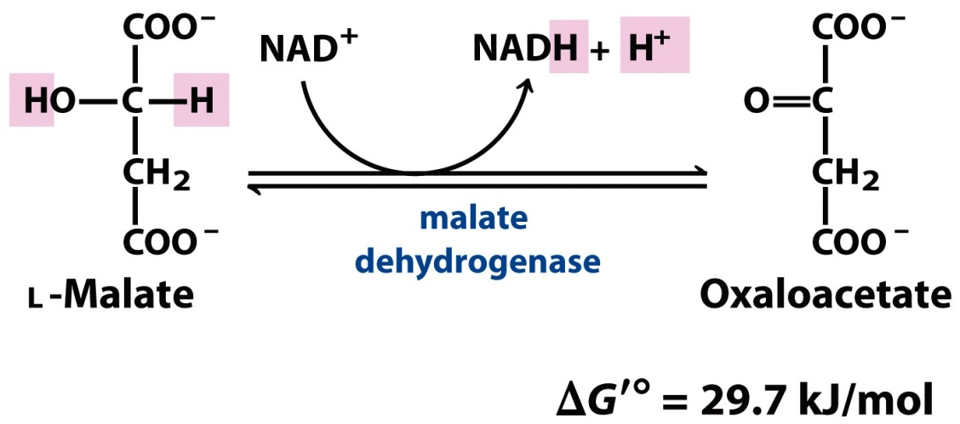
TCA Cycle
8. L-Malate Dehydrogenase
Catalyzes the oxidation of L-Malate to oxaloacetate
ΔG = + 7.0 kJ/mol
At standard conditions, the equilibrium of this reaction lies far to the left. Then why, in a cell, does this reaction proceed forward?
In intact cells, oxaloacetate is being continually removed by the highly exergonic reaction of citrate synthase (step #1). This keeps the [OAA] low and thus the equilibrium is shifted toward the formation of oxaloacetate
What does this teach you about ΔG’⁰ vs. ΔG?
The standard free energy change, ΔG’⁰, is a characteristic of a reaction that shows which direction a reaction proceeds and how far a reaction must go to reach equilibrium (remember @ equilibrium ΔG’⁰ = 0), therefore it’s a constant. The actual free energy change, ΔG, is function of the reactant and product concentrations (and temp), which may or may not by the same as standard conditions, therefore it is variable.

Slide 53
TCA Cycle Regulation
Under normal conditions, the rates of glycolysis (PDH) and TCA cycle are integrated so that only as much glucose is metabolized as needed to supply the TCA cycle with its fuel.
Basically this is an efficiency game and you can think of ATP and NADH as global regulators of metabolism. They reflect metabolic flux as well as the energy status of the cell.
Other factors in TCA cycle Regulation:
Product Inhibition
Substrate Availability
Allosteric feedback inhibition of enzyme that catalyze early steps in cycle

Slide 54
TCA Cycle Regulation
With that said….
Other than acting like a “global regulator,” how does NADH regulate the TCA cycle?
For isocitrate and α-KG dehydrogenases, it is a product inhibitor.
Other than acting like a “global regulator,” how does ATP regulate the TCA cycle?
For citrate synthase and isocitrate DH it is a feedback inhibitor because it is the final product from GTP catalyzed by nucleoside diphosphate kinase. For citrate synthase, ATP inhibition is relieved by ADP, an allosteric activator
Citrate is a product inhibitor for citrate synthase. What other type of metabolic inhibitor is citrate? Where in metabolism does this occur?
Citrate is a feedback inhibitor of phosphofructokinase (PFK-1) in glycolysis
Notes:
For L-Malate DH, which is not regulated since its reaction is essentially at equilibrium (think subtrate-limited), [OAA] is low when NADH/NAD⁺ is high, thus slowing the first step of the cycle, citrate synthase (which is regulated)

Slide 55
RECAP
So far glycolysis and the TCA cycle have achieved…
Carbons of glucose has been completely oxidized to CO₂
Substrate-level phosphorylation has conserved some of the energy released from oxidation
However, most of the energy is conserved (temporarily) in the reducing power of NADH and FADH₂

Slide 56
RECAP
So what’s next?
NADH and FADH₂ accept e⁻ from catabolic intermediates and transfer them, via a series of protein complexes to the final e⁻ acceptor, O₂
The energy released from this series of transfers drives the translocation of H⁺ across mitochondrial membrane
These H⁺ flow back across membrane via channels provided by ATP synthase, which is an enzyme complex that synthesizes ATP, in a process known as oxidative phosphorylation

Slide 57
Reduction Potentials
Reduction potential, E, measures how well a compound becomes reduced (accepts e⁻)
E’⁰ is the reduction potential of a substance at standard biochemical state
A high E’⁰ = a high affinity for e⁻
e⁻ move from a lower reduction potential to a higher reduction potential
The change in reduction potential is calculated:
ΔE = E_{(e- acceptor)} – E_{(e- donor)}
The change in free energy, can be related to the reduction potential:
ΔG⁰’ = -nFΔE⁰’ or ΔG = -nFΔE
where: n = # of e⁻ transferred (in biochemistry usually but not always 2)
F = Faraday’s constant (96.5 kJ V⁻¹ mol⁻¹)
The actual reduction potential can be calculated by:
$$E= E^{0′}+ \frac{RT}{nF}\ln{\frac{[e^{−}acceptor]}{[e^{−}donor]}}$$

Slide 58
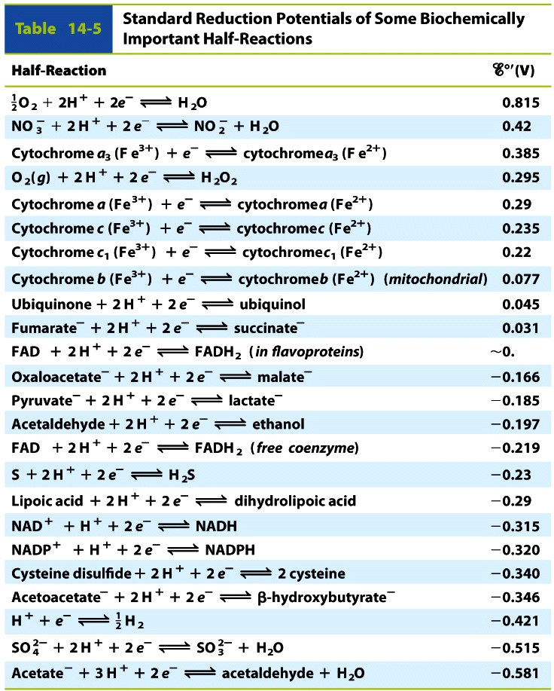
Reduction Potentials
Why is NADH and FADH₂ able to accept e⁻ from catabolic intermediates and donate them ultimately to O₂?
Electrons flow from lower to higher reduction potentials (can think lower affinity to higher affinity) and from the table to the right you can see that both NADH and FADH₂ have intermediate reduction potentials. Therefore they are able accept e⁻ from intermediates that have lower E’⁰ and donate them to O₂ that has the highest E’⁰ (via protein complexes)

Slide 59
Reduction Potentials
Why doesn’t NADH and FADH₂ directly donate their e⁻ O₂?
The direct e⁻ transfer from NADH/FADH₂ to O₂ in a single redox reaction would be highly spontaneous but not efficient in order to maximize ATP production
Alternatively, the e⁻ are passed through a series of protein complexes, containing multiple redox centers, with increasingly higher and higher reduction potentials until finally to O₂. This is process is called the electron transport chain (ETC) and it releases energy in small increments to maximize ATP production

Slide 60
Electron Transport Chain

Slide 61
Electron Transport Chain
Electrons flow from lower reduction potential to increasingly higher reduction potentials with the change in free energy becoming more favorable by decreasing in + value
E’⁰
ΔG’⁰
_
+
+
_

Slide 62
Electron Transport Chain
Complex I:
NADH + H⁺ + Q → NAD⁺ + CoQH
2 e⁻ from NADH are transferred to CoQ
QH₂ diffuses in membrane from comp I to comp III
4 H⁺ are pumped from matrix to IM space
Complex II
Succinate + Q → Fumerate + QH₂
2 e⁻ from FADH₂ are transferred to CoQ
Does NOT pump any protons!
Complex III
QH₂ + 2 cyt c­₁ → Q + 2 cyt c₁
Transfers e⁻ from CoQ to cyt c one e⁻ at a time
4 H⁺ are pumped to IM space
Complex IV
2 cyt c₁ + 2H⁺ + ½ O₂ → 2 cyt c₁ + H₂O
Accepts one e⁻ at a time from cyt c
Donates a total of 4 electrons per O₂ molecule
2 H⁺ are pumped to IM space
Overview

Slide 63
Electron Transport Chain
What is special about the FMN’s ability to transfer e⁻ in Complex I?
Overview
It has the ability to transfer 1 or 2 e⁻ allowing it to mediate between accept 2 e⁻ from NADH and donating them one at a time to the Fe/S centers, which only accept 1 e⁻
Where do the protons on QH₂ come from?
CoQ binds to complexes I and II near the interface of the matrix and the inner mitochondrial membrane, therefore it picks up its protons from the matrix
Would raising the pH of the fluid in the intermembrane space result in ATP synthesis in the matrix?
No. Raising the pH would eliminate the H⁺ gradient, which is the essential driving force of ATP synthase.
* Remember that in a gradient substances flow from higher concentration to lower concentration. Raising the pH would decrease the [H⁺] and they would no longer flow back toward the matrix (pH_{inside} ≈ pH_{outside})

Slide 64
Electron Transport Chain
E^{0'} _ + | mitochondria membrane protein complex |  | Full name |  | redox center | oxidized | reduced | e⁻ passed | H⁺ pumped
 | Complex I | Complex II | I | NADH-coenzyme Q oxidoreductase | FMN, ion-sulfer clusters | NADH | Q | 2 | 4
 |  |  | II | succinate-coenzyme Q oxidoreductase | FAD, ion-sulfer cluster | FADH₂ | Q | 2 | 0
 | Complex III |  | coenzyme Q-cytochrome c oxidoreductase |  | cytochrome c₁, b_{L}, and b_{H,} ion-sulfer protein | QH₂ | cyt c | 2 | 4
 | Complex IV |  | cytochrome c oxidase |  | cytochrome a, cytochrome a₃, Cu_{B}, Cu_{A} | cyt c | O₂ | 2 | 2

Slide 65
ATP Synthase
Enzyme complex that catalyzes the formation of ATP
ADP + P_{i} → ATP + H₂O
Overview
The F_{o} Complex
Membrane-spanning
13 subunits total
10 c subunits (c₁₀) form a ring in membrane and acts as a pore to carry H⁺
2 b subunits (b₂) act to stabilize the F₁ subunit relative to membrane and c+10 ring
1 a subunit
The F₁Complex
Attached to F_{o} and protrudes out toward the matrix
Where ATP synthesis occurs
5 different subunits (α₃ β₃ γ δ ε)
3 αβ dimers surround the central shaft, γ, each with a slightly different conformational state, which affect the affinity in which they bind ADP, P_{i}, and ATP
Each β has one catalytic acitve site for ATP synthesis

Slide 66
ATP Synthase
Enzyme complex that catalyzes the formation of ATP
ADP + P_{i} → ATP + H₂O
“Binding change” Mechanism
Stator
The c₁₀ subunits in the F_{o} complex and the ε γ subunits in the F₁ complex act as the rotor (rotates)
The α β₂ δ subunits in the F₁ complex act as the stator (remain stationary relative to the rotor)
Every time 3 H⁺ are bound and released in the c₁₀ subunits, the rotor rotates 120⁰
As the rotor moves past each αβ dimer, it induces a conformational change
Each 120⁰ rotation results in the synthesis of 1 ATP
Rotor

Slide 67
ATP Synthase
Enzyme complex that catalyzes the formation of ATP
ADP + P_{i} → ATP + H₂O
The αβ dimers participate in 3 different conformational states
L
T
Loose (ADP and P₁ binding)
Tight (ATP formation)
Open (empty)
O
Paul Boyer (of Boyer Hall fame at UCLA) proposed a rotational catalysis mechanism is which each active site takes turns catalyzing the synthesis of ATP
The subunits act in such a way that when one adopts the open state, the one next to it MUST adopt the Loose state and the one next to that MUST adopt the Tight state and so forth

Slide 68
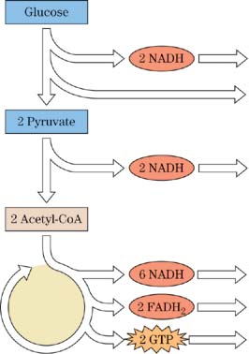
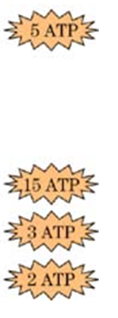
ATP Counts
P/O ratios for FADH₂ and NADH
$$\frac{10 H^{+}pumped}{2e^{−} from NADH}×\frac{ATP}{4H^{+}}=2.5$$
$$\frac{6 H^{+}pumped}{2e^{−} from {FADH}_{2}}×\frac{ATP}{4H^{+}}=1.5$$
Straight to CoQ
(via Glcerol-3-P DH) from IM Space
Transferred from IM space
to matrix via malate
or
Substrate-level phosphorylation
What is the total ATP count for an anarobic organism?
2
(substrate-level phosphorylation)
Oxidative phosphorylation
What is the total ATP count for an aerobic organism?
30 or 32
(substrate-level phosphorylation and oxidative phosphorylation)

Slide 69
ATP Synthase Animation
http://www.dnatube.com/video/104/ATP-synthase-structure-and-mechanism

Slide 70
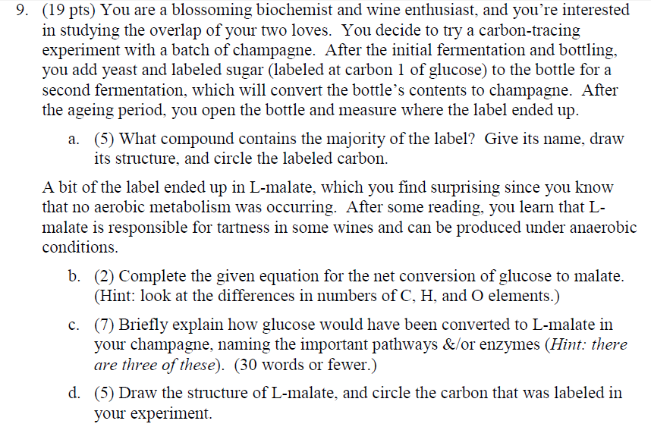
Previous Exam Questions

Slide 71
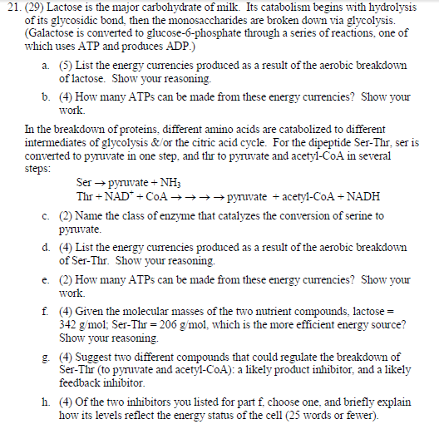
Previous Exam Questions

Slide 72
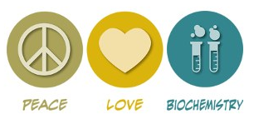
Great luck studying!
Thanks for a great quarter, biochemists!
P.S. Yes, yes you can ☺

