Slide 1
Practice Problems or How to put the pieces of the puzzle correctly together?

Slide 2
Proposed Algorithm
1. Carbonyl (C=O, 1630-1800 cm⁻¹ (strong), see table for further details)
2. Hydroxyl (OH, 3200-3600 cm⁻¹ (broad, strong))
3. Amino (NH_{x}, 3200-3400 cm⁻¹ (medium-strong), less intense and less broad than OH, one peak for secondary amine, two peaks for primary amine)
4. C-H functions (sp³, <3000 cm⁻¹, sp² 3000-3100 cm⁻¹, sp ~3300 cm⁻¹ for stretching), (1465-1370 cm⁻¹ for CH₂ and CH₃ bending)
5. Triple bonds (C≡C ~2100-2250 cm⁻¹, C­≡N ~2200-2250 cm⁻¹ (medium-weak))
6. Double bonds (C=C, alkene ~1650 cm⁻¹ (medium), aromatic 1450-1600 cm⁻¹)
7. Nitro group (two peaks: ~1300-1400 cm⁻¹, ~1500-1600 cm⁻¹(strong))
8. Sulfone group (two peaks: ~1140-1200 cm⁻¹, ~1300-1400 cm⁻¹(strong))
9. Carbon-Oxygen bond (two peaks between 1000-1300 cm⁻¹ (strong))
10. Carbon-Halogen bond (F: 1000-1200 cm⁻¹, Cl: 700-900 cm⁻¹, Br: 500-700 cm⁻¹ (medium-strong))
11. Out of plane bending for alkenes and aromatic systems (700-1000 cm⁻¹ (medium-strong))

Slide 3
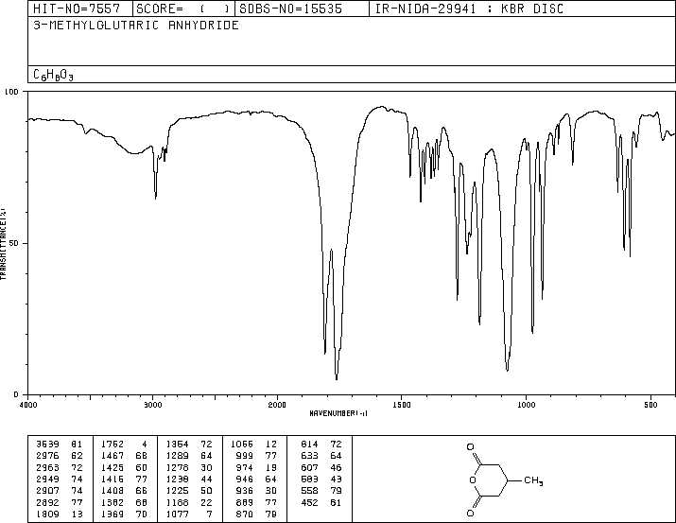
Spectrum 1
ν(C-H, sp³)
ν(C=O)
ν(COC)
Carbonyl group
Hydroxyl group
Amino group
C-H functions
Triple bonds
Double bonds
Nitro group
Carbon-Oxygen bond
Carbon-Halogen bond

Slide 4
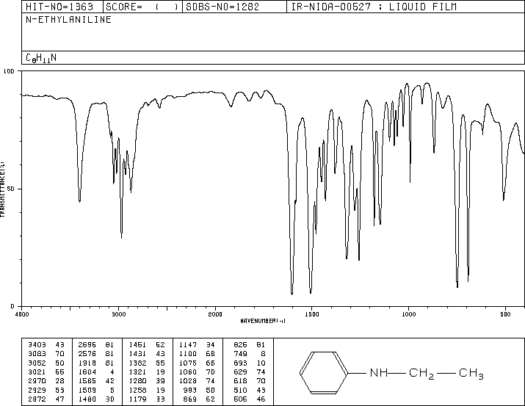
Spectrum 2
ν(NH)
ν(C-H, sp³)
ν(C-H, sp²)
ν(C=C)
Oop, mono
Carbonyl group
Hydroxyl group
Amino group
C-H functions
Triple bonds
Double bonds
Nitro group
Carbon-Oxygen bond
Carbon-Halogen bond

Slide 5
Spectrum 3
ν(OH)
ν(C-H, sp³)
ν(C=C)
ν(C-H, sp²)
ν(C-OH)
Oop, mono
Carbonyl group
Hydroxyl group
Amino group
C-H functions
Triple bonds
Double bonds
Nitro group
Carbon-Oxygen bond
Carbon-Halogen bond

Slide 6
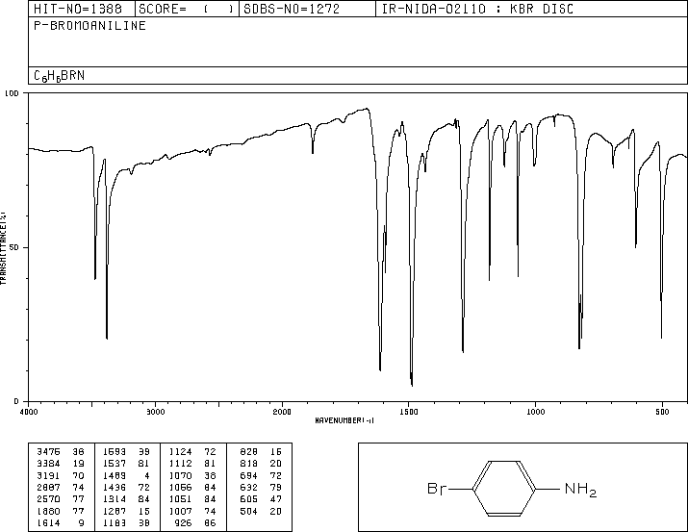
Spectrum 4
δ(NH₂)
ν(NH₂)
ν(C=C)
Oop, para
Carbonyl group
Hydroxyl group
Amino group
C-H functions
Triple bonds
Double bonds
Nitro group
Carbon-Oxygen bond
Carbon-Halogen bond

Slide 7
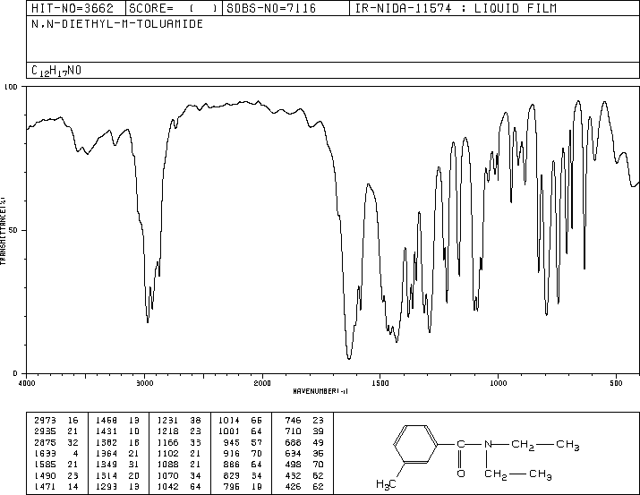
Spectrum 5
ν(C-H, sp²)
ν(C-H, sp³)
ν(C=O)
ν(C=C)
Carbonyl group
Hydroxyl group
Amino group
C-H functions
Triple bonds
Double bonds
Nitro group
Carbon-Oxygen bond
Carbon-Halogen bond

Slide 8
Spectrum 6
ν(C-D)
ν(C-Cl)
Carbonyl group
Hydroxyl group
Amino group
C-H functions
Triple bonds
Double bonds
Nitro group
Carbon-Oxygen bond
Carbon-Halogen bond

Slide 9
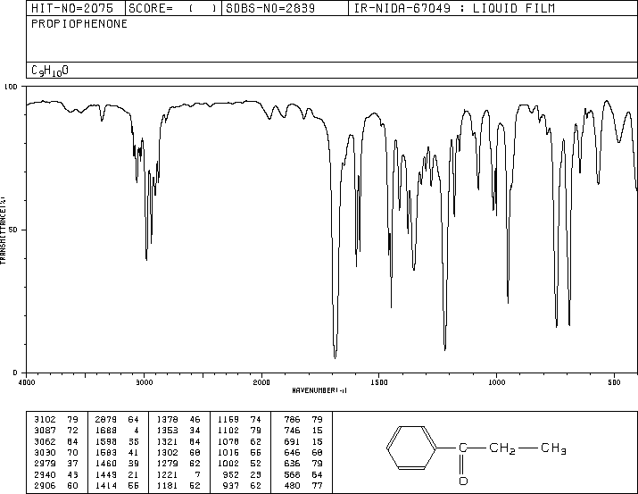
Spectrum 7
ν(C-H, sp²)
ν(C-H, sp³)
ν(C=O)
ν(C=C)
ν_{as}(CCC)
Oop, mono
Carbonyl group
Hydroxyl group
Amino group
C-H functions
Triple bonds
Double bonds
Nitro group
Carbon-Oxygen bond
Carbon-Halogen bond

Slide 10
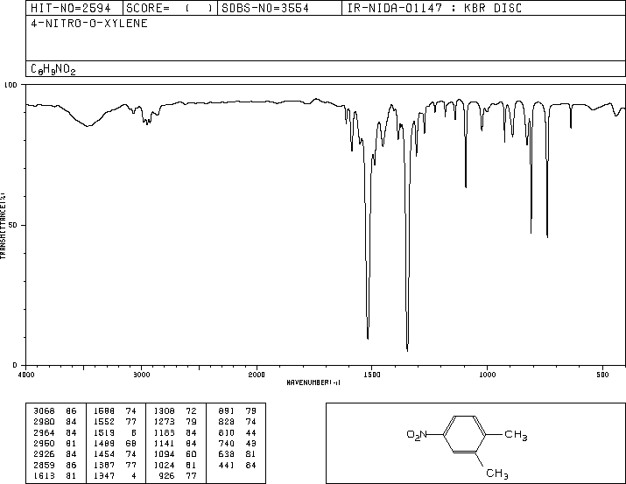
Spectrum 8
ν(C-H, sp²)
ν(C-H, sp³)
ν(C=C)
ν(NO₂)
Carbonyl group
Hydroxyl group
Amino group
C-H functions
Triple bonds
Double bonds
Nitro group
Carbon-Oxygen bond
Carbon-Halogen bond

Slide 11
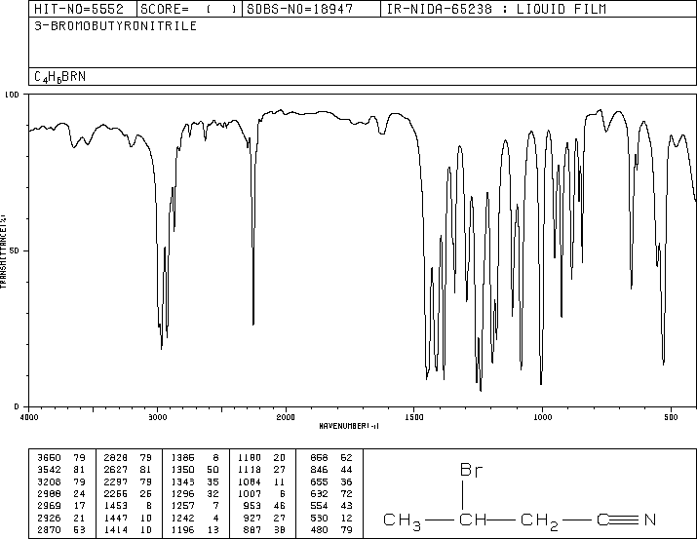
Spectrum 9
ν(C≡N)
ν(C-H, sp³)
ν(C-Br)
Carbonyl group
Hydroxyl group
Amino group
C-H functions
Triple bonds
Double bonds
Nitro group
Carbon-Oxygen bond
Carbon-Halogen bond

Slide 12
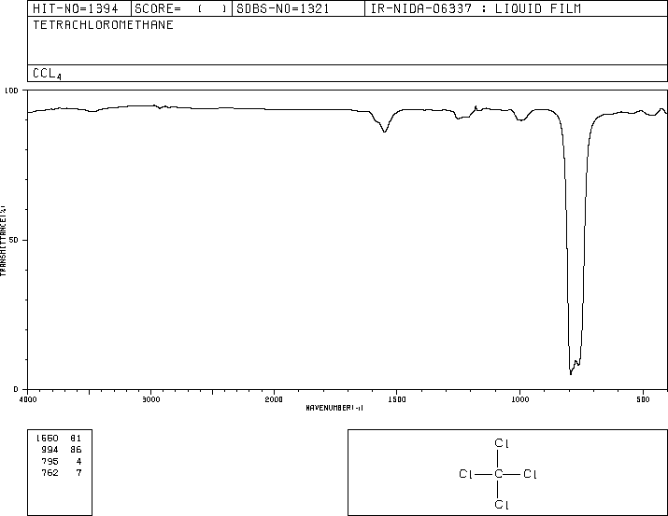
Spectrum 10
ν(C-Cl)
Carbonyl group
Hydroxyl group
Amino group
C-H functions
Triple bonds
Double bonds
Nitro group
Carbon-Oxygen bond
Carbon-Halogen bond

Slide 13
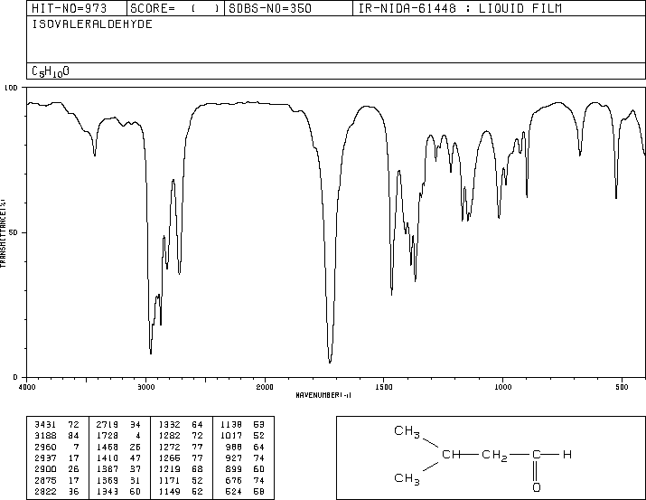
Spectrum 11
ν(CHO)
ν(C-H, sp³)
ν(C=O)
Carbonyl group
Hydroxyl group
Amino group
C-H functions
Triple bonds
Double bonds
Nitro group
Carbon-Oxygen bond
Carbon-Halogen bond

Slide 14
Spectrum 12
ν(NH₂)
δ(NH₂)
ν(C-H, sp³)
Carbonyl group
Hydroxyl group
Amino group
C-H functions
Triple bonds
Double bonds
Nitro group
Carbon-Oxygen bond
Carbon-Halogen bond

Slide 15
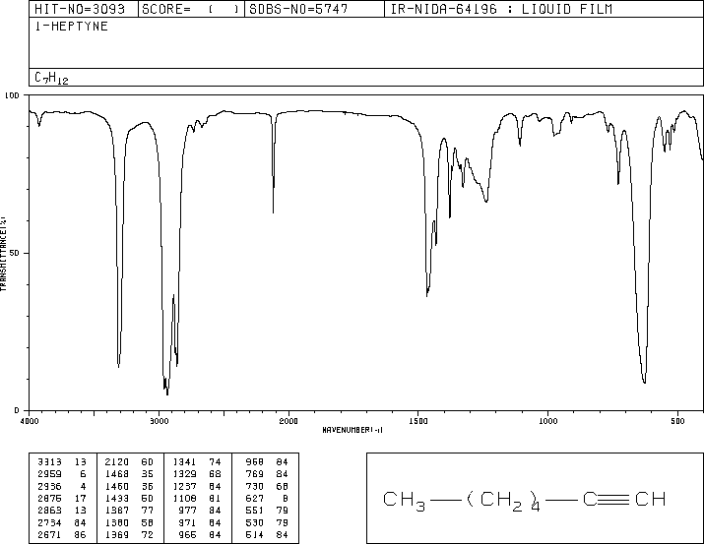
Spectrum 13
ν(C≡C)
ν(C-H, sp)
ν(C-H, sp³)
δ(CH, sp)
Carbonyl group
Hydroxyl group
Amino group
C-H functions
Triple bonds
Double bonds
Nitro group
Carbon-Oxygen bond
Carbon-Halogen bond

Slide 16
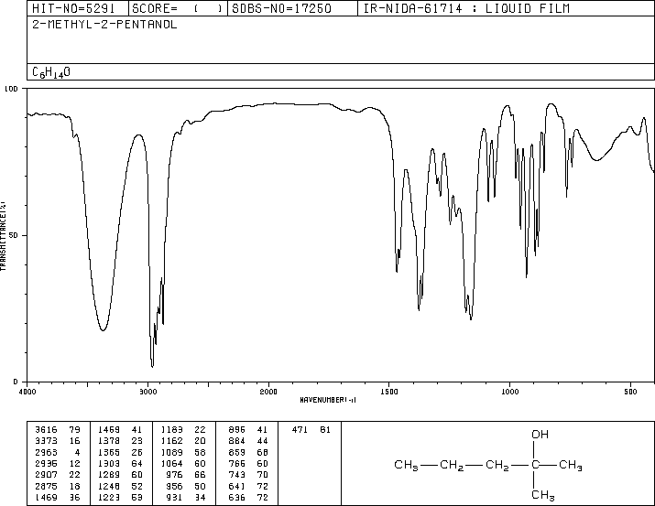
Spectrum 14
ν(OH)
ν(C-H, sp³)
ν(C-OH)
Carbonyl group
Hydroxyl group
Amino group
C-H functions
Triple bonds
Double bonds
Nitro group
Carbon-Oxygen bond
Carbon-Halogen bond

Slide 17
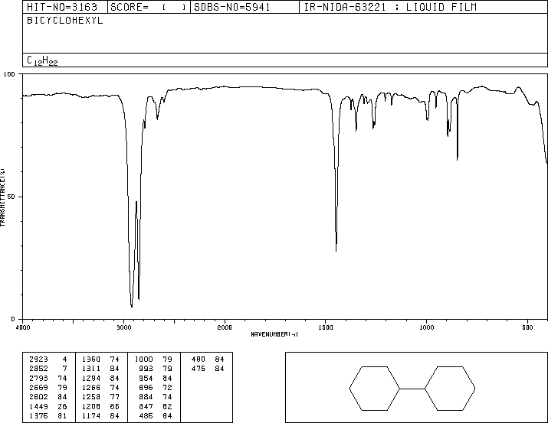
Spectrum 15
δ(CH₂)
ν(C-H, sp³)
Carbonyl group
Hydroxyl group
Amino group
C-H functions
Triple bonds
Double bonds
Nitro group
Carbon-Oxygen bond
Carbon-Halogen bond

Slide 18
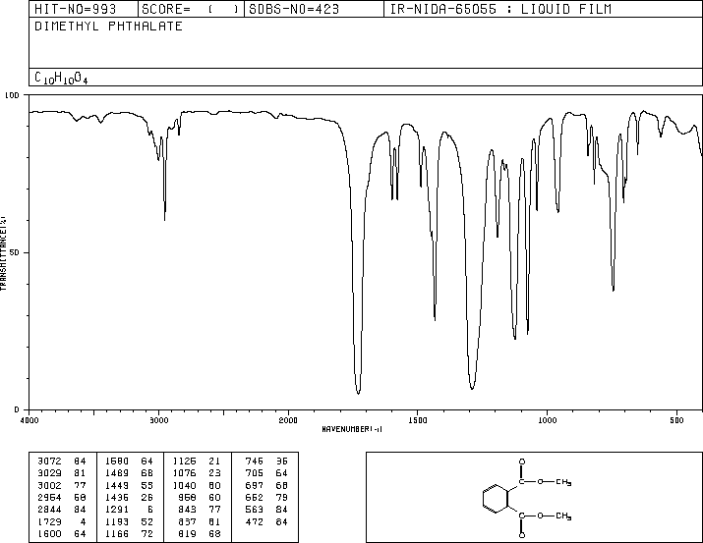
Spectrum 16
ν(C-H, sp²)
ν(C-H, sp³)
ν(C=O)
ν(C=C)
Oop, ortho
ν(COC)
Carbonyl group
Hydroxyl group
Amino group
C-H functions
Triple bonds
Double bonds
Nitro group
Carbon-Oxygen bond
Carbon-Halogen bond

Slide 19
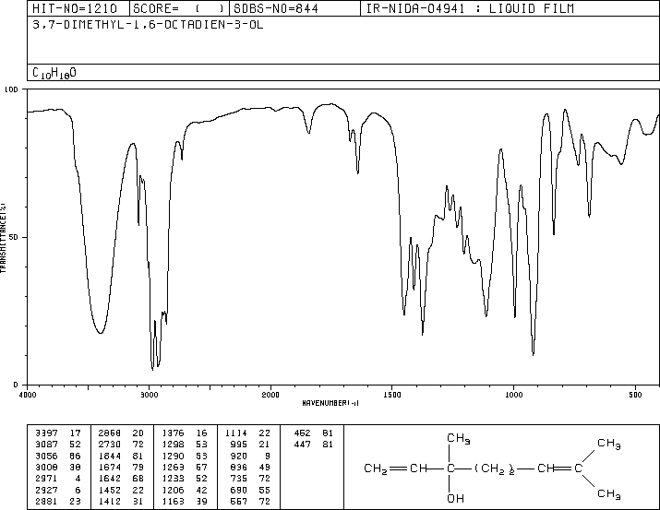
Spectrum 17
ν(OH)
ν(C=C)
ν(C-H, sp²)
ν(C-H, sp³)
ν(C-OH)
oop, mono
Carbonyl group
Hydroxyl group
Amino group
C-H functions
Triple bonds
Double bonds
Nitro group
Carbon-Oxygen bond
Carbon-Halogen bond

Slide 20
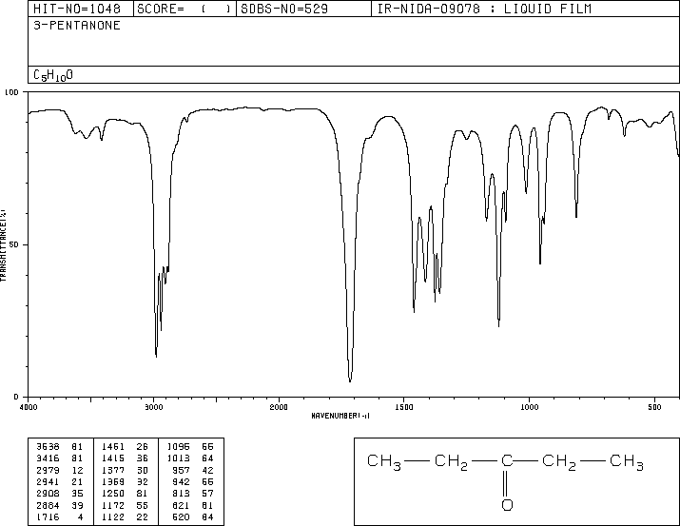
Spectrum 18
ν(C-H, sp³)
ν(C=O)
ν_{as}(CCC)
Carbonyl group
Hydroxyl group
Amino group
C-H functions
Triple bonds
Double bonds
Nitro group
Carbon-Oxygen bond
Carbon-Halogen bond

Slide 21
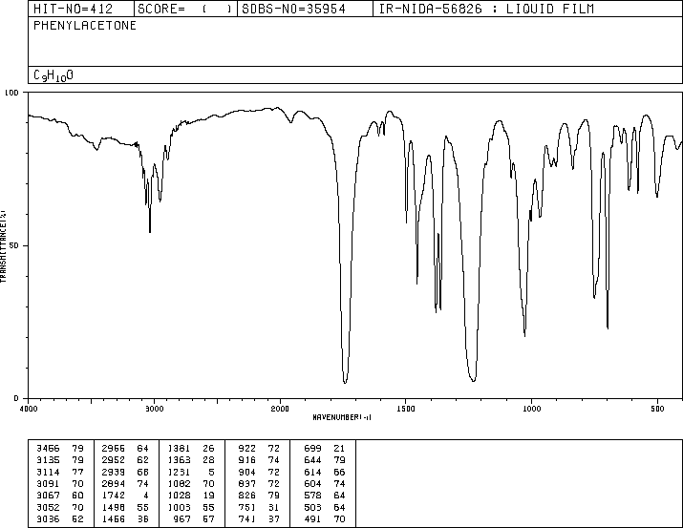
Spectrum 19
ν(C-H, sp²)
ν(C-H, sp³)
ν(C=O)
oop, mono
ν(C=C)
ν_{as}(CCC)
Carbonyl group
Hydroxyl group
Amino group
C-H functions
Triple bonds
Double bonds
Nitro group
Carbon-Oxygen bond
Carbon-Halogen bond

Slide 22
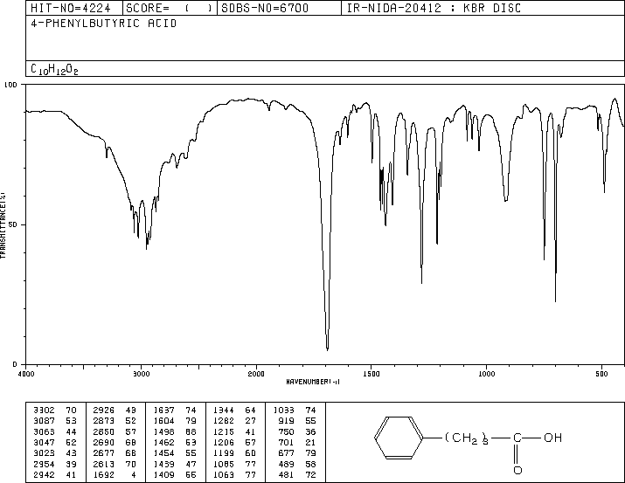
Spectrum 20
ν(OH)
ν(C-H, sp³)
oop, mono
ν(C=O)
ν(C=C)
Carbonyl group
Hydroxyl group
Amino group
C-H functions
Triple bonds
Double bonds
Nitro group
Carbon-Oxygen bond
Carbon-Halogen bond

Slide 23
Final Words
In order to identify a compound, it is usually not necessary to assign every peak in the spectrum
The focus should be on peaks that help to identify key functional groups in the molecule (zone analysis)
Developing an algorithm to solve spectroscopic problems helps a lot mastering this skill
When performing a reaction in the lab, it is good practice to research the spectra for the product, all reactants, the solvents and other compounds used in the experiment
Acquiring a quality spectrum in the lab makes the identification of the compound much easier

