Slide 1
Practice Problems or How to put the pieces of the puzzle correctly together?

Slide 2
Proposed Algorithm
1. Carbonyl (C=O, 1630-1800 cm⁻¹ (strong), see table for further details)
2. Hydroxyl (OH, 3200-3600 cm⁻¹ (broad, strong))
3. Amino (NH_{x}, 3200-3400 cm⁻¹ (medium-strong), less intense and less broad than OH, one peak for secondary amine, two peaks for primary amine)
4. C-H functions (sp³, <3000 cm⁻¹, sp² 3000-3100 cm⁻¹, sp ~3300 cm⁻¹ for stretching), (1465-1370 cm⁻¹ for CH₂ and CH₃ bending)
5. Triple bonds (C≡C ~2100-2250 cm⁻¹, C­≡N ~2200-2250 cm⁻¹ (medium-weak))
6. Double bonds (C=C, alkene ~1650 cm⁻¹ (medium), aromatic 1450-1600 cm⁻¹)
7. Nitro group (two peaks: ~1300-1400 cm⁻¹, ~1500-1600 cm⁻¹(strong))
8. Sulfone group (two peaks: ~1140-1200 cm⁻¹, ~1300-1400 cm⁻¹(strong))
9. Carbon-Oxygen bond (two peaks between 1000-1300 cm⁻¹ (strong))
10. Carbon-Halogen bond (F: 1000-1200 cm⁻¹, Cl: 700-900 cm⁻¹, Br: 500-700 cm⁻¹ (medium-strong))
11. Out of plane bending for alkenes and aromatic systems (700-1000 cm⁻¹ (medium-strong))

Slide 3
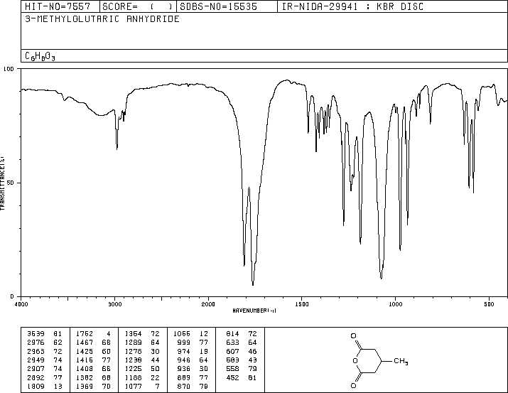
Spectrum 1
Carbonyl group
Hydroxyl group
Amino group
C-H functions
Triple bonds
Double bonds
Nitro group
Carbon-Oxygen bond
Carbon-Halogen bond

Slide 4
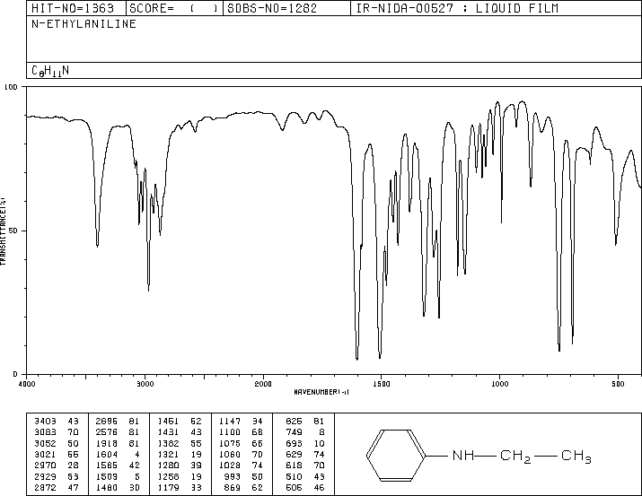
Spectrum 2
Carbonyl group
Hydroxyl group
Amino group
C-H functions
Triple bonds
Double bonds
Nitro group
Carbon-Oxygen bond
Carbon-Halogen bond

Slide 5
Spectrum 3
Carbonyl group
Hydroxyl group
Amino group
C-H functions
Triple bonds
Double bonds
Nitro group
Carbon-Oxygen bond
Carbon-Halogen bond

Slide 6
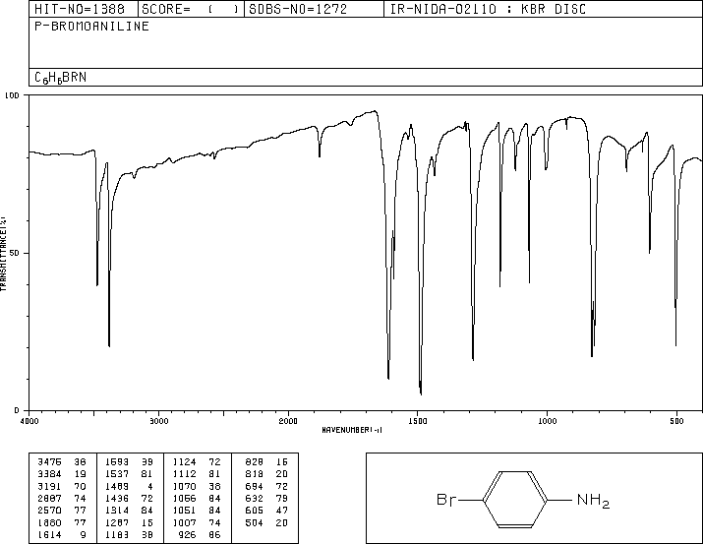
Spectrum 4
Carbonyl group
Hydroxyl group
Amino group
C-H functions
Triple bonds
Double bonds
Nitro group
Carbon-Oxygen bond
Carbon-Halogen bond

Slide 7
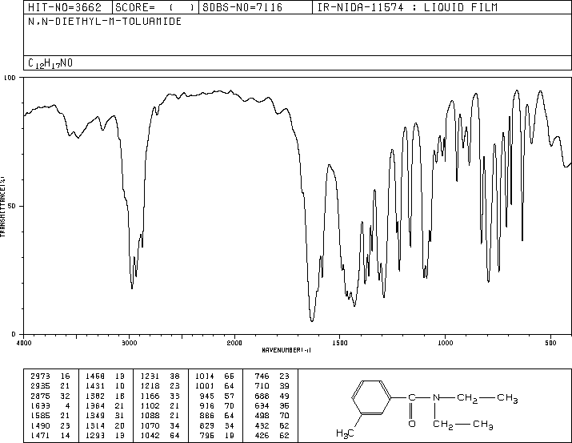
Spectrum 5
Carbonyl group
Hydroxyl group
Amino group
C-H functions
Triple bonds
Double bonds
Nitro group
Carbon-Oxygen bond
Carbon-Halogen bond

Slide 8
Spectrum 6
Carbonyl group
Hydroxyl group
Amino group
C-H functions
Triple bonds
Double bonds
Nitro group
Carbon-Oxygen bond
Carbon-Halogen bond

Slide 9
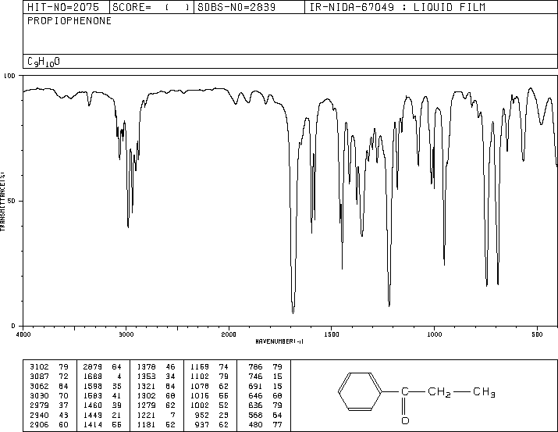
Spectrum 7
Carbonyl group
Hydroxyl group
Amino group
C-H functions
Triple bonds
Double bonds
Nitro group
Carbon-Oxygen bond
Carbon-Halogen bond

Slide 10
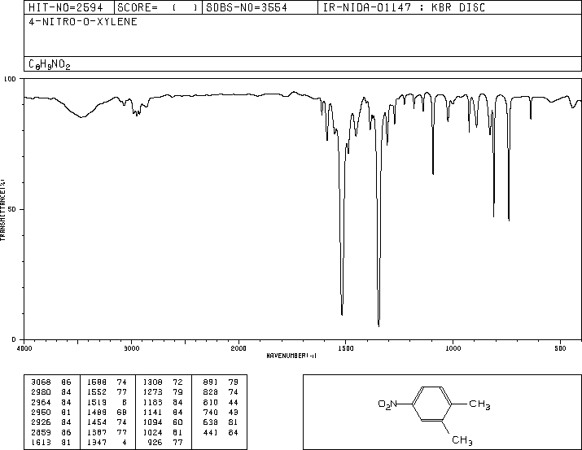
Spectrum 8
Carbonyl group
Hydroxyl group
Amino group
C-H functions
Triple bonds
Double bonds
Nitro group
Carbon-Oxygen bond
Carbon-Halogen bond

Slide 11
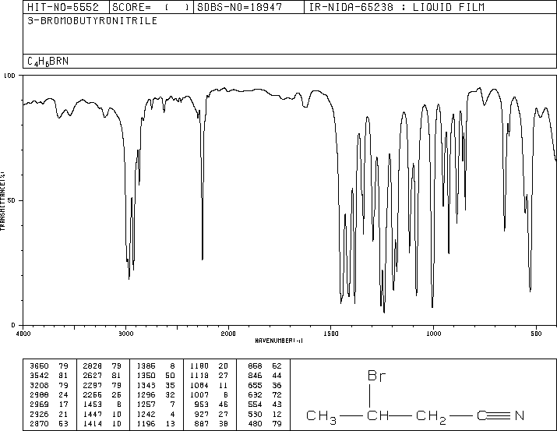
Spectrum 9
Carbonyl group
Hydroxyl group
Amino group
C-H functions
Triple bonds
Double bonds
Nitro group
Carbon-Oxygen bond
Carbon-Halogen bond

Slide 12
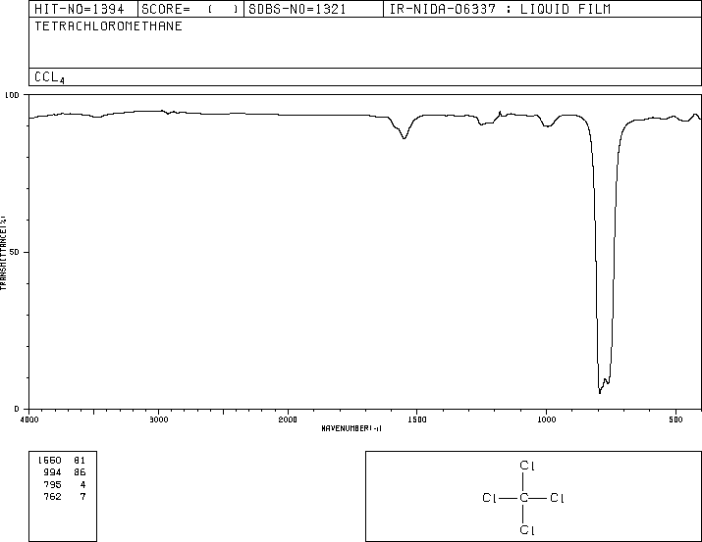
Spectrum 10
Carbonyl group
Hydroxyl group
Amino group
C-H functions
Triple bonds
Double bonds
Nitro group
Carbon-Oxygen bond
Carbon-Halogen bond

Slide 13
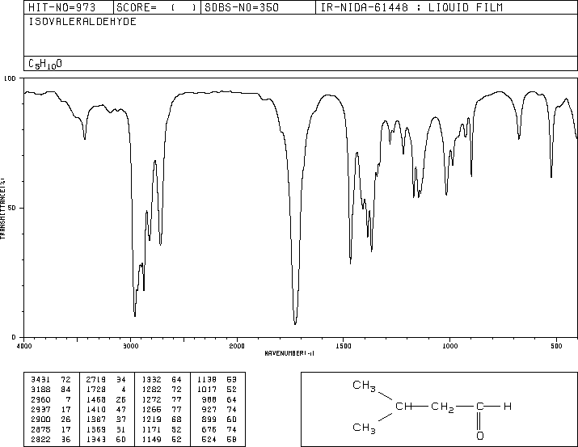
Spectrum 11
Carbonyl group
Hydroxyl group
Amino group
C-H functions
Triple bonds
Double bonds
Nitro group
Carbon-Oxygen bond
Carbon-Halogen bond

Slide 14
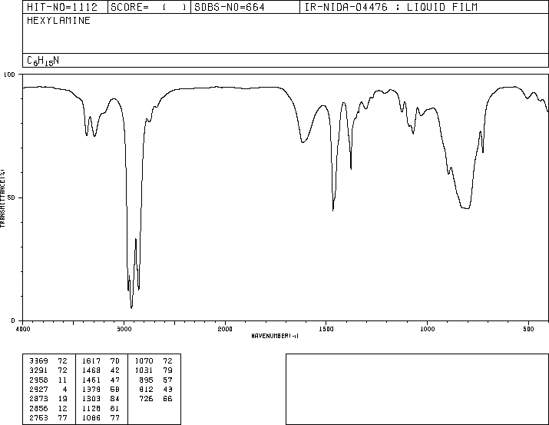
Spectrum 12
Carbonyl group
Hydroxyl group
Amino group
C-H functions
Triple bonds
Double bonds
Nitro group
Carbon-Oxygen bond
Carbon-Halogen bond

Slide 15
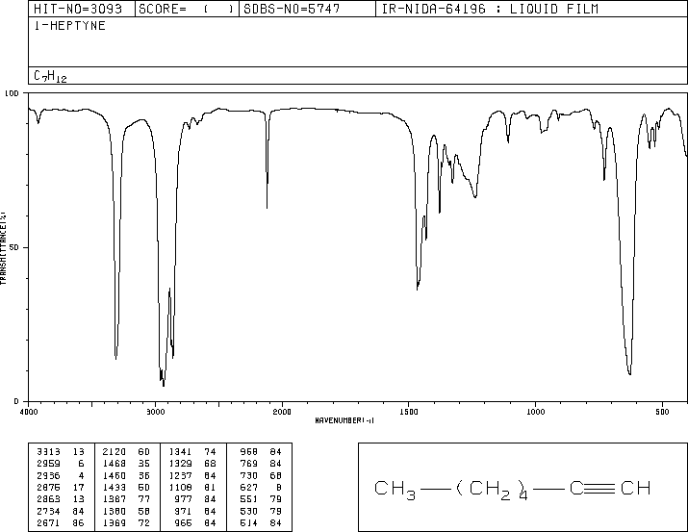
Spectrum 13
Carbonyl group
Hydroxyl group
Amino group
C-H functions
Triple bonds
Double bonds
Nitro group
Carbon-Oxygen bond
Carbon-Halogen bond

Slide 16
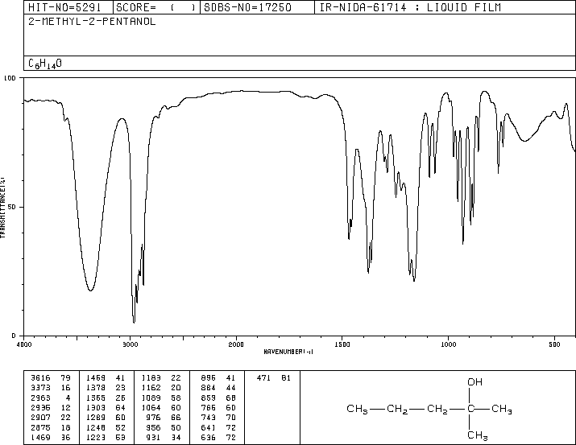
Spectrum 14
Carbonyl group
Hydroxyl group
Amino group
C-H functions
Triple bonds
Double bonds
Nitro group
Carbon-Oxygen bond
Carbon-Halogen bond

Slide 17
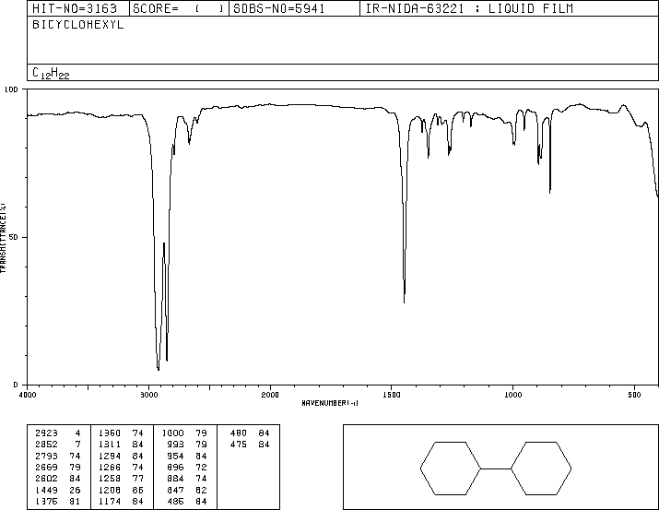
Spectrum 15
Carbonyl group
Hydroxyl group
Amino group
C-H functions
Triple bonds
Double bonds
Nitro group
Carbon-Oxygen bond
Carbon-Halogen bond

Slide 18
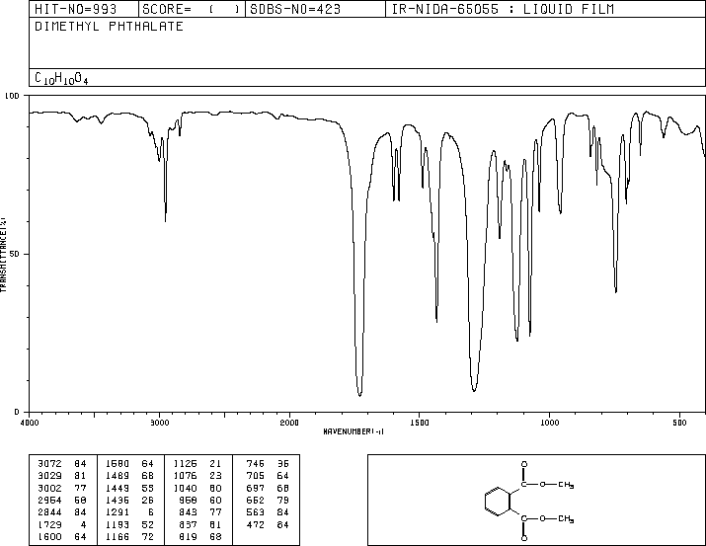
Spectrum 16
Carbonyl group
Hydroxyl group
Amino group
C-H functions
Triple bonds
Double bonds
Nitro group
Carbon-Oxygen bond
Carbon-Halogen bond

Slide 19
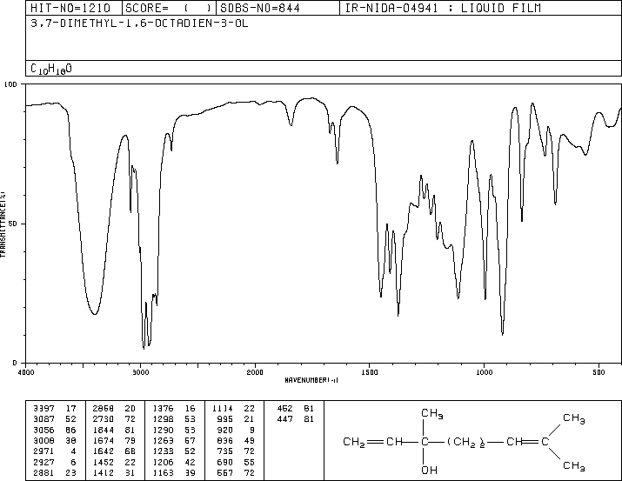
Spectrum 17
Carbonyl group
Hydroxyl group
Amino group
C-H functions
Triple bonds
Double bonds
Nitro group
Carbon-Oxygen bond
Carbon-Halogen bond

Slide 20
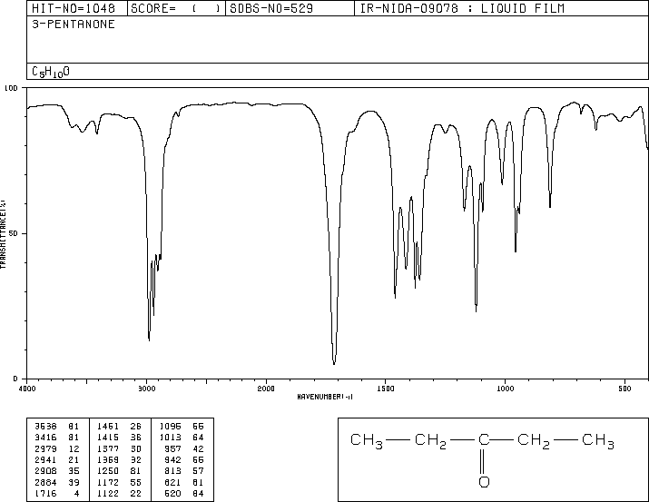
Spectrum 18
Carbonyl group
Hydroxyl group
Amino group
C-H functions
Triple bonds
Double bonds
Nitro group
Carbon-Oxygen bond
Carbon-Halogen bond

Slide 21
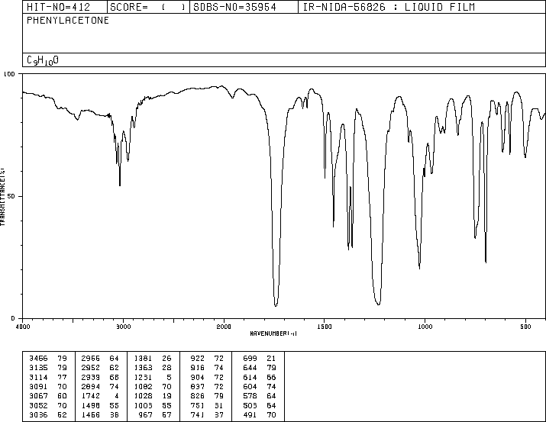
Spectrum 19
Carbonyl group
Hydroxyl group
Amino group
C-H functions
Triple bonds
Double bonds
Nitro group
Carbon-Oxygen bond
Carbon-Halogen bond

Slide 22
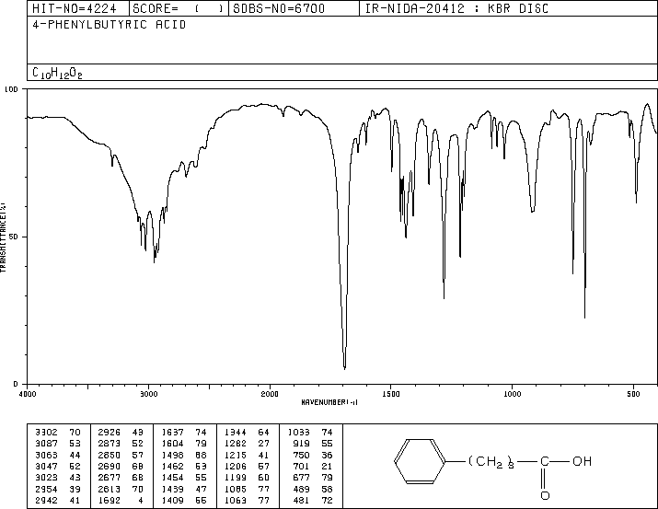
Spectrum 20
Carbonyl group
Hydroxyl group
Amino group
C-H functions
Triple bonds
Double bonds
Nitro group
Carbon-Oxygen bond
Carbon-Halogen bond

