Slide 1


Introduction to Infrared Spectroscopy or
Molecular Gymnastics

Slide 2
The Spectroscopy Tool Shed
Which methods are used in the organic chemistry lab?
Technique | Wavelength Range | Observation | Information | Matrix
Infrared Spectroscopy (Raman Spectroscopy) | 10⁻⁶…10⁻³ m (200 - 4000 cm⁻¹) | Rotation and vibration in molecules | Presence of functional groups Symmetry | Solid (KBr), Liquid, Gas
NMR Spectroscopy | 1 m …. 10 m | Nuclear spins in magnetic field | Structural information about molecules based on splitting pattern | Liquid, Solid, (Gas)
UV-Vis Spectroscopy | 10⁻⁸ …. 10⁻⁶ m (200 - 800 nm) | Excitation of electrons from bonding/non-bonding to anti-bonding orbitals | Conjugation Quantitative description of color | Liquid, Solid
Mass Spectrometry | 1 …. 1000 amu | Fragmentation of molecules | Molecular weight Structural information from fragmentation pattern | “Gas”
EPR Spectroscopy | 0.01 …. 0.1 m | Electron spins in the magnetic field | Location of unpaired electrons in paramagnetic compounds | Solid, Liquid
X-Ray Diffraction | 10⁻¹¹ …. 10⁻⁸ m | Diffraction of X-rays on nuclei in a solid | Crystal structure | Solid

Slide 3
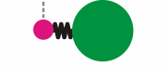

The Basic Equation
Vibrational modes within a molecule can be
described using the (an)harmonic oscillator model.
This model assumes that the two masses (with known mass) are connected with a spring (with known strength).
  What is wrong with this picture?
Using this model and the help of quantum mechanical calculations (Schrödinger equation), the frequencies of basic stretching and bending modes are obtained by
μ₁, μ₂ = masses of involved atoms, F=force constant (in N/cm)
In chemistry, the modes are measured in wavenumber in units of “cm⁻¹” while engineers often use “μm” (4000 cm⁻¹ = 2.5 μm).

Slide 4
Effect of Bond Strength
If the force constant F, which relates to the bond strength, increases, the wavenumber for the stretching mode will increase as well as shown below:
  A double bond is about twice as strong compared to a single bond, and the ν(C=C) stretching mode increases by a factor of x= ~√2.
  Similar trends are observed for C-O and C-N bonds as well.
CC bond | triple | double | single
Functional group | alkyne | alkene | alkane
Bond strength | 966 kJ/mol | 727 kJ/mol | 376 kJ/mol
Bond distance | 120 pm | 133 pm | 154 pm
ν (in cm⁻¹) | ~2150 | ~1650 | ~1130

Slide 5
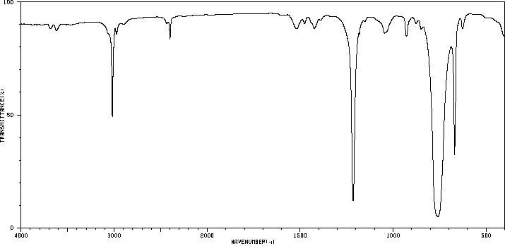
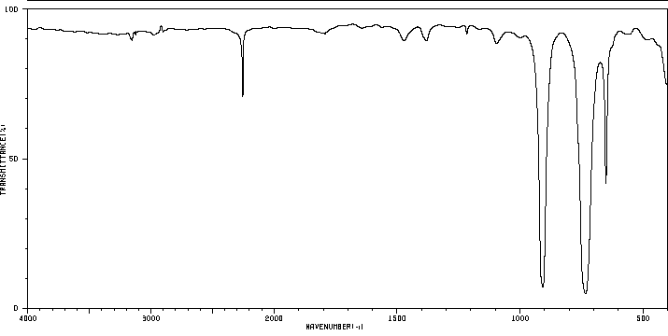
Effect of Mass
If the masses m of the involved atoms increase,
the peak will shift to lower wavenumbers
i.e., H/D-exchange in labeling experiments
where the bond strength remains almost constant.
In chloroform (CHCl₃) all peaks involving
a movement of the hydrogen atom move to
the right in deuterochloroform (CDCl₃)
i.e., ν(CH)=3019 cm⁻¹, ν(CD)=2254 cm⁻¹.
The other peaks in the infrared spectrum (ν_{as}(CCl₃): 761 cm⁻¹ to 736 cm⁻¹, ν_{s}(CCl₃): 668 cm⁻¹ to 652 cm⁻¹) are hardly shifted (Δν= 15-25 cm⁻¹).
ν(CH, sp³)
δ(HCCl)
ν (in cm⁻¹) | H-X | D-X | T-X
X=H | 4161 | 3632 | 3435
X=C | ~3000 | ~2200 | ~1800
X=Cl | 2990 | 2145 | 1737
X=O (ν_{as} in E₂O) | 3756 | 2671 | 2358
CHCl₃
CHCl₃
ν(CD, sp³)
δ(DCCl)
CDCl₃
CDCl₃

Slide 6
Number of Peaks
The number of fundamental stretching and bending modes
(n=0 to n=1) expected for a molecule increases with the
number of atoms in the molecule (N=number of atoms):
  Non-linear molecules 3N-6 (2N-5 bending, N-1 stretching) vibrations are observed.
  Linear molecules, one expects to observe 3N-5 modes
  (2N-4 bending, N-1 stretching) because the rotation about
  the molecular axis cannot be observed.
  In addition, overtones (n=0 to n=2) (i.e., carbonyl overtones between 3300 and 3600 cm⁻¹) and combination overtones are observed in many spectra as well i.e., aromatic overtones
  between 1660 and 2000 cm⁻¹ (Note that the individual modes
  do not have to be infrared active).
Thus, infrared spectroscopy is usually only used for small molecules because large, asymmetric molecules will display too many peaks, which will result very difficult to analyze spectra.

Slide 7
Fundamental Modes
Stretching Mode
  The movement of the atoms occurs primarily
  along the bond axis keeping the bond angles
  (almost) constant.
  For organic compounds, they are usually located on the left hand side or the middle of the spectrum.
Bending Mode
  The movement of the atoms is perpendicular
  to the bond axis keeping the bond distances
  constant.
  Since bending modes require less energy than stretching modes,
  they are usually located in the middle and on the right hand side
  of the spectrum while stretching modes.

Slide 8
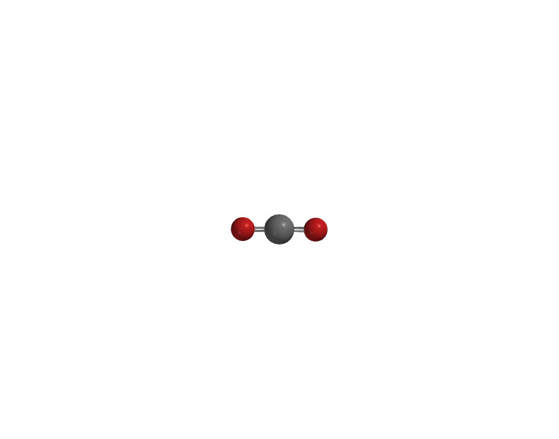
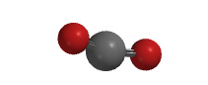
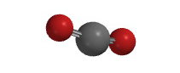
Carbon dioxide
Carbon dioxide (4 modes=3*N-5, N=3)
Most infrared spectra exhibit the “doublet” at ν~2350 cm⁻¹.
Nitrogen and oxygen do not appear in the infrared spectrum
because they do not have infrared active modes due to the
lack of a permanent dipole moment.
Water does appear in the infrared spectrum because it possesses infrared active modes (ν_{s}=3657 cm⁻¹, ν_{as}=3756 cm⁻¹, δ=1595 cm⁻¹).
ν_{s}
Mode | Symbol | Infrared/Raman | ν(cm⁻¹)
Symmetric stretching | ν_{s} | Infrared inactive/Raman active | 1388, 1286
Asymmetric stretching | ν_{as} | Infrared active/Raman inactive | 2349
Deformation | δ | Infrared active/Raman inactive | 667
Deformation | δ | Infrared active/Raman inactive | 667
ν_{as}
δ
δ

Slide 9
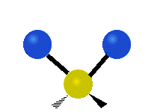
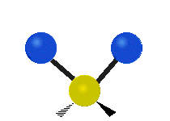



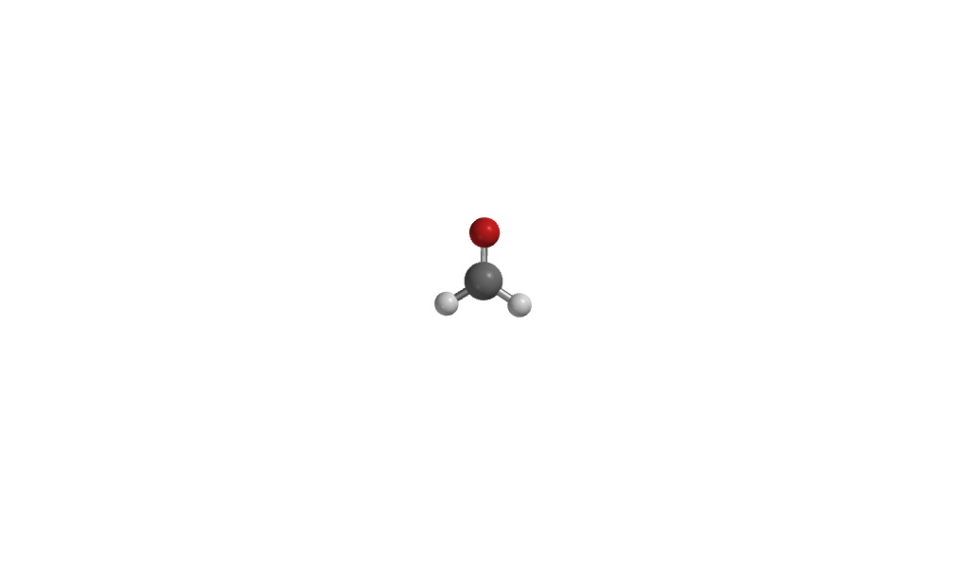
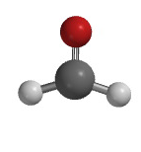
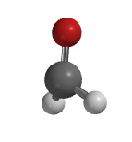
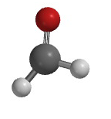
Formaldehyde
For the methylene group, there are two stretching and four bending modes observed.
Formaldehyde has six fundamental modes (=3*4-6, non-linear, N=4, all IR active).
symmetric asymmetric scissoring rocking twisting wagging
stretching stretching bending bending bending bending
Symmetric Asymmetric Carbonyl In-plane Out-of-plane Rocking
Stretching Stretching Stretching Bending Bending Bending
ν_{s}(CH₂) ν_{as}(CH₂) ν(CO) δ(CH₂) γ ρ(CH₂)
2766 cm⁻¹ 2843 cm⁻¹ 1746 cm⁻¹ 1501 cm⁻¹ 1167 cm⁻¹ 1247 cm⁻¹

Slide 10
Exclusion Rule
If there is no symmetry in the molecule, most of the vibrational modes will be observed the infrared spectrum while the remaining modes will be observed in a Raman spectrum.
If the molecule possesses a center of inversion, a mode can only
be infrared or Raman active based on the Exclusion Rule:
  In Z-dichloroethene both ν(C-H) stretching modes are infrared active (3072 and 3077 cm⁻¹), while in E-dichloroethene only the asymmetric mode is infrared active (3084 cm⁻¹). The symmetric
  ν_{s} (C-H) stretching mode is infrared inactive (3075 cm⁻¹) because
  it is symmetric about the inversion center.
  The same observation can be made for the ν(C-Cl) vibrations, where the Z-isomer shows both modes (711, 848 cm⁻¹), while
  the E-isomer only shows the asymmetric mode (815 cm⁻¹) in
  the infrared spectrum. The symmetric ν_{s}(C-Cl) mode in the
  E-isomer (847 cm⁻¹) only appears in the Raman spectrum.

Slide 11
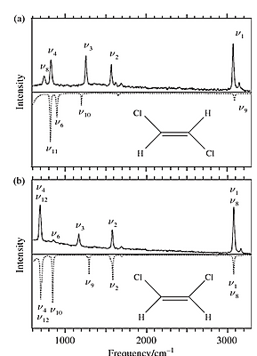
Exclusion Rule

Slide 12
Peak Intensity
A vibration will only be infrared active, if the dipole moment changes during the vibration because only then electromagnetic radiation can
be absorbed or be emitted. The intensity of a peak is proportional to
the change of dipole moment (I² ~ dμ/dr).
  This is more likely for groups, which already possess a significant dipole moment i.e., C-O, C=O, C=N, N=O, S=O, P=O, C-F, C-Cl, O-H, etc., which usually show strong peaks in the infrared spectrum.
  Functional groups in which the atoms have a small difference in electronegativity i.e., C-H, C-C, C=C and C≡C, will usually show as
  weak or medium sized peaks in the infrared spectrum unless there are many groups of this type present, which can overlap resulting in a
  higher peak intensity i.e., longer alkyl chain.
  The intensity of these groups will also increase if a dipole moment
  is induced due to an asymmetric substitution (acceptor-C=C-donor,
  acceptor-C≡C-donor) i.e., RO-C≡C-COOR’.

Slide 13
Ranges in the Infrared Spectrum
Depending on which text book is used and/or who teaches the topic, there are different approaches to the analysis of infrared spectra.
In the lecture today, the infrared spectrum will be divided into five major zones of interest that might be relevant to
an organic chemist:
  Zone I: 2700 - 4000 cm⁻¹ (E-H stretching: E=B, C, N, O, S)
  Zone II: 2000 - 2700 cm⁻¹ (E-X triple bonds: E=X=C, N, O)
  Zone III: 1500 - 2000 cm⁻¹ (E-X double bonds: E=X=C, N, O)
  Zone IV: 1000 - 1500 cm⁻¹ (E-X-single bonds, deformation,
  rocking modes, E-X double bonds: E=P, S; X=N, O)
  Zone V: below 1000 cm⁻¹ (out of plane modes, C-X: X=Cl, Br, I, heavier atoms)

Slide 14
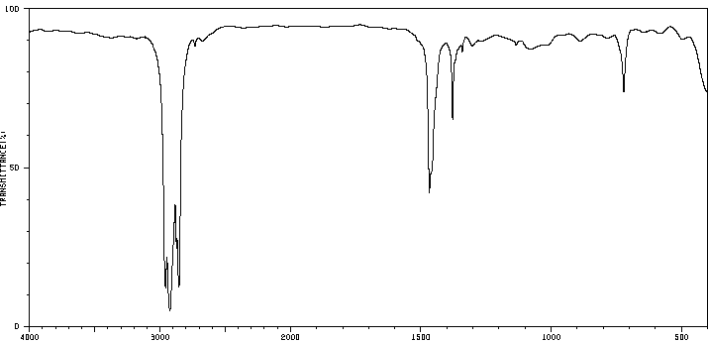
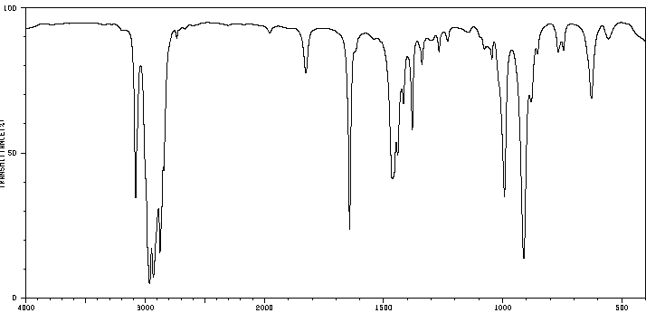
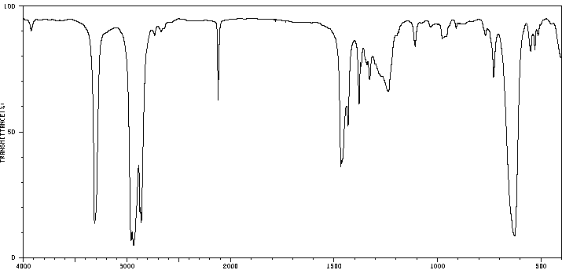
Zone I (C-H Stretching)
3000 cm⁻¹
The C-H stretching modes can be found between 2780 and 3300 cm⁻¹, depending
on the type of hybridization:
  Alkanes (sp³(C-H)): ~2810-3000 cm⁻¹
  Alkenes or aromatic ring (sp²(C-H)): ~3000-3150 cm⁻¹
  Terminal alkynes (sp(C-H)): ~3300 cm⁻¹
The C-H bond distance decrease from
110 pm (sp³(C-H), 422 kJ/mol) over
108 pm (sp²(C-H), 464 kJ/mol) to
106 pm (sp(C-H), 556 kJ/mol) indicating an increase in bond strength.
The higher the s-character in the bond is, the stronger the bond is because the electrons are closer to the nucleus.
sp³(C-H)
ν(C=C)
sp²(C-H)
sp³(C-H)
ν(C≡C)
sp(C-H)
sp³(C-H)

Slide 15
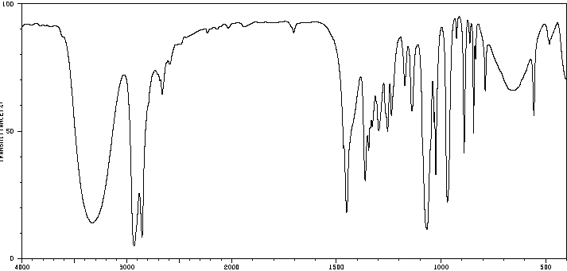
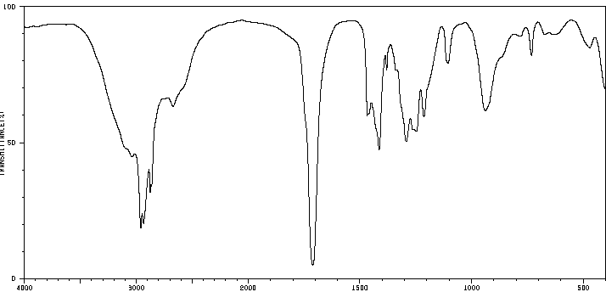
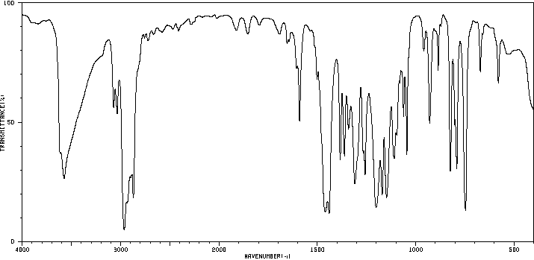
Zone I (O-H Stretching)
3500 cm⁻¹
The O-H stretching modes of alcohols and phenols are mostly broad and very strong (3200-3650 cm⁻¹).
The O-H peaks that are due to carboxylic acid are usually much broader (between 2500 and 3500 cm⁻¹) and also less intense.
The change in peak shape is a result of the different degree and nature of hydrogen bonds in alcohols, phenols and carboxylic acids, which often form dimeric species.
Intramolecular hydrogen bonds to nitro or carbonyl functions shift the peak maximum to lower wavenumbers and lead to broadening:
Phenols that possess two large (branched) alkyl groups in the ortho positions to the OH-function exhibit a sharp peak for the OH stretching mode that are located at very high wavenumbers (i.e., R=tert.-C₄H₉: 3646 cm⁻¹ , iso-C₃H₇: 3575 cm⁻¹, 2,6-Me: 3413 cm⁻¹ vs. 3,5-Me: 3297 cm⁻¹) because of their reduced ability to form hydrogen bonds.
Phenols | Ortho (cm-¹) | Meta (cm-¹) | Para(cm-¹)
Nitro | 3249 (m, br) | 3393 (s) | 3331 (s)
Acetophenone | 3061 (m, br) | 3179 (s) | 3147 (s)
Benzaldehyde | 3189 (m, br) | 3219 (s) | 3199 (s)
Methyl ester | 3199 (m, br) | 3380 (s) | 3301 (s)

Slide 16
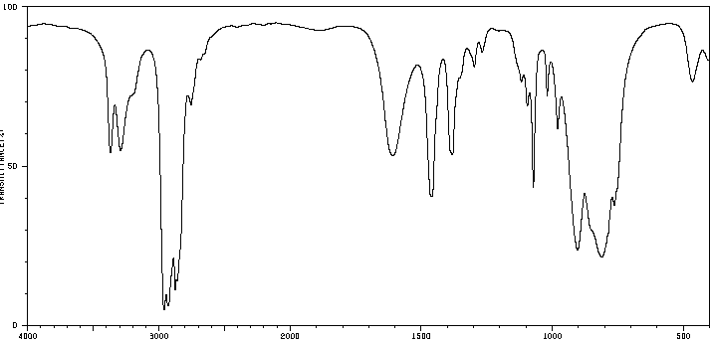
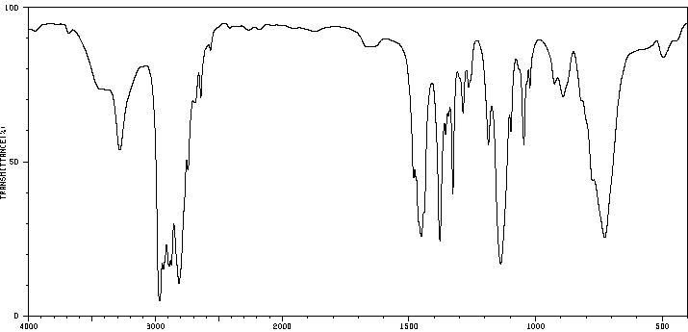
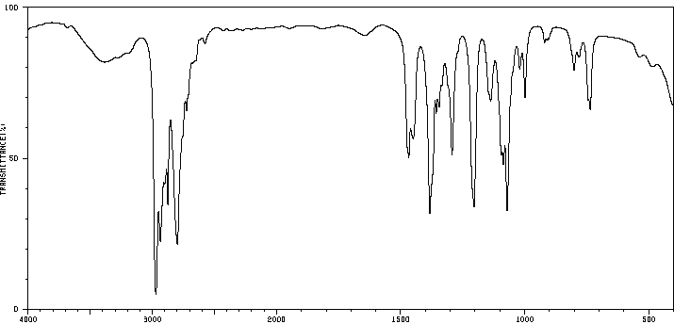
Zone I (N-H Stretching)
Peaks that are due to N-H stretching modes fall in the
same range (3300-3500 cm⁻¹) but are usually a little
sharper than O-H peaks.
The NH stretches of aromatic amines are about 60-80 cm⁻¹ higher compared to aliphatic amines (C₆H₅NH₂: 3354,
3429 cm⁻¹; C₆H₁₁NH₂: 3278, 3366 cm⁻¹) because the
higher s-character of the NH bond in aromatic amines.
N-H peaks are less intense than O-H peaks because the
N-H bond displays a lower polarity than the O-H bond.
The bands due to N-H groups are less broad due to the lower tendency to form hydrogen bonding, which can
also been seen in their lower boiling points:
  Primary amines exhibit two peaks due to the presence of
  a symmetric (lower) and an asymmetric (higher) vibration mode in this range.
  Secondary amines show only one peak in this range.
  There are no peaks observed in this area for tertiary amines. Why?
ν(NH₂)
δ(NH₂)
ν(C-N)
ν(NH)
ν(C-N)
no ν(ΝΗ)
ν(C-N)

Slide 17
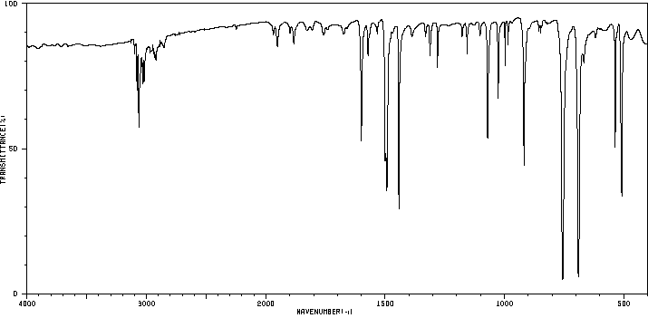
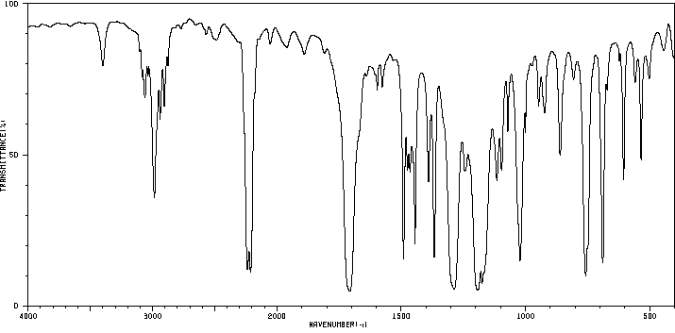
Zone II (E≡X Stretching)
The ν(C≡C) mode of alkynes (2100-2250
cm⁻¹) is often weak, particularly if only alkyl groups are attached.
The situation will change if the triple bond
is asymmetrically substituted i.e., with a carbonyl function on one side and an alkyl
or aryl group on the other side.
ν(C≡C)
ν(C≡C)
ν(C≡C)

Slide 18
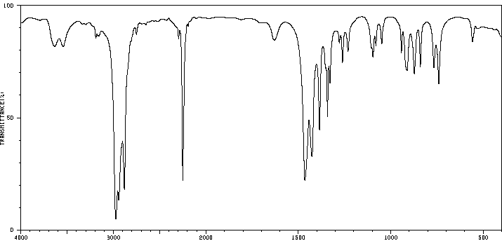
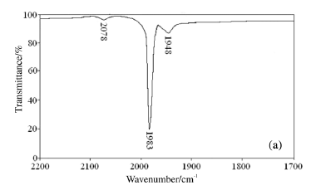
Zone II (E≡X Stretching)
The ν(C≡N) stretching mode of nitriles (2200-2260 cm⁻¹) shows as a sharp, medium intense peak.
Organometallic chemists also look for ν(C≡O) modes from metal carbonyl compounds in this area i.e., M(CO)₆ (M=Cr, Mo, W), ν_{as}(C≡O)=2000 (Cr), 2004 (Mo), 1998 (W) cm⁻¹.
In most cases, a peak with varying intensity around 2350 cm⁻¹ (sometimes together with 667 cm⁻¹) is observed in
the spectrum. This is due to the CO₂
in the beam (poor background correction).
ν(C≡N)
Mo(CO)₆
in hexane

Slide 19
Zone III (C=O stretching)
This is considered the most important range of the entire infrared spectrum for organic chemists.
A very strong peak between 1630 and 1850 cm⁻¹ usually indicates the presence of a carbonyl function in the molecule.
The analysis of the exact peak position can reveal further details about
the type of carbonyl function present.
A good rule of thumb is that the more reactive the carbonyl compound
is, the further to the left (=higher wavenumber) the carbonyl stretching frequency will be. The following sequence is usually observed:

Slide 20
Zone III (C=O stretching)
Carbonyl Functions
Note: The purple line in the following spectrum represents ν=1700 cm⁻¹.
Carbonyl Derivative | ν(C=O) (cm⁻¹) | Comment
Acyl chloride (RCOCl) | 1780-1820 (sat.) 1750-1780 (conj.) | strong peak between 550-900 cm⁻¹ for ν(C-Cl)
Anhydride (RCO)₂O | 1760 and 1820 (sat.) 1720 and 1780 (conj.) | two peaks with varying intensity
Ester (RCOOR’) | 1730-1750 (sat.) 1710-1730 (conj.) | two medium or strong peaks (1000 and 1300 cm⁻¹)
Aldehyde (RCHO) | 1720-1740 (sat.) 1680-1705 (conj.) | two weak or medium peaks at 2750 and 2850 cm⁻¹
Ketone (RCOR’) | 1705-1725 (sat.) 1665-1690 (conj.) | ν_{as}(CCC) at 1230-1300 cm⁻¹ (aromatic) ν_{as}(CCC) at 1100-1230 cm⁻¹ (alkyl)
Carboxylic acid (RCOOH) | 1700-1725 (sat.) 1680-1700 (conj.) | broad peak between 2500 and 3500 cm⁻¹ ν (COH) at 1250-1300 cm⁻¹
Amide (RCONRR’) | 1680-1715 (sat.) 1630-1680 (conj.) | additional strong peaks at 3300-3500 cm⁻¹ for prim. or sec. amides

Slide 21
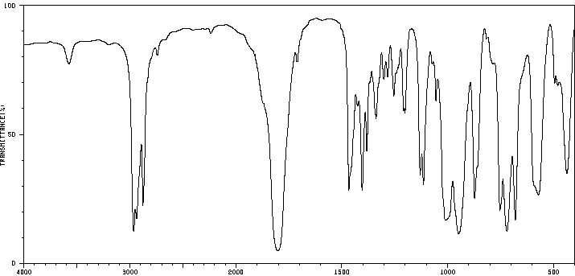
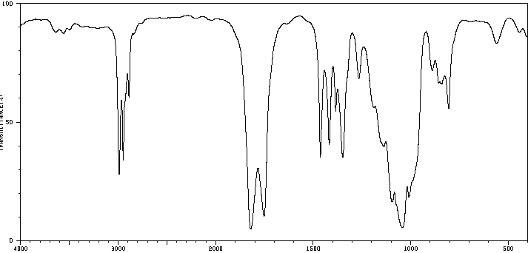
Zone III (C=O stretching)
Acyl chloride and Anhydride
  Both functional groups display a C=O stretching mode significantly higher than 1700 cm⁻¹ (=purple line).
  In the anhydrides, the asymmetric stretching mode is higher than
  the symmetric stretching mode. The relative peaks
  intensities do vary depending on if the anhydride
  function is part of a ring, the ring size and the
  degree of conjugation.
C=O overtone

Slide 22
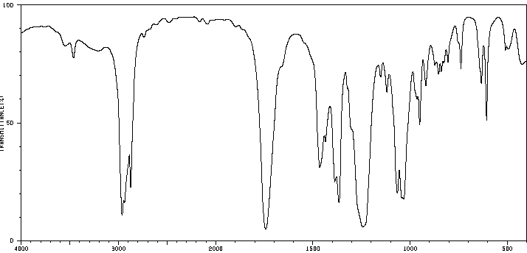
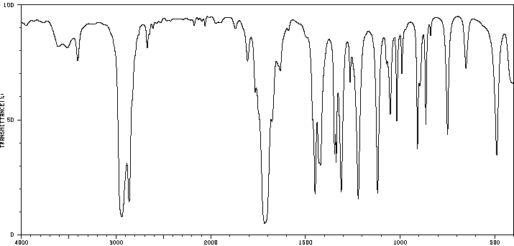
Zone III (C=O stretching)
Ester and Ketone
  Esters also display two strong peaks in the range from ν=1000-1300 cm⁻¹ because the COC function is non-linear, which means that both ν(COC) modes are infrared active. These modes are usually higher for aromatic ester (1100-1200, 1200-1300 cm⁻¹) than for aliphatic esters (1000-1100, 1100-1200 cm⁻¹).
  Aliphatic ketones have a ν_{as}(CCC)=1100-1230 cm⁻¹.
C=O overtone
C=O overtone
ν(COC)
ν_{as}(CCC)

Slide 23
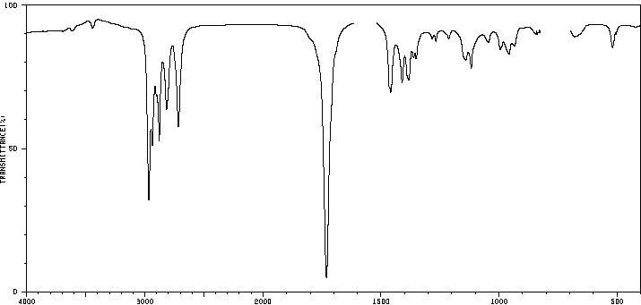
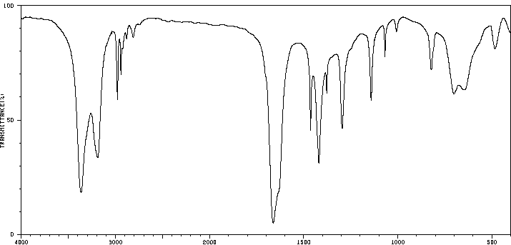
Zone III (C=O stretching)
Aldehyde and Amide
Aldehydes display a doublet in the 2720 and 2820 cm⁻¹ range, which is not observed for ketones.
Amides exhibit a very low carbonyl stretching mode
due to the amide resonance, which weakens the
C=O bond significantly.
Primary and secondary amides show intense and broad ν(N-H) stretching modes in
the 3200-3500 cm⁻¹ range because of the higher NH-bond polarity.
Primary or secondary amines also display an N-H bending mode in the range from
1550-1640 cm⁻¹.
ν(CHO)
ν(C-N)
ν(NH₂)
δ(NH₂)

Slide 24
Zone III (C=O stretching, Ring Strain)
Increase of Carbonyl Stretching Frequency
  Ring strain usually increases the carbonyl stretching frequency.
  Ketones undergo keto-enol tautomerization. The formation of
  the enol would lead to two sp²-carbon atoms in the ring, which would increase the ring strain further in small rings:
3 sp³-C + 1 sp²-C
2 sp³-C + 2 sp²-C

Slide 25
Zone III (C=O stretching, Ring Strain)
The smaller the ring, the shorter the C=O bond is resulting in a higher carbonyl stretching frequency because the ketone favors the keto form over the
enol form (the calculated bond order of the carbonyl group is given in parenthesis).
Total ring size | Ketone (ν in cm⁻¹) | d(C=O) [pm] (HF 6-31G*) | Conj. Ketone (ν in cm⁻¹) | d(C=O) [pm] (HF 6-31G*)
4 | 1783 | 118.1 (1.92)
5 | 1747 | 118.9 (1.88) | 1707 | 119.1 (1.84)
6 | 1714 | 119.3 (1.86) | 1686 | 119.6 (1.81)
7 | 1702 | 121.4 (1.83) | 1663 | 119.6 (1.82)

Slide 26
Zone III (C=O stretching, Ring Strain)
The effect of ring strain can also be observed in lactones (cyclic esters) and lactams (cyclic amides) (the bond order of the carbonyl group is given in parenthesis):
Lactams display a lower bond order and lower carbonyl stretching frequency than lactones because of the amide resonance.
Total ring size | Lactone (ν in cm⁻¹) | d(C=O) [pm] (HF 6-31G*) | Lactam (ν in cm⁻¹) | d(C=O) [pm] (HF 6-31G*)
4 | 1823 | 117.2 (1.93) | 1760 | 118.1 (1.92)
5 | 1770 | 118.0 (1.90) | 1690 | 119.6 (1.82)
6 | 1730 | 118.4 (1.88) | 1666 | 120.1 (1.78)
7 | 1732 | 118.5 (1.89) | 1658 | 120.2 (1.80)

Slide 27
Zone III (C=O stretching, Conjugation)
Decrease of Carbonyl Stretching Frequency
  It is observed when the carbonyl group is connected to other double bonds (aromatics, alkenes) due to partial C-O single bond character.
  The carbonyl stretching frequency decreases in the sequence acetone (1715 cm⁻¹), acetophenone (PhCOCH₃, 1685 cm⁻¹) and benzophenone (PhCOPh, 1666 cm⁻¹) due
  to the increased degree of conjugation of the carbonyl group with the phenyl rings.
  The effect will be even stronger if electron-donating groups are attached to the ring.
Substituents | ν(C=O) [cm⁻¹] | d(C=O) [pm]
H | 1655 | 121.4
4-Methyl | 1655 | 121.8
4,4’-Dimethyl | 1645 | 122.2
4,4’-Dimethoxy | 1645 | 121.5
4,4’-Di(dimethylamino) | 1601 | 123.7
4,4’-Di(diethylamino) | 1600 | 123.5
4,4’-Difluoro | 1650 | 121.7
4,4’-Dichloro | 1656 | 121.3
4,4’-Dinitro | 1670 | 121.0

Slide 28
Zone III (C=O stretching, H-bonding)
Intramolecular Hydrogen Bonds
  They cause a shift to lower wavenumbers as well i.e., benzaldehyde
  and salicylaldehyde (2-hydroxybenzaldehyde).
  The shift in 2-methoxybenzaldehyde is solely due to the resonance
  effect of the OR-group.
  Note that the meta isomers display the least shift because of the lack
  of the resonance effect:
Substituents | ν(C=O) [cm⁻¹] | d(C=O) [pm]
H | 1704
2-hydroxy | 1665 | 123.0
3-hydroxy | 1673 | 120.9
4-hydroxy | 1669 | 122.0
2-methoxy | 1689
3-methoxy | 1699
4-methoxy | 1692 | 121.4

Slide 29
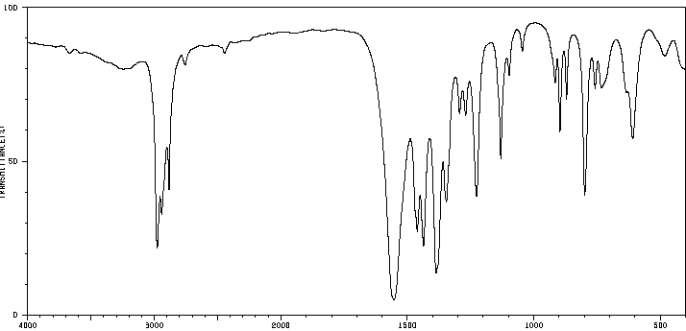
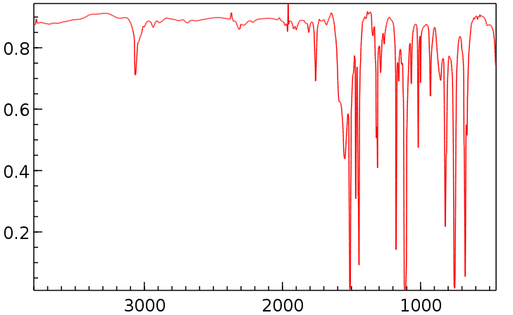
Zone III (N=O stretching)
  Nitro Groups
    They display two very intense peaks in the range
    between 1260-1390 cm⁻¹ (symmetric mode) and
    1500-1640 cm⁻¹ (asymmetric mode).
    The high peak intensity of the nitro peaks is a result of the dipolar character of the N-O bond, in which the nitrogen atom carries a significant positive charge and the oxygen a negative charge
    (Octet rule!).
    Nitroso compounds only display one peak around 1550 cm⁻¹ because there is only one N=O bond that displays a double bond character.
ν(NO₂)
ν(NO)

Slide 30
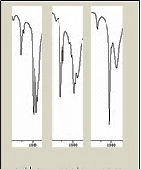
Zone III (C=C stretching)
C-C Double Bonds
  Alkenes usually display a single peak in the range from 1620-1680 cm⁻¹.
  Two medium or strong peaks in around 1500 and 1600 cm⁻¹ correspond to an aromatic ring:
    The intensities of these two peaks can vary and there are several other peaks i.e., ~1500 cm⁻¹
    as well that can be attributed to modes in the benzene ring (the double bonds are omitted here).
    For instance, a 1,4-disubstitution with the same substituent would lower the dipole moment in the ring and the mode at ν=1600 cm⁻¹ would be fairly weak as shown below for three xylene isomers (dimethylbenzenes).
1600 1500 1600 1500 1600 1500
ortho meta para

Slide 31
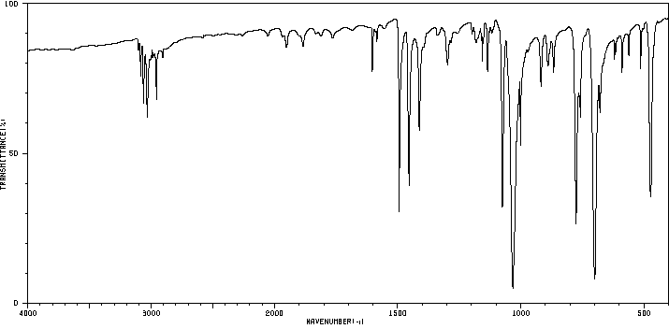
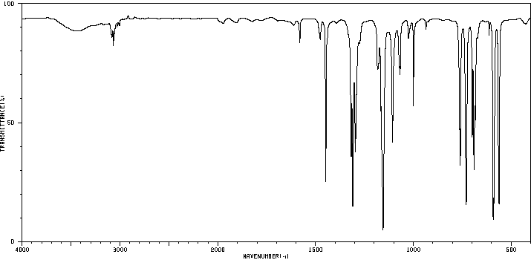
Zone IV (S=O stretching)
  Sulfoxide and Sulfone Groups
    Due to the lower formal oxidation state of sulfur, sulfoxides display a significantly weaker S=O bond than sulfones (350 kJ/mol vs. 470 kJ/mol, i.e., Ph₂SO: 149 pm vs. Ph₂SO₂: 145 pm) resulting in a lower wavenumber for the ν(S=O) mode in sulfoxide (1000-1050 cm⁻¹) compared to sulfones (1140-1200 cm⁻¹, 1300-1400 cm⁻¹). A similar trend is observed for selenoxide (Ph₂SeO: 820 cm⁻¹) and selenone (Ph₂SeO₂: 887, 940 cm⁻¹).
    Since sulfur and selenium are heavier than nitrogen, the ν(E=O) modes are significantly lower than ν(N=O) modes in nitroso groups. Due to the E-O bond polarity (R₂E⁺-O⁻), the peaks are strong as well.
    Like nitro groups, sulfones display two peaks for the EO₂ stretching modes (asym. and sym.) because the O=S=O group is bent.
ν(S=O)
ν(SO₂)

Slide 32
Zone IV (C-X stretching)
A strong peak around 1450 cm⁻¹ (asymmetric deformation mode) indicates the presence of methyl or methylene groups. An additional strong peak about 1375 cm⁻¹
is caused by a methyl group.
The C-O-C-functions of aliphatic ethers (ν_{as}=1070-1140, ν_{s}=700-920 cm⁻¹) and
esters (ν_{as}=1190-1300, ν_{s}=1000-1050 cm⁻¹) are typically found as strong peaks
in the range between 1000 and 1300 cm⁻¹. Since these groups are non-linear the symmetric and asymmetric mode are observed for both groups.
Carboxylic acids and phenols exhibit only one strong peak between 1250 and
1300 cm⁻¹ for the C-OH mode because the high sp²-character the C-O bond.
Alcohols show one peak at the lower end of this range (primary: 1050-1090 cm⁻¹, secondary: 1090-1125 cm⁻¹, tertiary: 1125-1205 cm⁻¹).
The C-N functions for amine appear in the same range (primary: 1020-1090 cm⁻¹, secondary: 1130-1190 cm⁻¹, tertiary: 1150-1210 cm⁻¹).
The P=O modes in phosphine oxides (R₃P=O) appear in the range from
ν=1140-1210 cm⁻¹ (i.e., Me₃PO: 1161 cm⁻¹, Ph₃PO: 1186 cm⁻¹) depending on
the effect of the R-group.

Slide 33
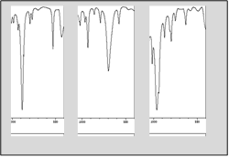
Zone V (Out-of-Plane Bending)
Out of plane modes (oop), C-X: X=Cl, Br, I, heavy atoms
  Alkenes
Substitution | Peaks at cm⁻¹ | Intensity
mono-substitution | 895-915, 985-995 | strong, strong
cis-substitution | 680-730 | strong
trans-substitution | 960-970 | strong
1,1-substitution | 855-885 | strong
tri-substitution | 790-830 | medium
tetra-substitution | ---------- | ----------
1000 500 1000 500 1000 500
1,1-subst. cis-alkene trans-alkene

Slide 34
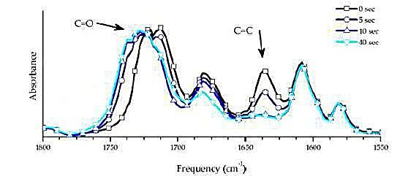
Applications
It is used in monitoring applications such as the long-term unattended measurement of CO₂ concentrations in greenhouses and growth chambers
It is used in measuring the degree of polymerization in polymer manufacturing by monitoring the presence of certain functional groups i.e., UV curing of methacrylated system

Slide 35
Applications
It is used in forensic analysis in both criminal and civil cases, for example in identifying polymer degradation, drugs, automotive paints and pigments, toners/inks, etc.
It can also be used in detecting how much alcohol is in the blood of a suspected drunk driver

Slide 36
Summary I
A certain range of the electromagnetic radiation (micrometer range) is able to excite molecules
and cause them to stretch and/or bend (and rotate).
Mid-range infrared spectroscopy (400-4000 cm⁻¹) is traditionally used as tool to identify functional groups
in organic molecules in liquid and solid state.
The location of a peak can be rationalized based on the masses of the atoms involved and the bond strength, i.e., ν(C≡C)>ν(C=C)>ν(C-C), ν(C-H)>ν(C-O)>ν(C-S).

Slide 37
Summary II
The peak intensity is a function of the change in dipole moment during the excitation i.e., ν(C-O)
is much more intense than ν(C-H).
The proper and efficient analysis of infrared spectra should employ an algorithm.
Practice is needed to know where and how the important peaks appear i.e., carbonyl, hydroxyl, etc.

