Slide 1
Introduction to NMR Spectroscopy
Part III (DEPT and 2D-Methods)

Slide 2
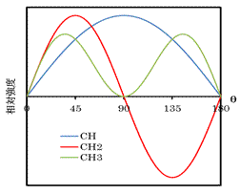
DEPT-Introduction
Recall that most ¹³C-NMR are acquired as proton decoupled spectra because of the ¹³C nucleus is significantly less abundant than the ¹H nucleus (1.11 % (¹³C) vs. 99.85 % (¹H)).
Distortionless Enhancement by Polarization Transfer, or also called DEPT, is a technique that is used to compensate for some shortcomings of ¹³C-NMR spectroscopy.
The technique utilizes the fact that different CH-functions behave differently in an experiment, where the polarization is transferred from the proton to the carbon atom.
# of attached hydrogens | 0 (-C-) | 1 (CH) | 2 (CH₂) | 3 (CH₃)
DEPT 135 | 0 | up | down | up
DEPT 90 | 0 | up | 0 | 0
DEPT 45 | 0 | up | up | up

Slide 3
DEPT-Example I
The original spectrum of isoamyl acetate displays only six signals due to the symmetry in the side chain.
The carbonyl carbon atom (C2) at δ=172 ppm does not show up in either DEPT spectrum because it is a quaternary carbon.
The methylene functions (CH₂) at δ=38 ppm (C4) and δ=61 ppm (C3) point down in the DEPT 135 spectrum.
The methine function (CH) at δ=25 ppm (C5) shows up in all three DEPT spectra.
The DEPT spectrum cannot determine which of the signals at δ=21 ppm and δ=24 ppm belongs to C1 and C6.
Full Spectrum
1/6
3
4
5
2
DEPT 135
DEPT 90
DEPT 45

Slide 4
DEPT-Example II
The full spectrum of camphor displays ten signals due to the lack of symmetry.
The signal at δ=218 ppm (C1) is due to the carbonyl group.
The signals at δ=47 ppm (C3) and δ=57 ppm (C2) are due to the other two quaternary carbon atoms.
Thus, these three carbon atoms do not appear in any of the DEPT spectra.
2
3
1

Slide 5
DEPT-Example II
The range of the DEPT spectra show here is from δ=0-50 ppm (the three quaternary peaks are removed).
The signal at δ=43.6 ppm (furthest to the left) is due to the methine function (C4).
The signals at δ=43.4 ppm, δ=30 ppm and δ=27 ppm are due to methylene groups (C5, C6, C7).
The signals at δ=19.8 ppm, δ=19.2 ppm and δ=9 ppm are due to the methyl groups (C8, C9, C10).
For the methylene and the methyl groups, it is very difficult to identify the correct carbon atom without additional information.
4
6
7
5
8 9
10

Slide 6
DEPT-Example III
The reaction of 1,2-diphenylpropanediol with a strong acids leads to the formation of an aldehyde (I) or ketone (II) (or a mixture of them) depending on the conditions during the reaction (i.e., temperature, amount and type of catalyst, etc.).
How could the ¹³C{¹H}-NMR spectrum and the DEPT spectra be used to determine the nature of the product?

Slide 7
DEPT-Example III
The aldehyde displays seven signals due to the symmetry of the two phenyl groups.
Aldehyde carbon: 201 ppm
Four carbon atoms: 126-145 ppm (2 t, m, s)
Quaternary carbon atom: 62 ppm
Methyl group: 21 ppm
Full Spectrum
2 signals
DEPT 135
DEPT 90
DEPT 45

Slide 8
DEPT-Example III
The ketone displays eleven signals due to the lack of symmetry
Ketone carbon: 200 ppm
Eight carbon atoms: 128-141 ppm
136 and 141 ppm (quaternary C)
Methine carbon atom: 48 ppm
Methyl group: 20 ppm
Full Spectrum
DEPT 135
DEPT 90
DEPT 45

Slide 9
2D Techniques - Introduction
There is a broad variety of two-dimensional NMR techniques used in chemistry and biochemistry to deduce structures for relative complicated molecules i.e., proteins, macromolecules, etc.
Some of these experiments allow the experimenter to get additional information about his molecule because some of these techniques to look at long-range effects or connectivity between different types of atoms.

Slide 10
2D Techniques - Introduction
We will only discuss HMQC spectroscopy, which permits conclusions about the connectivity of carbon and hydrogen atom(s). The other, more advanced techniques require a more in-depth knowledge of NMR spectroscopy.
Method | Effect observed
COSY | COrrelation SpectroscopY, good for determining basic connectivity via J-couplings (through-bond).
NOESY | Nuclear Overhauser Effect SpectroscopY, allows one to see through-space effects, useful for investigating conformation and for determining proximity of adjacent spin systems. Not so useful for MWs in the 1 kDa range due to problems arising from the NMR correlation time.
ROESY | Rotational Overhauser Effect SpectroscopY, same as NOESY, but works for all molecular weights. Has the disadvantage of producing more rf heating, hence it requires more steady state scans.
HMQC | Heteronuclear Multiple Quantum Correlation, allows one to pair NH or CH resonances. Often uses X-nucleus decoupling and hence gives rise to rf heating, requires reasonably well calibrated pulses and many steady state scans.
HSQC | Heteronuclear Single Quantum Correlation, provides the same information as HMQC, but gives narrower resonances for ¹H-¹³C correlations. Also requires X-decoupling and hence a large number of steady state scans and is also more sensitive to pulse imperfections.
HMBC | Heteronuclear Multiple Bond Correlation, a variant of the HMQC pulse sequence that allows one to correlate X-nucleus shifts that are typically 2-4 bonds away from a proton.

Slide 11
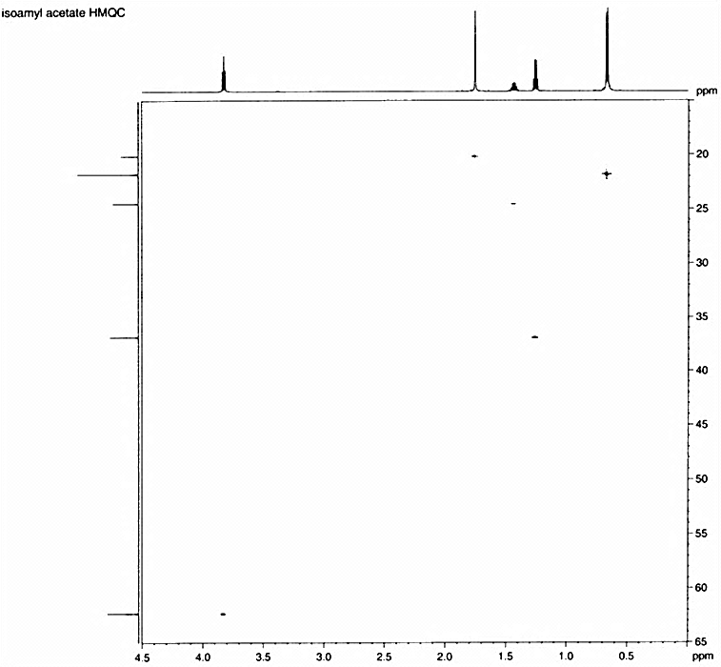
2D Techniques – Example I
In the HMQC spectrum, the horizontal axis displays the ¹H-NMR (δ=0-4.5 ppm) spectrum while the vertical axis displays the ¹³C-NMR spectrum (δ=15-65 pm).
The ¹H-NMR spectrum displays the following signals: 0.7 ppm (d, 6 H, H6), 1.25 ppm (q, 2 H, H4), 1.45 ppm (m, 1 H, H5), 1.75 ppm (s, 3 H, H1) and 3.75 ppm (t, 2 H, H3).
Thus, the signal at δ=21 ppm belongs to the methyl group that is attached to the carbonyl group while the signal at δ=22 ppm is due to the two methyl groups in the alkyl chain.
¹H-NMR
H1
H6
H3
H4
H5
¹³C-NMR

Slide 12
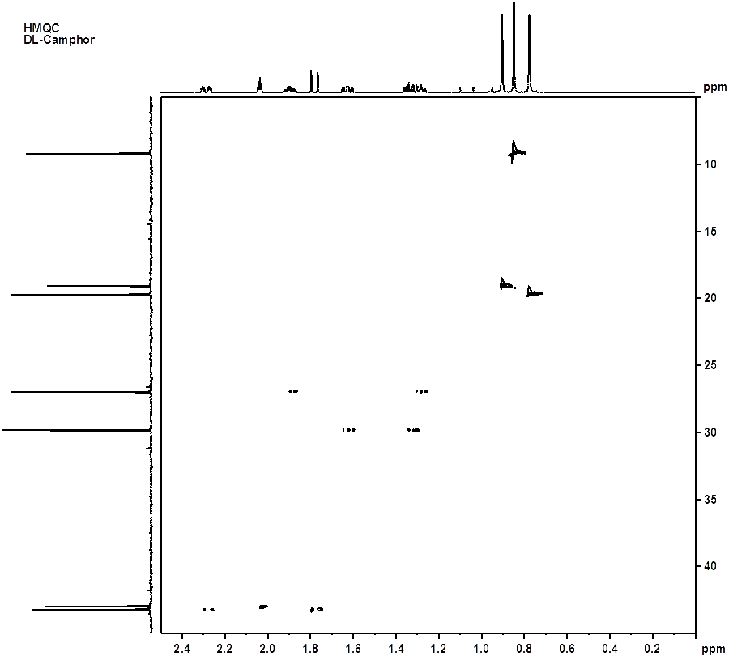
2D Techniques – Example II
The signal at δ=9.25 ppm in the carbon spectrum relates to the signal at δ=0.75 ppm in the ¹H-NMR spectrum, while the two signals at δ= ~19 ppm relate to the signals at δ=0.7 ppm and δ=0.82 ppm in the ¹H-NMR spectrum.
The signals at δ=27, 30 and 43.3 ppm are each connected to two different hydrogen atoms (1.24 and 1.85, 1.28 and 1.61, 1.77 and 2.28 ppm) which implies that these are diastereotopic hydrogen atoms. The resulting coupling with other hydrogen atoms on neighboring carbon atoms leads to complicated splitting patterns (i.e., ddddd).
Finally, the signal at δ=43.1 ppm is connected to one proton signal (2.01 ppm).

Slide 13
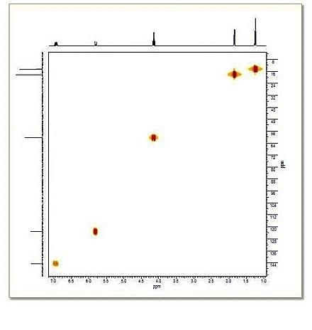
2D Techniques – Example III
Trans-Ethyl crotonate (HMQC)
How many signals do we expect?
¹H-NMR?
¹³C{¹H}-NMR?
The hydrogen atom and the carbon atom in the β-position to the carbonyl group are more downfield shifted than the corresponding atoms in the α-position because of the resonance effect.
dq d q d t
dq
q
d
d
t
5
6

Slide 14
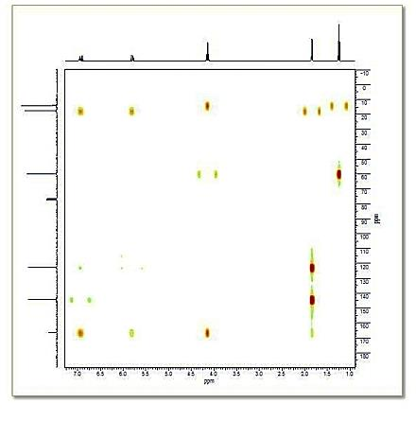
2D Techniques – Example III
Trans-Ethyl crotonate (HMBC)
In the HMBC spectrum, the two- and three- bond couplings between protons and carbons can be seen as cross-peaks.
J correlations sometimes break through filter; show through filter show up as multiplet cross-peaks.

Slide 15
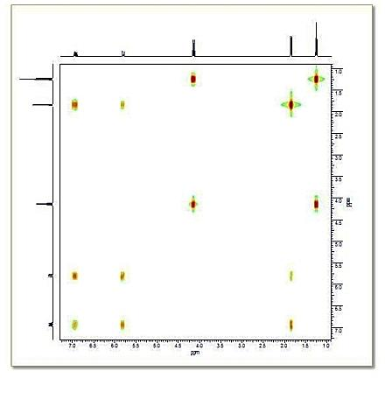
2D Techniques – Example III
Trans-Ethyl crotonate (HH COSY)
The HH COSY shows the coupling network within the molecule.
The triplet and quartet of the ethyl group share a cross peak.
The alkene protons can be seen to couple to both each another and the terminal methyl group.

Slide 16
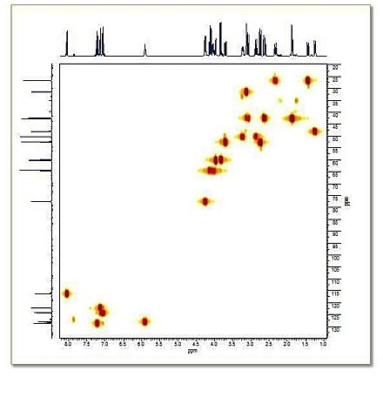
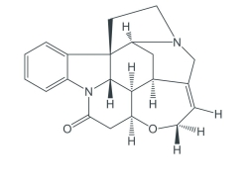
2D Techniques – Example IV
Strychine (HMQC)
In the HMQC spectrum, the one-bond direct CH couplings can be viewed as cross-peaks between the proton and carbon projections.

Slide 17
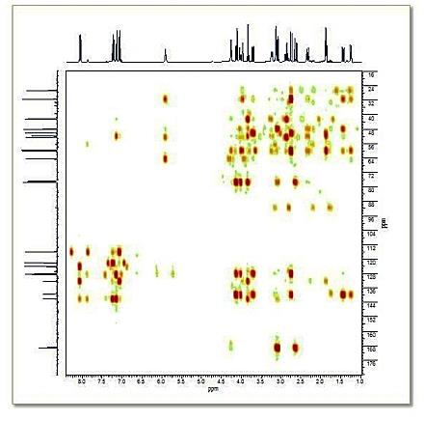
2D Techniques – Example IV
Strychine (HMBC)
In the HMBC spectrum, the two- and three- bond couplings between protons and carbons can be seen as cross-peaks.
The spectrum shows many more peaks than the HMQC.

Slide 18
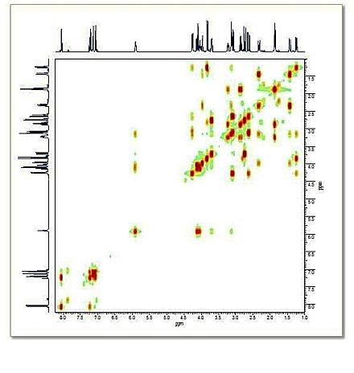
2D Techniques – Example IV
Strychine (HH COSY)
The HH COSY spectrum of strychnine shows the proton coupling network within the molecule.

