Slide 1
Introduction to
NMR Spectroscopy
Part II (¹³C-NMR)

Slide 2
¹³C-NMR Spectroscopy - Introduction
The ¹³C-atom possesses like protons a nuclear spin of I=½.
The signals are much weaker because of the much lower natural abundance of
the ¹³C-isotope (~1 %) compared to ¹H-nucleus.
Most ¹³C-NMR spectra are acquired as proton decoupled spectra, which means
that the signal is not split by any attached protons.
A methylene group shows as a triplet in a proton coupled spectrum but as a singlet
in a proton decoupled spectrum (⇨ singlets observed only).
The sensitivity of the experiment increases, but some important information is lost i.e., how many hydrogen atoms are attached to the carbon.
However, couplings between carbon and deuterium atoms (and other NMR active nuclei) are still observed i.e., CDCl₃, which shows three lines (2*n*I+1, I=1, n=1)
at δ= ~77 ppm.

Slide 3
¹³C-NMR Spectroscopy - Chemical Shift
While proton NMR spectra are mainly limited in a range between 0-15 ppm, the chemical shifts in ¹³C-NMR spectroscopy range from 0-220 ppm.
The effect of shielding and deshielding is much stronger because the heteroatom, which causes this chemical shift, is directly attached to the carbon atom.
The smaller magnetogyric ratio compared to hydrogen causes a lower resonance frequency (about a quarter of the one used for hydrogen nuclei).
Functional Type | Hybridization | Chemical Shift (ppm)
Carbonyl compounds, C=O Aldehyde and ketone Carboxylic acid, ester, anhydrides Amide | sp² | 185-220 160-185 150-180
Imine | sp² | 140-170
Aromatic and alkene | sp² | 100-170
Nitrile | sp | 120-130
Alkyne | sp | 60-100
O-C, Ether | sp³ | 60-90
C-X, Alkyl halide | sp³ | 10-65
RCH₂R, Alkyl | sp³ | 0-50

Slide 4
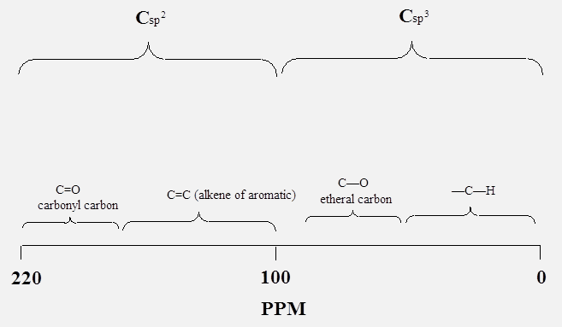
¹³C-NMR Spectroscopy - Chemical Shift
The chemical shift also reveals some information about the chemical environment.
Like in ¹H-NMR spectra, there is a characteristic range for carbons with
sp² (δ=100-220 ppm) and sp³ hybridization (δ=0-100 ppm). The sp-hybridized carbon atoms can be found in the range between δ=60-130 ppm.
Like in ¹H-NMR, electronegative atoms like oxygen, nitrogen, chlorine and fluorine cause a shift to higher ppm values.
Carbon atoms in carbonyl and imine functions are shifted downfield due to the effect of hybridization and electronegativity. This effect will be less pronounced
if these functions are conjugated because the polarization is less.
CH₃X | Electronegativity | Chemical shift
F | 4.0 | 71.6 ppm
OH | 3.5 | 50.1 ppm
NH₂ | 3.0 | 25.4 ppm
Cl | 3.0 | 25.6 ppm
Br | 2.8 | 9.6 ppm
SH | 2.5 | 6.5 ppm
PH₂ | 2.1 | -4.4 ppm
H | 2.1 | -2.1 ppm
C_{sp}

Slide 5
Monosubstitution - General
For a mono-substituted ring, four signals are observed in
the ¹³C-NMR spectrum because there is a symmetry plane
passing through C₁ and C₄.
A small signal will be observed for the ipso-carbon
(C₁, the carbon with the ligand directly attached),
a medium sized signal for the para C-atom (C₄)
and two tall peaks for the ortho C-atoms (C₂) and
meta C-atoms (C₃).
Many substituents, which are attached via a heteroatom normally cause a significant downfield shift on the ipso-carbon atom (C_{i}), while the ortho and para carbon atoms are shifted upfield because the electron-density increases in these positions if the heteroatom has a lone pair.

Slide 6
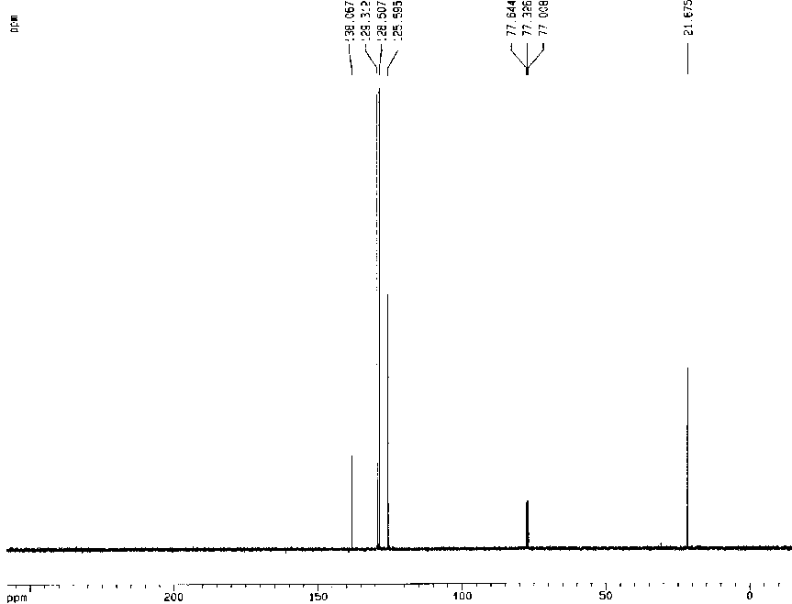
Monosubstitution - Examples
Toluene
  The carbon atoms of the aromatic ring are clustered closely together due to the weak effect of the methyl group in the different positions.
  The aromatic range consists of one small peak (C₁), one medium sized peak (C₄) and two tall peaks (C₂, C₃).
  The methyl group on the ring is shifted to about δ=22 ppm.
C₁ | 138.0
C₂ | 129.3
C₃ | 128.5
C₄ | 125.6
CH₃ | 21.7
CDCl₃

Slide 7
Monosubstitution - Examples
Anisole
  The carbon atoms of the aromatic ring are spread due to the strong effect of the methoxy group in different positions.
  The ipso-carbon atom in the ring is shifted downfield (δ=160 ppm) while the ortho and para carbon atoms are shifted upfield (δ=114,
  121 ppm) due to the resonance contribution on the methoxy group.
  The methoxy carbon is shifted to
  about δ=55 ppm due to the high
  electronegativity of the oxygen atom.
C₁ | 159.9
C₂ | 114.1
C₃ | 129.7
C₄ | 120.8
CH₃ | 55.1
CDCl₃

Slide 8
Monosubstitution - Examples
N,N-Dimethylaniline
  The carbon atoms of the aromatic ring spread out due to the effect of the dimethylamino group.
  The ipso-carbon atom in the ring is shifted downfield (δ=151 ppm) while the ortho and para carbon atoms are shifted upfield (δ=113,
  117 ppm) due to the resonance contribution on the amine group.
  The methyl group on the ring is
  shifted to about δ=41 ppm, which
  is less than for the oxygen atom
  because nitrogen is somewhat
  less electronegative than oxygen.
C₁ | 151.1
C₂ | 113.1
C₃ | 129.5
C₄ | 117.1
CH₃ | 40.9
CDCl₃

Slide 9
Para-substitution - General
Case 1:
  If the two substituents in para position are identical (R=R’=X), the molecule will contain two perpendicular symmetry planes.
  Thus, only two carbon signals are observed in
  the ¹³C-NMR spectrum: one small (C₁) and
  one very tall (C₂).
Case 2:
  If two different substituents are attached to the ring, only one symmetry plane (through C₁ and C₄) will remain.
  Thus, four signals will be observed in the
  ¹³C-NMR spectrum: two small signals (C₁, C₄)
  and two tall signals (C₂, C₃).

Slide 10
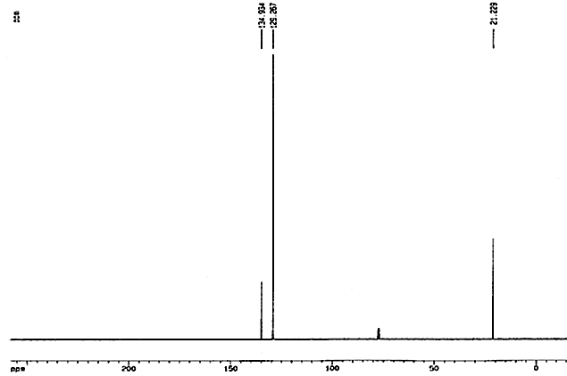
Para-substitution - Examples
Case 1:
  The carbon atoms of the aromatic ring are close together due to the weak effect of the methyl groups.
  The aromatic range displays two signals: one small signal (δ=135 ppm) for the two ipso-carbon atoms (C₁) and one tall signal for the four unsubstituted carbon atoms (C₂) in the ring.
  The methyl group on the ring is
  shifted to about δ=21 ppm.
C₁ | 134.9
C₂ | 129.3
CH₃ | 21.2
CDCl₃

Slide 11
Para-substitution - Examples
Case 2:
  The carbon atoms of the aromatic ring are spread out due to the strong effect of the methoxy group.
  The ipso-carbon atom of the phenol function in the ring is shifted downfield (δ=161 ppm) while the ortho carbon atoms to the phenol function are shifted upfield (δ=116 ppm) due to the resonance contribution on the hydroxyl group.
  The carbon atom attached to the nitro
  group is shifted downfield (δ=142 ppm)
  as well and is also very small.
CDCl₃
C₁ | 161.4
C₂ | 115.7
C₃ | 126.3
C₄ | 142.4

Slide 12
Ortho-substitution - General
Case 1:
  If the two substituents in ortho position are identical (R=R’=X), the molecule will contain one symmetry plane.
  Thus, only three carbon signals are observed in the
  ¹³C-NMR spectrum: one small (C₁) and two very tall (C₂, C₃).
Case 2:
  If two different substituents are attached to the ring, there will be no symmetry plane.
  Thus, six signals will be observed in the ¹³C-NMR spectrum: two small signals (C₁, C₆) and four tall signals (C₂, C₃, C₄, C₅).

Slide 13
Ortho-substitution - Examples
Case 1:
  The carbon atoms of the aromatic ring are clustered close together due to the relative weak effect of the chlorine atoms.
  The aromatic range displays three signals: one small signal (δ=133 ppm) for the two ipso-carbon atoms (C₁) and two tall signals for the other four carbon atoms (C₂, C₃) in the ring.
C₁ | 132.6
C₂ | 130.6
C₃ | 127.8
CDCl₃

Slide 14
Ortho-substitution - Examples
Case 2:
  The six signals of the carbon atoms of the aromatic ring are spread out due to the strong effect of the phenol function in the different positions.
  The aromatic range displays six signals: two small signals (δ=155 ppm (C₁) and δ=120 ppm (C₆)) for the two ipso-carbon atoms and four tall signals for the other four carbon atoms (C₂, C₃, C₄, C₅) in the ring.
C₁ | 155.0
C₂ | 119.9
C₃ | 137.5
C₄ | 120.2
C₅ | 124.6
C₆ | 133.6
CDCl₃

Slide 15
Meta-substitution - General
Case 1:
  If the two substituents in meta position are identical (R=R’=X), the molecule will contain one symmetry plane.
  Thus, only four carbon signals are observed in the ¹³C-NMR spectrum: one small (C₂), two medium sized signals (C₁, C₄) and one tall signal (C₃).
Case 2:
  If two different substituents are attached to the ring, there will be no symmetry plane.
  Thus, six signals will be observed in the ¹³C-NMR spectrum: two small signals (C₁, C₅) and four tall signals (C₂, C₃, C₄, C₆).

Slide 16
Meta-substitution - General
Case 1:
  The carbon atoms of the aromatic ring are clustered together due to the weak effect of the chlorine atoms.
  The aromatic range displays three signals: one small signal (δ=134 ppm) for the two ipso-carbon atoms (C₂), two medium sized signal (C₁, C₄) and one tall signals for the carbon atoms (C₃) in the ring.
C₁ | 128.7
C₂ | 134.0
C₃ | 126.9
C₄ | 130.4
CDCl₃

Slide 17
Meta-substitution - General
Case 2:
  The six signals of the carbon atoms of the aromatic ring are spread out due to the strong effect of the amine group.
  The aromatic range displays six signals: two small signals (δ=149 ppm (C₁) and δ=148 ppm (C₅)) for the two ipso-carbon atoms and four tall signals for the other four carbon atoms (C₂, C₃, C₄, C₆) in the ring.
CDCl₃
C₁ | 149.2
C₂ | 113.1
C₃ | 129.9
C₄ | 120.7
C₅ | 147.5
C₆ | 109.0

Slide 18
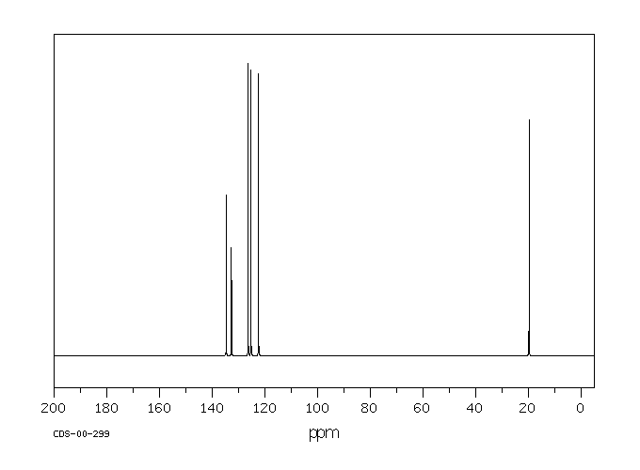
Special Examples I
1,5-Dimethylnaphthalene
  Only six signals are observed, five for the naphthalene ring and one of the methyl groups despite the fact that the compound does not have any symmetry plane.
  However, there is a two-fold axis in the center of the molecule.
  Two of the signals are small (C₁, C₅) because these carbon atoms do not have a hydrogen atom attached.
C₁ | 134.7
C₂ | 126.4
C₃ | 125.3
C₄ | 122.4
C₅ | 132.7
CH₃ | 19.7

Slide 19
Special Examples II
Mesitylene (1, 3, 5-Trimethylbenzene)
  Mesitylene has a mirror plane. Based on this, one should observe six peaks in the ¹³C-NMR spectrum.
  However, the spectrum only exhibits three signals. The reason is that the molecule possesses a threefold axis in the center (). A rotation
  of 120º affords an identical molecule.
  The spectrum displays one small
  peak (C₁), one tall peak (C₂) and
  the methyl carbon around δ=21 ppm.
C₁ | 137.7
C₂ | 127.0
C₃ | 21.2
CDCl₃

Slide 20
Special Examples III
12-Crown-4 (1, 4, 7, 10-Tetraoxacyclododecane)
  The cyclic ether 12-crown-4 shows only one signal in the ¹³C-NMR
  at δ=~70 ppm and only one signal in the ¹H-NMR spectrum (δ=3.70 ppm), because all carbon and hydrogen atoms are equivalent.
  The molecule has a fourfold axis in the center. Hence, a rotation of 90º affords an identical molecule. Within the subunit, the two carbon atoms
  are equivalent as well.
CDCl₃

Slide 21
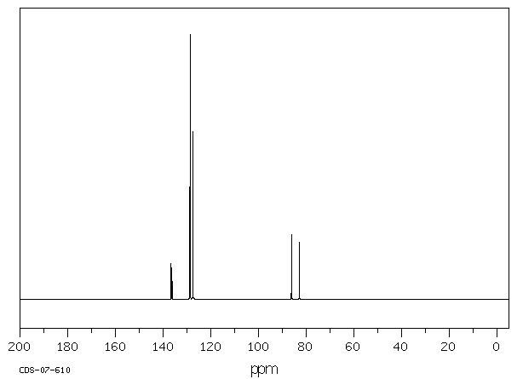
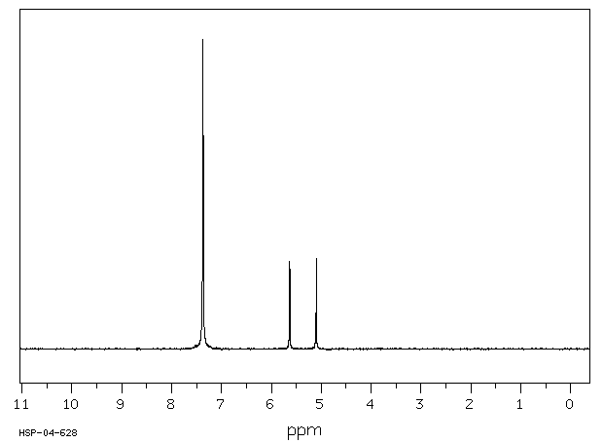
Special Examples IV
Coupling with other nuclei i.e., fluorine (I=½)
  Example: Benzyl fluoride
    All carbon signals split into doublets other than the meta-C.
    The coupling constant decreases going away from the fluorine atom: benzylic carbon: J_{C-F}=166 Hz, ipso: J_{C-F}=17 Hz, ortho: J_{C-F}=3.5 Hz)
    The coupling is also observed in the ¹H-NMR spectrum (J_{H-F}=48 Hz).
50 MHz
90 MHz
50 MHz
90 MHz
Δδ=3.3 ppm
Δδ=0.53 ppm

Slide 22
Special Examples V
Coupling with other nuclei i.e., phosphorus (I=½)
  Example: Triphenylphosphine (P-C: J₁=11 Hz, J₂=18.9 Hz, J₃=6.7 Hz)

