Slide 1
Introduction to
NMR Spectroscopy
Part I (¹H-NMR)

Slide 2
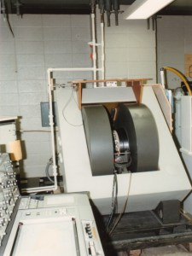
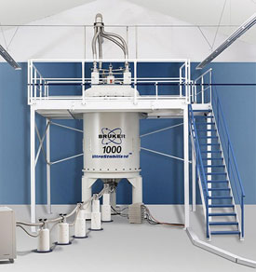
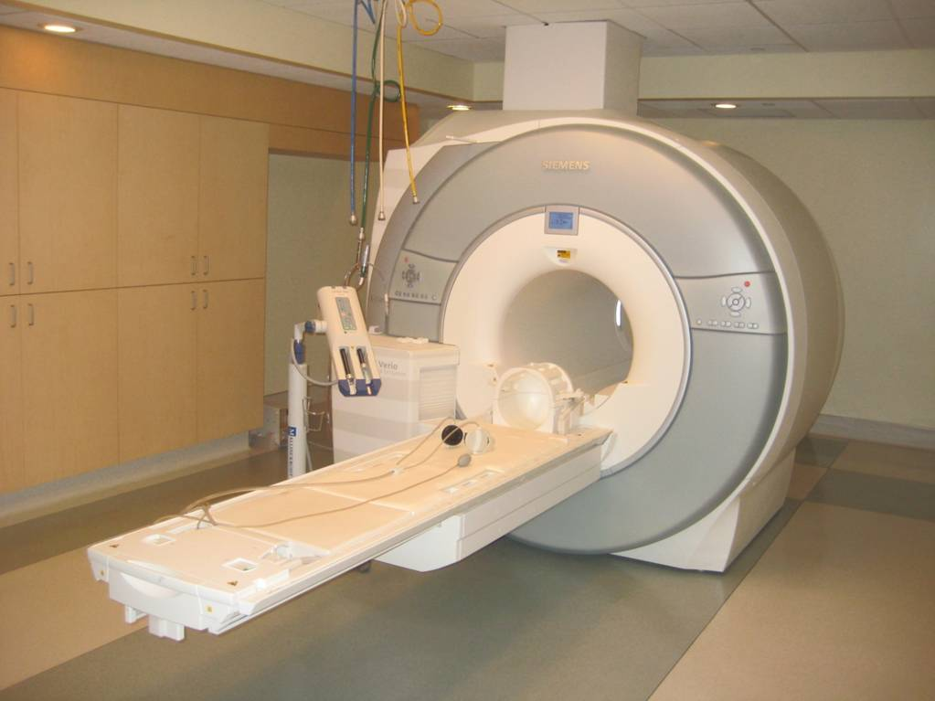
Introduction
Nuclear Magnetic Resonance (NMR) Spectroscopy is a technique that is used to determine the type, number and relative positions of certain atoms in a molecule.
Originally discovered by Felix Bloch and Edward Purcell
in 1946 (both shared the Nobel Prize in Physics in 1952 for their pioneering work), it has seen a significant increase in popularity with the development of FT-NMR spectrometers.

Slide 3
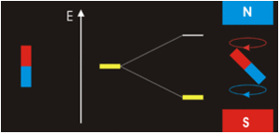
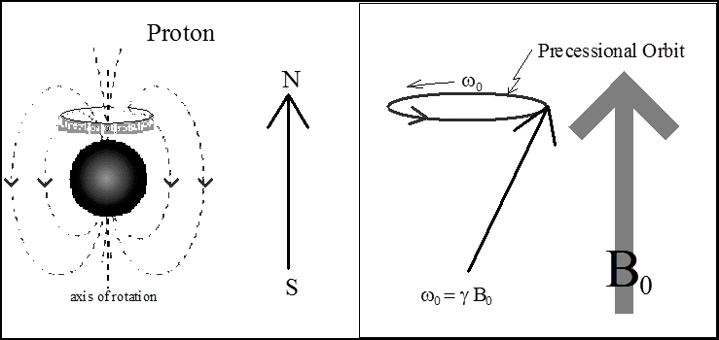
Physical Background of NMR Spectroscopy I
Nuclei, which are moving and charged particles, generate a magnetic field when doing so.
The precession of a nucleus with a nonzero magnetic
momentum can be described using a vector model.
Generally, the precession is a quantized phenomenon:
  The magnetic moment m is either aligned (m_{I}= ½) or opposed (m_{I}= -½)
  (for a nucleus with I= ½) to the applied field, resulting into two energy states.
  The magnetic moment m assumes (2*I+1) states for a nucleus in an applied field (i.e., D: I= 1, m_{I}= -1, 0, 1).
Energy
m_{I}= -½
ΔE= f(γB_{o})= hν
m_{I}= +½
Increased magnetic field B_{o}

Slide 4
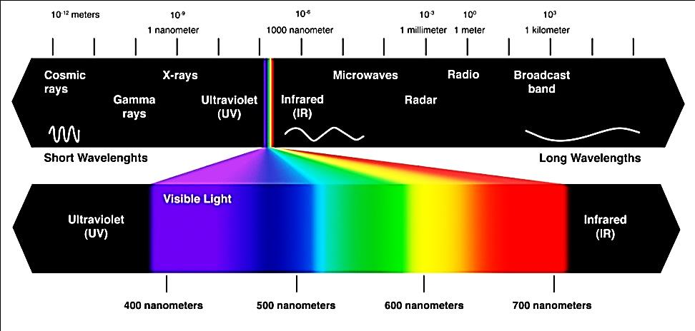
Physical Background of NMR Spectroscopy II
A resonance phenomenon occurs when the aligned nuclei interact with the applied field and are forced to change their spin orientation.
The energy, which is absorbed, is equal to energy difference ΔE between the two spin states. This resonance energy is about 10⁻⁶ kJ/mol (the radio-frequency).
The stronger the applied field, the greater energy difference between the spin states (ΔE) becomes, which allows distinguishing even between very similar atoms.
  The NMR spectrometers with stronger magnetic fields provide better resolution.
  The NMR experiment itself becomes more sensitive as well because saturation is
  less of a problem due to a more uneven population of the energy levels.
60 MHz
600 MHz

Slide 5
Physical Background of NMR Spectroscopy III
The effective magnetic field is a result of the applied magnetic field and
the changes that are induced by the environment:
The changes are often summarized into a shielding constant, σ.
  The larger the shielding constant and the smaller the effective field, the higher the applied field has to be in order for the nucleus to resonate at constant frequency.
  If a constant magnetic field is applied, the resonance frequency will decrease with increasing shielding.
In ¹H-NMR spectroscopy, the diamagnetic and neighboring effects are the most important contributions because only s-orbitals are important.
In ¹³C-NMR, the paramagnetic term becomes more significant because of the larger contributions from the p-electrons resulting in a larger shift range.

Slide 6
NMR Active Nuclei
Most elements possess at least one NMR active nucleus, but many of them several (i.e.,¹¹⁵Sn,
¹¹⁷Sn and ¹¹⁹Sn, ⁹⁵Mo and ⁹⁷Mo, etc.). However, in order for an atom to be NMR active, the
spin quantum number (I) must not equal zero.
If the proton and neutron number are even, the spin quantum number will be zero. Nuclei like ¹²C, ¹⁶O or ³²S will not be observable, but ¹³C, ¹⁷O and ³³S are NMR active nuclei.
Nuclei with a spin quantum number larger than I=½ often show broad lines because of their quadrupole moment.
There is a significant difference in abundance in these NMR active nuclei and the sensitivity
of these experiments differs quite a bit as well.
Nucleus | Spin Quantum Number, I | Protons | Neutrons | Natural Abundance | Magnetogyric ratio, g (10⁷ rad T⁻¹s⁻¹) | NMR Active | Standard
¹H | ½ | 1 | 0 | 99.985 % | 26.7519 | YES | (CH₃)₄Si
²H | 1 | 1 | 1 | 0.015 % | 4.1066 | YES | (CD₃)₄Si
³H | ½ | 1 | 2 | trace | 28.535 | YES | TMS-T₁
¹²C | 0 | 6 | 6 | 98.89 % |  | NO ☹
¹³C | ½ | 6 | 7 | 1.11 % | 6.7283 | YES | (CH₃)₄Si
¹⁴N | 1 | 7 | 7 | 99.6 % | 1.934 | YES | CH₃NO₂
¹⁵N | ½ | 7 | 8 | 0.37 % | -2.712 | YES | CH₃NO_{2,} NH_{3(l)}
¹⁶O | 0 | 8 | 8 | 99.76 % |  | NO ☹
¹⁷O | ⁵∕₂ | 8 | 9 | 0.04 % | -3.62808 | YES | D₂O
¹⁹F | ½ | 9 | 10 | 100 % | 25.181 | YES | CCl₃F
³¹P | ½ | 15 | 16 | 100 % | 10.841 | YES | 85 % H₃PO₄

Slide 7
Information from the NMR Spectrum I
Symmetry
  If there are fewer signals than atoms of a particular kind, there has to be symmetry in the molecule.
  Even for simple groups this assumes that there is free rotation about σ-bonds, which will strictly speaking only be true when the temperature is high enough to provide enough energy for this process.

Slide 8
Information from the NMR Spectrum II
Multiplet
  From coupled spectra i.e., ¹H-NMR spectra, it is often possible to obtain information about the neighboring
  atoms based on the splitting of the signal.
    This holds especially true for proton spectra, where the multiplet structure reveals how many hydrogen neighbors a given CH_{x}-function (x=1-3) has.
    Most of the ¹³C-NMR spectra are obtained as proton-decoupled spectra (¹³C{¹H}), which means that this information cannot be obtained from those spectra. However, the coupling with other nuclei (i.e., D, F, P, etc.) will still be observed (i.e., CDCl₃ displays
    a triplet at δ=77 ppm). Note that the coupling constants can be quite large.

Slide 9
Information from the NMR Spectrum III
Integration
  The integral is the area under a signal (group), which is expressed as an integral line over the signal or a number
  beneath the signal. Integration is not the height of a signal!
  Integration works relatively well for ¹H-NMR spectra but
  less well for ¹³C-NMR and some other nuclei because the relaxation times for these nuclei tend to vary much more.
  If signals are too close together, the software often integrates them together as well, which means that the integration line
  has to be used to estimate the individual integrals.
  Very broad signals are sometimes also very difficult to analyze because the integration limits are somewhat set arbitrarily.

Slide 10
Information from the NMR Spectrum IV
Chemical Shift
  The chemical shift of a signal permits indirect conclusions about the presence of certain heteroatoms and functionalities.
  Electronegative heteroatoms i.e., oxygen, fluorine, chlorine, etc. cause
  a shift to higher ppm values, as does sp²-hybridization (see below).
  The chemical shift δ (or τ in the older literature) is defined by
  The chemical shift (δ) is measured against a standard reference, (tetramethylsilane (TMS) in ¹H, ¹³C and ²⁹Si-NMR), which is defined as zero (δ=0.00 ppm) and is independent from the applied magnetic field.
  These values are generally given in units of ppm (parts per million) because the observed changes are very small compared to the applied magnetic field.
  In the older literature, chemical shifts are often given as offset in terms of Hz (compared to a reference compound).

Slide 11
¹H-NMR Spectroscopy – Chemical Shift
CH₃F
The chemical shift of protons is mainly due to the effect of neighboring groups, which are either electron-withdrawing groups/atoms that cause protons to be more deshielded, or electron-donating groups/atoms, which results in more shielded protons.
The first group causes a shift downfield (to higher ppm values!), while the second group causes the signals to appear upfield (at lower ppm values). Several effects influence these shifts.
Electronegativity (red line in graphs on the right is δ=3 ppm)
  The higher the electronegativity of the attached heteroatom, the further downfield the corresponding signal is shifted due to the deshielding of the hydrogen atom. Note that the effect is fairly pronounced in some cases because hydrogen is less electronegative compared to carbon (EN=2.5).
CH₃Cl
CH₃Br
CH₃X | Electronegativity | CH₃X | CH₂X₂ | CHX₃
F | 4.0 | 4.26 | 5.45 | 6.25
Cl | 3.1 | 3.05 | 5.30 | 7.26
Br | 2.8 | 2.68 | 4.95 | 6.83
I | 2.5 | 2.16 | 3.87 | 4.90
H | 2.1 | 0.23 | 0.23 | 0.23
CH₃I

Slide 12
¹H-NMR Spectroscopy – Chemical Shift
Hybridization
  Hydrogen atoms from saturated systems (sp³ without functional groups) appear usually between δ=0-2 ppm.
  Those, which are attached to sp² carbon atoms (alkenes, arenes) are found in the range between δ=4.5-8 ppm.
  Alkyne protons are located between δ=2-3 ppm due an anomalous anisotropy (see next slide).
  Aldehyde protons can be found in the range between δ=9-11 ppm due
  to the fact that they are attached to a sp²-carbon and also experience
  the electronegativity of the oxygen atom.
  Imine functions (H-C=N) usually are found around δ=8-8.5 ppm due
  to the lower electronegativity of nitrogen compared oxygen.

Slide 13
¹H-NMR Spectroscopy – Chemical Shift
Hybridization (continued)
  In arenes, alkenes, alkynes and for carbonyl functions a special effect
  is observed, called anisotropy.
  These functional groups possess circulating π-electrons, which cause
  a secondary magnetic field.
  The chemical shift of the protons in these molecules highly depends where these protons are located in respect to this secondary magnetic field. (“+” denotes shielded areas, while “-“ denotes deshielded areas)
  In the case of arenes, alkenes and carbonyl functions these protons exhibit less shielding and are shifted downfield.
  In alkynes, the protons are located in the area of increased shielding
  and therefore are less shifted than alkene protons.

Slide 14
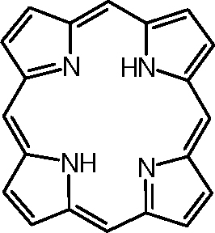
¹H-NMR Spectroscopy – Chemical Shift
Hybridization (continued)
  In some cases, the shielding through a secondary magnetic field is so strong that these protons appear at negative δ-values as in the example ([18]-annulene) below at low temperatures.
  The system has 18 π-electrons, hence it is considered aromatic. The inner hydrogen atoms (H_{i}) are highly shielded, while the outer ones are highly deshielded.
  A similar behavior is observed for [22]-annulene.
  A similar trend is observed for porphyrins in which
  the NH-protons appear at δ= -3 ppm.
T= -70 ºC: H_{i}: δ = -2.99 ppm (6 H), H_{o}: δ =9.28 ppm (12 H)
T= +110 ºC: δ =5.45 ppm (weighted average: δ =5.19 ppm)

Slide 15
¹H-NMR Spectroscopy – Chemical Shift
Acidic and Exchangeable Protons
  The protons of phenols, alcohols, amines and amides can be found in very broad range between δ=0.5 and 7 ppm while protons of carboxylic acids show up in the range between δ=10.5 and 12 ppm.
  In some cases, enol-type protons can appear as high as δ=15-16 ppm
  i.e., acetyl acetone (2,5-pentanedione, H₃CCOCH₂COCH₃).
  The appearance of the signal depends highly on the condition at which the spectrum was obtained (solvent, temperature, concentration, impurities):
    In diluted solutions and in nonpolar solvents sharp peaks are usually observed because there are no (or very little) hydrogen bonding between the X-H-functions (X=O, N).
    In more concentrated solution, broad peaks are observed that can also easily be overlooked.
  Many of these protons can be exchanged by treating the solution with D₂O. The corresponding signal would disappear in the ¹H-NMR spectrum if the proton was exchangeable, which simplifies the spectrum.

Slide 16
¹H-NMR Spectroscopy - Integration
2. Integration
  The NMR spectroscopy cannot only distinguish between magnetically different protons, but also determine the approximate ratio of these protons.
  The NMR spectrometer does the integration and provides the information either as a number under the signal as shown in the spectrum below (39.9 and 60.0) or draws a vertically rising line.
  In order to determine the true ratio of the signals, the distance between the foot and
  the top of the integration line above a peak has to be measured.
  All values are then divided by the smallest number to obtain the relative ratios.
  If a ratio is not an integer (i.e., 1:1.5), a factor has to be found to make it an integer
  as shown in the example above (multiply by 2 makes it 2:3).

Slide 17
¹H-NMR Spectroscopy - Multiplet
3. Multiplet Structure
  The multiplet structure of a signal is due to a spin-spin splitting of magnetically
  non-equivalent protons. For a group of n adjacent protons, a signal containing (2*n*I+1=2*n*½= n+1 for I=½) peaks is observed.
  For instance, bromoethane exhibits a triplet (=three peaks) at δ=1.53 ppm for the methyl group (CH₃) due to the splitting from the two neighboring hydrogen atoms.
  The methylene group (CH₂) shows as a quartet (=four peaks) at δ=3.31 ppm, which is
  shifted downfield because of the bromine attached to the same carbon atom.
  There is no splitting observed within the methyl or methylene group here because there is a free rotation about the C-C single bond making all protons within these groups chemically equivalent.
  The distance between the individual peaks of a multiplet is called spin coupling constant (J)

Slide 18
¹H-NMR Spectroscopy - Multiplet
3. Multiplet Structure
    These protons can have different spins (m_{I}= ±½) and therefore cause
    an additional shielding (same spin compared to the applied field) or deshielding (opposite spin) of the observed protons.
    If there are more than one hydrogen atom on the adjacent C-atom,
    more spin arrangements will be possible i.e., methyl group.
    The methylene group will appear as a quartet. The four lines will
    display a relative intensity of 1:3:3:1 (theoretically).
Scenario 1 | Scenario 2 | Scenario 3 | Scenario 4
↑ ↑ ↑ | ↑ ↑ ↓ ↑ ↓ ↑ ↓ ↑ ↑ | ↑ ↓ ↓ ↓ ↑ ↓ ↓ ↓ ↑ | ↓ ↓ ↓
1 possibility | 3 possibilities | 3 possibilities | 1 possibility

Slide 19
¹H-NMR Spectroscopy - Multiplet
3. Multiplet Structure
  A neighboring methyl group splits a signal into a quartet, which ideally shows relative intensities of the peaks of 1:3:3:1. Generally, the line intensities can be predicted using Pascal’s triangle (for well separated multiplets using _{n}C_{r}):
1 Singlet
1 1 Doublet
1 2 1 Triplet
1 3 3 1 Quartet
1 4 6 4 1 Quintet
1 5 10 10 5 1 Sextet
1 6 15 20 15 6 1 Septet
1 7 21 35 35 21 7 1 Octet
1 8 28 56 70 56 28 8 1 Nonet
  The higher the multiplicity, the larger the size discrepancy of the outer and the inner lines.
  When a lot of lines are observed, it is often difficult to identify the exact number of lines within a multiplet because the outermost lines are barely (or not) visible in those cases.
  Sometimes it helps to determine the ratio of the two lines farthest to the outside
  of the multiplet.

Slide 20
¹H-NMR Spectroscopy - Multiplet
3. Multiplet Structure
  If the coupling multiplets are close together, the ratio of the intensity of the lines changes. This effect is called multiplet skewing (“leaning”) and allows one to locate the coupling partner.
  The outermost lines tend to be smaller than the innermost lines of a coupling system as the following scheme.
  This effect is the greater the closer the signals are. This can even lead to the disappearance of the outermost lines i.e., in the aromatic range because the signals are relatively close together there. In some cases a triplet converts into a ‘doublet’ or two doublets appear as one ‘singlet’ due to this effect.

Slide 21
¹H-NMR Spectroscopy - Multiplet
3. Multiplet Structure
  Splitting patterns for common alkyl groups
  Alkyl groups show relatively simple and characteristic splitting patterns
  (as shown in the table above). Note that strictly speaking the “sextet” in
  the n-propyl group is a triplet of quartets.
  However, the complicated splitting pattern will only be observed if the
  coupling constants and/or chemical shifts are very different for the
  methylene and the methyl group.
Group | Multiplet (Relative Integration)
X-CH₃ | singlet (3 H)
X-CH₂CH₃ | quartet (2 H) + triplet (3 H)
X-CH(CH₃)₂ | septet (1 H) + doublet (6 H)
X-CH₂CH₂CH₃ | triplet (2 H) + “sextet” (2 H) + triplet (3 H)
X-C(CH₃)₃ | singlet (9 H)
X-CH₂CH(CH₃)₂ | doublet (2 H) + multiplet (1 H) + doublet (6 H)
X-CH(CH₃)CH₂CH₃ | “sextet” (1 H) + doublet (3 H) + ”quartet” (2 H) + triplet (3 H)
X-CH₂CH₂CH₂CH₃ | triplet (2 H) + “quintet” (2 H) + “sextet” (2 H) + triplet (3 H)

Slide 22
¹H-NMR Spectroscopy - Multiplet
3. Multiplet Structure
  The situation is more complicated in aromatic systems,
  which often show very complicated (due to overlap and
  long-range coupling through the π-system) and difficult
  to analyze patterns for beginners.
  The following examples illustrate some important points
  but are by all means far from being complete:
    The first step is to understand the patterns in the aromatic range
    due to symmetry, the second step is to identify the effect of different groups onto the various protons on the ring.
    Aromatic protons usually show up in the range of δ=6-9 ppm.
    (Strictly speaking, the coupling patterns are much more complicated, but for the sake of simplicity only the first order couplings will be considered here because this is what can be observed on a normal spectrum!).

Slide 23
¹H-NMR Spectroscopy - Monosubstitution
Mono-substitution (general)
  A mono-substituted benzene ring displays a plane of symmetry going through C_{i} and C_{p} atom.
  As a result, there are only three different types of protons observed. H_{o} should show a doublet, while H_{m} and H_{p} appear as a triplet each (strictly speaking a doublet of doublets for H_{m}).
  The integrations for H_{o} (2 H), H_{m} (2 H) and
  H_{p} (1 H), respectively.

Slide 24
¹H-NMR Spectroscopy - Monosubstitution
Mono-substitution (examples)
  Toluene
  The two signal groups at δ=7.4-7.5 ppm corresponds to the ring protons, while the singlet at δ=2.6 ppm
  is due to the methyl group on the ring.
  The expansion of the aromatic range on the right hand side shows a triplet (H_{m}) and a triplet (H_{p}) that is overlapped by a doublet (H_{o}) on the left side. The ortho and para protons are shifted about the same if a methyl group is attached to the ring (Δδ = -0.18 ppm (ortho) and Δδ= -0.20 ppm (para)).
  In addition, a strong multiplet skewing is observed because the signals are very close together. Note that
  the two outer lines of the triplet at δ=7.5 ppm possess very different intensities.
m o/p

Slide 25
¹H-NMR Spectroscopy - Monosubstitution
Mono-substitution (examples)
  Anisole
p o
  If the substituent R was an electron-donating group i.e., alkoxy (i.e., anisole), amino
  (i.e., aniline), a distinguished splitting of the protons would be observed in this region
  of the spectrum.
  The meta protons are slightly shifted downfield (triplet at δ=7.48 ppm), while the ortho (doublet at δ=7.12 ppm) and para protons (triplet at δ=7.15 ppm) are shifted upfield, because the electron-density increased in these positions (as shown in the diagram).
  The singlet around δ=3.9 ppm is due to the protons of the methyl group attached to the oxygen atom.
m p o
m p o

Slide 26
¹H-NMR Spectroscopy - Monosubstitution
Mono-substitution (examples)
  N,N-Dimethylaniline
  The triplet at δ=7.66 ppm is due to the meta protons, while the doublet for the ortho and para proton overlaps δ=7.1-7.2 ppm.
  The protons of the methyl groups are less shifted (δ=3.2 ppm) due
  to the lower electronegativity of the nitrogen atom compared to the oxygen atom, but the integration for this signal is higher because it represents six equivalent hydrogen atoms.
m p o
m p o

Slide 27
¹H-NMR Spectroscopy - Monosubstitution
Mono-substitution (examples)
  Ethyl benzoate
  The signal at δ=8.0 ppm is due to ortho hydrogen atoms (downfield shift
  ~0.65 ppm), while the signal at δ=7.2-7.4 ppm is due to the meta and para hydrogen atoms (both triplets downfield shift about 0.1-0.2 ppm).
  The quartet at δ=4.3 ppm corresponds to the CH₂-group in the ester part.
  The increased shift is due to the oxygen atom of the ester function. The
  triplet at δ=1.35 ppm is due to the methyl group.
o p m
o p m

Slide 28
¹H-NMR Spectroscopy - Monosubstitution
Electron-donating groups
  The ortho/para protons are shifted upfield due to the increased electron-density in these positions (partial negative charge)
  Groups: -OR, -OH, -NR₂, -alkyl
Electron-withdrawing groups
  The ortho protons are shifted downfield due to the decreased electron-density in this position (partial positive charge)
  Groups: carbonyl, nitro, nitroso, sulfo

Slide 29
¹H-NMR Spectroscopy – Parasubstitution
Para-substitution (general)
  Case 1: Identical substituents
    The molecule has two symmetry planes perpendicular to each other.
    All four protons on the ring will be chemically equivalent resulting in one singlet in the
    ¹H-NMR spectrum because they do not couple with each other.
  Case 2: Different substituents
    There is only one symmetry plane in the molecule.
    There are two different types of hydrogen atoms on the ring. Usually two doublets are observed for this substitution pattern.

Slide 30
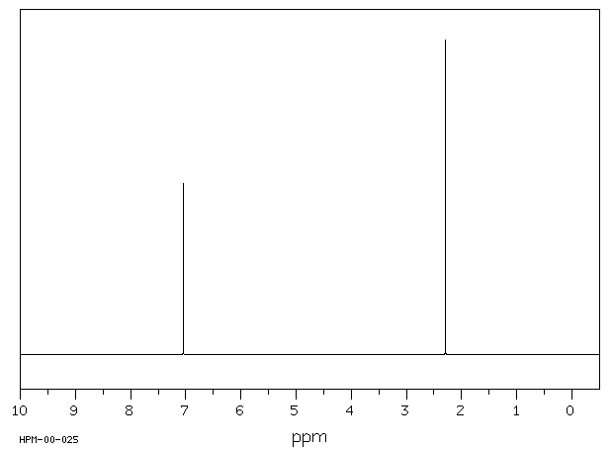
¹H-NMR Spectroscopy – Parasubstitution
Para-substitution (examples)
  Case 1: p-Dichlorobenzene
  Both compounds display one singlet for the aromatic protons due to the high symmetry.
  p-Xylene displays an additional peak at δ=2.2 ppm
  due to the methyl groups on the ring.
  p-Xylene

Slide 31
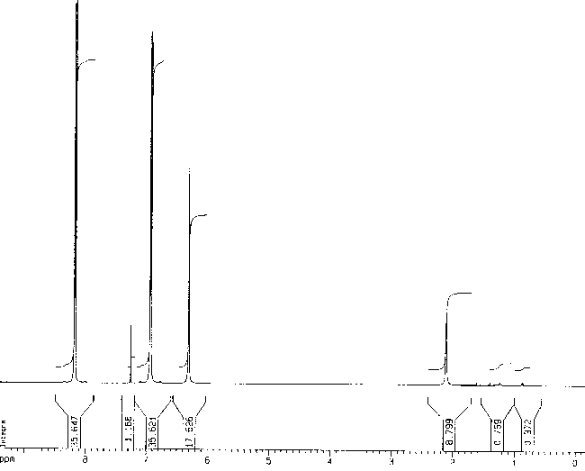
¹H-NMR Spectroscopy – Parasubstitution
Para-substitution (examples)
  Case 2: p-Nitrophenol
  If X=donor and Y=acceptor, typically an AA’BB’ spin system (=two doublets in first order coupling) is observed. The molecule possesses one symmetry plane.
  The two protons near the X=acceptor will be shifted downfield (Δδ=0.95 ppm for X=NO₂), while the two protons near Y=donor will be shifted upfield (Δδ=0.56 ppm for Y=OH).
  The typical coupling constant in this case ranges from J₃=7-10 Hz (coupling between two adjacent hydrogen atoms on the ring).
  The broad signal at δ=6.3 ppm is due to the phenolic OH group. This signal will change its location if a different solvent is used to acquire the NMR spectrum.
H₂ H₁ OH

Slide 32
¹H-NMR Spectroscopy – Orthosubstitution
Ortho-substitution (general)
  Case 1: Identical substituents
    This substitution pattern will usually lead to a symmetric set of signals, consisting of a doublet (H₁) and a “triplet” (H₂),both with an integral of two hydrogen atoms.
    Often times, these signals are very close together and/or overlap. However, the signal groups are usually relatively symmetric.
  Case 2: Different substituents
    An asymmetric ortho-substitution leads to a very complex splitting pattern in the aromatic range because there is no symmetry anymore (H₁ and H₄ form a doublet each, H₂ and H₃ form a triplet each, integration one hydrogen atom each).
    Due to the possible overlap, these patterns are often difficult to recognize and analyze as well.

Slide 33
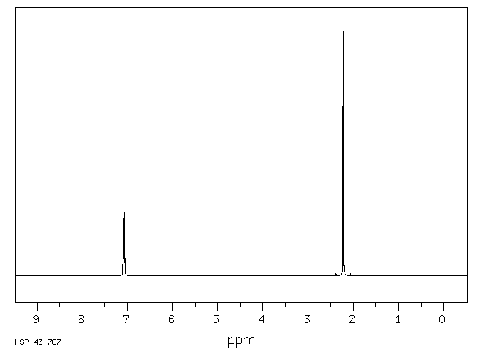
¹H-NMR Spectroscopy – Orthosubstitution
Ortho-substitution (examples)
  Case 1: o-Dichlorobenzene
  The spectrum of o-dichloromethane displays two signal groups, while the two groups overlap in the case of
  o-xylene.
  The additional signal at δ=2.2 ppm is due to the two methyl groups on the ring.
  o-Xylene

Slide 34
¹H-NMR Spectroscopy – Orthosubstitution
Ortho-substitution (examples)
  Case 2: o-Nitrophenol
  In the spectrum of o-nitrophenol, a doublet (δ=~8.01 ppm, H₁ if X=NO₂ and Y=OH) and a triplet (δ=~7.52 ppm, H₃) can clearly be identified.
  The other doublet (δ=7.08 ppm) and the triplet (δ=6.90 ppm) are due to
  H₄ and H₂
  The phenol function forms a strong intramolecular hydrogen bond with neighboring nitro group and is therefore more shifted downfield (δ=~10.5 ppm)
OH
H₁ H₃ H₄ H₂

Slide 35
¹H-NMR Spectroscopy – Metasubstitution
Meta-substitution (general)
  Case 1: Identical substituents
    If both substituents are the identical, a symmetry plane (going through C1 and C4) will be observed in the molecule.
    As a result three signals are observed: a singlet (H₁), a doublet (H₂) and a triplet (H₃) (integration ratio: 1 H:2 H:1 H).
    Due to the possible overlap, these patterns are often difficult to recognize and analyze as well.
  Case 2: Different substituents
    An asymmetric meta-substitution leads to a very complex splitting pattern in the aromatic range:
    H₁ forms a singlet, H₂ and H₄ show as a doublet each, and H₃ as a triplet (integration one hydrogen each).
    Due to the possible overlap, these patterns are often difficult to recognize and analyze as well.

Slide 36
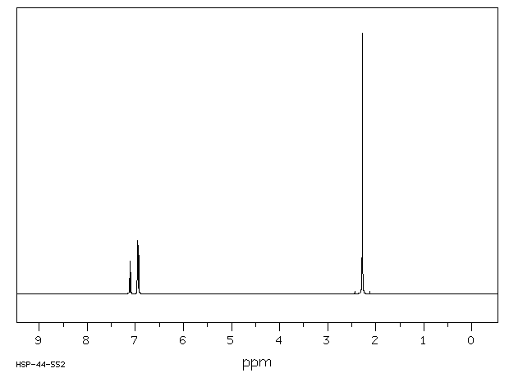
¹H-NMR Spectroscopy – Metasubstitution
Meta-substitution (examples)
  Case 1: m-Dichlorobenzene
  For m-dichlorobenzene, the expected singlet for H₁ is not signal most downfield. The signals for H₂ and H₃ overlap
  at δ=7.2 ppm.
  The additional signal at δ=2.3 ppm is due to the two methyl groups on the ring
  m-Xylene
H₁ H₂/H₃

Slide 37
¹H-NMR Spectroscopy – Metasubstitution
Meta-substitution (examples)
  Case 2: m-Nitroaniline
  For m-nitroaniline (Y=NO₂, X=NH₂) the signal for H₁ located at δ=7.47 ppm is clearly a singlet (H₁).
  The two doublets (at δ=6.95 and δ=7.54 ppm) are a result of H₂ and H₄.
  The signal at δ=7.25 ppm is a triplet, which is due to H₃.
  The amino group appears as a broad signal at δ=~4.0 ppm.
NH₂
H₄ H₁ H₃ H₂

Slide 38
¹H-NMR Spectroscopy – Coupling Constants
Coupling Constants
  The spacing between the lines of a multiplet is called coupling constant.
  The coupling constant is identical within the multiplet and its coupling partner. In other words, nucleus A couples with nucleus B with the coupling constant J_{AB}, and nucleus B couples with nucleus A with the same coupling constant, J_{AB}. This allows matching multiplets, which couple with each other.
  Signal splitting results from spin-spin coupling of neighboring protons and is generally observed if:
    1. the protons are no more than 2 or 3 σ bonds apart (J­₂ and J₃).
    2. the protons are not magnetically equivalent.
    3. it can occur through the π bonds (long-range coupling) and this is why splitting patterns of aromatic protons are often difficult to analyze.

Slide 39
¹H-NMR Spectroscopy – Coupling Constants
Coupling Constants (continued)
  Coupling constants are angle dependent as can be seen in the in the diagram below, which was generated using the vicinal Karplus relationship (M. Karplus, Noble Prize in Chemistry in 2013).
  The highest J-values are obtained for angles of Θ=0 and 180º, while
  the J-value for Θ=90º is very small.
  The degree of coupling is a function of the overlap of the involved orbitals. If they are co-aligned, the interaction will be very strong. If they are perpendicular, the overlap is going to be weak resulting in a low coupling constant.

Slide 40
¹H-NMR Spectroscopy – Coupling Constants
Coupling Constants (continued)
  Coupling constants are obtained from the NMR spectrum by the following equation:
  J (in Hz) = average line spacing in multiplet (in ppm) * sweep frequency (in MHz)
  Coupling constants are usually given in Hertz (Hz) and not in ppm.
  For proton spectra they are usually in the range of J_{H-H}=0-20 Hz (see below),while the coupling constants with other nuclei are often significantly larger (~10²-10³ Hz) i.e., J_{H-F}(CH₂F₂)= 50 Hz, J_{P-H}((CH₃)₂PH)=192 Hz, etc. Coupling constants are independent from sweep frequency of the NMR spectrometer used.

Slide 41
Dimethylphosphine
Me₂PH (400 MHz)
  Me: dd, P-H: d, sept; J₁(P, H)=192 Hz, J₃(H, H)=7.7 Hz

Slide 42
Difluoromethane
CH₂F₂ (400 MHz)
  CH₂: t
  J₂(H, F)=50 Hz

