Slide 1
Lecture 4a
Enantioselective Epoxidation I

Slide 2
Catalyst Design I
The catalyst possesses an asymmetric bridge that controls the access of the alkene
Approach 1: Jacobsen
Approach 2: Katsuki
Main catalyst features
  Tert.-butyl groups in 3- and
  5-position block the access
  from the front and the sides
  The asymmetric cyclohexane
  bridge controls the orientation
  of alkene during the approach:
  the smaller ligand R₂ is
  preferentially oriented to the
  left side in both cases, which
  results in an e.e.-value < 100 %
1
2

Slide 3
Catalyst Design II
Reactivity of catalyst
  Donor groups i.e., methoxy, phenoxy, etc. attached to the benzene ring lower its reactivity
  Additives i.e., 4-phenylpyridine N-oxide (=PPNO) lower its reactivity as well (=L in the diagram on the previous slide)
  Both type of ligands above are electron-donating and increase the electron-density on the Mn(III)-ion slightly, which decreases its electrophilic character
    The Mulliken charge on Mn atom
    according (Spartan, PM6) when
    X is located in 5,5’-position
Substituent | Charge on Mn
H | 1.985
tert.-Bu | 1.982
OMe | 1.981
NO₂ | 1.987

Slide 4
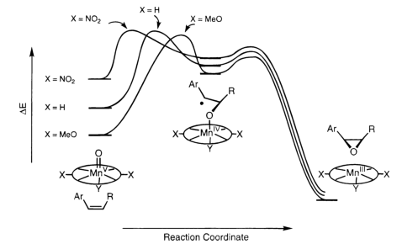
Catalyst Design III
The activation energy of the first step will increase if an electron-donating group is attached to the benzene ring
This leads to an improved stereoselectivity in many reactions due
to a late transition state (Hammond Postulate)
  The stereochemical aspect during the approach of the alkene to the active specie becomes more important because the oxo-ligand is transferred at a later stage because the Mn=O bond is stronger
  Example: 2,2-dimethylchromene: X=OCH₃ (98 % ee), X=tert.-Bu
  (83 % ee), X=NO₂ (66 % ee)
2,2-dimethylchromene

Slide 5
Catalytic Cycle
The Jacobsen catalyst is oxidized with suitable oxidant
i.e., bleach (r.t.), iodosobenzene (r.t.), m-CPBA (-78 ºC)
to form a manganese(V) oxo specie
Due to its shallow nature, Jacobsen’s catalyst works
well for cis, tri- and tetra-substituted alkenes, with the e.e.-values for these alkene exceeding often 90 %

Slide 6
Mechanistic Studies I
If cis alkenes are used as substrates, several pathways are possible.

Slide 7
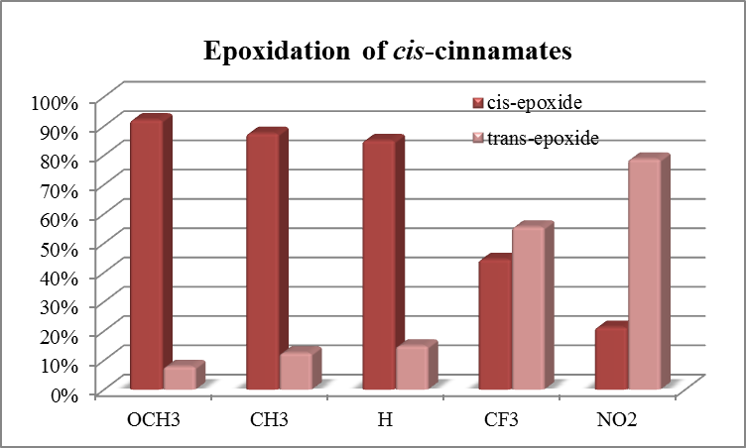
Mechanistic Studies II
Example 1: Cis/trans ratio for substituted cis-cinnamates
Bottom line:
  Electron-withdrawing ligands favor the formation of trans epoxide
  over cis epoxides due to the longer life-time of the radical
R-group | cis/trans | ee_{cis} | ee_{trans}
OCH₃ | 11.7 | 72 | 66
CH₃ | 7.0 | 79 | 41
H | 5.7 | 85 | 62
CF₃ | 0.8 | 79 | 55
NO₂ | 0.27 | 91 | 53

Slide 8
Mechanistic Studies III
Example 2: Reactivity of dienes with Jacobsen’s catalyst
Bottom line:
  Cis alkenes are significantly more reactive than trans alkenes (~5:1 above)
  Donor substituted alkene functions are much more reactive than acceptor substituted alkenes (~6:1 above)

Slide 9
Epoxide Chemistry
Epoxides are very reactive  good starting materials for many reaction, but also difficult to handle
Example 1: Acid catalyzed hydrolysis leading to trans diols
Example 2: Base catalyzed hydrolysis leading to diols
Example 3: Acid catalyzed rearrangement i.e., silica column

Slide 10
Industrial Examples I
Example 4: Diltiazem (anti-hypertensive, angina pectoris)
Example 5: Ohmefentanyl (very powerful analgesic, used to tranquilize large animals i.e., elephants)

Slide 11
Industrial Examples II
Example 6: Taxol (anti-cancer drug)
From 1967 to 1993 it was isolated from the bark of Pacific yew tree (Taxus brevifolia)  very negative environmental impact ☹
Bristol-Myers Squibb uses plant fermentation technology

