Slide 1
Lecture 3a
Catalyst

Slide 2
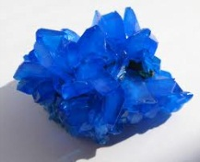
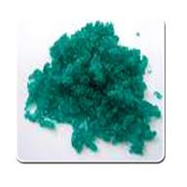
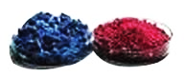
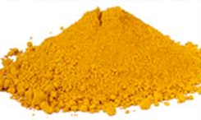
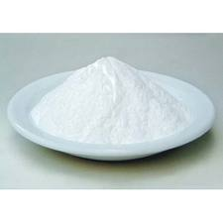
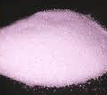
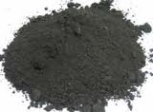
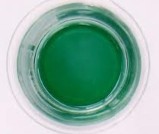
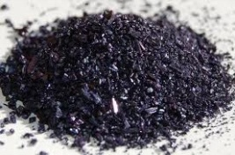
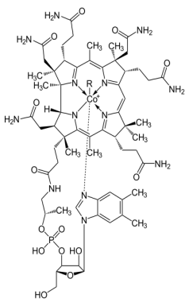
Transition Metals
Many TM compounds are very colorful due to d-d transitions (i.e., Cu(II) is blue/green,
Ni(II) is green, Co(II) is red/blue, Fe(III) is orange (all of these are hydrates except the
blue Co-compound))
However, many simple Zn(II), Cd(II) and Hg(II) compounds are white (d¹⁰ configuration)
Different oxidation states of a metal display characteristic colors due to different number of
d-electrons i.e., Mn(II) pale pink, Mn(IV) dark brown, Mn(VI) green, Mn(VII) dark purple
Most TM exhibit many more oxidation states than main group elements
i.e., Mn(0) in Mn₂(CO)₁₀ to Mn(VII) in KMnO₄, most commonly used is Mn(II)
Several TM play important roles in biological processes i.e., cobalt (cobalamin),
iron (hemoglobin, cytochromes), molybdenum (iron-molybdenum-sulfur proteins
in nitrogenase, Xanthine oxidase catalyzes the oxidation of hypoxanthine
to uric acid), nickel (carbon monoxide dehydrogenase), manganese ((D)-tartrate
dehydratase), etc.
Fe
Cu
Ni
Co
Zn

Slide 3
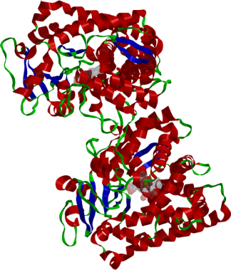
Cytochrome
Cytochrome P₄₅₀: it facilitates the oxidation of a C-H function
to C-OH function using oxygen
  It contains an iron center that
  goes through various oxidation
  states during the catalytic cycle
  (Fe(II), Fe(III) and Fe(V))
    Superoxide (hyperoxide)
    Peroxide
    The key intermediate is an
    iron oxo specie “(Fe=O)”
Overall: R-H + O₂ + 2 H⁺ + 2 e⁻ R-OH + H₂O

Slide 4
Catalyst Synthesis (Theory)
Two step reaction
Step 1: Formation of the Mn(II) salen complex (light yellow)
Step 2: Formation of the Mn(III) salen complex (dark brown)
by oxidation with oxygen in air
The configuration in the backbone (cyclohexane) is retained during the reaction leading to the R,R-enantiomer of the catalyst

Slide 5
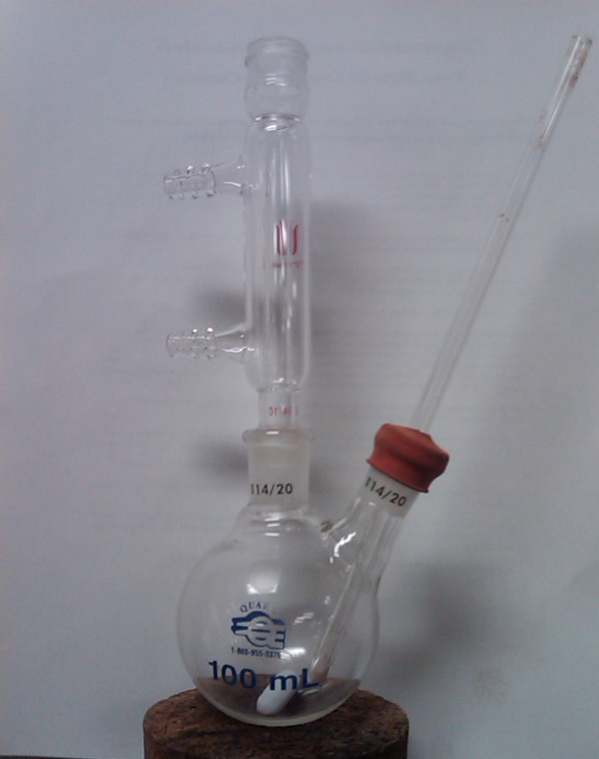
Catalyst Synthesis I
Assemble the following setup
Increase the diameter of
the glass tube by wrapping
some parafilm around it
Water outlet
Water-jacketed condenser
Air inlet tube
Water inlet
Two-necked round-bottomed flask

Slide 6
Catalyst Synthesis II
Suspend the ligand in 95 % ethanol
Reflux the mixture
Add the crushed Mn(OAc)₂*4 H₂O
Reflux the mixture
Introduce an air stream via the glass tube immersed in the solution
Monitor the reaction with TLC
After the ligand is consumed,
add LiCl und reflux again
Remove the solvent completely using rotary evaporator
Why is the reflux required here?
Why is the Mn-salt crushed?
Which observation expected?
Which solvent is used here?
When is the first TLC plate developed?
What is the purpose of LiCl?
Why is it used here?
To increase the rate of the reaction
A color change to dark brown
Ethyl acetate:hexane (1:4)
About 45 minutes into the reaction
It serves as the chloride source

Slide 7
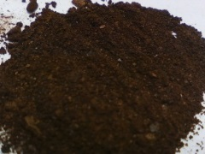
Catalyst Synthesis III
Extract the residue with ethyl acetate
Wash the organic layer with water and then saturated sodium chloride solution
Dry over a minimum amount of anhydrous Na₂SO₄
Rinse the drying agent with ethyl acetate
Add high-boiling petroleum ether (hbPE, b.p.=100-140 ºC)
Slowly remove the solvent using rotary evaporator until a light brown suspension is obtained
Place suspension in an ice-bath
Isolate the solids by vacuum filtration
How much solvent should be used here?
Why?
What is high-boiling petroleum ether?
Why is hbPE added here?
Why is the solvent removed afterwards?
2*10 mL
The polar catalyst absorbs
strongly on the drying agent
A mixture of hydrocarbons
To lower the polarity of the solution
To further lower the polarity
of the solution facilitating the
precipitation of the catalyst

Slide 8
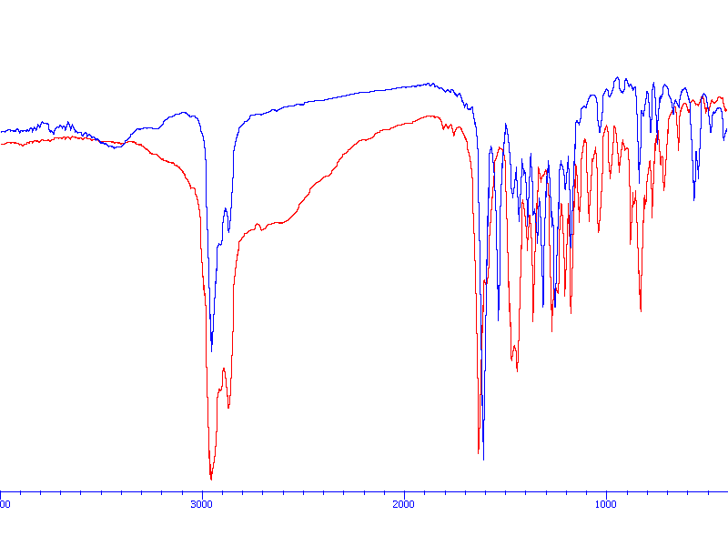
Characterization I
Infrared spectrum
  ν(C=N)=1610 cm⁻¹
  It is shifted to lower
  wavenumber due to the
  coordination of the nitrogen
  atoms to Mn(III)
  ν(Mn-O)=545 and 565 cm⁻¹
  Not present in ligand
  ν(OH)=2500-3100 cm⁻¹
  is absent!
UV-Vis spectrum
  Solvent: absolute ethanol
  Cuvette: quartz ($$$)
  Range: λ=200-600 nm
  Concentration: Based on ε-values from the literature
No NMR spectrum will be acquired because the catalyst is paramagnetic
No optical rotation will be obtained because the catalyst is too dark in color
What could be used to determine the optical purity?
Red: ligand
Blue: catalyst
ν(Mn-O)
ν(C=N)

Slide 9
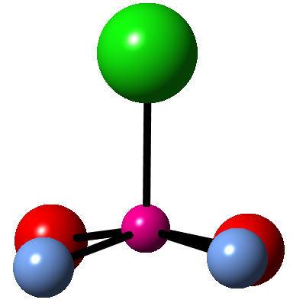
Characterization II
Crystal Structure
Bond lengths:
  d(Mn-O)=186-187 pm
  d(Mn-N)=197-199 pm
  d(C=N)=129.5 pm (ligand: 127.2 pm)
  The six-membered ring Mn-O1-C2-C7-C8-N9 is almost planar
  The two oxygen atoms and the two nitrogen atoms for the basal plane of a square pyramid
  The Mn-atom is located 33 pm above the basal plane
  The chlorine atom assumes the apex
Cl
O
O
N
Mn
N

