Slide 1
Lecture 2b
Ligand Synthesis

Slide 2
Chiral Diamines as Part of a Chiral Catalysts
Jacobsen ligand and derivatives
1,2-Diaminocyclohexane is also used as the backbone of the Trost ligand (used for palladium-catalyzed asymmetric allylic alkylation)
All of these ligands are tetradentate (coordinate via four atoms to the metal atom
i.e., NNOO or NNPP)
The platinum oxalate complex with (R,R)-diaminocyclohexane as ligand is used in the cancer chemotherapy (colorectal, Eloxatin)
C2 symmetric bridge
Salen ligand

Slide 3
Jacobsen Ligand (Theory)
The formation of the ligand is two step process
  Step 1: The in-situ formation of the free diamine by the reaction of the tartrate salt with two equivalents of potassium carbonate (trans-C₆H₁₀(NH₂)₂: pK_{a}= 6.47, 9.94; H₂CO₃: pK_{a}= 6.70, 10.33)
  Step 2: The nucleophilic attack of the diamine on the carbonyl group of the aldehyde. The configuration of the ligand is retained during the reaction ((R,R)-diammonium salt  (R,R)-ligand)

Slide 4
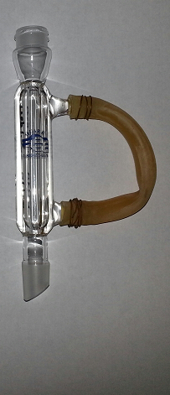
Jacobsen Ligand (Synthesis I)
Stir the tartrate salt and two equivalents of potassium carbonate in water until they are completely dissolved
Add 95 % ethanol
Heat to a gentle reflux
Add the ethanolic aldehyde solution (slightly more than two equivalents compared to the salt)
Reflux for at least 45 min
Add a small amount of water to mixture before allowing to cool down
Why are two equivalents of K₂CO₃ used here?
Why is 95 % ethanol added?
What does reflux imply?
Why are more than two
equivalents used here?
Which observation should be
made here?
Why is the mixture refluxed?
Why is water added?
Two ammonium functions have to be
deprotonated and the bicarbonate is
too weak as a base
The lower the polarity of the solution
Boiling of solution
Reflux ring in lower third
A bright yellow precipitate
Contains
propylene
glycol
To lower the solubility of the ligand gradually while the solution is cooling to room temperature

Slide 5
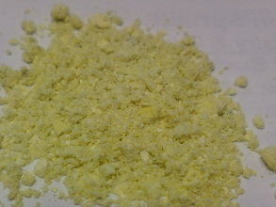
Jacobsen Ligand (Synthesis II)
Place the mixture in an ice-bath
Isolate the precipitate by vacuum filtration
Dissolve the crude ligand in a mixture of ethyl acetate and hexane (1:1, v/v)
Extract the organic layer with saturated sodium chloride solution
Dry the organic layer over anhydrous Na₂SO₄
Remove the solvent using the rotary evaporator
Product:
What is an ice-bath?
Which funnel is used here?
What is used to wash the ligand?
Why is a solvent mixture used here?
Why is this step performed?
Why is rotary evaporator used here?
How can the final product be removed from the round bottom flask?
The wet ligand does not dissolve well
in either solvent alone
Mechanically (spatula)
Add a small amount of EtOAc to dissolve the ligand in the flask and remove solvent in a small beaker

Slide 6
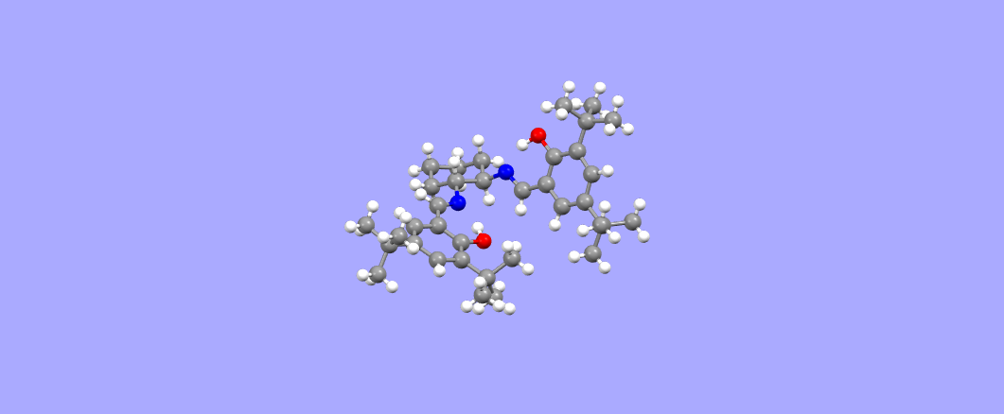
Jacobsen Ligand (Characterization I)
Crystal structure (for reference see reader)
  The two salicylideneimine moieties are planar
  and almost perpendicular to each other
  The C-N bond distances (127.2 pm) are in the normal range for C-N double bonds, which are longer than C-O double bonds (~120 pm) but shorter than C-C double bonds (~134 pm)
  The bond distances O1…N9 (260.4 pm) and the O24…N16 (260.2 pm) are indicative of a strong hydrogen bonding because the O-N distance is much shorter than the sum of the van der Waals radii (O: 150 pm, N: 155 pm)
  The barrier for the nitrogen inversion on the
  imine nitrogen is about 100 kJ/mol, which is
  a higher than the energy at room temperature which accounts for the broad signals in the
  ¹H-NMR spectrum

Slide 7
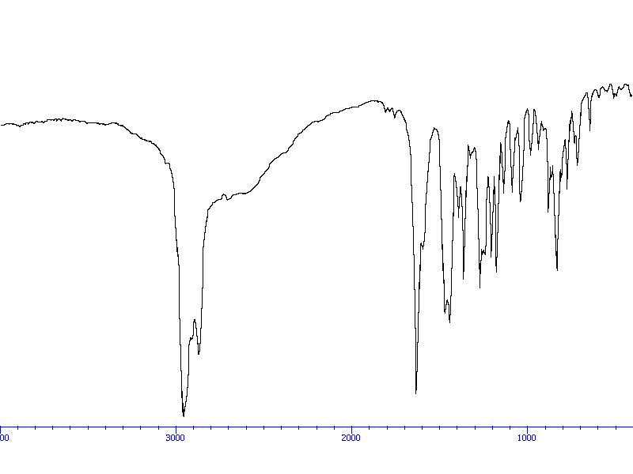
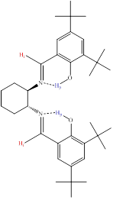
Jacobsen Ligand (Characterization II)
Polarimetry: 1-2 % solution
in EtOAc:hexane (1:1)
UV-Vis spectroscopy:
  Hexane, quartz cuvette ($$$)
  Range: λ=200-600 nm
  The concentration is based on
  ε-values from the literature
Infrared spectrum
  ν(C=N)=1631 cm⁻¹, weaker than a carbonyl group in terms of intensity and bond strength (aldehyde: ν(C=O)=~1650 cm⁻¹)
  ν(OH)=2300-3100 cm⁻¹, shifted to significantly lower wavenumbers due to the strong intramolecular hydrogen bond between phenolic hydroxyl group and the imine nitrogen atom
  ν(CH, sp³)=2850-2960 cm⁻¹ (tert.-Bu, cyclohexane)
ν(OH)
ν(CH, sp³)
ν(C=N)

Slide 8
Jacobsen Ligand (Characterization III)
¹H-NMR spectrum
OH
tert.-Bu
CDCl₃
Imine-H
CH-N
cyclohexane

Slide 9
Jacobsen Ligand (Characterization IV)
¹³C{¹H}-NMR spectrum
C=N
CN

