Slide 1
Lecture 2a
Optical Purity

Slide 2
Optical Purity Assessment
Conversion to enantiomers into diastereomers followed by quantitation using ¹H-NMR spectroscopy ($$)
Chiral solvent ($$$)
Chiral NMR shift reagents ($$$)
Chromatography on chiral HPLC or GC phases ($$)
Polarimetry ($$)

Slide 3
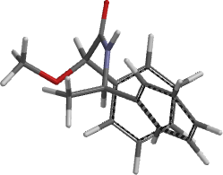
Mosher’s Acid
Example: (±)-α-phenylethylamine is reacted with α-methoxy- phenylacetyl chloride to form diastereomeric amides
The methyl groups in the amine (marked in red in the amide) appear at different chemical shifts in the ¹H-NMR spectrum (Δδ=0.07 ppm) in the diastereomeric amides because of the hindered rotation about the C-N bond, which possesses a significant double bond character
Accuracy of this method is about Δ= ±5 %

Slide 4
Chiral NMR Shift Reagents I
Chiral NMR shift reagents are compounds that contain lanthanide ions that form complexes with chelating molecules i.e., chiral camphor derivatives like in Eu(hfc)₃ or Eu(tfc)₃
They are weakly paramagnetic because they possess low-lying excited states, which have a magnetic moment and which are partially occupied at room temperature
The Eu³⁺-ion induces a spreading of the chemical shifts over a wider range according to the McConnell-Robertson equation (J. Chem. Phys. 1958, 29, 1361)
The following spectra illustrate on how lanthanide shift reagent works using ethyl 3-hydroxybutanoate as an example

Slide 5
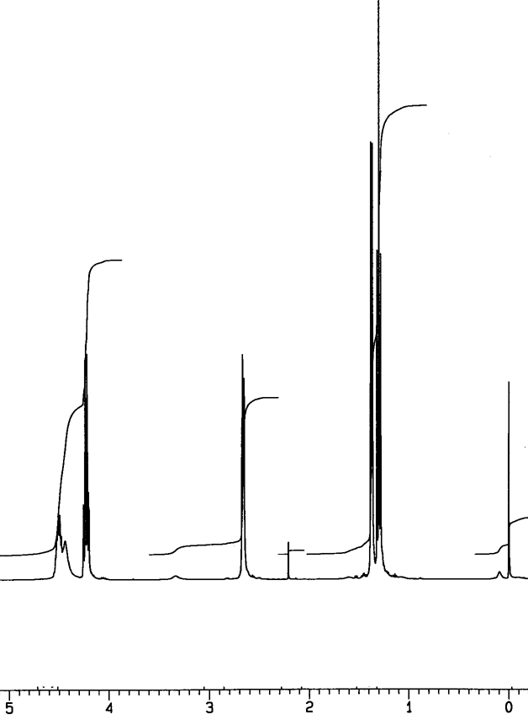
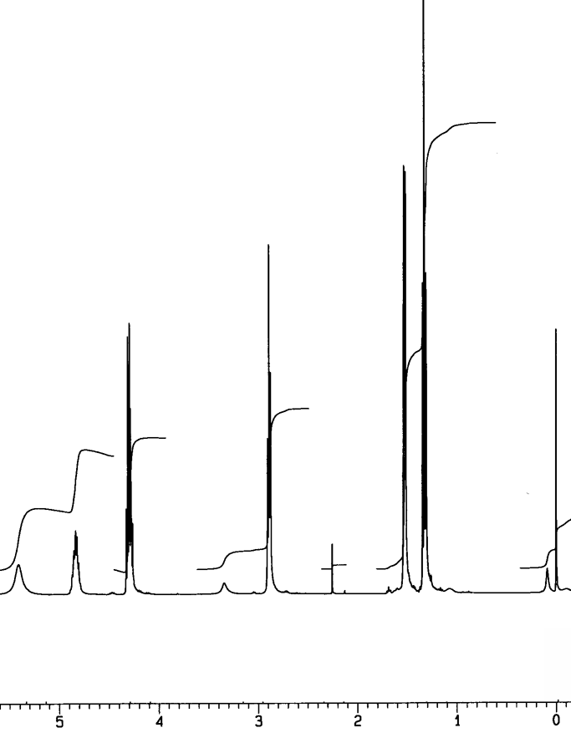
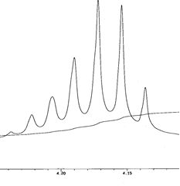
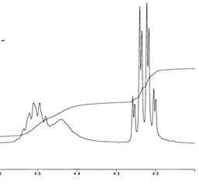
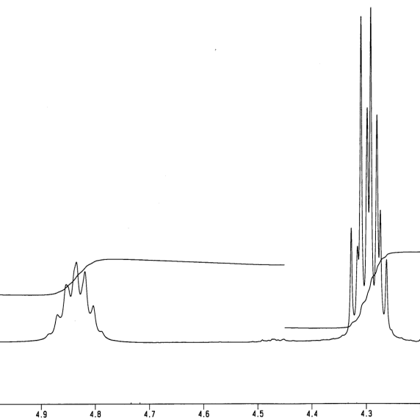
Chiral NMR Shift Reagents II
Full spectrum
No CSR
Full spectrum
40 mg CSR
Full spectrum
80 mg CSR
Expansion ~4.2 ppm
No CSR
Expansion ~4.2 ppm
40 mg CSR
Expansion ~4.2 ppm
80 mg CSR

Slide 6
Chiral NMR Shift Reagents III
The strength of the effect of the chiral shift reagent depends on:
The nature of the NMR shift reagent (metal and ligand)
The concentration of the NMR shift reagent
The proximity of the hydrogen atom to the metal ion
The solvent because it determines how strong the molecule is coordinated to the metal center
The temperature
Most chiral shift reagents are very expensive (> $100/g)

Slide 7
Polarimetry I
Optical activity was discovered by E.L. Malus (1808)
Chiral molecules rotate the plane of polarization of polarized light
The specific optical rotation is a physical property like a melting point or boiling point
Compound | [α]_{D} (in º)
(1R)-(+)-Camphor | +44.26
Sucrose | +66.47
Cholesterol | -31.50
Morphine | -132.00
(-)-TADDOL | -65.50
L-Proline (in water) | -84.00
(S,S)-Jacobsen catalyst | +1175.00

Slide 8
Polarimetry II
How does it work?
Monochromatic light is polarized by a Nicol prism (polarizer)
The plane-polarized light passes through a polarimetry cell in which the plane of the light will be rotated if the cells contains a chiral compound
The analyzer at the end of the setup rotates the plane of the light back to its original orientation
Polarizer
Analyte
Analyzer

Slide 9
Polarimetry III
The value of the optical rotation (α) depends on the wavelength (the subscript “D” refers to λ=589.3 nm), the path length (l), the concentration (c) and the specific optical rotation for the specific enantiomer and to a lesser degree on the temperature (X)
The sign of the optical rotation is independent from the absolute configuration!
The sign and absolute value can depend on the solvent because the observer might look at different compounds i.e., cation, anion or neutral specie for amino acids.
The specific rotation can be used to assess the optical purity of a chiral compound by comparing it with published data

Slide 10
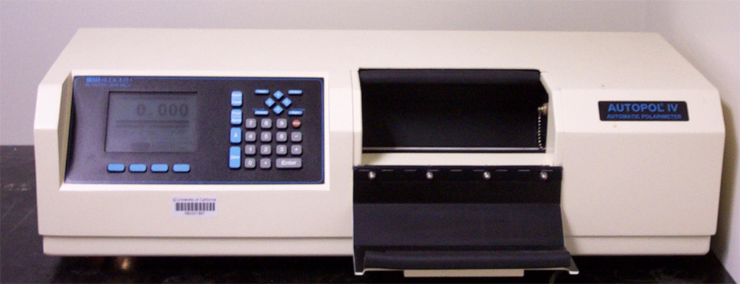
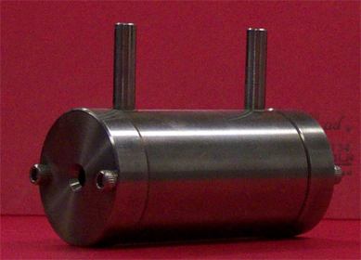
Polarimetry IV
Polarimeter (located in YH 6104)
Polarimetry cell (~$1000)
Concentration: usually 0.5-3 % depending on specific optical rotation, the amount of material available for the measurement and the intensity of the color of the compound
It is important that there are no air bubbles in the path of the light because they will cause problems in the measurement (i.e., dark sample error)
Note that the sample used for polarimetry can be recovered from the solution if needed

