Slide 1
Lecture 9a
Grignard Reaction

Slide 2
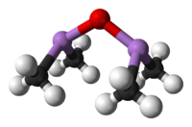
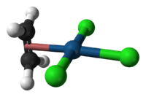

Introduction I
Metalorganic compounds have carbon in the compound but no direct metal-carbon bond i.e., sodium acetate
Organometallic compounds have a direct metal-carbon bond
i.e., methyl lithium (LiCH₃), methylmagnesium bromide (CH₃MgBr)
Organometallic compounds are known for more than
250 years
  Cadet’s fuming liquid (~1760, (CH₃)₂As)₂O) is the first
  organometallic compound described in the literature
  Zeise’s Salt (1827, Na[PtCl₃(CH₂=CH₂)]) is used as
  starting material for cisplatin (cis-PtCl₂(NH₃)₂)
  Nickel tetracarbonyl (1890, Ni(CO)₄) is used to refine
  Ni-metal
  Ferrocene (Fe(C₅H₅)₂) that was discovered in 1951 by
  P. Pauson and S. A. Miller introduced a new bond model
  (sandwich complexes) for transition metal compounds

Slide 3
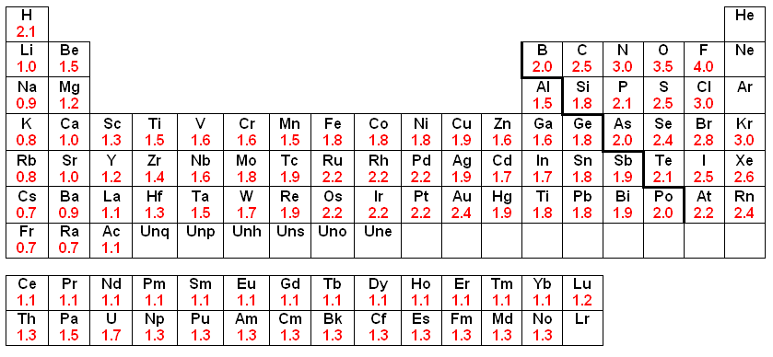
Introduction II
In many organic compounds i.e., carbonyl compounds, organohalides, etc., the carbon atom possesses an electrophilic character
Organometallic compounds are largely covalent but the carbon atom has a different bond polarity compared to most organic compounds (“Umpolung”)
In organometallic compounds
the carbon atom has a higher
electronegativity (EN: C=2.5)
than the metal atom (EN<2.0),
which makes the carbon atom
nucleophilic
X

Slide 4
Introduction III
Organometallic compounds have been proven to be very good synthetic tools in organic chemistry
  Gilman reagents (organocuprates compounds)
    They are used to perform substitution reactions on or adjacent to sp²-carbon atoms
    They are very mild nucleophiles due to low bond polarity in the Cu-C bond (EN: Cu=1.9, C=2.5  ΔEN= 0.6)
    They usually favor 1,4-additions on α,β-unsaturated carbonyl compounds
    Note that in most reactions only one R-group of the cuprate is transferred

Slide 5
Introduction IV
Palladium catalyzed reaction
  Heck reaction, Stille reaction, Suzuki coupling, Negishi coupling (not shown)
  Catalysts: Pd(PPh₃)₄, PdCl₂, Pd(OAc)₂, Pd₂dba₃
  Nobel Prize in Chemistry (2010): Heck, Negishi and Suzuki

Slide 6
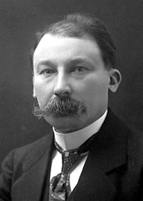
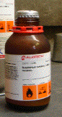
Grignard Reagents I
Grignard reagents were discovered around 1900 by the French
chemist Victor Grignard (NP 1912)
These reagents are formed by the reaction of magnesium metal
with alkyl or aryl halides
Most of the time these reagents are produced in-situ and are considered pyrophoric
Commonly used Grignard reagents i.e., PhMgBr, MeMgBr, MeMgI, EtMgBr, etc. are commercially available as solutions in diethyl ether, tetrahydrofuran or solvent mixtures (delivered in Sure/Seal bottles).
The reaction of a Grignard reagent with ketone affords a tertiary alcohol

Slide 7
Grignard Reagents II
1. Nature of the Halide Substrate
  Fluorides are generally not suitable due to the high C-F bond strength
  Iodides are the most reactive class but they are very expensive and labile (most of them are light and temperature sensitive)
  Bromides are most commonly used because they exhibit only a slightly lower reactivity but a significantly lower price compared to iodides
  Alkyl halides are more reactive than aryl halides as can be seen by comparison of the bond lengths
C-X bond | Average Dissociation Energy for C-X bond in kJ/mol | d(C-X) in CyX^{HF/6-31G*} | d(C-X) in PhX ^{HF/6-31G*} | Cost per mole of PhX
C-F | 460 (sp³), 526 (sp²) | 138.5 pm (0.78) | 133.1 pm (0.84) | $12
C-Cl | 350 (sp³), 400 (sp²) | 181.2 pm (0.98) | 174.5 pm (1.02) | $5
C-Br | 294 (sp³), 336 (sp²) | 198.1 pm (0.97) | 190.5 pm (1.01) | $6
C-I | 239 (sp³), 272 (sp²) | 213.2 pm (1.19) | 210.8 pm (1.37) | $57

Slide 8
Grignard Reagents III
2. Solvent
  A solvent that contains acidic protons i.e., alcohols, amine, etc. or electrophilic atoms i.e., ester, ketone, nitro compounds, sulfoxide, etc. cannot be used
  Hydrocarbons are non-polar and do not dissolve Grignard reagent
  well enough when they are used as a single solvent
  Ethers are most commonly used because they are stable and polar enough to dissolve most Grignard reagents
    Diethyl ether: low boiling point (36 ºC), temperature in the system is moderated, good phase separation with aqueous layers
    Tetrahydrofuran: higher boiling point (66 ºC), poorer separation with most aqueous layers because it’s miscibility with water, more difficult to dry than diethyl ether because it is much more hygroscopic
    A comparison of diethyl ether (μ=1.15 D) and THF (μ=1.75 D) shows that
    THF is a stronger Lewis Base because of its higher dipole moment compared
    to diethyl ether (d(Mg-O): 209 pm (THF), 213 pm (Et₂O) (HF, 6-31G**) in MeMgBr*2 L).

Slide 9
Grignard Reagents IV
3. Activity of the Metal
  Magnesium is covered with an oxide layer than prevents the electron transfer to occur ☹
  To remove the oxide layer, the magnesium turnings have to be crushed or etched i.e., iodine, bromine, CCl₄, etc.
  Highly reactive magnesium metal can be obtained by the reaction
  of MgCl₂ with potassium metal (Rieke magnesium, large surface area, no oxide layer, pyrophoric) under inert gas

Slide 10
Theory for In-lab Experiment I
The Grignard reaction is the first step of a multi-step synthesis
The Grignard reagent is generated in-situ and reacted with carbon dioxide to yield benzoic acid after an acidic work-up
The second step of the sequence is the formation methyl benzoate via a Fischer esterification
The last step is a nitration reaction that affords methyl
m-nitrobenzoate

Slide 11
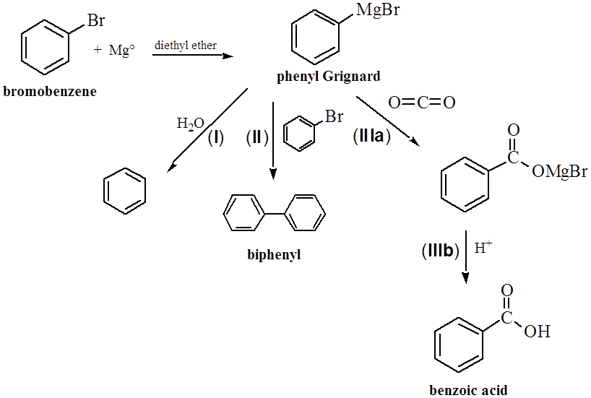
Theory for In-lab Experiment II
Goal
  Part 1: Bromobenzene is reacted with Mg-metal in diethyl ether to yield the phenyl Grignard
  The Grignard reagent is reacted with carbon dioxide to yield benzoic acid after the acidic
  work-up
Problems
  The presence of water leads to the hydrolysis of the Grignard reagent
  and formation of MgBr(OH) ☹
  The rapid addition of PhBr affords to formation of biphenyl
+ MgBr(OH)

Slide 12
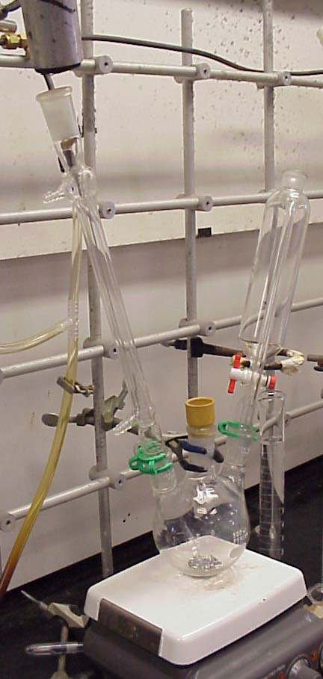
Experiment I
Setup
  Check out the equipment from lab support (the entire set is about $600!! The student will be held responsible for breakage!)
  The initial set-up should consist of:
    two or three-necked round bottomed flask (250 mL)
    addition funnel (125 mL)
    magnesium turnings
    spin bar
    water-jacketed condenser (30-40 cm)

Slide 13
Experiment II
Setup (hints)
  If the flask still contains some white solid, it has to be treated with
  diluted sulfuric acid, water and acetone
  The addition funnel has to be checked for leaks at the stopcock before assembling the setup
  The water-jacketed condenser should not be connected to the water outlet until the heating is completed
  The apparatus should be clamped at the center neck using a clamp that is appropriate for the neck size of the flask
  All ground glass joints have to be greased lightly on the upper third
  part of the joint only. If sufficient lubricant is applied, this part of the
  joint will become clear upon rotating the addition funnel or the
  water-jacketed condenser
  One has to make sure that there is no dirt or Mg-turnings stuck inside
  the joints
  The rubber septa have to be folded over in order to seal properly

Slide 14
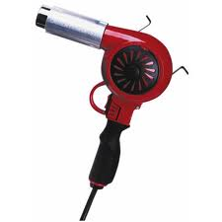
Experiment III
Setup (cont.)
  The heat guns in the laboratory are industrial strength heat guns.
  They allow for temperatures up to 500 ºC. The temperature can
  be controlled by opening or closing the intake shuffle.
  During the step, all flammable materials (i.e., flammable solvents
  (diethyl ether, acetone), paper towels, etc.) have to be removed
  from the area to prevent fires.
  The heating commences at the point the farthest away from the vacuum connection
  to drive the water out of the glassware.
  Direct heat to the ground glass joints has to be avoided to avoid the freezing of the joints
  After the heating is completed, a filled drying tube is placed immediately on top of the reflux condenser and the remaining holes are plugged with rubber septa
  After the student completed the heating of the glassware, the switch has to be set to cooling in order to cool down the filament in the front part of the nozzle. Failure to
  do so will cause the filament to burn out
  The setup is heated from the bottom up (exact details will be shown during the in-lab demonstration on 2/9/2015 at 4:00 pm, YH 6086)

Slide 15

Experiment IV
Prepare the glassware as previously described
Prepare a solution of bromobenzene in diethyl ether
Place the solution in the addition funnel
Turn the water on to cool the condenser
Add about 5 mL of the solution to the Mg-turnings
Why is all this fuzz necessary?
How is the done most efficiently?
Why is this necessary?
Why is so little added only?
What should be observed here?
How can the reaction be initiated?
To minimize the amount of water
in the system as much as possible
Use a short stem funnel
By heating with a warm water bath
Addition of a few crystals of iodine

Slide 16
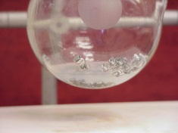
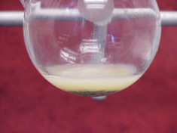
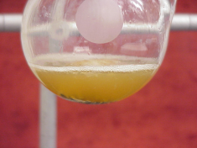
Experiment V
After the reaction initiated, add the bromobenzene solution
After the addition is completed, gently reflux the mixture
Cool the mixture and pour it in a large beaker containing dry ice
Place watch glass on the top of the beaker
Which observations are made here?
How fast should the solution be added?
Why is it important to use a large beaker?
When is the dry-ice weight?
Why is the watch glass placed on the top?
The mixture has to maintain a gentle boil
The mixture will foam heavily
The keep the moisture out during the reaction

Slide 17
Experiment VI
Allow the mixture to warm up to
0 ºC and then add chipped ice and conc. sulfuric acid
Extract the organic layer twice with 5 % NaOH
Combine the aqueous layers and add 6 M HCl
Isolate the solid using vacuum filtration with a small Büchner funnel
Dry the solid thoroughly
Why is ice and H₂SO₄ added?
How can the remaining solid be removed?
How much solution should be used here?
Which layer is important here?
How much HCl is needed here?
What is the student looking for here?
How can the solid be dried well?
Why is this necessary?
3*15 mL
The aqueous layer=bottom layer
pH<3
Water interferes with the esterification!

Slide 18
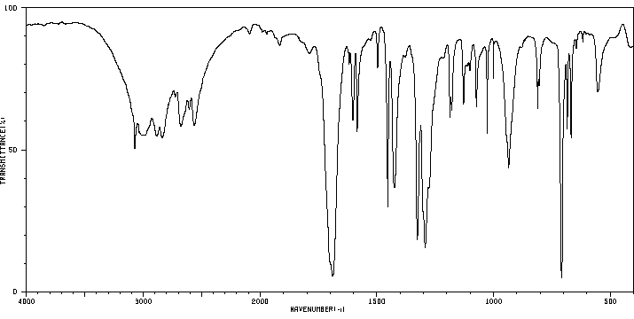
Characterization I
Melting point
Infrared spectrum
  ν(C=O)=1689 cm⁻¹
  ν(OH)=2300-3300 cm⁻¹
  (the exact peak appearance
  depends on the water
  content of the acid)
ν(OH)
ν(C=O)

Slide 19
Additional Safety Notes
Make sure to set up the equipment at least two foot apart
After the initial heating of the glassware, the heat guns should not be used anymore because of the danger of fires
Diethyl ether is very flammable and many heat sources (i.e., hotplate, nozzle of heat gun) can cause the vapors to ignite. Use only warm water baths for heating.
Grignard reagents are known to be pyrophoric and should be handled carefully (i.e., no ignition sources close)

