Slide 1
Lecture 8b
Spectroscopy of Amides

Slide 2
Infrared Spectroscopy
The location of the carbonyl stretching frequency varies significantly between the different carbonyl functionalities (CH₃COX, HF/6-31**)
The table shows that a shorter the C=O bond is associated with a higher carbonyl stretching frequency
  Acyl chlorides are on the high end of this range because of the inductive effect of the chlorine atom (B.O. for (C=O)=1.937 (CH₃COCl))
  Amides are found on the low end of the range because of the strong resonance effect (B.O. for (C=O)=1.718 (CH₃CON(CH₃)₂)). The C-N bond is usually significantly shorter in amide compared to amines due to the partial double bond ((B.O. for (C-N)=1.14)
Carbonyl compound | Reactivity | ν(C=O) | d(C=O)^{X} | Bond order | pK_{a} of acid
CH₃COBr | extremely high | 1817 cm⁻¹ | 116.3 pm | 1.939 | (-9) (HBr)
CH₃COCl | extremely high | 1806 cm⁻¹ | 116.7 pm | 1.937 | (-7) (HCl)
(CH₃CO)₂O | very high | 1761 cm⁻¹ | 117.8 pm | 1.848 | ~3-5 (RCOOH)
CH₃COOCH₃ | medium | 1748 cm⁻¹ | 118.8 pm | 1.835 | 16-19 (ROH)
CH₃COOH | low | 1715 cm⁻¹ | 118.7 pm | 1.870 | 16 (H₂O)
CH₃CON(CH₃)₂ | extremely low | 1662 cm⁻¹ | 120.2 pm | 1.718 | 38 (NH­₃)

Slide 3
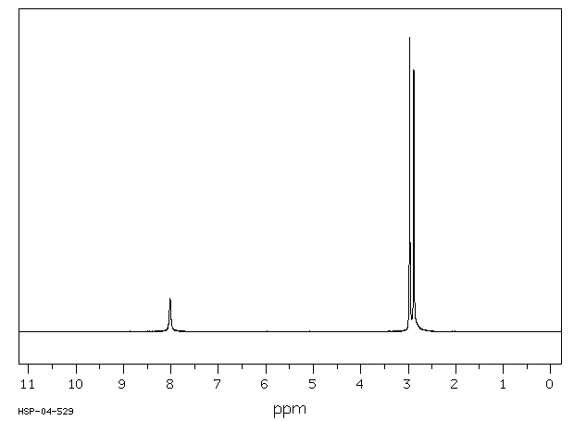
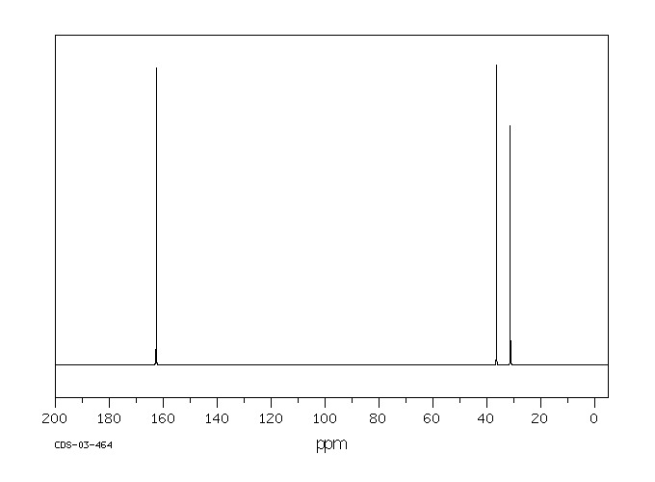
NMR Spectroscopy I
¹H and ¹³C-NMR spectra
  How many signals would we expect to see on the ¹H-NMR and the ¹³C-NMR spectrum?
  The additional signals are observed due to the lower apparent symmetry i.e., two signals for the methyl groups in the ¹H-NMR and the ¹³C-NMR spectrum
  The spectra are temperature and solvent dependent
Compound | Rotational Barrier
N,N-Dimethylformamide | 92 kJ/mol (D₂O)
N,N-Dimethylacetamide | 80 kJ/mol (D₂O)
N,N-Dimethylbenzamide | 66 kJ/mol (CDCl₃)

Slide 4
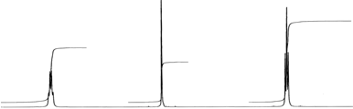
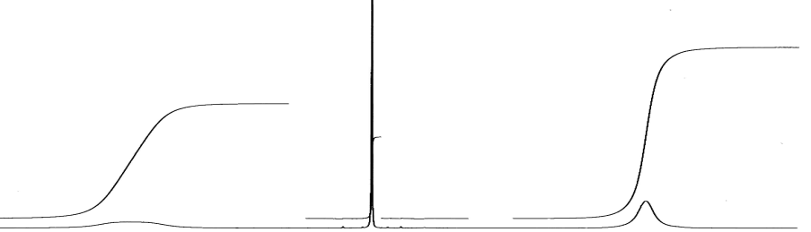
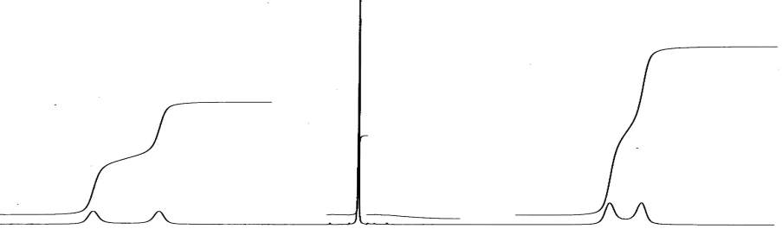
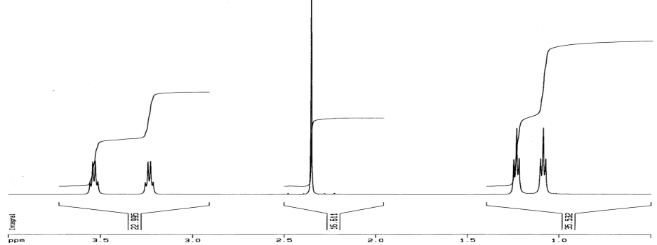
NMR Spectroscopy II
T=370 K
DEET
  If a free rotation about the
  O=C-N bond was observed,
  there should be three signals
  in the range below 4.0 ppm.
  Three signals are observed at
  high temperatures, but five
  signals at room temperature
  and below because of the
  slow rotation which makes
  the two ethyl groups
  non-equivalent
T=320 K
T=300 K
T=280 K

Slide 5
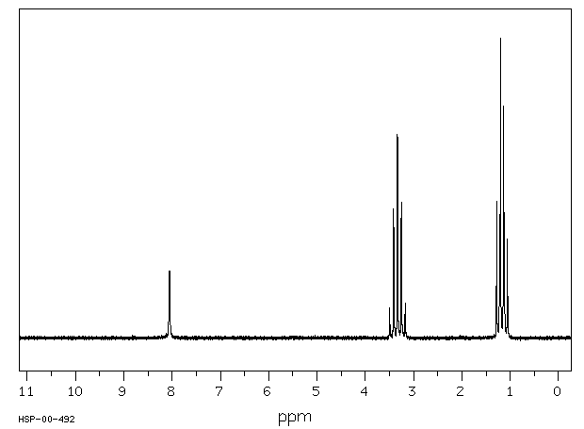
Example
N,N-Diethylformamide
  What would be expect to observe in the ¹H-NMR spectrum?
  How can one rationalize the quintet at δ=3.3 ppm and the quartet at δ=1.1 ppm?
  Two overlapping quartets
  or triplets, respectively

Slide 6
Amide Conformers I
Secondary amides are found as trans- or/and cis-conformers (rotamers)
  For bulky R’-groups (i.e., tert.-Bu, Ph, o-Tol, etc.), the cis rotamer is dominant in solution (CDCl₃)
  For R’-groups that contain atoms like nitrogen (i.e., lidocaine) or oxygen
  in a reasonable distance, the trans rotamer is favored due to the possibility
  of intramolecular hydrogen bonding
    A lower ν(NH) stretching mode (ν<3300 cm⁻¹) and increase in the δ(NH) mode
    (δ>1500 cm⁻¹)
    An increased chemical shift of the amide proton (δ=9.5-11 ppm)
  At higher concentrations, aggregates of the trans rotamer are found in solution.

Slide 7
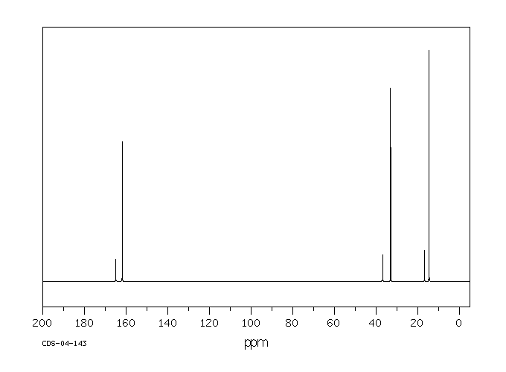
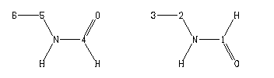
Amide Conformers II
Example 1: N-Ethylformamide (0.5 mL : 1.5 mL CDCl₃)
Two sets of signals due to the cis rotamer (small signals) and trans rotamer (large signals) conformers in the solution
The trans conformer clearly being favored here (88:12)
trans
trans
trans
cis
cis
cis

Slide 8
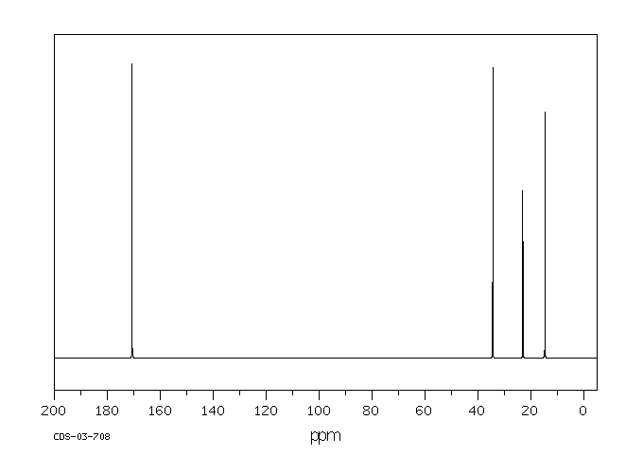
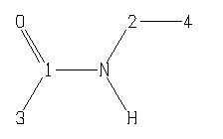
Amide Conformers III
Example 1: N-Ethylacetamide (0.5 mL : 1.5 mL CDCl₃)
For R-groups that are larger than H, the trans rotamer is usually highly favored

