Slide 1
Lecture 7b
Synthesis of Lidocaine (Step 2)

Slide 2
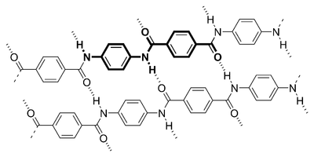
Introduction
Amides play a very important role in biochemistry, pharmaceuticals and materials
  Peptide bonds i.e., the Aspartame (Nutrasweet)
  which is the methyl ester the dipeptide of
  L-aspartate and L-phenylalanine
  Penicillin G is a tripeptide formed from
  L-aminoadipic acid, L-cysteine and
  L-valine
  Polymers
    Nylon 6,6: Y=Z=(CH₂)₄
    Kevlar: Y=Z=p-C₆H₄
    Both of them are homopolymers
Kevlar

Slide 3
Formation of Amides
Most acid derivatives are more reactive than amides and can be used as reactants
Ester + ammonia
  Byproduct: alcohol
Anhydride
  Byproduct: salt
Ester + sec. amine
  Byproduct: alcohol
Acid + amine
  Byproducts: first a salt,
  then water

Slide 4
Theory of Amide Formation I
In the lab, an acyl chloride is used as carboxylic acid source
  Advantages:
    Possesses a high reactivity in chemical reactions, which can be carried out under milder conditions i.e., Schotten-Baumann esterification
    The higher reactivity is due to a better leaving group (chloride)
    The carbonyl group is very electrophilic due to the inductive effect of chlorine, which is a poor resonance contributor due its larger size compared to carbon resulting in a poor overlap of the 2p-orbitals of carbon with the 3p-orbitals in chlorine
  Disadvantages:
    They are more difficult to handle due to their tendency to hydrolyze in air

Slide 5
Theory of Amide Formation II
In the lab, α-chloroacetyl chloride is used because it has two functional groups
The amine function reacts preferentially with the acyl chloride over the alkyl chloride because the acyl carbon is much more electrophilic
The protonated form of the amide is soluble in acetic acid
The acetate ion is able to deprotonate the protonated form
of the amide (pK_{a}= ~ -1) but not the ammonium salt (pK_{a}= ~ 4)
The neutral form of the amide is weakly polar and insoluble
in aqueous acetic acid

Slide 6
Experimental (Step 2, Part I)
Dissolve 2,6-xylidine in glacial acetic acid
Add 1.1 equivalent of the acyl chloride
Heat the mixture to 40-50 ºC
in water bath for 10 minutes
Cool mixture to room temperature
Why is glacial acetic acid used here again?
What does 1.1 equivalent refer to?
Why is it used in excess?
Which observation is made here?
Why is the reaction mixture heated?
To minimize the water in the system
To the number of moles of the amine
A pink or purple solution
To increase the rate of reaction

Slide 7
Experimental (Step 2, Part II)
Add a 5 % sodium acetate solution
Isolate the precipitate by vacuum filtration
Wash the solid with water
Press the solid with a stopper while suction is applied as well
Allow the solid to dry in open beaker
Why is this solution added?
Which observation should the student make here?
Why is the solid pressed?
Why is it important that the solid is very dry?
To deprotonate the protonated form
of the amide
Water interferes with the lidocaine formation!

Slide 8
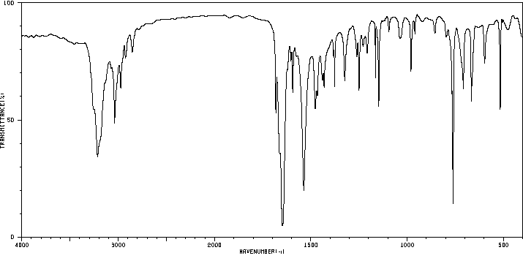
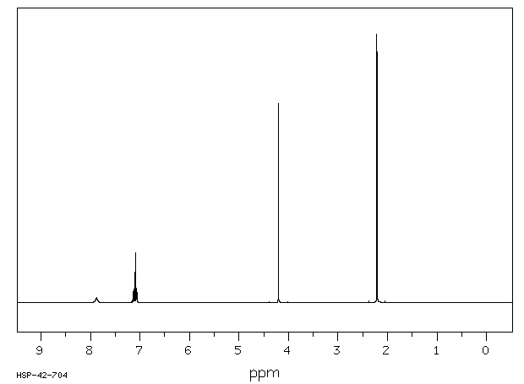
Characterization I
Melting point
Infrared spectrum
  ν(NH)=3214 cm⁻¹
  ν(C=O, amide I)=1648 cm⁻¹
  ν(CN, amide II)=1537 cm⁻¹
¹H-NMR spectrum
  δ(NH)=7.88 ppm
  δ(CH₂)=4.20 ppm
ν(NH)
ν(CN)
ν(C=O)
CH₂
NH

