Slide 1
Lecture 7a
Synthesis of Lidocaine (Step 1)

Slide 2
Introduction
Pain relief is big business ($837B in 2009, projected to be $1.14T by 2014)
Top ten drugs sold worldwide in 2013 (* developed at UCLA)
Name | Manufacturer | Treatment for | Launched | Revenue (in billion $)
Humira | Abbie | Rheumatoid arthritis | 2003 | 11.0
Enbrel | Amgen | Rheumatoid arthritis | 1998 | 8.75
Advair | GlaxoSmithKline | Asthma, COPD | 2001 | 8.3
Remicade | Johnson&Johnson | Rheumatoid arthritis | 1998 | 8.3
Rituxan | Roche/Genentech | Lymphoma, leukemia | 1997 | 8.0
Lantus | Sanofi | Diabetes | 2000 | 7.5
Avastin | Roche | Cancer | 2004 | 6.5
Herceptin* | Roche/Genentech | Cancer | 1998 | 6.5
Crestor | AstraZeneca | High cholesterol | 2003 | 6.0
Januvia | Merck&Co | Type 2 Diabetes | 2006 | 6.0

Slide 3
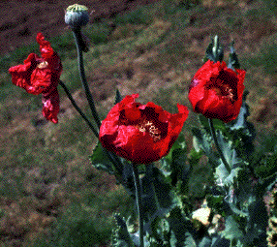
Opiates
Very potent pain relievers
Used mainly for acute (severe) pain
Mostly alkaloids i.e., opium, morphine, codeine, etc.
Narcotic side effects, their use leads to potentially serious addiction for long-term therapy i.e., soldiers treated with morphine in the American Civil War and World War II
(Army Disease, 400,000 after the Civil War)
Morphine
Codeine
Hydrocodone
Heroin

Slide 4
Salicylates
Examples: aspirin, methyl salicylate, Mg-salicylate (Doan), bismuth subsalicylate (Pepto-Bismol), Salsalate, etc.
  Less powerful
  Used mainly for headaches, fever, inflammations, topical, etc.
  Non-addictive, but aspirin can cause stomach bleeding, etc.
Aspirin
NSAID
Methyl salicylate
Used in deep heating
liniments, TOXIC
Diflunisal
NSAID used in
arthritis treatment
Salsalate
NSAID, used as
alternative to ibuprofen

Slide 5
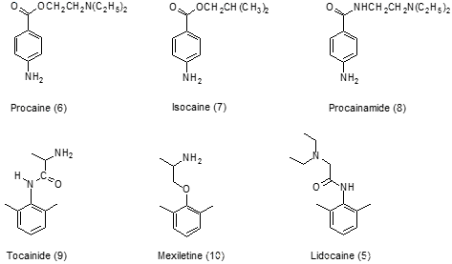
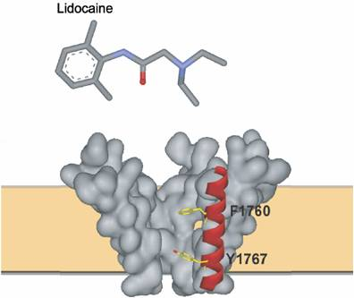
Antiarrhythmic Agents
Vaughan Williams: five classes
Class 1b are sodium channel blockers
Lidocaine blocks the fast gated sodium channels in the cell membrane via the binding sites F1760 and Y1767

Slide 6
Theory of Reduction I
The product of the reduction of a nitro group depends strongly on reducing reagent and pH-value during the reaction
Azoxybenzene
Pale yellow solid
Nitrosobenzene
Light yellow solid
Aniline
Colorless liquid
Phenylhydroxylamine
White solid
Azobenzene
Orange-red solid
Hydrazobenzene
Yellow solid

Slide 7
Theory of Reduction II
Mechanism

Slide 8
Theory of Reduction III
Step 1a: The reduction of the nitro compound with SnCl₂/conc. HCl yields the xylidinium salt (2)
Step 1b: The deprotonation of the xylidinium salt with hydroxide ion affords the free amine (2,6-xylidine, (3))

Slide 9
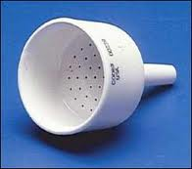

Experimental (Step 1, Part I)
Dissolve SnCl₂*2 H₂O in conc. hydrochloric acid
Dissolve 2,6-dimethyl-nitrobenzene in glacial acetic acid
Combine the two solutions
After 15 minutes place the mixture in an ice-bath
Collect the precipitate
Do not wash with water!
Why is concentrated HCl used here?
What is glacial acetic acid?
Why is it used here?
How?
Why is the solid not washed with water?
To maintain a low pH-value
100 % acetic acid
To lower the polarity of the
solution
It will dissolve!

Slide 10
Experimental (Step 1, Part II)
Dissolve/suspend the solids in
30 mL of water
Add 8 M KOH solution slowly
Place mixture in ice-bath
Extract the cold mixture twice with diethyl ether
Wash the combined organic layers with water
Dry organic layer over potassium carbonate
Can the student use more water than that?
How much base has to be added here?
Which observation should the experimenter make here?
How much solvent is used here?
Why is potassium carbonate used here?
NO
pH>10
A yellow oil collects on the top
2*10 mL
The product is a base and absorbs
much stronger on Na₂SO₄ or MgSO₄

Slide 11
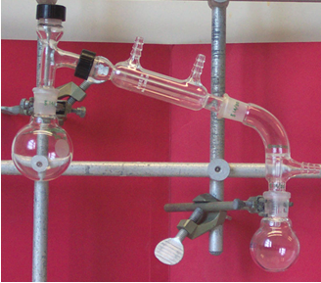
Experimental (Step 1, Part III)
Compression cap
with flat septum
Distillation
Parts
  A: round-bottomed flask with solution
  B: Three-way distilling head
  C: Water-jacketed condenser
  D: Vacuum adapter
  E: Receiving flask
Clamp at the neck of the flasks with appropriate sized clamps
After the distillation is completed, a small amount of a yellowish oil should remain
Submit GC/MS sample
(1-2 mg/mL hexane)
Outlet
Inlet
B
C
D
A
open
E

Slide 12
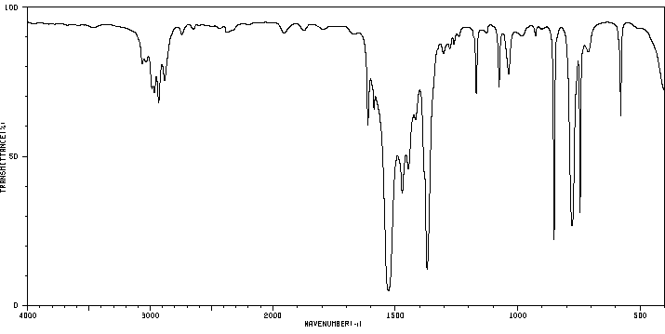
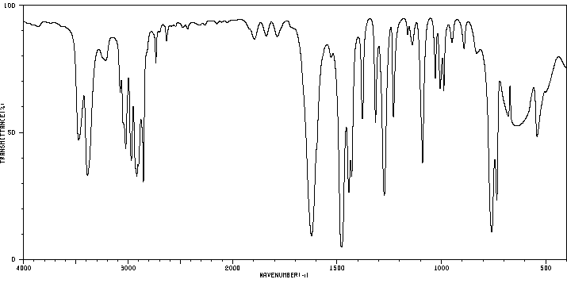
Characterization I
Reactant (2,6-dinitrobenzene)
  ν(NO₂)=1370, 1528 cm⁻¹
  δ(NO₂)=852 cm⁻¹
  ν(C-H) modes are weak
  because of the strong
  peaks of the nitro group
Product (2,6-xylidine)
  ν(NH₂)=3388, 3473 cm⁻¹
  δ(NH₂)=1622 cm⁻¹
ν(NO₂)
δ(NO₂)
ν(NH₂)
δ(NH₂)

Slide 13
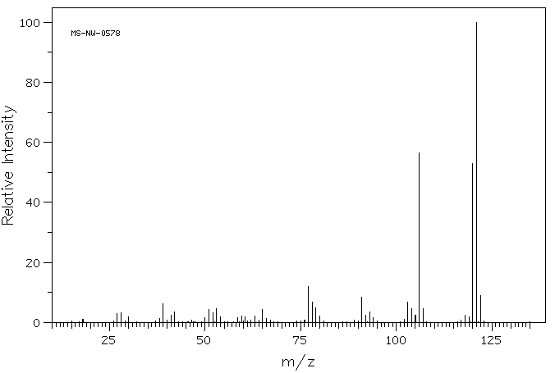
Characterization II
GC/MS (EI)
  m/z=121: molecular ion [M]⁺
  m/z=120: [M-H]⁺
  m/z=106: [M-CH₃]⁺
Question: In which sequence do the nitro compound and the amine elute in the GC given the fact that a low polarity column is used (HP-5)?
m/z=121
m/z=106
m/z=120

