Slide 1
Lecture 5b
Mass Spectrometry

Slide 2
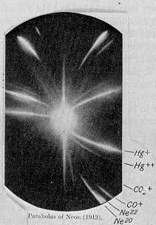
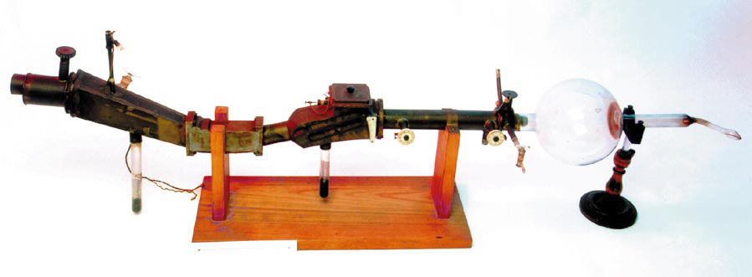
History I
J. J. Thompson was able to separate two neon
isotopes (Ne-20 and Ne-22) in 1913, which was
the first evidence that isotopes exist for stable
elements (Noble Prize 1906 in Physics)
F. W. Aston discovered isotopes in a large
number of nonradioactive elements by means
of his mass spectrograph (first one build)
(Noble Prize in Chemistry in 1922).

Slide 3
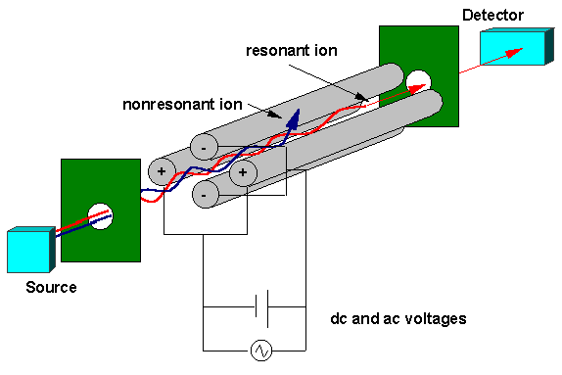
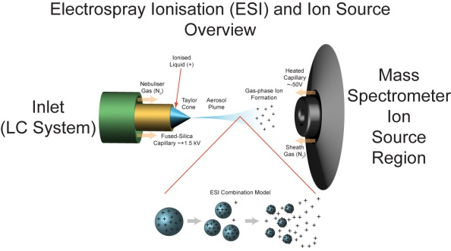
History II
H. Dehmelt and W. Paul built the first quadrupole mass spectrometer in 1953 (Noble Prize 1989 in Physics)
K. Tanaka and J.B. Fenn developed the electrospray and soft laser desorption method, which are used for a lot of proteins (Noble Prize 2002 in Chemistry)

Slide 4


Electron Impact Mass Spectrometry I
Electron Impact (EI) is hard ionization technique
  An ionizing beam of electrons generated in the ionization chamber causes the ionization and/or fragmentation of the molecule
  The higher the energy of the electrons is, the more fragmentation is observed up to the point
From GC
AB
AB
AB
AB
AB⁺
B⁺
AB⁺
A⁺
B⁺
AB⁺
A⁺
B⁺
AB⁺
AB⁺
AB⁺

Slide 5
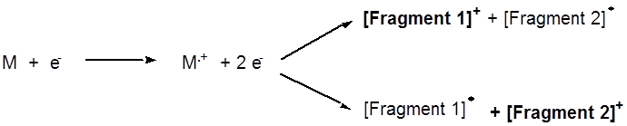
Electron Impact Mass Spectrometry II
Mass spectrometers are often connected to gas chromatographs (GC/MS)
They only require very small amounts of sample (~1 ng)
The mass spectrometer employs an ultrahigh vacuum (<10⁻⁶ torr)
Since there is only one detector, the magnetic field has to be scanned during the acquisition in order to collect ions with different m/z ratio, which arrive at different times
The neutral fragments do not interact with the magnetic field
and are lost in the process (bounce into the walls)

Slide 6
Information from the Mass Spectrum I
The mass spectrum is a plot of the relative ion abundance
versus m/z (mass/charge)
The molecular ion peak (=parent peak) is the peak that is
due to the cation of the complete molecule
The base peak is the largest peak in the spectrum (=100 %)
Stevenson’s rule: When a fragmentation takes place, the positive charge remains on the fragment with the lowest ionization energy
  The more stable the fragment is, the higher the abundance of
  the ion is resulting in a larger peak because its lifetime is longer
  Commonly observed stable ions: m/z=43 (acylium or iso-propyl), m/z=57 (tert.-Bu or propylium), m/z=91 (benzyl), m/z=105 (benzoyl), etc.

Slide 7

Information from the Mass Spectrum II
Molecular Mass
Presence of an odd number of nitrogen atoms (if molecular mass is odd)
The presence of certain fragments/groups gives rise to peaks with a high abundance i.e., benzyl (tropylium), acylium, etc.
Presence of certain functional groups result in characteristic fragments being lost (mass difference) or being observed i.e., terminal alcohols exhibit a peak at m/z=31 due to [CH₂OH]-fragment

Slide 8
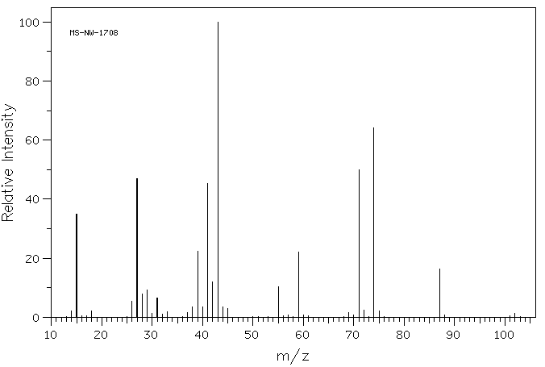
Information from the Mass Spectrum III
Number of carbon atoms from the ratio of [M+1]/[M]-peaks (1.1 % for
each carbon) i.e., the ratio would be 11 % (=0.11) if there were ten carbon atoms in the fragment
The McLafferty rearrangement is an intramolecular hydrogen transfer
via a six-membered transition state from a γ-carbon atom leading to
a β-cleavage to the keto-group

Slide 9
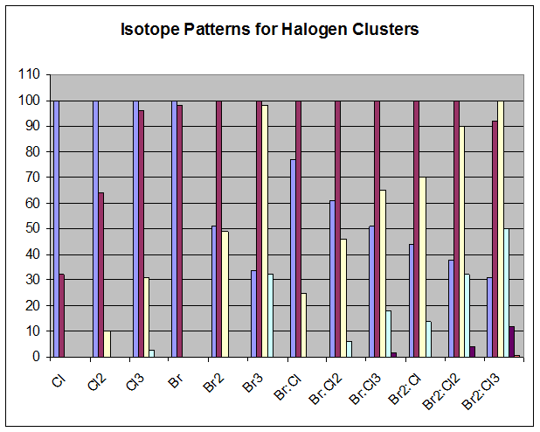
Information from the Mass Spectrum IV
If several chlorine and/or bromine atoms are present in the molecule, isotope clusters consisting of (n+1) peaks are found in the spectrum
Pattern for halogen clusters
Elements | X | X₂ | X₃
Cl | 100:32 | 100:64:10 | 100:96:31:3
Br | 100:98 | 51:100:49 | 34:100:98:32
Elements | Cl | Cl₂ | Cl₃
Br | 77:100:25 | 61:100:46:6 | 51:100:65:18:1.7
Br₂ | 44:100:70:14 | 38:100:90:32:4 | 31:92:100:50:12:1

Slide 10
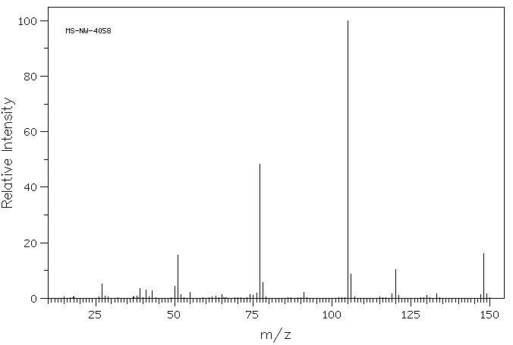
Fragmentation I
Example 1: Butyrophenone (C₆H₅COCH₂CH₂CH₃) (PhCOCH₂CH₂CH₃)
m/z=105
((Ph-C≡O)⁺)
m/z=120
((M-C₂H₄)⁺)
m/z=148
(M⁺)

Slide 11
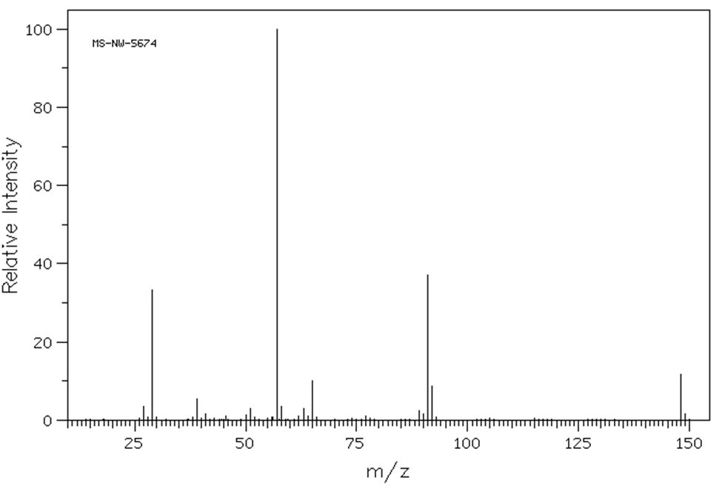
Fragmentation II
Example 2: 1-Phenyl-2-butanone (C₆H₅CH₂COCH₂CH₃)
m/z=57
(CH₃CH₂CO⁺)
m/z=91
(PhCH₂⁺)
No peak at m/z=120
m/z=148
(M⁺)

Slide 12
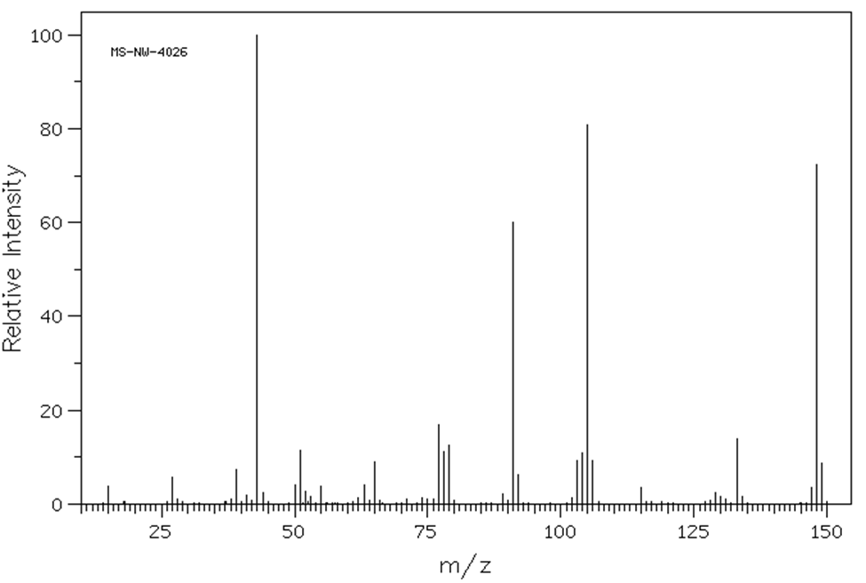
Fragmentation III
Example 3: 4-Phenyl-2-butanone (C₆H₅CH₂CH₂COCH₃)
m/z=43
(CH₃CO⁺)
m/z=105
(PhCHCH₃⁺)
m/z=148
(M⁺)
m/z=91
(PhCH₂⁺)

Slide 13
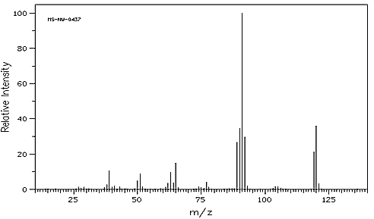
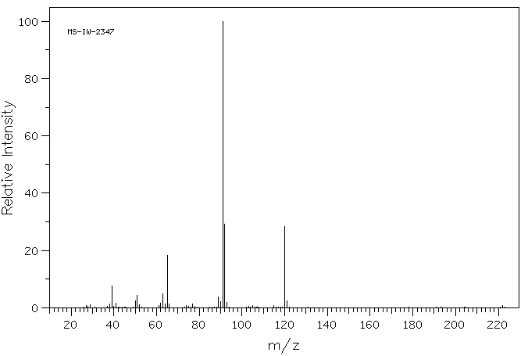
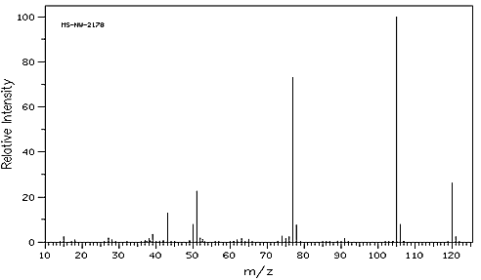
Epoxide Analysis
Styrene oxide Phenylacetaldehyde Acetophenone
Differences
  m/z=91 ([C₇H₇]⁺): only found in phenylacetaldehyde and styrene oxide, but not in acetophenone
  m/z=105 ([C₇H₅O]⁺): only found in acetophenone!
  m/z=119 ([C₈H₇O]⁺): only found in styrene oxide!
  m/z=92 ([C₇H₈]⁺): due to McLafferty rearrangement!

Slide 14
Chemical Ionization Mass Spectrometry I
Chemical Ionization is considered a soft ionization technique
  It uses less energy, which results in less fragmentation, allowing in many cases the observation of the molecular ion peak
  Methane (CH₄), isobutane (C₄H₁₀) or ammonia (NH₃) is used as gas
    Primary Ion formation: CH₄ + e⁻ CH₄⁺ + 2e⁻
    Secondary Ion formation: CH₄ + CH₄⁺ CH₅⁺ + CH₃
    Product formation: M + CH₅⁺ CH₄ + [M+H]⁺
    AH + CH₃⁺ A⁺ + CH₄
Chemical ionization can be performed in PCI (positive mode) or NCI (negative mode)
The NCI mode is used for PCBs, pesticides and fire retardants because they contain halogens with a high electronegativity, which makes the detection more sensitive for the compounds

Slide 15
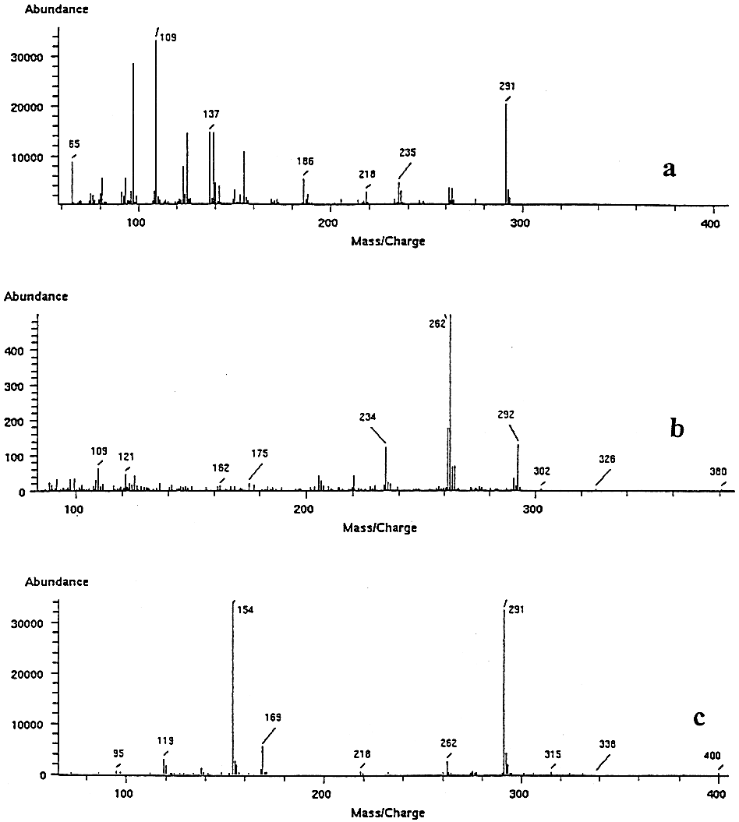
Chemical Ionization Mass Spectrometry II
Comparison of (a) EI, (b) PCI and
(c) NCI for Parathion-ethyl (pesticide)
The EI spectrum shows significantly more fragmentation than the PCI and the NCI spectrum and therefore provides more structural information
EI: 291 [M]⁺, 109 [C₂H₅OPO₂H]⁺
137 [(C₂H₅O)₂PO]⁺
PCI: 292 [M+H]⁺, 262 [M-C₂H₅]⁺
NCI: 291 [M]⁻, 154 (C₂H₅O)₂PSH]⁻
169 [O₂NC₆H₄O⁻]
EI
PCI
NCI

