Slide 1
Lecture 1d
Resolution

Slide 2
Introduction
Most enantiomers have identical physical and spectroscopic properties
Separation by simple techniques i.e., recrystallization or distillation is often not possible
Separation of enantiomers
  Spontaneous resolution followed by a mechanical separation (Pasteur)
  Biochemical processes
  Formation of diastereomers by reaction with one enantiomer of the resolving agent
  (i.e., Pasteur used optically active (+)-cinchotoxine to resolve tartaric acid (1853); strychnine (Purdie, 1895) and morphine (Irvine, 1905) have been used early on to
  resolve lactic acid)
  Chiral columns used in HPLC or GC (discussed later)
  Chiral recognition (Donald Cram, UCLA, Noble Prize in Chemistry in 1987)
Compound | Common Name | m.p. | [α]_{D} | Water Solubility
(R, R)-tartaric acid | L-(+)-tartaric acid | 171-174 ºC | +12.0º | 1390 g/L at 20 ºC
(S, S)-tartaric acid | D-(-)-tartaric acid | 171-174 ºC | -12.0º | 1390 g/L at 20 ºC
(R, S)-tartaric acid | meso-tartaric acid | 165-166 ºC | 0.0º | 1250 g/L at 20 ºC

Slide 3
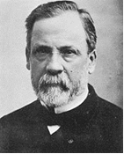
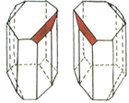
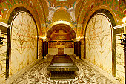
Spontaneous Resolution
This method was used by Louis Pasteur who recognized that ammonium sodium tartrate formed two different crystalline forms that are mirror images of each other
He was able to separate them with tweezers under
a microscope
The mechanical separation will only be successful
for well shaped crystals, which requires well controlled conditions during the crystallization step
This technique is not very useful for larger quantities since it is very time-consuming
Methadone will also undergo spontaneous resolution
if it is seeded with enantiomerically pure crystals
The addition of a seed of (-)-hydrobenzoin to a solution
of (±)-hydrobenzoin will cause the (-)-enantiomer to preferentially crystallize out

Slide 4
Biochemical Processes
Example 1: Reduction of ethyl acetoacetate with Baker’s yeast
Example 2: Ester hydrolysis using lipase
Example 3: Ibuprofen/Candida rugosa, selective esterification of (R)-ibuprofen with butanol
S
R

Slide 5
Diastereomeric Salts I
While enantiomers usually have identical physical properties, diastereomers do not. Thus, the conversion of an enantiomer
into a diastereomer can be used for the separation
Example: Resolution of lactic acid using brucine
The resolution takes advantage of the different solubility of the resulting salts in water
Other examples:
  Resolution of ibuprofen using α-phenethylamine
  Resolution of Duloxetine (=Cymbalta) using mandelic acid

Slide 6
Diastereomeric Salts II
Commonly used resolution reagents are:
Chiral carboxylic acids and chiral amines are converted into diastereomeric salts that are separated by fractionated crystallization in a suitable solvent i.e., water, methanol, etc.
Chiral alcohols are resolved by converting them to (half) esters
Chiral aldehyde and ketones are converted into diastereomeric phenylhydrazones or semicarbazones (the menthyl group is chiral)
Compound | Resolution agent
Carboxylic acids | brucine, strychnine, ephedrine, cinchonine
Amines | camphor-10-sulfonic acid, tartaric acid, mandelic acid
Alcohols | phthalic acid, succinic acid (via half ester)
Aldehyde, ketone | mentylsemicarbazide, mentylhydrazine

Slide 7

Diastereomeric Salts III
How does this relate to the in-lab work? (Or now it would be convenient time for you to wake up again!)
In the lab, a racemic mixture of trans-1,2-diaminocyclohexane
is provided
In order to synthesize the chiral ligand and the chiral catalyst in high enantiomeric purity, one enantiomer of the diamine is isolated that serves as a chiral backbone
(L)-(+)-tartaric acid is used as resolving agent here, which selectively crystallizes the (R,R)-enantiomer of the diamine
If two (or more) equivalents of L-(+)-tartaric acid was used, the precipitation of (S,S)-diammoniumcyclohexane (R,R)-hydrogen-tartrate would be observed

Slide 8
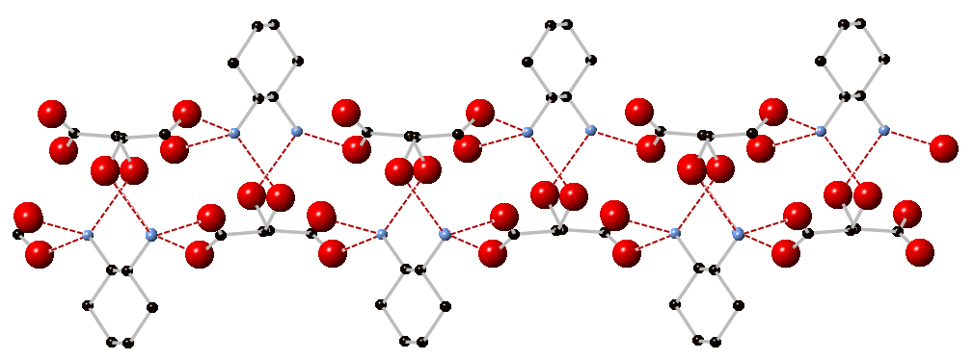
Diastereomeric Salts IV
Why does this form of the diamine precipitate?
The cation and anion geometry match well which results in a very strong interaction between the ammonium functions (=hydrogen bond donor) and the hydroxyl and carboxylate groups (=hydrogen bond acceptors) through multiple hydrogen bonds (six hydrogen bonds to three molecules leading to double-strands)
Note that based on the composition of the starting material, the maximum yield of
the salt can only be 50 % based on the total amount of diamine added because the mixture only contains 50 % of the (R, R)-enantiomer

Slide 9
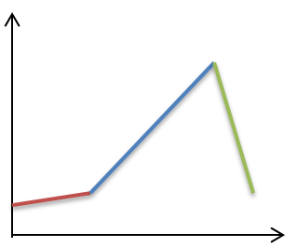
Experiment I
Prepare a concentrated solution
of (L)-(+)-tartaric acid in water
Add trans-1,2-diaminocyclohexane slowly in neat form
After mixture cooled down a little, add glacial acetic acid
Why is a concentrated solution used here?
Why is the diamine added slowly?
Which observations are to be expected?
What exactly is glacial acetic acid?
Why is it added?
The product dissolves up to
5 % in water
The acid-base reaction is
exothermic
pH
Partial protonation
7
First a precipitate is formed
which dissolves upon further
addition of the diamine
Dication
Cation
Dication
time
100 % acetic acid
To lower the pH-value of the
solution without adding water

Slide 10
Experiment II
Allow mixture to cool slowly
If the product does not crystallize, scratch the inside of container with a glass rod
Isolate solids by vacuum filtration, wash with ice-cold water and ice-cold methanol
Recrystallize from boiling water (1:2-1:3 (w/v))
Dry well, then record the yield and characterize the product by GC/MS and melting point
What can be done if this does not work?
Why are ice-cold water and ice-cold methanol used?
What does w/v stand for?
Why is the ratio different here compared to Hanson paper?
Add a small amount of methanol
Weight per volume (g/mL)
The ratio in the Hanson paper
refers to the dry salt!

Slide 11
Experiment III
Dissolve some of the tartrate salt in water
Add sodium hydroxide solution
Extract with ethyl acetate
Dry the organic layer over anhydrous potassium carbonate
Submit a sample for GC/MS analysis on chiral GC column (modified β-cyclodextrin)
What does this accomplish?
Is the solvent removed after the drying process?
Are there any points to be kept in mind?
It releases the free diamine
NO
A GC/MS sample cannot
contain any water or solids
The sample has to be properly
signed in

Slide 12
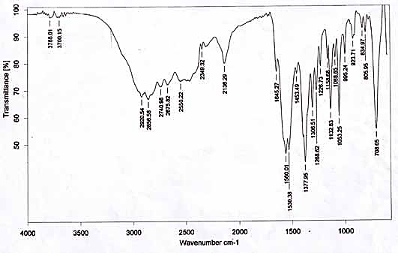
Characterization I
Infrared spectrum
  Very broad ν(OH/NH)-peak (2000-3200 cm⁻¹) due to many hydrogen bonds (see structure)
  Very low carbonyl stretching frequency (1378 and 1560 cm⁻¹) because of the anionic character of the carbonyl function (C=O and C-O) (comparable with the isoelectronic nitro group)
  δ(NH₃⁺)=1530 cm⁻¹
ν(OH/NH₃⁺)
ν_{as}(OCO)
ν_{s}(OCO)
δ(NH₃⁺)

Slide 13
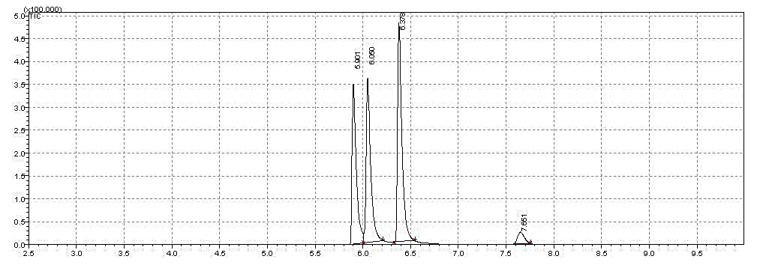
Characterization II
Melting point (273 ºC (dec.))
Optical purity via GC/MS of the free diamine on chiral GC-column (modified β-cyclodextrin,
Rt®-bDEXse)
  Elution sequence: (S, S) first, (R, R) next, (R, S) last
30 % (R, R)
40 % (R, S)
Injection: 1 mL (1 mg/mL)
T_{i}= 100 ºC to T_{f}= 130 ºC
Heating: 3 ºC/min
Flow: 1.48 mL/min He
30 % (S, S)
Impurity

Slide 14
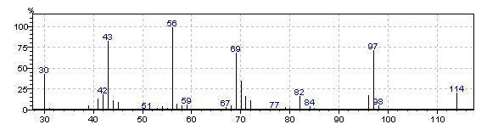
Characterization III
Mass spectrum (from 1st peak)

